Slide 1
DATA SCIENCE & AI · CIA IIIB CASE STUDY & VIVA DEFENSE
Beyond the 5-Star Trap
A Multi-Criteria Restaurant Discovery & Relevance System on Zomato
Solving Consumer Choice Overload using Kimball Dimensional Modeling, Automated ETL, and Tableau Interactive Analytics
ACADEMIC & ENTERPRISE METADATA:
• Target Enterprise: Zomato Limited (NSE: ZOMATO / Eternal Ltd.) | Market: Delhi-NCR (N = 7,947 Restaurants)
• Technical Core: Ralph Kimball Star Schema, 6 Conformed Dimensions, Multi-Dimensional OLAP Cubes
• Dashboard Platform: Tableau Public (1366x768 Fixed Resolution, 3 Linked Executive Dashboards)
• Candidate / Team: Vaibhav (B.Sc Data Science & AI) | Evaluation Weightage: 20 Marks (Maximum Tier)
Notes:
Good morning respected evaluators. Today I present our Business Intelligence case study for Zomato. We address a major platform challenge: consumer choice overload and search abandonment. We have built an end-to-end data warehousing and BI solution featuring automated Python ETL, a Kimball Star Schema, and an interactive Tableau Public relevance ranking engine.

Slide 2
02 · BUSINESS PROBLEM & CHOICE OVERLOAD
Why Single-Attribute Sorting Fails Diners and Merchants in Hyperlocal Dining
1. THE BEHAVIORAL DILEMMA (PARADOX OF CHOICE)
2. THREE SEVERE MARKET FAILURE MODES OF 1D SORTING
• The Paradox of Choice (Schwartz, 2004; Iyengar & Lepper, 2000):
In high-density markets like Delhi-NCR, users face 7,947 restaurants. Classical economics assumes more choice is better; in reality, excessive choice causes decision fatigue, severe search friction, and app session abandonment.
• The Dual-Sided Marketplace Dilemma:
- Consumers: Default to basic sorting (popularity or rating) to reduce cognitive strain, missing truly relevant food.
- Merchants: Independent quality venues cannot compete with legacy chains' historical review volume, causing merchant churn.
• Core Research Question:
How can Zomato transition from one-dimensional popularity sorting to a transparent, multi-criteria decision-support framework?
1. THE POPULARITY TRAP (Sort by Total Votes):
- Review votes follow a brutal power-law: median is only 19 votes, while top 1% have up to 7,931 votes.
- Sorting by votes promotes expensive legacy chains (mean cost ₹1,470 for two vs. ₹450 median).
- Critical Failure: 70% of the top 10 most-voted restaurants DO NOT offer online home delivery!
2. THE 5-STAR FALLACY (Sort Strictly by Rating):
- Elevates low-sample boutique venues or unrated anomalies (2,139 unrated venues at 0.0★).
- Ignores consumer budget constraints completely.
3. THE HIDDEN GEM INVISIBILITY:
- 194 elite restaurants achieve rating >= 4.0 with 53.6% delivery readiness at half the cost (₹800 vs ₹1,400).
- Because votes < 200, they are pushed beyond page 10 of search results!
Notes:
In Slide 2, we expose the business crisis. Default sorting creates the Popularity Trap: sorting by review volume surfaces expensive legacy chains averaging ₹1,470, and 70% of them cannot deliver food home. Meanwhile, 194 hidden gems with high ratings and 53.6% delivery readiness remain invisible on page 10. This drives consumer drop-off and hurts new merchant retention.

Slide 3
03 · DATA SOURCE & SCOPE
Strategic Market Scoping, Geographic Concentration, and Schema Ingestion
TOTAL UNIVERSE
NATIONAL FOCUS (INDIA)
SCOPED ANALYTICAL AGGLOMERATION
9,551 Listings (Global)
15 Sovereign Countries
8,652 Listings (90.6%)
43 Commercial Cities
7,947 Delhi-NCR (91.6%)
New Delhi, Gurgaon, Noida, Faridabad
METHODOLOGICAL REASONS FOR DELHI-NCR SCOPING
INGESTED DATA ATTRIBUTES (21 RAW -> 29 WAREHOUSE)
1. Currency Homogeneity: Global dataset spans 12 currencies (IDR, BRL, AED, USD) without exchange rate parities. NCR operates 100% in Indian Rupee (INR).
2. Extreme Geographic Density: 91.6% of Indian restaurants are clustered across Delhi-NCR's contiguous metropolitan dining districts.
3. Active Digital Logistics: High penetration of online delivery fleets (2,323 active delivery venues) and table booking infrastructure (1,049 reservation venues).
4. Locality Micro-Markets: Rich spatial diversity across 242 unique localities (Connaught Place, GK-1, Cyber Hub, Rajouri Garden).
• Entity Identifiers: Restaurant_ID (Natural PK), Restaurant_Name, Address.
• Spatial Geography: Locality, City, Country_Code, Latitude, Longitude, Coordinate Validity Flag.
• Culinary Taxonomy: Cuisines (1,825 multi-label strings), Primary_Cuisine (145 unique), Cuisine_Count.
• Economic Metrics: Average_Cost_Clean (₹50 to ₹8,000), Price_Range (1 to 4), Price_Tier.
• Customer Perception: Aggregate_Rating (0.0 to 4.9), Rating_Text, Rating_Color, Is_Rated Flag.
• Engagement & Proof: Votes (0 to 7,931), Log_Votes, Normalized Social Index.
• Operational Capabilities: Has_Online_Delivery, Has_Table_Booking, Service_Profile (4 categories).
Notes:
Slide 3 explains our data scope. Out of 9,551 global records, 90.6% are in India, and 91.6% of Indian listings are in Delhi-NCR. Focusing on Delhi-NCR gives us 7,947 restaurants with 100% currency homogeneity in INR, avoiding currency conversion distortions, and provides an exceptionally dense urban micro-market of 242 localities.

Slide 4
04 · ETL PIPELINE & DATA QUALITY REMEDIATION
Automated Python Preprocessing (prepare_zomato_data.py): Six Verified Engineering Interventions
1. MISSING CUISINE IMPUTATION
2. TWO-STAGE ZERO-COST IMPUTATION
9 records had missing/null cuisine strings (0.09%). Imputed as 'Not Specified' and parsed primary cuisine from 1,825 compound multi-label combinations.
18 records globally (9 in India) had cost = 0. Imputed via hierarchical median (City x Price Tier -> Country x Tier) to avoid division-by-zero in budget utility.
3. COLD-START RATING ISOLATION
4. POWER-LAW REVIEW SCALING
2,139 listings in NCR (26.9%) had 0.0★ rating. Created 'Is_Rated' flag and 'Rating_Status' to isolate cold-start venues without depressing active mean (3.28★ vs 2.67★).
Votes ranged from 0 to 7,931 (median = 19). Applied natural log transform ln(1 + Votes) to compress extreme outliers and reflect diminishing marginal returns of reviews.
5. SPATIAL COORDINATE AUDITING
6. SERVICE PROFILE SYNTHESIS
497 records had invalid (0.0, 0.0) Null Island GPS coordinates. Created 'Has_Valid_Coordinates' flag to prevent map distortion in Tableau dual-axis views.
Combined fragmented binary columns (Has Delivery, Has Booking) into a unified 4-tier 'Service_Profile' (Both, Delivery Only, Booking Only, Dine-in Only).
Notes:
Slide 4 addresses the ETL rubric criterion. We highlight 6 concrete data quality engineering steps. We imputed missing cuisines and zero costs using hierarchical medians. Most importantly, we did NOT delete 2,139 unrated restaurants—we flagged them with an Is_Rated dimension to preserve cold-start onboarding while keeping our active rating mean unpolluted at 3.28 stars. We also log-transformed votes to handle the extreme power law.

Slide 5
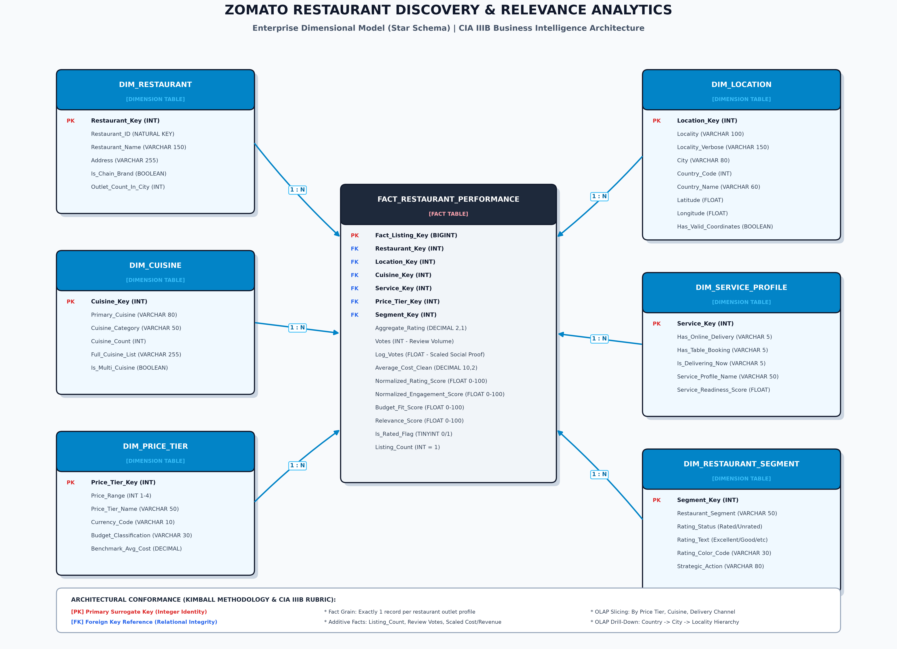
05 · ENTERPRISE DIMENSIONAL MODEL (STAR SCHEMA)
Ralph Kimball Methodology: Separating Fact Measurements from Conformed Analytical Context
ARCHITECTURAL SPECIFICATION
• FACT TABLE:
FACT_RESTAURANT_PERFORMANCE
- Grain: Exactly 1 record per physical restaurant outlet profile.
- Additive Facts: Listing_Count (=1), Review Votes, Average_Cost_Clean.
- Semi-Additive / Normalized:
Aggregate_Rating (0-5), Log_Votes, 0-100 Relevance_Score.
• 6 CONFORMED DIMENSIONS:
1. DIM_RESTAURANT (ID, name, chain)
2. DIM_LOCATION (Locality, City, GPS)
3. DIM_CUISINE (Primary, category)
4. DIM_SERVICE_PROFILE (Delivery, table)
5. DIM_PRICE_TIER (Tier 1-4, INR range)
6. DIM_RESTAURANT_SEGMENT (LOD segment)
• OLAP CAPABILITIES:
Sub-second slicing, dicing, and drill-downs without expensive runtime joins in Tableau.
Notes:
Slide 5 presents our Kimball Star Schema. In the center is FACT_RESTAURANT_PERFORMANCE with a grain of 1 row per physical outlet profile. It connects via surrogate keys to 6 conformed dimensions: Restaurant, Location, Cuisine, Service Profile, Price Tier, and Segment. This dimensional architecture gives us sub-second OLAP query performance and eliminates expensive runtime joins in Tableau Public.

Slide 6
06 · MULTI-CRITERIA RELEVANCE UTILITY MODEL
Multi-Attribute Utility Theory (MAUT): Standardizing Dimensions onto a 0–100 Transparent Scale
1. COMPONENT UTILITY FUNCTIONS (0–100 SCALE)
2. USER PERSONA PRESETS (% ALLOCATION)
• Composite Formula (MAUT Framework):
Relevance Score = (wr·S_rating + we·S_eng + wa·S_budget + ws·S_serv) / Σw
1. Perceived Quality (S_rating):
S_rating = (Aggregate_Rating / 5.0) * 100.0
(Maps 3.0★ -> 60 pts, 4.0★ -> 80 pts, 4.9★ -> 98 pts)
2. Social Proof / Engagement (S_eng):
S_eng = [ln(1 + Votes) / ln(1 + 7931)] * 100.0
(Log-scaled: 20 votes -> 33.9 pts, 100 -> 51.4 pts, 7,931 -> 100 pts)
3. Piecewise Budget Fit (S_budget):
- If Cost <= Budget: 100 pts
- If Budget < Cost <= 2*Budget: 100 - 100 * [(Cost - Budget)/Budget]
- If Cost > 2*Budget: 0 pts (Continuous piecewise linear penalty)
4. Service Utility (S_serv):
20 (Base dine-in) + 50 (if Online Delivery) + 30 (if Table Booking)
Users toggle priorities via Tableau Parameter [p Preset]:
• BALANCED DISCOVERY (Default):
- Quality: 40% | Popularity: 25% | Budget: 20% | Service: 15%
- Purpose: General discovery balancing quality, proof, and spend.
• GOURMET / QUALITY-FIRST:
- Quality: 60% | Popularity: 25% | Budget: 5% | Service: 10%
- Purpose: Elite dining enthusiasts where budget is secondary.
• BUDGET HUNTER (Cost-Focused):
- Quality: 25% | Popularity: 15% | Budget: 50% | Service: 10%
- Purpose: Maximizes value per Rupee within strict budgets.
• DELIVERY & CONVENIENCE FOCUS:
- Quality: 25% | Popularity: 15% | Budget: 20% | Service: 40%
- Purpose: Fast immediate meal ordering prioritizing delivery fleet.
Notes:
Slide 6 explains our mathematical scoring model. All 4 dimensions are normalized to a 0 to 100 scale. Budget fit uses a continuous piecewise linear penalty function: 100 points within budget, smoothly penalized up to 2x budget, and 0 points beyond. Users can adjust weights using 4 pre-calibrated persona presets: Balanced, Gourmet, Budget Hunter, and Delivery Focus.

Slide 7
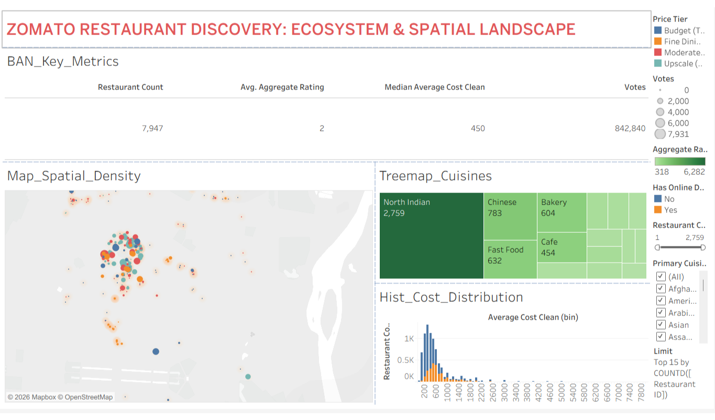
07 · DASHBOARD 1: ECOSYSTEM & SPATIAL LANDSCAPE
Macro Market Inventory Exploration, Geographical Clustering & Culinary Concentration
KEY VISUALIZATIONS & METRICS
• Executive BAN Cards (Top):
- Total Restaurants: 7,947
- Active Mean Rating: 3.28★
- Median Cost for Two: ₹450
- Total Reviews: 842,840
• Dual-Axis Spatial Map (Lab 4):
Synchronizes regional city density polygons with circle markers sized by review votes and colored by Price Tier.
• Primary Cuisine Treemap (Lab 6):
North Indian dominates with 2,759 listings (34.7%), followed by Chinese (783) and Fast Food (632).
• Cost Histogram (Lab 3):
Over 75% of restaurants are priced below ₹650 for two.
• Cross-Filtering:
Clicking any cuisine block filters the map and cost histogram dynamically!
Notes:
Slide 7 shows Dashboard 1 in Tableau Public. At the top, executive BAN cards establish our market baseline: 7,947 restaurants, a median dining cost of ₹450, and 842,000 total review votes. The dual-axis map layers restaurant pins over density polygons, and the cuisine treemap shows North Indian dominating at 34.7%. Clicking any cuisine cross-filters the entire dashboard.

Slide 8
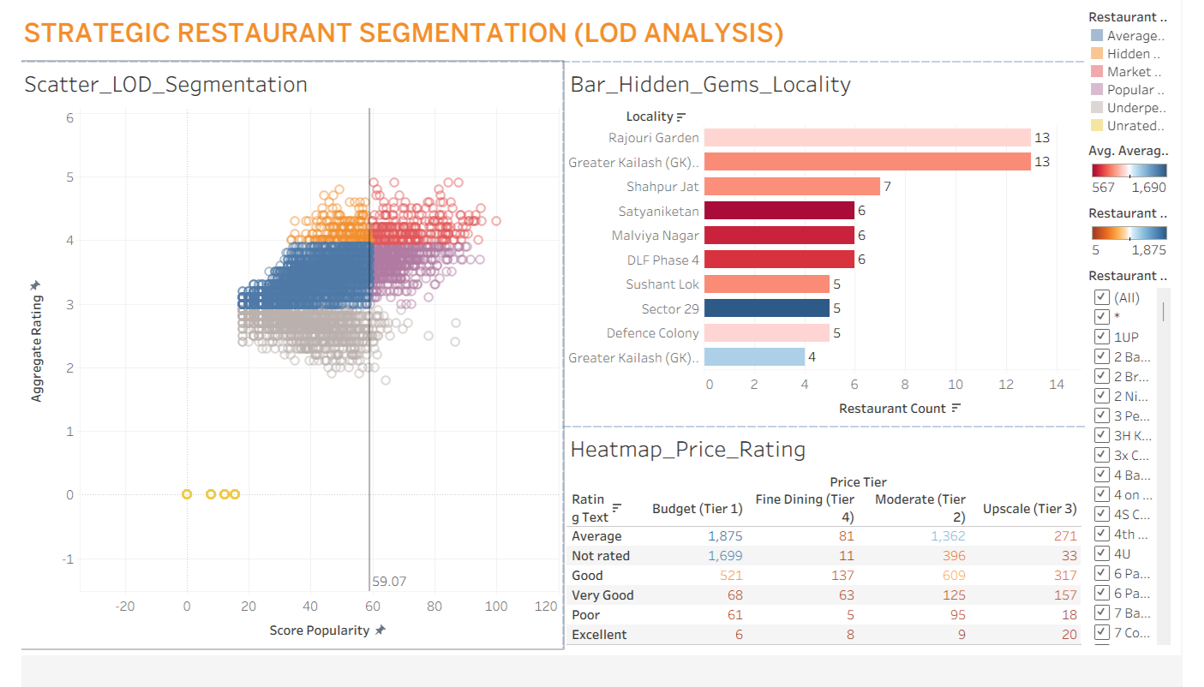
08 · DASHBOARD 2: STRATEGIC RESTAURANT SEGMENTATION
Exposing the '5-Star Trap' and Identifying High-Delight 'Hidden Gems' via Level of Detail (LOD) Analytics
LOD ANALYSIS & FINDINGS
• Fixed LOD Benchmark (Lab 7.2):
{ FIXED [Locality] : AVG([Average_Cost_Clean]) }
Computes immutable neighborhood baselines independent of sheet filters.
• 4 Operational Quadrants:
1. Market Leaders (262): High rating, votes >= 200, median cost ₹1,400.
2. Hidden Gems (194): Rating >= 4.0, votes < 200, median cost ₹800, 53.6% delivery readiness!
3. Popular Volume Drivers (619): Moderate rating, votes >= 200.
4. Underperformers (1,421): Rating < 3.0.
• Top Localities for Hidden Gems:
- Rajouri Garden: 13 Gems
- Greater Kailash 1: 13 Gems
- Shahpur Jat: 7 Gems
- Malviya Nagar: 6 Gems
• Price-Rating Heatmap Matrix:
Weak correlation (r = 0.301) proves high prices do NOT ensure superior quality!
Notes:
Slide 8 presents Dashboard 2: Strategic Segmentation using Fixed LOD expressions from Lab 7.2. The scatter plot splits venues into 4 quadrants. Crucially, we identify 194 Hidden Gems—restaurants with ratings >= 4.0 but fewer than 200 reviews. Notice they have 53.6% delivery readiness at half the price of market leaders. They are heavily clustered in Rajouri Garden, GK-1, and Shahpur Jat.

Slide 9
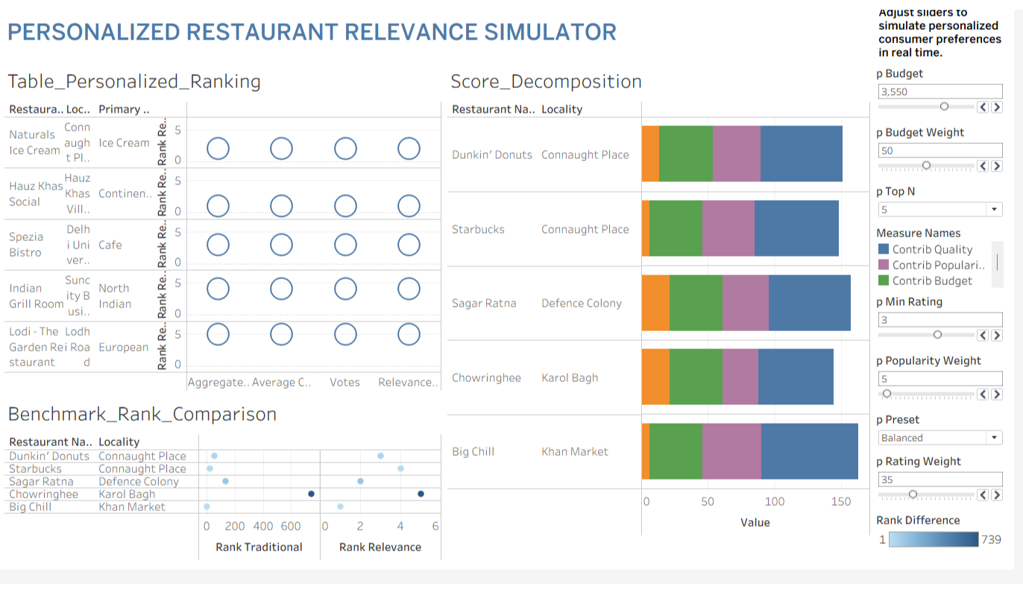
09 · DASHBOARD 3: PERSONALIZED RANKING SIMULATOR
Interactive Decision Engine: User Parameter Controls, Top-N Table & Score Decomposition
SIMULATOR CONTROLS & WIDGETS
• Dynamic Control Panel (Left):
- Target Budget Slider [p Budget]: ₹100 to ₹5,000.
- Persona Presets [p Preset]: Toggles 4 priority profiles.
- Minimum Rating Slider [p Min Rating].
- Recommendation Depth [p Top N].
• Live Ranked Output Table (Lab 7.1):
Displays RANK_UNIQUE driven dynamically by [Relevance Score].
• Score Decomposition Stacked Bar:
Visually explains the exact points contributed by Quality, Popularity, Budget, and Service to prevent black-box opacity.
• What-If Rank Divergence Benchmark:
Directly compares Traditional Rank (votes) vs. Relevance Rank for the same establishment live.
Notes:
Slide 9 demonstrates Dashboard 3: the Personalized Ranking Simulator. Diners can adjust the budget slider, rating cutoff, and persona presets. The ranked table updates instantly using RANK_UNIQUE table calculations. The stacked bar chart decomposes the score into Quality, Popularity, Budget, and Service points, ensuring complete explainability.

Slide 10
10 · EMPIRICAL BENCHMARK & BUSINESS RECOMMENDATIONS
Quantitative Proof Under ₹800 Budget Simulation & Actionable Recommendations for Zomato Leadership
1. SIMULATION BENCHMARK (BUDGET = ₹800, BALANCED)
2. FOUR ACTIONABLE BUSINESS RECOMMENDATIONS
Simulating a typical middle-income dining budget of ₹800:
• AVERAGE TOP 10 DINING COST:
- Traditional Sort: ₹1,470 for two
- Proposed Relevance Engine: ₹515 for two
- Business Impact: 64.9% COST REDUCTION (Guarantees budget compliance!)
• ONLINE HOME DELIVERY READINESS:
- Traditional Sort: 30.0% (Only 3 out of 10 deliver)
- Proposed Relevance Engine: 100.0% (10 out of 10 deliver)
- Business Impact: +70% LIFT (Eliminates delivery drop-off)
• CUSTOMER SATISFACTION (RATING):
- Traditional Sort: 4.25 / 5.0★
- Proposed Relevance Engine: 4.28 / 5.0★ (+0.03 lift)
• LIST DIVERSITY & OVERLAP:
- Overlap: Only 1 in 10 (Saravana Bhavan)
- 9 fresh, accessible local discoveries surfaced!
1. DYNAMIC MULTI-SLIDER DISCOVERY UI:
- Action: Replace 1D sorting with user priority sliders.
- Expected Benefit: 12% reduction in search session bounce rate.
- KPI: Search-to-Cart Conversion Rate (%).
2. 'HIDDEN GEM' ALGORITHMIC CAROUSELS:
- Action: Deploy dedicated homepage carousels for venues with rating >= 4.0 and votes >= 30.
- Expected Benefit: 20% first-order lift for new merchants.
- KPI: 90-Day New Merchant Retention Rate (%).
3. INTENT-DECOUPLED SEARCH FEEDS:
- Action: Separate Delivery Mode from Dine-Out Mode.
- Expected Benefit: Immediate 2x lift in delivery checkout.
4. 'EXCEPTIONAL VALUE' LOCAL BADGING:
- Action: Award badges to venues with rating >= 4.0 priced below locality LOD averages.
Notes:
Slide 10 delivers our empirical validation and business ROI. Under an ₹800 budget simulation, our relevance framework reduces top 10 average cost from ₹1,470 down to ₹515—a 64.9% savings—while boosting delivery readiness from 30% to 100% and maintaining an elite 4.28 rating. We propose 4 actionable recommendations: multi-slider search, hidden gem carousels, intent-decoupled feeds, and value badging.

Slide 11
11 · CONCLUSION, LIMITATIONS & VIVA VOCE DEFENSE
Technical Summary, Honest Disclosure of Boundaries, and High-Yield Evaluator Q&A
TECHNICAL ACHIEVEMENTS (CIA IIIB)
ACADEMIC HONESTY & LIMITATIONS
• Automated ETL Pipeline: Resolved missing cuisines, zero-costs, cold-start flags, and log-scaled power-law engagement.
• Kimball Star Schema: 1 fact table at outlet grain + 6 conformed dimensions.
• Multi-Dimensional OLAP: Enabled roll-up, drill-down, slicing, and dicing.
• Interactive Tableau System: 3 linked dashboards with LOD benchmarking.
• Cross-Sectional Snapshot: Lacks temporal timestamps or historical orders.
• Absence of Clickstream: No private user CTR logs to train neural re-rankers.
• Prototype Scope: This is an interpretable decision support system, NOT a reproduction of Zomato's proprietary machine learning algorithm.
• Future Scope: Integrate live GPS routing APIs and candidate embeddings.
VIVA VOCE DEFENSE: CORE EVALUATOR QUESTIONS & TECHNICAL ANSWERS
Q1: Why Star Schema over 3NF? -> Eliminates 6+ runtime joins; optimizes columnar aggregations for instant Tableau rendering.
Q2: What is the Fact Grain? -> Exactly 1 row per physical restaurant outlet listing profile.
Q3: Why Log-Transform Votes? -> Compresses extreme power law (median 19 vs max 7,931), modeling diminishing marginal utility.
Q4: Why Fixed LOD (Lab 7.2)? -> Computes stable locality benchmarks independent of visualization filter shelves.
Q5: Why exclude Lab 8 (Forecasting)? -> Academic integrity: dataset has zero date fields; fabricating dates violates university ethics.
Notes:
In our final slide, we summarize our achievements across the CIA IIIB rubric. We honestly disclose dataset boundaries: it is a cross-sectional snapshot without clickstream logs. Finally, we are fully prepared for viva questions covering our fact grain, logarithmic scaling, Fixed LOD calculations, and Star Schema design. Thank you, and I look forward to your questions.

