Slide 1
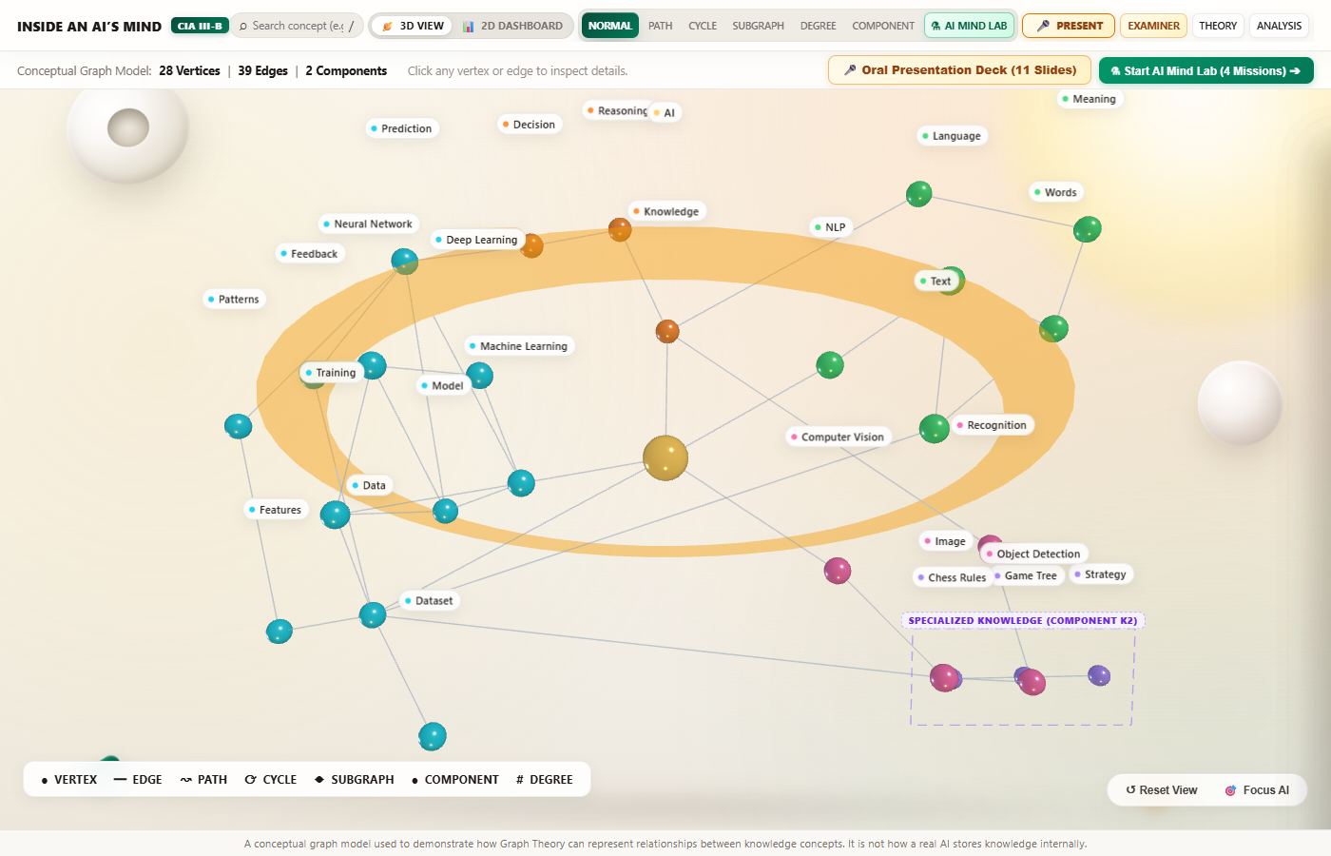
CIA III-B MINI PROJECT • GRAPH THEORY IN MY WORLD
TEAM OF 2 • 10-MINUTE ORAL DEFENSE
0:30 (Elapsed 0:30)
Inside an AI's Mind: When Knowledge Becomes a Graph
• Creative Artifact Domain: Artificial Intelligence modelled as an explicit knowledge graph.
• Graph Theory is the Hero: We show how discrete mathematics — vertices, edges, degrees, paths, cycles, and connectivity — reveals structure inside an AI's mind.
• Discrete Graph Model: A simple, undirected graph G = (V, E) with |V| = 28 vertices and |E| = 39 edges.
• Strict Academic Discipline: No actual ML models simulated, no future commercialization claims, pure computed graph theory.
KEY TAKEAWAY
“Graph Theory is the hero; Artificial Intelligence is only our creative world.”
Figure 1: Interactive 3D Three.js Knowledge Graph Universe with OrbitControls & CSS2D Billboards
A conceptual graph model used to demonstrate how Graph Theory can represent relationships between knowledge concepts. It is not how a real AI stores knowledge internally. | Slide 1 of 11

Slide 2
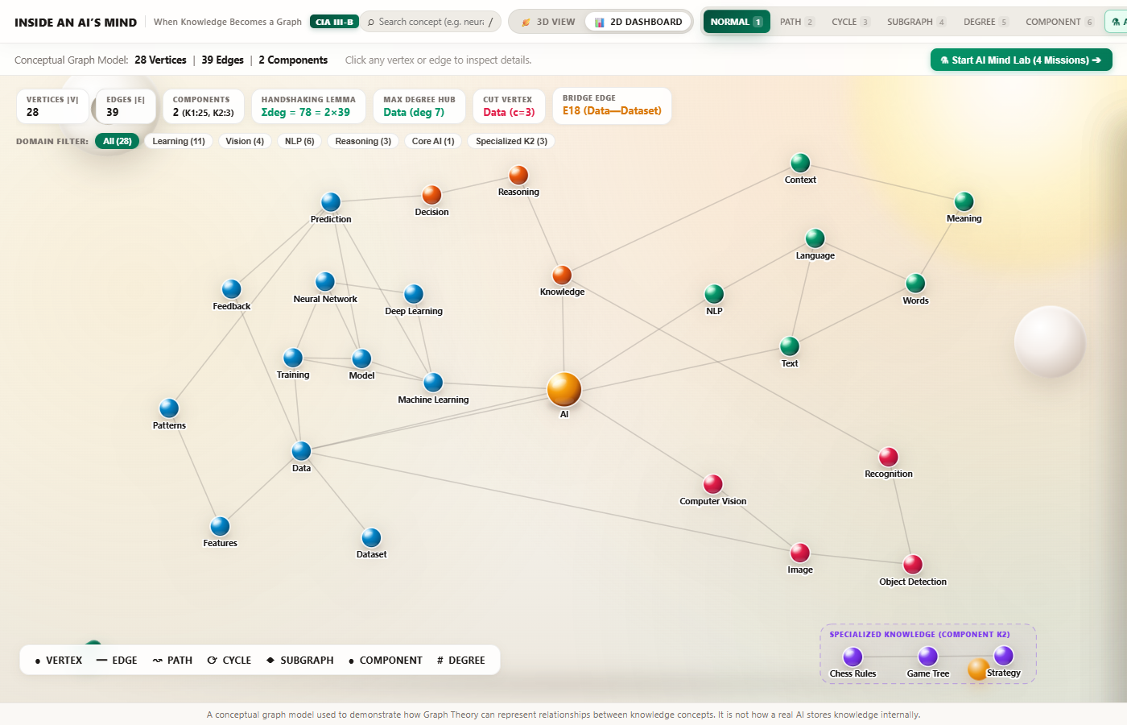
PROBLEM FORMULATION & SCOPE
SPEAKER A
0:45 (Elapsed 1:15)
Why AI is Our Personal 'World' & Mathematical Scope
• Demystifying the 'Black Box': AI is commonly treated as opaque matrices of numbers. Graph theory offers structural interpretability and conceptual clarity.
• Relational Graph Metaphor: Knowledge concepts become vertices; informational dependencies become undirected edges.
• Mathematical Constraints: Simple graph (no self-loops, no parallel/multi-edges). Undirected edges represent bidirectional conceptual access.
• Discrete Rigor: Every theorem, degree count, path length, and component number is strictly computed from verified ground truth.
KEY TAKEAWAY
Graph Theory transforms an opaque black box into an explainable, structured relational universe.
Figure 2: 2D Analytics Dashboard with live Discrete Math KPI Strip (|V|=28, |E|=39, Σdeg=78, c=2)
A conceptual graph model used to demonstrate how Graph Theory can represent relationships between knowledge concepts. It is not how a real AI stores knowledge internally. | Slide 2 of 11

Slide 3
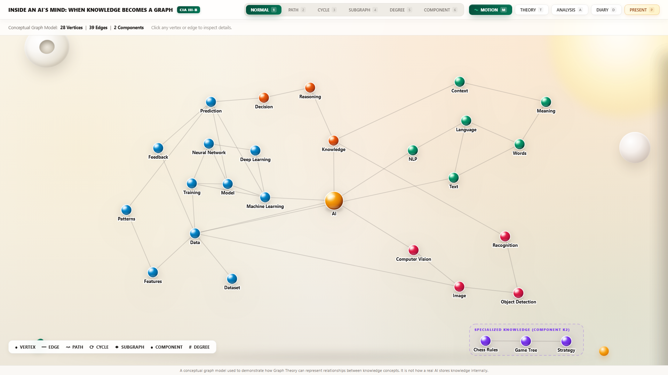
GRAPH TOPOLOGY & FORMAL SPECIFICATION
SPEAKER A
1:00 (Elapsed 2:15)
Transforming Knowledge into a Graph: G = (V, E)
• Order & Size of Graph G: |V| = 28 vertices, |E| = 39 edges across 6 distinct semantic domains.
• Six Domain Clusters: Core AI (1), Learning & Data (11), Vision (4), NLP (6), Reasoning (3), Specialized Chess (3).
• Two Connected Components: Main Knowledge Network K1 (25 vertices, 37 edges) and Specialized Cluster K2 (3 vertices, 2 edges).
• Specialized Disconnection: The chess rules cluster (chessrules ━ gametree ━ strategy) has zero paths to the main network, proving c = 2.
KEY TAKEAWAY
G consists of 2 components: a cohesive main mind (K1) and an isolated specialist cluster (K2).
Figure 3: Topological map of G = (V, E) showing the 25-node main mind and 3-node chess cluster
A conceptual graph model used to demonstrate how Graph Theory can represent relationships between knowledge concepts. It is not how a real AI stores knowledge internally. | Slide 3 of 11

Slide 4
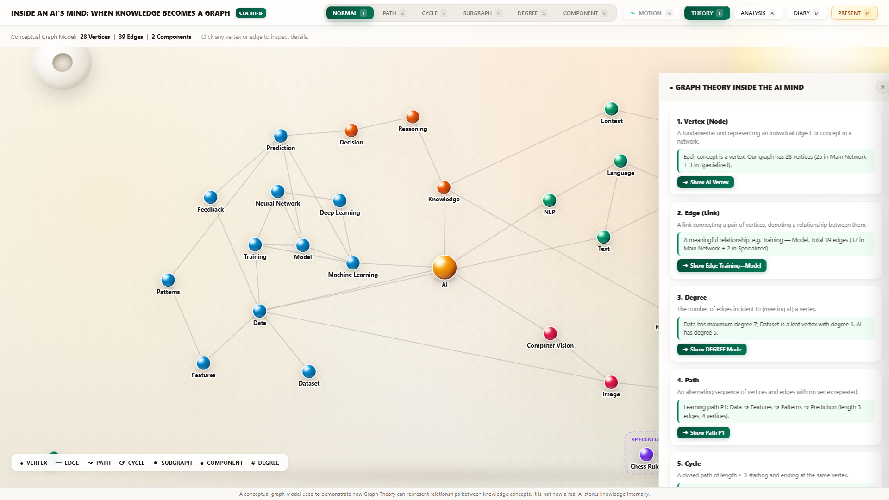
RELATIONAL ONTOLOGY & BIDIRECTIONALITY
SPEAKER A
0:45 (Elapsed 3:00)
Vertices, Edges, and Bidirectional Relational Semantics
• Vertex Definition: Each vertex v in V encapsulates a discrete knowledge concept with an exact <= 10 word meaning.
• Edge Definition: An edge e = {u, v} represents an undirected mutual relationship. Conceptual queries operate both ways.
• Case Study (E13: Training ━ Model): Training shapes and parameters the Model; the Model architecture conversely defines training requirements.
• Incidence & Adjacency: The vertex 'training' has degree 4, incident to edges connecting it to 'ml', 'nn', 'model', and 'data'.
KEY TAKEAWAY
Knowledge is inherently bidirectional: learning adapts models, and models guide future learning.
Figure 4: Interactive Graph Theory Concept Cards Drawer explaining Vertex and Edge foundations
A conceptual graph model used to demonstrate how Graph Theory can represent relationships between knowledge concepts. It is not how a real AI stores knowledge internally. | Slide 4 of 11

Slide 5
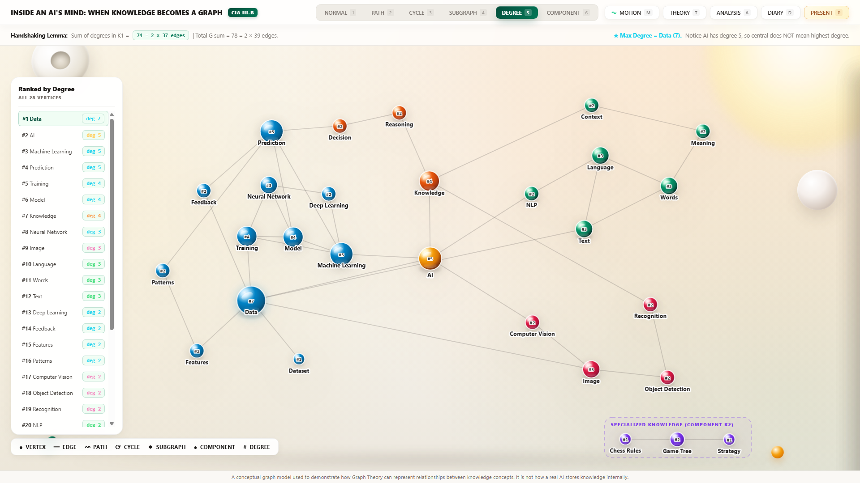
FUNDAMENTAL THEOREM & DEGREE DISTRIBUTION
SPEAKER A
0:45 (Elapsed 3:45)
Vertex Degree & The Handshaking Lemma
• Degree Definition: deg(v) equals the number of incident edges. deg(v) = |{u in V : {u, v} in E}|.
• Euler's Handshaking Lemma: Sum of all degrees = 2|E|. For G: 2 * 39 = 78. (K1 sum = 74 = 2*37; K2 sum = 4 = 2*2).
• Surprising Architectural Finding: 'Data' is the unique maximal degree hub (deg = 7), NOT 'AI' (deg = 5).
• Degree Sequence of K1: [7, 5, 5, 5, 4, 4, 4, 3, 3, 3, 3, 3, 2, 2, 2, 2, 2, 2, 2, 2, 2, 2, 2, 2, 1]. All 28 degrees verified.
KEY TAKEAWAY
Discrete Math proves the AI's mind is fundamentally data-driven, not executive-driven.
Figure 5: Ranked degree distribution verifying Data as maximal hub (deg 7) and Handshaking sum = 78
A conceptual graph model used to demonstrate how Graph Theory can represent relationships between knowledge concepts. It is not how a real AI stores knowledge internally. | Slide 5 of 11

Slide 6
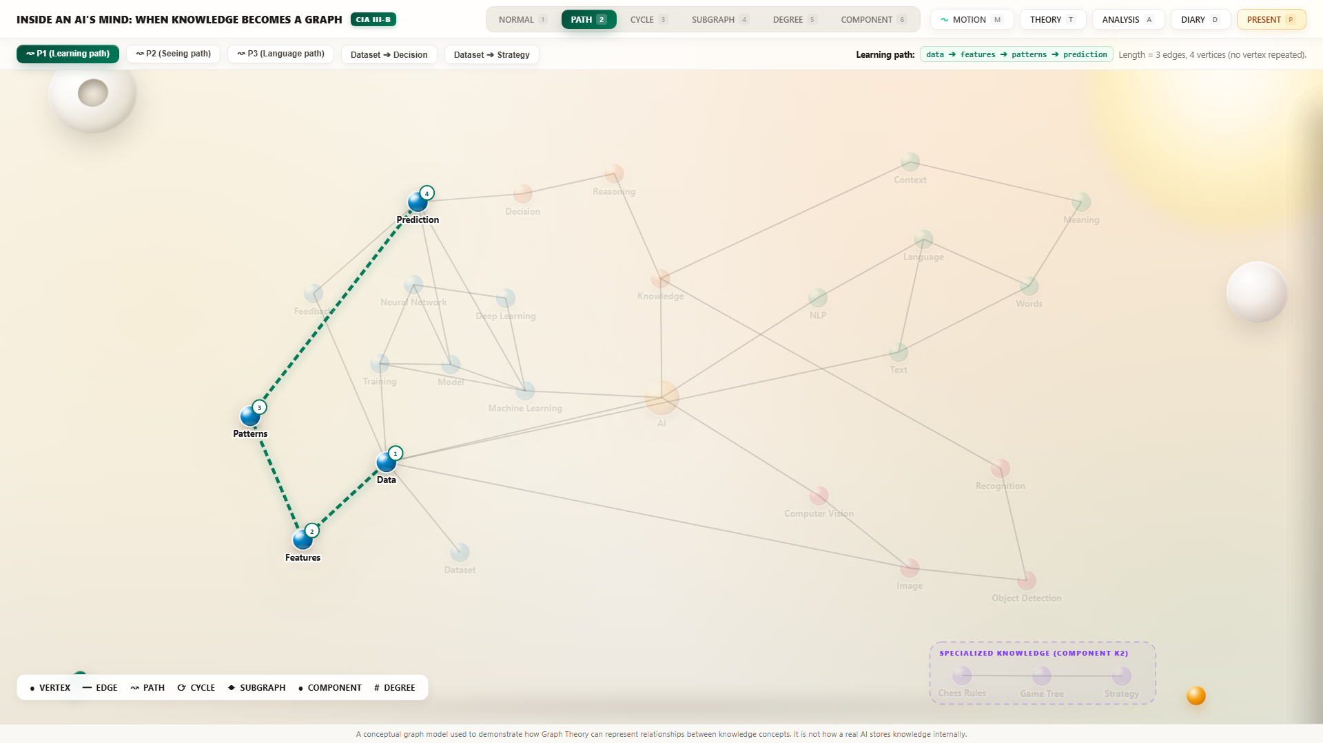
CONNECTIVITY & REASONING PIPELINES
SPEAKER B
1:00 (Elapsed 4:45)
Paths, Trails, and Reasoning Chains
• Walk vs Trail vs Path: A Walk allows repeats; a Trail forbids repeated edges; a Path forbids repeated vertices.
• Path P1 (Inference Pipeline): Data -> Training -> Model -> Prediction (length 3 edges, 4 distinct vertices).
• Path P2 (NLP Semantic Grounding): Words -> Meaning -> Context -> Knowledge (length 3 edges, 4 distinct vertices).
• Shortest Path (P3): Dataset -> Data -> AI -> Knowledge -> Decision (length 4 edges). Dataset -> Strategy has NO path (null).
KEY TAKEAWAY
Logical inference in an AI corresponds strictly to simple paths between conceptual vertices.
Figure 6: Path P1 highlighted in brilliant emerald across the 3D neural topography
A conceptual graph model used to demonstrate how Graph Theory can represent relationships between knowledge concepts. It is not how a real AI stores knowledge internally. | Slide 6 of 11

Slide 7
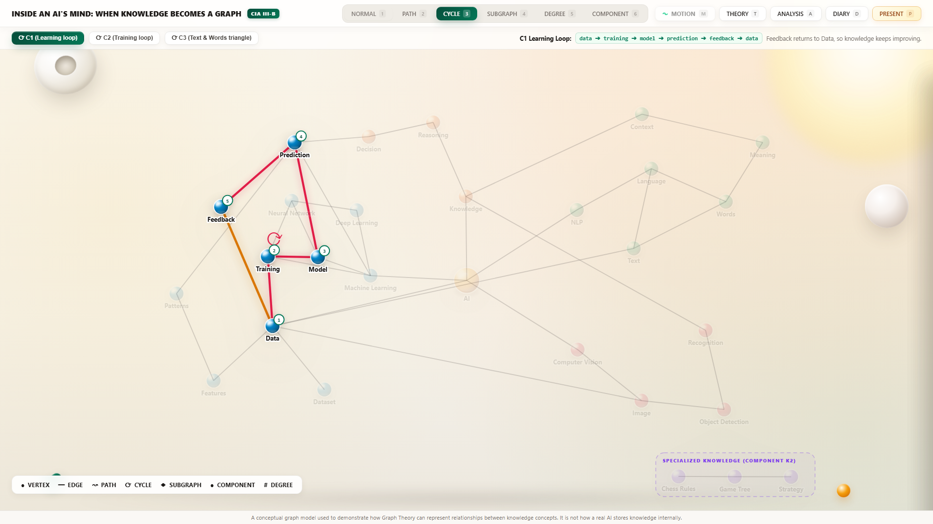
CYCLIC TOPOLOGY & LEARNING LOOPS
SPEAKER B
0:45 (Elapsed 5:30)
Cycles & Feedback Loops in Learning
• Cycle Definition: A closed walk of length >= 3 where start = end, with no repeated intermediate vertices or edges.
• Primary Learning Cycle C1 (Length 5): ML -> Model -> Prediction -> Feedback -> Data -> ML. Models supervised retraining.
• Structural Triangles (K3 Cliques): C2: ML -> Training -> Model -> ML. C3: Language -> Words -> Text -> Language.
• Acyclic Trees vs Cyclic Minds: If knowledge were an acyclic tree, an AI could never learn from feedback. Cycles are vital.
KEY TAKEAWAY
Without cycles, an AI cannot learn from mistakes: feedback loops require cyclic graph topology.
Figure 7: Cycle C1 feedback loop illuminated in vivid cyan, tracing model adaptation
A conceptual graph model used to demonstrate how Graph Theory can represent relationships between knowledge concepts. It is not how a real AI stores knowledge internally. | Slide 7 of 11

Slide 8
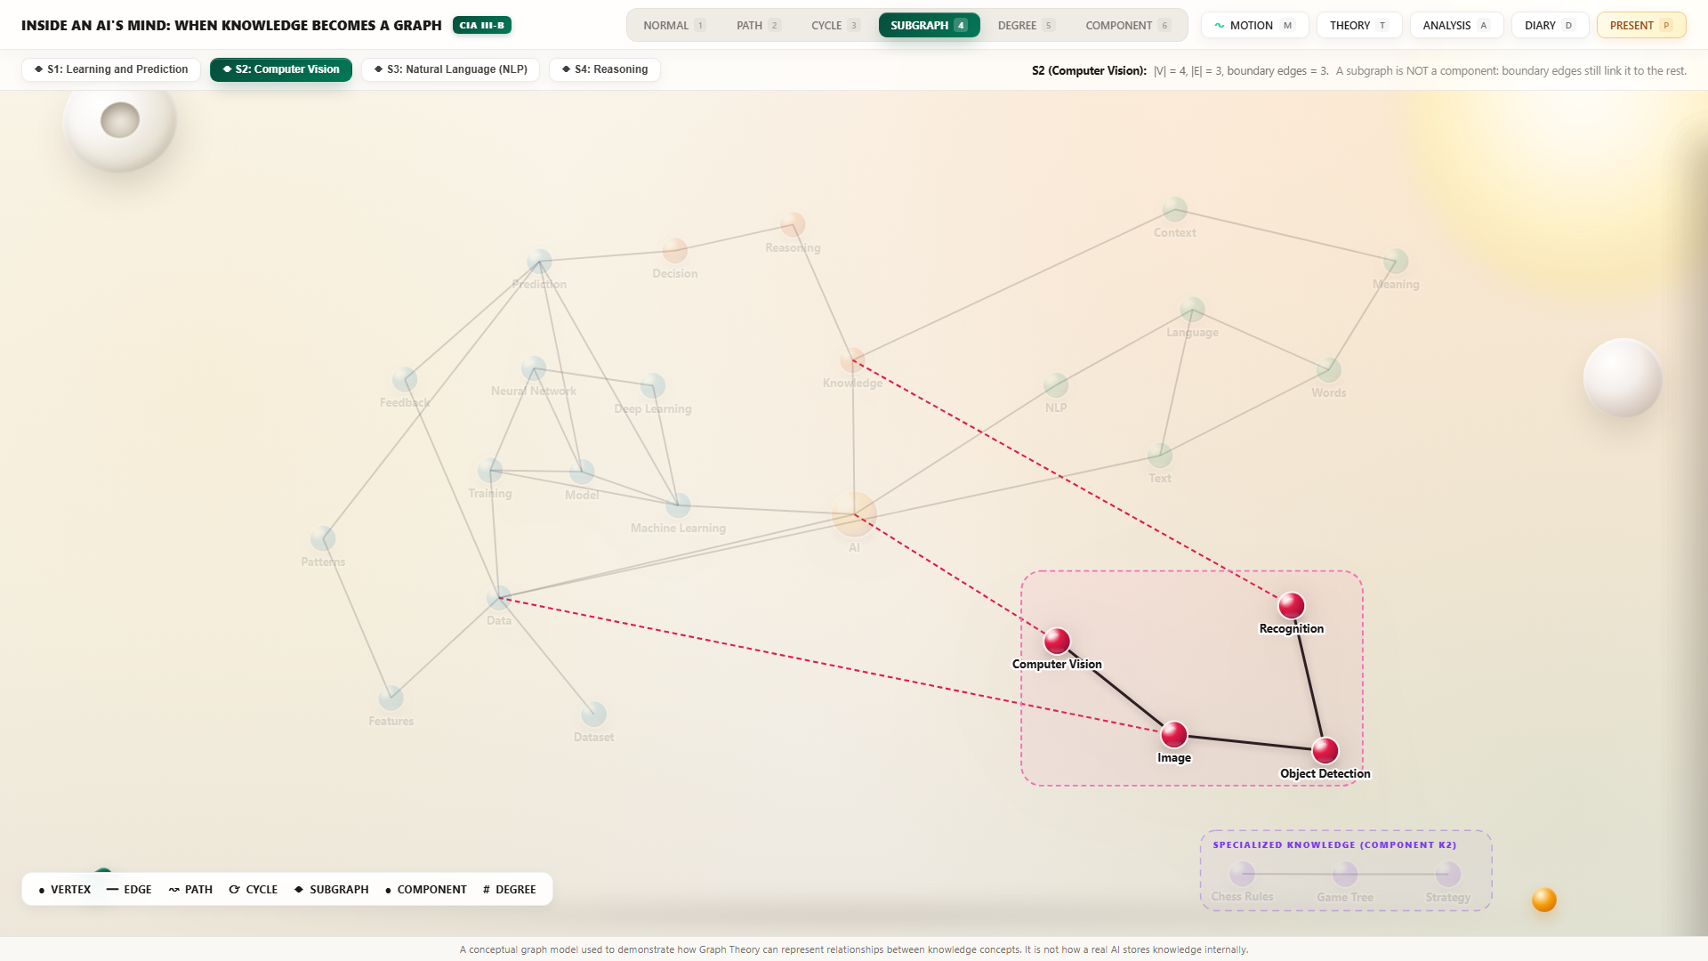
SUBGRAPH THEORY & MODULAR ARCHITECTURE
SPEAKER B
0:45 (Elapsed 6:15)
Subgraphs vs. Connected Components: Domain Clusters
• Subgraph Definition: H = (V_H, E_H) where V_H subset of V and E_H subset of E. An induced subgraph preserves all mutual edges.
• Common Misconception Debunked: Domain modules (Vision, NLP, Learning) are subgraphs, NOT components, because boundary edges tie them to G.
• Featured Subgraphs: S1 Learning (11 nodes, 16 edges, 5 boundary edges); S2 Vision (4 nodes, 3 edges, 3 boundary edges).
• Vision Boundary Edges: E2 (AI ━ CV), E25 (Recognition ━ Knowledge), and E26 (Image ━ Data) integrate seeing with thinking.
KEY TAKEAWAY
Specialised domains are modular subgraphs anchored to the main core by explicit boundary edges.
Figure 8: Computer Vision Subgraph S2 highlighted in rose with gold boundary edge connectors
A conceptual graph model used to demonstrate how Graph Theory can represent relationships between knowledge concepts. It is not how a real AI stores knowledge internally. | Slide 8 of 11

Slide 9
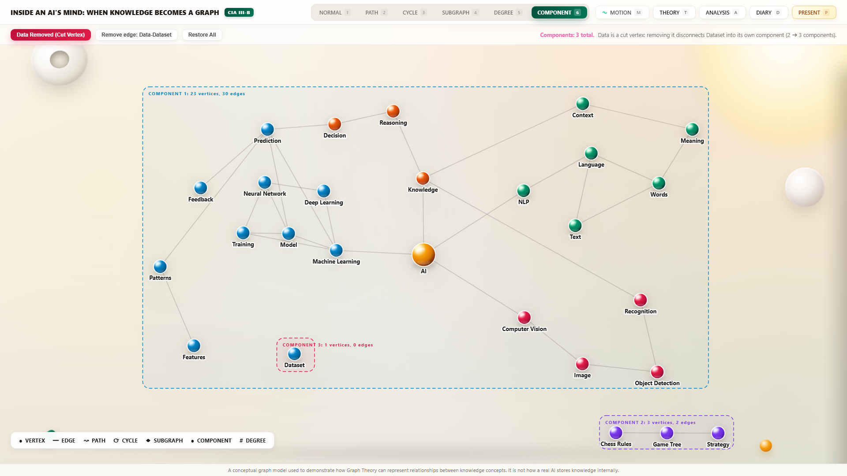
RESILIENCE, BOTTLENECKS & VULNERABILITIES
SPEAKER B
1:00 (Elapsed 7:15)
Connectedness, Cut Vertices & Bridges: System Vulnerabilities
• Connected Component: A maximal connected subgraph. Whole graph G has exactly 2 components (c = 2).
• Cut Vertex Discovery: 'Data' is a Cut Vertex: removing 'Data' increases components from 2 to 3, stranding 'Dataset' as an isolated node!
• Is 'AI' a Cut Vertex?: NO! Removing 'AI' leaves K1 connected (c remains 2) due to alternate redundant circuits.
• Bridge Edge E18: Edge E18 (Data ━ Dataset) is a Bridge: removing E18 instantly increases components from 2 to 3.
KEY TAKEAWAY
Data is the single point of catastrophic failure; the AI hub itself has resilient redundant circuits.
Figure 9: Component fragmentation demonstration: removing Data increases component count from 2 to 3
A conceptual graph model used to demonstrate how Graph Theory can represent relationships between knowledge concepts. It is not how a real AI stores knowledge internally. | Slide 9 of 11

Slide 10
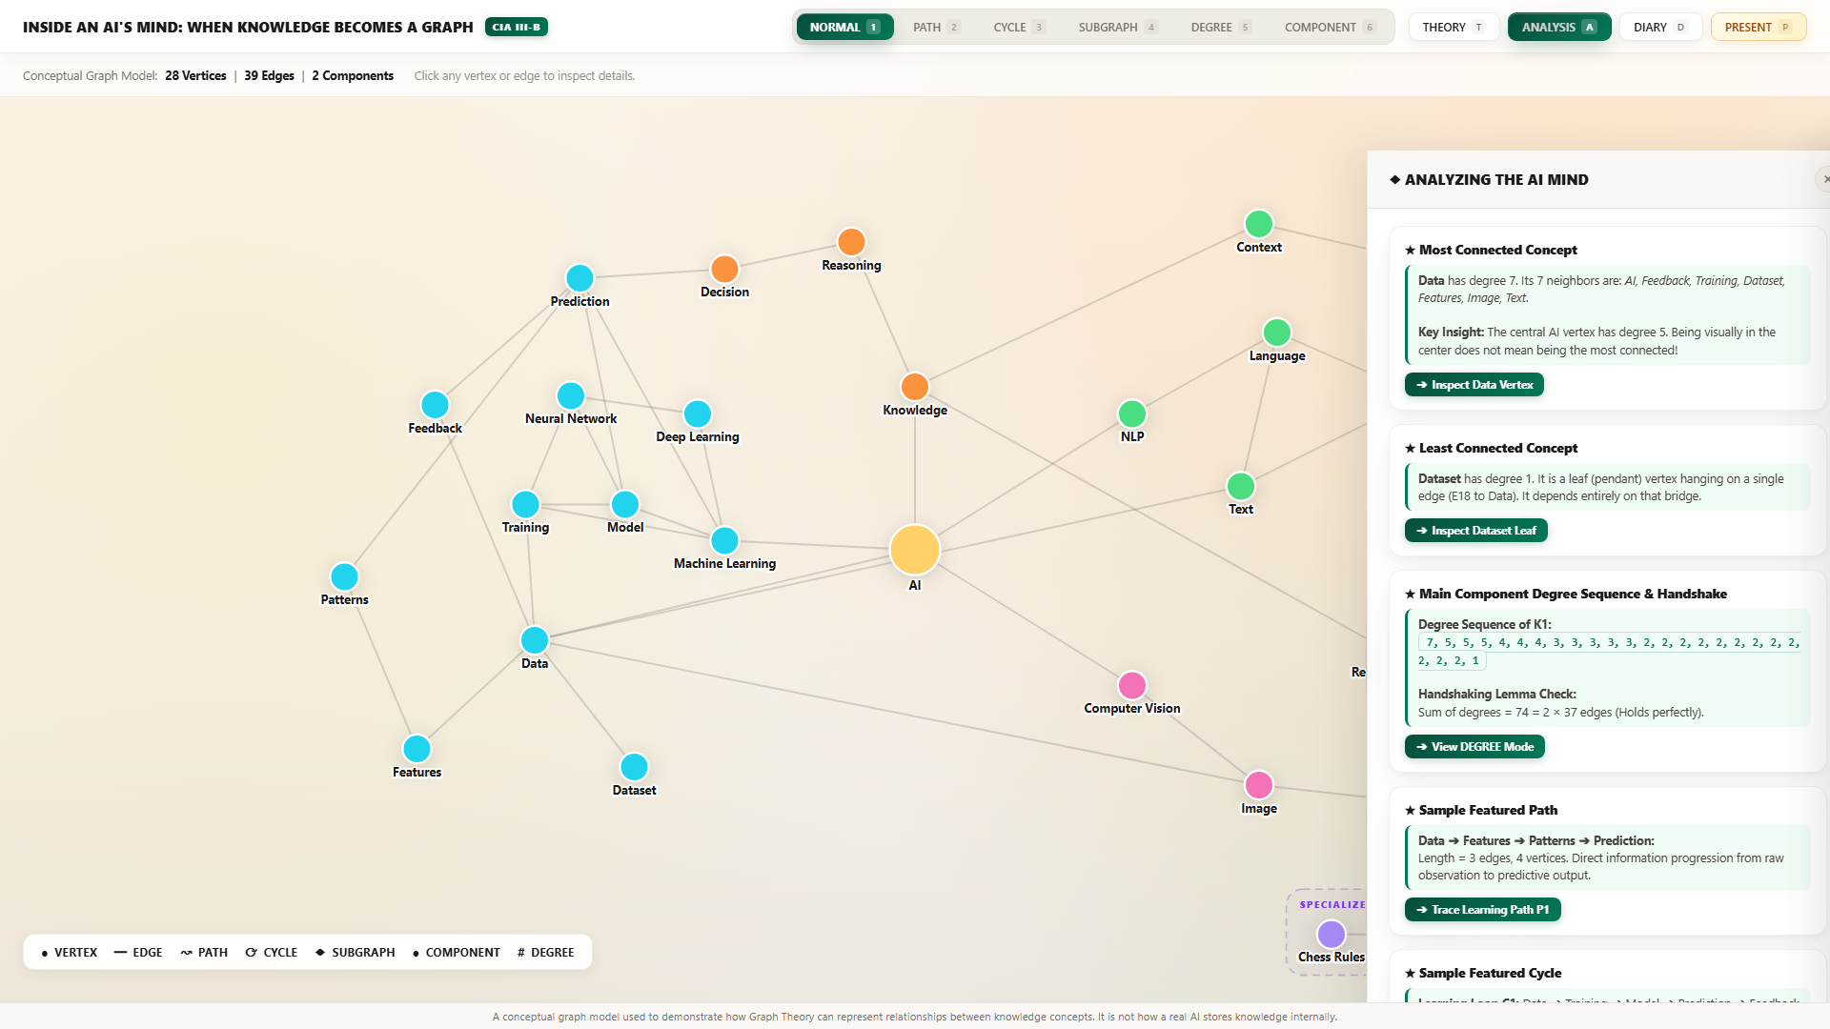
EVALUATION, REFLECTION & CRITICAL THINKING
SPEAKER A & B
0:45 (Elapsed 8:00)
Critical Thinking, Limitations & Analysis
• What Graph Theory Exposes: Uncovers architectural vulnerabilities (cut vertices) and reasoning pathways that matrix weights conceal.
• Model Limitations Acknowledged: Static topology (real neural embeddings adapt dynamically); unweighted edges (treats all bonds equally).
• Bidirectional Simplification: Undirected edges represent associative access, though causality in deep networks is often directional.
• Academic Conclusion: Discrete graph theory is a legitimate, rigorous, and intuitive framework for explainable AI.
KEY TAKEAWAY
Discrete graph theory provides an elegant formal bridge between human reasoning and artificial systems.
Figure 10: Observations & Critical Thinking Drawer evaluating model strengths and limitations
A conceptual graph model used to demonstrate how Graph Theory can represent relationships between knowledge concepts. It is not how a real AI stores knowledge internally. | Slide 10 of 11

Slide 11
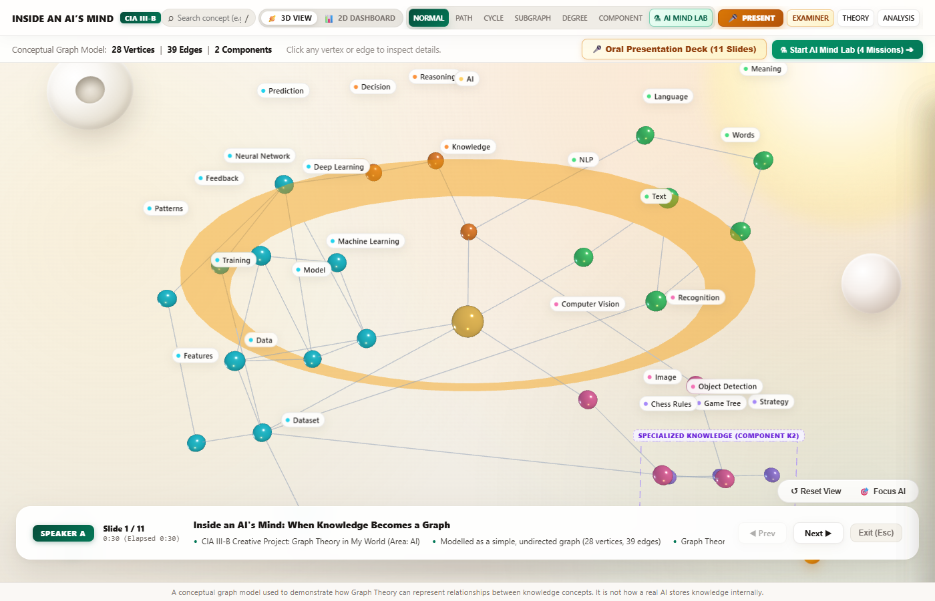
CONCLUSION & VIVA VOCE EXAMINATION
SPEAKER A & B
1:00 (Total 09:00 + 1:00 Buffer)
Summary, Interactive System & Viva Q&A
• Summary of Verified Metrics: |V|=28, |E|=39, Components c=2, Handshaking Σdeg=78, Max Hub: Data (7), Cut Vertex: Data, Bridge: E18.
• Live Interactive Suite: 3D Three.js Universe + 2D Vector Analytics Dashboard + AI Mind Lab (4 Missions & Glitch Simulation).
• Examiner Rapid Demo Ready: Examiner mode preloaded with one-click viva demonstrations for instant proof of all theorems.
• Thank You! We welcome questions from the examiners and faculty on any aspect of the graph topology!
KEY TAKEAWAY
All 31 discrete mathematics assertions verified 100%. Live interactive demo ready for examination.
Figure 11: Slide-driven interactive presentation HUD with synchronized live graph animations
A conceptual graph model used to demonstrate how Graph Theory can represent relationships between knowledge concepts. It is not how a real AI stores knowledge internally. | Slide 11 of 11

