Slide 1
AI Assisted
Self Healing SDN
Current demonstration results explained simply
BCSE308P Computer Networks Lab
Fall Semester 2026–27
24BCE2052
Vaibhav Bakshi
Notes:
The implemented scope is binary path degradation detection and automatic rerouting. Presenter: Vaibhav Bakshi, registration number 24BCE2052, matching the report. Sources: README.md and Self_Healing_SDN_Full_Report.docx. Delivery note: this trimmed project contains the final report and PPT, merged Python code, and one fitted forest. Old collections, campaign folders, and build/audit scripts are omitted. New demos save logs under .runtime/runs. The historical study numbers on these slides are unchanged.

Slide 2
What this project demonstrates
Two network paths connect the sender and receiver. The application starts on the primary path.
The controller checks both paths. If the selected path fails and the other is healthy, it changes the forwarding rules.
We test whether communication returns while the injected fault is still present.
Rerouting needs a usable backup. The system cannot repair a disconnected physical link.
Notes:
Motivation and research question from the report experiment protocol. Background on programmable forwarding: Kreutz et al., Software-defined networking: A comprehensive survey, 2014, https://arxiv.org/abs/1406.0440. Delivery note: this trimmed project contains the final report and PPT, merged Python code, and one fitted forest. Old collections, campaign folders, and build/audit scripts are omitted. New demos save logs under .runtime/runs. The historical study numbers on these slides are unchanged.

Slide 3
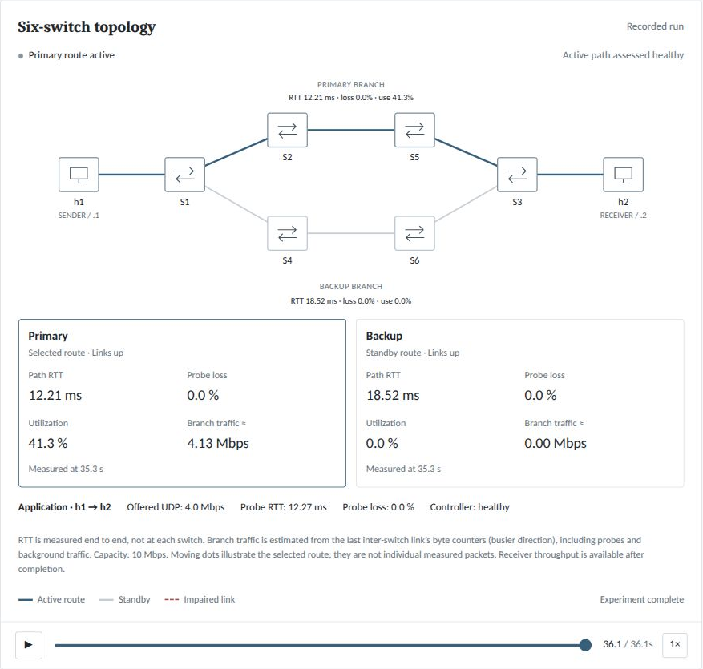
Reading the network diagram
Blue means selected
The application uses the blue branch. Its card shows measured round trip time, probe loss and estimated traffic.
Grey means standby
The controller still sends small test probes through the backup. That is why an unused application route has an RTT reading.
Notes:
Screenshot captured from the current dashboard on 27 October 2026. Recorded normal operation: 20261027T151646Z-776f29cf. The card measurement timestamp belongs to replay, not wall clock. Blue is the selected application branch. Source: dashboard/static/app.js, src/selfheal/telemetry.py.
.runtime/runs/20261027T151646Z-776f29cf/summary.json and metadata.json

Slide 4
The conditions used for these results
Setting | Value
Network | Six switches with primary and backup branches
Application traffic | 4 Mbps offered to a 10 Mbps branch
Traffic duration | 36 seconds, plus setup and cleanup
Fault schedule | Requested around 10 to 26 seconds
Evidence set | Six default scenarios plus two detector comparisons
Eight runs, one per condition, at 10 Mbps capacity. New runs can set capacity independently; these saved results are unchanged.
Notes:
Current runs recorded on 27 October 2026. One run per listed condition.
.runtime/runs/20261027T150945Z-5b433df7/summary.json and events.jsonl
.runtime/runs/20261027T151025Z-7bbacb9c/summary.json and events.jsonl
.runtime/runs/20261027T151105Z-3f4808d8/summary.json and events.jsonl
.runtime/runs/20261027T151646Z-776f29cf/summary.json and events.jsonl
.runtime/runs/20261027T151725Z-f6caa845/summary.json and events.jsonl
.runtime/runs/20261027T151807Z-9c06ddef/summary.json and events.jsonl
.runtime/runs/20261027T151849Z-811520ad/summary.json and events.jsonl
.runtime/runs/20261027T151928Z-180225f4/summary.json and events.jsonl
Actual fault timestamps can differ from requested times. Both methods in the comparison use the same topology, offered load and requested timing.

Slide 5
The three detection methods
Method | How it decides
RF only | A trained random forest judges the measurements.
RF + loss guard | The same forest plus a fixed rule for loss of at least 15%.
Fixed rules | Limits on loss, RTT, missing replies and utilization.
All methods share the same forwarding and recovery policy. Hard link failures use a separate link-state check.
RF + loss guard is the default shown in the scenario results.
Notes:
Sources: src/selfheal/core.py and learning.py. Fixed rules are loss >=15%, RTT >=40 ms, missing RTT, or utilization >=90%. RF uses degraded score >=0.65. Soft faults require two confirmations and observe the five-second hold-down. A down candidate is never selected.

Slide 6
Route change and recovery are different
2.10 seconds to change route
After the link failed, the controller selected and installed the backup route. This records the forwarding action.
8.02 seconds to confirm recovery
The runner then observed two healthy application probe windows while the fault remained active. Probe timing and timeouts add to this delay.
Example from the current link-failure run. Both times start at actual fault onset.
Notes:
Current runs recorded on 27 October 2026. One run per listed condition.
.runtime/runs/20261027T151725Z-f6caa845/summary.json and events.jsonl
Fault at 10.0093 s, route change at 12.1107 s. Detection and actuation 2.1014 s. Verified recovery 8.0222 s after fault onset. The recovery value includes the two-window confirmation process and is not exact packet-level outage duration.

Slide 7
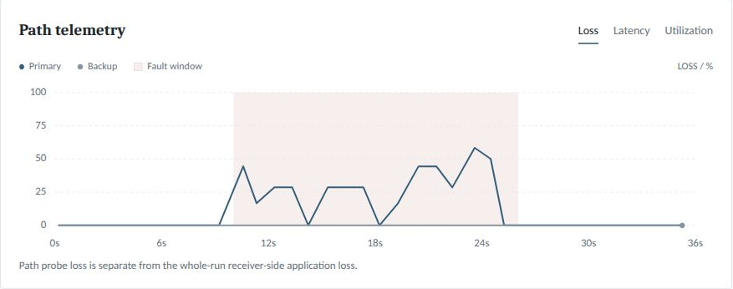
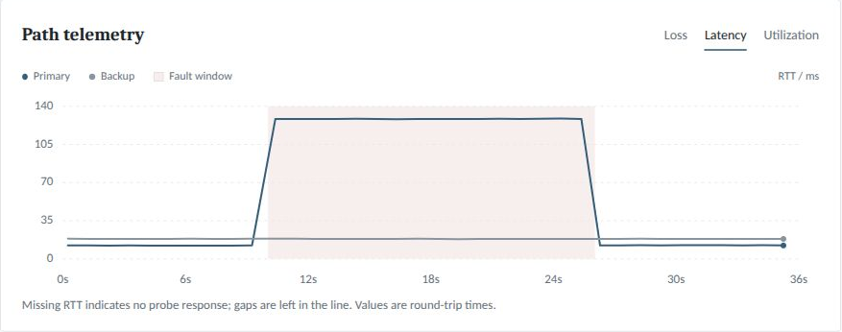
Reading loss and latency
Loss in percent
Round trip time in milliseconds
Loss asks whether test packets returned. The primary can still show loss after the application moves to the backup.
Latency asks how long a reply took. It measures the complete round trip. A missing reply does not mean zero delay.
Pink shading marks the fault window. Lines connect sampled observations.
Notes:
Current dashboard screenshots. Loss run 20261027T150945Z-5b433df7; delay run 20261027T151849Z-811520ad. The delay run used the guarded forest and does not prove reliable delay-only RF detection. Configured link delay is 60 ms in each direction. Source: dashboard/static/app.js, src/selfheal/telemetry.py and src/selfheal/network.py.
.runtime/runs/20261027T150945Z-5b433df7/summary.json and metadata.json
.runtime/runs/20261027T151849Z-811520ad/summary.json and metadata.json

Slide 8
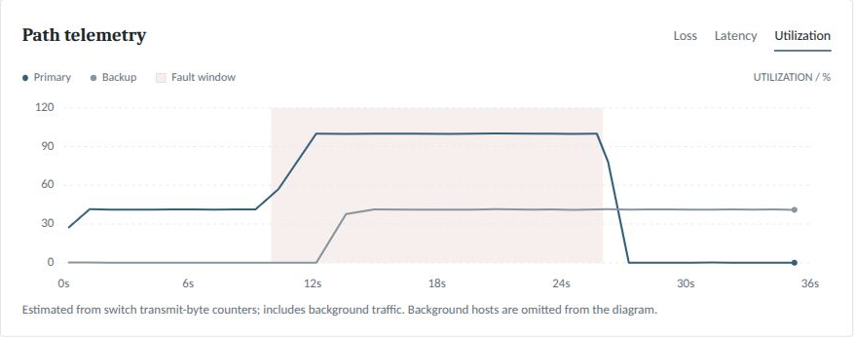
Utilization and application load
Measured link use
Counter rate ÷ capacity gives utilization.
4.11 Mbps ÷ 10 Mbps = 41.1%.
Capacity applies to both branches. Utilization uses the chosen capacity. At 20 Mbps, 4 Mbps is approximately 20% utilization before other traffic.
Set link capacity in the dashboard or use --capacity 20 --load 4. Default: 10 Mbps; maximum: 100 Mbps. Congestion background = 1.2 × capacity.
Notes:
Utilization screenshot: 20261027T151807Z-9c06ddef. Estimate uses transmit-byte deltas on the last inter-switch link of each branch and the larger direction, normalized by configured capacity. It is not receiver goodput or a whole-path average. Counter position, queues and sampling can produce rates near or above nominal capacity. The 4.11 Mbps / 41.1% calculation is an illustrative reading, not a new receiver-throughput result.
.runtime/runs/20261027T151807Z-9c06ddef/summary.json and metadata.json

Slide 9
What happened in each scenario
Scenario | Data received | Packets lost | What happened
Normal | 4.00 Mbps | 0.00% | No fault to recover from
Link failure | 3.76 Mbps | 5.86% | Restored in 8.02 s
Packet loss | 3.97 Mbps | 0.64% | Restored in 3.30 s
Congestion | 3.89 Mbps | 2.81% | Restored in 4.98 s
Increased delay | 4.00 Mbps | 0.01% | Restored in 3.33 s
Both paths down | 2.00 Mbps | 50.02% | No healthy alternative
Default RF + loss guard, six switches, 4 Mbps offered traffic. Each row is one current 36-second run.
“Restored” means two healthy application probe windows after rerouting while the fault remains active.
Notes:
Current runs recorded on 27 October 2026. One run per listed condition.
.runtime/runs/20261027T151646Z-776f29cf/summary.json and events.jsonl
.runtime/runs/20261027T151725Z-f6caa845/summary.json and events.jsonl
.runtime/runs/20261027T150945Z-5b433df7/summary.json and events.jsonl
.runtime/runs/20261027T151807Z-9c06ddef/summary.json and events.jsonl
.runtime/runs/20261027T151849Z-811520ad/summary.json and events.jsonl
.runtime/runs/20261027T151928Z-180225f4/summary.json and events.jsonl

Slide 10
How long did recovery confirmation take
A shorter bar means earlier confirmation in that run. Link failure took about 8 seconds including probe waits and confirmation.
Normal needs no recovery; both paths down has no reroute recovery. Neither means zero seconds.
Notes:
Current runs recorded on 27 October 2026. One run per listed condition.
.runtime/runs/20261027T151725Z-f6caa845/summary.json and events.jsonl
.runtime/runs/20261027T150945Z-5b433df7/summary.json and events.jsonl
.runtime/runs/20261027T151807Z-9c06ddef/summary.json and events.jsonl
.runtime/runs/20261027T151849Z-811520ad/summary.json and events.jsonl
These are four individual guarded demonstrations, not averages. Normal and both_down have null recovery values and are intentionally omitted.

Slide 11
Which method handled packet loss
Packet-loss test | RF + guard | RF only | Fixed rules
Changed route? | Yes | No | Yes
Confirmed recovery | 3.30 s | Not observed | 3.35 s
Data received | 3.97 Mbps | 3.63 Mbps | 3.97 Mbps
Packets lost | 0.64% | 9.24% | 0.72%
The same packet-loss scenario ran once with each method. Both guarded RF and fixed rules restored communication. RF alone missed it.
The guard helps in this test. A small timing difference between successful methods does not prove that one is consistently faster.
Notes:
Current runs recorded on 27 October 2026. One run per listed condition.
.runtime/runs/20261027T150945Z-5b433df7/summary.json and events.jsonl
.runtime/runs/20261027T151025Z-7bbacb9c/summary.json and events.jsonl
.runtime/runs/20261027T151105Z-3f4808d8/summary.json and events.jsonl

Slide 12
How much application traffic was lost
RF only lost about 9.24% of application packets in this run. Guarded RF lost 0.64%, and fixed rules lost 0.72%.
Receiver-side UDP loss differs from primary-path ping loss.
Notes:
Current runs recorded on 27 October 2026. One run per listed condition.
.runtime/runs/20261027T150945Z-5b433df7/summary.json and events.jsonl
.runtime/runs/20261027T151025Z-7bbacb9c/summary.json and events.jsonl
.runtime/runs/20261027T151105Z-3f4808d8/summary.json and events.jsonl
Literal chart values are the raw percentage measurements divided by 100 for percentage formatting. New embedded workbook snapshots are intentionally generated from these complete values. No historical chart data are used.

Slide 13
Why RF needs safeguards
Question | What the current implementation does
What does RF read? | Loss, round trip time, RTT variation and utilization
What does the guard add? | It declares measured loss of 15% or more unhealthy.
What handles a broken link? | A separate link-state check
How reliable is the model? | Stored validation covers its original lab data only.
What did the live test expose? | RF alone missed the packet-loss fault.
The stored model report says 100% on 544 validation rows. This is not a guarantee for new faults or networks.
The 0.65 decision threshold does not mean 65% accuracy. A guarded success cannot be credited entirely to RF.
Notes:
Source: training_report in src/selfheal/assets/detector.joblib, learning.py and core.py. There are 1,094 fitting rows, 544 validation rows (481 normal, 63 degraded), 200 trees, and a score threshold of 0.65. Dedicated loss runs were excluded from fitting. The original fitting datasets are absent. The stored score was not independently reproduced.
Current runs recorded on 27 October 2026. One run per listed condition.
.runtime/runs/20261027T151025Z-7bbacb9c/summary.json and events.jsonl

Slide 14
What the current tests establish
Guarded RF restored communication in the link failure, packet loss, congestion and delay demonstrations.
RF alone missed packet loss. The loss guard and fixed rules both recovered in that comparison.
When both paths failed, there was no healthy alternative. These are single-run observations on this testbed.
Notes:
Current runs recorded on 27 October 2026. One run per listed condition.
.runtime/runs/20261027T150945Z-5b433df7/summary.json and events.jsonl
.runtime/runs/20261027T151025Z-7bbacb9c/summary.json and events.jsonl
.runtime/runs/20261027T151105Z-3f4808d8/summary.json and events.jsonl
.runtime/runs/20261027T151646Z-776f29cf/summary.json and events.jsonl
.runtime/runs/20261027T151725Z-f6caa845/summary.json and events.jsonl
.runtime/runs/20261027T151807Z-9c06ddef/summary.json and events.jsonl
.runtime/runs/20261027T151849Z-811520ad/summary.json and events.jsonl
.runtime/runs/20261027T151928Z-180225f4/summary.json and events.jsonl

