Slide 1
GOVERNMENT ENGINEERING COLLEGE,PATAN
INTERSHIP ON
DATA SCIENCE
FROM
INFOLABZ IT SERVICES PVT. LTD
PARTICIPATED BY
VAIBHAV RAVAL(190220131117)
WITH GUIDANCE BY
PROF. D.U.BAVISA

Slide 2

Outlines
Introduction
About Compony
Tools and technology
RFM analysis
Recommendation system
References

Slide 3

About Company
InfoLabz IT Services Pvt. Ltd.
OFFICE ADDRESS
405, Vraj Avenue, Near. Commerce Six Road, Navrangpura,
Ahmedabad, Gujarat - 380009
MENTOR
MR. CHINTAN NAGRECHA
SELECTION PROCESS
INTERVIEW (TECHNICAL + HR)
HR
MS. ZARNA SHAH

Slide 4

Predicting Customer Behavior for Maximizing Revenue with Data-Driven Sales: Harnessing the Power of Customer Data for Increased Revenue

Slide 5




TOOLS & TECHNOLOGY
PROGRAMMING LANGUAGE
Integrated Development Environments (IDEs)
PyCharm IDE
Jupyter Notebook
Google Colab

Slide 6






Libraries in Python
Various libraries are used in Python like,
TensorFlow
NumPy
Pandas
Matplotlib
Keras
Scikit-Learn

Slide 7
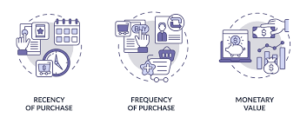
RFM ANALYSIS
RFM stands for Recency, Frequency, and Monetary value.
Recency refers to how recently a customer has made a purchase
frequency refers to how often they make purchases
monetary value refers to how much they spend
RFM analysis involves assigning scores to each customer based on their behavior and then grouping them into segments based on these scores.

Slide 8
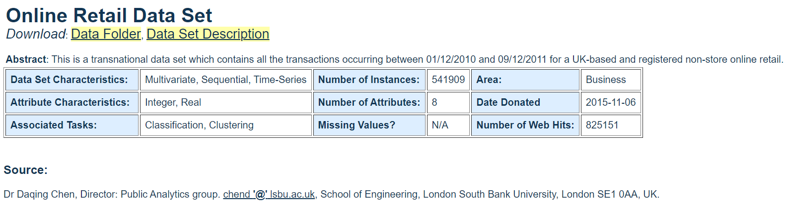
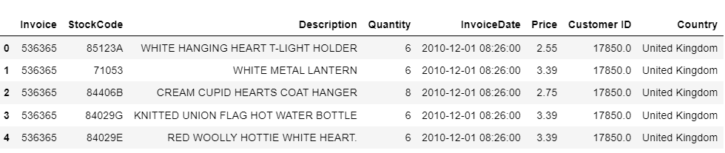
Overview of the dataset

Slide 9
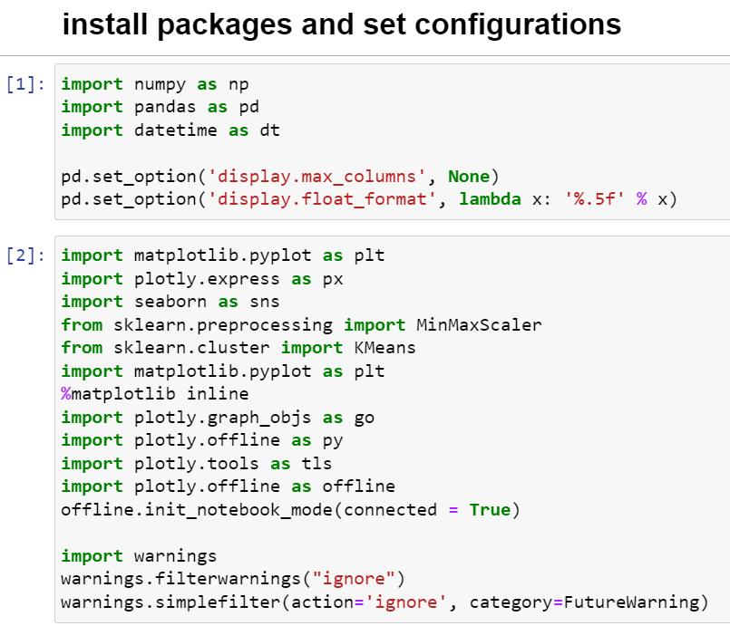
Import libraries

Slide 10
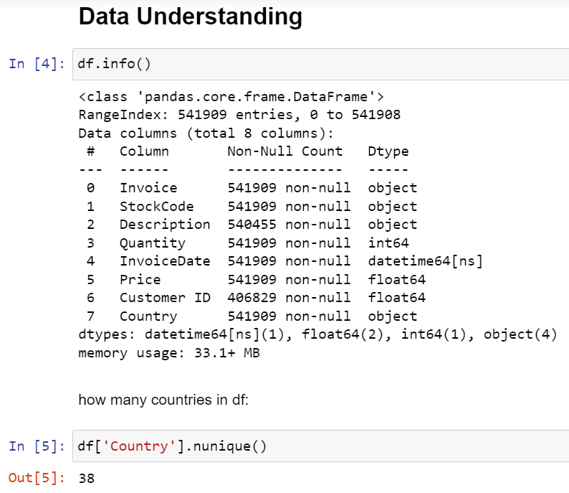
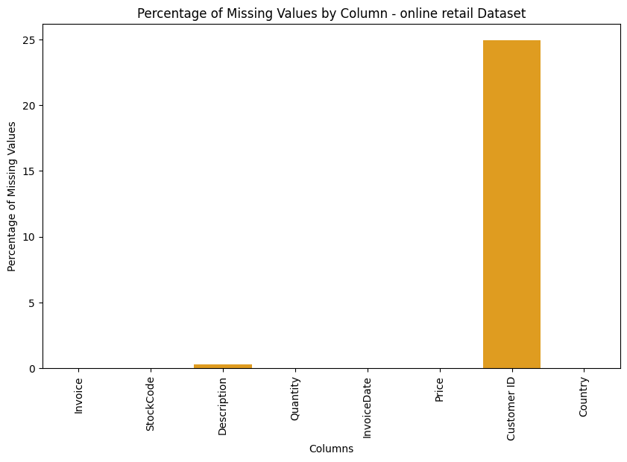
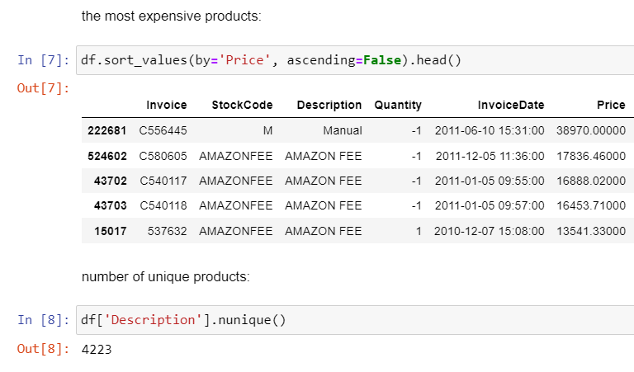
Data Understanding

Slide 11
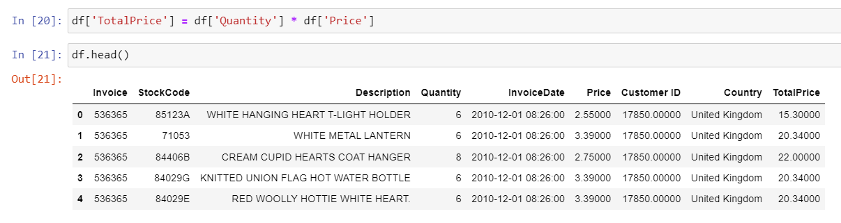
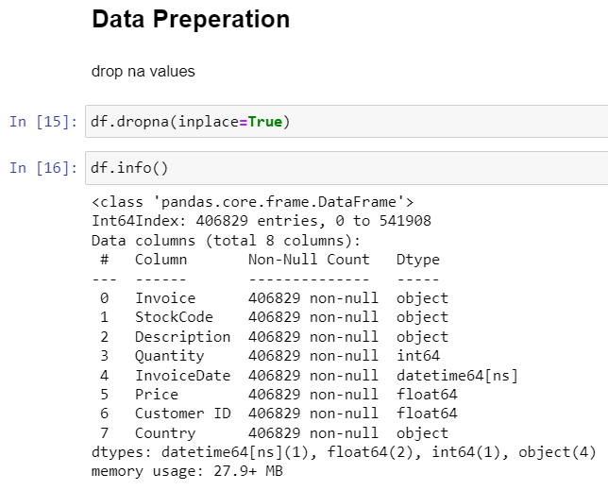
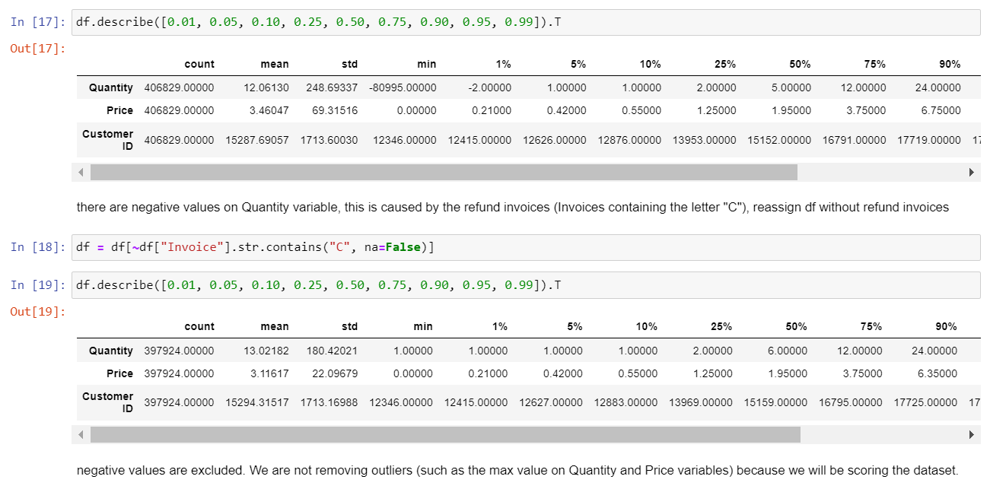
Data Preparation

Slide 12
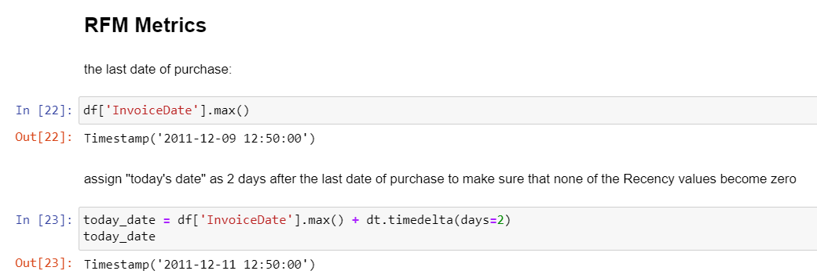
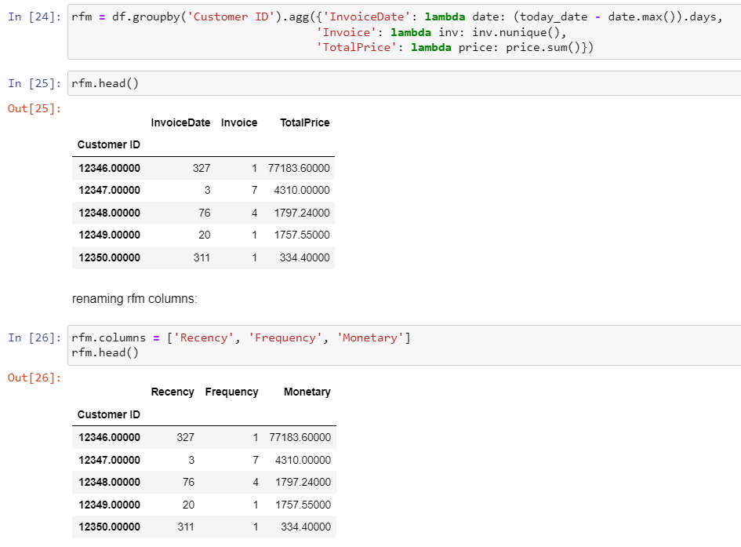
RFM metrics

Slide 13
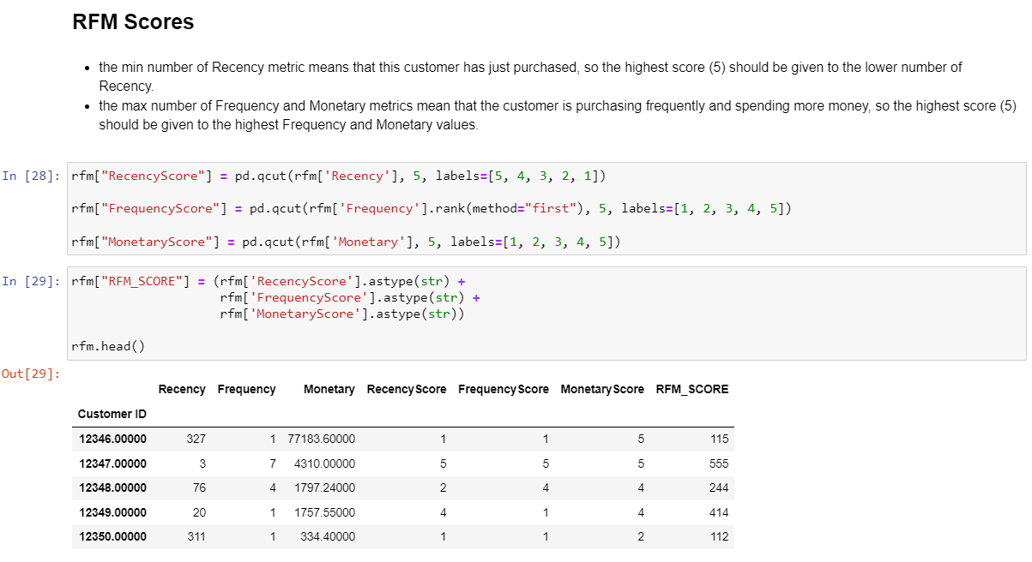
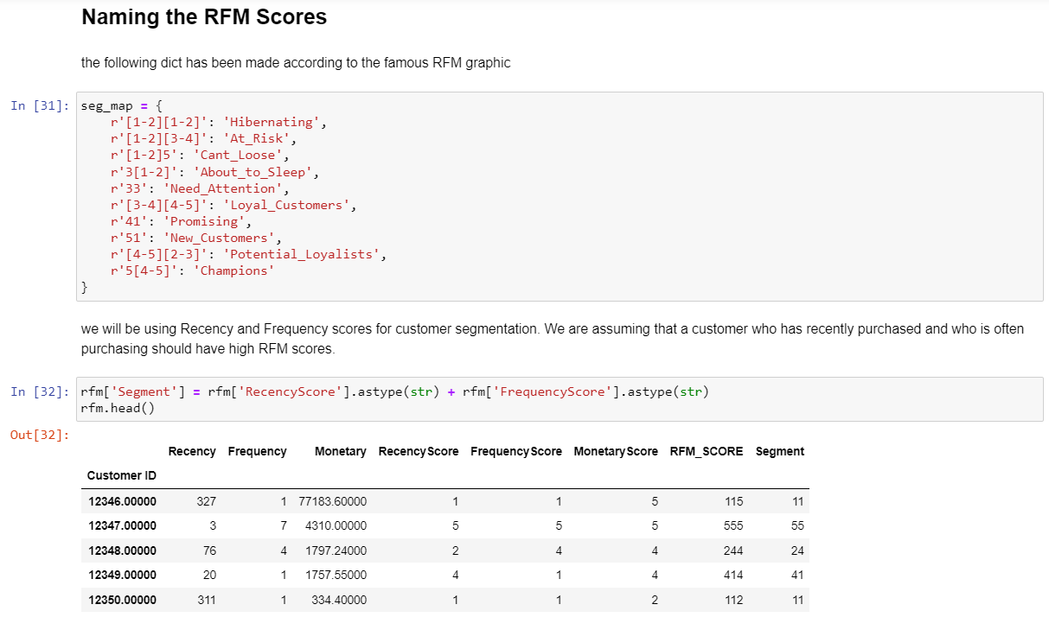
RFM score

Slide 14
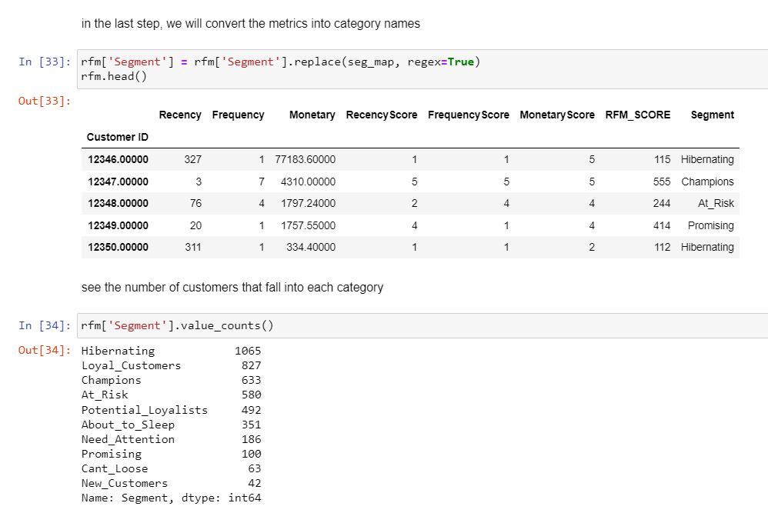
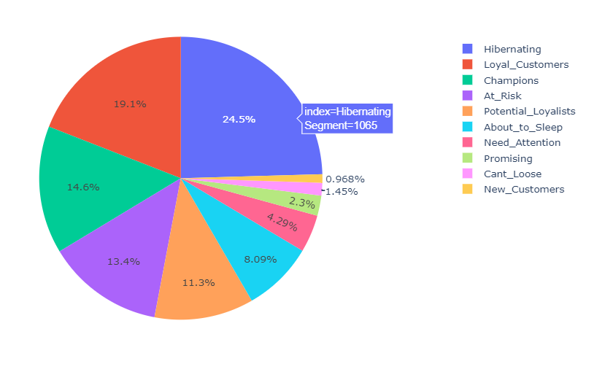
Naming the RFM score

Slide 15
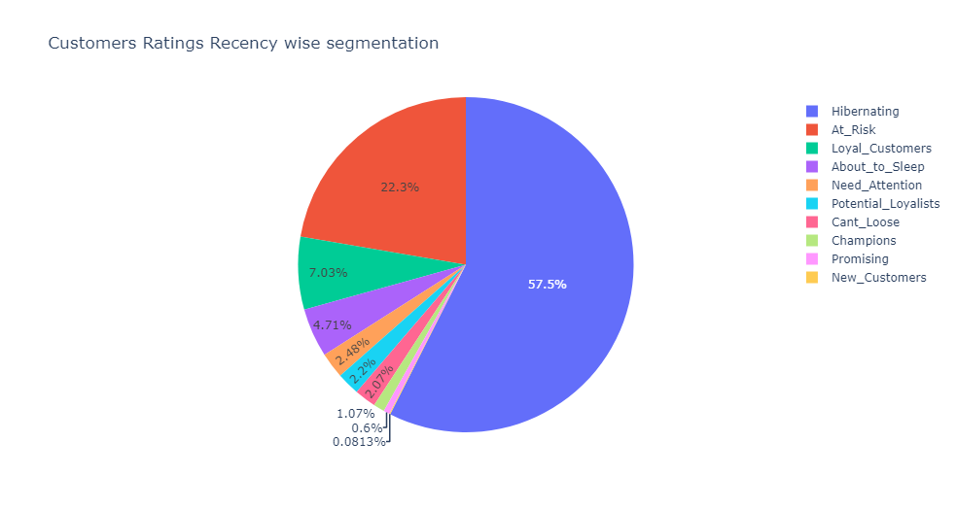
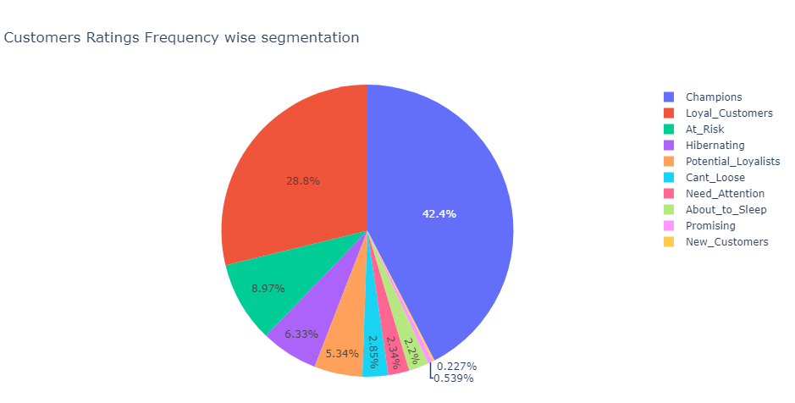
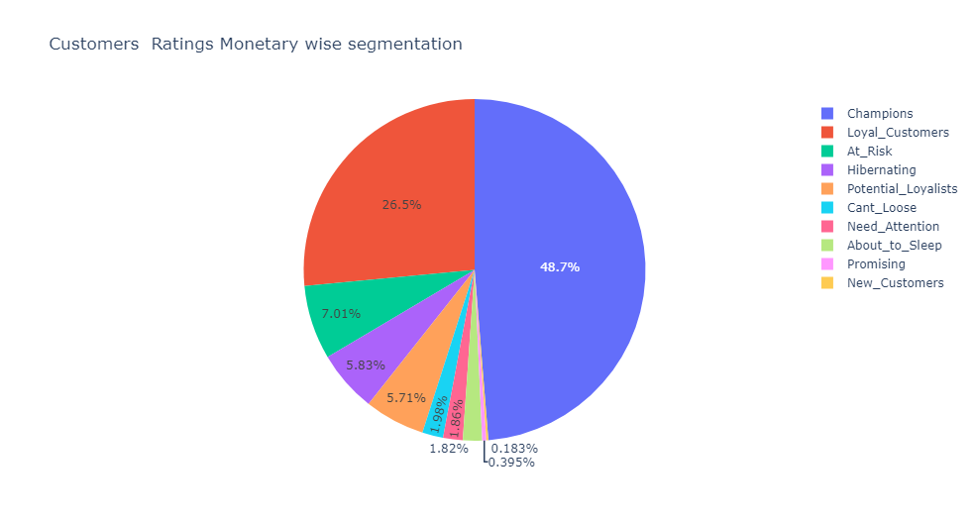
Charts based on RFM score

Slide 16
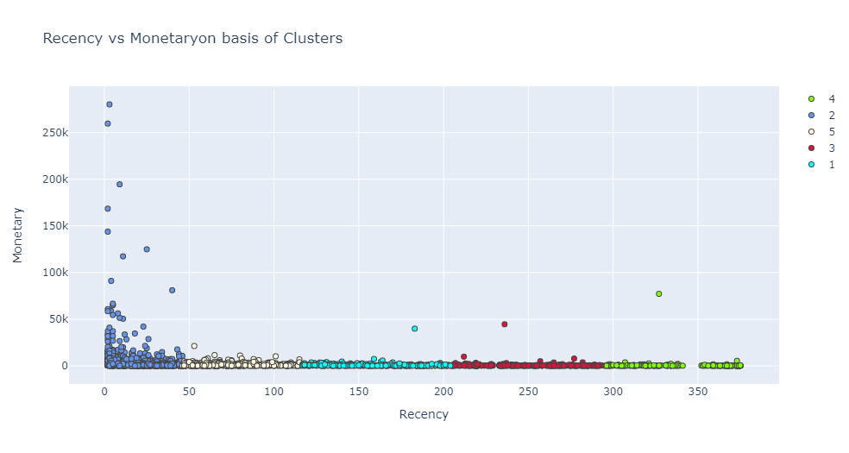
K-Means Clustering

Slide 17
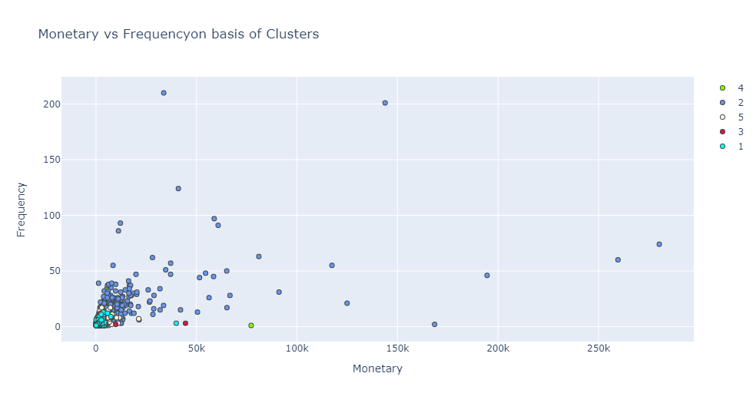
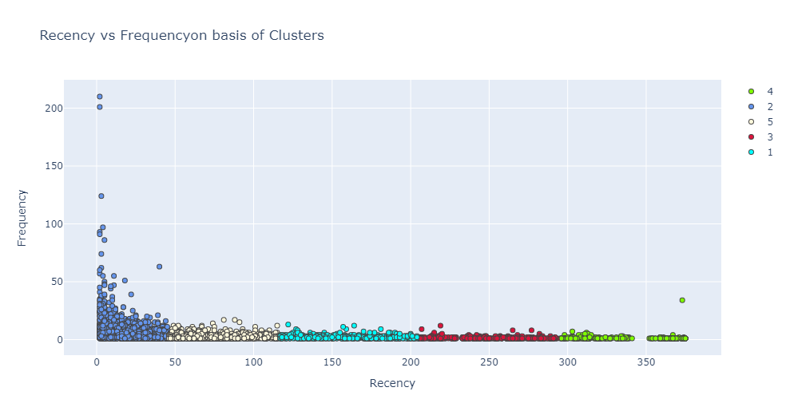

Slide 18
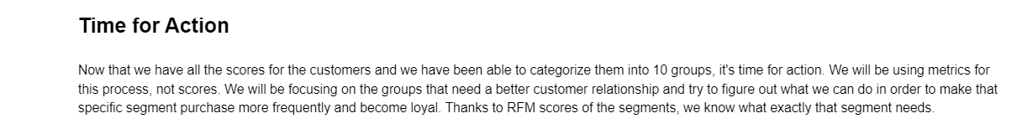
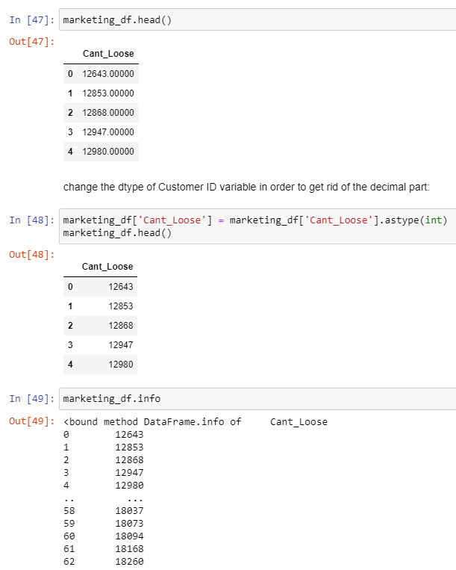
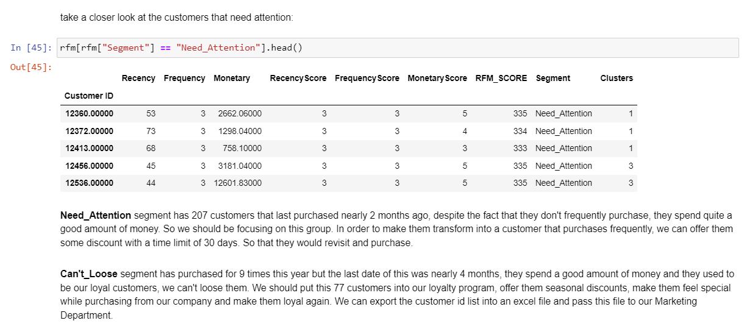
Time for action

Slide 19
Recommendation system

Slide 20
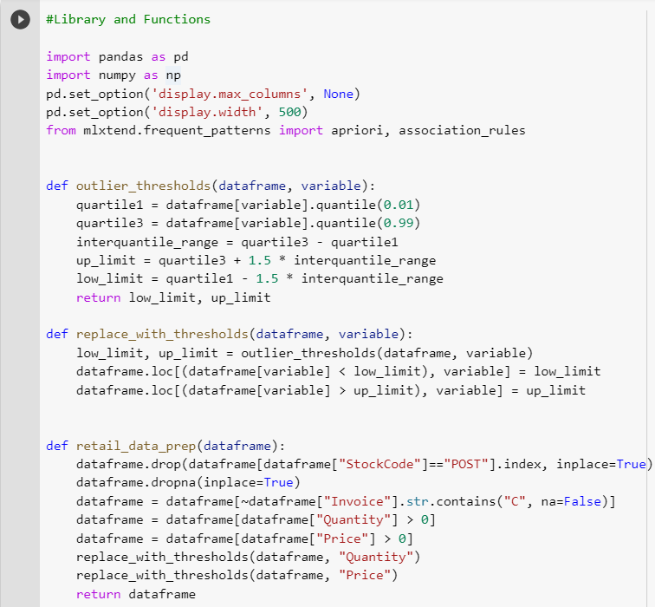
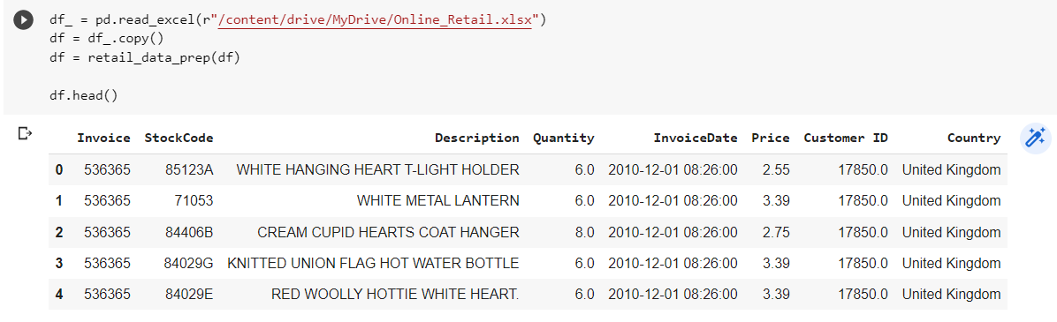
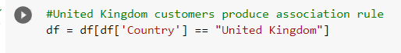
Remove outliers

Slide 21
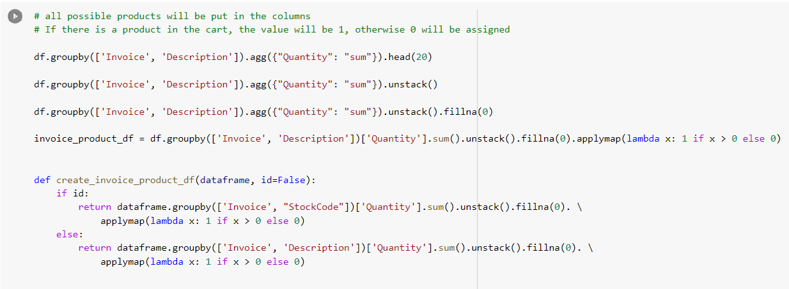
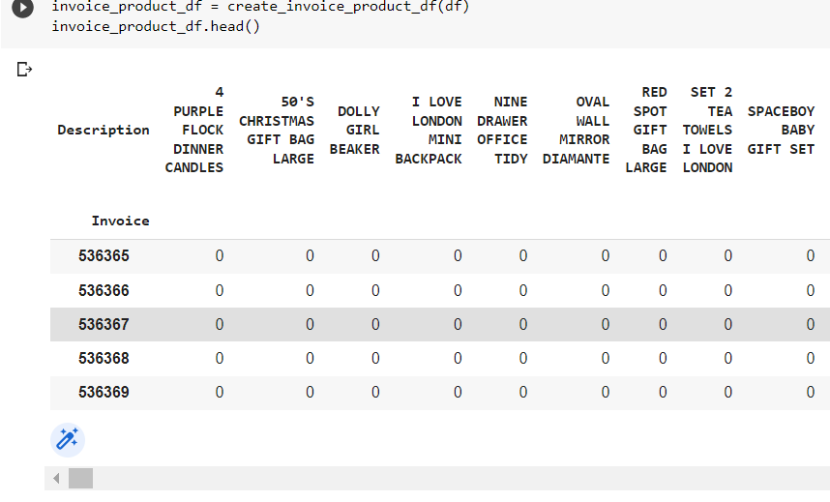
Creating a binary matrix

Slide 22
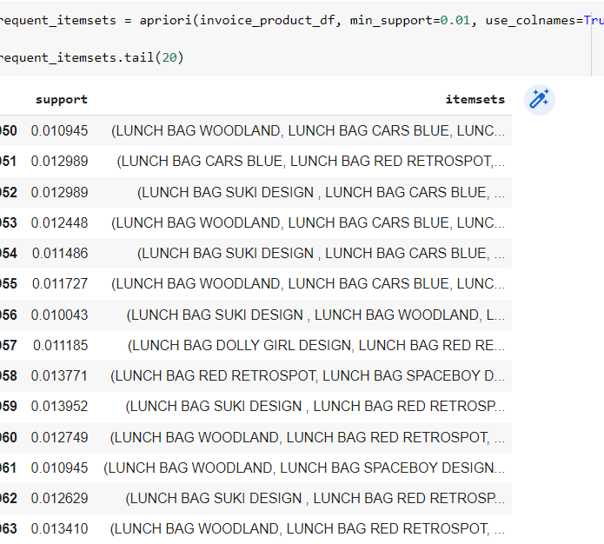
Frequent itemset

Slide 23
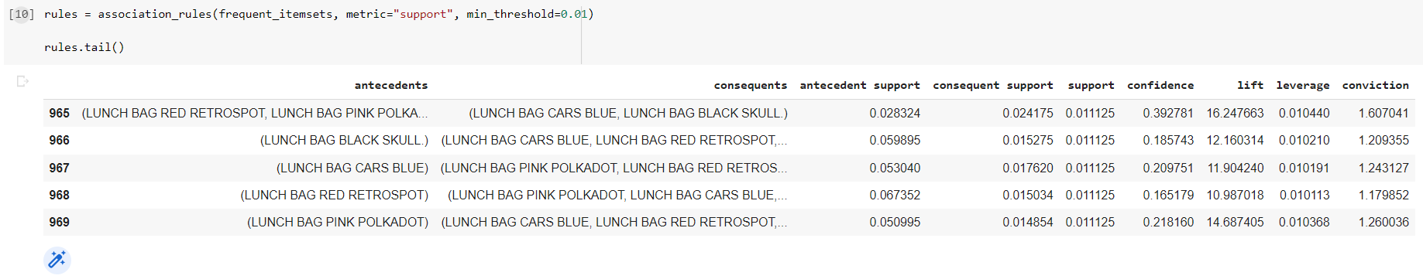
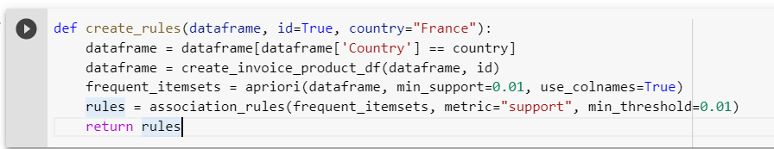
Create association rules

Slide 24
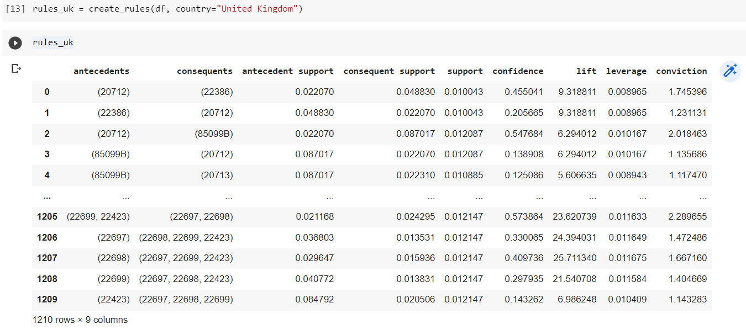
Apply association rules to dataframe

Slide 25
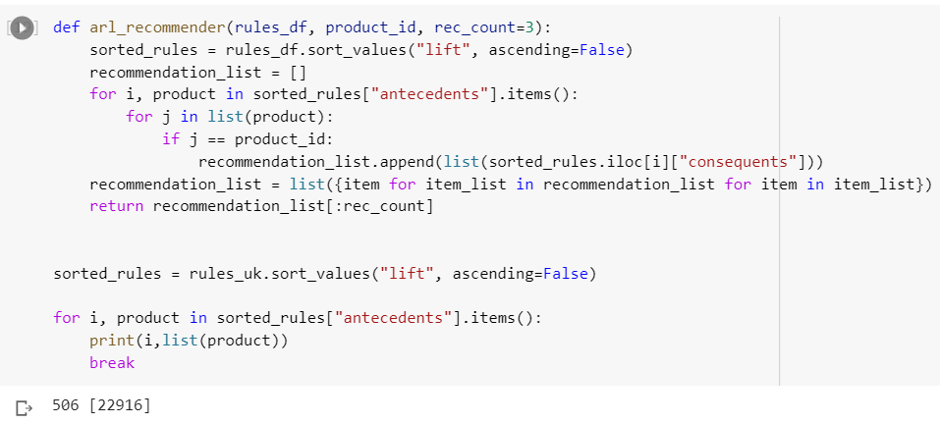
Create Recommender function

Slide 26
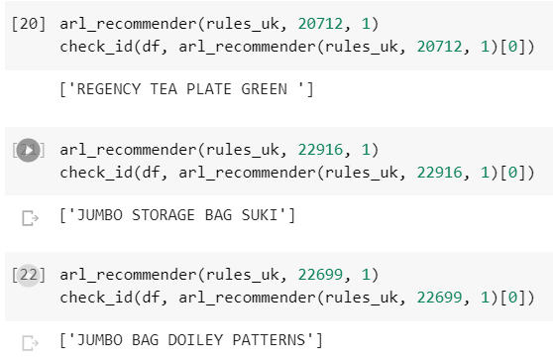
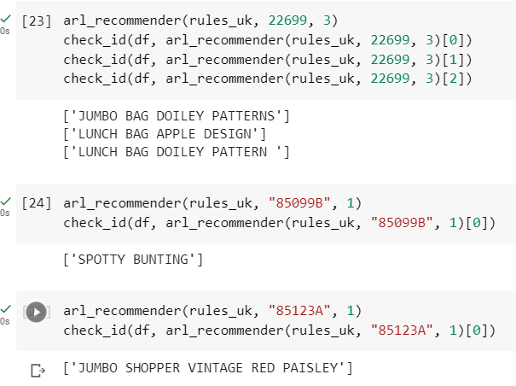
Apply Recommender function

Slide 27
References
https://archive.ics.uci.edu/ml/datasets/online%20retail - Data Source
https://www.geeksforgeeks.org/machine learning-with-python/ - M L
https://stackoverflow.com/ -for any programming query
https://colab.research.google.com/ -google Colab
https://jupyter.org/ -Jupyter notebook
https://www.kaggle.com/ -Kaggle
https://www.tableau.com/academic/students -Tableau
https://powerbi.microsoft.com/en-us/desktop/ -power bi

Slide 28

THANK YOU

