Slide 1
GOVERNMENT ENGINEERING COLLEGE,PATAN
INTERSHIP ON
DATA SCIENCE
FROM
INFOLABZ IT SERVICES PVT. LTD
PARTICIPATED BY
VAIBHAV RAVAL(190220131117)
WITH GUIDANCE BY
PROF. D.U.BAVISA

Slide 2
Outlines:
Python introduction -What is python?
Libraries in python
Application of python
Data Analytics Introduction
Data Analytics Process Step
Types of Data for analysis -Local Data , API Data , File Data
Machine Learning Introduction
Work of Machine Learning
Application of Machine Learning
Refences
Project Implementation

Slide 3


PYTHON-INTRODUCTION

Slide 4

What is Python?
Python is a popular programming language. It was created by Guido van Rossum and released in 1991.
Definition of Python:-Python is an interpreted, object-oriented, high level programming language.
It is used for,
Build websites and software
Automate tasks
Conduct data analytics
Mathematics
Python can connect to database systems. It can also read and modify files.
Python can be used for rapid prototyping, or for production-ready software development.
Python works on different platforms (Windows, Mac, Linux, Raspberry Pi, etc).

Slide 5






Libraries in Python
Various libraries are used in Python like,
TensorFlow
NumPy
Pandas
Matplotlib
Keras
Scikit-Learn

Slide 6
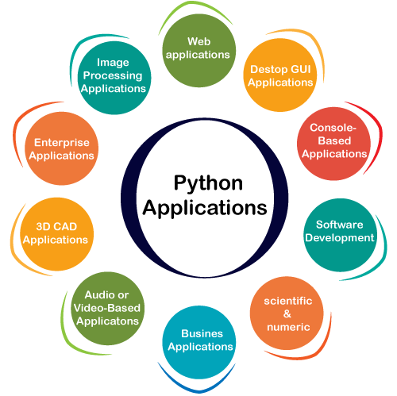
Application
of
Python

Slide 7
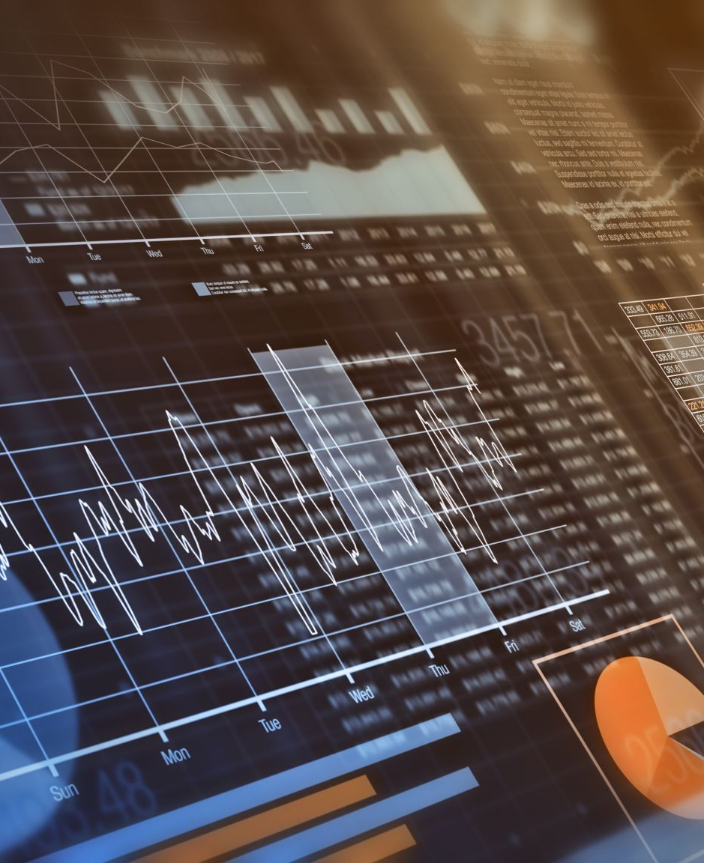
DATA ANALYTICS

Slide 8
Data Analytics refers to the techniques used to analyse data to enhance productivity and business gain.
Data is extracted from various sources and is cleaned and categorized to analyse various behavioural patterns. The techniques and the tools used vary according to the organization or individual.
Data analytics is the process of exploring and analyzing large datasets to make predictions and boost data-driven decision making.
Data analytics allows us to collect, clean, and transform data to derive meaningful insights.
Data Analytics-Introduction

Slide 9
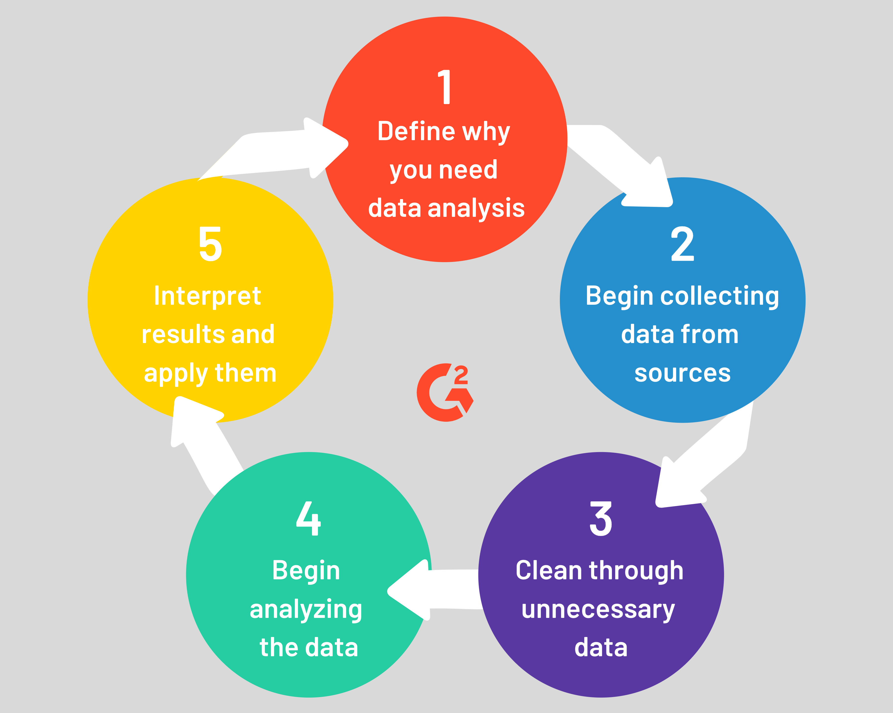
Data Analytics Process Steps

Slide 10
Types of Data for analysis
1. Local Data
2. API Data
3. File Data

Slide 11
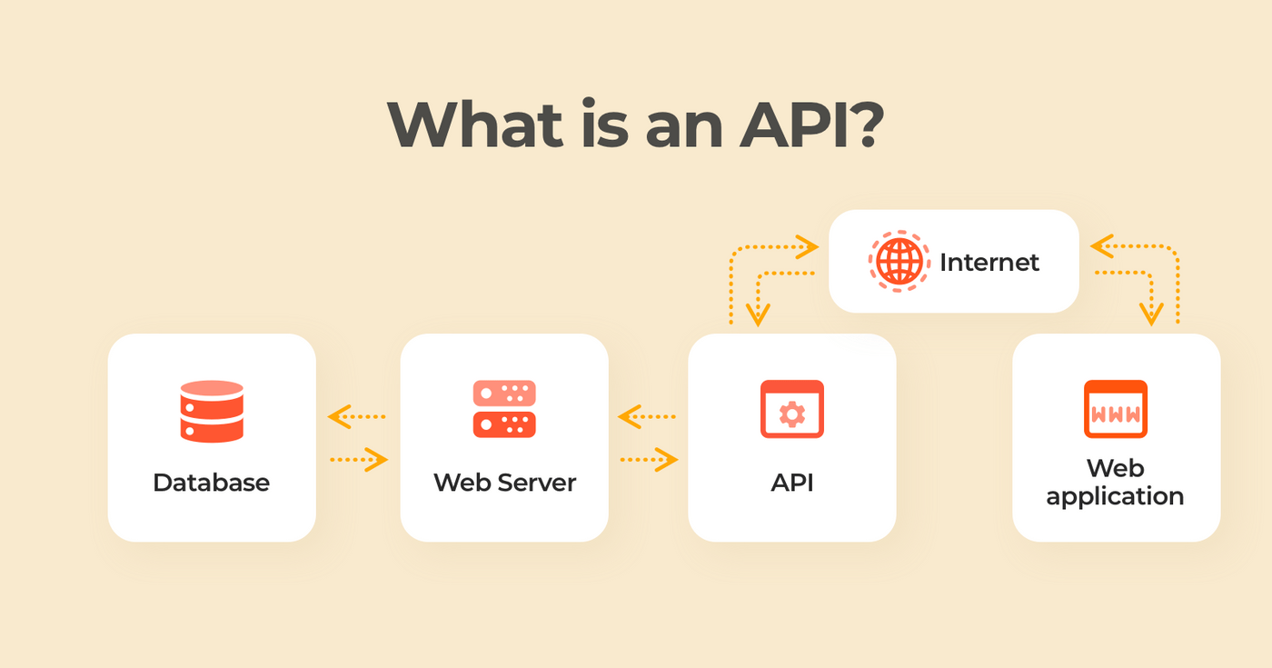
Local Data API Data File Data
Definition :- Local data is any set of data which is collected by another body or by any local authority including your own.
Examples of Local Data:-
Council tax data
School, college admission data
Customer service records
Housing and rent data
Parking permits data
Local authority billing and payments data etc.
Definition:- File data analysis helps organization address their increasing data volumes by mapping the location of their data and identify who has access to what data.
Including,
File shares
Email databases
Enterprise file sync and share
Records managements
Enterprise content management
Data archives
Application Programming Interface (API) is a software interface that allows two applications to interact with each other without any user intervention.
API is defined as a code that helps two different software’s to communicate and exchange data with each other.

Slide 12

MACHINE LEARNING

Slide 13
Machine Learning-Introduction
Machine learning is a branch of artificial intelligence (AI) and computer science which focuses on the use of data and algorithms to imitate the way that humans learn, gradually improving its accuracy.
Machine learning is an important component of the growing field of data science. Through the use of statistical methods, algorithms are trained to make classifications or predictions, and to uncover key insights in data mining projects.
Machine learning algorithms are typically created using frameworks that accelerate solution development, such as TensorFlow and PyTorch.

Slide 14
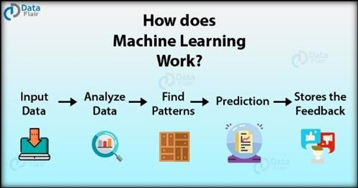
Work of Machine Learning
Machine learning uses two types of techniques,
Supervised Learning
Unsupervised Learning
Reinforcement Learning
Supervised Learning:- which trains a model on known input and output data so that it can predict future outputs.
unsupervised Learning:- which find hidden patterns or intrinsic structures in input data.
Reinforcement learning (RL) is an area of machine learning concerned with how intelligent agents ought to take actions in an environment in order to maximize the notion of cumulative reward

Slide 15
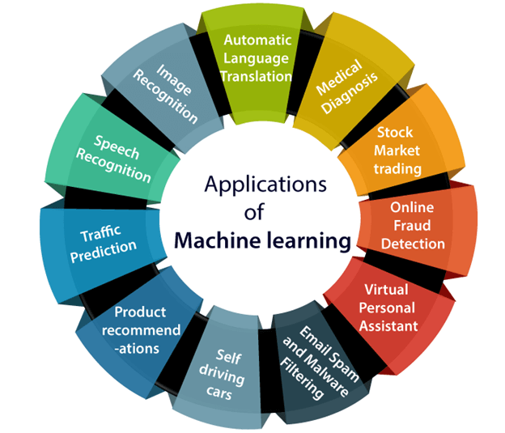
Application of Machine Learning

Slide 16
References
https://www.tutorialspoint.com/excel_da ta_analysis/index.htm - Data Analysis
https://www.geeksforgeeks.org/machine- learning-with-python/ - M L
https://stackoverflow.com/ -for any programming query
https://rapidapi.com/blog/how-to-use- an-api-with-python/ - API in Python
https://inshorts.deta.dev/news?category= -API - date wise history
https://data.covid19india.org/data.json - covid 19 data API
https://api.coindesk.com/v1/bpi/currentprice.json -bitcoin API
https://api.postalpincode.in/pincode/382745 - Pincode API

Slide 17
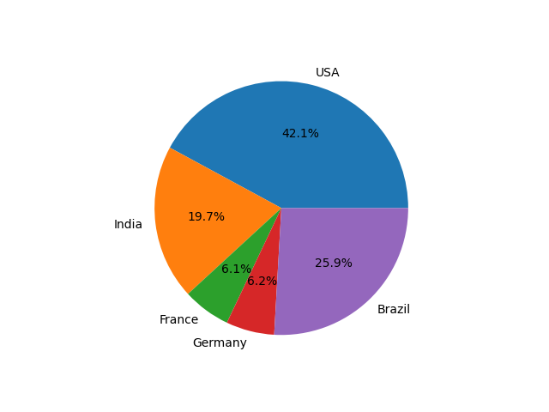
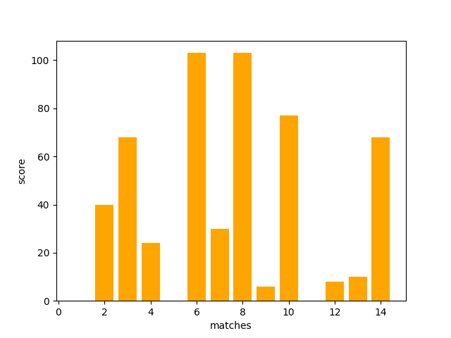
Project Implementation :
Pie chart
Bar graph

Slide 18
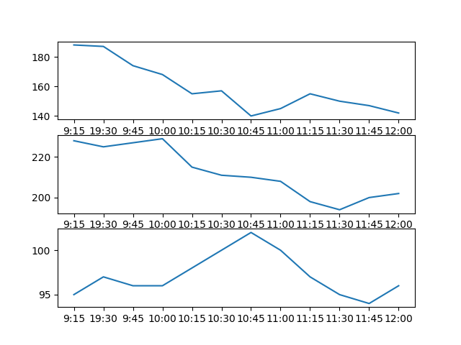
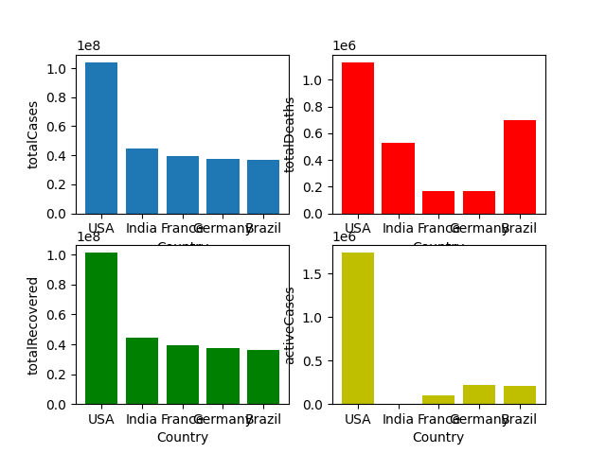
Project Implementation :
Subplot –line graph
Subplot – bar graph

Slide 19
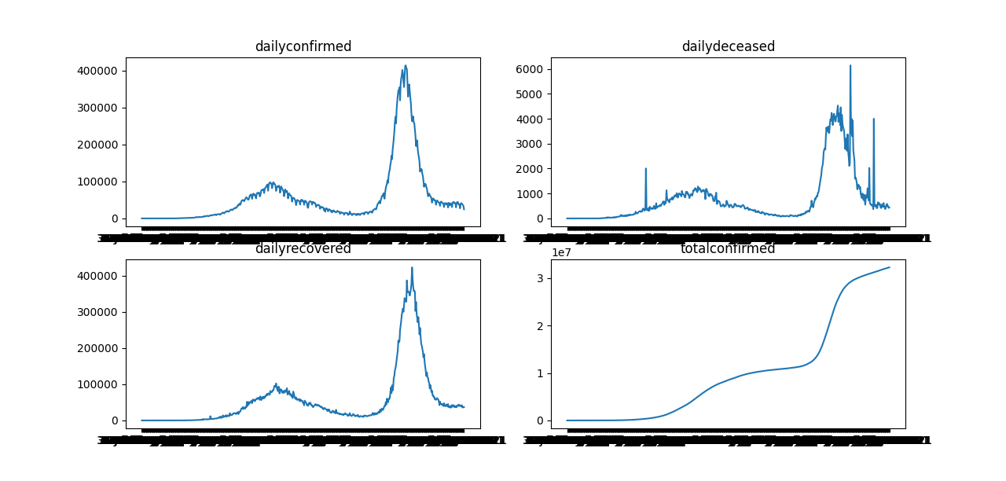
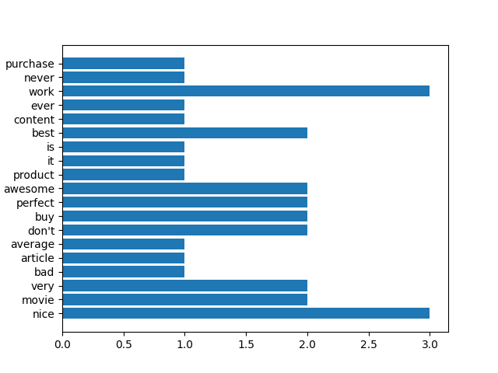
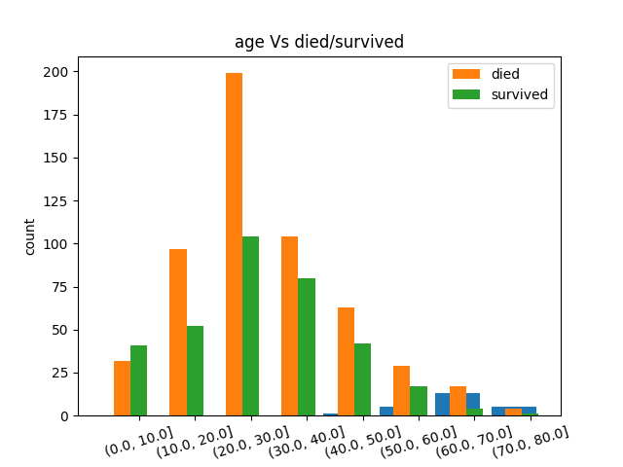
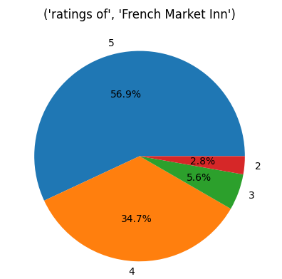
Project Implementation : visualization from csv file

Slide 20

THANK YOU

