Slide 1
Detection of Possible Illicit Messages Using Natural Language Processing using Computer Vision on Twitter and Linked Websites
Submitted in the partial fulfillment for the award of the degree of
BACHELOR OF ENGINEERING
IN
COMPUTER SCIENCE AND ENGINEERING WITH
SPECIALIZATION IN BIG DATA AND ANALYTICS
Submitted by:
Vaibhav Kumar Singh
(20BCS3842)
Under the Supervision of:
Dr.Alankrita Aggarwal
Department of AIT-CSE
DISCOVER . LEARN . EMPOWER

Slide 2
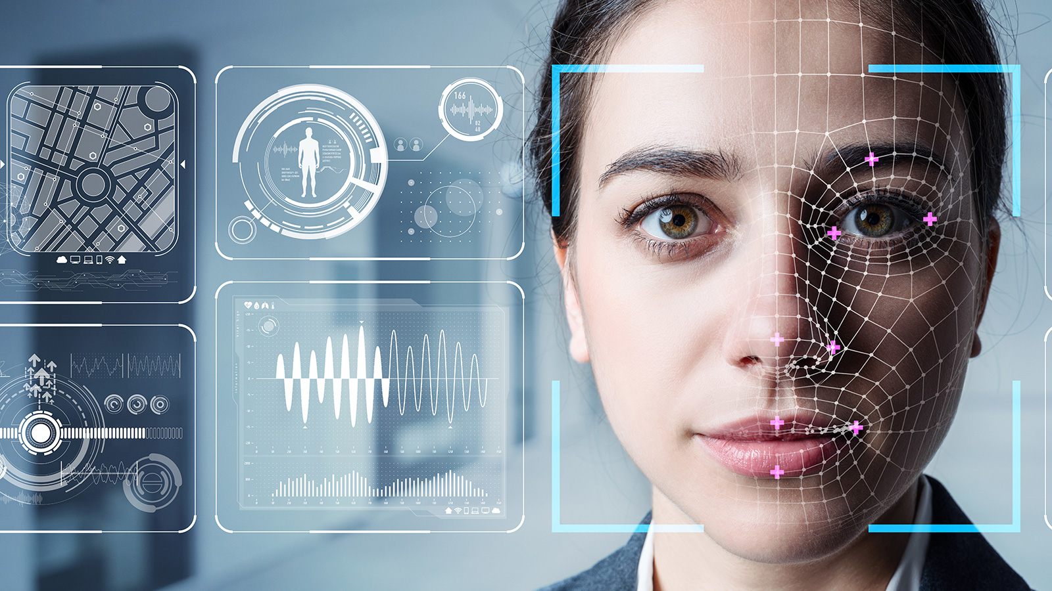
Outline
Introduction to Project
Problem Formulation
Objectives of the work
Methodology used
Conclusion
Future Scope
References

Slide 3
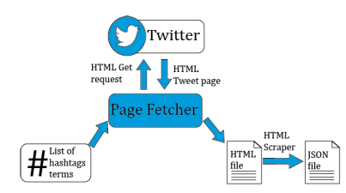
Introduction
From the innovation and arrival of web 2.0, there was a revolutionary and radical change since the user stopped being a simple spectator and became an active individual in social networks such as Facebook, Twitter, Instagram, among others .
They use a deep multimodal model called Human Trafficking Deep Network, and they obtained an F1 value of 75.3% with a recall of 70.9%.

Slide 4
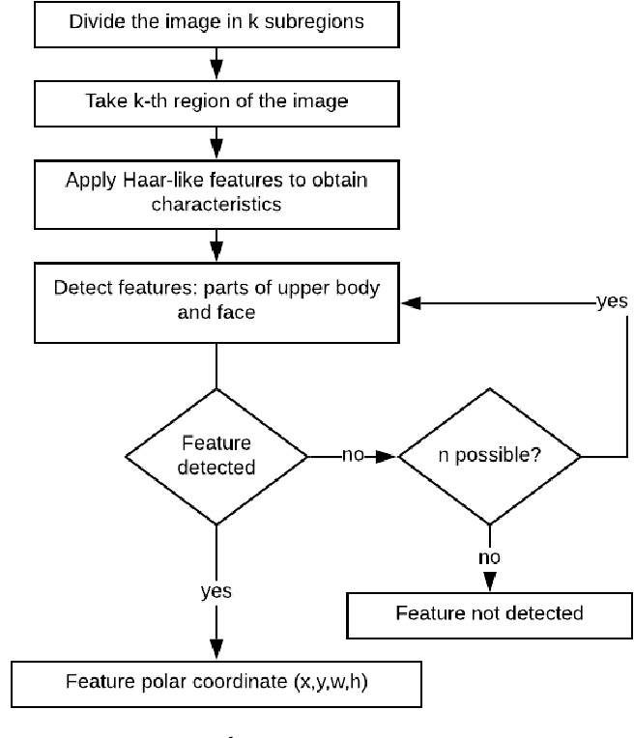
Tweet classification based on natural language processing.

Slide 5

Problem Formulation
The algorithm classifies subjects into four different age categories in four key stages: Pre-processing, facial feature extraction by a novel geometric feature-based method, face feature analysis, and age classification. In order to apply the algorithm to the problem, a face image database focusing on people's age information is required.

Slide 6
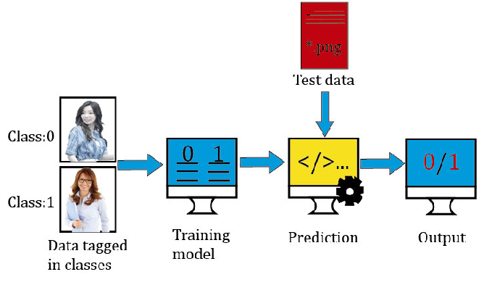
Objectives
Human trafficking is a global problem that strips away the dignity of millions of victims. Currently, social networks are used to spread this crime through the online environment by using covert messages that serve to promote these illegal services. In this context, since law enforcement resources are limited, it is vital to automatically detect messages that may be related to this crime and could also serve as clues.

Slide 7
Methodology used
Support Vector Machine(SVM) is a supervised machine learning algorithm used for both classification and regression.
A Convolutional Neural Network (ConvNet/CNN) is a Deep Learning algorithm which can take in an input image, assign importance to various aspects/objects in the image and be able to differentiate one from the other.

Slide 8
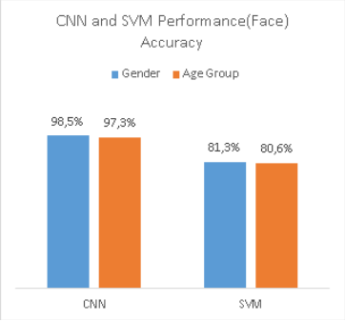
Conclusion
Face recognition algorithms and machine learning models have been improved during the last years. For example, in the ILSVRC competition, an accuracy value of 90% +− 5% was obtained
In these conditions, machine learning recognition can be similar to visual object recognition used by human beings.
In this work, we probed that satisfactory performance can be obtained using just geometric features of the torso and not only facial characteristics.
Haar filters combined with an SVM classifier were used for the extraction process of features, and then we classified the age group and gender with an SVM classifier

Slide 9
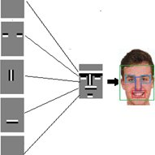
Future Scope
The study of some characteristics related to ethnic and racial features
To extend the proposal to extract geometric features of the entire body, another kind of images, or inclusive videos in different formats
Detection of medical issues by means the analysis of features extracted from torso images, legs, back, among other characteristics
The use of other algorithms or the applicability in other networks like Instagram.

Slide 10
References
[1] B. Bangerter, S. Talwar, R. Arefi, and K. Stewart, ‘‘Networks and devices for the 5G era,’’ IEEE Commun. Mag., vol. 52, no. 2, pp. 90–96, Feb. 2014.
F. Laczko, ‘‘Data and research on human trafficking,’’ Int. Migration, vol. 43, nos. 1–2, pp. 5–16, Jan. 2005.
M. Lee, ‘‘Human trafficking and border control in the global south,’’ in The Borders of Punishment: Migration, Citizenship, and Social Exclusion. Oxford, U.K.: Oxford Univ. Press, 2013, pp. 128–149.

