Slide 1


Vaibhav pawar present’s
BUSINESS ANALYST CAREER PROGRAM
CAPSTONE PROJECT
www.linkedin.com/in/vaibhavpawar000

Slide 2
CAPSTONE PROJECT SUMMARY:
FINANCIAL ANALYSIS OF WESTERN COUNTRIES
The objective of this capstone project was to perform a comprehensive financial analysis of Western countries using various data analysis tools such as SQL, Excel and Power BI.
Data Exploration and Analysis
Data Cleaning and Preparation: Used Excel to clean and prepare the dataset for analysis.
Descriptive Statistics: Conducted in Excel to Summarize the statistical measures.
Excel Analysis: Advanced calculations, pivot tables, and initial visualizations were created.
SQL Queries: Extracted and analyzed meaningful trends and segments in the data.
Power BI Dashboards: Developed interactive dashboards to visualize financial performance and trends over time.

Slide 3
EXPLORING DATA WITH EXCEL

Slide 4
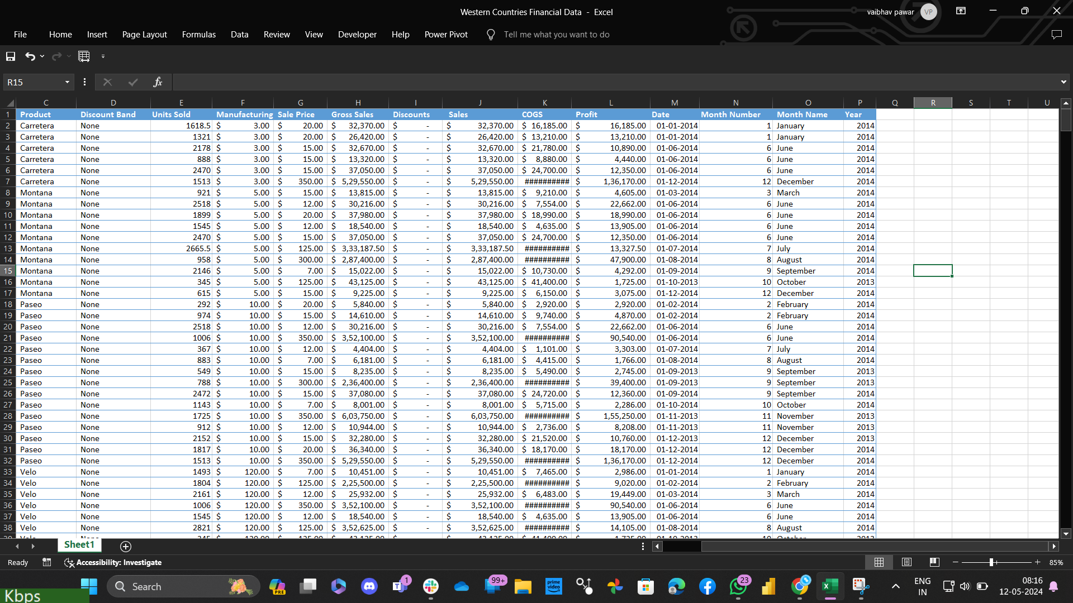

Slide 5
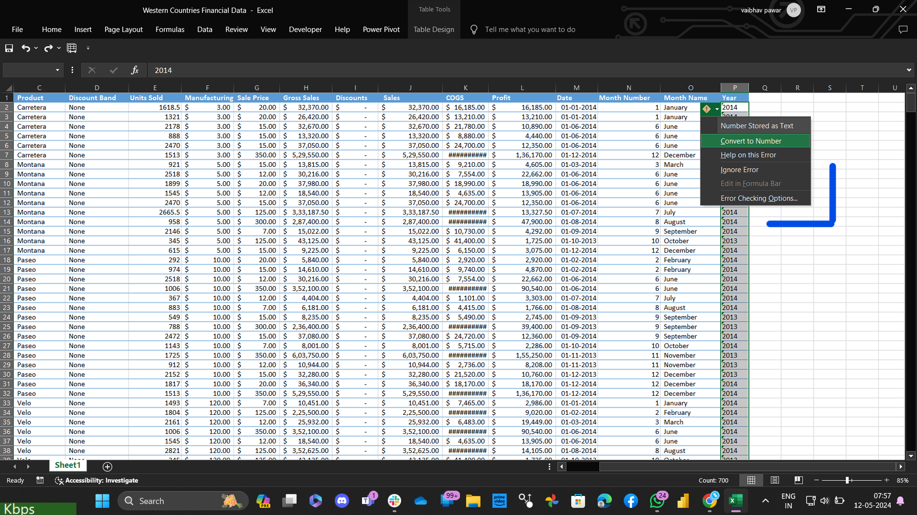
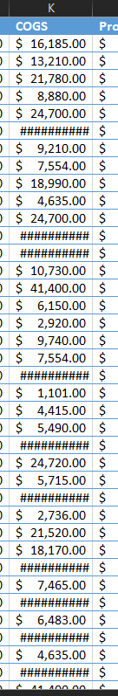
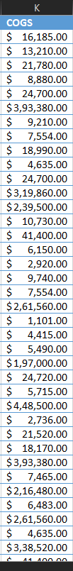
SALES DATASET CLEANING AND SUMMARY
In the last column, I discovered an error which I promptly corrected. Previously, the fields were in text format, but I converted them into numbers. This particular column now represents the extracted years from a date column. All cleaned up now!
Columns and Types:
Product: Categorical (type of product)
Discount Band: Categorical (level of discount)
Units Sold: Numerical (quantity of units sold)
Manufacturing Price: Numerical (price at which the product is manufactured)
Sale Price: Numerical (price at which the product is sold)
Gross Sales: Numerical (total sales revenue)
Discounts: Numerical (discount amount)
Sales: Numerical (net sales after discounts)
COGS (Cost of Goods Sold): Numerical (cost of producing the goods sold)
Profit: Numerical (profit generated from sales)
Date: Date (date of the transaction)
Month Number: Numerical (month number)
Month Name: Categorical (name of the month)
Year: Numerical (extracted year from the date)
I noticed that this column wasn't properly fitted, so I adjusted its length to ensure a better fit. Now it looks much neater and well-aligned.
Summary :
The dataset comprises sales data, including product details, quantities sold, prices, revenue, discounts, costs, and profits. It spans multiple years, with each row representing a transaction. Key columns include product type, discount level, units sold, prices, and financial metrics. The dataset allows for analysis of sales patterns, profitability, and discount effectiveness.

Slide 6
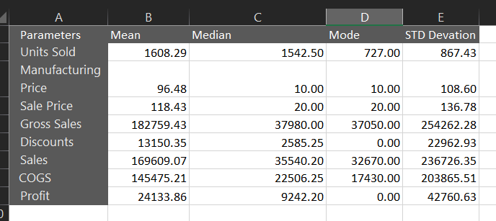
SUMMARIZING THE STATISTICAL MEASURES
The dataset presents a wide range of sales transactions, showing considerable variation in sales, discounts, profit margins, units sold, manufacturing prices, and cost of goods sold. While average values offer a central view, the presence of common figures alongside high variability underscores the dynamic nature of the data. This highlights the diverse and fluctuating landscape of sales, emphasizing the importance of understanding both typical values and the range of possibilities within the dataset.

Slide 7
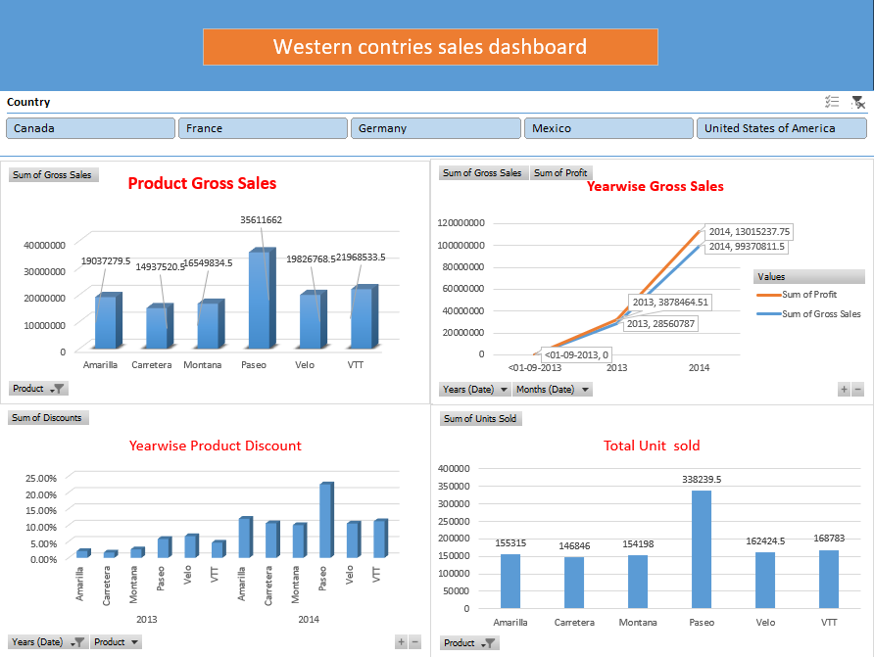
Western Countries Sales Dashboard
Overview
An interactive Excel dashboard for analyzing sales performance across Western countries.
Features
Country Slicer: Filter data by selecting one or multiple countries.
Visualizations:
Product Gross Sales: Bar chart showing gross sales per product.
Yearwise Gross Sales: Line chart of gross sales over the years.
Yearwise Product Discount: Bar plot of product discounts.
Total Unit Sales: Bar chart of total units sold per product.
Layout
Country Slicer: Located on the top.
Main Charts:
Top-Left: Product Gross Sales
Top-Right: Yearwise Gross Sales
Bottom-Left: Tearwise Product Discount
Bottom-Right: Total Unit Sales
Benefits
Interactive Filtering: Real-time updates with country slicer.
User-Friendly: Clear visualizations and tooltips.
Comprehensive Analysis: Combines multiple sales metrics.

Slide 8
EXPLORING DATA WITH SQL

Slide 9
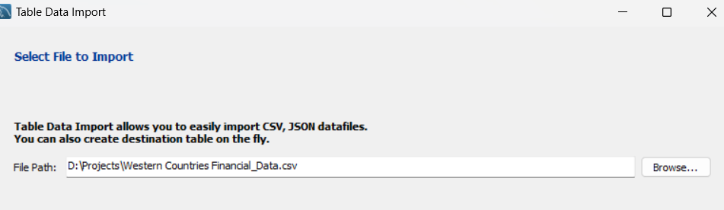
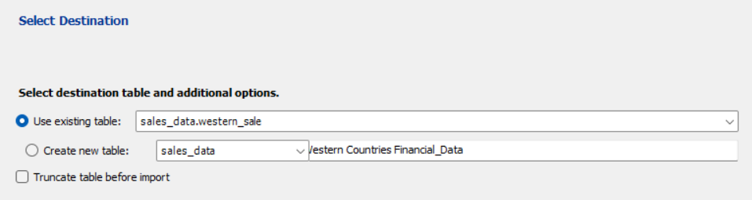
Import data CSV to SQL

Slide 10
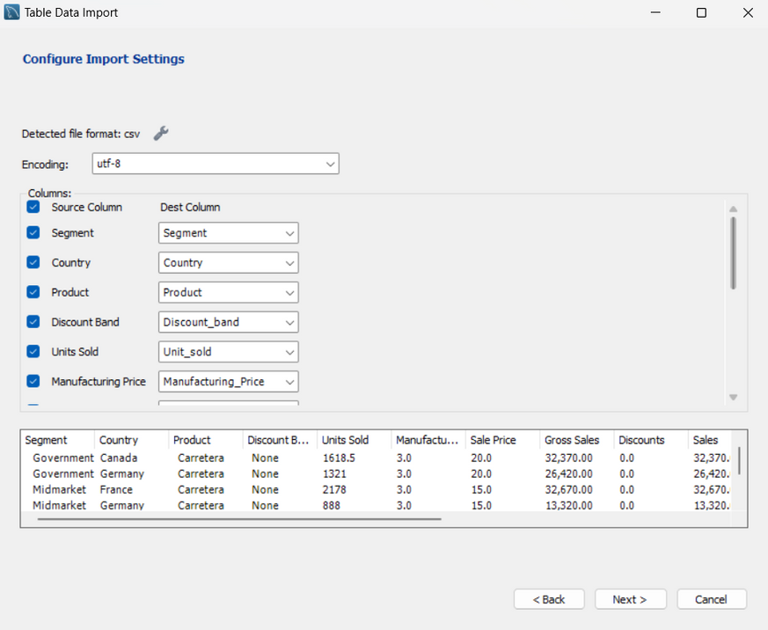
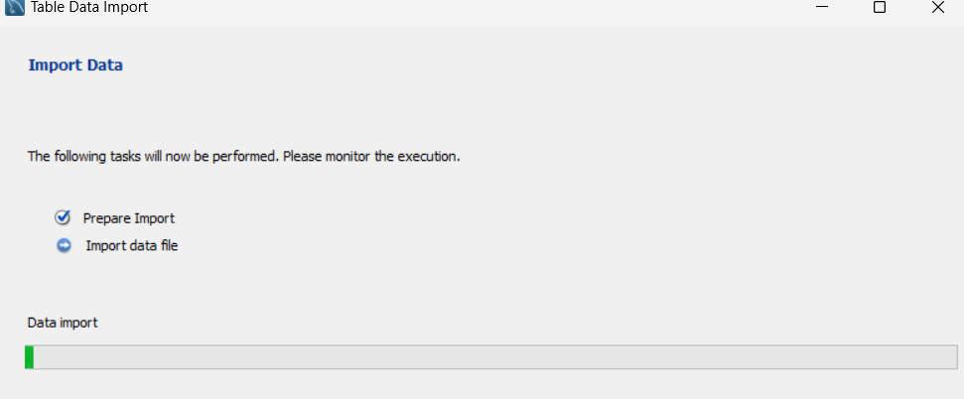
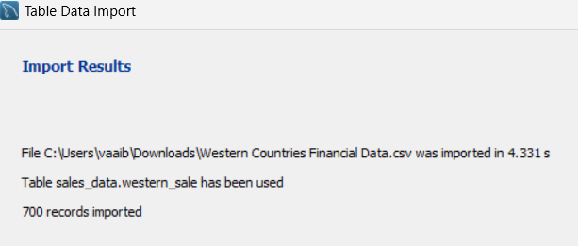
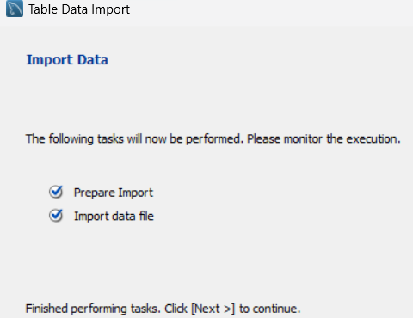

Slide 11
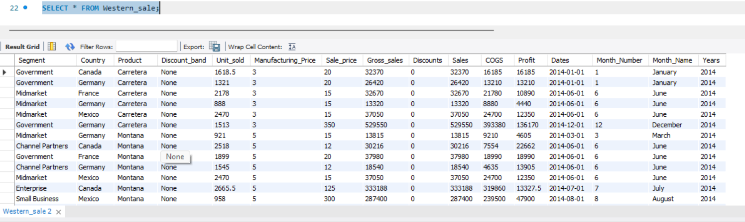

Slide 12
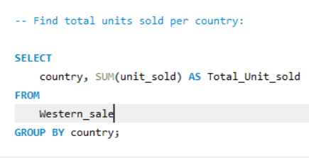
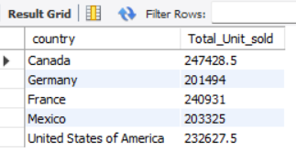
Find total units sold per country:

Slide 13
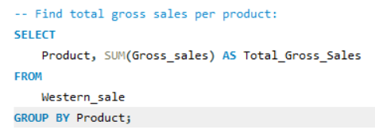
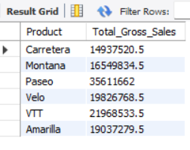
Find total gross sales per product:

Slide 14
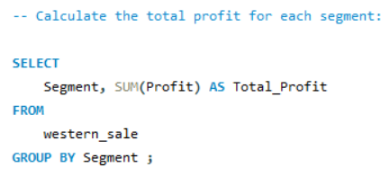
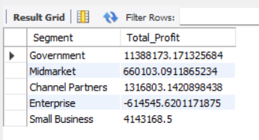
Calculate the total profit for each segment:

Slide 15
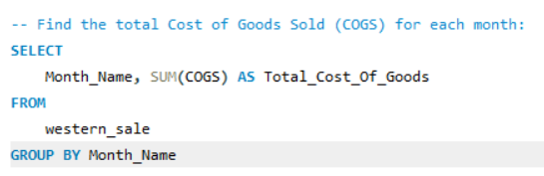
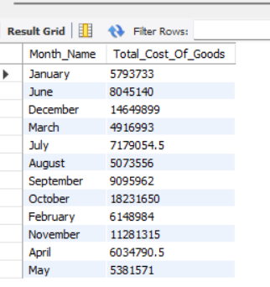
Find the total Cost of Goods Sold (COGS) for each month:

Slide 16
EXPLORING DATA WITH POWERBI

Slide 17
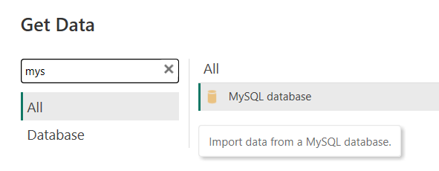
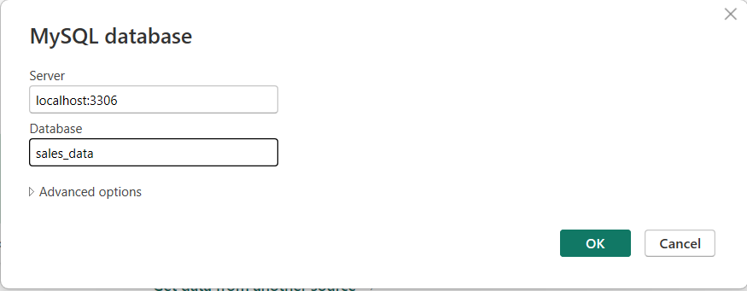
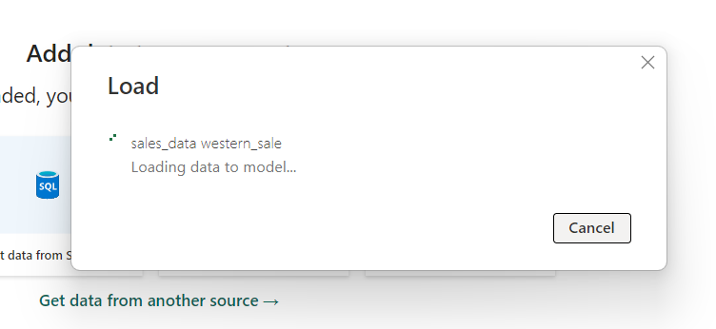
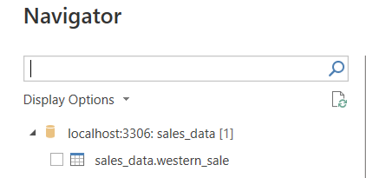
Importing MySQL to PowerBi
1
2
3
4

Slide 18
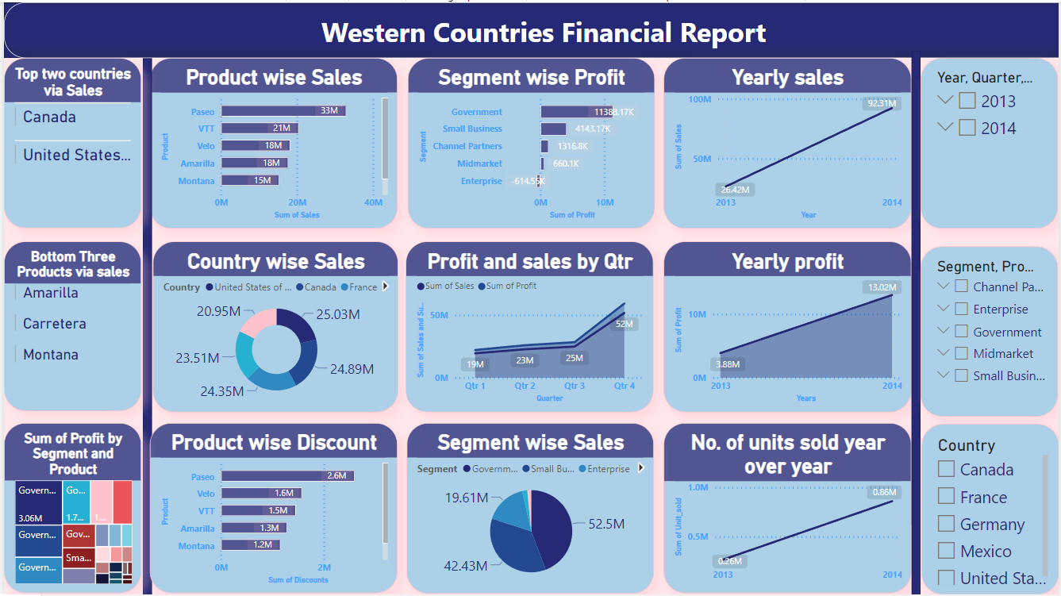

Slide 19



JOIN ME
THANK
YOU
www.linkedin.com/in/vaibhavpawar000

