Slide 1

KAVAYITRI BAHINABAI CHAUDHARI NORTH MAHARASHTRA UNIVERSITY, JALGAON
FACULTY OF SCIENCE AND TECHNOLOGY | MCA
S.S.V.P. SANSTHA’S · LATE KARMAVEER DR. P. R. GHOGREY SCIENCE COLLEGE, DHULE
EduPredict
MODEL SNAPSHOT
STUDENT PASS / FAIL
PREDICTION SYSTEM
0.9082
ROC–AUC
83.50%
Machine learning for academic early-warning support
Logistic Regression accuracy
2,000 records • 4 models
MCA-521: Research Project • Semester III
W.E.F. 2024–25 | Research prototype & working demo
Presenter(s): ____________________ Guide: ____________________

Slide 2
Research problem & motivation
01 • PROBLEM IDENTIFICATION
The practical challenge
Research question
Student marks, attendance, assignments and backlog signals are often reviewed in separate records. At-risk patterns can be recognized late, limiting time for support.
Can a supervised classification workflow combine common academic and engagement indicators into a repeatable early-warning estimate that staff can inspect and act on?
Research gap addressed by this prototype
Model notebooks often stop at evaluation; this project connects inference to a usable, auditable web workflow.
Prediction is presented with probabilities and context—not as an automatic grade or disciplinary decision.
Focus: lightweight deployment, multiple-model comparison, student-facing access and transparent limitations.
KBCNMU JALGAON • MASTER OF COMPUTER APPLICATIONS • SEMESTER III
02

Slide 3
Objectives, scope & course outcomes
02 • RESEARCH DESIGN
Project objectives
MCA-521 learning alignment
1 Build a repeatable PASS/FAIL classification pipeline.
2 Compare four estimators using held-out and cross-validation metrics.
3 Persist student profiles and versioned prediction logs.
4 Deliver an administrator dashboard and student portal.
5 Provide a runnable SQLite demo and reproducible test suite.
CO1 — define a real-world problem: early identification of academic risk.
CO2 — analyze literature and state the implementation gap.
CO3 — apply a stratified evaluation methodology.
CO4 — create a working Flask + ML prototype.
CO5 — evaluate and communicate results responsibly.
KBCNMU JALGAON • MASTER OF COMPUTER APPLICATIONS • SEMESTER III
03

Slide 4
Literature review & research gap
03 • LITERATURE AND CONTEXT
Educational data mining
Model evaluation
Identified gap
Prior work studies student outcomes from educational records; data quality, validation and interpretation are central.
Class imbalance means accuracy alone is incomplete. Precision, recall, F1, ROC-AUC and confusion matrices offer complementary views.
A small, deployable prototype should connect measured models to access-controlled workflows, logs and human-readable guidance.
Selected sources
Romero & Ventura (2010), Educational data mining: a review of the state of the art.
Baker & Inventado (2014), Educational data mining and learning analytics.
Breiman (2001), Random Forests; Han, Kamber & Pei (2012), Data Mining: Concepts and Techniques.
Scikit-learn model evaluation and preprocessing documentation; Flask documentation.
KBCNMU JALGAON • MASTER OF COMPUTER APPLICATIONS • SEMESTER III
04

Slide 5
Research methodology & dataset
04 • METHOD
01
02
03
04
Dataset
›
Split & scaling
›
Model comparison
›
Evaluation
2,000 labelled records
11 numeric predictors
PASS 1,343 · FAIL 657
Stratified 80:20
1,600 train / 400 test
StandardScaler
Logistic Regression
RBF SVM · Gradient Boosting
Random Forest
Accuracy · Precision
Recall · F1 · ROC-AUC
5-fold CV
Feature set: five subject marks, internal marks, attendance, study hours, assignment completion, prior backlogs, and derived average marks.
KBCNMU JALGAON • MASTER OF COMPUTER APPLICATIONS • SEMESTER III
05

Slide 6
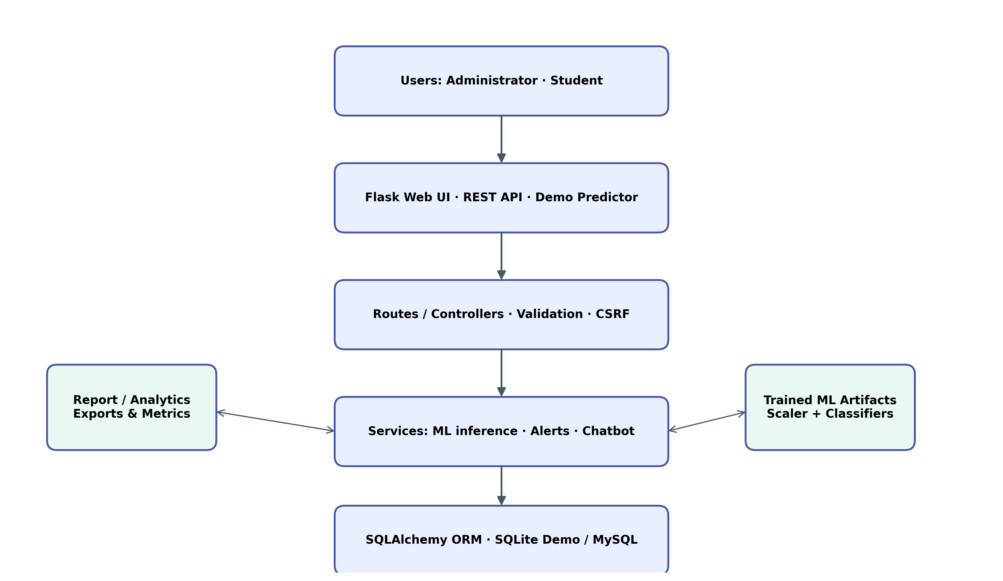
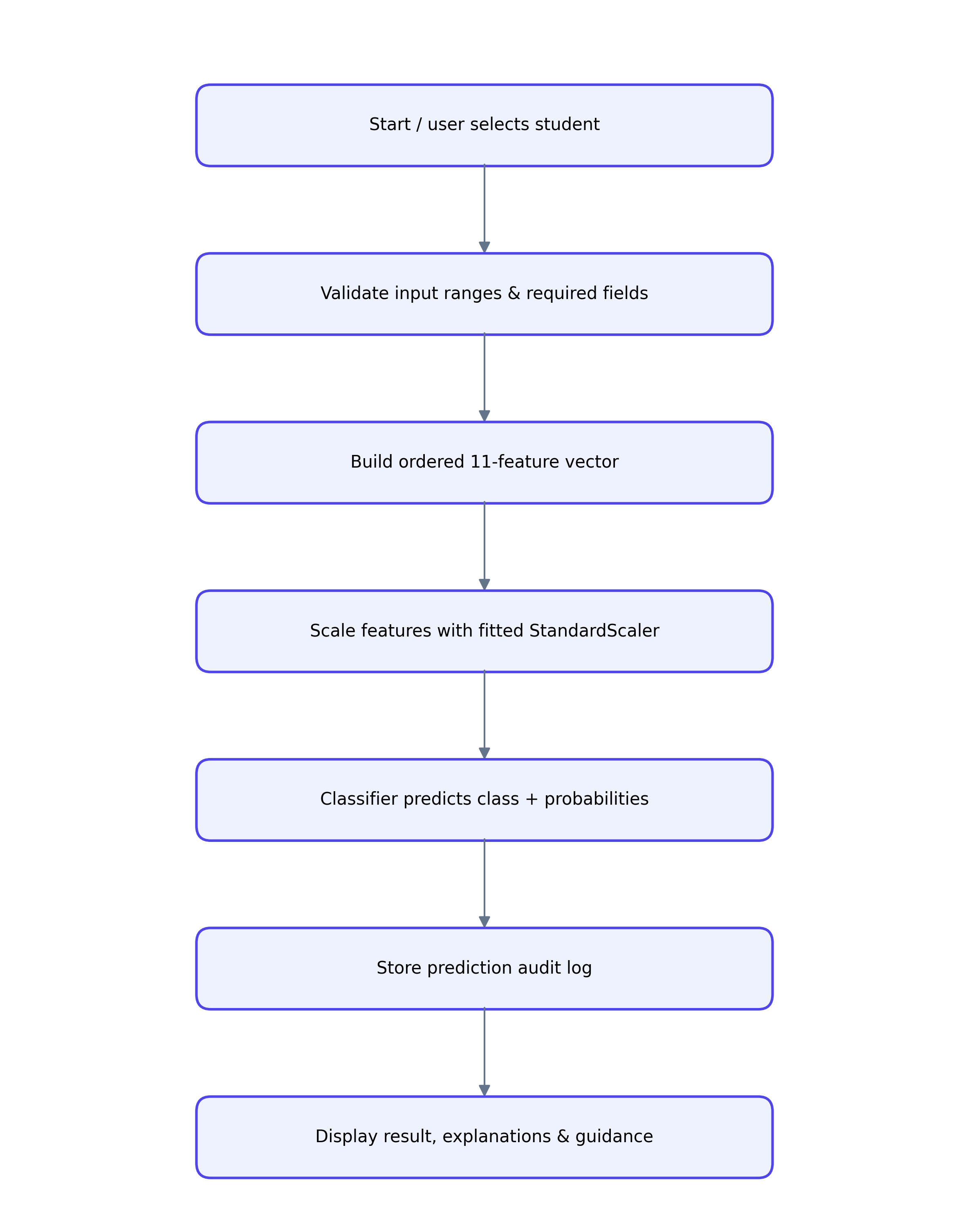
System architecture & prediction workflow
05 • SYSTEM DESIGN
Figure: Application components
Figure: Inference flow
KBCNMU JALGAON • MASTER OF COMPUTER APPLICATIONS • SEMESTER III
06

Slide 7
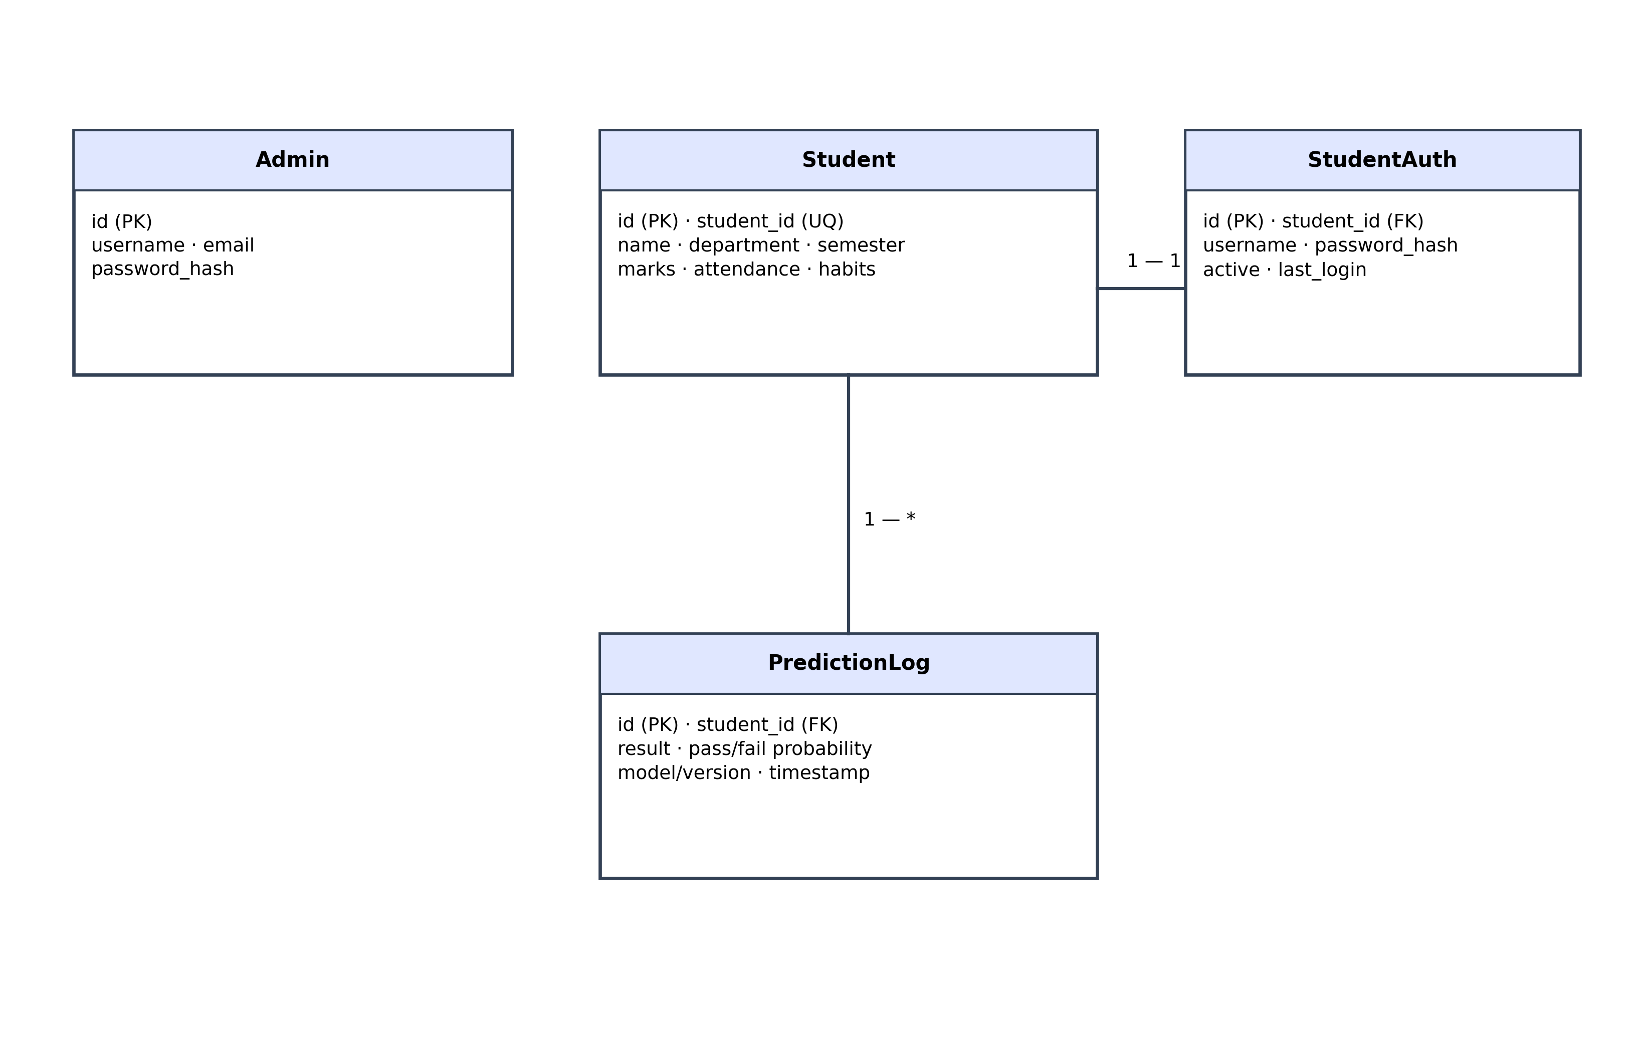
Prototype modules & data design
06 • IMPLEMENTATION
Application modules
Demo delivery
Flask routes + templates · SQLAlchemy ORM · MLService · authentication and CSRF · student management · analytics · chatbot · report endpoints.
SQLite zero-setup launcher · 30 example profiles · actual saved-model inference · PASS / at-risk student access · interactive feature sliders and presets.
Four entities: Admin, Student, StudentAuth (1:1 with Student), PredictionLog (1:many with Student).
KBCNMU JALGAON • MASTER OF COMPUTER APPLICATIONS • SEMESTER III
07

Slide 8
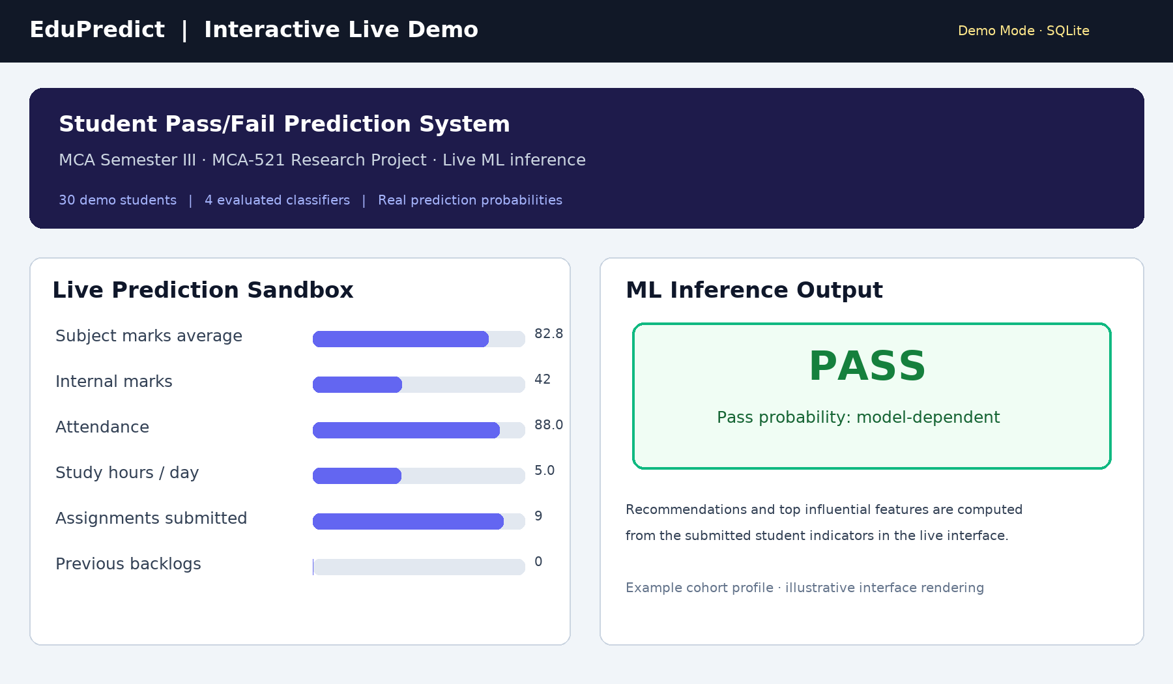
Working demo: interactive predictor
07 • PROTOTYPE
Try it live
Open `/demo/` to change sliders or choose a profile preset.
Quick access
Admin dashboard and student PASS / at-risk portals are available in Demo Mode.
Important note
The output is a model estimate for support; it does not guarantee a result.
Figure: illustrative high-resolution interface view; live page performs real inference.
KBCNMU JALGAON • MASTER OF COMPUTER APPLICATIONS • SEMESTER III
08

Slide 9
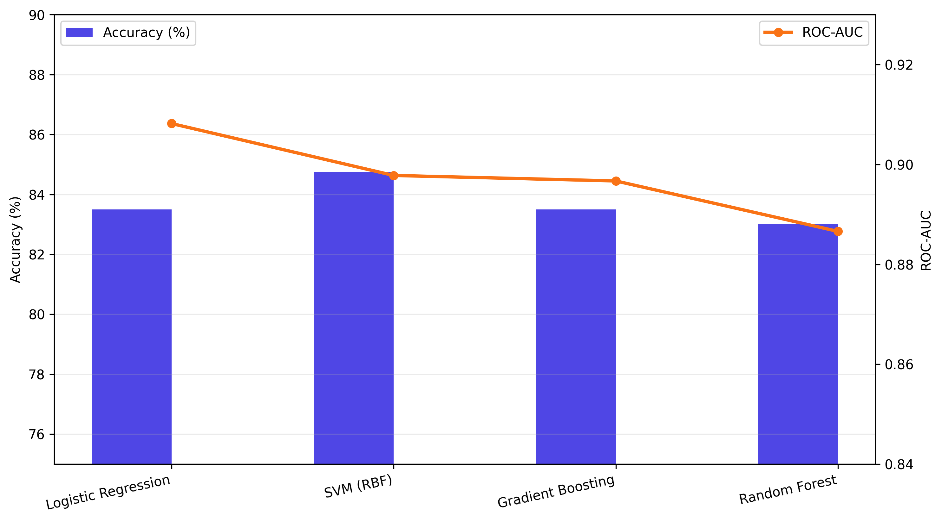
Evaluation results & observations
08 • RESULTS
Selected by ROC-AUC
Logistic Regression · 0.9082
Best observed accuracy
RBF SVM · 84.75%
Logistic Regression
83.50% accuracy · 88.00% F1
Held-out Logistic Regression confusion matrix (400): TP 242 · TN 92 · FP 39 · FN 27. FAIL recall = 70.23%; missed risk remains a concern.
KBCNMU JALGAON • MASTER OF COMPUTER APPLICATIONS • SEMESTER III
09

Slide 10
Implementation, testing & reproducibility
09 • VERIFICATION
Verified functionality
Automated tests
Reproduce locally
Live Flask demo on port 5000
Real-time JSON inference
Admin and student portal routes
Demo seed/reset workflow
39 tests passed
ML pipeline and validators
Demo route integration
Student login & key pages
Install requirements
Run: `python demo.py`
Visit: `/demo/`
Seeded accounts are demo-only; change credentials before real use.
Environment: Python 3.11 · Flask · scikit-learn · SQLite demo / MySQL configuration · pytest.
KBCNMU JALGAON • MASTER OF COMPUTER APPLICATIONS • SEMESTER III
10

Slide 11
Research ethics, limitations & risk
10 • RESPONSIBLE USE
Dataset-specific evidence: evaluation is based on one dataset and one held-out split; no external institution validation is claimed.
Class imbalance and threshold choice matter: at-risk recall is not perfect, so some students may not be flagged.
Predictions are not causal explanations, official grades, or guarantees; humans must review context before support decisions.
Use de-identified, consented data; restrict access; define retention and correction procedures; assess subgroup error before deployment.
Demo profiles and credentials are illustrative and must never be treated as real student records.
KBCNMU JALGAON • MASTER OF COMPUTER APPLICATIONS • SEMESTER III
11

Slide 12
Conclusion & future research
11 • FINDINGS AND NEXT STEPS
Conclusion
Future work
EduPredict connects academic indicators, a comparative ML workflow, stored prediction history and accessible web views. The working demo makes the end-to-end system inspectable without requiring MySQL.
External and longitudinal validation · probability calibration · threshold tuning for early-risk sensitivity · fairness analysis · institutional SSO · privacy governance · controlled intervention study.
Key takeaway: a useful early-warning prototype must pair predictive performance with validation, transparency and responsible human action.
KBCNMU JALGAON • MASTER OF COMPUTER APPLICATIONS • SEMESTER III
12

Slide 13
References & discussion
12 • SOURCES
Romero, C. & Ventura, S. (2010). Educational data mining: a review of the state of the art. IEEE TSMC-C, 40(6), 601–618.
Baker, R.S.J.d. & Inventado, P.S. (2014). Educational data mining and learning analytics. In Learning Analytics, Springer.
Breiman, L. (2001). Random Forests. Machine Learning, 45, 5–32.
Han, J., Kamber, M. & Pei, J. (2012). Data Mining: Concepts and Techniques, 3rd ed. Morgan Kaufmann.
Scikit-learn documentation: model evaluation and StandardScaler. https://scikit-learn.org/
Flask documentation. https://flask.palletsprojects.com/
Project repository: https://github.com/Vaibhav41-cmd/edupredict
Thank you • Questions & discussion
KBCNMU JALGAON • MASTER OF COMPUTER APPLICATIONS • SEMESTER III
13

