Slide 1

House Price Prediction Using Machine Learning
By: Vaibhav Madan
A2305220394

Slide 2
Objectives
The objective is to build a machine learning model which predicts house prices based on the Data Set using different machine learning algorithms like linear regression and integrating this model in a Web App to use it easily

Slide 3
Steps involved in making the Project
Finding the Data Set
1
Data Cleaning
2
Finding Correlations
3
Detecting and Removing Outliers
4
Building the model
5
Building the Web App
6

Slide 4

Finding a good Data Set
To get an accurate machine learning model we need lots of data so that we can easily divide it into parts and train the model to get good accuracy

Slide 5
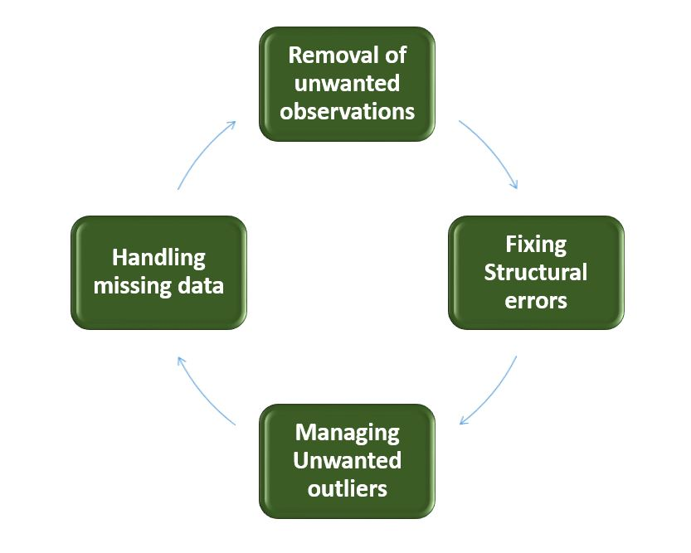
Data Cleaning
A proper data set is needed to get good accuracy for the machine learning model.
To improve the data set, Data cleaning is done in different steps so that all unnecessary data can be handled

Slide 6
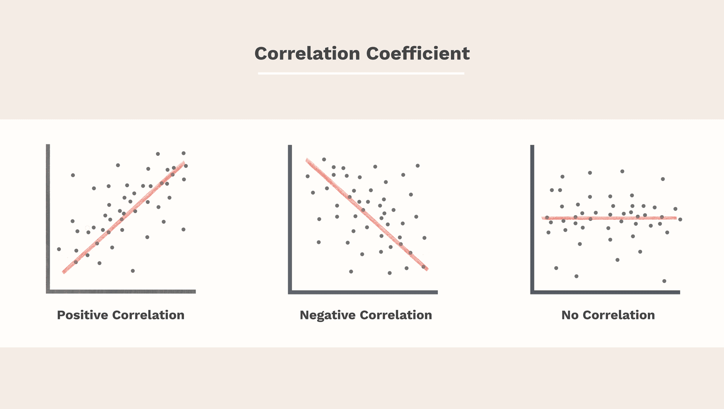
Finding Correlations
Finding good correlations between attributes in your data set is important because it tells us about the more important factors which may affect your generated output. We do this by checking Correlation coefficient between two values

Slide 7
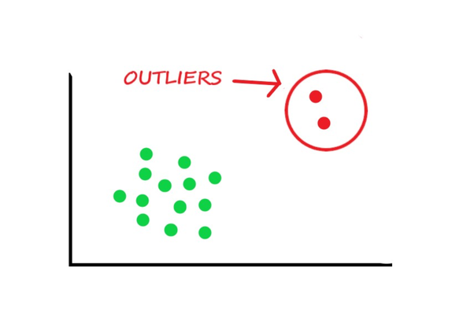
Detecting and Removing Outliers
Outliers are Data values which lie away from normal values and will affect the accuracy of the model if they are taken into consideration for the model training

Slide 8
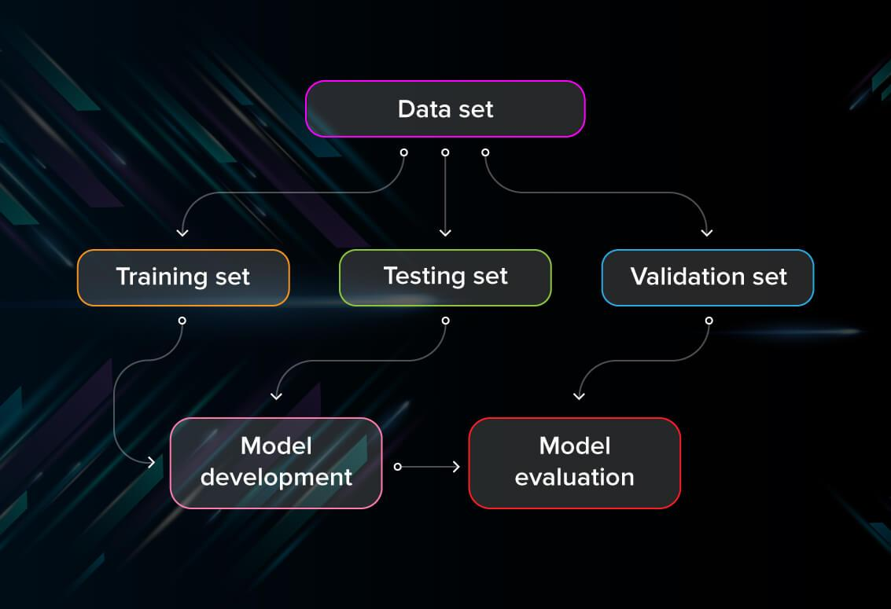
Building Machine Learning Model
To make the model we need to divide the data set into different parts which will help train the model using the machine learning algorithm and then we can test the model on the other set of the data set

Slide 9
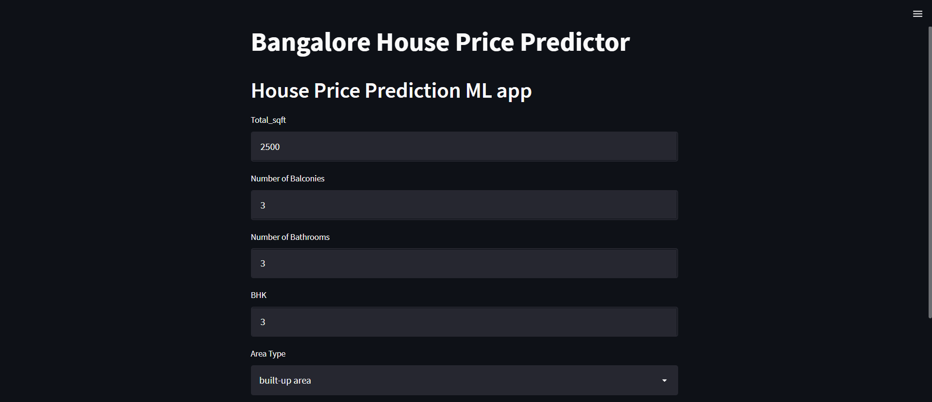

Building Web App
We can easily build the Web App using StreamLit which helps in inserting data and graph easily and integrate the machine learning model in the Web App easily and we can also deploy the web application using StreamLit

