Slide 1
Name- Vaibhav Mahadev katkar Enrollment number- EBEON1221492472 Batch- 2021-6315 Title – Front End Project ("Minimallist portfolio website)

Slide 2
Problem Statement

Slide 3
"Minimallist portfolio website
::user should be able to see hover states for all interactive elements throughout the site.
Click on the the""about me"" call to the action home page and have th screen scroll down to the next section.
Receive an error message when the contact form is submitted if: The name ,Email address or message fields are empty should show ""This field is required"".
The email address is not formatted correctly should show ""please use valid email address""

Slide 4
TOPICS COVERED

Slide 5
1.HTML
HYPERTEXT MARKUP LANGUAGE
The HyperText Markup Language, or HTML is the standard markup language for documents designed to be displayed in a web browser.

Slide 6
Tags Used:
<html>
<body>
<head>
<title>
<header>
<footer>
<form>
<div>
<img>
<a>
<article>
<h1>
<h2>
<h3>
<h4>
<script>
<link>
<p>
<label>
<input>
<select>
<button>
<optgroup>
<option>

Slide 7
2.CSS
CASCADING STYLE SHEET
Cascading Style Sheets is a style sheet language used for describing the presentation of a document written in a markup language such as HTML. CSS is a cornerstone technology of the World Wide Web, alongside HTML and JavaScript.

Slide 8
CSS Properties:
background-color
background-size
background-image
background-repeat
background
border
border-radius
border-style
bottom
box-shadow
box-sizing
color
content
column
cursor
display
font
font-family
font-style
font-weight
height
left
margin
margin-left
margin-right
margin-top
margin-bottom
max-height
max-width
@media
min-height
min-width
object-fit
object-position
opacity
overflow
overflow-x
padding
padding-right
padding-top
padding-left
padding-bottom
position
right
text-align
text-decoration
top
width
z-index
align-content
flex
flex-wrap
float
flex-direction
transition
transform

Slide 9
3.JAVASCRIPT
JavaScript, often abbreviated JS, is a programming language that is one of the core technologies of the World Wide Web, alongside HTML and CSS. Over 97% of websites use JavaScript on the client side for web page behavior, often incorporating third-party libraries.

Slide 10
Tag used: <script>
JavaScript Keywords used:
else, if, toggle, loop, return
JavaScript Message Box Used:
Alert box
Comparison
Operators Used:
$, True, False

Slide 11
Design & Overview

Slide 12
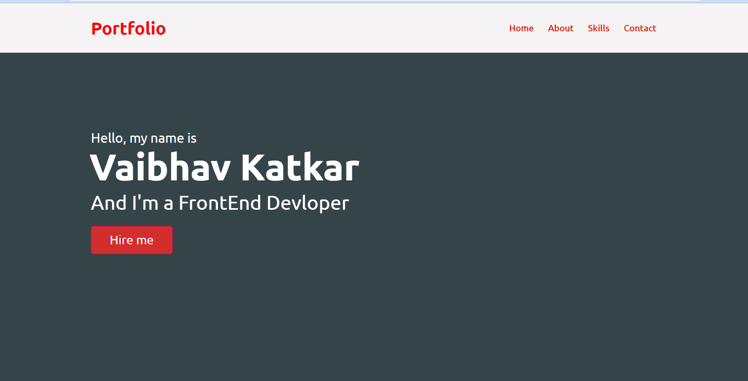

Slide 13
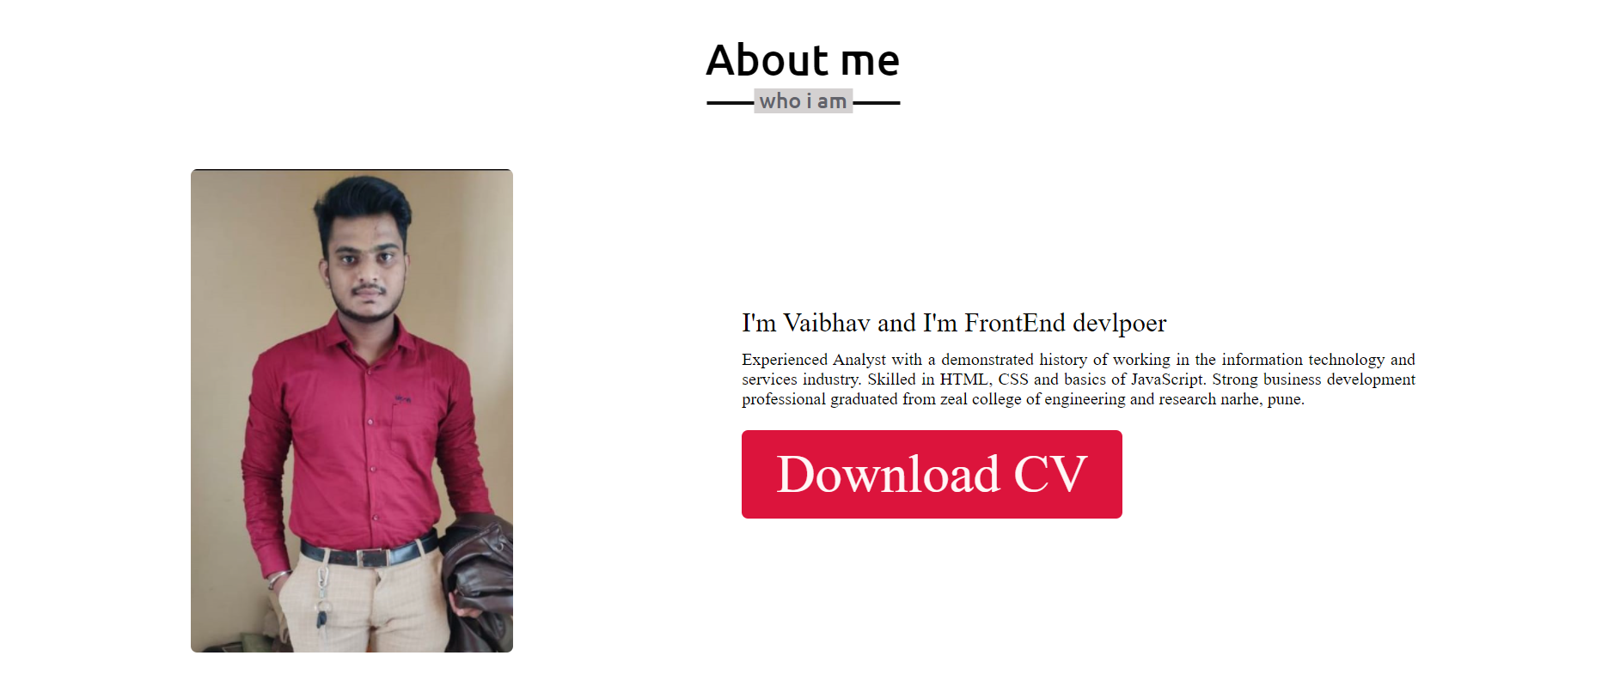

Slide 14
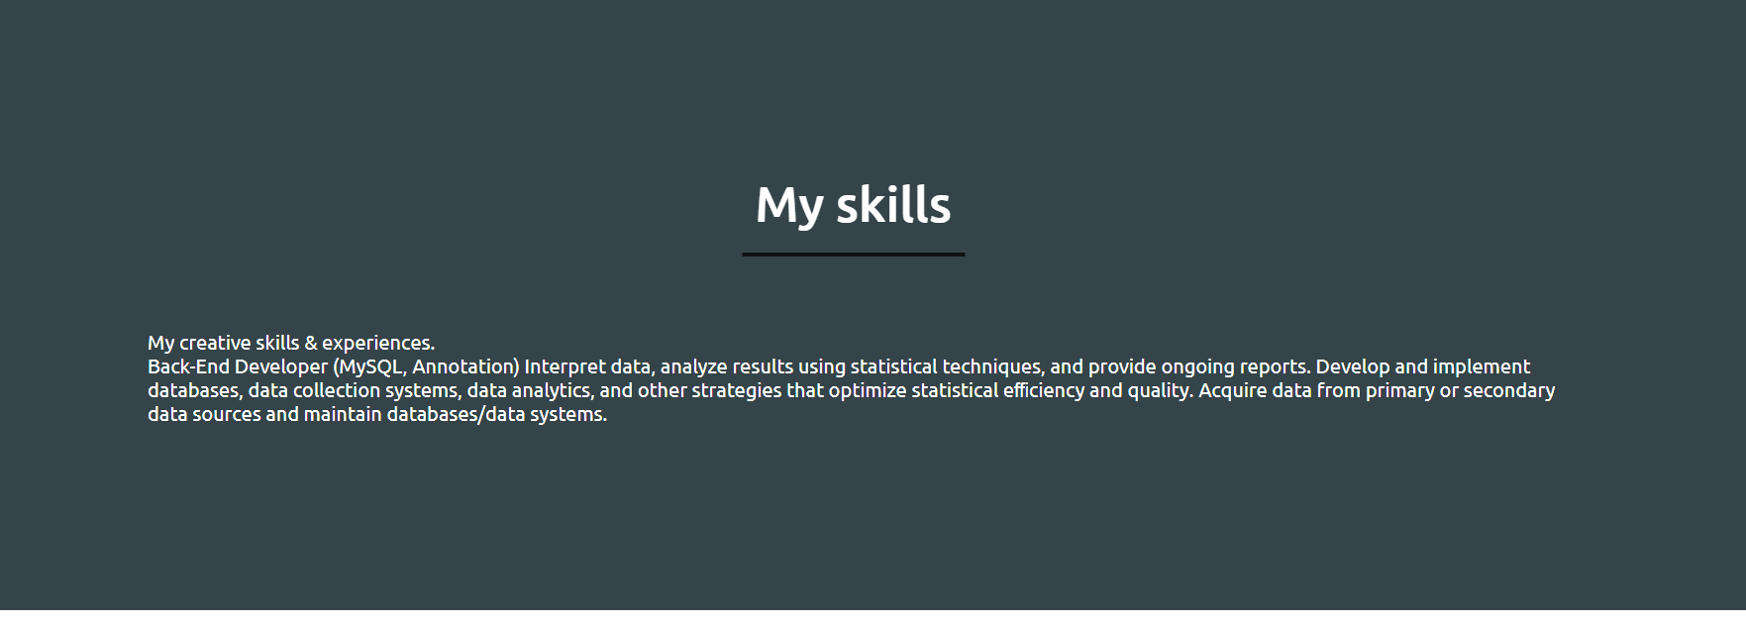

Slide 15
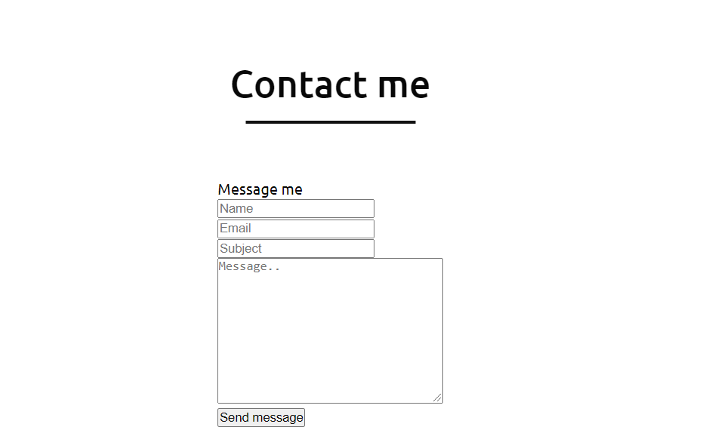

Slide 16
Thank You

