Slide 1

SMART INDIA HACKATHON 2026
KIWI · SecureMailScope
  Problem Statement ID – SIH26159
  Problem Statement Title - SecureMailScope: AI-Assisted Cryptographic Security Posture Assessment for Secure Email Communications
  Theme - Blockchain & Cybersecurity
  PS Category - Software
  Team ID -
  Team Name - Overfitters

Slide 2
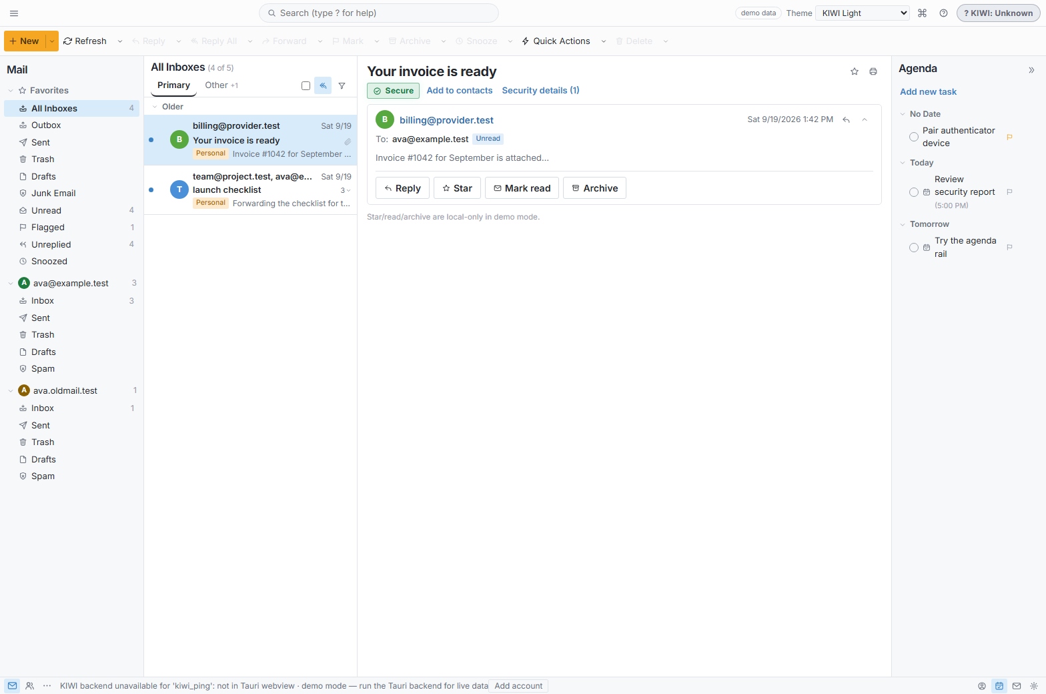
Kiwi Mail
Overfitters
Mail client with Passive PCAP forensics + endpoint TLS evidence for SMTP · IMAP · POP3
▪ Proposed solution — a passive forensic engine that ingests PCAP, rebuilds SMTP/IMAP/POP3 sessions and TLS handshakes, validates certificates, then scores the cryptographic posture.
▪ How it addresses the problem — deterministic rules flag weak TLS, broken STARTTLS and bad certs; an AI layer classifies risk, spots anomalous handshakes and recommends fixes — it explains, it never asserts.
▪ Innovation & uniqueness — the only entry that is also a working mail client — endpoint evidence sees what passive capture cannot (comparison below).

Slide 3
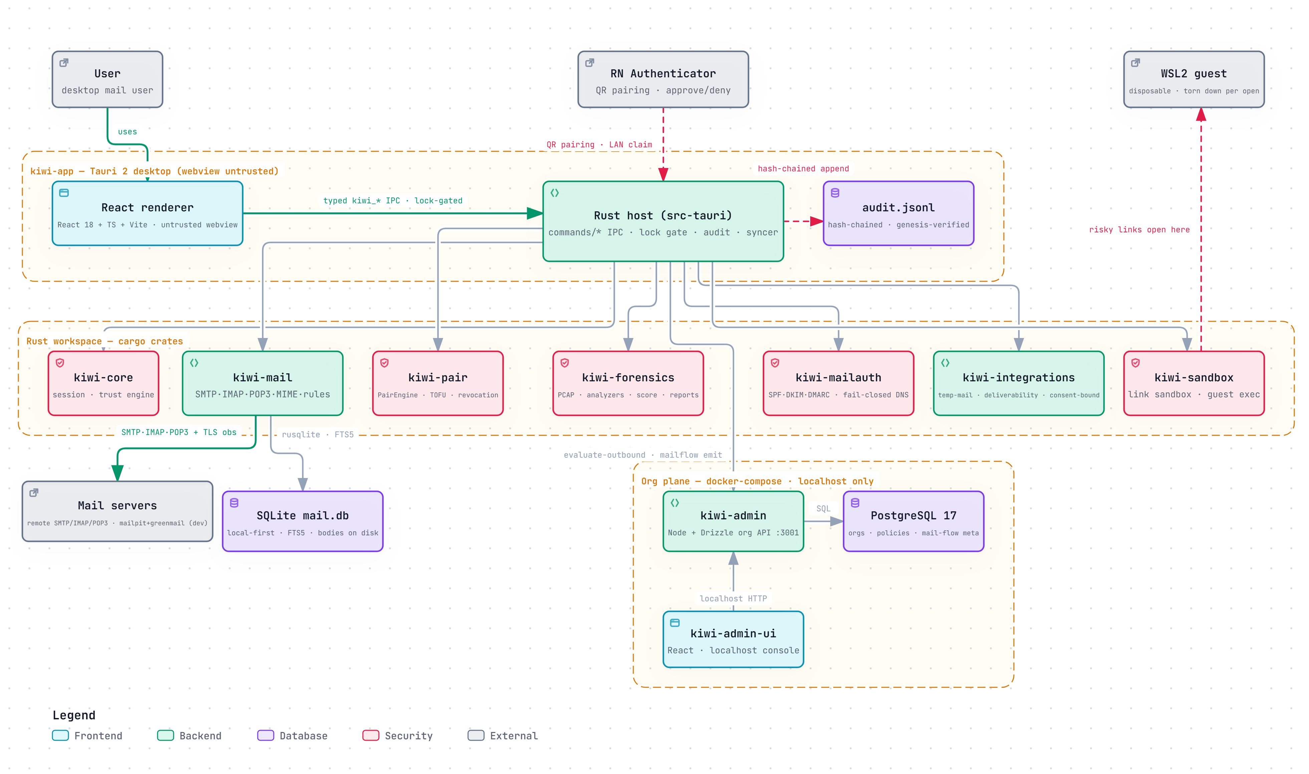
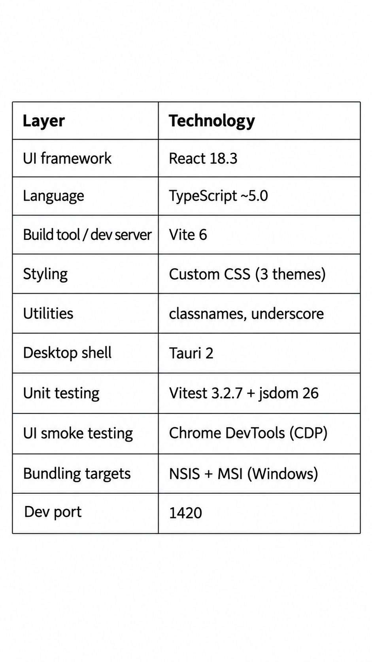
TECHNICAL APPROACH
Overfitters

Slide 4
FEASIBILITY AND VIABILITY
Overfitters
Analysis of the feasibility of the idea · Potential challenges and risks · Strategies for overcoming these challenges
FEASIBLE — ALREADY BUILT
CHALLENGES & RISKS
OUR MITIGATIONS
▪ PCAP ingest + TCP stream reassembly in kiwi-forensics
▪ TlsObservation capture: version, cipher, FS, cert chain, STARTTLS
▪ Deterministic rule engine → scored, reproducible findings
▪ Self-verifying export envelope (canonical bytes + SHA-256)
▪ Working Tauri client + dashboard; cargo/vitest/CDP CI gates
▪ TLS 1.3 encrypts certificates — passive capture goes blind
▪ Fragmented / out-of-order PCAP in real networks
▪ AI must never invent findings or verdicts
▪ Heterogeneous server stacks; STARTTLS stripping tricks
▪ Endpoint vantage fills the passive blind spot — hybrid model
▪ Robust sequencer; incomplete streams flagged, never guessed
▪ Rules are authoritative; AI only classifies + explains
▪ Lab-validated vs. Mailpit/GreenMail corpora + PS dataset
Viable: offline-first desktop — no licences, no cloud, deployable inside air-gapped SOCs; MPL-2.0 open source.

Slide 5
IMPACT AND BENEFITS
Overfitters
WHO BENEFITS — AND HOW
SOC / DFIR / IR teams
posture triage in seconds — prioritised findings instead of raw packets
Govt. & enterprise admins
concrete remediation: TLS upgrades, STARTTLS fixes, cert renewals
Auditors & compliance
tamper-evident, self-verifying reports — proof, not claims
Capability | Wireshark | Zeek | SSLyze / testssl.sh | KIWI
Passive PCAP analysis — no live probing | ✓ | ✓ | ✗ active scan only | ✓
Email-aware: SMTP · IMAP · POP3 + STARTTLS | ~ decode only | ~ scripts needed | ✗ | ✓ native
Auto posture score + prioritised findings | ✗ | ✗ | ~ grade only | ✓ rule-based score
AI risk classification + anomaly detection | ✗ | ✗ | ✗ | ✓ explains, never asserts
Endpoint vantage + self-verifying report | ✗ | ✗ | ✗ | ✓ SHA-256 envelope
India / sovereign stack
3
4
1
0
offline-capable MPL-2.0 tool — no vendor lock-in, no data egress
protocols
SMTP·IMAP·POP3
verdict tiers
allow→deny
self-verifying
forensic report
fabricated
findings

Slide 6
RESEARCH AND REFERENCES
Overfitters
Details / Links of the reference and research work
STANDARDS & GUIDANCE
BASELINES & PROJECT EVIDENCE
▪ RFC 3207 / 2595 — SMTP & IMAP STARTTLS negotiation
▪ RFC 8314 — cleartext mail deprecated — implicit TLS
▪ RFC 8461 / 8996 — MTA-STS · TLS 1.0/1.1 deprecated
▪ NIST SP 800-52r2 — TLS configuration guidelines
▪ CA/B Forum BRs — certificate validation baseline
▪ MITRE ATT&CK — T1040 sniffing · T1557 adversary-in-the-middle
▪ Wireshark · Zeek — packet tooling baseline — decode, no posture
▪ SSLyze · testssl.sh — active-scan baseline compared in slide 2
▪ SIH26159 dataset — attached synthetic PCAP corpus for validation
▪ KIWI repo — docs/contracts/forensics.md — FSV-1 report vocabulary
▪ Working prototype — 10-crate Rust workspace, CI-gated, ~30 MB binary
KIWI doesn't ask you to trust it — it shows you the evidence.
Every claim in this deck is verifiable in the repo: deterministic capture, rule-based scoring, hash-chained audit, self-verifying exports.

