Slide 1
KIWI
Email that proves its security.
A full desktop mail client and a security platform in one product —
built from scratch on Rust + Tauri 2. Every claim backed by
deterministic, tamper-evident evidence.
hackathon build · MPL-2.0 · alpha

Slide 2
THE PROBLEM
“This connection was encrypted.” — says who?
— Trust without evidence. Every day we click links, open attachments, and hand our inbox credentials, contracts, and conversations — and no mainstream client can prove it did the secure thing.
— Indicators that lie. Green checkmarks get painted from assumptions; when the evidence isn't there, most clients show it anyway — or invent scareware.
— Nothing to check later. No record of what actually happened on the wire — no TLS facts, no DNS verdicts, no audit trail to stand behind a claim.
KIWI's design rule
Every security claim must be backed by evidence —
and when the evidence isn't there, the UI says so
instead of painting a fake green.
KIWI · 2

Slide 3
THE PRODUCT
One app: a real mail client + a security platform
On the surface — a mail client you know
Underneath — security work most clients skip
— Four-pane mailbox, unified inbox across accounts
— Compose with undo-send, send-later, templates
— FTS5 search, contacts, attachments, rules, snooze
— Multiple accounts — Gmail OAuth2 included — themes
— Every SMTP / IMAP / POP3 connection captured at the protocol layer
— Scored by deterministic rules — no invented findings
— Recorded as tamper-evident evidence, hash-chained on disk
— Not a Thunderbird or Mailspring fork — built from scratch
KIWI · 3

Slide 4
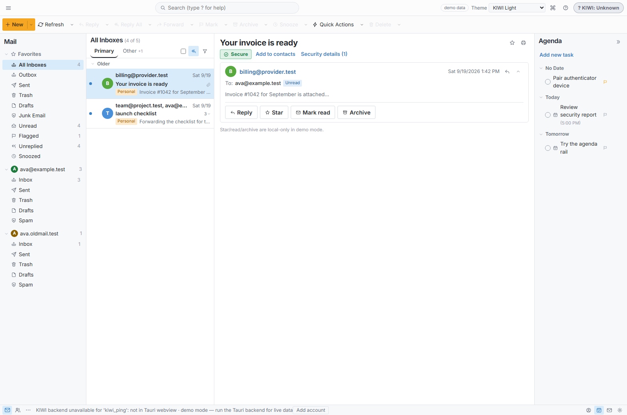
THE CLIENT
Four-pane mailbox, honest by design
Unified inbox
across accounts — Gmail OAuth2, IMAP, POP3
Per-message trust stamps
risk + auth evidence attached at ingest
Agenda rail + quick actions
keyboard-first, snooze, templates, drag-to-folder
Themes
light / dark / high-contrast
KIWI · 4

Slide 5
WHO IT SERVES
Three audiences, one binary
The everyday user
The security professional
The organization
— A polished, complete mail client
— Honest indicators instead of scareware
— Absent data renders absent — never a fake green
— Deterministic TlsObservation per session — TLS version, cipher, key exchange, forward secrecy, cert chain, STARTTLS
— Captured, not inferred
— SPF / DKIM / DMARC over fail-closed DNS
— Admin plane: orgs, domains, users, roles
— Recipient-domain policy + mail-flow metadata — never message bodies
— Its own audit trail
KIWI · 5

Slide 6
WHY IT'S DIFFERENT
Four claims other clients can't make
Deterministic evidence, not vibes
1
Every connection yields a TlsObservation — real TLS facts at the protocol layer. kiwi-forensics turns sessions into findings; no score exists without a rule behind it.
The lock is real
2
Suspicious signals feed a trust engine. When trust drops, the endpoint locks — enforced in Rust IPC across the entire command surface, not just a UI overlay. A compromised renderer can't bypass it.
Tamper-evident audit
3
Every mutation lands in a hash-chained audit.jsonl, genesis-verified on open. Corruption surfaces as audit-corrupt in the UI instead of being hidden.
Fail closed over fabricate
4
Absent data renders absent. A missing backend disables the action and says so. No placeholder signatures, no fabricated green — ever.
AI explains, never asserts. AI may translate a finding into plain language — it never decides a verdict. The deterministic rule engine is the only authority.
KIWI · 6

Slide 7
IN ACTION
What happens when you click a link in KIWI
stamps
hints
click-gate
sandbox
evidence
risk + auth stamps attached at ingest
→
per-message evidence read at render
→
verdict: allow · confirm · sandbox · deny
→
risky links open in a disposable WSL2 guest — torn down before the session is recorded
→
every step lands in the audit chain
— Re-openable, not bypassable. Opening a link again re-checks the source risk — the gate can't be cached around.
— Verifiable reports. Forensics reports export as canonical bytes in a self-verifying SHA-256 envelope — you can prove the report wasn't altered after the fact.
KIWI · 7

Slide 8
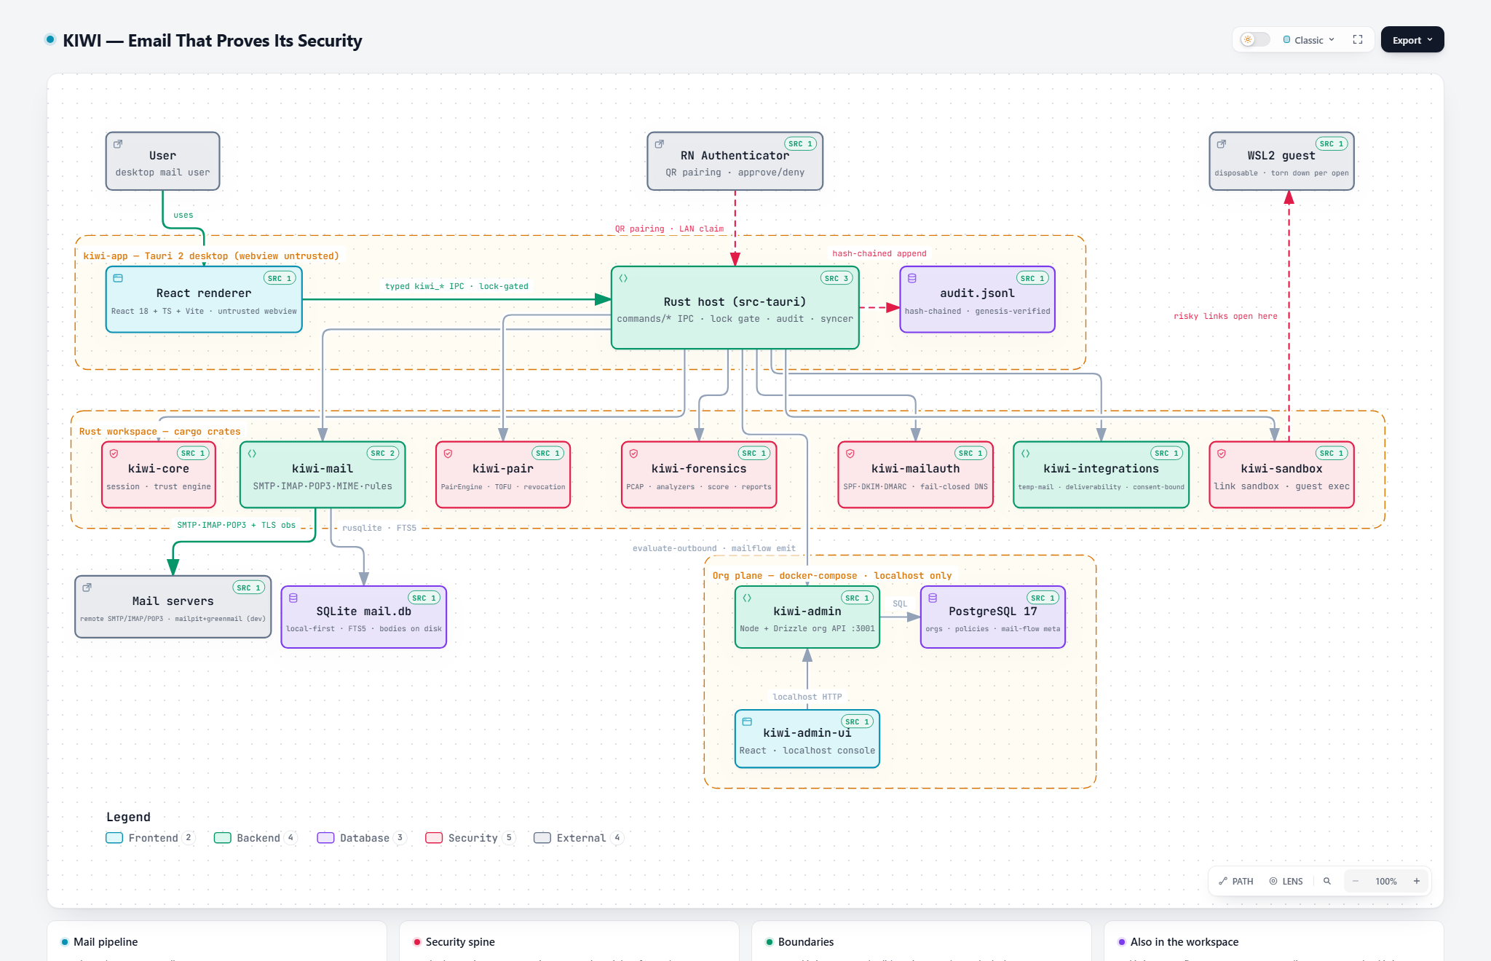
UNDER THE HOOD
Untrusted webview, trustworthy core
KIWI · 8

Slide 9
THE TECH
Tauri 2 · Rust workspace · typed lock-gated IPC
Desktop — Tauri 2
Rust 2024 workspace — ten crates
— Rust host + React 18 / TS / Vite renderer — the webview is untrusted by design
— Every typed kiwi_* IPC command validates input, runs the lock gate, writes audit evidence
— Secrets live only in the OS credential store; unsafe_code forbidden workspace-wide
— kiwi-mail real SMTP·IMAP·POP3, MIME, SQLite+FTS5, rules, mbox, TLS capture
— kiwi-core · kiwi-pair trust engine, device identity, QR pairing authority
— kiwi-forensics · kiwi-mailauth PCAP reassembly + scoring; SPF/DKIM/DMARC on fail-closed DNS
— kiwi-sandbox · kiwi-integrations · kiwi-autoconfig · kiwi-contacts WSL2 guest, consent-bounded services, OAuth2 discovery, vCard
— kiwi-app ~25 IPC command modules, audit chain, syncer, notifications
Sidecars: kiwi-admin (Node + Drizzle + PostgreSQL org plane, React admin UI) · React Native authenticator for QR-paired approvals | Dev/CI: Docker mailpit + GreenMail · cargo test/clippy/fmt · tsc · vitest · CDP smoke
KIWI · 9

Slide 10
KIWI doesn't ask you to trust it —
it shows you the evidence.
A real mail client for daily use. A security platform underneath. Every claim backed by deterministic, tamper-evident proof.
Email that proves its security.
Tauri 2 · Rust 2024 (unsafe forbidden) · React 18 · SQLite+FTS5 · SPF/DKIM/DMARC · WSL2 sandbox · hash-chained audit · MPL-2.0 · alpha, ~30 MB

