Slide 1
Web Development Internship Project
By Vaibhav Chawla
BCA (AI & ML), MRIIRS
17th July 2025

Slide 2
About Organization
CodSoft offers software development and training with real-time project exposure.

Slide 3
Project Overview
Projects include:
1. Calculator Web App
2. India Today Landing Page
3. Portfolio Website
Built using HTML, CSS, JS.

Slide 4
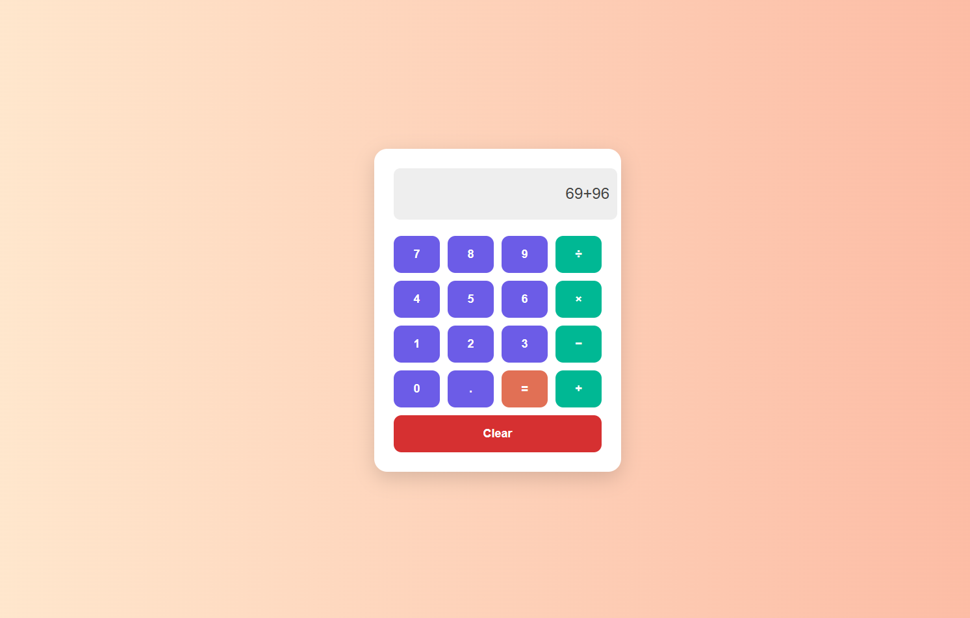
1. Calculator Web App

Slide 5
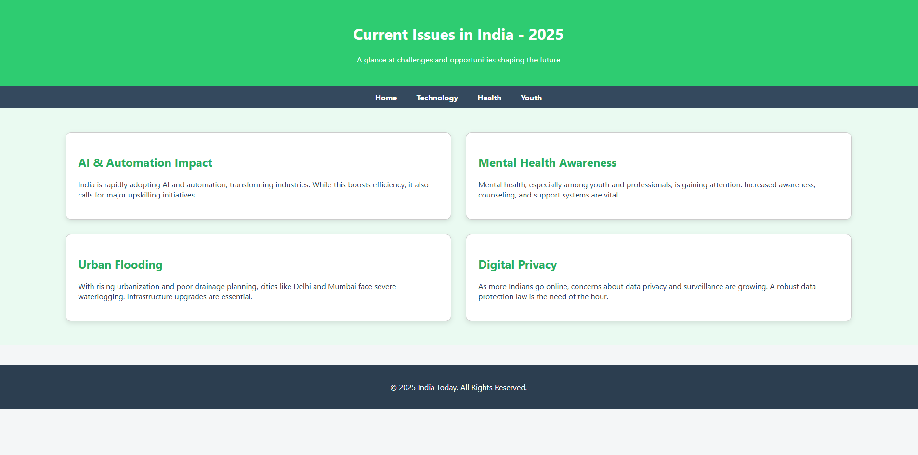
2.India Today Landing Page

Slide 6
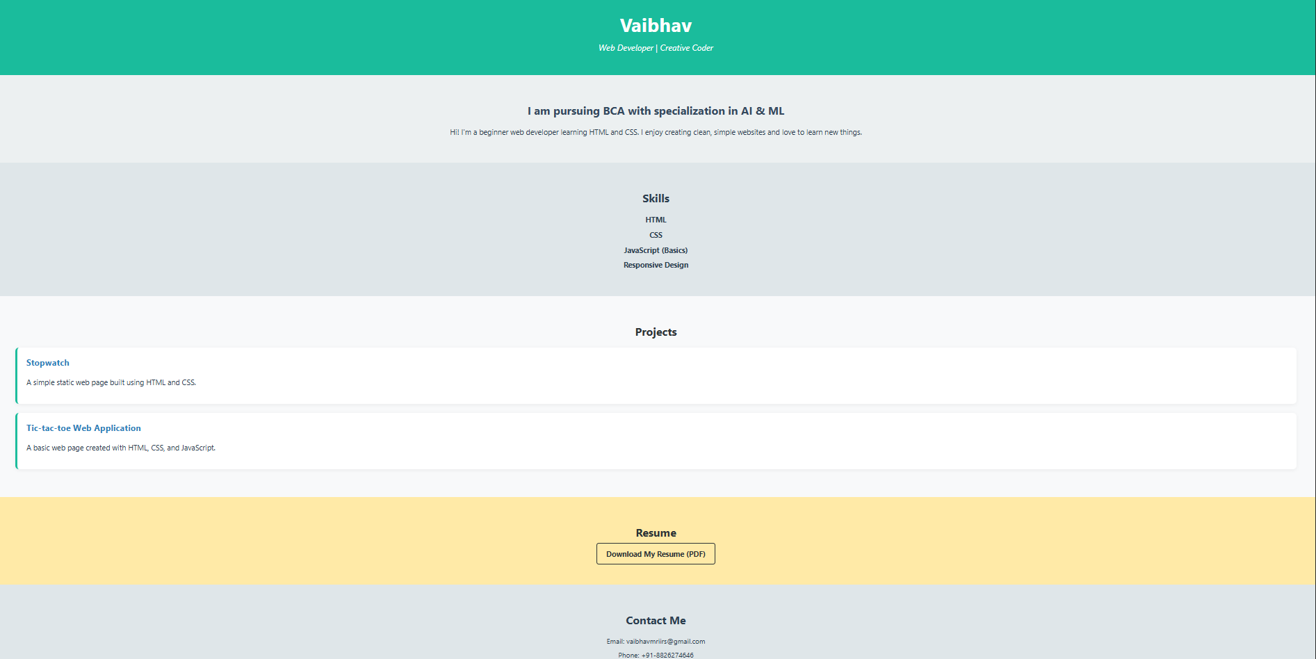
3. Portfolio Website

Slide 7
System Limitations
No backend or dynamic content.
No error handling.
Not fully responsive.
No animations or accessibility.

Slide 8
SYSTEM IMPLEMENTATION
(a) System Requirements (Hardware/Software):
1. Hardware Requirements
Processor: Minimum Dual-core 1.6 GHz or higher for smooth development.
RAM: At least 2 GB to run code editor and browser simultaneously.
Storage: Minimum 500 MB free space to store HTML, CSS, JS, and media files.
Display: A 13-inch or larger screen for better visibility and layout testing.
Input Devices: Standard keyboard and mouse for coding and navigation.
Internet Connection: Needed for live testing, hosting, and feedback collection.
2. Software Requirements
Operating System: Compatible with Windows 10/11, Linux, or macOS.
Code Editor: Visual Studio Code or any lightweight text editor (e.g., Sublime Text).
Web Browser: Google Chrome, Firefox, or Microsoft Edge (latest version preferred).
Deployment Platform (Optional): GitHub Pages, Netlify, or Vencel for hosting.
File Type Support: Works with .html, .CSS, .JS, .pdf, .jpg, and .PNG.
3. Optional Tools
Live Server Extension: For real-time preview while editing in VS Code.
W3C Validator: To check HTML and CSS code validity.
Google Page Speed Insights: To test website performance and loading speed.
4. Text Editor
Visual Studio Code (VS Code) was used for writing HTML, CSS, and JavaScript code.
It provides syntax highlighting, auto-completion, and error checking for efficient coding.
Extensions like Live Server were used for real-time preview in the browser.
Its user-friendly interface made it ideal for beginner-level web development.
Integrated terminal helped run local servers and manage files easily.

Slide 9
Proposed Improvements
Add backend, responsive design, safe parsing, contact forms, and admin panel.

Slide 10
Feasibility Study
Technical: HTML, CSS, JS in VS Code.
Behavioral: Simple UI.
Economic: No cost; monetization possible.

Slide 11
Project Timeline
Week 1: Planning
Week 2: Design
Week 3: Development
Week 4: Testing & Final Report

Slide 12
Testing Summary
Tested calculator, portfolio, landing page for responsiveness, functionality, and usability.
All test cases passed.

Slide 13
System Design
Used HTML, CSS, JS
Separate files per project.
Media used in portfolio.
Simple file structures and comments for maintenance.

Slide 14
Scope of Project
3 Static Projects
Frontend only
Beginner level
Responsive design
Future: Add contact form, analytics, social features

Slide 15
BIBLIOGRAPHY
1. Tutorials:
- HTML & CSS:
- MDN Web Docs –
HTML: [https://developer.mozilla.org/enUS/docs/Web/HTML] (https://developer.mozilla.org/enUS/docs/Web/HTML)
- MDN Web Docs
– CSS: [https://developer.mozilla.org/en-US/docs/Web/CSS] (https://developer.mozilla.org/enUS/docs/Web/CSS)
- W3Schools
– HTML Tutorial: [https://www.w3schools.com/html/] (https://www.w3schools.com/html/)
- W3Schools
– CSS Tutorial: [https://www.w3schools.com/css/] (https://www.w3schools.com/css/)
US/docs/Web/JavaScript] (https://developer.mozilla.org/en-US/docs/Web/JavaScript)
- JavaScript.info: [https://javascript.info/] (https://javascript.info/)
- W3Schools
– JavaScript Tutorial: [https://www.w3schools.com/js/] (https://www.w3schools.com/js/)
- Git & Version Control:
- Git Handbook: [https://guides.github.com/introduction/githandbook/] (https://guides.github.com/introduction/githandbook/)
2. Deployment Platforms:
- GitHub Pages: [https://pages.github.com/] (https://pages.github.com/)

