Slide 1
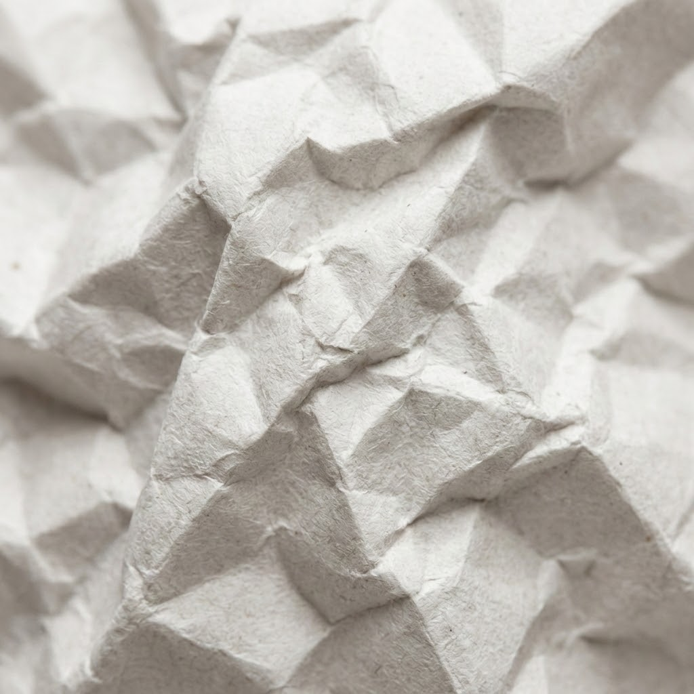
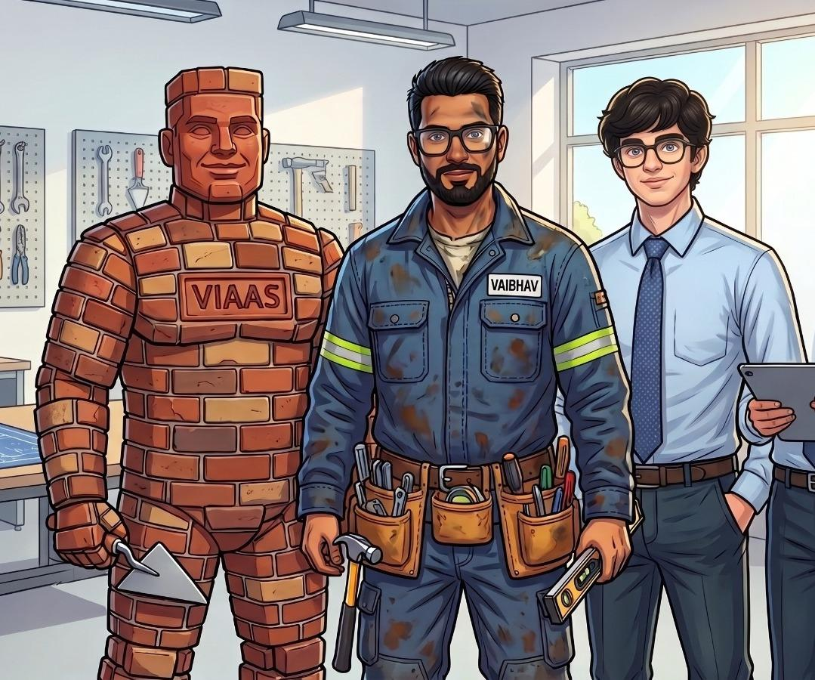
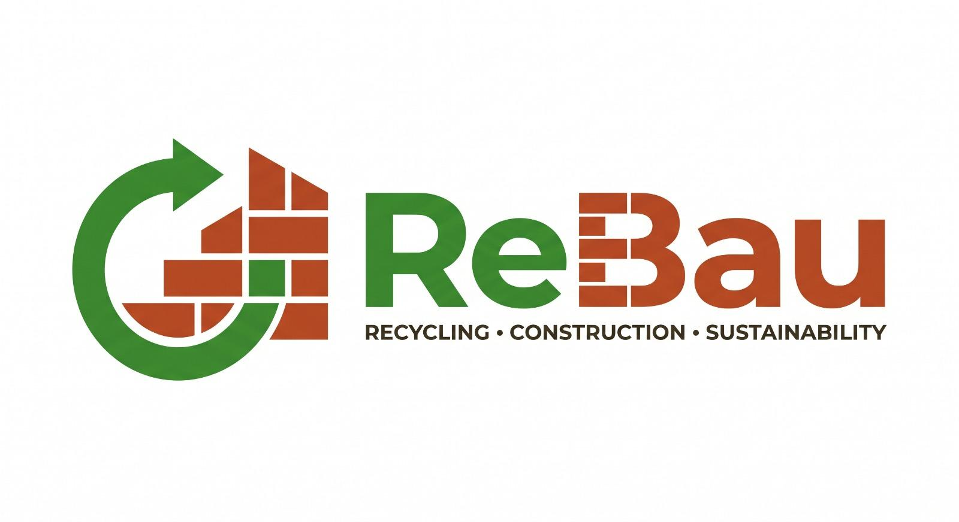
Imagine ….

Slide 2
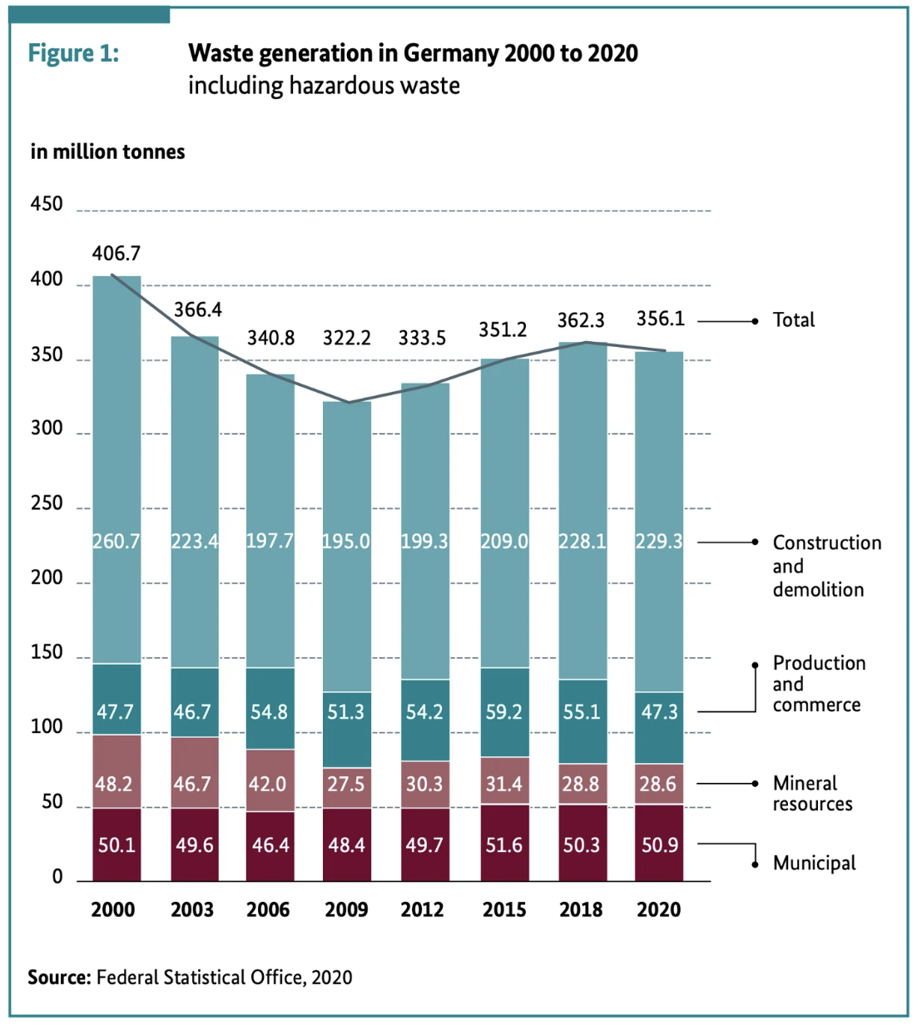

Germany's Waste Crisis
THE PROBLEM
207.9M
million tonnes of waste created in Germany every year - and construction is at the heart of it.
Source: Federal Statistical Office, 2020. Total waste generation in Germany 2000–2020 (million tonnes), including hazardous waste.

Slide 3
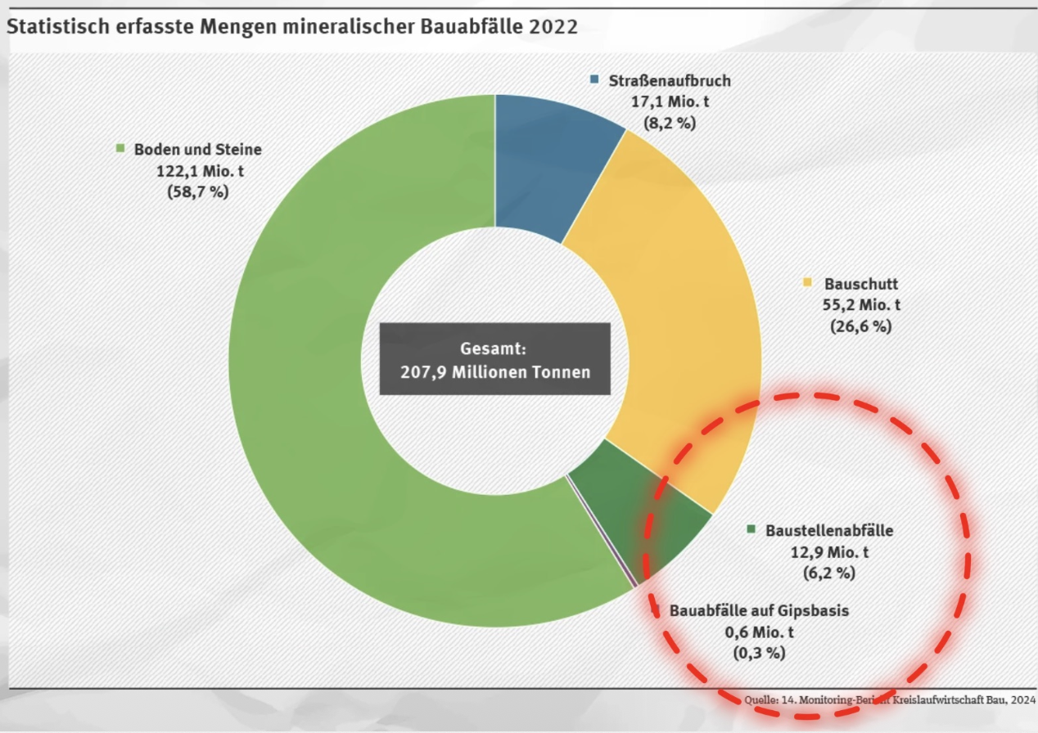

The Hidden Slice
Of Germany's 207.9 million tonnes of mineral construction waste in 2022, one category is consistently overlooked - yet it holds the greatest untapped value.
Construction Waste: 12.9 Mio. t (6.2%) - the segment circled in red. These are reusable construction site materials being thrown away.
💶 €12.9 Billion
☁️ 9M Tonnes CO₂
Wasted every year on materials thrown away from construction sites
Emitted just from disposing of these reusable construction materials
Source: 14. Monitoring-Bericht Kreislaufwirtschaft Bau, 2024. Baustellenabfälle (12.9 Mio. t) - the most reusable, most wasted segment.

Slide 4
THE OPPORTUNITY
Reuse First. Recycle Only When Needed.
"Reuse first. Recycle only when needed." - European Commission, EU Circular Economy Strategy
If we stop throwing away reusable construction materials, the impact is enormous. The EU Circular Economy Strategy makes clear that reuse delivers far greater value than recycling - both financially and environmentally.
💶 €6.7 Billion Saved
🌿 2× CO₂ Reduction
❓ But How Do We REUSE?

Slide 5
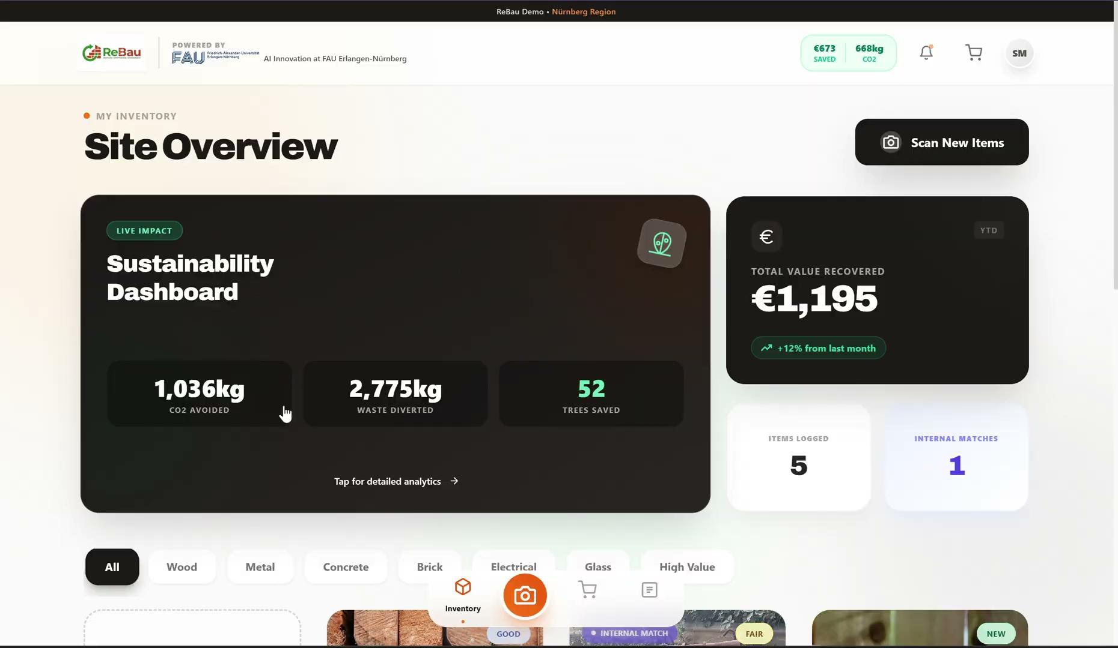

How ReBau Works
From Capture to Marketplace in Seconds
Capture
One AI
Smartphone photo of materials on site.
Object detection (52% acc, 300 images trained).
Cloud AI
ReBau

Slide 6


Upload. Analyze. Save.
From building plan to circular procurement in seconds.
Upload Plans
AI Analyzes
Cart & Savings
How Smart Plan Analysis Works
📋 Example Savings Card
1
📄 Upload Building Plans
Project: "Residential Block München Nord"
Materials matched: 14 of 22 line items
💶 € Saved: €34,200 vs. new materials
🌿 CO₂ Avoided: 8.4 tonnes
Construction companies upload project plans (PDF/CAD) with their required materials list. Example: 500 m² timber beams · 200 steel rods · 80 window frames.
2
🔍 ReBau Analyzes Availability
Our AI cross-references every line item against live ReBau marketplace inventory - matching by material type, quantity, and condition grade.
Stop procuring new. Start procuring smart.
3
🛒 Cart + Savings Report
Matched reclaimed materials are added to cart automatically. A summary card shows total € saved vs. buying new and total CO₂ tonnes avoided.

Slide 7
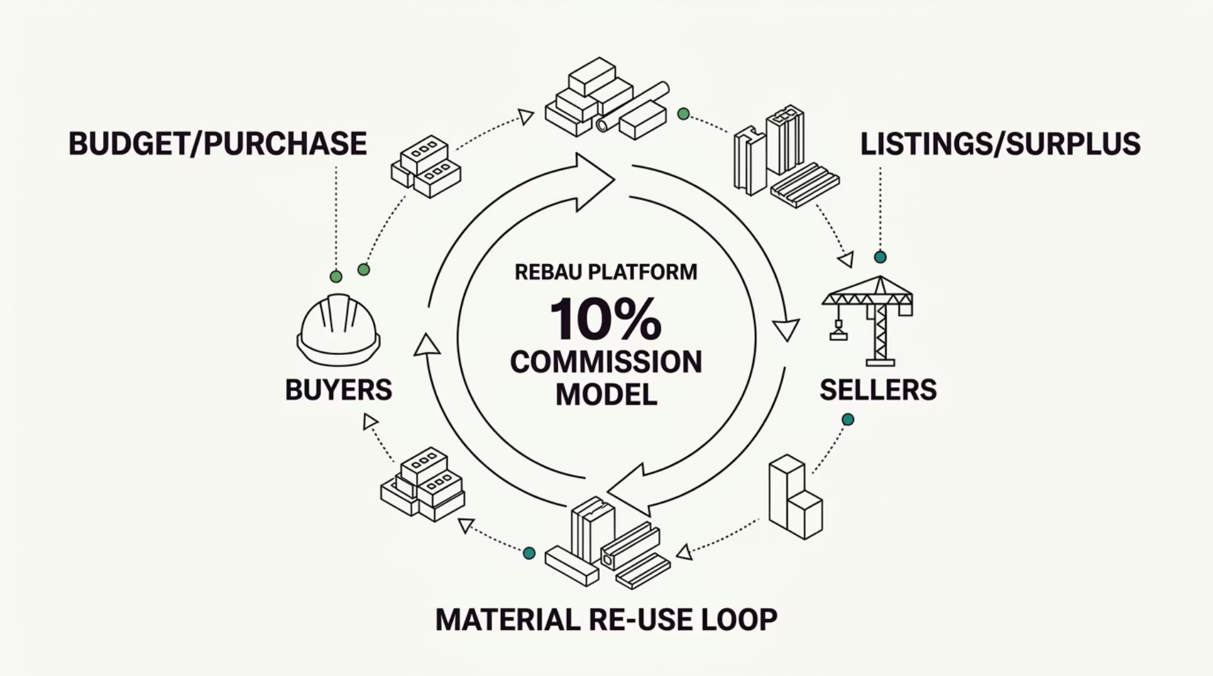

Business Model & Market Size
Circular Economy Platform
€25B
10%
€12.5M
Annual Market
Second-Hand Target
Revenue Potential
Yearly spending on construction materials in Germany alone
Second-hand adoption unlocks a €2.5B addressable market
Capturing 5% of the market at 10% commission = €12.5M revenue
Model: ReBau charges a 10% commission on every transaction between buyers and sellers of reclaimed construction materials.

Slide 8

Why ReBau?
How we compare to existing platforms
Feature
Concular
CircoTRADE
ReBau ✅
AI Material Recognition
❌
❌
✅
Real-time Value
❌
❌
✅
CO₂ Impact Tracking
❌
⚠️ Partial
✅
Instant Matching
❌
❌
✅
Internal Reuse
❌
❌
✅
Marketplace
✓
✓
✓ + Automated
ReBau is the only platform combining AI material recognition, real-time valuation, CO₂ tracking, instant matching, internal reuse, and a fully automated marketplace — all in one solution.

Slide 9
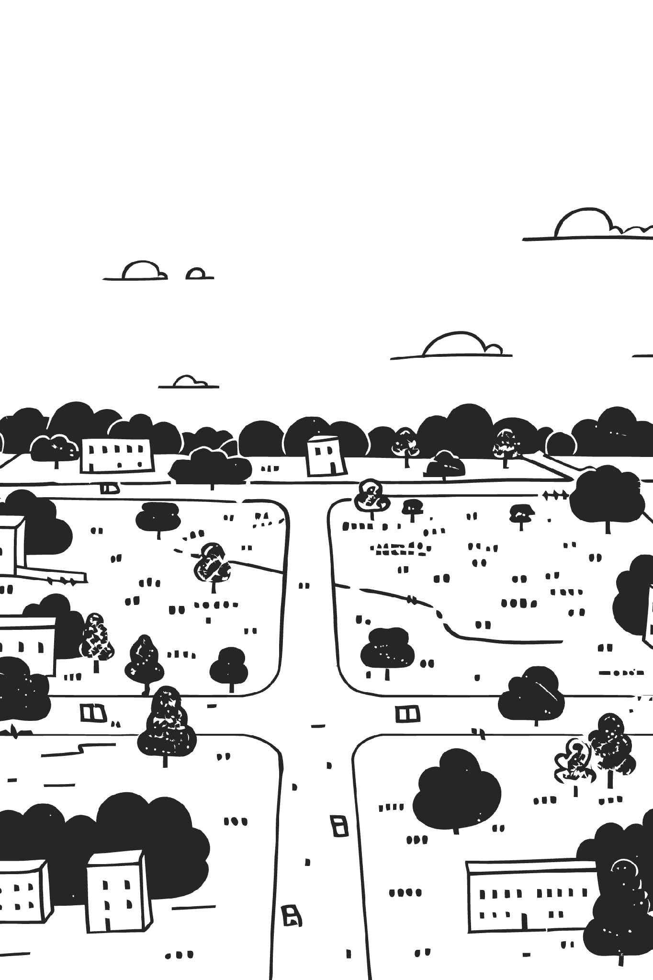



Impact
ReBau delivers measurable value across three dimensions - financial, environmental, and operational - transforming how the construction industry handles materials.
💰 Financial Impact
🌱 Environmental Impact
€6.7B saved annually across the industry
20–70% value recovery per component depending on material type and condition
8M tonnes CO₂ avoided annually through material reuse
12.9M tonnes of construction waste diverted from landfill
⚙️ Operational Impact
40% faster on-site material sorting
15–20% fewer new material purchases per project
Easy real-time inventory tracking across all sites

Slide 10




Expenses
Three-Phase Investment Plan - Total: €250,000 over 12 Months
🚀 Full Launch (6–12 months)
↔️ Commercial Pilot (3–6 months)
€130,000 - Full platform launch, marketing campaign, sales team, infrastructure scaling, DaCH market preparation.
📊 Initial MVP
€50,000 - Core AI model development, basic marketplace UI, initial testing with pilot construction partners.
€70,000 - Onboard first paying customers, refine AI accuracy, build Smart Plan Analysis feature, expand material categories.
🧱 Total 12-Month Investment: €250,000
A lean, milestone-driven budget designed to reach profitability before the end of Year 1.

Slide 11



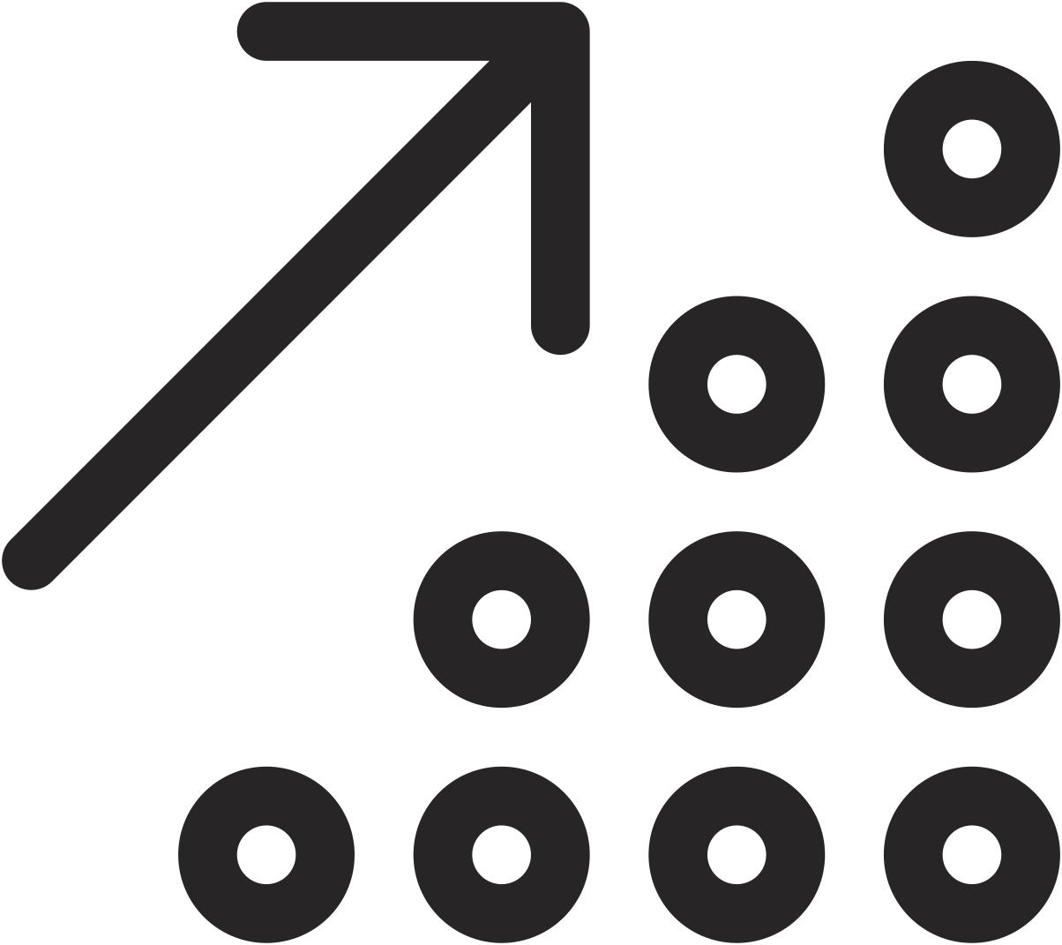



Road Map
From Hackathon to DaCH Expansion
Q2 2026
Hack it at FAUErlangen-Nürnberg → Connect with people, validate concept, build founding team
Q4 2026
Push MVP, continue testing with real construction sites, iterate on AI model accuracy
Q1 2027
Launch Product - first paying customers, Smart Plan Analysis live, marketplace fully operational
Q4 2027
Scale operations - expand team, grow marketplace listings, increase AI training data
Q1 2028
Expand DaCH 🇩🇪 + 🇨🇭 + 🇦🇹 - full German-speaking market coverage
Technical Roadmap
🌿 ReBau
Extend to multimodal (classification + object detection combined)
Recycling · Construction · Sustainability
Building the circular economy for construction - one brick at a time.
Add more construction-site objects to training dataset
Semantic segmentation - detect damage and cut points on materials
Instance counting - automatically count bags, boards, tiles in a photo

Slide 12
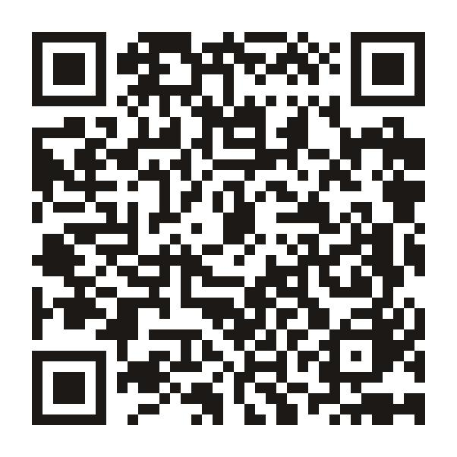
Live Website

Slide 13
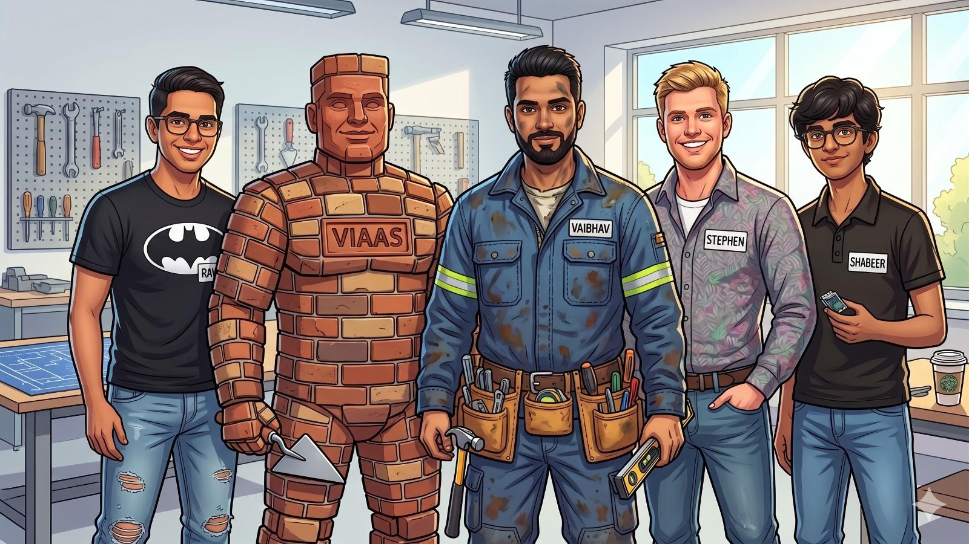
Our Team

