Slide 1

BLACK FRIDAY SALES PREDICTION
PROJECT USING MongoDB and PySpark
VAIBHAV ARORA

Slide 2
IMPORTANT LINKS
COLAB NOTEBOOK : https://colab.research.google.com/drive/1eGfaM5o8QZoRWGpR1omgDFOswgYlbSrm?usp=sharing
DATA :
https://drive.google.com/file/d/132RNyVqCpz6U-uvIZv_AUkwkrkYL35Pw/view?usp=share_link

Slide 3
PROBLEM STATEMENT
Retail is the sale of goods and services from individuals or businesses to the end- user. The retail industry provides consumers with goods and services for their everyday needs. In retail one of crucial part is to understand the consumer behavior and make various arrangements for the sales of the company. A retail company “ABC Private Limited” wants to understand the customer purchase behavior (specifically, purchase amount) against various products of different categories. They have shared purchase summary of various customers for selected high volume products from last month.

Slide 4
ABOUT THE DATASET
This dataset comprises of sales transactions captured at a retail store. This is a regression problem. The dataset has 550,069 rows and 12 columns.
Problem: Predict purchase amount.
Data Overview
Dataset has 550068 rows (transactions) and 12 columns (features) as described below:
User_ID: Unique ID of the user.
Product_ID: Unique ID of the product.
Gender: indicates the gender of the person making the transaction.
Age: indicates the age group of the person making the transaction.
Occupation: shows the occupation of the user, already labeled with numbers 0 to 20.
City_Category: User's living city category. Cities are categorized into 3 different categories 'A', 'B' and 'C’.
Stay_In_Current_City_Years: Indicates how long the users has lived in this city.
Marital_Status: is 0 if the user is not married and 1 otherwise.
Product_Category_1 to _3: Category of the product. All 3 are already labaled with numbers.
Purchase: Purchase amount.

Slide 5
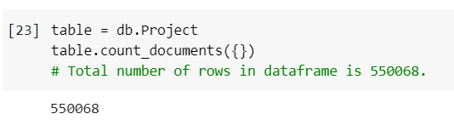
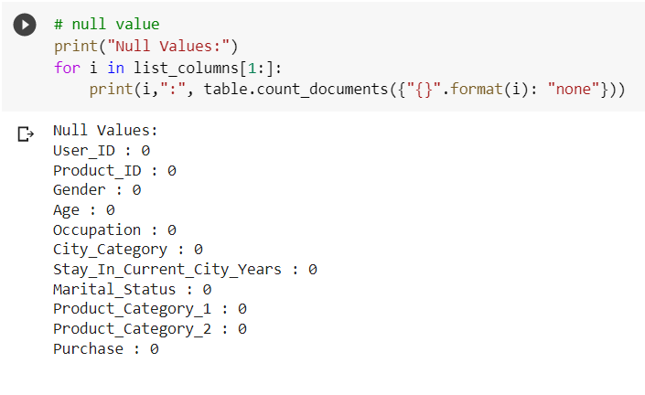
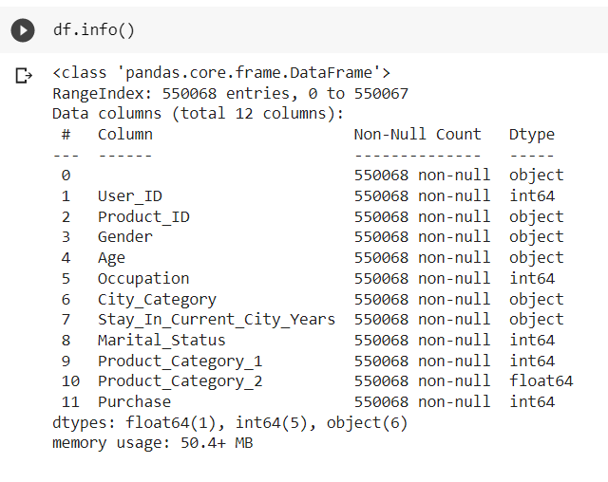
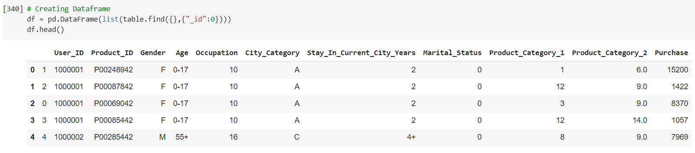
EDA on MongoDB

Slide 6
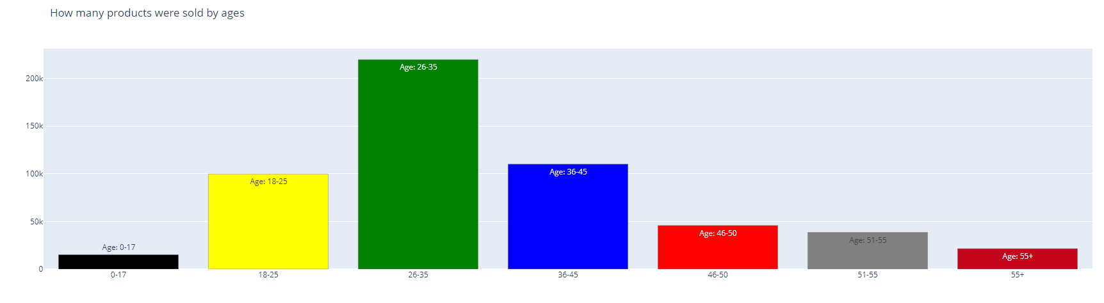
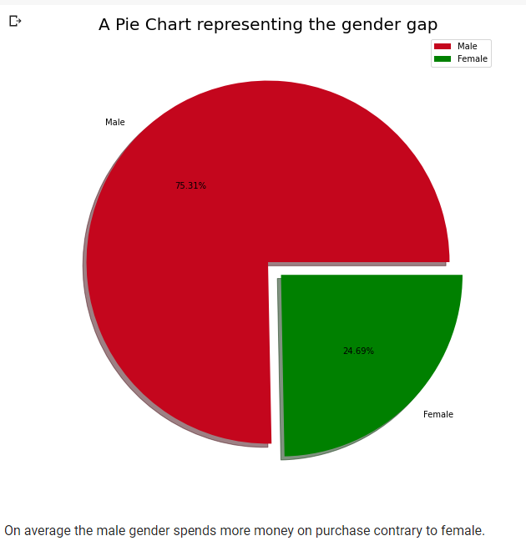
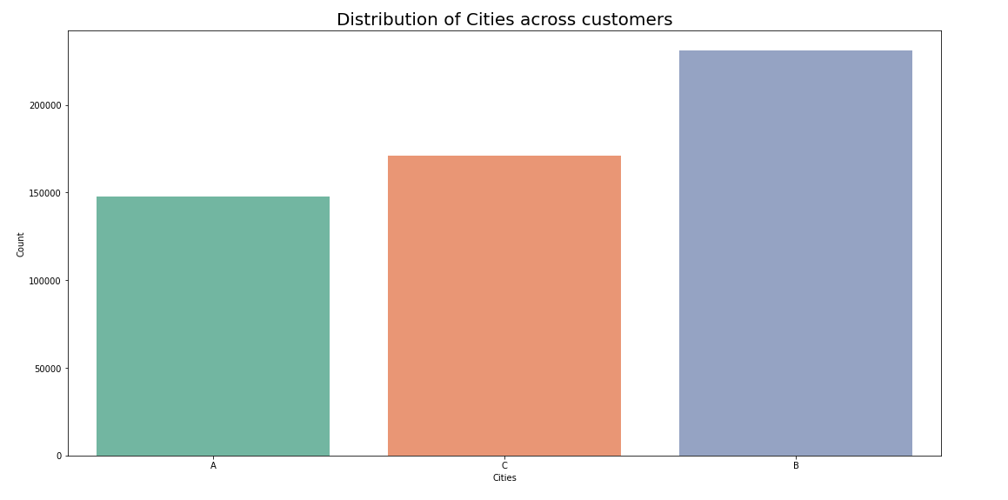
Categorical Variables

Slide 7

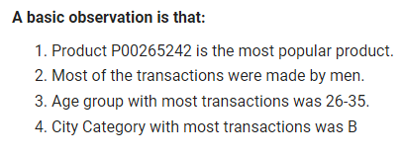

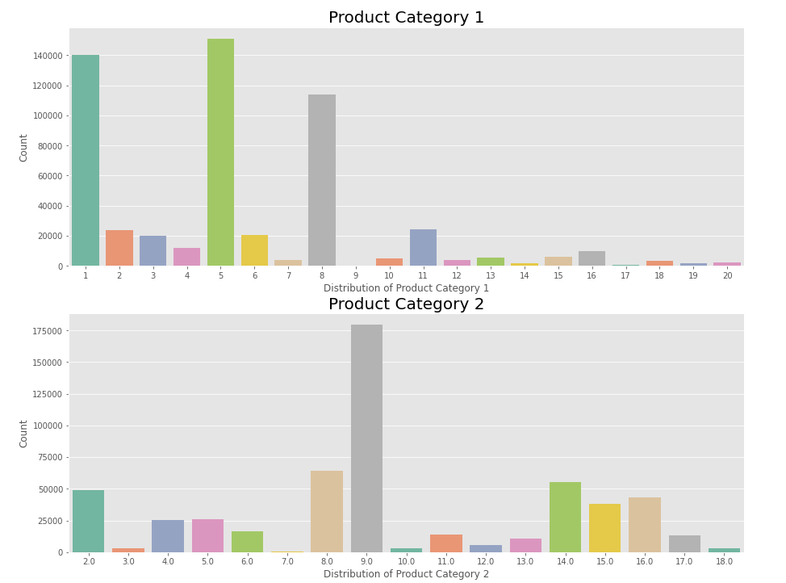



Insights from Variable

Slide 8
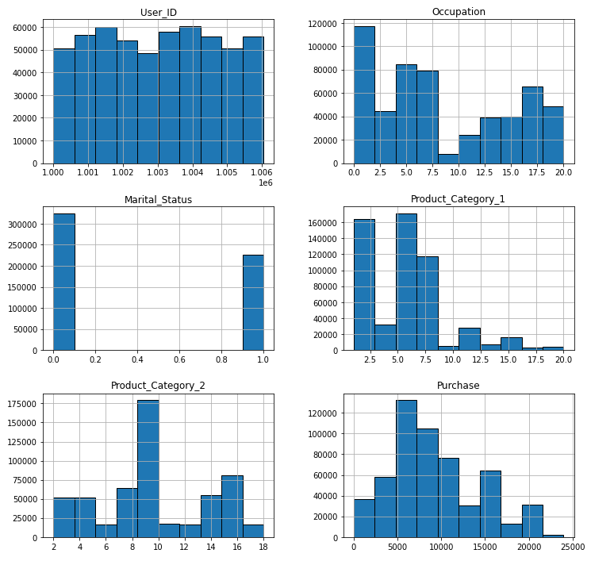
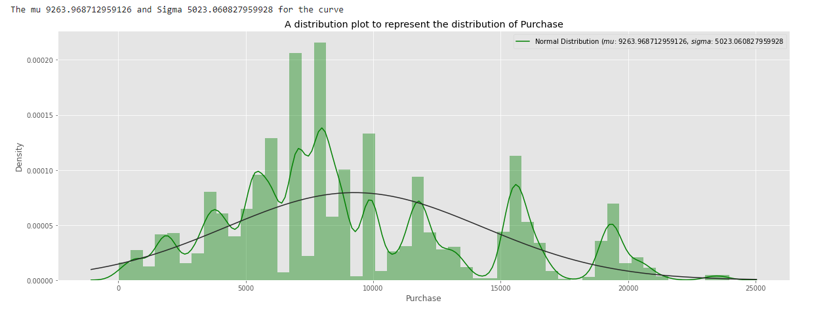
Numerical Variable

Slide 9
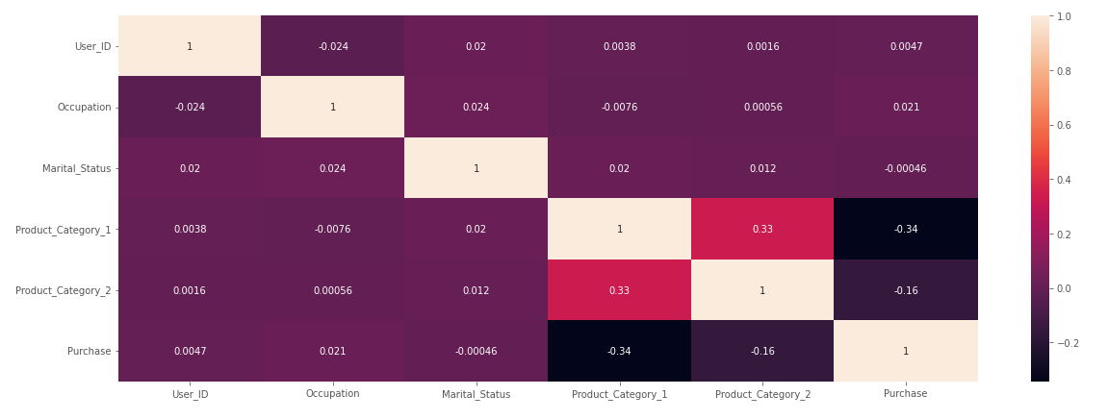
Checking for Multicollinearity
From the correlation heatmap we can see that the linear association/ correlation between our variables is not more than 0.4 in all the cases which can be considered as weak correlation. So we can conclude that there are minimal chances of multicollinearity in our dataset.

Slide 10
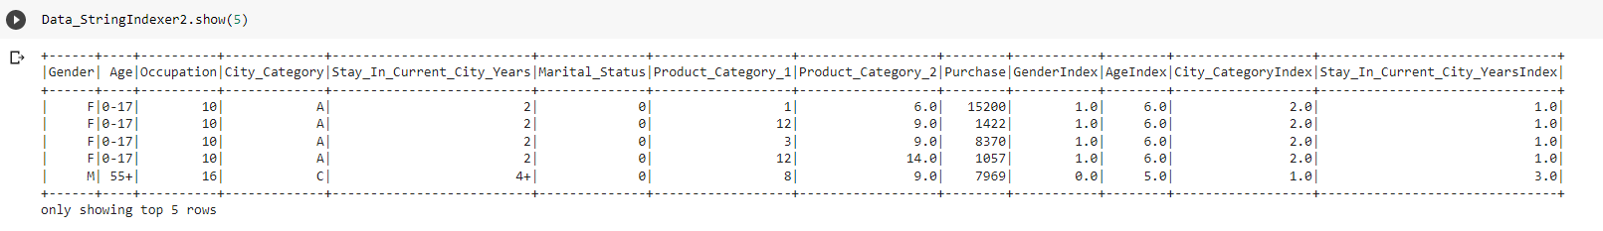
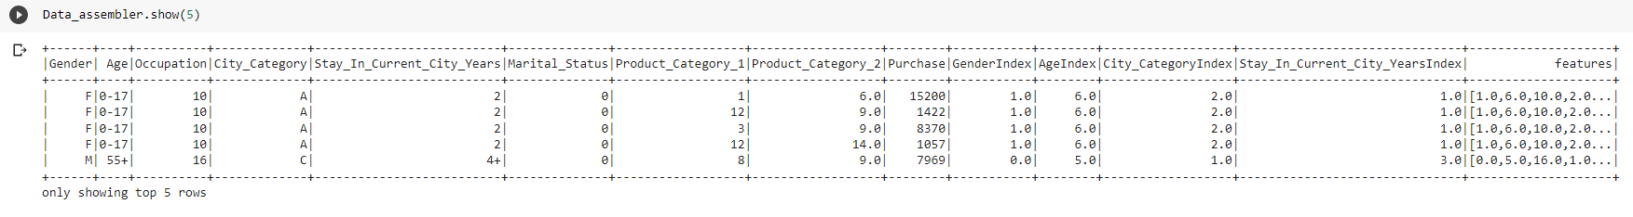
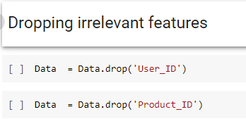
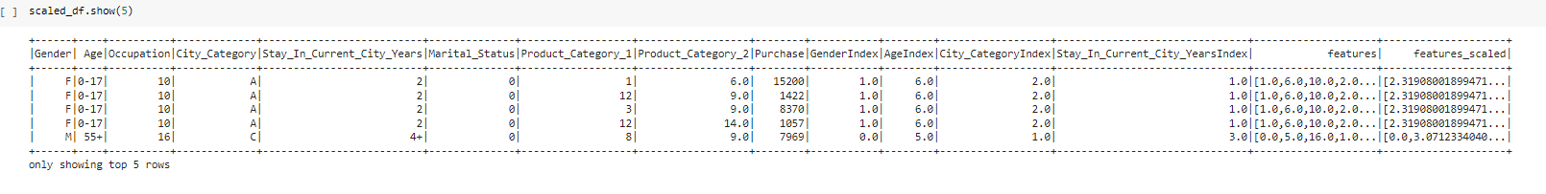
Data Pre-Processing
Dropping Irrelevant Variables
For the purpose of data pre-processing we have used the following tools :
String Indexer
Assembler
Standard Scaler

Slide 11

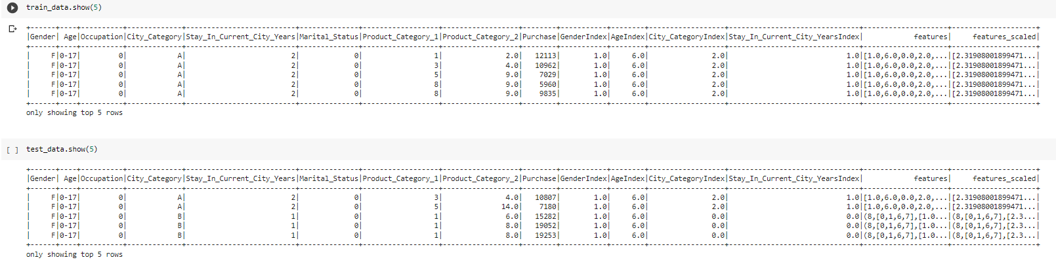
Train Test Split
Our dataset is split into training and testing in the ratio of 80 percent, 20 percent respectively.

Slide 12
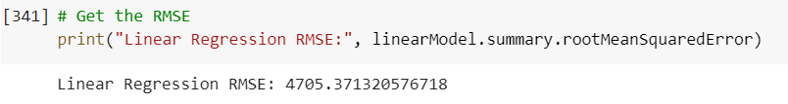
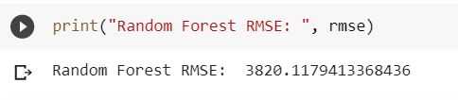

MODEL TRAINING USING PYSPARK
Linear Regression
Random Forest
Gradient Boost Regressor
3 different models used for training the data and the outputs were evaluated

Slide 13
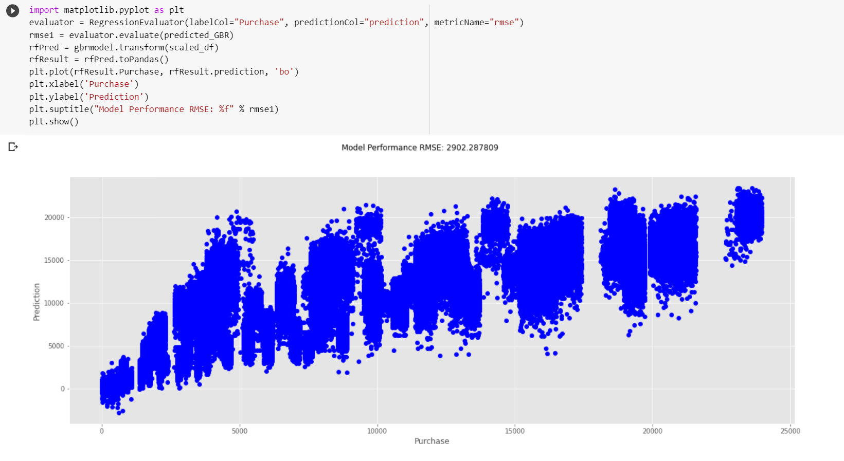
MODEL EVALUATION

Slide 14
CONCLUSION
Gradient Boost Regressor is giving the best result in our case when compared with other models because GBR starts with building a primary model from available training data sets then it identifies the errors present in the base model. After identifying the error, a secondary model is built, and further, a third model is introduced in this process. In this way, this process of introducing more models is continued until we get a complete training data set by which model predicts correctly.

