Slide 1
IBM DATA SCIENCE PROFESSIONAL CERTIFICATE.
Applied Data Science Capstone
-Vaibhav Bodhe

Slide 2
Introduction
Pune has been an Educational center for India as well as Maharashtra for over decades and also the introduction of IT sector in the city has populated a huge amount of Engineers and Students in the city , these specific population has a lot technical buff on their plate , also that involves long hours of sleeplessness and focusing .

Slide 3
Introduction
Therefore through this project we try to segment the neighborhoods of Pune according to the availability of coffee shops and help the Coffee Shops/ Café franchise willing to open an outlet in Pune by availing the areas with less Competition and more customer turn over.

Slide 4
Business Problem
The main objective of this project is to help the investors and Coffee Shop franchises by segmenting the area of Pune and providing them the list of areas where there is lack of Coffee Shop/Café so as to defend them from high Competition and also helping them achieve great turnout of customers. If a Coffee shop/Café franchise is interested to open an outlet in Pune what are the areas they should be targeting..??

Slide 5
Target Audience
Coffee Shop / Café franchise interested for an outlet in Pune.
Coffee lovers who like to spend time working at Café.(Secondary Audience)

Slide 6
Data :
List of Neighborhoods in Pune .This basically sets a scope of our project .
Area Markers i.e Longitudes and Latitude of the Scope and also the neighborhoods targeted for analysis.
Venue data , for calculation of customer occurrences and availability of specific venue in an area.

Slide 7
Sources for Data Availability
First and foremost Source for list of neighborhood in Pune can be made available through Wikipedia . A csv file is created containing the list which is further merged with area markers.
The Coordinates of Neighborhood can be extracted from Python Geocoder Package.
Venue data can be extracted from Foursquare.com site , which is prestigious site four venue details , ratings etc. A Developer account needs to be created so as to avail API calls.

Slide 8
Results
The results after clustering (k=3) clearly exhibits that we can categorize the neighborhoods into 3 clusters based on the frequency of occurrence for “Coffee shop / café ”:
Cluster 0(RED): Neighborhoods with moderate number of Coffee Shops .
Cluster 1(PURPLE): Neighborhoods with low number to no existence of Café.
Cluster 2(MINT GREEN): Neighborhoods with high concentration of Coffee shops .

Slide 9
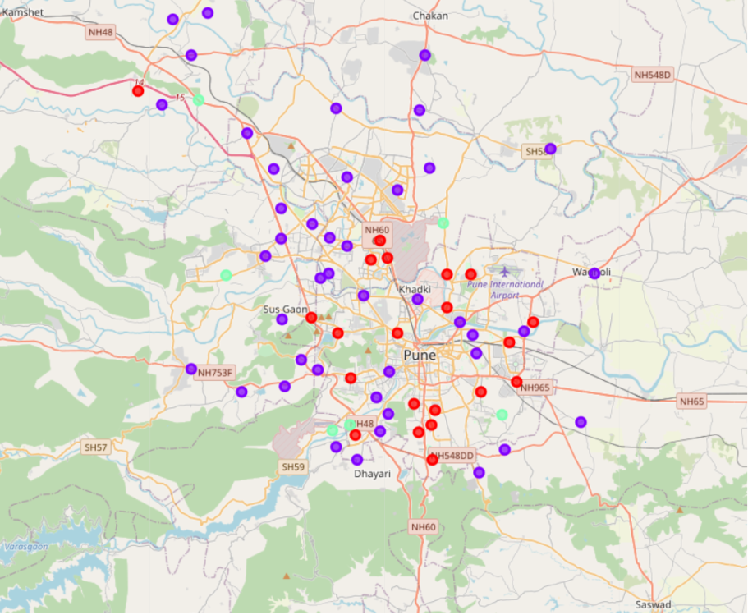
All the clusters are visualized with markers

Slide 10
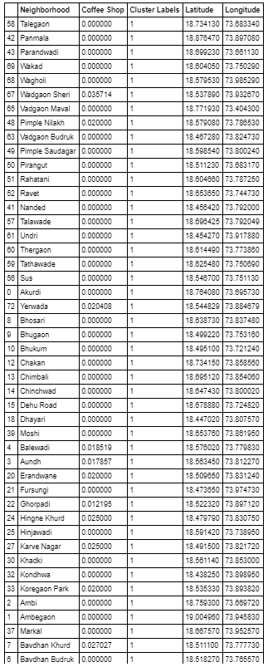
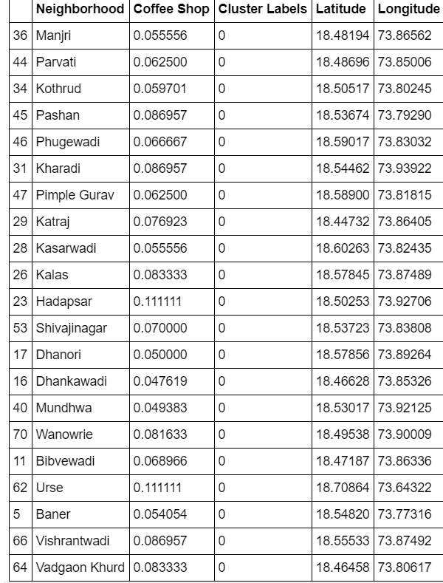
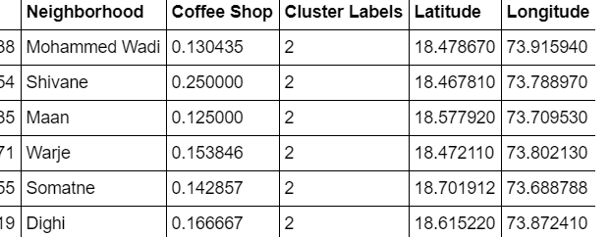
Clusters :

Slide 11
Discussion :
As inferred from the visualization of clusters it is clear that the franchise targeting the areas in Cluster2 will be facing a lot of competition from its peers as the number of Coffee shop in this areas is highly concentrated whereas Cluster1 serves to be the new market for cafes as these areas gravely lack in those amenities , also Cluster0 can be a fair choice but moderation in number wouldn’t hype up the sales but can surely attract moderate amount of customers with fair amount of competition.
Best Areas to be targeted : Areas in Cluster 1 ( PURPLE)

Slide 12
Conclusion :
In this project, we have gone through the process of identifying the business problem, specifying the data required, extracting and preparing the data, performing machine learning by clustering the data into 3 clusters based on their similarities, and lastly providing recommendations to the relevant stakeholders i.e Coffee franchise eager to invest in Pune region by opening a new outlet. To answer the business question that was raised in the introduction section, the answer proposed by this project is: The neighborhoods in cluster 1 are the most preferred locations to open a new Café . The findings of this project will help the relevant stakeholders to capitalize on the opportunities on high potential locations while avoiding overcrowded areas in their decisions to open a new Coffee shop / Café .

Slide 13
References
Category: Neighborhoods in Pune , India .Retrieved fro (https://en.wikipedia.org/wiki/List_of_neighbourhoods_in_Pune)
Foursquare Developers Documentation. Foursquare. Retrieved from https://developer.foursquare.com/docs.

