Slide 1

Telecom Customer Defection Prediction
Guided By:
Mr. Tushar Kute
Mrs.Trupti Joshi
Submitted By:
Anand Gaurav
Shrinidhi Siddhanti
Vaibhav Bakhal

Slide 2

Outline
Introduction
Problem Statement
System Architecture
Data Pre-Processing
Methodology
Machine Learning Algorithms
Flask deployment
Data Visualization & Representation
Conclusion
Future Scope
References
2

Slide 3
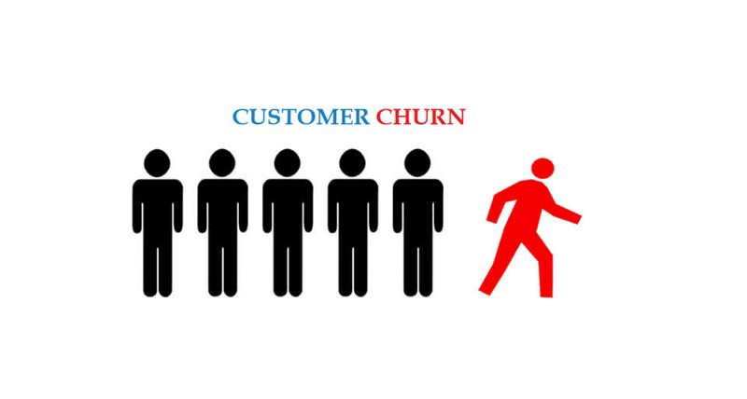
Introduction :
Customer Defection
Defection is the process of customers switching from one firm to another in given time. Retaining the existing customers is more profitable than fetching the new customers.
The Companies concentrate to the extant customers to avert defection. A defection prediction model is needed to predict the defectors.

Slide 4
Introduction
The fast growth of marketplace in every business is giving rise to increased subscriber base. Accordingly, companies have recognized the significance of retaining the customers who is on hand.
It has become necessary for service-providers to reduce the defection rate of customers since the inattention might negatively influence profitability of the company.
Defection prediction contributes to identify those users who are likely to switch a company over another. The dataset used for customer defection is of telecom industry. It is collected from www.ibm.com that contains customer and service information for telecom industry.
4

Slide 5
Problem Statement
Using the data provided, this project aims to analyze the data to determine what variables are correlated with customer defection .
We examines customer data from Customer Data Sets with the aim of building and comparing several customer defection prediction models.
To find out the Machine Learning Algorithm model for Predicting Customer Defection to give maximum accuracy.
5

Slide 6
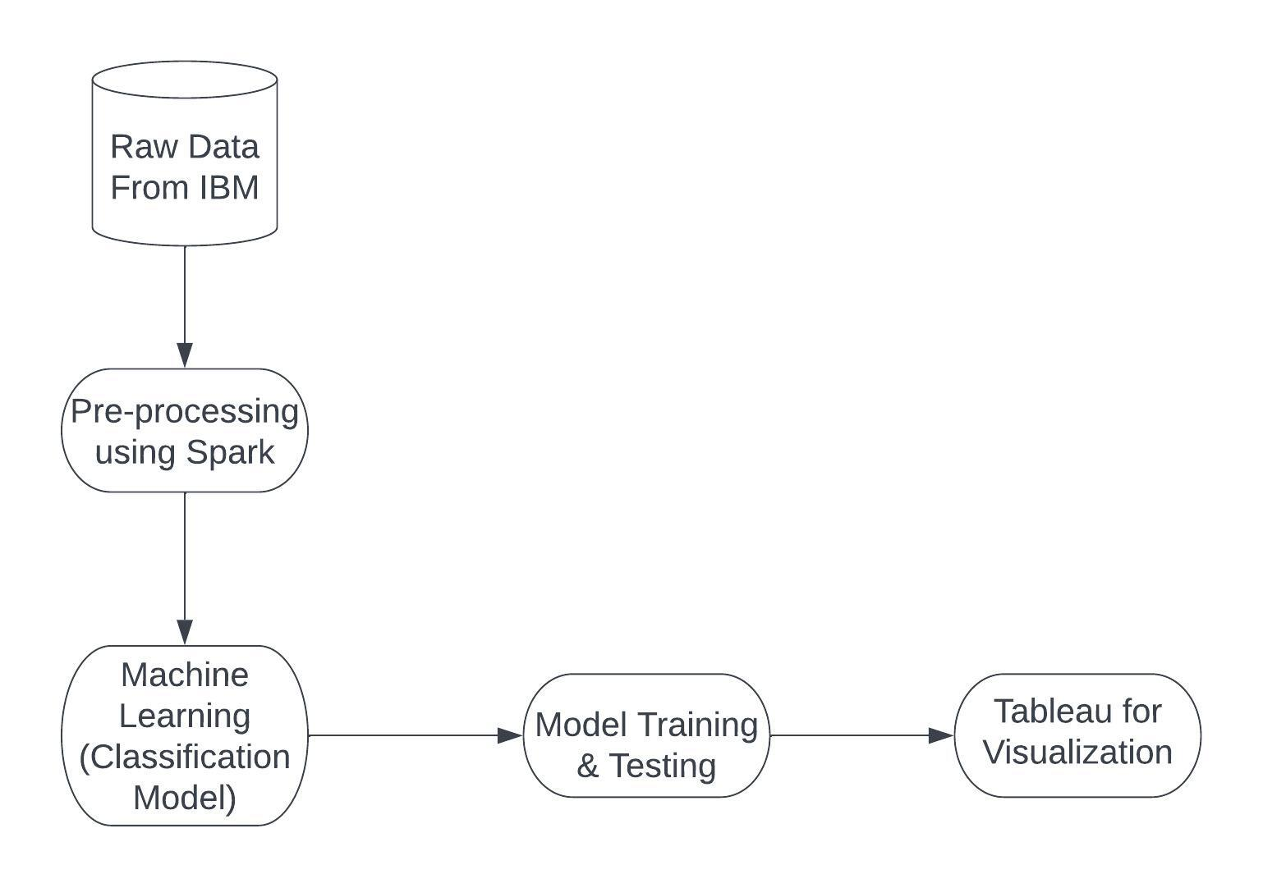
System Architecture
Fig: System Architecture of Telecom Customer Defection Data
6

Slide 7
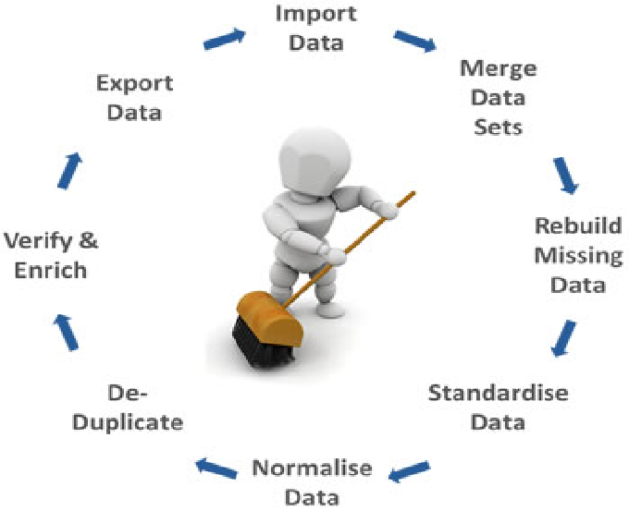
Data Pre-Processing :
Missing values
Missing values in the Total Charges columns are replaced with “mean” of that column.
7

Slide 8
Methodology :
Data Used :
Telecom Customer Defection Dataset
Data Filtering :
Cleaned & transformed the data in the format we can access it
Machine Learning Used :
Logistic Regression, Random Forest, Decision Tree, GaussianNB, GBT Classifier
Visualizing the Data :
Visualised the data using Tableau
Fig: Process of Analyzing And Predicting Telecom Customer Defection
8

Slide 9
Machine Learning Algorithms
Logistic Regression:
Logistic regression is a classification algorithm used to assign observations to a discrete set of classes. Some of the examples of classification problems are Email spam or not spam, Online transactions Fraud or not Fraud, Tumor Malignant or Benign. And we use this for data surety.
2. Decision Tree Classifier:
It is a tree-structured classifier, where internal nodes represent the features of a dataset, branches represent the decision rules and each leaf node represents the outcome.
In a Decision tree, there are two nodes, which are the Decision Node and Leaf Node. Decision nodes are used to make any decision and have multiple branches, whereas Leaf nodes are the output of those decisions and do not contain any further branches.
3. GBT Classifier:
GBT stands for Gradient Boosted Trees, which is a type of ensemble machine learning algorithm that combines multiple decision tree models to make predictions. In GBT, each decision tree model is trained on the residuals (or errors) of the previous model, with the aim of reducing the overall prediction error.
.
9

Slide 10
4. Random Forest:
A random forest is a machine learning technique that's used to solve regression and classification problems.
It utilizes ensemble learning, which is a technique that combines many classifiers to provide solutions to complex problems. A random forest algorithm consists of many decision trees
5. Gaussian NB Classifier:
A Gaussian NB Classifier is a type if Naïve Bayes Classifier, which is probabilistic algorithm used for classification task.
The classifier assumes that the features are normally distributed and calculates the probability of a sample belonging to a particular class based on the mean and variance of each feature in that class.

Slide 11
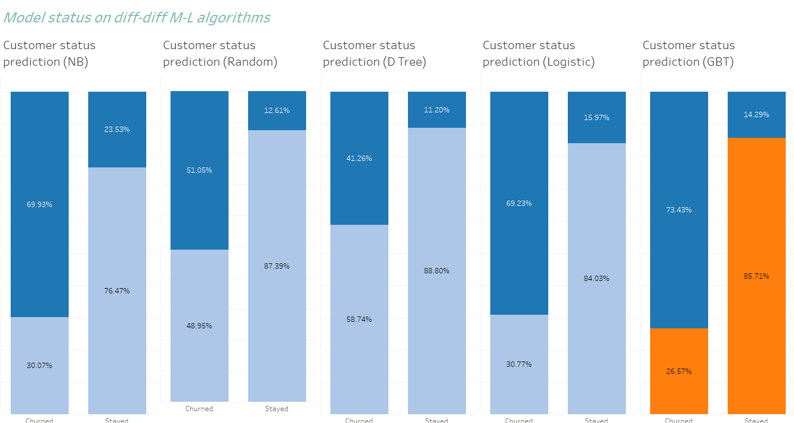

Slide 12
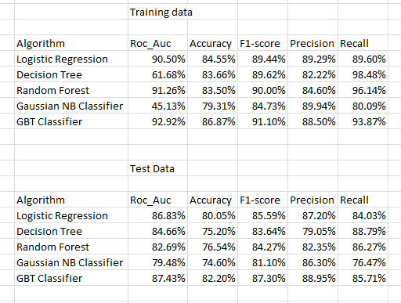

Slide 13
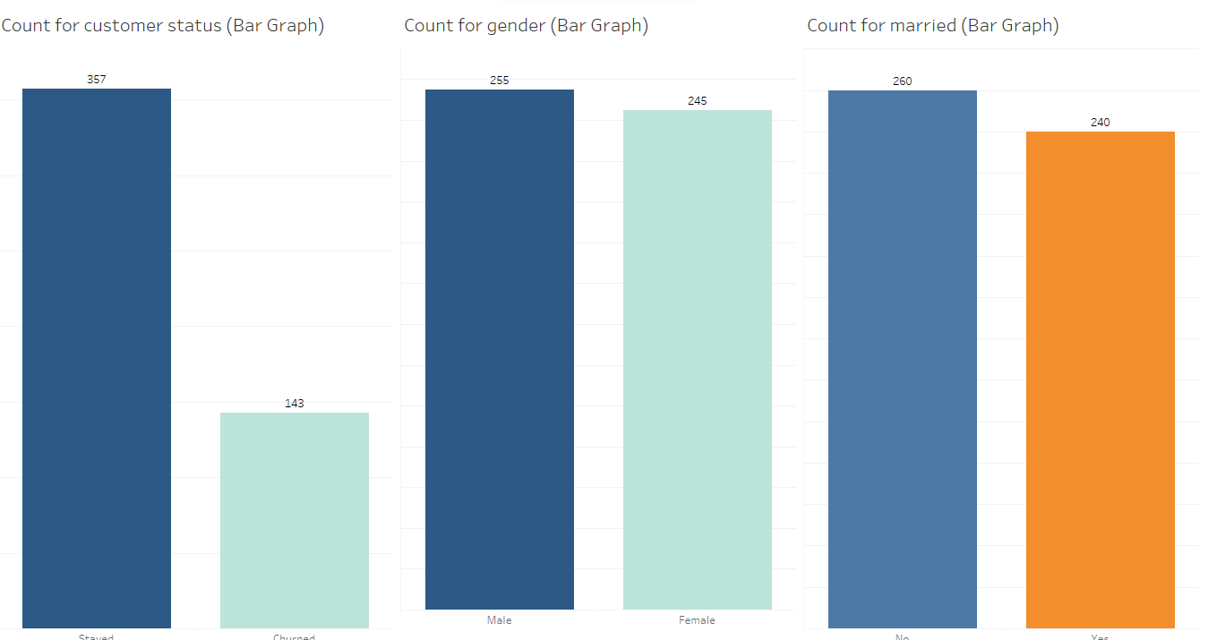
Fig.: Customer Category (Partner, Gender, Senior Citizen, Dependents) Defection Percentage

Slide 14
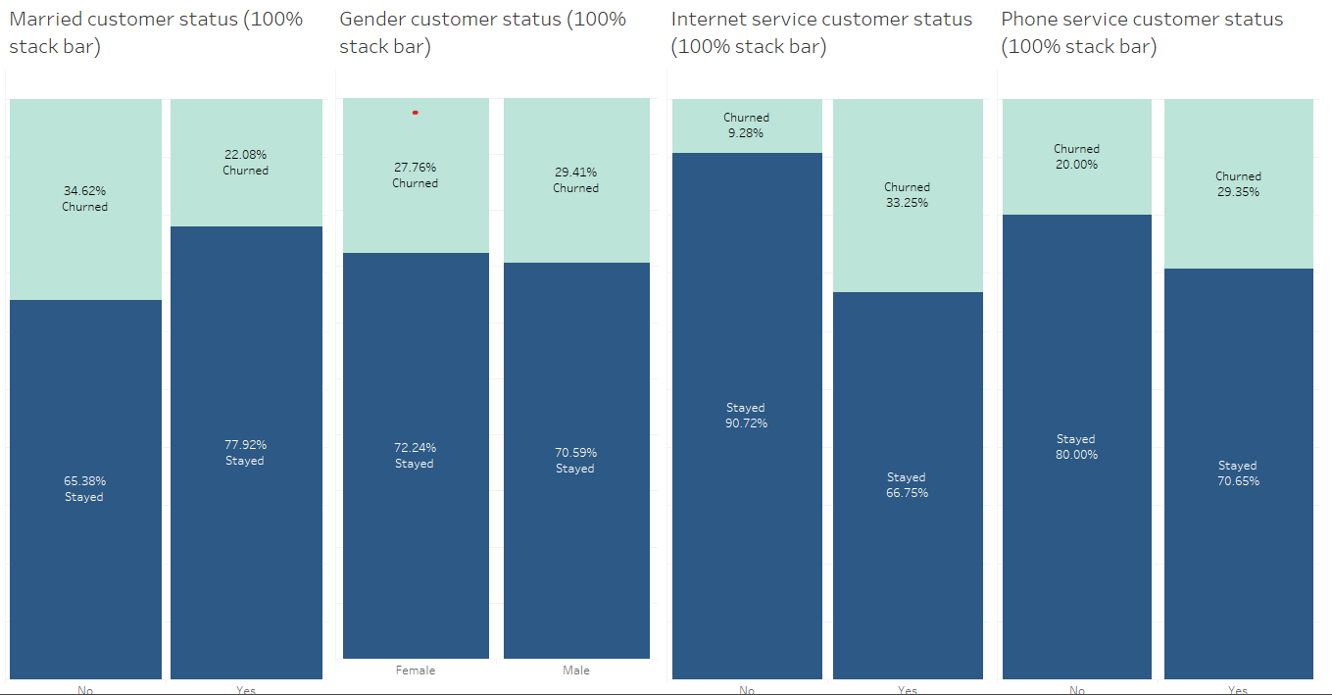
Fig.: Gender By Contract Defection Analysis

Slide 15
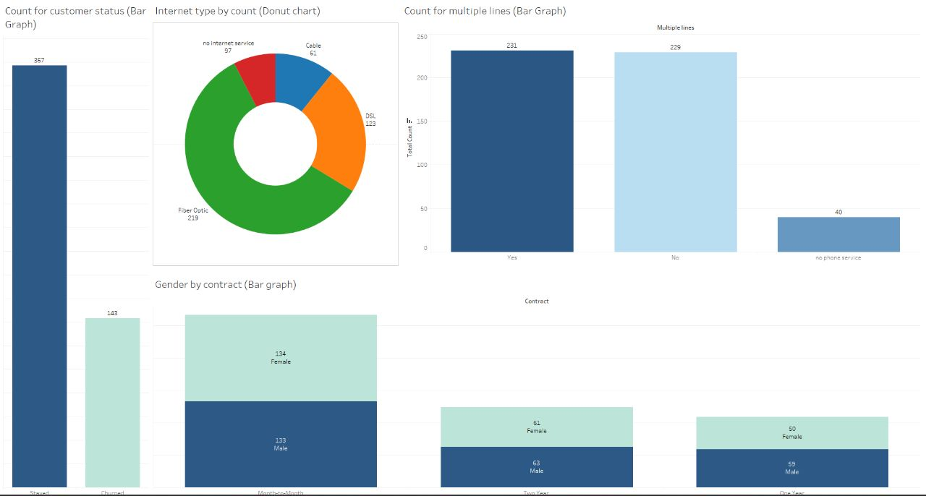
Fig.: Tenure and Defection Analysis

Slide 16
Insights from Graphs
High Churn seen in case of month to month contracts, No online security, First year of subscription and Fiber Optics Internet.
Low Churn is seen in case of Long term contracts, Subscriptions without internet service.
Factors like Gender, Availability of Phone Service and multiple lines have almost No impact on Churn
Electronic check medium are the highest churners
Contract Type - Monthly customers are more likely to churn because of no contract terms, as they are free to go customers.
No Online security, Non senior Citizens are high churners

Slide 17
Conclusion :
Telecom customer defection is a central issue
Various classification models are used to predict telecom defection
The results of this project will give us the ability to predict customer behavior and loss accurately.
The findings will help companies reduce costs and optimize their budgets.
17

Slide 18
Future Scope :
On the given data and best machine learning model we can build a GUI where we can predict which new customer or the existing customer is more likely to defect.
We can also build a Recommendation system where we can give better offers to those customers who are more likely to defect.
We can perform Customer segmentation on the given data and can predict who are loyal customers and who are not.

Slide 19

19

