Slide 1
MADHAV INSTITUTE OF TECHNOLOGY & SCIENCE, GWALIOR
Cornerstone Project Lab | Final Evaluation & Project Expo
AI Chatbot for Academic and
College Information Services
A date-aware RAG help desk for the IT Department and college-wide information
Shahid Khan (BTIT24O1124)
Vaibhav Bansal (BTIT25O3D06)
Mentor: Ms. Aradhana Saxena, Asst. Professor
B.Tech IT, 5th Semester | Session 2026–27
Category: AI & ML Systems | SDG 4: Quality Education | SDG 9: Industry, Innovation and Infrastructure
Notes:
Introduce yourselves and the guide. One line: we built a chatbot that answers IT department questions from the official website and always shows the source.

Slide 2
The Problem
• Students keep asking the same things: exam dates, syllabus, time table, faculty
• The answers are already on the IT department website, but spread over many pages, PDFs and Drive links
• No search inside PDFs, so finding one detail takes many clicks
• Faculty and office staff answer the same questions again and again
• ChatGPT-like bots don't know our college and can make up answers
"Mid sem kab se hai?"
"5th sem syllabus kahan milega?"
"Who is the HOD of IT?"
"DBMS lab kis din hai?"
Typical questions we see in class groups
AI Chatbot for Academic and College Information Services
2
Notes:
Explain from our own experience as students of this department.

Slide 3
Objectives
1
Answer questions
Build a chatbot for IT department students that answers academic and department questions
2
Use official content only
Use RAG so answers come from the department website and uploaded documents, not guesses
3
Show the source
Every answer links to the page or PDF it came from, so students can verify it
4
Easy for staff
Admin panel to upload/remove documents and see usage and 👍/👎 feedback, without storing questions
5
Measure it
66 graded test questions and 105 automated tests: accuracy, refusals, response time
AI Chatbot for Academic and College Information Services
3

Slide 4
Existing Systems and Their Gaps
Existing approach | Limitation
College website / notice board | Information is scattered, no search inside PDFs
Asking faculty / office | Only during college hours, same questions repeated
WhatsApp groups | Messages get buried, old or wrong info gets forwarded
Rule-based FAQ bots (AIML, Dialogflow) [4] | Every answer written by hand, fails on differently worded questions
General AI chatbots (ChatGPT, Gemini) | Don't know our college, can hallucinate, no source shown [5]
Our approach: RAG [1]. Search official content first, then let the AI write the answer only from what was found, and show the source.
AI Chatbot for Academic and College Information Services
4

Slide 5
How It Works
Student asks
English / Hindi / Hinglish
Understand it
semester · batch · follow-ups
Hybrid search
BM25 + FAISS + re-ranker
AI writes answer
newest dated source wins
Answer + source
link to page / PDF
Before this, done once (and again whenever content changes):
Crawl MITS website
IT dept + college-wide pages
Extract text + OCR
scanned PDFs read too
Date + chunk
~900 chars, each one dated
Embed & store
multilingual e5 + BM25
If the answer is not in the retrieved text, the bot is told to say so instead of guessing.
AI Chatbot for Academic and College Information Services
5
Notes:
RAG = Retrieval-Augmented Generation. Retrieval: find the right text. Generation: AI writes the answer from that text.

Slide 6
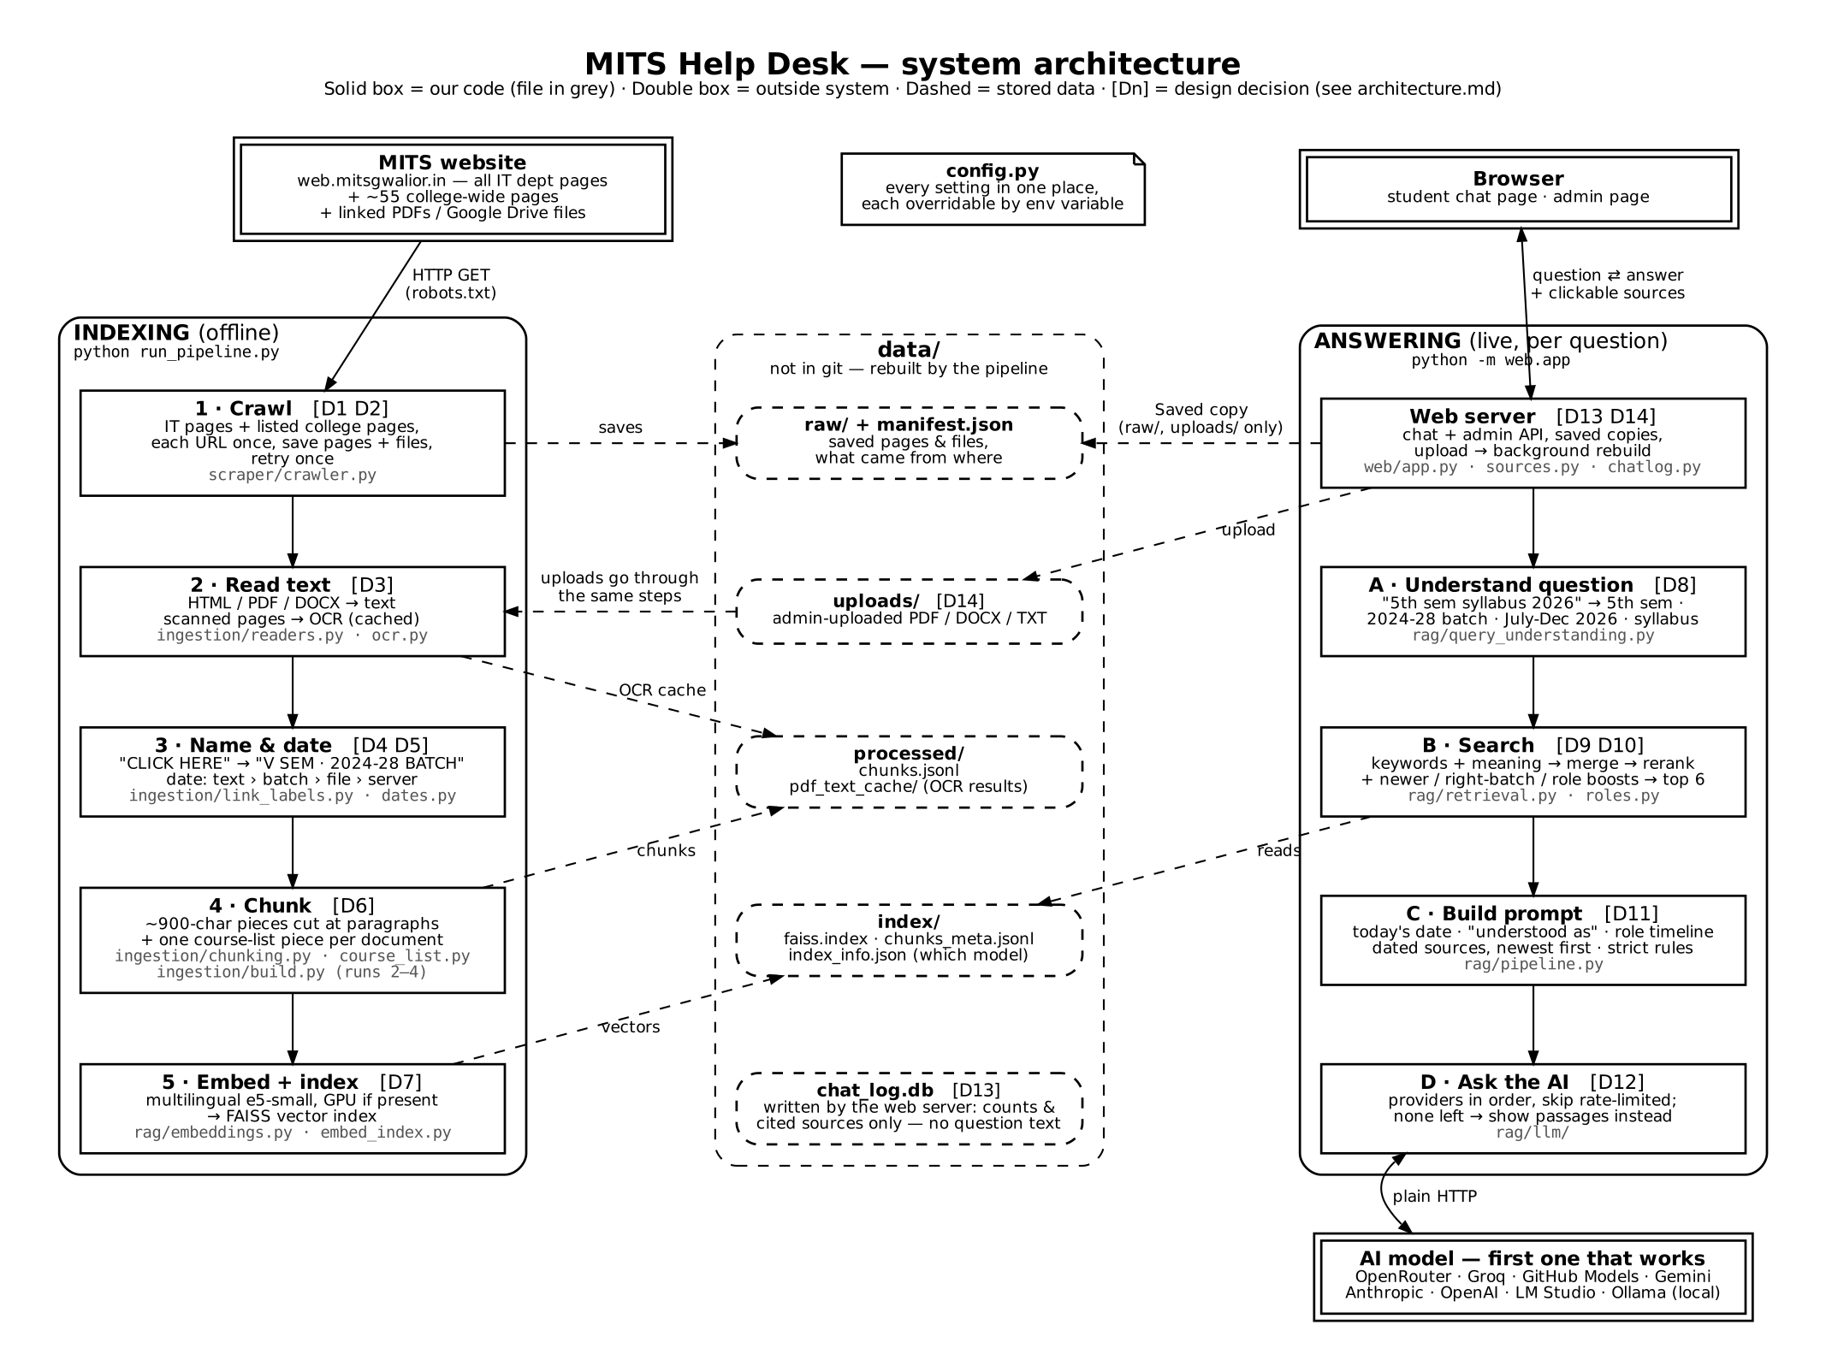
System Architecture
Indexing (offline) and answering (live) share one data folder; tags like [D3] point to the 22 recorded design decisions.
AI Chatbot for Academic and College Information Services
6

Slide 7
Data Collection: Scope-Limited Crawler
• Starts at the IT department page on web.mitsgwalior.in
• Follows only department links (URL prefix + department sidebar menu)
• Never leaves web.mitsgwalior.in; also ~55 college-wide pages (rules, fees, exams, hostels)
• Visits every URL once so link loops can't cause an endless crawl
• Downloads PDFs, images and public Google Drive files (time tables)
• Respects robots.txt with a delay between requests and a 500-page cap
• Saves a manifest of everything collected and where it came from
Web pages
cleaned HTML → text
PDF / Word files
pypdf; scanned pages read with OCR
Images / media
stored + described so they can be cited
AI Chatbot for Academic and College Information Services
7

Slide 8
Modules and Status
Module | What it does | Status
Web crawler | Collects department pages and linked files | Done
Document processing | HTML / PDF text, OCR, dates, chunks | Done
Embedding + hybrid index | Meaning (FAISS) + keywords (BM25) | Done
Retrieval + answer generation | Groq first, automatic fallback to backups | Done
Student chat interface | Sources, live progress, follow-ups, 👍/👎 | Done
Admin panel | Upload / remove documents, usage stats | Done
Usage log | Counts + sources only, never question text | Done
Admin authentication | Password for upload / delete | Done
Evaluation on test questions | 66 questions: 62/66, fixes 24/24 | Done
Deployment | One-command setup on any laptop (CPU) | Done
AI Chatbot for Academic and College Information Services
8

Slide 9
Tech Stack
Part | Planned (Milestone 1) | Used now | Why we changed
Language | JavaScript (Node.js) | Python 3.11 | Best libraries for embeddings and vector search
Backend | Express.js | Flask | Same role, Python-based
Frontend | React.js | HTML + CSS + JavaScript | Two simple pages, no build step needed
Vector DB | Pinecone | FAISS (local) | Free, runs offline, no account needed
Database | MongoDB | SQLite + JSON files | Usage counts + feedback, no questions
Document reading | pdf-parse, mammoth | pypdf, BeautifulSoup | Python equivalents
LLM | LLM API | Groq (gpt-oss) + automatic backups | Can switch with one setting
We switched to Python early on: embeddings, FAISS, OCR and re-rankers are all Python-first.
AI Chatbot for Academic and College Information Services
9
Notes:
Be upfront: we moved to Python while building because sentence-transformers and FAISS are Python-first. Design from Milestone 2 is unchanged.

Slide 10
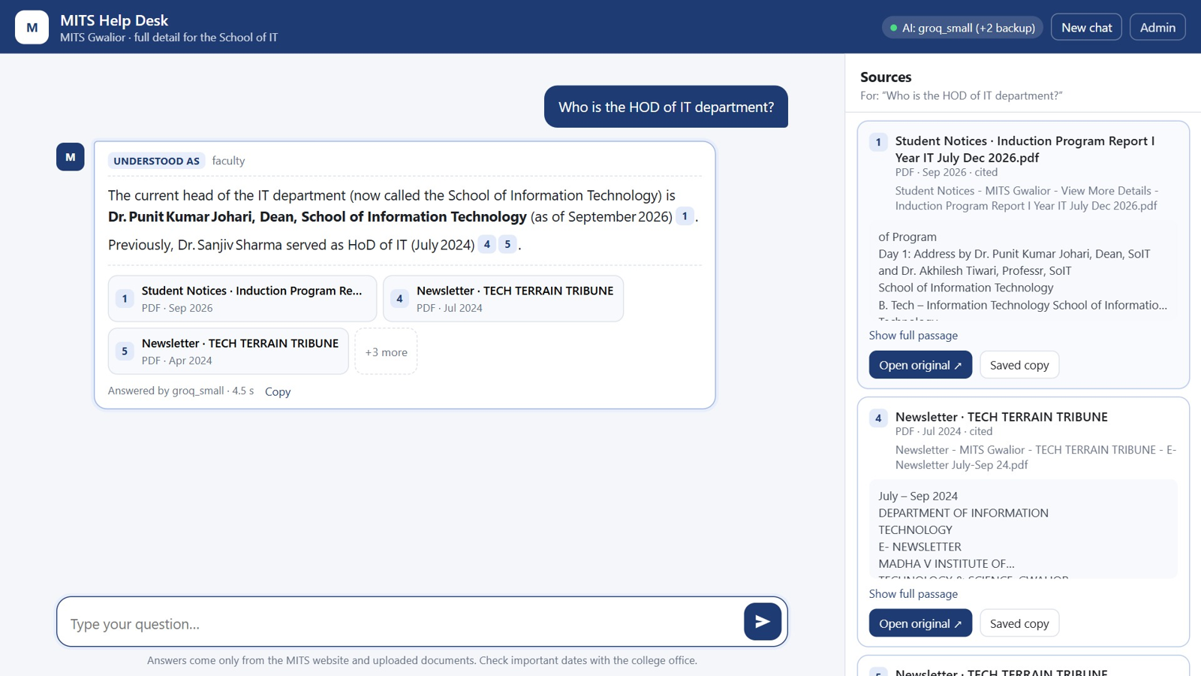
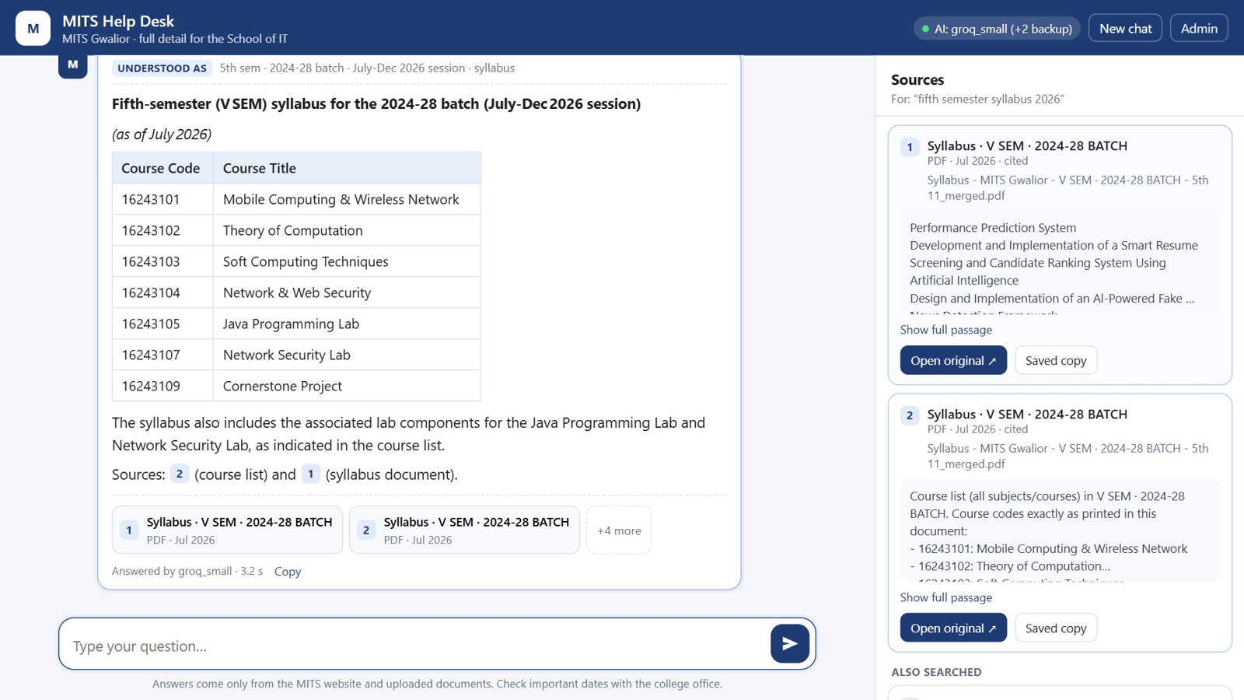
What We Built
"Who is the HOD?": the current Dean, with every source it used
"fifth semester syllabus 2026": the right batch, exact course codes
Also: Hinglish questions, follow-ups, honest "I don't know". Admin panel: documents, uploads, usage, feedback.
AI Chatbot for Academic and College Information Services
10

Slide 11
Testing and Evaluation
Done
66 graded test questions
• 105 automated tests (pytest), all passing
• Crawler scope, OCR cache, dates and chunks
• Search ranking, batches, whole documents
• Follow-ups and the AI fallback chain
• Web API: questions, streaming, uploads, feedback
Metric | Result
Overall score | 43/55 → 62/66; then 24/24
Follow-up questions | 3 / 3
Sources | Every answer cites [n]
Refusal | Says "don't know" off-topic
Response time | Median 5.4 s (Groq)
English + Hinglish questions, graded against the real crawled data; failures read by hand.
AI Chatbot for Academic and College Information Services
11

Slide 12
Timeline
Week 1–2
Week 3–4
Week 5–6
Week 7–8
Week 9–10
Problem identification, literature survey
Requirement analysis, system design
Crawler, processing, RAG pipeline
Chat UI, admin panel, testing
Evaluation, fixes, documentation, final report
Done
Done
Done
Done
Done
AI Chatbot for Academic and College Information Services
12

Slide 13
Limitations and Future Work
Current limitations
Future work
• Only as up to date as the last crawl
• Other departments not covered yet
• Free AI limits (per minute / per day)
• Needs internet for AI answers
• Partly scanned pages: fix ready, not re-indexed
• All departments of MITS
• Help widget on website / AMS / SDMS
• College-hosted AI model
• Automatic weekly re-crawl
• WhatsApp / Telegram bot
• Voice questions in Hindi / Hinglish
AI Chatbot for Academic and College Information Services
13

Slide 14
References
[1] P. Lewis et al., "Retrieval-augmented generation for knowledge-intensive NLP tasks," NeurIPS, 2020.
[2] N. Reimers and I. Gurevych, "Sentence-BERT: Sentence embeddings using Siamese BERT-networks," EMNLP-IJCNLP, 2019.
[3] J. Johnson, M. Douze, and H. Jégou, "Billion-scale similarity search with GPUs," IEEE Trans. Big Data, 2021.
[4] B. R. Ranoliya, N. Raghuwanshi, and S. Singh, "Chatbot for university related FAQs," ICACCI, 2017.
[5] Z. Ji et al., "Survey of hallucination in natural language generation," ACM Computing Surveys, 2023.
[6] W. Wang et al., "MiniLM: Deep self-attention distillation ...," NeurIPS, 2020.
[7] Department of IT, MITS Gwalior. web.mitsgwalior.in/academics/departments/information-technology
[8] S. Robertson and H. Zaragoza, "The probabilistic relevance framework: BM25 and beyond," Found. Trends Inf. Retr., 2009.
[9] G. V. Cormack, C. L. A. Clarke, and S. Büttcher, "Reciprocal rank fusion outperforms Condorcet ...," SIGIR, 2009.
[10] L. Wang et al., "Multilingual E5 text embeddings: A technical report," arXiv:2402.05672, 2024.
AI Chatbot for Academic and College Information Services
14

Slide 15
Thank You
Questions?
Shahid Khan · Vaibhav Bansal

