Slide 1
MADHAV INSTITUTE OF TECHNOLOGY & SCIENCE, GWALIOR
Cornerstone Project Lab | Minor Evaluation
AI Chatbot for Academic and
College Information Services
A RAG-based help desk for the IT Department
Shahid Khan (BTIT24O1124)
Vaibhav Bansal (BTIT25O3D06)
Mentor: Ms. Aradhana Saxena, Asst. Professor
B.Tech IT, 5th Semester | Session 2026–27
Category: AI & ML Systems | SDG 4: Quality Education | SDG 9: Industry, Innovation and Infrastructure
Notes:
Introduce yourselves and the guide. One line: we built a chatbot that answers IT department questions from the official website and always shows the source.

Slide 2
The Problem
• Students keep asking the same things: exam dates, syllabus, time table, faculty
• The answers are already on the IT department website, but spread over many pages, PDFs and Drive links
• No search inside PDFs, so finding one detail takes many clicks
• Faculty and office staff answer the same questions again and again
• ChatGPT-like bots don't know our college and can make up answers
"Mid sem kab se hai?"
"5th sem syllabus kahan milega?"
"Who is the HOD of IT?"
"DBMS lab kis din hai?"
Typical questions we see in class groups
AI Chatbot for Academic and College Information Services
2
Notes:
Explain from our own experience as students of this department.

Slide 3
Objectives
1
Answer questions
Build a chatbot for IT department students that answers academic and department questions
2
Use official content only
Use RAG so answers come from the department website and uploaded documents, not guesses
3
Show the source
Every answer links to the page or PDF it came from, so students can verify it
4
Easy for staff
Admin panel to upload/remove documents and see what students ask
5
Measure it
Evaluate retrieval accuracy, answer correctness and response time
AI Chatbot for Academic and College Information Services
3

Slide 4
Existing Systems and Their Gaps
Existing approach | Limitation
College website / notice board | Information is scattered, no search inside PDFs
Asking faculty / office | Only during college hours, same questions repeated
WhatsApp groups | Messages get buried, old or wrong info gets forwarded
Rule-based FAQ bots (AIML, Dialogflow) [4] | Every answer written by hand, fails on differently worded questions
General AI chatbots (ChatGPT, Gemini) | Don't know our college, can hallucinate, no source shown [5]
Our approach: RAG [1]. Search official content first, then let the AI write the answer only from what was found, and show the source.
AI Chatbot for Academic and College Information Services
4

Slide 5
How It Works
Student asks
English / Hindi / Hinglish
Question → vector
MiniLM embedding model
Find top-5 chunks
FAISS similarity search
AI writes answer
only from those chunks
Answer + source
link to page / PDF
Before this, done once (and again whenever content changes):
Crawl IT dept website
pages + PDFs + Drive files
Extract & clean text
HTML, PDF, DOCX
Split into chunks
~1000 characters each
Embed & store
FAISS vector index
If the answer is not in the retrieved text, the bot is told to say so instead of guessing.
AI Chatbot for Academic and College Information Services
5
Notes:
RAG = Retrieval-Augmented Generation. Retrieval: find the right text. Generation: AI writes the answer from that text.

Slide 6
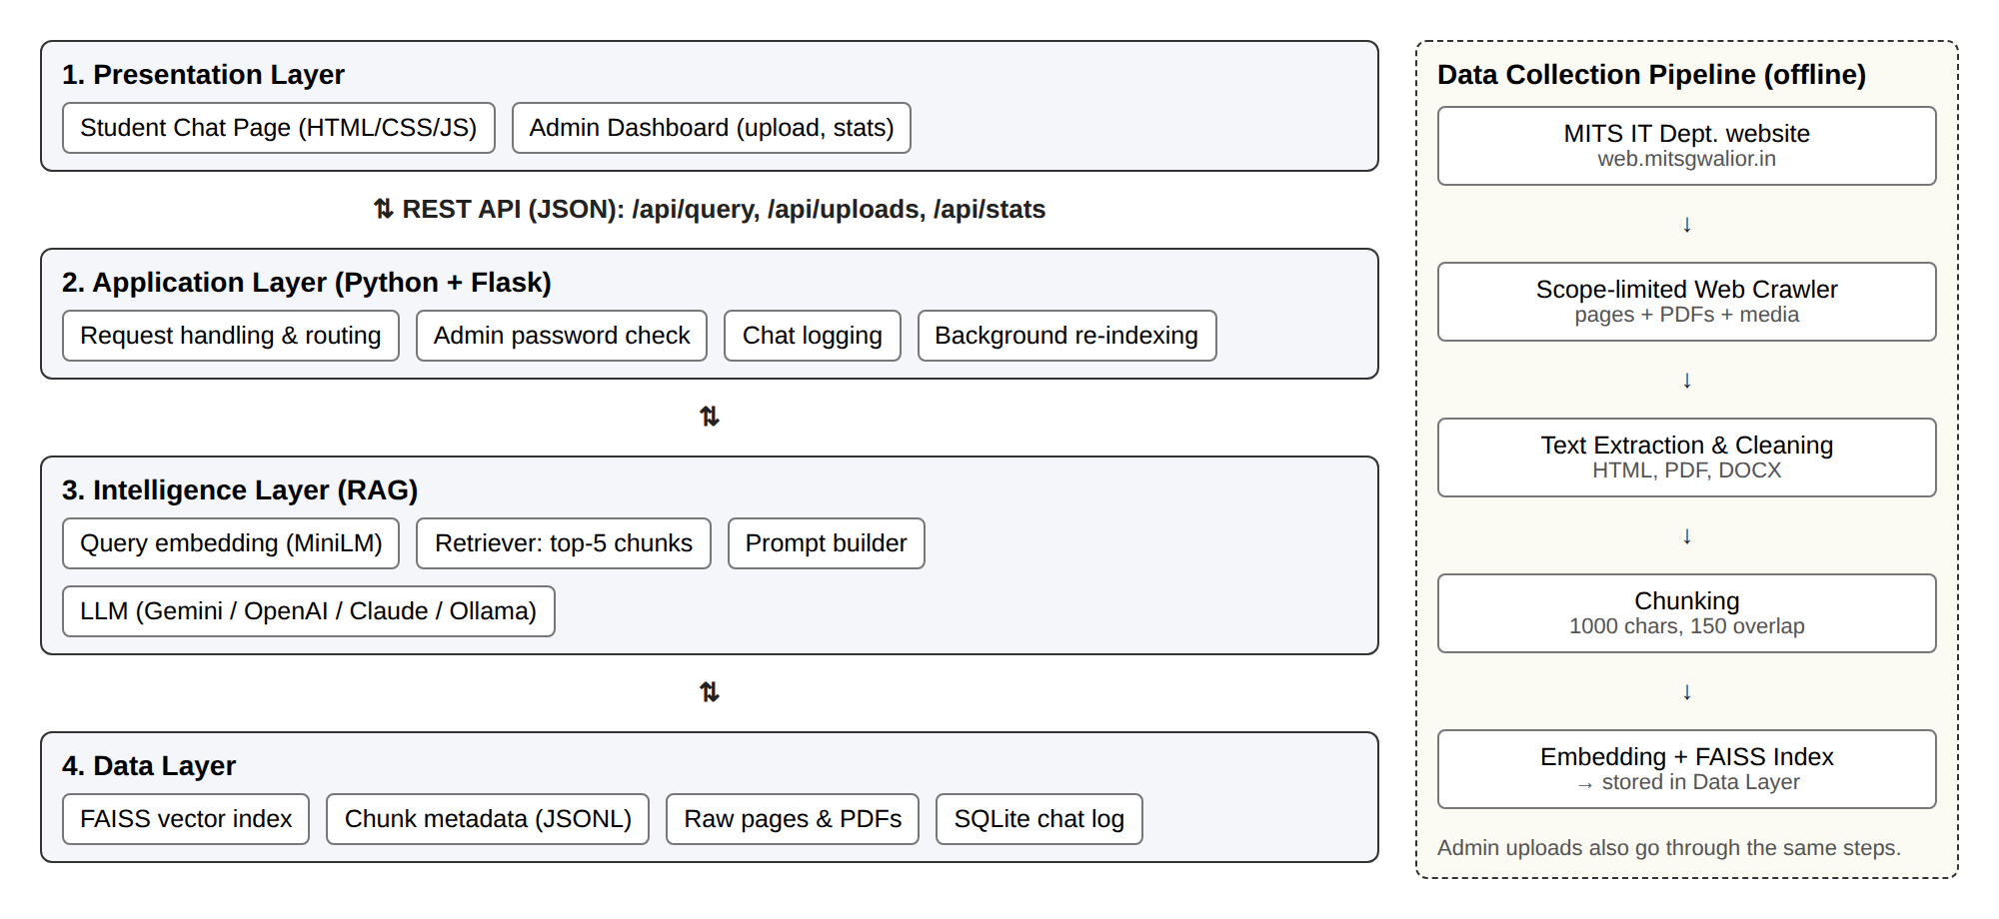
System Architecture
Same 4-layer design as Milestone 2: each layer only talks to the one next to it.
AI Chatbot for Academic and College Information Services
6

Slide 7
Data Collection: Scope-Limited Crawler
• Starts at the IT department page on web.mitsgwalior.in
• Follows only department links (URL prefix + department sidebar menu)
• Never leaves the college domain, ignores site-wide header/footer links
• Visits every URL once so link loops can't cause an endless crawl
• Downloads PDFs, images and public Google Drive files (time tables)
• Respects robots.txt with a delay between requests and a 500-page cap
• Saves a manifest of everything collected and where it came from
Web pages
cleaned HTML → text
PDF / Word files
text extracted with pypdf
Images / media
stored + described so they can be cited
AI Chatbot for Academic and College Information Services
7

Slide 8
Modules and Current Progress
Module | What it does | Status
Web crawler | Collects department pages and linked files | Done
Document processing | HTML / PDF / DOCX text, chunking | Done
Embedding + FAISS index | Makes content searchable by meaning | Done
Retrieval + answer generation | RAG with Gemini / OpenAI / Claude / Ollama | Done
Student chat interface | Chat page with source tags | Done
Admin panel | Upload / remove documents, usage stats | Done
Chat history | Every question logged (SQLite) | Done
Admin authentication | Password for upload / delete | Basic
Evaluation on test questions | Accuracy + response time | In progress
Cloud deployment | Host online for students | Planned
AI Chatbot for Academic and College Information Services
8

Slide 9
Tech Stack
Part | Planned (Milestone 1) | Used now | Why we changed
Language | JavaScript (Node.js) | Python 3.10+ | Best libraries for embeddings and vector search
Backend | Express.js | Flask | Same role, Python-based
Frontend | React.js | HTML + CSS + JavaScript | Two simple pages, no build step needed
Vector DB | Pinecone | FAISS (local) | Free, runs offline, no account needed
Database | MongoDB | SQLite + JSON files | Enough for chat logs at this stage
Document reading | pdf-parse, mammoth | pypdf, BeautifulSoup | Python equivalents
LLM | LLM API | Gemini / OpenAI / Claude / Ollama | Can switch with one setting
The architecture and modules stayed the same; only the tools changed.
AI Chatbot for Academic and College Information Services
9
Notes:
Be upfront: we moved to Python while building because sentence-transformers and FAISS are Python-first. Design from Milestone 2 is unchanged.

Slide 10
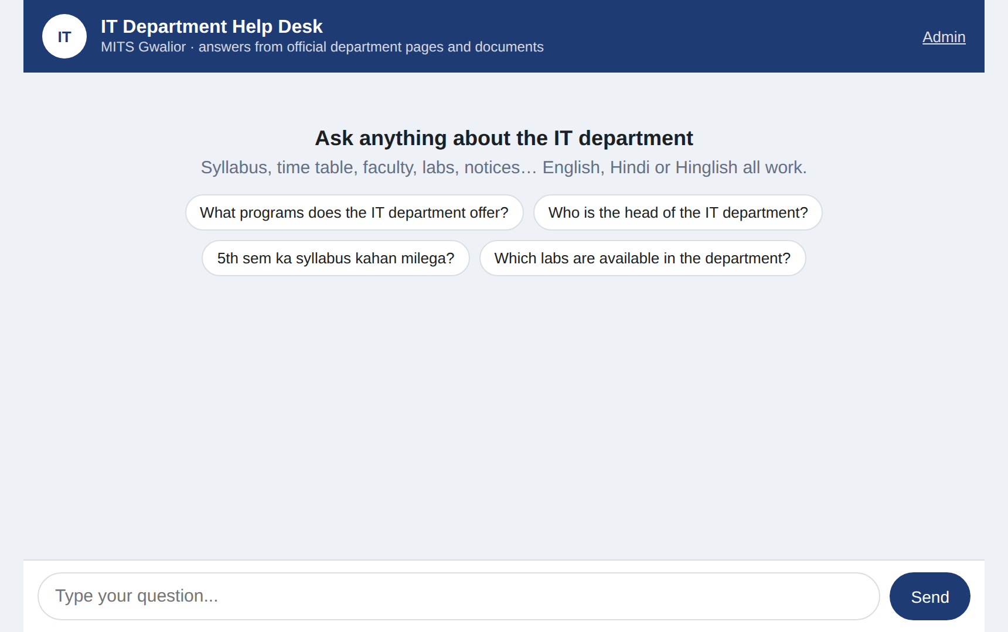
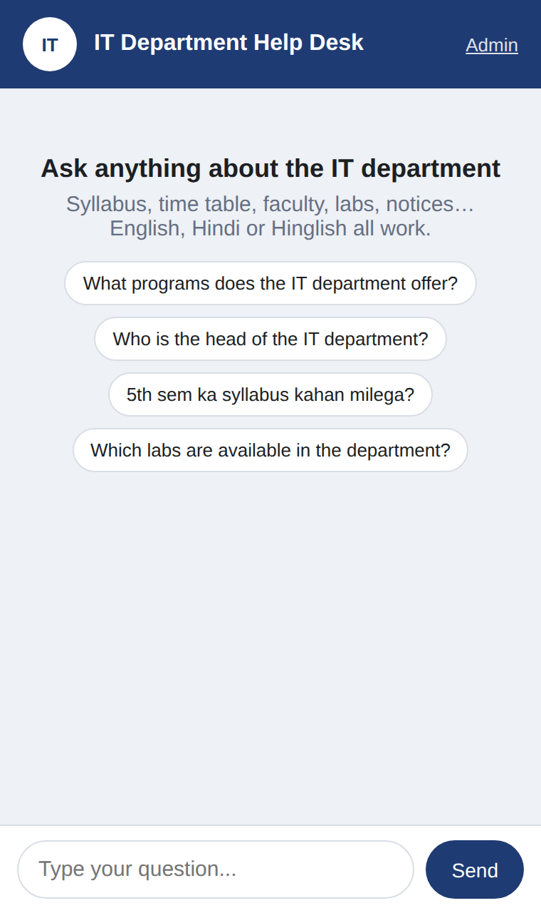
What We Built
Student chat page: every answer shows its source
Same page on a phone
Admin panel at /admin: upload / remove documents, usage stats. Live demo: python -m web.app
AI Chatbot for Academic and College Information Services
10

Slide 11
Testing and Evaluation
Done
Next: evaluation
• 16 automated tests (pytest), all passing
• Crawler never leaves scope and never visits a page twice
• Text extraction and chunking
• Uploaded document indexing
• Web API: questions, uploads, wrong password
Metric | How we measure
Retrieval accuracy | Right chunk in top 5? (Hit@5)
Answer correctness | Correct / partly / wrong
Source correctness | Cited page has the answer?
Refusal | Says "don't know" when off-topic
Response time | Logged per question, target < 5 s
On ~50 real questions (English + Hinglish) with known answers.
AI Chatbot for Academic and College Information Services
11

Slide 12
Timeline
Week 1–2
Week 3–4
Week 5–6
Week 7–8
Week 9–10
Problem identification, literature survey
Requirement analysis, system design
Crawler, processing, RAG pipeline
Chat UI, admin panel, testing
Evaluation, documentation, final PPT
Done
Done
Done
Done
In progress
AI Chatbot for Academic and College Information Services
12

Slide 13
Limitations and Future Work
Current limitations
Future work
• Only as up to date as the website
• Scanned PDFs can't be read (no OCR)
• Hindi search is weaker (English embedding model)
• No ERP / attendance / result data
• Text only, no voice
• All departments of MITS
• OCR for scanned notices
• Multilingual embedding model
• Automatic weekly re-crawl
• WhatsApp / Telegram bot
• Host online for all students
AI Chatbot for Academic and College Information Services
13

Slide 14
References
[1] P. Lewis et al., "Retrieval-augmented generation for knowledge-intensive NLP tasks," NeurIPS, 2020.
[2] N. Reimers and I. Gurevych, "Sentence-BERT: Sentence embeddings using Siamese BERT-networks," EMNLP-IJCNLP, 2019.
[3] J. Johnson, M. Douze, and H. Jégou, "Billion-scale similarity search with GPUs," IEEE Trans. Big Data, 2021.
[4] B. R. Ranoliya, N. Raghuwanshi, and S. Singh, "Chatbot for university related FAQs," ICACCI, 2017.
[5] Z. Ji et al., "Survey of hallucination in natural language generation," ACM Computing Surveys, 2023.
[6] W. Wang et al., "MiniLM: Deep self-attention distillation ...," NeurIPS, 2020.
[7] Department of IT, MITS Gwalior. web.mitsgwalior.in/academics/departments/information-technology
AI Chatbot for Academic and College Information Services
14

Slide 15
Thank You
Questions?
Shahid Khan · Vaibhav Bansal

