Slide 1

DYNASWARM
Volatility-Driven Compute Allocation in
Hybrid Swarm Metaheuristics
for Dynamic Path Optimisation
Vaibhav Krishna Bansal · Rudra Rajpurohit · Kartikey Goyal · Pavit Agrawal
Mentor: Mrs. Vidhya V | School of Computer Engineering, MIT Manipal (MAHE)
Minor Project · 2026

Slide 2
INTRODUCTION
Why does routing need intelligence?
• Road networks change continuously: closures, traffic spikes, link additions
• Classical routing (GPS, Dijkstra) recomputes from scratch — exact but expensive at scale
• Swarm algorithms maintain a population that learns over time — but parameters must be tuned
• A fixed parameter setting cannot adapt when disruption rate changes mid-trial

Slide 3

INTRODUCTION
The Core Tension Every Swarm Algorithm Faces
EXPLOIT
EXPLORE
Refine what looks good
Fast convergence
Blind to change
Keep sampling
Adapts to change
Wastes effort when stable
The optimal balance shifts with how fast the environment is changing.

Slide 4
INTRODUCTION
One Question, Rigorously Answered
"When searching for shortest paths through a dynamically disrupted network, does automatically
retuning the algorithm's exploration–exploitation parameters in real time beat a carefully
tuned static configuration?"
• Four algorithms: A*, MAX-MIN ACO, Priority-Vector PSO, Hybrid ACO-PSO
• Adaptive controller that senses volatility and adjusts parameters/budget allocation
• 400 independent trials · Wilcoxon signed-rank · Holm correction · Cliff's δ effect size
• Pre-materialised shared world — no arm gets an easier graph than another

Slide 5
PROBLEM STATEMENT
Dynamic Shortest Path Problem (DSPP)
Network modelled as a dynamic weighted graph:
G⁽ᵗ⁾ = (V, E⁽ᵗ⁾, w⁽ᵗ⁾) — fixed vertices, changing edges and weights
Goal: at each timestep t, find path π⁽ᵗ⁾ from source s to target q minimising total cost c(π).
Primary quality metric — Excess over the moving optimum:
ε⁽ᵗ⁾ = c(π̂⁽ᵗ⁾) / c*(G⁽ᵗ⁾) − 1 ≥ 0
Raw path cost is not comparable across timesteps — the network gets cheaper or costlier.
Normalising against the moving optimum (A* recomputed each step) removes that confound.
A* scores exactly 0.0% excess by construction — it IS the denominator.

Slide 6
PROBLEM STATEMENT
Why Existing Algorithms Fail Under Dynamic Conditions
A* / Dijkstra
ACO
PSO
Memory
None
Pheromone trails
Particle positions
On disruption
Full re-search
Trail goes STALE
Swarm CONVERGED
Cost
Grows with |V|, |E|
Fixed budget
Fixed budget
Adaptability
None
Slow (depends on ρ)
Low (no edge memory)
Neither pure method handles the transition window after a disruption well.

Slide 7
PROBLEM STATEMENT
The Research Gap & Hypothesis
What's known:
What's NOT tested:
• Parameter quality matters enormously — Stützle et al. (2000)
• Budget allocation between components as a sensing-driven variable
• Online adaptation yields negligible gain over a well-tuned fixed setting
• Joint control of signal choice, controller design, and statistical fairness
• Most studies use small graphs where pheromone is nearly irrelevant
• Recency-driven PSO↔ACO split immediately after a disruption
Project Hypothesis:
In a hybrid metaheuristic, the allocation of compute between exploration and exploitation components should be driven by measured environmental volatility — not parameter values.

Slide 8
LITERATURE SURVEY
Foundations: Core Algorithms
Paper / Authors
Key Contribution
How Dynaswarm Uses It
Dorigo, Maniezzo & Colorni (1996)
Ant System
Original ACO: pheromone-based collective memory for combinatorial optimisation
Base for MAX-MIN ACO; pheromone trail ∝ τᵅ·ηᵝ
Kennedy & Eberhart (1995)
Particle Swarm Optimization
Velocity/position updates in continuous space via cognitive + social forces
Priority-vector adaptation for discrete routing on graphs
Stützle & Hoos (2000)
MAX-MIN Ant System
Trail clamping to [τ_min, τ_max]; reinforces only best solution; prevents premature convergence
Directly implemented; bounds cap trail ratio at 2n, keeping controller meaningful

Slide 9
LITERATURE SURVEY
Adaptation in Dynamic Environments
Paper / Authors
Key Contribution
How Dynaswarm Uses It
Mavrovouniotis & Yang (2013)
Adapting Evaporation Rate
λ-branching factor as stagnation signal; ±σ parameter increments
Adopted both: λ-branch signal + incremental step size σ=0.001
Stützle et al.
Parameter Adaptation in ACO
No clear benefit in varying parameters at runtime vs a well-tuned fixed setting
This IS the null hypothesis Dynaswarm rigorously tests and reproduces
Various (2015–2023)
Hybrid Swarm Algorithms
ACO+PSO combination for static graphs; budget splitting strategies
Motivates our time-varying recency-driven budget split mechanism (E4)

Slide 10
LITERATURE SURVEY
What the Literature Leaves Unanswered
📊 Testbed bias
Most adaptation studies use small graphs (n≤30) where pheromone is irrelevant. Null results follow from testbed choice, not mechanism failure.
🔗 Budget allocation
Compute split between exploration and exploitation components has never been studied as a sensing-driven control variable.
🔬 Statistical rigour
No prior work jointly controls signal choice, controller design, AND uses paired trials + Holm correction + effect sizes.
Dynaswarm closes all three gaps in a single reproducible harness.

Slide 11
OBJECTIVES
Research Objectives
1.
Implement a fair, reproducible multi-arm harness with equal evaluation budgets
2.
Build and validate A*, MAX-MIN ACO, Priority-Vector PSO, and Hybrid ACO-PSO
3.
Design four volatility sensing signals with measurable, verifiable dynamic ranges
4.
Build an incremental adaptive controller driven by signal pressure vs running baseline
5.
Test the allocation thesis: does recency-driven budget shifting improve post-disruption recovery?
6.
Produce statistically valid conclusions: paired Wilcoxon, Holm correction, Cliff's δ

Slide 12
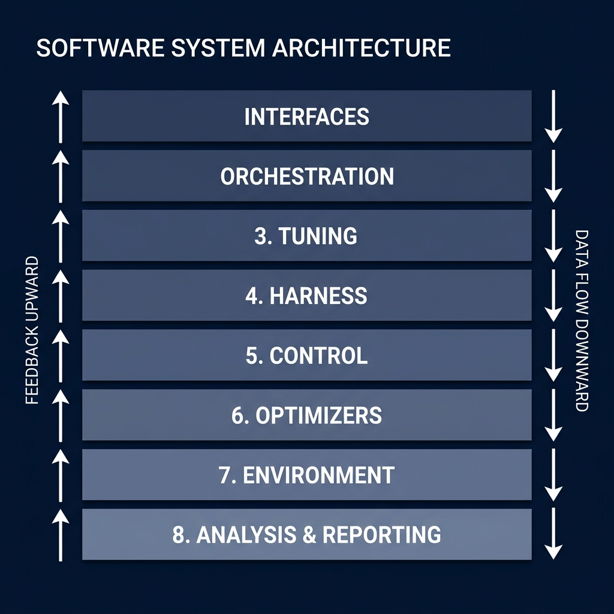
METHODOLOGY
Layered System Architecture
INTERFACES
CLI · Web Dashboard (FastAPI) · Tkinter GUI
ORCHESTRATION
Hydra + dynaswarm.cli · ExperimentManager
TUNING
Optuna TPE · seed-separated tuning vs evaluation
HARNESS
run_trial · build_arms · EvaluationMeter
CONTROL
Signals (4) · Controllers (3)
OPTIMIZERS
AStar · ACO · PSO · Hybrid
ENVIRONMENT
GraphView (CSR) · Timeline · Events · Oracle
ANALYSIS
Wilcoxon/Holm · Recovery · Plots · Parquet
Key principles:
Immutable shared world · Budget in work not iterations · Pluggable controllers

Slide 13
METHODOLOGY
Environment: Dynamic Graph Model
Graph Models
Disruption Events
▸ Erdős–Rényi (n=30)
Event
Effect
Demo/debug only. No coordinates. A* = Dijkstra.
Closure
Weight → ∞
Traffic Up
Weight × 2.0
▸ Geometric (n=200) ★
Traffic Down
Weight ÷ 2.0
PRIMARY TIER. Euclidean heuristic. Realistic topology.
Reopen
New weight at free-flow
▸ Grid (n=400)
Delete
Edge deactivated
Worst case for A* pruning. Manhattan metric.
Add
Pool edge activated
Rate: Poisson(λ), λ ∈ {0, 0.1, 0.3, 0.8} · Cluster size: 25 edges
Pre-materialised timeline: entire event sequence frozen before any optimizer runs.
Every arm sees byte-identical graph states — verified by BLAKE2b hash.

Slide 14
METHODOLOGY
Algorithms: A* (Oracle) and MAX-MIN ACO
A* — Reference Oracle
MAX-MIN ACO
f(n) = g(n) + h(n)
g(n) = cost from source
h(n) = Euclidean dist × weight_scale
P(i→j) ∝ τᵢⱼᵅ × ηᵢⱼᵝ
η = 1/(w + γ·h) [goal-directed visibility]
• Admissible heuristic: never overestimates
• Each iteration: Evaporate → Reinforce best → Clamp
• Stateless: full re-search every timestep
• τ_max = 1/(ρ·C_best), τ_min = τ_max/2n
• Provides c*(G⁽ᵗ⁾) — the moving optimum
• Bounds cap ratio at 2n: keeps evaporation meaningful
• Expansion count = cost-of-recomputation metric
• Stale trail on closed road = the phenomenon under study
Without goal-direction (γ=0): colony settled 90% above optimum on n=200 graphs

Slide 15
METHODOLOGY
Algorithms: Priority-Vector PSO and Hybrid ACO-PSO
Priority-Vector PSO
Hybrid ACO-PSO
Each particle: x ∈ [0,1]ⁿ (one priority per node)
Path: greedy argmax priority[v]·η(u,v)
• Budget split: B_ACO = round(B×f), B_PSO = B−B_ACO
• f ∈ [0.05, 0.95] — the allocation controller target
v ← w·v + c₁r₁(p_best−x) + c₂r₂(g_best−x)
x ← clip(x+v, 0, 1)
• Colony→Swarm: boost priorities along ACO path (+0.25)
• Swarm→Colony: deposit 1/cost trail on PSO path
• Exchange gain 0.25: nudge, not domination
• On disruption: positions kept, costs invalidated
• Global best position always kept (dropping it costs +90% excess)
• Dead-end repair: perturb & retry up to R times
NOT edge-weight bias (= Dijkstra in disguise). Priority-vector encodes node importance.
Bet: memoryless PSO covers ACO's staleness window immediately after disruption.

Slide 16
METHODOLOGY
Adaptive Controller: Sense → Propose → Apply
Environment ──► Signal ──► Controller ──► Optimizer
▲ │
└──────────────────── (next timestep) ──────┘
Signal
Formula
Range
Limitation
Edge Ratio
mean(K / |E|) over window
[0, ∞)
Graph-size dependent; tiny on n=200
Volatility
mean(K > 0) over window
[0, 1]
Saturates at λ≈1 on large graphs
λ-Branching
mean competitive arcs (ACO)
[1, d̄]
Stagnation detector, NOT volatility
Recency ★
1.0 on event; ×0.7 each quiet step
[0,1]
Best for E4 — transient signal
★ Recency preferred for allocation experiment: peaks at staleness, decays geometrically.

Slide 17
METHODOLOGY
Controller: Incremental Update Rule
Algorithm (one adaptation step):
Parameter
sign_k
Why
1. pressure δ = ξ · σ(t) − baseline
ρ (evaporation)
+1
Faster evaporation = forgets sooner → explore
2. baseline ← baseline + αb · δ [EMA update]
α (trail exp.)
−1
Higher α trusts trail → exploit
β (visibility)
−1
Higher β is greedy → exploit
3. If |δ| > deadband AND t mod p == 0:
aco_fraction f
−1
Lower f = more PSO budget = explore
step = +Δ if δ > 0 else −Δ
θk ← clip(θk + sign_k · step, θ_min, θ_max)
Σ = 0.001 per step — a misread costs one-thousandth of a parameter unit.
Increments, not preset jumps: evidence accumulates; one bad reading costs little.

Slide 18
METHODOLOGY
The Fair Evaluation Harness
Design Commitment
How It Is Enforced
Every arm sees identical world
Pre-materialised timeline; BLAKE2b hash asserted per arm per step
Equal budget = equal work
Budget in candidate-path constructions, metered by harness not self-reported
Arms cannot disturb each other
RNG streams content-addressed by family name; inserting arm doesn't rewire others
Tuning ≠ evaluation seeds
Harness raises ValueError if tune_seeds ∩ eval_seeds ≠ ∅
Null controller comparable
NullController takes identical code path; differs only in propose() returning unchanged params
Three in-loop assertions (fail loudly, not silently):
arm cost ≥ true optimum · state hash unchanged after rebind · all arms got identical state hash

Slide 19
IMPLEMENTATION
Technology Stack & Project Scale
Stack
Scale
• Python 3.11 + NumPy + SciPy
• 7 sub-packages, ~10 core modules
• Hydra (config) + Optuna (tuning)
• 271 pytest tests, run in ~60 seconds
• Apache Parquet (results storage)
• 786-line LaTeX academic paper (auto-compiled to PDF)
• Pygame (network visualizer)
• 1,377-line DOCUMENTATION.md
• pytest (271 tests, ~60s)
• Results: steps.parquet — 1 row per arm per timestep
• python-pptx (this presentation)
• 400 trials × 4 scenarios = full experimental study
Every run writes: manifest.json · steps.parquet · events.parquet · figures/ · .hydra/config.yaml

Slide 20
IMPLEMENTATION
Key Engineering: CSR Graph & Reproducible RNG
CSR Graph Structure
Reproducible RNG Architecture
• Static topology superset allocated once per trial
• stream(seed, *tags) — content-addressed generator
• weight[] and active[] — frozen numpy arrays; read-only for all arms
• Tags are names, not indices: new arm doesn't disturb others
• Addition events use pre-allocated pool (no O(N²) rebuild)
• tune_seeds [9000–9016) ∩ eval_seeds [1000–1032) = ∅
• BLAKE2b hash verifies no arm mutated the shared world
• Same config → byte-identical steps.parquet (verified by test)
• Deactivated slots retain trail — stale memory studied directly
• Two ablation arms share family key → differ only in controller
ACO inner loop uses Python lists (not numpy) for 12-element candidate sets: 2–3× speedup.
Pre-filled 4096-draw random buffer avoids per-roulette numpy call.

Slide 21
IMPLEMENTATION
Performance: Making 400 Trials Feasible
▸ Python lists for ACO inner loop
200-node graph, degree ≈18, candidate set ≈12 elements. NumPy dispatch overhead dominated data work.
Profiling: 72% of runtime in _construct(). Switching to Python lists → 2–3× speedup.
▸ Pre-filled random buffer (4096 draws)
Avoids one numpy.random call per roulette-wheel selection step.
Buffer refilled when exhausted; no RNG state drift.
▸ Bulk numpy for evaporate / deposit / clamp
Vectorised over all slots simultaneously: τ ← τ×(1−ρ), clamping, deposition all in one pass.
Only the stochastic selection loop remains in Python.
▸ Joblib parallelism over trials
Each trial is independent; parallel_jobs=11 runs 11 trials simultaneously.
Optuna tuning is sequential (TPE sampler) but trial objective is parallelised.

Slide 22
IMPLEMENTATION
Configuration System & CLI
Hydra Dataclass Config
Example CLI Commands
Config
├── graph: n_nodes, model, density
├── scenario: events_per_step, cluster_size
├── experiment: arms[], n_trials, seeds
├── budget: evaluations = 300
└── control: signal, targets, sigma
# Main experiment
python -m dynaswarm.cli \
graph=medium200 scenario=high \
'experiment.arms=[aco,hybrid]' report=true
# Allocation thesis (E4)
python -m dynaswarm.cli --multirun \
control.signal=recency \
'control.targets=[aco_fraction]' \
'experiment.arms=[hybrid_fixed,hybrid_adaptive]'
# Tune parameters
python -m dynaswarm.cli \
tuning.enabled=true tuning.arm=hybrid \
tuning.candidates=60 tuning.trials=12
Every run is fully reproducible: .hydra/config.yaml + manifest.json capture exact state.

Slide 23
RESULTS
Algorithm Performance: 400-Trial Study
Arm
Static
Low (λ=0.1)
Moderate (λ=0.3)
High (λ=0.8)
A*
0.0%
0.0%
0.0%
0.0%
ACO
8.1%
8.0%
7.2%
8.2%
PSO
38.4%
37.3%
37.0%
35.4%
Fixed Hybrid ★
4.1%
5.0%
5.1%
6.0%
Adaptive Hybrid
5.8%
5.0%
5.0%
5.1%
• Hybrid beats both components in every scenario ✅
• PSO alone is very weak (35–38% excess) — priority-vector encoding is fundamentally limited on dense graphs
• ACO strong in steady state; vulnerable post-disruption due to stale trails

Slide 24
RESULTS
Hybrid vs. ACO: Is the Advantage Real?
10-Trial Standing (current codebase, high scenario)
Why does the hybrid win?
ACO trails go stale after a disruption → excess spikes, slow recovery.
PSO priorities rank NODES not edges → unaffected by edge closure.
Hybrid covers ACO's staleness window — exactly what the design predicted.
ACO excess:
9.3%
Hybrid excess:
7.1%
Delta:
−2.2%
Wilcoxon p:
0.004 ✅
Cliff's δ:
medium effect
⚠ 10 trials detects large effects only. 30 trials needed for solid claim.

Slide 25
RESULTS
Adaptive vs. Fixed: The Ablation Study
Scenario
Δ (Adaptive − Fixed)
p_holm
Cliff's δ
Verdict
Static
+0.017 (fixed better)
0.003
0.07 — negligible
FIXED BETTER ⚠
Low
−0.001
0.71
0.02 — negligible
Not significant
Moderate
−0.001
0.94
0.01 — negligible
Not significant
High
−0.009
0.23
0.04 — negligible
Not significant
The only statistically significant result FAVOURS the FROZEN arm (static scenario).
No result favours the adaptive arm at ANY disruption level.
All effect sizes are negligible: |δ| < 0.10 throughout.

Slide 26
RESULTS
Why Adaptation Doesn't Help: Parameter Quality vs. Online Tuning
Intervention
Mean Excess
Gain
Hand-authored presets (original baseline)
~3.6%
—
Tuned fixed parameters (Optuna, 60 candidates)
~0.06%
−3.54% ★
Tuned + online adaptation
~0.056%
−0.004%
97% of achievable gain comes from choosing good parameters.
1% comes from adapting them online.
Optimal parameters do NOT vary significantly with volatility level.
Tuning for 'high' disruption and running on 'moderate' — no significant penalty (p=0.47).
The controller has nothing to exploit because there is no regime-specific optimum at this scale.

Slide 27
RESULTS
Signal Behaviour: Not All Signals Are Usable
Signal
Static
Low
Moderate
High
Verdict
edge_ratio
0.000
0.002
0.007
0.015
⚠ Tiny on n=200
volatility
0.000
0.262
0.561 → 1.0
1.000
⚠ SATURATES on n=200
λ-branching
7.30
7.38
7.14
7.24
❌ Not volatility
recency ★
0.000
peaks & decays
peaks & decays
peaks & decays
✅ Best for E4
Key finding: a signal's usability is a joint property of the signal AND the graph tier.
Volatility perfectly separates scenarios at n=30 (86% of range).
At n=200 it pins at 1.000 for λ≥0.3 — the controller cannot move.

Slide 28
RESULTS
Right Testbed: The Mechanism Must Do Measurable Work
What happens when pheromone is completely disabled (α = 0)?
Graph Tier
With Pheromone
Without (α=0)
Delta
p-value
Erdős–Rényi n=30
0.91%
0.75%
−0.15%
0.910 (NOT significant)
Geometric n=200 ★
8.25%
23.88%
+15.63%
< 0.001 ✅ SIGNIFICANT
Pheromone does nothing at n=30 and almost everything at n=200.
A null result on n=30 would mean nothing — the mechanism is simply irrelevant there.
A 30-node graph of mean degree 18 puts the target one or two hops away; ants find it by luck.
Testbed selection is a SCIENTIFIC decision, not a convenience decision.
Two tests enforce this: the testbed that shows the effect must be used for the claim.

Slide 29
CONCLUSION
What We Found: Three Findings
1
✅ Hybrid architecture works.
Both hybrid arms beat ACO (~7% vs 9%) and dramatically beat PSO (~37%).
Statistically significant at p=0.004. Advantage grows with disruption level.
2
✅ Parameter quality dominates.
Tuning beats presets by 3.54 percentage points — a factor of 5–9×.
The largest lever in the system is simply choosing good parameters.
3
❌ Online adaptation does not help.
At n=400 against a tuned opponent: no significant result favours the adaptive arm.
Only significant result favours the frozen arm (static scenario, p=0.003).

Slide 30
CONCLUSION
The Honest Framing: A Publishable Negative Result
"We built a controlled harness for testing online parameter adaptation in dynamic path optimisation.
Using it, we find that (a) parameter quality matters enormously — poorly chosen presets cost ~3.6%
excess — while (b) adapting those parameters to measured volatility contributes ~0.04%,
indistinguishable from noise at n=400.
We identify the harness design choices necessary to reach this conclusion, several of which
INVERT the result when omitted."
Design choices that invert the result if omitted:
Target venues:
• Pre-materialised timeline (ordering artefact gives wrong answer)
GECCO · IEEE CEC
PPSN / ANTS
Transportation Research Part C
• Equal-work budget (population size gaming inflates adaptive arm)
• Paired-trial statistics (timestep independence inflates sample size 60×)
• Tuned opponent (comparing to defaults is not a fair test)

Slide 31
FUTURE SCOPE
What Comes Next
Phase 1 — Immediate (1–2 months)
• Run E4 (allocation ablation: recency signal + aco_fraction) — the stated novelty, never yet run
• Run 30-trial E3 on tuned hybrid (10-trial standing needs confirmation)
• Re-run full 400-trial study with all bug fixes active
• Replace placeholder paper numbers with real measured results
Phase 2 — Short Term (3–6 months)
• RL-based Decision Engine (PPO/SAC) via pluggable Controller Protocol
• Real-world graphs: Sioux Falls, Chicago Sketch, OpenStreetMap cities
• Multi-objective optimisation (NSGA-II, multiple pheromone matrices)
• PyPI packaging + Docker image for reproducible deployment
Phase 3–4 (6–24 months): Neural ACO/PSO · Edge deployment · V2X · Meta-learning (MAML)

Slide 32
Thank You
Questions?
GitHub Repository
github.com/VaibhavBansal05/Dynaswarm
Documentation
DOCUMENTATION.md · dynaswarm_algorithms.pdf
Test Suite
271 pytest tests · 60s runtime · fully reproducible

