Slide 1

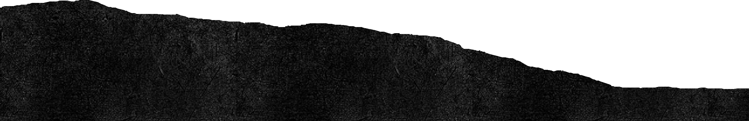
Fraud Detection in Stock Market:
Identifying Circular Trading
Using Data Analysis & Machine Learning to Enhance Market Integrity
Debug Dynasty 15/2/2025 DecodeX

Slide 2
Introduction
Stock market fraud, particularly circular trading, manipulates trade volumes and prices.
Circular trading involves coordinated buy-sell transactions to create a false
perception of market demand.
Our project aims to detect and prevent such fraudulent activities using data
analysis & machine learning.

Slide 3
Problem Statement
Circular trading reduces investor trust and damages market integrity.
It can lead to artificial price inflation and financial losses for genuine investors.
Regulatory bodies need effective ways to automate fraud detection and take proactive actions.
How can we analyze trading patterns and detect fraud before it escalates?

Slide 4
Data Collection & Preparation
Datasets Used:
Orders Dataset: Contains all placed orders.
Trades Dataset: Contains successfully executed trades.
Dataset Statistics:
Orders: 602,473 records over 7 days.
Trades: 414,957 records over 7 days.
Key Data Cleaning Steps:
Standardized column names.
Fixed incorrect timestamps.
Merged order & trade datasets for better analysis.

Slide 5
Approach & Techniques Used
1 Statistical Methods:
Z-score analysis to identify unusual trading volumes.
Interquartile Range (IQR) method for detecting outliers.
2 Machine Learning:
Isolation Forest Algorithm to detect anomalies
3 Graph-Based Analysis:
Network visualization of buyer-seller relationships.
Circular trading detection using graph cycles.
4 Time Series Analysis:
Daily trade volume trends to spot irregular activity.

Slide 6
Data Analysis - Identifying Anomalies
Z-score Analysis:
Trades with Z-score > 3 are considered suspicious.
Detected 858 anomalies based on unusual trade quantities.
IQR Method:
Flagged 49,108 trades with unusually high or low trade volumes.
Machine Learning (Isolation Forest):
Identified 4,130 trades as anomalies based on trade quantity, trade rate, and trade
value.
Anomalous Trades (Z-score): 858
Outlier Trades (IQR): 11745

Slide 7
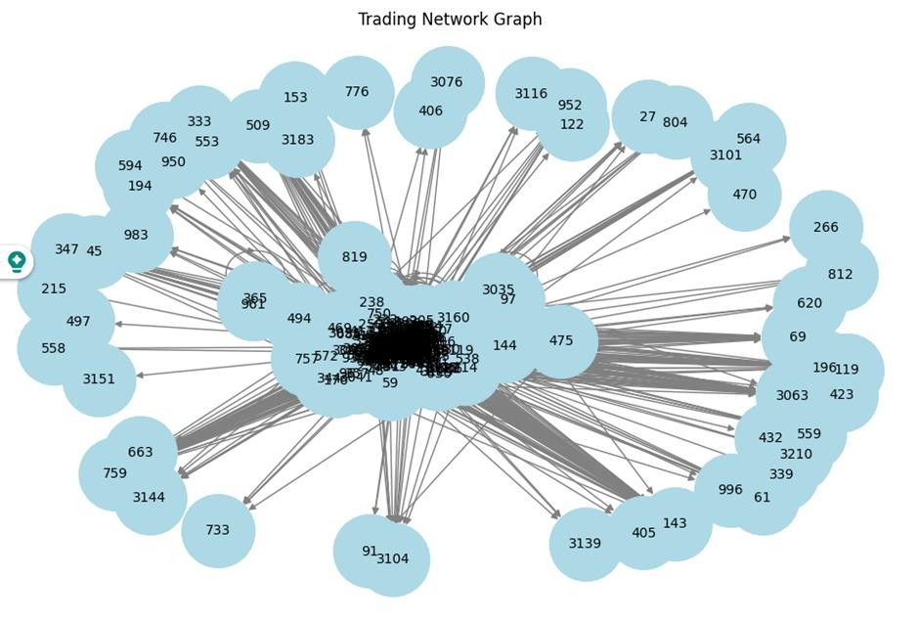
Detecting Circular Trading

Slide 8
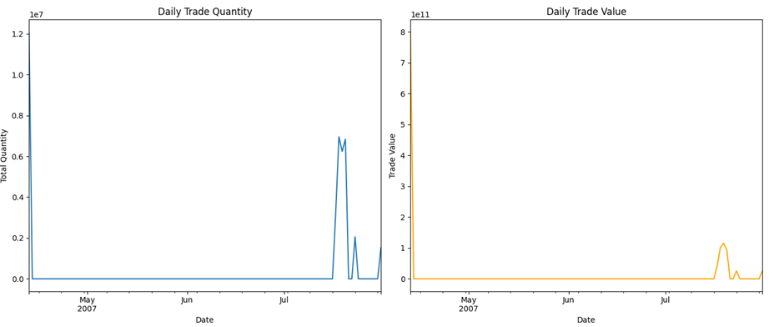
Time Series Analysis

Slide 9
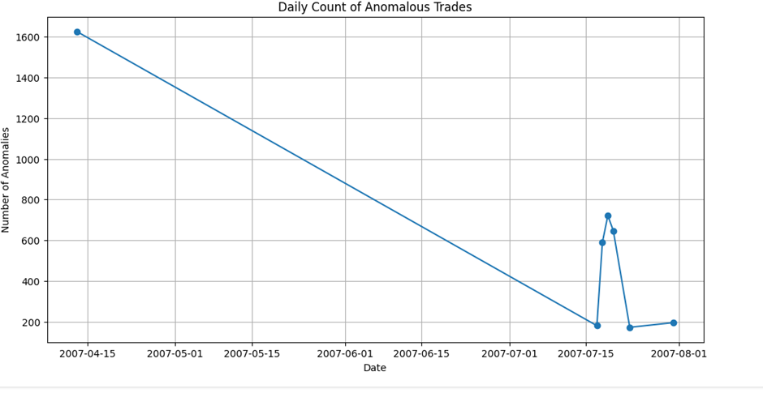
Daily Trends of Anomalous Trades.

Slide 10
Machine Learning-Based Anomaly Detection
How It Works?
Features Used: Trade Quantity, Trade Rate, Trade Value. Scaled Data using Standard Scaler.
"X" with the actual number of flagged trades.
Results:
X high-risk trades flagged by machine learning.
Overlaps with manual & statistical detections confirmed accuracy.

Slide 11


Conclusion
Key Takeaways:
Our multi-technique approach (statistical analysis, ML, network, and time-series analysis) enhances fraud detection in stock markets.
Focuses investigative efforts on high-risk trades, reducing manual workload.
Improves efficiency, saving time by narrowing down massive datasets. Scalable framework—can be refined with more data and advanced models. Strengthens market integrity, boosting investor confidence.
Proactively detecting circular trading is key to maintaining trust in financial markets. Our approach provides a scalable, data-driven solution to safeguard investors and ensure market integrity

Slide 12
Thank You

