Slide 1
Chapter 6: Integrity and Security
Domain Constraints
Referential Integrity
Assertions
Triggers
Security
Authorization
Authorization in SQL

Slide 2
Domain Constraints
Integrity constraints guard against accidental damage to the database, by ensuring that authorized changes to the database do not result in a loss of data consistency.
Domain constraints are the most elementary form of integrity constraint.
They test values inserted in the database, and test queries to ensure that the comparisons make sense.
New domains can be created from existing data types
  E.g. create domain Dollars numeric(12, 2)
  create domain Pounds numeric(12,2)
We cannot assign or compare a value of type Dollars to a value of type Pounds.
  However, we can convert type as below
  (cast r.A as Pounds)
  (Should also multiply by the dollar-to-pound conversion-rate)

Slide 3
Domain Constraints (Cont.)
The check clause in SQL-92 permits domains to be restricted:
  Use check clause to ensure that an hourly-wage domain allows only values greater than a specified value.
  create domain hourly-wage numeric(5,2)
  constraint value-test check(value > = 4.00)
  The domain has a constraint that ensures that the hourly-wage is greater than 4.00
  The clause constraint value-test is optional; useful to indicate which constraint an update violated.
Can have complex conditions in domain check
  create domain AccountType char(10)
  constraint account-type-test
  check (value in (‘Checking’, ‘Saving’))
  check (branch-name in (select branch-name from branch))

Slide 4
Referential Integrity
Ensures that a value that appears in one relation for a given set of attributes also appears for a certain set of attributes in another relation.
  Example: If “Perryridge” is a branch name appearing in one of the tuples in the account relation, then there exists a tuple in the branch relation for branch “Perryridge”.
Formal Definition
  Let r₁(R₁) and r₂(R₂) be relations with primary keys K₁ and K₂ respectively.
  The subset α of R₂ is a foreign key referencing K₁ in relation r₁, if for every t₂ in r₂ there must be a tuple t₁ in r₁ such that t₁[K₁] = t₂[α].
  Referential integrity constraint also called subset dependency since its can be written as
  ∏_{α} (r₂) ⊆ ∏_{K1} (r₁)

Slide 5
Referential Integrity in the E-R Model
Consider relationship set R between entity sets E₁ and E₂. The relational schema for R includes the primary keys K₁ of E₁ and K₂ of E₂.
Then K₁ and K₂ form foreign keys on the relational schemas for E₁ and E₂ respectively.
Weak entity sets are also a source of referential integrity constraints.
  For the relation schema for a weak entity set must include the primary key attributes of the entity set on which it depends
E1
R
E2

Slide 6
Checking Referential Integrity on Database Modification
The following tests must be made in order to preserve the following referential integrity constraint:
∏_{α} (r₂) ⊆ ∏_{K} (r₁)
Insert. If a tuple t₂ is inserted into r₂, the system must ensure that there is a tuple t₁ in r₁ such that t₁[K] = t₂[α]. That is
t₂ [α] ∈ ∏_{K} (r₁)
Delete. If a tuple, t₁ is deleted from r₁, the system must compute the set of tuples in r₂ that reference t₁:
σ_{α = t1[K]} (r₂)
If this set is not empty
  either the delete command is rejected as an error, or
  the tuples that reference t₁ must themselves be deleted
  (cascading deletions are possible).

Slide 7
Database Modification (Cont.)
Update. There are two cases:
  If a tuple t₂ is updated in relation r₂ and the update modifies values for foreign key α, then a test similar to the insert case is made:
    Let t₂’ denote the new value of tuple t₂. The system must ensure that
    t₂’[α] ∈ ∏_{K}(r₁)
  If a tuple t₁ is updated in r₁, and the update modifies values for the primary key (K), then a test similar to the delete case is made:
    The system must compute
    σ_{α = t1[K]} (r₂)
    using the old value of t₁ (the value before the update is applied).
    If this set is not empty
      the update may be rejected as an error, or
      the update may be cascaded to the tuples in the set, or
      the tuples in the set may be deleted.

Slide 8
Referential Integrity in SQL
Primary and candidate keys and foreign keys can be specified as part of the SQL create table statement:
  The primary key clause lists attributes that comprise the primary key.
  The unique key clause lists attributes that comprise a candidate key.
  The foreign key clause lists the attributes that comprise the foreign key and the name of the relation referenced by the foreign key.
By default, a foreign key references the primary key attributes of the referenced table
  foreign key (account-number) references account
Short form for specifying a single column as foreign key
  account-number char (10) references account
Reference columns in the referenced table can be explicitly specified
  but must be declared as primary/candidate keys
  foreign key (account-number) references account(account-number)

Slide 9
Referential Integrity in SQL – Example
create table customer
(customer-name char(20),
customer-street char(30),
customer-city char(30),
primary key (customer-name))
create table branch
(branch-name char(15),
branch-city char(30),
assets integer,
primary key (branch-name))

Slide 10
Referential Integrity in SQL – Example (Cont.)
create table account
(account-number char(10),
branch-name char(15),
balance integer,
primary key (account-number),
foreign key (branch-name) references branch)
create table depositor
(customer-name char(20),
account-number char(10),
primary key (customer-name, account-number),
foreign key (account-number) references account,
foreign key (customer-name) references customer)

Slide 11
Cascading Actions in SQL
create table account
. . .
foreign key(branch-name) references branch
on delete cascade
on update cascade
. . . )
Due to the on delete cascade clauses, if a delete of a tuple in branch results in referential-integrity constraint violation, the delete “cascades” to the account relation, deleting the tuple that refers to the branch that was deleted.
Cascading updates are similar.

Slide 12
Cascading Actions in SQL (Cont.)
If there is a chain of foreign-key dependencies across multiple relations, with on delete cascade specified for each dependency, a deletion or update at one end of the chain can propagate across the entire chain.
If a cascading update to delete causes a constraint violation that cannot be handled by a further cascading operation, the system aborts the transaction.
  As a result, all the changes caused by the transaction and its cascading actions are undone.
Referential integrity is only checked at the end of a transaction
  Intermediate steps are allowed to violate referential integrity provided later steps remove the violation
  Otherwise it would be impossible to create some database states, e.g. insert two tuples whose foreign keys point to each other
    E.g. spouse attribute of relation
    marriedperson(name, address, spouse)

Slide 13
Referential Integrity in SQL (Cont.)
Alternative to cascading:
  on delete set null
  on delete set default
Null values in foreign key attributes complicate SQL referential integrity semantics, and are best prevented using not null
  if any attribute of a foreign key is null, the tuple is defined to satisfy the foreign key constraint!

Slide 14
Assertions
An assertion is a predicate expressing a condition that we wish the database always to satisfy.
An assertion in SQL takes the form
create assertion <assertion-name> check <predicate>
When an assertion is made, the system tests it for validity, and tests it again on every update that may violate the assertion
  This testing may introduce a significant amount of overhead; hence assertions should be used with great care.
Asserting
for all X, P(X)
is achieved in a round-about fashion using
not exists X such that not P(X)

Slide 15
Assertion Example
The sum of all loan amounts for each branch must be less than the sum of all account balances at the branch.
create assertion sum-constraint check
(not exists (select * from branch
where (select sum(amount) from loan
where loan.branch-name =
branch.branch-name)
>= (select sum(amount) from account
where loan.branch-name =
branch.branch-name)))

Slide 16
Assertion Example
Every loan has at least one borrower who maintains an account with a minimum balance or $1000.00
create assertion balance-constraint check
(not exists (
select * from loan
where not exists (
select *
from borrower, depositor, account
where loan.loan-number = borrower.loan-number
and borrower.customer-name = depositor.customer-name
and depositor.account-number = account.account-number
and account.balance >= 1000)))

Slide 17
Triggers
A trigger is a statement that is executed automatically by the system as a side effect of a modification to the database.
To design a trigger mechanism, we must:
  Specify the conditions under which the trigger is to be executed.
  Specify the actions to be taken when the trigger executes.
Triggers introduced to SQL standard in SQL:1999, but supported even earlier using non-standard syntax by most databases.

Slide 18
Trigger Example
Suppose that instead of allowing negative account balances, the bank deals with overdrafts by
  setting the account balance to zero
  creating a loan in the amount of the overdraft
  giving this loan a loan number identical to the account number of the overdrawn account
The condition for executing the trigger is an update to the account relation that results in a negative balance value.

Slide 19
Trigger Example in SQL:1999
create trigger overdraft-trigger after update on account
referencing new row as nrow for each row
when nrow.balance < 0
begin atomic
insert into borrower
(select customer-name, account-number
from depositor
where nrow.account-number =
depositor.account-number);
insert into loan values
(n.row.account-number, nrow.branch-name,
– nrow.balance);
update account set balance = 0
where account.account-number = nrow.account-number
end

Slide 20
Triggering Events and Actions in SQL
Triggering event can be insert, delete or update
Triggers on update can be restricted to specific attributes
  E.g. create trigger overdraft-trigger after update of balance on account
Values of attributes before and after an update can be referenced
  referencing old row as : for deletes and updates
  referencing new row as : for inserts and updates
Triggers can be activated before an event, which can serve as extra constraints. E.g. convert blanks to null.
create trigger setnull-trigger before update on r
referencing new row as nrow
for each row
when nrow.phone-number = ‘ ‘
set nrow.phone-number = null

Slide 21
Statement Level Triggers
Instead of executing a separate action for each affected row, a single action can be executed for all rows affected by a transaction
  Use for each statement instead of for each row
  Use referencing old table or referencing new table to refer to temporary tables (called transition tables) containing the affected rows
  Can be more efficient when dealing with SQL statements that update a large number of rows

Slide 22
External World Actions
We sometimes require external world actions to be triggered on a database update
  E.g. re-ordering an item whose quantity in a warehouse has become small, or turning on an alarm light,
Triggers cannot be used to directly implement external-world actions, BUT
  Triggers can be used to record actions-to-be-taken in a separate table
  Have an external process that repeatedly scans the table, carries out external-world actions and deletes action from table
E.g. Suppose a warehouse has the following tables
  inventory(item, level): How much of each item is in the warehouse
  minlevel(item, level) : What is the minimum desired level of each item
  reorder(item, amount): What quantity should we re-order at a time
  orders(item, amount) : Orders to be placed (read by external process)

Slide 23
External World Actions (Cont.)
create trigger reorder-trigger after update of amount on inventory
referencing old row as orow, new row as nrow
for each row
when nrow.level < = (select level
from minlevel
where minlevel.item = orow.item)
and orow.level > (select level
from minlevel
where minlevel.item = orow.item)
begin
insert into orders
(select item, amount
from reorder
where reorder.item = orow.item)
end

Slide 24
Triggers in MS-SQLServer Syntax
create trigger overdraft-trigger on account
for update
as
if inserted.balance < 0
begin
insert into borrower
(select customer-name,account-number
from depositor, inserted
where inserted.account-number =
depositor.account-number)
insert into loan values
(inserted.account-number, inserted.branch-name,
– inserted.balance)
update account set balance = 0
from account, inserted
where account.account-number = inserted.account-number
end

Slide 25
When Not To Use Triggers
Triggers were used earlier for tasks such as
  maintaining summary data (e.g. total salary of each department)
  Replicating databases by recording changes to special relations (called change or delta relations) and having a separate process that applies the changes over to a replica
There are better ways of doing these now:
  Databases today provide built in materialized view facilities to maintain summary data
  Databases provide built-in support for replication
Encapsulation facilities can be used instead of triggers in many cases
  Define methods to update fields
  Carry out actions as part of the update methods instead of
  through a trigger

Slide 26
Security
Security - protection from malicious attempts to steal or modify data.
  Database system level
    Authentication and authorization mechanisms to allow specific users access only to required data
    We concentrate on authorization in the rest of this chapter
  Operating system level
    Operating system super-users can do anything they want to the database! Good operating system level security is required.
  Network level: must use encryption to prevent
    Eavesdropping (unauthorized reading of messages)
    Masquerading (pretending to be an authorized user or sending messages supposedly from authorized users)

Slide 27
Security (Cont.)
  Physical level
    Physical access to computers allows destruction of data by intruders; traditional lock-and-key security is needed
    Computers must also be protected from floods, fire, etc.
      More in Chapter 17 (Recovery)
  Human level
    Users must be screened to ensure that an authorized users do not give access to intruders
    Users should be trained on password selection and secrecy

Slide 28
Authorization
Forms of authorization on parts of the database:
Read authorization - allows reading, but not modification of data.
Insert authorization - allows insertion of new data, but not modification of existing data.
Update authorization - allows modification, but not deletion of data.
Delete authorization - allows deletion of data

Slide 29
Authorization (Cont.)
Forms of authorization to modify the database schema:
Index authorization - allows creation and deletion of indices.
Resources authorization - allows creation of new relations.
Alteration authorization - allows addition or deletion of attributes in a relation.
Drop authorization - allows deletion of relations.

Slide 30
Authorization and Views
Users can be given authorization on views, without being given any authorization on the relations used in the view definition
Ability of views to hide data serves both to simplify usage of the system and to enhance security by allowing users access only to data they need for their job
A combination or relational-level security and view-level security can be used to limit a user’s access to precisely the data that user needs.

Slide 31
View Example
Suppose a bank clerk needs to know the names of the customers of each branch, but is not authorized to see specific loan information.
  Approach: Deny direct access to the loan relation, but grant access to the view cust-loan, which consists only of the names of customers and the branches at which they have a loan.
  The cust-loan view is defined in SQL as follows:
create view cust-loan as
select branchname, customer-name
from borrower, loan
where borrower.loan-number = loan.loan-number

Slide 32
View Example (Cont.)
The clerk is authorized to see the result of the query:
        select *
        from cust-loan
When the query processor translates the result into a query on the actual relations in the database, we obtain a query on borrower and loan.
Authorization must be checked on the clerk’s query before query processing replaces a view by the definition of the view.

Slide 33
Authorization on Views
Creation of view does not require resources authorization since no real relation is being created
The creator of a view gets only those privileges that provide no additional authorization beyond that he already had.
E.g. if creator of view cust-loan had only read authorization on borrower and loan, he gets only read authorization on cust-loan

Slide 34
Granting of Privileges
The passage of authorization from one user to another may be represented by an authorization graph.
The nodes of this graph are the users.
The root of the graph is the database administrator.
Consider graph for update authorization on loan.
An edge U_{i} →U_{j} indicates that user U_{i} has granted update authorization on loan to U_{j.}
U₁
U₄
DBA
U₂
U₅
U₃

Slide 35
Authorization Grant Graph
Requirement: All edges in an authorization graph must be part of some path originating with the database administrator
If DBA revokes grant from U₁:
  Grant must be revoked from U₄ since U₁ no longer has authorization
  Grant must not be revoked from U₅ since U₅ has another authorization path from DBA through U₂
Must prevent cycles of grants with no path from the root:
  DBA grants authorization to U₇
  U7 grants authorization to U₈
  U8 grants authorization to U₇
  DBA revokes authorization from U₇
Must revoke grant U₇ to U₈ and from U₈ to U₇ since there is no path from DBA to U₇ or to U₈ anymore.

Slide 36
Security Specification in SQL
The grant statement is used to confer authorization
grant <privilege list>
on <relation name or view name> to <user list>
<user list> is:
  a user-id
  public, which allows all valid users the privilege granted
  A role (more on this later)
Granting a privilege on a view does not imply granting any privileges on the underlying relations.
The grantor of the privilege must already hold the privilege on the specified item (or be the database administrator).

Slide 37
Privileges in SQL
select: allows read access to relation,or the ability to query using the view
  Example: grant users U₁, U₂, and U₃ select authorization on the branch relation:
grant select on branch to U₁, U₂, U₃
insert: the ability to insert tuples
update: the ability to update using the SQL update statement
delete: the ability to delete tuples.
references: ability to declare foreign keys when creating relations.
usage: In SQL-92; authorizes a user to use a specified domain
all privileges: used as a short form for all the allowable privileges

Slide 38
Privilege To Grant Privileges
with grant option: allows a user who is granted a privilege to pass the privilege on to other users.
  Example:
      grant select on branch to U₁ with grant option
    gives U₁ the select privileges on branch and allows U₁ to grant this
    privilege to others

Slide 39
Roles
Roles permit common privileges for a class of users can be specified just once by creating a corresponding “role”
Privileges can be granted to or revoked from roles, just like user
Roles can be assigned to users, and even to other roles
SQL:1999 supports roles
      create role teller
      create role manager
      grant select on branch to teller
      grant update (balance) on account to teller
      grant all privileges on account to manager
      grant teller to manager
      grant teller to alice, bob
      grant manager to avi

Slide 40
Revoking Authorization in SQL
The revoke statement is used to revoke authorization.
  revoke<privilege list>
  on <relation name or view name> from <user list> [restrict|cascade]
Example:
  revoke select on branch from U₁, U₂, U₃ cascade
Revocation of a privilege from a user may cause other users also to lose that privilege; referred to as cascading of the revoke.
We can prevent cascading by specifying restrict:
  revoke select on branch from U₁, U₂, U₃ restrict
With restrict, the revoke command fails if cascading revokes are required.

Slide 41
Revoking Authorization in SQL (Cont.)
<privilege-list> may be all to revoke all privileges the revokee may hold.
If <revokee-list> includes public all users lose the privilege except those granted it explicitly.
If the same privilege was granted twice to the same user by different grantees, the user may retain the privilege after the revocation.
All privileges that depend on the privilege being revoked are also revoked.

Slide 42
Limitations of SQL Authorization
SQL does not support authorization at a tuple level
  E.g. we cannot restrict students to see only (the tuples storing) their own grades
With the growth in Web access to databases, database accesses come primarily from application servers.
  End users don't have database user ids, they are all mapped to the same database user id
All end-users of an application (such as a web application) may be mapped to a single database user
The task of authorization in above cases falls on the application program, with no support from SQL
  Benefit: fine grained authorizations, such as to individual tuples, can be implemented by the application.
  Drawback: Authorization must be done in application code, and may be dispersed all over an application
  Checking for absence of authorization loopholes becomes very difficult since it requires reading large amounts of application code

Slide 43
Audit Trails
An audit trail is a log of all changes (inserts/deletes/updates) to the database along with information such as which user performed the change, and when the change was performed.
Used to track erroneous/fraudulent updates.
Can be implemented using triggers, but many database systems provide direct support.

Slide 44
Encryption
Data may be encrypted when database authorization provisions do not offer sufficient protection.
Properties of good encryption technique:
  Relatively simple for authorized users to encrypt and decrypt data.
  Encryption scheme depends not on the secrecy of the algorithm but on the secrecy of a parameter of the algorithm called the encryption key.
  Extremely difficult for an intruder to determine the encryption key.

Slide 45
Encryption (Cont.)
Data Encryption Standard (DES) substitutes characters and rearranges their order on the basis of an encryption key which is provided to authorized users via a secure mechanism. Scheme is no more secure than the key transmission mechanism since the key has to be shared.
Advanced Encryption Standard (AES) is a new standard replacing DES, and is based on the Rijndael algorithm, but is also dependent on shared secret keys
Public-key encryption is based on each user having two keys:
  public key – publicly published key used to encrypt data, but cannot be used to decrypt data
  private key -- key known only to individual user, and used to decrypt data.
  Need not be transmitted to the site doing encryption.
Encryption scheme is such that it is impossible or extremely hard to decrypt data given only the public key.
The RSA public-key encryption scheme is based on the hardness of factoring a very large number (100's of digits) into its prime components.

Slide 46
Authentication
Password based authentication is widely used, but is susceptible to sniffing on a network
Challenge-response systems avoid transmission of passwords
  DB sends a (randomly generated) challenge string to user
  User encrypts string and returns result.
  DB verifies identity by decrypting result
  Can use public-key encryption system by DB sending a message encrypted using user’s public key, and user decrypting and sending the message back
Digital signatures are used to verify authenticity of data
  E.g. use private key (in reverse) to encrypt data, and anyone can verify authenticity by using public key (in reverse) to decrypt data. Only holder of private key could have created the encrypted data.
  Digital signatures also help ensure nonrepudiation: sender
  cannot later claim to have not created the data

Slide 47
Digital Certificates
Digital certificates are used to verify authenticity of public keys.
Problem: when you communicate with a web site, how do you know if you are talking with the genuine web site or an imposter?
  Solution: use the public key of the web site
  Problem: how to verify if the public key itself is genuine?
Solution:
  Every client (e.g. browser) has public keys of a few root-level certification authorities
  A site can get its name/URL and public key signed by a certification authority: signed document is called a certificate
  Client can use public key of certification authority to verify certificate
  Multiple levels of certification authorities can exist. Each certification authority
    presents its own public-key certificate signed by a
    higher level authority, and
    Uses its private key to sign the certificate of other web sites/authorities

Slide 48
End of Chapter

Slide 49
Statistical Databases
Problem: how to ensure privacy of individuals while allowing use of data for statistical purposes (e.g., finding median income, average bank balance etc.)
Solutions:
  System rejects any query that involves fewer than some predetermined number of individuals.
  ∗ Still possible to use results of multiple overlapping queries to deduce data about an individual
  Data pollution -- random falsification of data provided in response to a query.
  Random modification of the query itself.
There is a tradeoff between accuracy and security.

Slide 50
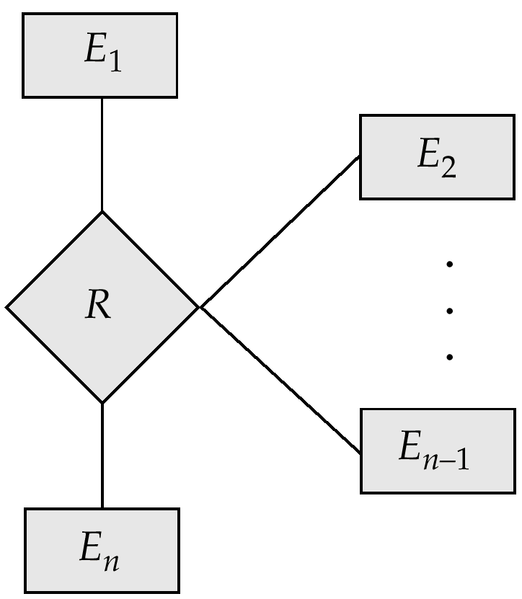
An n-ary Relationship Set

Slide 51
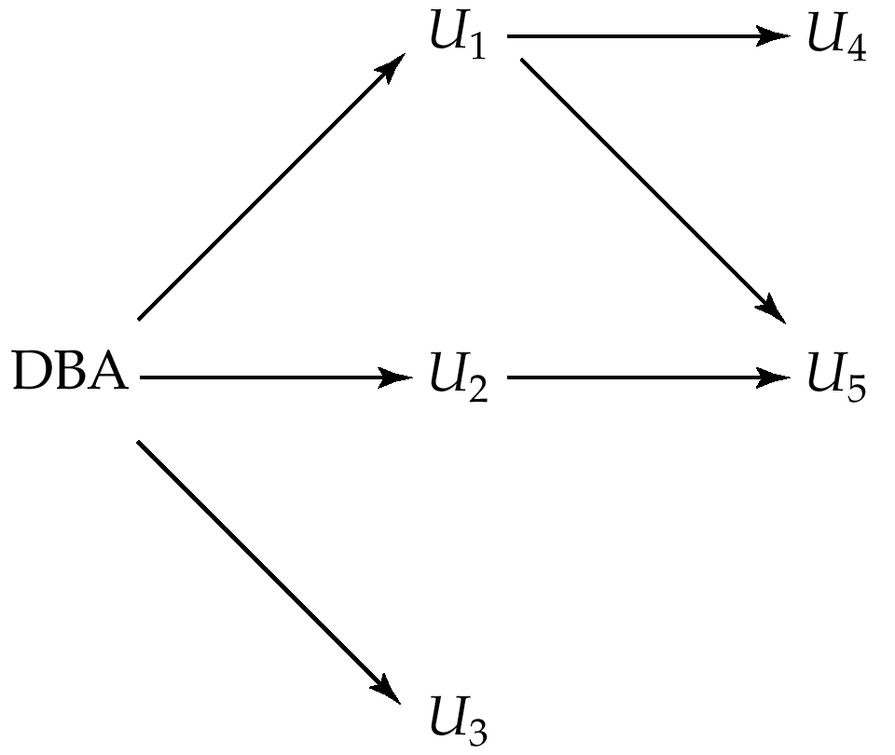
Authorization-Grant Graph

Slide 52
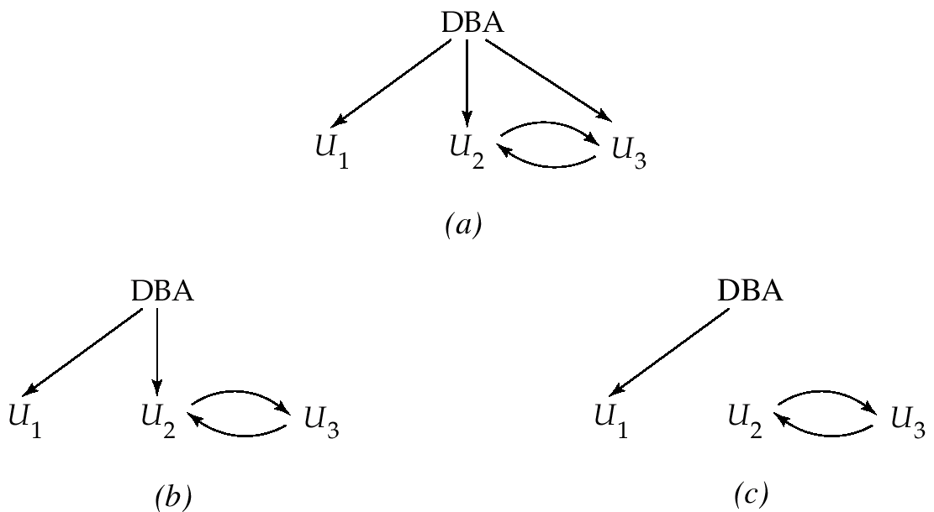
Attempt to Defeat Authorization Revocation

Slide 53
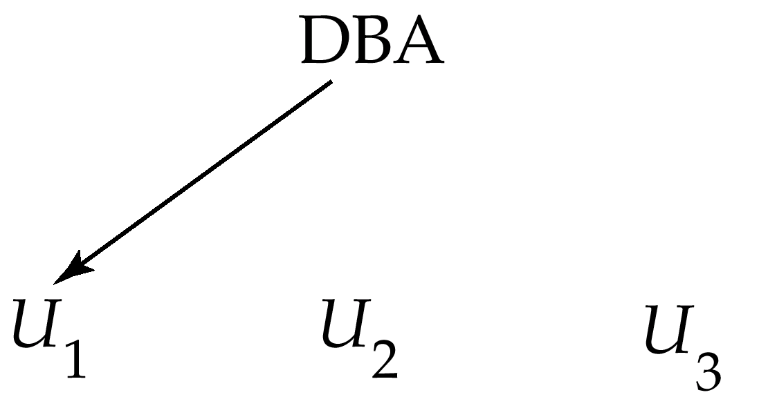
Authorization Graph

Slide 54
Physical Level Security
Protection of equipment from floods, power failure, etc.
Protection of disks from theft, erasure, physical damage, etc.
Protection of network and terminal cables from wiretaps non-invasive electronic eavesdropping, physical damage, etc.
Solutions:
Replicated hardware:
  mirrored disks, dual busses, etc.
  multiple access paths between every pair of devises
Physical security: locks,police, etc.
Software techniques to detect physical security breaches.

Slide 55
Human Level Security
Protection from stolen passwords, sabotage, etc.
Primarily a management problem:
  Frequent change of passwords
  Use of “non-guessable” passwords
  Log all invalid access attempts
  Data audits
  Careful hiring practices

Slide 56
Operating System Level Security
Protection from invalid logins
File-level access protection (often not very helpful for database security)
Protection from improper use of “superuser” authority.
Protection from improper use of privileged machine intructions.

Slide 57
Network-Level Security
Each site must ensure that it communicate with trusted sites (not intruders).
Links must be protected from theft or modification of messages
Mechanisms:
  Identification protocol (password-based),
  Cryptography.

Slide 58
Database-Level Security
Assume security at network, operating system, human, and physical levels.
Database specific issues:
  each user may have authority to read only part of the data and to write only part of the data.
  User authority may correspond to entire files or relations, but it may also correspond only to parts of files or relations.
Local autonomy suggests site-level authorization control in a distributed database.
Global control suggests centralized control.

Slide 59
Chapter 7: Relational Database Design

Slide 60
Chapter 7: Relational Database Design
First Normal Form
Pitfalls in Relational Database Design
Functional Dependencies
Decomposition
Boyce-Codd Normal Form
Third Normal Form
Multivalued Dependencies and Fourth Normal Form
Overall Database Design Process

Slide 61
First Normal Form
Domain is atomic if its elements are considered to be indivisible units
  Examples of non-atomic domains:
    Set of names, composite attributes
    Identification numbers like CS101 that can be broken up into parts
A relational schema R is in first normal form if the domains of all attributes of R are atomic
Non-atomic values complicate storage and encourage redundant (repeated) storage of data
  E.g. Set of accounts stored with each customer, and set of owners stored with each account
  We assume all relations are in first normal form (revisit this in Chapter 9 on Object Relational Databases)

Slide 62
First Normal Form (Contd.)
Atomicity is actually a property of how the elements of the domain are used.
  E.g. Strings would normally be considered indivisible
  Suppose that students are given roll numbers which are strings of the form CS0012 or EE1127
  If the first two characters are extracted to find the department, the domain of roll numbers is not atomic.
  Doing so is a bad idea: leads to encoding of information in application program rather than in the database.

Slide 63
Pitfalls in Relational Database Design
Relational database design requires that we find a “good” collection of relation schemas. A bad design may lead to
  Repetition of Information.
  Inability to represent certain information.
Design Goals:
  Avoid redundant data
  Ensure that relationships among attributes are represented
  Facilitate the checking of updates for violation of database integrity constraints.

Slide 64
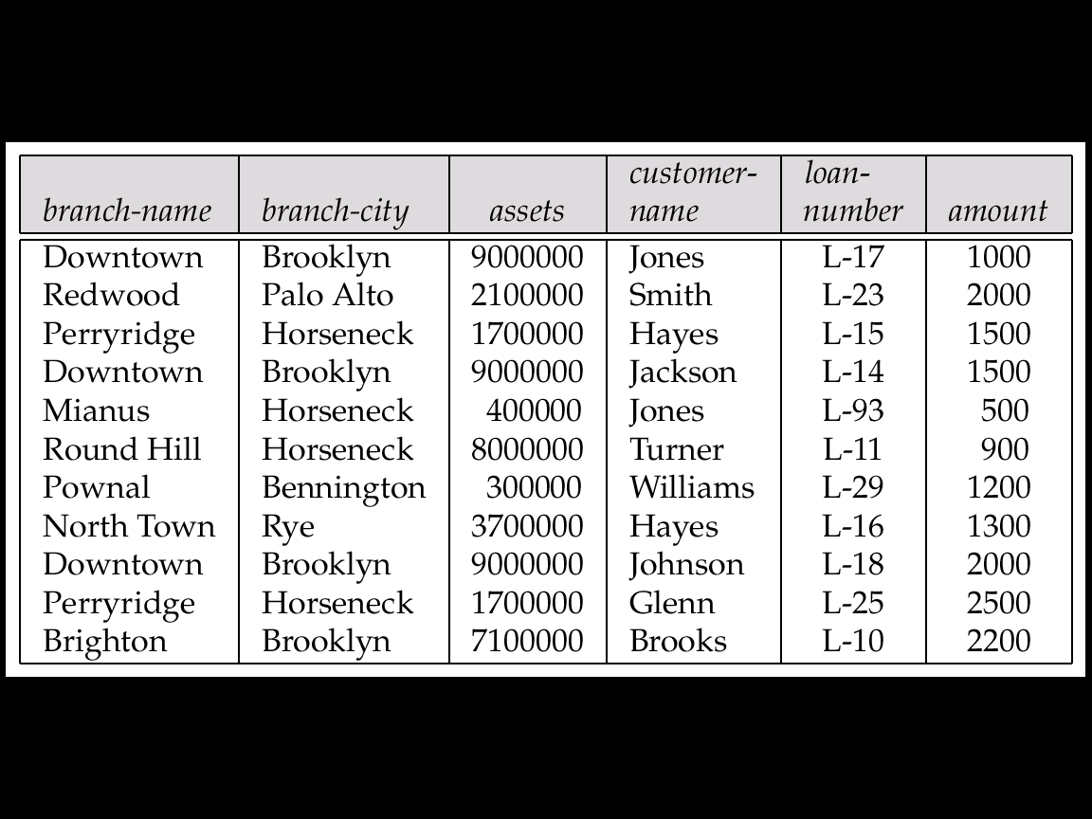
Example
Consider the relation schema:
Lending-schema = (branch-name, branch-city, assets,
customer-name, loan-number, amount)
Redundancy:
  Data for branch-name, branch-city, assets are repeated for each loan that a branch makes
  Wastes space
  Complicates updating, introducing possibility of inconsistency of assets value
Null values
  Cannot store information about a branch if no loans exist
  Can use null values, but they are difficult to handle.

Slide 65
Decomposition
Decompose the relation schema Lending-schema into:
Branch-schema = (branch-name, branch-city,assets)
Loan-info-schema = (customer-name, loan-number,
branch-name, amount)
All attributes of an original schema (R) must appear in the decomposition (R₁, R₂):
R = R₁ ∪ R₂
Lossless-join decomposition.
For all possible relations r on schema R
r = ∏_{R1} (r) ∏_{R2} (r)

Slide 66
Example of Non Lossless-Join Decomposition
Decomposition of R = (A, B)
R₁ = (A) R₂ = (B)
A
B
A
B
α
α
β
1
2
1
α
β
1
2
∏_{A}(r)
∏_{B(r)}
r
∏_{A} (r) ∏_{B} (r)
A
B
α
α
β
β
1
2
1
2

Slide 67
Goal — Devise a Theory for the Following
Decide whether a particular relation R is in “good” form.
In the case that a relation R is not in “good” form, decompose it into a set of relations {R₁, R₂, ..., R_{n}} such that
  each relation is in good form
  the decomposition is a lossless-join decomposition
Our theory is based on:
  functional dependencies
  multivalued dependencies

Slide 68
Functional Dependencies
Constraints on the set of legal relations.
Require that the value for a certain set of attributes determines uniquely the value for another set of attributes.
A functional dependency is a generalization of the notion of a key.

Slide 69
Functional Dependencies (Cont.)
Let R be a relation schema
α ⊆ R and β ⊆ R
The functional dependency
α → β
holds on R if and only if for any legal relations r(R), whenever any two tuples t₁ and t₂ of r agree on the attributes α, they also agree on the attributes β. That is,
t₁[α] = t₂ [α] ⇒ t₁[β ] = t₂ [β ]
Example: Consider r(A,B) with the following instance of r.
On this instance, A → B does NOT hold, but B → A does hold.
4
1 5
3 7

Slide 70
Functional Dependencies (Cont.)
K is a superkey for relation schema R if and only if K → R
K is a candidate key for R if and only if
  K → R, and
  for no α ⊂ K, α → R
Functional dependencies allow us to express constraints that cannot be expressed using superkeys. Consider the schema:
Loan-info-schema = (customer-name, loan-number,
branch-name, amount).
We expect this set of functional dependencies to hold:
loan-number → amount
loan-number → branch-name
but would not expect the following to hold:
loan-number → customer-name

Slide 71
Use of Functional Dependencies
We use functional dependencies to:
  test relations to see if they are legal under a given set of functional dependencies.
    If a relation r is legal under a set F of functional dependencies, we say that r satisfies F.
  specify constraints on the set of legal relations
    We say that F holds on R if all legal relations on R satisfy the set of functional dependencies F.
Note: A specific instance of a relation schema may satisfy a functional dependency even if the functional dependency does not hold on all legal instances.
  For example, a specific instance of Loan-schema may, by chance, satisfy
  loan-number → customer-name.

Slide 72
Functional Dependencies (Cont.)
A functional dependency is trivial if it is satisfied by all instances of a relation
  E.g.
    customer-name, loan-number → customer-name
    customer-name → customer-name
  In general, α → β is trivial if β ⊆ α

Slide 73
Closure of a Set of Functional Dependencies
Given a set F set of functional dependencies, there are certain other functional dependencies that are logically implied by F.
  E.g. If A → B and B → C, then we can infer that A → C
The set of all functional dependencies logically implied by F is the closure of F.
We denote the closure of F by F⁺.
We can find all of F⁺ by applying Armstrong’s Axioms:
  if β ⊆ α, then α → β (reflexivity)
  if α → β, then γ α → γ β (augmentation)
  if α → β, and β → γ, then α → γ (transitivity)
These rules are
  sound (generate only functional dependencies that actually hold) and
  complete (generate all functional dependencies that hold).

Slide 74
Example
R = (A, B, C, G, H, I)
F = { A → B
A → C
CG → H
CG → I
B → H}
some members of F⁺
  A → H
    by transitivity from A → B and B → H
  AG → I
    by augmenting A → C with G, to get AG → CG
    and then transitivity with CG → I
  CG → HI
    from CG → H and CG → I : “union rule” can be inferred from
      definition of functional dependencies, or
      Augmentation of CG → I to infer CG → CGI, augmentation of
      CG → H to infer CGI → HI, and then transitivity

Slide 75
Procedure for Computing F⁺
To compute the closure of a set of functional dependencies F:
F⁺ = F
repeat
for each functional dependency f in F⁺
apply reflexivity and augmentation rules on f
add the resulting functional dependencies to F⁺
for each pair of functional dependencies f₁and f₂ in F⁺
if f₁ and f₂ can be combined using transitivity
then add the resulting functional dependency to F⁺
until F⁺ does not change any further
NOTE: We will see an alternative procedure for this task later

Slide 76
Closure of Functional Dependencies (Cont.)
We can further simplify manual computation of F⁺ by using the following additional rules.
  If α → β holds and α → γ holds, then α → β γ holds (union)
  If α → β γ holds, then α → β holds and α → γ holds (decomposition)
  If α → β holds and γ β → δ holds, then α γ → δ holds (pseudotransitivity)
  The above rules can be inferred from Armstrong’s axioms.

Slide 77
Closure of Attribute Sets
Given a set of attributes α, define the closure of α under F (denoted by α⁺) as the set of attributes that are functionally determined by α under F:
α → β is in F⁺ ⬄ β ⊆ α⁺
Algorithm to compute α⁺, the closure of α under F
result := α;
while (changes to result) do
for each β → γ in F do
begin
if β ⊆ result then result := result ∪ γ
end

Slide 78
Example of Attribute Set Closure
R = (A, B, C, G, H, I)
F = {A → B
A → C
CG → H
CG → I
B → H}
(AG)⁺
  1. result = AG
  2. result = ABCG (A → C and A → B)
  3. result = ABCGH (CG → H and CG ⊆ AGBC)
  4. result = ABCGHI (CG → I and CG ⊆ AGBCH)
Is AG a candidate key?
  Is AG a super key?
    Does AG → R? == Is (AG)⁺ ⊇ R
  Is any subset of AG a superkey?
    Does A → R? == Is (A)⁺ ⊇ R
    Does G → R? == Is (G)⁺ ⊇ R

Slide 79
Uses of Attribute Closure
There are several uses of the attribute closure algorithm:
Testing for superkey:
  To test if α is a superkey, we compute α^{+,} and check if α⁺ contains all attributes of R.
Testing functional dependencies
  To check if a functional dependency α → β holds (or, in other words, is in F⁺), just check if β ⊆ α⁺.
  That is, we compute α⁺ by using attribute closure, and then check if it contains β.
  Is a simple and cheap test, and very useful
Computing closure of F
  For each γ ⊆ R, we find the closure γ⁺, and for each S ⊆ γ⁺, we output a functional dependency γ → S.

Slide 80
Canonical Cover
Sets of functional dependencies may have redundant dependencies that can be inferred from the others
  Eg: A → C is redundant in: {A → B, B → C, A → C}
  Parts of a functional dependency may be redundant
    E.g. on RHS: {A → B, B → C, A → CD} can be simplified to
    {A → B, B → C, A → D}
    E.g. on LHS: {A → B, B → C, AC → D} can be simplified to
    {A → B, B → C, A → D}
Intuitively, a canonical cover of F is a “minimal” set of functional dependencies equivalent to F, having no redundant dependencies or redundant parts of dependencies

Slide 81
Extraneous Attributes
Consider a set F of functional dependencies and the functional dependency α → β in F.
  Attribute A is extraneous in α if A ∈ α
  and F logically implies (F – {α → β}) ∪ {(α – A) → β}.
  Attribute A is extraneous in β if A ∈ β
  and the set of functional dependencies
  (F – {α → β}) ∪ {α →(β – A)} logically implies F.
Note: implication in the opposite direction is trivial in each of the cases above, since a “stronger” functional dependency always implies a weaker one
Example: Given F = {A → C, AB → C }
  B is extraneous in AB → C because {A → C, AB → C} logically implies A → C (I.e. the result of dropping B from AB → C).
Example: Given F = {A → C, AB → CD}
  C is extraneous in AB → CD since AB → C can be inferred even after deleting C

Slide 82
Testing if an Attribute is Extraneous
Consider a set F of functional dependencies and the functional dependency α → β in F.
To test if attribute A ∈ α is extraneous in α
  compute ({α} – A)⁺ using the dependencies in F
  check that ({α} – A)⁺ contains A; if it does, A is extraneous
To test if attribute A ∈ β is extraneous in β
  compute α⁺ using only the dependencies in
  F’ = (F – {α → β}) ∪ {α →(β – A)},
  check that α⁺ contains A; if it does, A is extraneous

Slide 83
Canonical Cover
A canonical cover for F is a set of dependencies F_{c} such that
  F logically implies all dependencies in F_{c,} and
  F_{c} logically implies all dependencies in F, and
  No functional dependency in F_{c} contains an extraneous attribute, and
  Each left side of functional dependency in F_{c} is unique.
To compute a canonical cover for F:
repeat
Use the union rule to replace any dependencies in F
α₁ → β₁ and α₁ → β₂ with α₁ → β₁ β₂
Find a functional dependency α → β with an
extraneous attribute either in α or in β
If an extraneous attribute is found, delete it from α → β
until F does not change
Note: Union rule may become applicable after some extraneous attributes have been deleted, so it has to be re-applied

Slide 84
Example of Computing a Canonical Cover
R = (A, B, C)
F = {A → BC
B → C
A → B
AB → C}
Combine A → BC and A → B into A → BC
  Set is now {A → BC, B → C, AB → C}
A is extraneous in AB → C
  Check if the result of deleting A from AB → C is implied by the other dependencies
    Yes: in fact, B → C is already present!
  Set is now {A → BC, B → C}
C is extraneous in A → BC
  Check if A → C is logically implied by A → B and the other dependencies
    Yes: using transitivity on A → B and B → C.
      Can use attribute closure of A in more complex cases
The canonical cover is: A → B
B → C

Slide 85
Goals of Normalization
Decide whether a particular relation R is in “good” form.
In the case that a relation R is not in “good” form, decompose it into a set of relations {R₁, R₂, ..., R_{n}} such that
  each relation is in good form
  the decomposition is a lossless-join decomposition
Our theory is based on:
  functional dependencies
  multivalued dependencies

Slide 86
Decomposition
Decompose the relation schema Lending-schema into:
Branch-schema = (branch-name, branch-city,assets)
Loan-info-schema = (customer-name, loan-number,
branch-name, amount)
All attributes of an original schema (R) must appear in the decomposition (R₁, R₂):
R = R₁ ∪ R₂
Lossless-join decomposition.
For all possible relations r on schema R
r = ∏_{R1} (r) ∏_{R2} (r)
A decomposition of R into R₁ and R₂ is lossless join if and only if at least one of the following dependencies is in F⁺:
  R₁ ∩ R₂ → R₁
  R₁ ∩ R₂ → R₂

Slide 87
Example of Lossy-Join Decomposition
Lossy-join decompositions result in information loss.
Example: Decomposition of R = (A, B)
R₁ = (A) R₂ = (B)
A
B
A
B
α
α
β
1
2
1
α
β
1
2
∏_{A}(r)
∏_{B(r)}
r
∏_{A} (r) ∏_{B} (r)
A
B
α
α
β
β
1
2
1
2

Slide 88
Normalization Using Functional Dependencies
When we decompose a relation schema R with a set of functional dependencies F into R₁, R₂,.., R_{n} we want
  Lossless-join decomposition: Otherwise decomposition would result in information loss.
  No redundancy: The relations R_{i} preferably should be in either Boyce-Codd Normal Form or Third Normal Form.
  Dependency preservation: Let F_{i} be the set of dependencies F⁺ that include only attributes in R_{i}.
    Preferably the decomposition should be dependency preserving, that is, (F₁ ∪ F₂ ∪ … ∪ F_{n})⁺ = F⁺
    Otherwise, checking updates for violation of functional dependencies may require computing joins, which is expensive.

Slide 89

Example
R = (A, B, C)
F = {A → B, B → C)
  Can be decomposed in two different ways
R₁ = (A, B), R₂ = (B, C)
  Lossless-join decomposition:
  R₁ ∩ R₂ = {B} and B → BC
  Dependency preserving
R₁ = (A, B), R₂ = (A, C)
  Lossless-join decomposition:
  R₁ ∩ R₂ = {A} and A → AB
  Not dependency preserving
  (cannot check B → C without computing R₁ R₂)

Slide 90
Testing for Dependency Preservation
To check if a dependency α→β is preserved in a decomposition of R into R₁, R₂, …, R_{n} we apply the following simplified test (with attribute closure done w.r.t. F)
  result = α
  while (changes to result) do
  for each R_{i} in the decomposition
  t = (result ∩ R_{i})⁺ ∩ R_{i}
  result = result ∪ t
  If result contains all attributes in β, then the functional dependency
  α → β is preserved.
We apply the test on all dependencies in F to check if a decomposition is dependency preserving
This procedure takes polynomial time, instead of the exponential time required to compute F⁺ and (F₁ ∪ F₂ ∪ … ∪ F_{n})⁺

Slide 91
Boyce-Codd Normal Form
A relation schema R is in BCNF with respect to a set F of functional
dependencies if for all functional dependencies in F⁺ of the form
α → β, where α ⊆ R and β ⊆ R, at least one of the following holds:
α  → β is trivial (i.e., β ⊆ α)
α is a superkey for R

Slide 92
Example
R = (A, B, C)
F = {A → B
B → C}
Key = {A}
R is not in BCNF
Decomposition R₁ = (A, B), R₂ = (B, C)
  R₁ and R₂ in BCNF
  Lossless-join decomposition
  Dependency preserving

Slide 93
Testing for BCNF
To check if a non-trivial dependency α →β causes a violation of BCNF
  1. compute α⁺ (the attribute closure of α), and
  2. verify that it includes all attributes of R, that is, it is a superkey of R.
Simplified test: To check if a relation schema R is in BCNF, it suffices to check only the dependencies in the given set F for violation of BCNF, rather than checking all dependencies in F⁺.
  If none of the dependencies in F causes a violation of BCNF, then none of the dependencies in F⁺ will cause a violation of BCNF either.
However, using only F is incorrect when testing a relation in a decomposition of R
  E.g. Consider R (A, B, C, D), with F = { A →B, B →C}
    Decompose R into R₁(A,B) and R₂(A,C,D)
    Neither of the dependencies in F contain only attributes from
    (A,C,D) so we might be mislead into thinking R₂ satisfies BCNF.
    In fact, dependency A → C in F⁺ shows R₂ is not in BCNF.

Slide 94
BCNF Decomposition Algorithm
result := {R};
done := false;
compute F⁺;
while (not done) do
if (there is a schema R_{i} in result that is not in BCNF)
then begin
let α  → β be a nontrivial functional
dependency that holds on R_{i}
such that α  → R_{i} is not in F⁺,
and α ∩ β = ∅;
result := (result – R_{i} ) ∪ (R_{i} – β) ∪ (α, β );
end
else done := true;
Note: each R_{i} is in BCNF, and decomposition is lossless-join.

Slide 95
Example of BCNF Decomposition
R = (branch-name, branch-city, assets,
  customer-name, loan-number, amount)
  F = {branch-name → assets branch-city
  loan-number → amount branch-name}
  Key = {loan-number, customer-name}
Decomposition
  R₁ = (branch-name, branch-city, assets)
  R₂ = (branch-name, customer-name, loan-number, amount)
  R₃ = (branch-name, loan-number, amount)
  R₄ = (customer-name, loan-number)
Final decomposition
R₁, R₃, R₄

Slide 96
Testing Decomposition for BCNF
To check if a relation R_{i} in a decomposition of R is in BCNF,
  Either test R_{i} for BCNF with respect to the restriction of F to R_{i} (that is, all FDs in F⁺ that contain only attributes from R_{i})
  or use the original set of dependencies F that hold on R, but with the following test:
      for every set of attributes α ⊆ R_{i}, check that α⁺ (the attribute closure of α) either includes no attribute of R_{i}- α, or includes all attributes of R_{i}.
    If the condition is violated by some α → β in F, the dependency
    α → (α⁺ - α ) ∩ R_{i}
    can be shown to hold on R_{i}, and R_{i} violates BCNF.
    We use above dependency to decompose R_{i}

Slide 97
BCNF and Dependency Preservation
It is not always possible to get a BCNF decomposition that is
dependency preserving
R = (J, K, L)
F = {JK → L
L → K}
Two candidate keys = JK and JL
R is not in BCNF
Any decomposition of R will fail to preserve
JK → L

Slide 98
Third Normal Form: Motivation
There are some situations where
  BCNF is not dependency preserving, and
  efficient checking for FD violation on updates is important
Solution: define a weaker normal form, called Third Normal Form.
  Allows some redundancy (with resultant problems; we will see examples later)
  But FDs can be checked on individual relations without computing a join.
  There is always a lossless-join, dependency-preserving decomposition into 3NF.

Slide 99
Third Normal Form
A relation schema R is in third normal form (3NF) if for all:
α → β in F⁺
at least one of the following holds:
  α → β is trivial (i.e., β ∈ α)
  α is a superkey for R
  Each attribute A in β – α is contained in a candidate key for R.
  (NOTE: each attribute may be in a different candidate key)
If a relation is in BCNF it is in 3NF (since in BCNF one of the first two conditions above must hold).
Third condition is a minimal relaxation of BCNF to ensure dependency preservation (will see why later).

Slide 100
3NF (Cont.)
Example
  R = (J, K, L)
  F = {JK → L, L → K}
  Two candidate keys: JK and JL
  R is in 3NF
  JK → L JK is a superkey
  L → K K is contained in a candidate key
  BCNF decomposition has (JL) and (LK)
    Testing for JK → L requires a join
There is some redundancy in this schema
Equivalent to example in book:
  Banker-schema = (branch-name, customer-name, banker-name)
  banker-name → branch name
  branch name customer-name → banker-name

Slide 101
Testing for 3NF
Optimization: Need to check only FDs in F, need not check all FDs in F⁺.
Use attribute closure to check for each dependency α → β, if α is a superkey.
If α is not a superkey, we have to verify if each attribute in β is contained in a candidate key of R
  this test is rather more expensive, since it involve finding candidate keys
  testing for 3NF has been shown to be NP-hard
  Interestingly, decomposition into third normal form (described shortly) can be done in polynomial time

Slide 102
3NF Decomposition Algorithm
Let F_{c} be a canonical cover for F;
i := 0;
for each functional dependency α → β in F_{c} do
if none of the schemas R_{j}, 1 ≤ j ≤ i contains α β
then begin
i := i + 1;
R_{i} := α β
end
if none of the schemas R_{j}, 1 ≤ j ≤ i contains a candidate key for R
then begin
i := i + 1;
R_{i} := any candidate key for R;
end
return (R₁, R₂, ..., R_{i})

Slide 103
3NF Decomposition Algorithm (Cont.)
Above algorithm ensures:
  each relation schema R_{i} is in 3NF
  decomposition is dependency preserving and lossless-join
  Proof of correctness is at end of this file (click here)

Slide 104
Example
Relation schema:
  Banker-info-schema = (branch-name, customer-name,
  banker-name, office-number)
The functional dependencies for this relation schema are:
banker-name → branch-name office-number
customer-name branch-name → banker-name
The key is:
{customer-name, branch-name}

Slide 105
Applying 3NF to Banker-info-schema
The for loop in the algorithm causes us to include the following schemas in our decomposition:
Banker-office-schema = (banker-name, branch-name,
office-number)
Banker-schema = (customer-name, branch-name,
banker-name)
Since Banker-schema contains a candidate key for
Banker-info-schema, we are done with the decomposition process.

Slide 106
Comparison of BCNF and 3NF
It is always possible to decompose a relation into relations in 3NF and
  the decomposition is lossless
  the dependencies are preserved
It is always possible to decompose a relation into relations in BCNF and
  the decomposition is lossless
  it may not be possible to preserve dependencies.

Slide 107
Comparison of BCNF and 3NF (Cont.)
Example of problems due to redundancy in 3NF
  R = (J, K, L)
  F = {JK → L, L → K}
J
L
K
j₁
j₂
j₃
null
l₁
l₁
l₁
l₂
k₁
k₁
k₁
k₂
A schema that is in 3NF but not in BCNF has the problems of
repetition of information (e.g., the relationship l₁, k₁)
need to use null values (e.g., to represent the relationship
l₂, k₂ where there is no corresponding value for J).

Slide 108
Design Goals
Goal for a relational database design is:
  BCNF.
  Lossless join.
  Dependency preservation.
If we cannot achieve this, we accept one of
  Lack of dependency preservation
  Redundancy due to use of 3NF
Interestingly, SQL does not provide a direct way of specifying functional dependencies other than superkeys.
Can specify FDs using assertions, but they are expensive to test
Even if we had a dependency preserving decomposition, using SQL we would not be able to efficiently test a functional dependency whose left hand side is not a key.

Slide 109
Testing for FDs Across Relations
If decomposition is not dependency preserving, we can have an extra materialized view for each dependency α →β in F_{c} that is not preserved in the decomposition
The materialized view is defined as a projection on α β of the join of the relations in the decomposition
Many newer database systems support materialized views and database system maintains the view when the relations are updated.
  No extra coding effort for programmer.
The functional dependency α → β is expressed by declaring α as a candidate key on the materialized view.
Checking for candidate key cheaper than checking α → β
BUT:
  Space overhead: for storing the materialized view
  Time overhead: Need to keep materialized view up to date when
  relations are updated
  Database system may not support key declarations on
  materialized views

Slide 110
Multivalued Dependencies
There are database schemas in BCNF that do not seem to be sufficiently normalized
Consider a database
classes(course, teacher, book)
such that (c,t,b) ∈ classes means that t is qualified to teach c, and b is a required textbook for c
The database is supposed to list for each course the set of teachers any one of which can be the course’s instructor, and the set of books, all of which are required for the course (no matter who teaches it).

Slide 111
Multivalued Dependencies (Cont.)
course
teacher
book
database
database
database
database
database
database
operating systems
operating systems
operating systems
operating systems
Avi
Avi
Hank
Hank
Sudarshan
Sudarshan
Avi
Avi
Jim
Jim
DB Concepts
Ullman
DB Concepts
Ullman
DB Concepts
Ullman
OS Concepts
Shaw
OS Concepts
Shaw
classes
There are no non-trivial functional dependencies and therefore the relation is in BCNF
Insertion anomalies – i.e., if Sara is a new teacher that can teach database, two tuples need to be inserted
(database, Sara, DB Concepts)
(database, Sara, Ullman)

Slide 112
Multivalued Dependencies (Cont.)
Therefore, it is better to decompose classes into:
course
teacher
database
database
database
operating systems
operating systems
Avi
Hank
Sudarshan
Avi
Jim
teaches
course
book
database
database
operating systems
operating systems
DB Concepts
Ullman
OS Concepts
Shaw
text
We shall see that these two relations are in Fourth Normal Form (4NF)

Slide 113
Multivalued Dependencies (MVDs)
Let R be a relation schema and let α ⊆ R and β ⊆ R. The multivalued dependency
α →→ β
holds on R if in any legal relation r(R), for all pairs for tuples t₁ and t₂ in r such that t₁[α] = t₂ [α], there exist tuples t₃ and t₄ in r such that:
t₁[α] = t₂ [α] = t₃ [α] = t₄ [α]
t₃[β] = t₁ [β]
t₃[R – β] = t₂[R – β]
t₄ [β] = t₂[β]
t₄[R – β] = t₁[R – β]

Slide 114
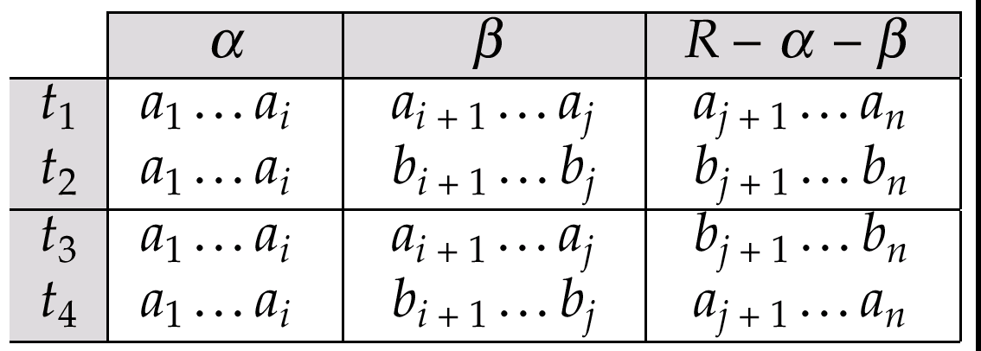
MVD (Cont.)
Tabular representation of α →→ β

Slide 115
Example
Let R be a relation schema with a set of attributes that are partitioned into 3 nonempty subsets.
Y, Z, W
We say that Y →→ Z (Y multidetermines Z)
if and only if for all possible relations r(R)
< y₁, z₁, w₁ > ∈ r and < y₂, z₂, w₂ > ∈ r
then
< y₁, z₁, w₂ > ∈ r and < y₂, z₂, w₁ > ∈ r
Note that since the behavior of Z and W are identical it follows that Y →→ Z if Y →→ W

Slide 116
Example (Cont.)
In our example:
course →→ teacher
course →→ book
The above formal definition is supposed to formalize the notion that given a particular value of Y (course) it has associated with it a set of values of Z (teacher) and a set of values of W (book), and these two sets are in some sense independent of each other.
Note:
  If Y → Z then Y →→ Z
  Indeed we have (in above notation) Z₁ = Z₂
  The claim follows.

Slide 117
Use of Multivalued Dependencies
We use multivalued dependencies in two ways:
  1. To test relations to determine whether they are legal under a given set of functional and multivalued dependencies
  2. To specify constraints on the set of legal relations. We shall thus concern ourselves only with relations that satisfy a given set of functional and multivalued dependencies.
If a relation r fails to satisfy a given multivalued dependency, we can construct a relations r′ that does satisfy the multivalued dependency by adding tuples to r.

Slide 118
Theory of MVDs
From the definition of multivalued dependency, we can derive the following rule:
  If α → β, then α →→ β
That is, every functional dependency is also a multivalued dependency
The closure D⁺ of D is the set of all functional and multivalued dependencies logically implied by D.
  We can compute D⁺ from D, using the formal definitions of functional dependencies and multivalued dependencies.
  We can manage with such reasoning for very simple multivalued dependencies, which seem to be most common in practice
  For complex dependencies, it is better to reason about sets of dependencies using a system of inference rules (see Appendix C).

Slide 119
Fourth Normal Form
A relation schema R is in 4NF with respect to a set D of functional and multivalued dependencies if for all multivalued dependencies in D⁺ of the form α →→ β, where α ⊆ R and β ⊆ R, at least one of the following hold:
  α →→ β is trivial (i.e., β ⊆ α or α ∪ β = R)
  α is a superkey for schema R
If a relation is in 4NF it is in BCNF

Slide 120
Restriction of Multivalued Dependencies
The restriction of D to R_{i} is the set D_{i} consisting of
  All functional dependencies in D⁺ that include only attributes of R_{i}
  All multivalued dependencies of the form
    α →→ (β ∩ R_{i})
  where α ⊆ R_{i} and α →→ β is in D⁺

Slide 121
4NF Decomposition Algorithm
result: = {R};
done := false;
compute D⁺;
Let D_{i} denote the restriction of D⁺ to R_{i}
while (not done)
if (there is a schema R_{i} in result that is not in 4NF) then
begin
let α →→ β be a nontrivial multivalued dependency that holds
on R_{i} such that α → R_{i} is not in D_{i}, and α∩β=φ;
result := (result - R_{i}) ∪ (R_{i} - β) ∪ (α, β);
end
else done:= true;
Note: each R_{i} is in 4NF, and decomposition is lossless-join

Slide 122
Example
R =(A, B, C, G, H, I)
F ={ A →→ B
B →→ HI
CG →→ H }
R is not in 4NF since A →→ B and A is not a superkey for R
Decomposition
a) R₁ = (A, B) (R₁ is in 4NF)
b) R₂ = (A, C, G, H, I) (R₂ is not in 4NF)
c) R₃ = (C, G, H) (R₃ is in 4NF)
d) R₄ = (A, C, G, I) (R₄ is not in 4NF)
Since A →→ B and B →→ HI, A →→ HI, A →→ I
e) R₅ = (A, I) (R₅ is in 4NF)
f)R₆ = (A, C, G) (R₆ is in 4NF)

Slide 123
Further Normal Forms
Join dependencies generalize multivalued dependencies
  lead to project-join normal form (PJNF) (also called fifth normal form)
A class of even more general constraints, leads to a normal form called domain-key normal form.
Problem with these generalized constraints: are hard to reason with, and no set of sound and complete set of inference rules exists.
Hence rarely used

Slide 124
Overall Database Design Process
We have assumed schema R is given
  R could have been generated when converting E-R diagram to a set of tables.
  R could have been a single relation containing all attributes that are of interest (called universal relation).
  Normalization breaks R into smaller relations.
  R could have been the result of some ad hoc design of relations, which we then test/convert to normal form.

Slide 125
ER Model and Normalization
When an E-R diagram is carefully designed, identifying all entities correctly, the tables generated from the E-R diagram should not need further normalization.
However, in a real (imperfect) design there can be FDs from non-key attributes of an entity to other attributes of the entity
E.g. employee entity with attributes department-number and department-address, and an FD department-number → department-address
  Good design would have made department an entity
FDs from non-key attributes of a relationship set possible, but rare --- most relationships are binary

Slide 126
Universal Relation Approach
Dangling tuples – Tuples that “disappear” in computing a join.
  Let r₁ (R₁), r₂ (R₂), …., r_{n} (R_{n}) be a set of relations
  A tuple r of the relation r_{i} is a dangling tuple if r is not in the relation:
  ∏_{Ri} (r₁ r₂ … r_{n})
The relation r₁ r₂ … r_{n} is called a universal relation since it involves all the attributes in the “universe” defined by
  R₁ ∪ R₂ ∪ … ∪ R_{n}
If dangling tuples are allowed in the database, instead of decomposing a universal relation, we may prefer to synthesize a collection of normal form schemas from a given set of attributes.

Slide 127
Universal Relation Approach
Dangling tuples may occur in practical database applications.
They represent incomplete information
E.g. may want to break up information about loans into:
  (branch-name, loan-number)
  (loan-number, amount)
  (loan-number, customer-name)
Universal relation would require null values, and have dangling tuples

Slide 128
Universal Relation Approach (Contd.)
A particular decomposition defines a restricted form of incomplete information that is acceptable in our database.
  Above decomposition requires at least one of customer-name, branch-name or amount in order to enter a loan number without using null values
  Rules out storing of customer-name, amount without an appropriate loan-number (since it is a key, it can't be null either!)
Universal relation requires unique attribute names unique role assumption
  e.g. customer-name, branch-name
Reuse of attribute names is natural in SQL since relation names can be prefixed to disambiguate names

Slide 129
Denormalization for Performance
May want to use non-normalized schema for performance
E.g. displaying customer-name along with account-number and balance requires join of account with depositor
Alternative 1: Use denormalized relation containing attributes of account as well as depositor with all above attributes
  faster lookup
  Extra space and extra execution time for updates
  extra coding work for programmer and possibility of error in extra code
Alternative 2: use a materialized view defined as
account depositor
  Benefits and drawbacks same as above, except no extra coding work for programmer and avoids possible errors

Slide 130
Other Design Issues
Some aspects of database design are not caught by normalization
Examples of bad database design, to be avoided:
Instead of earnings(company-id, year, amount), use
  earnings-2000, earnings-2001, earnings-2002, etc., all on the schema (company-id, earnings).
    Above are in BCNF, but make querying across years difficult and needs new table each year
  company-year(company-id, earnings-2000, earnings-2001,
  earnings-2002)
    Also in BCNF, but also makes querying across years difficult and requires new attribute each year.
    Is an example of a crosstab, where values for one attribute become column names
    Used in spreadsheets, and in data analysis tools

Slide 131
Proof of Correctness of 3NF Decomposition Algorithm

Slide 132
Correctness of 3NF Decomposition Algorithm
3NF decomposition algorithm is dependency preserving (since there is a relation for every FD in F_{c})
Decomposition is lossless join
  A candidate key (C) is in one of the relations R_{i} in decomposition
  Closure of candidate key under F_{c} must contain all attributes in R.
  Follow the steps of attribute closure algorithm to show there is only one tuple in the join result for each tuple in R_{i}

Slide 133
Correctness of 3NF Decomposition Algorithm (Contd.)
Claim: if a relation R_{i} is in the decomposition generated by the
above algorithm, then R_{i} satisfies 3NF.
Let R_{i} be generated from the dependency α →β
Let γ → B be any non-trivial functional dependency on R_{i}. (We need only consider FDs whose right-hand side is a single attribute.)
Now, B can be in either β or α but not in both. Consider each case separately.

Slide 134
Correctness of 3NF Decomposition (Contd.)
Case 1: If B in β:
  If γ is a superkey, the 2nd condition of 3NF is satisfied
  Otherwise α must contain some attribute not in γ
  Since γ → B is in F⁺ it must be derivable from F_{c}, by using attribute closure on γ.
  Attribute closure not have used α →β - if it had been used, α must be contained in the attribute closure of γ, which is not possible, since we assumed γ is not a superkey.
  Now, using α→ (β- {B}) and γ → B, we can derive α →B
  (since γ ⊆ α β, and B ∉ γ since γ → B is non-trivial)
  Then, B is extraneous in the right-hand side of α →β; which is not possible since α →β is in F_{c}.
  Thus, if B is in β then γ must be a superkey, and the second condition of 3NF must be satisfied.

Slide 135
Correctness of 3NF Decomposition (Contd.)
Case 2: B is in α.
  Since α is a candidate key, the third alternative in the definition of 3NF is trivially satisfied.
  In fact, we cannot show that γ is a superkey.
  This shows exactly why the third alternative is present in the definition of 3NF.
Q.E.D.

Slide 136
End of Chapter

Slide 137
Sample lending Relation

Slide 138
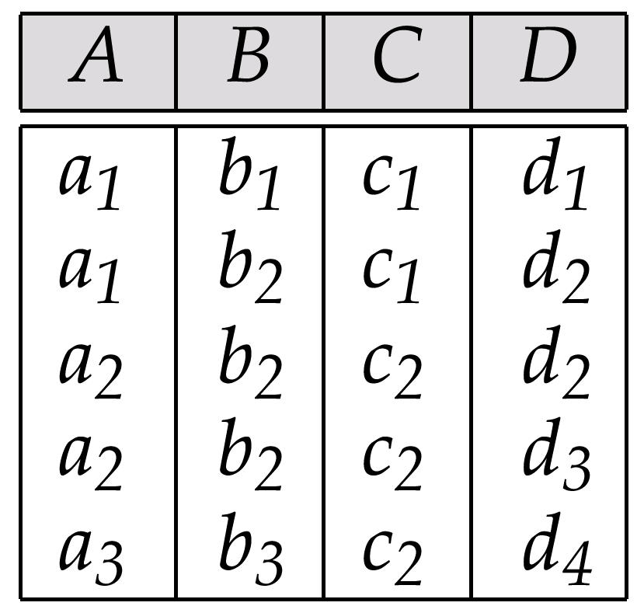
Sample Relation r

Slide 139
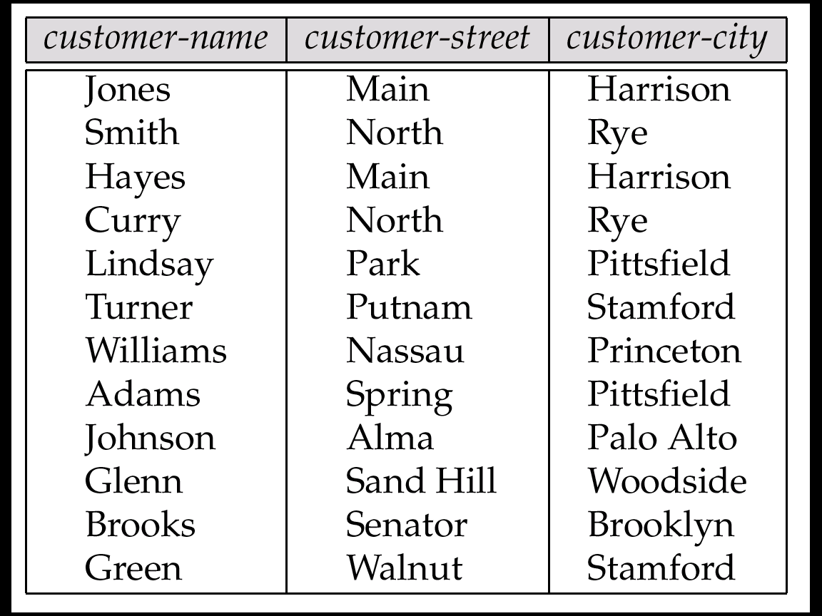
The customer Relation

Slide 140
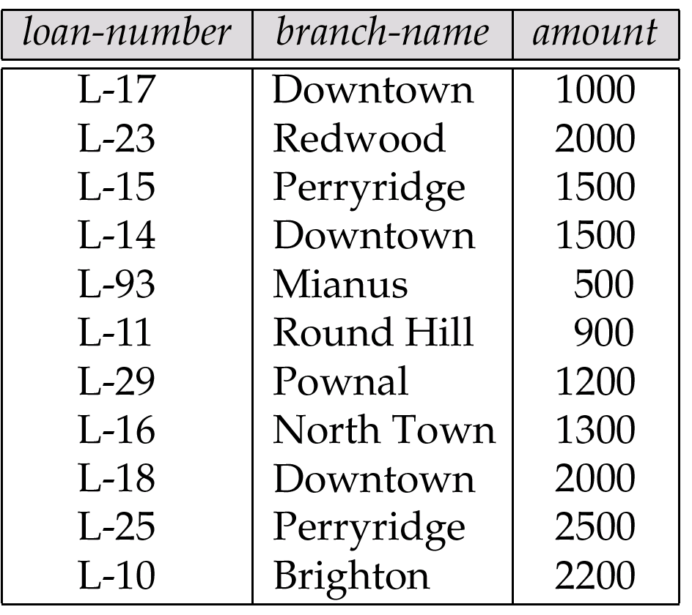
The loan Relation

Slide 141
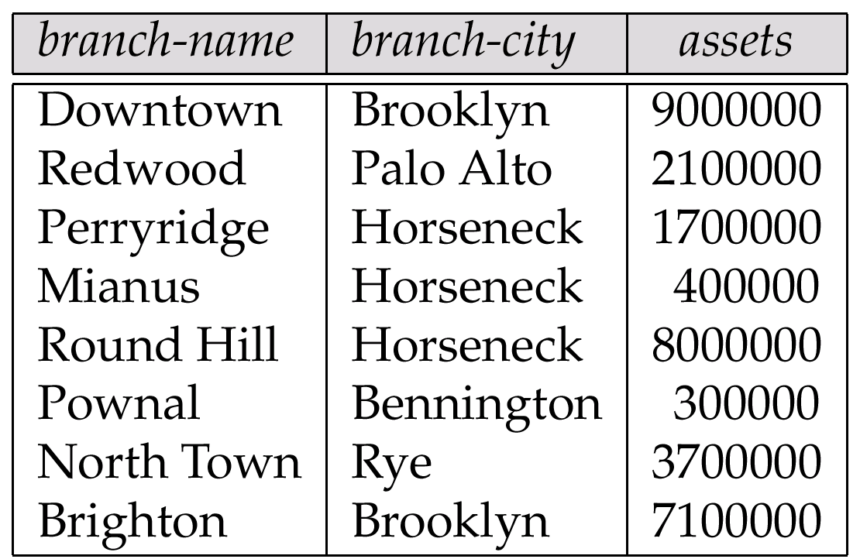
The branch Relation

Slide 142
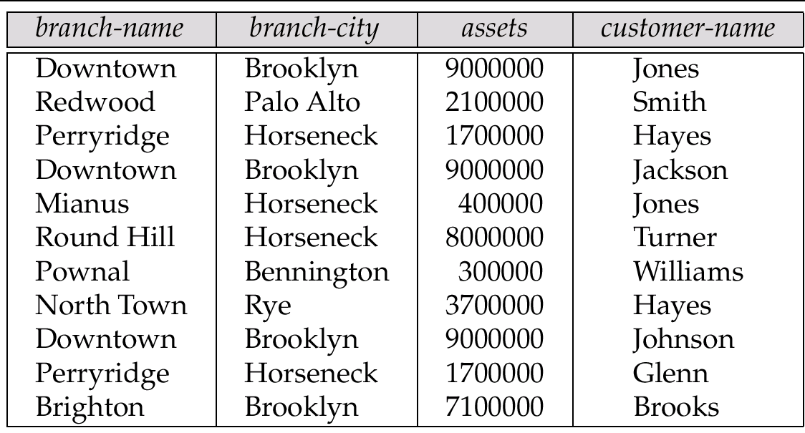
The Relation branch-customer

Slide 143
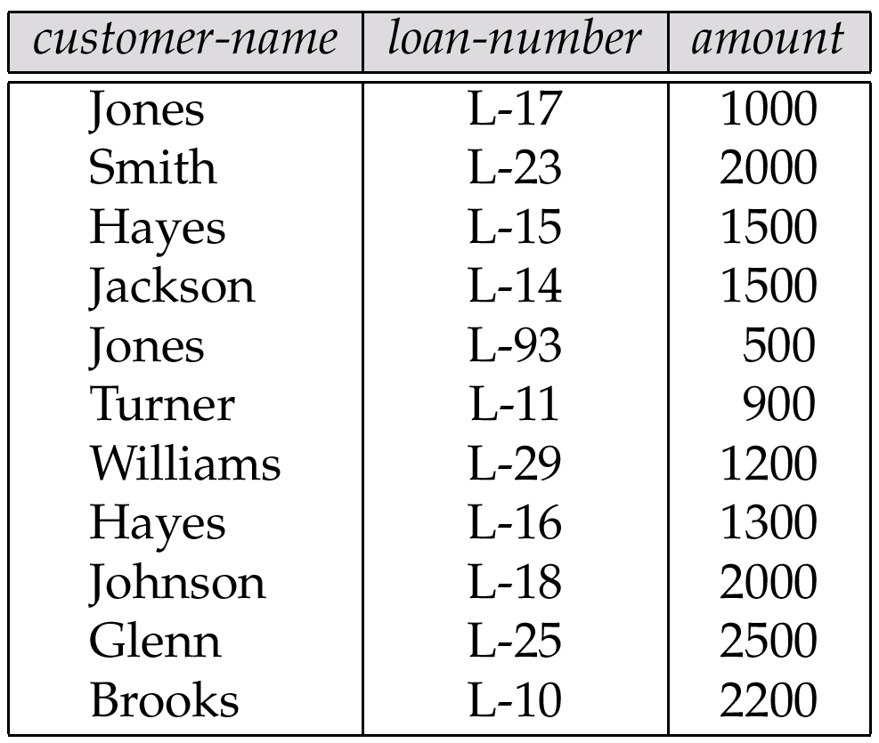
The Relation customer-loan

Slide 144
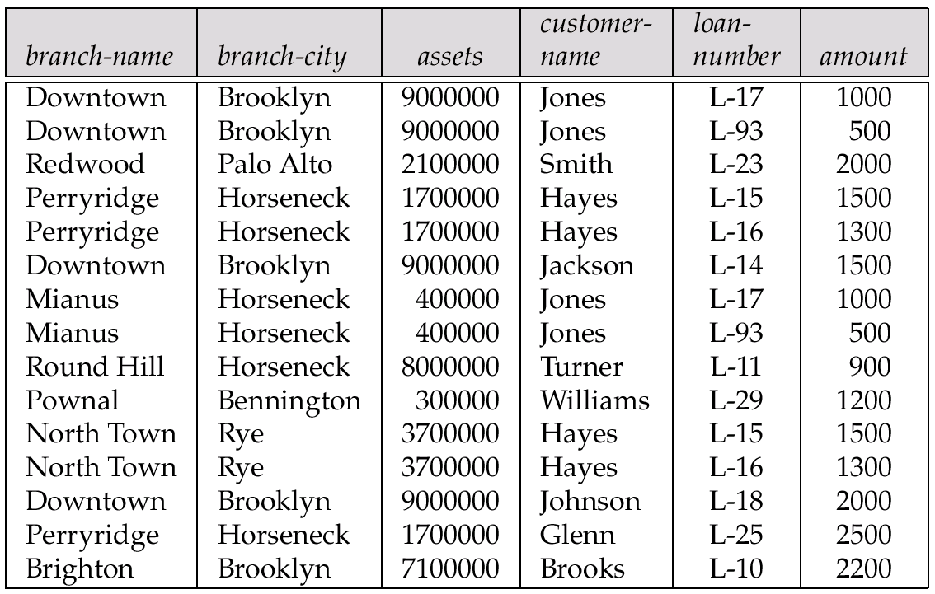
The Relation branch-customer customer-loan

Slide 145
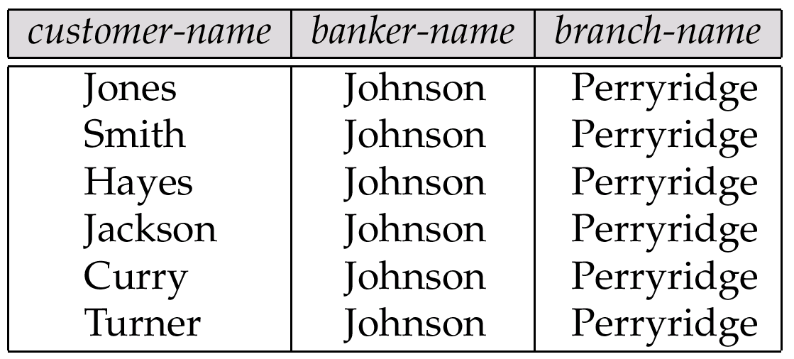
An Instance of Banker-schema

Slide 146
Tabular Representation of α →→ β

Slide 147
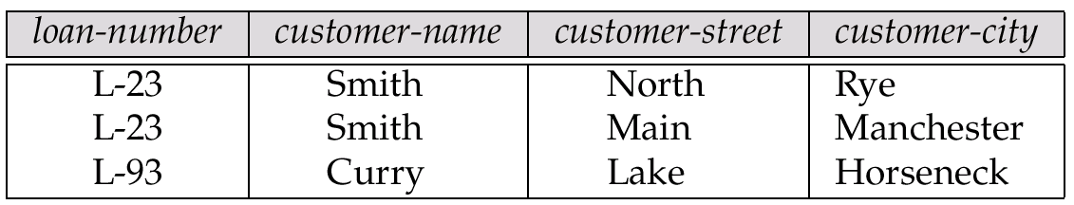
Relation bc: An Example of Reduncy in a BCNF Relation

Slide 148
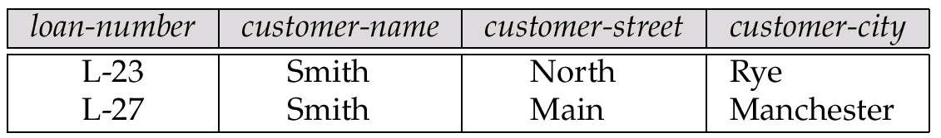
An Illegal bc Relation

Slide 149
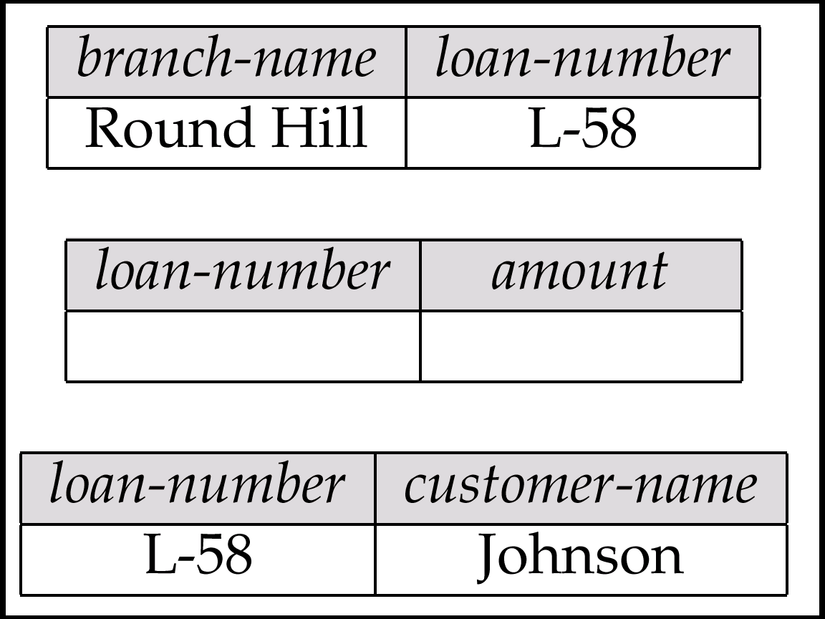
Decomposition of loan-info

Slide 150
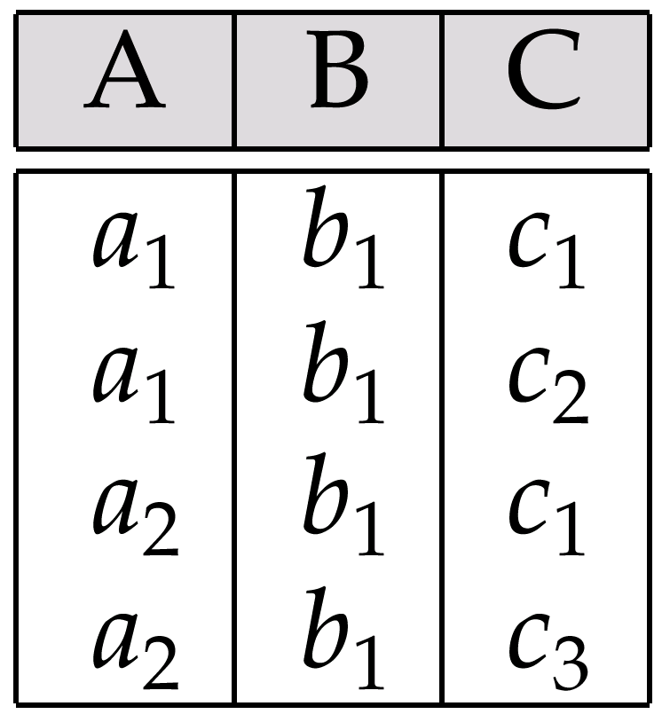
Relation of Exercise 7.4

