Slide 1
Exploratory Data Analysis
Python Foundations: Foodhub
June 23, 2023
Vaibhav Pradhan

Slide 2
Contents / Agenda
Executive Summary
Business Problem Overview and Solution Approach
Data Overview
EDA - Univariate Analysis
EDA - Multivariate Analysis

Slide 3
Executive Summary
Foodhub is a food aggregator company that has collected and stored data on orders made by registered customers in their online portal and is looking to understand demand for different restaurants to help enhance customer experience. The data was analyzed to gain valuable insights to understand customer preferences and behavior around the following
Restaurant demand
The top five restaurants with the most orders (Shake Shack, the Meatball Shop, Blue Ribbon Sushi, Blue Ribbon Fried Chicken, and Parm) account for 33.4% of all 1898 orders
Foodhub can offer promotions for these restaurants on their app/portal which has the potential to drive demand for the restaurants and increased revenue for FoodHub.
Repeat customers can also be further incentivized to generate demand
Popular Cuisines
There are 14 unique cuisines across 178 restaurants and “American” cuisine is the most popular (584 orders)
Top 5 popular cuisine in order of popularity are: American, Japanese, Italian, Chinese and Mexican
These restaurants could be encouraged to offer promo offers to customers further increasing demand and Foodhub revenue
Customer ratings
736 out of 1898 orderswere not rated.
Only neutral (3 star) and positive (4 and 5 star) reviews are given. 50.6% of reviews given were 5-star reviews, 33.2% were 4-star reviews, and 16.1% were 3 star reviews.
It is possible that customers with negative experience did not rate their orders
In order to gain a better understanding of negative customer experiences, and to gain a holistic view of customer experiences with FoodHub for each restaurant, FoodHub should incentivize customers to provide ratings for Foodhub
Ordering Trends on different days and delivery times
Delivery times are longer on weekdays (28 minutes on average) than on weekends (22 minutes on average)
The spread of delivery times on weekend is much higher than the spread of delivery times of weekdays. This indicates weekend delivery times have wider variance
In order to improve customer delivery times on weekdays, FoodHub could evaluate their delivery staffing during weekday rush hour and recruit more people as needed. They could also review if the traffic routing on their app is optimized to avoid areas with heavy traffic on weekdays..
Typical customer food order cost
The minimum money spent on an order was $4.47, and the most expensive order was $35.41 with an average cost of $16.5 and a mean cost of $14.14. The median value is lower than the mean value for cost_of_the_order and hence data is skewed to the right and tend to be on the higher side than the median value. Percentage of orders above 20 dollars 29.24 %
Korean and Vietnamese food orders tend to be lower side and have a lower spread on the cost
Day of the week does not have any impact on cost of the order
Data analysis did not indicate that cost of the order was contributing to customer demand

Slide 4

Business Problem Overview and Solution Approach
Business Context
Exploratory Data Analysis approach is to be leveraged to analyze and summarize main characteristics and uncover hidden insights from the data.
Observations from the analysis can help to enhance customer experience, improve operational efficiency, and make informed business decisions to offer promotions that can drive demand
FoodHub is a food aggregator company that offers a smartphone app that allows customers to access multiple restaurants and help place online orders.
The app facilitates the entire order and delivery process, from the restaurant receiving the order to a delivery person picking it up and delivering it to the customer's location.
Customers can rate their orders, and FoodHub earns revenue by collecting a fixed margin from the restaurants for each delivery order.
Data Analysis includes univariate and multivariate analysis of the dataset to review summary statistics and visualization to identify data patterns, relationship between data elements and data anomalies
Foodhub has collected and stored data on orders made by registered customers in their online portal and is looking to understand demand for different restaurants to help enhance customer experience
Foodhub data can be analyzed to gain valuable insights to understand customer preferences and behavior around the following
Problem Overview
Solution Approach
Restaurant demand
Popular Cuisines
Customer ratings
Order delivery times
Ordering trends on different days
Typical customer food order cost

Slide 5
Data Overview
The data contains details on the orders that were submitted by Foodhub customers on the online portal and includes restaurant name, cuisine, customer ratings and delivery related information. Table below outlines the data dictionary
Variable | Description | Datatype | # of missing values
order_id | Unique ID of the order | Integer (int64) | 0
customer_id | ID of the customer who ordered the food | Integer (int64) | 0
restaurant_name | Name of the restaurant | String (Object) | 0
cuisine_type | Cuisine ordered by the customer | String (Object) | 0
cost_of_the_order | Cost of the order | Float (float64) | 0
day_of_the_week | Indicates whether the order is placed on a weekday or weekend (The weekday is from Monday to Friday and the weekend is Saturday and Sunday) | String (Object) | 0
rating | Rating given by the customer out of 5 | String (Object) | 0
food_preparation_time | Time (in minutes) taken by the restaurant to prepare the food. This is calculated by taking the difference between the timestamps of the restaurant's order confirmation and the delivery person's pick-up confirmation. | Integer (int64) | 0
delivery_time | Time (in minutes) taken by the delivery person to deliver the food package. This is calculated by taking the difference between the timestamps of the delivery person's pick-up confirmation and drop-off information | Integer (int64) | 0
Note:
The dataset provided included a total of 1898 rows (customer orders)
A total of 9 data columns / variables are included
All variables have data values available. However, about 736 orders have the customer rating variable value as “Not Given” which even though available is not very helpful

Slide 6
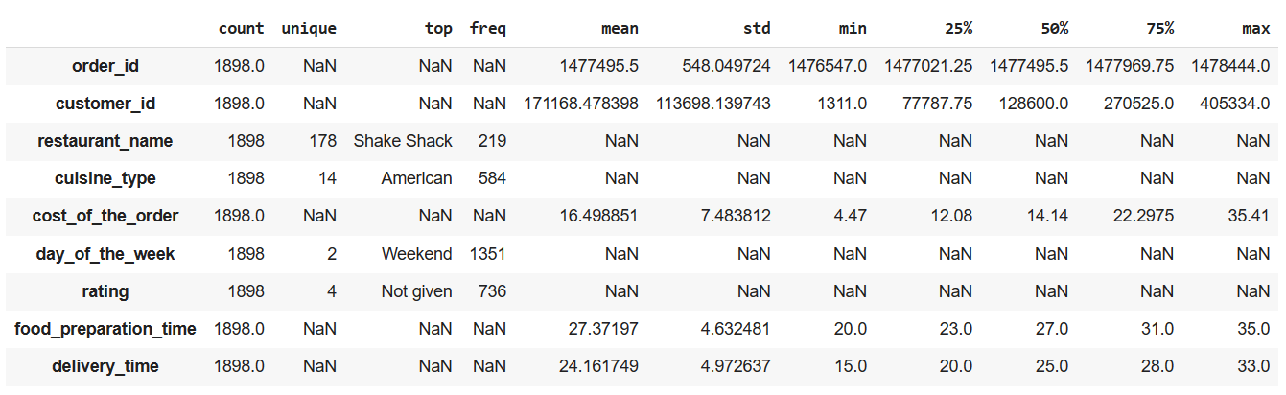
Data Overview
The statistical summary of the dataset for all data columns/variables is represented below.
Note:
Although order_id and customer_id are Integer, the summary statistics are not very relevant
The dataset includes data for a total of 178 restaurants with most orders (219) from “Shake Shack” restaurant
There are 14 unique cuisines across these 178 restaurants and “American” cuisine is the most popular (584 orders)
Order amount varied from a minimum of $4.47 to a maximum of $35.41 with an average order amount of ~ $16.50
The dataset includes primarily “Weekend” order with 1351 out of 1898 orders over the Weekend
736 out of 1898 customer orders do not have a customer defined rating
Food Preparation Time varied from a minimum of 20 mins to a maximum of 35 mins with an average of ~27.37 mins
Delivery Time varied from a minimum of 15 mins to a maximum of 33 mins with an average of ~24.16 mins

Slide 7
Univariate Analysis – order_id, customer_id, restaurant_name
Top 5 restaurants in terms of the number of orders received
The dataset includes 1898 unique customer orders. Minimum order_id is 1476547 and max order_id is 1478444
The dataset includes orders placed by 1200 unique customers. Minimum customer_id is 1311 and maximum customer_id is 405334
order_id and customer_id are Integer and represent unique identifiers for order and the customer, hence the summary statistics are not very relevant for these fields
The dataset includes order data for a total of 178 restaurants with most orders (219) from “Shake Shack” restaurant
Top 5 restaurants on the left account for ~33% of total orders
Many customers have repeat orders and the table on the left indicates top 3 repeat customers
restaurant_name | # of orders
Shake Shack | 219
The Meatball Shop | 132
Blue Ribbon Sushi | 119
Blue Ribbon Fried Chicken | 96
Parm | 68
Top 3 most frequent customers that can be offered 20% discount vouchers
Customer_id | # of orders
52832 | 13
47440 | 10
83287 | 9

Slide 8
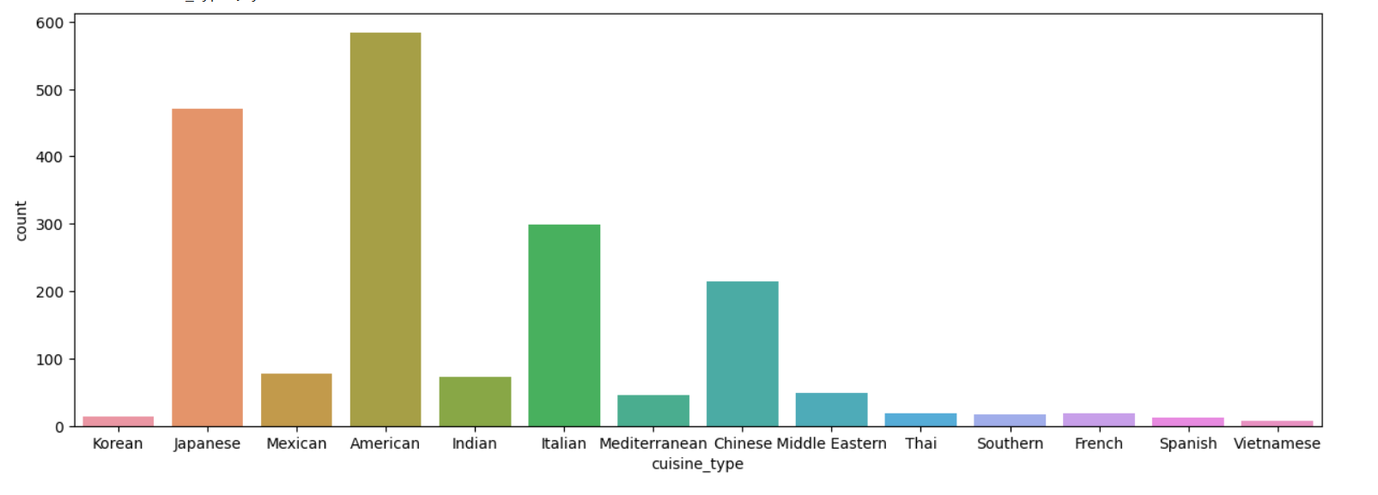
Univariate Analysis – cuisine_type
There are 14 unique cuisines across 178 restaurants and “American” cuisine is the most popular (584 orders)
Top 5 popular cuisine in order of popularity are: American, Japanese, Italian, Chinese and Mexican

Slide 9
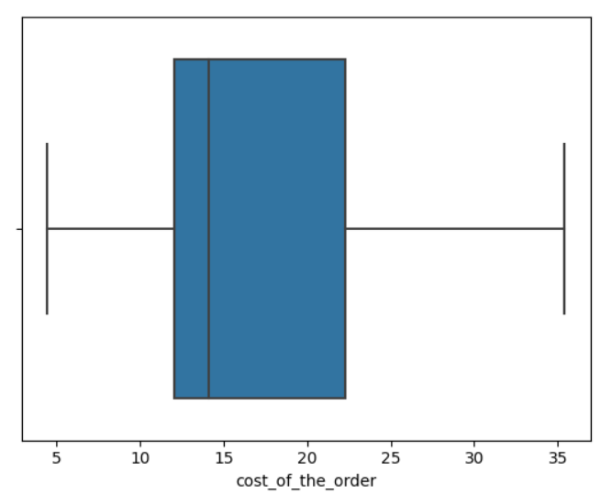
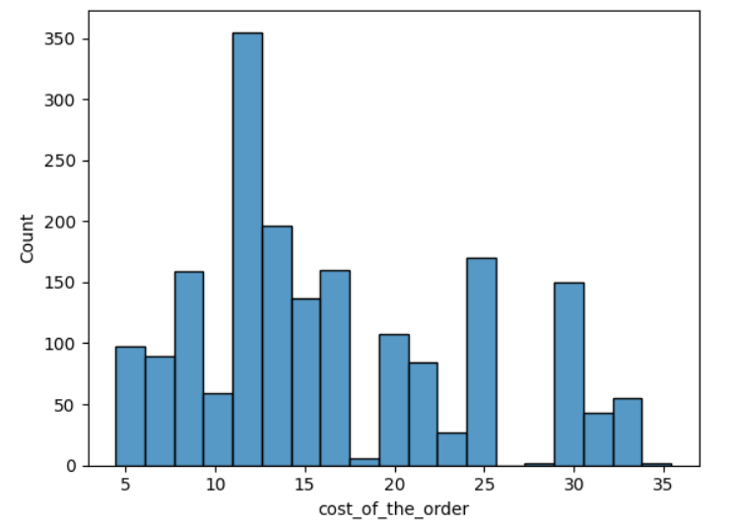
Univariate Analysis – cost_of_the_order
The number of total orders that cost above 20 dollars is: 555
Percentage of orders above 20 dollars: 29.24 %
The minimum money spent on an order was $4.47, and the most expensive order was $35.41 with an average cost of $16.5 and a mean cost of $14.14
The above is also evident from the histogram which depicts a longer tail of data to the right
The boxplot also indicates that the median value is lower than the mean value for cost_of_the_order and hence data is skewed to the right
There are no outliers on either minimum or maximum side of the data

Slide 10
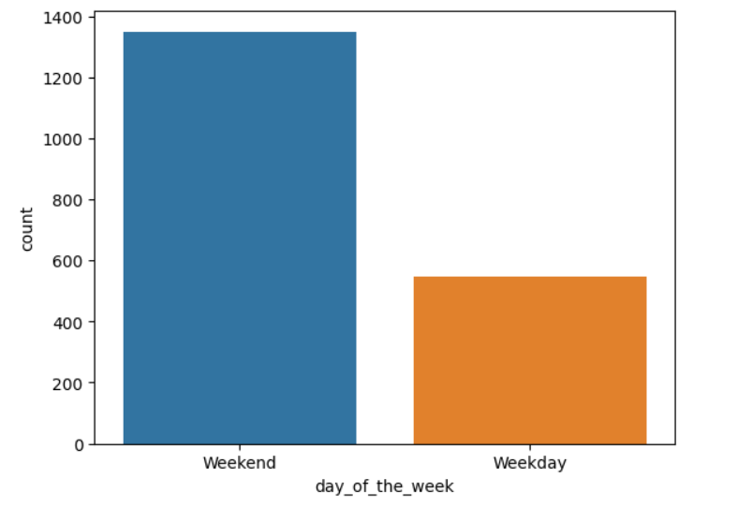
Univariate Analysis – day_of_the_week
Most popular cuisine on weekends
The dataset includes primarily “Weekend” order with 1351 out of 1898 (~ 71%) orders over the Weekend
Most popular cuisines over the weekend are depicted on the right which is aligned to the overall cuisine popularity
Cuisine | # of orders
American | 415
Japanese | 335
Italian | 207
Chinese | 163
Mexican | 53
Indian | 49
Mediterranean | 32
Middle Eastern | 32
Thai | 15
French | 13
Korean | 11
Southern | 11
Spanish | 11
Vietnamese | 4

Slide 11
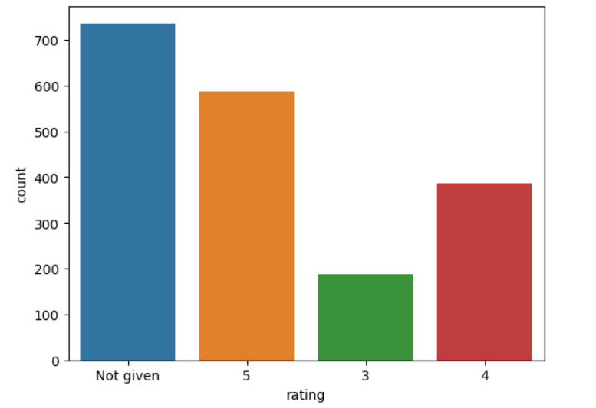
Univariate Analysis – rating
736 out of 1898 customer orders (~ 38% orders) do not have a customer defined rating
588 out of 1898 customer orders (~ 31% orders) have highest rating
386 orders received 4 stars
188 orders received 3 stars
No order received 1 or 2 stars

Slide 12
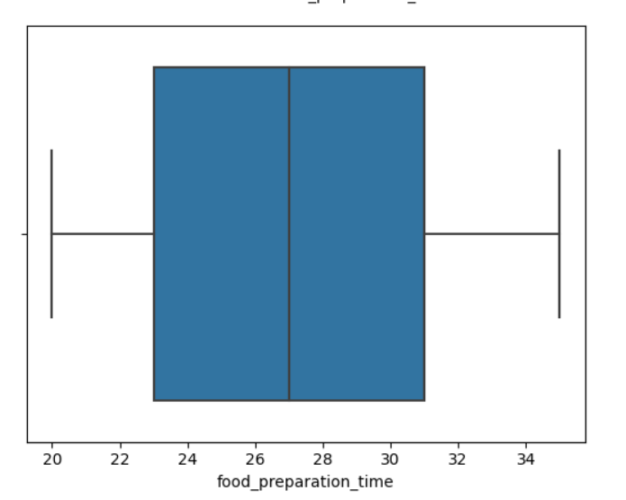
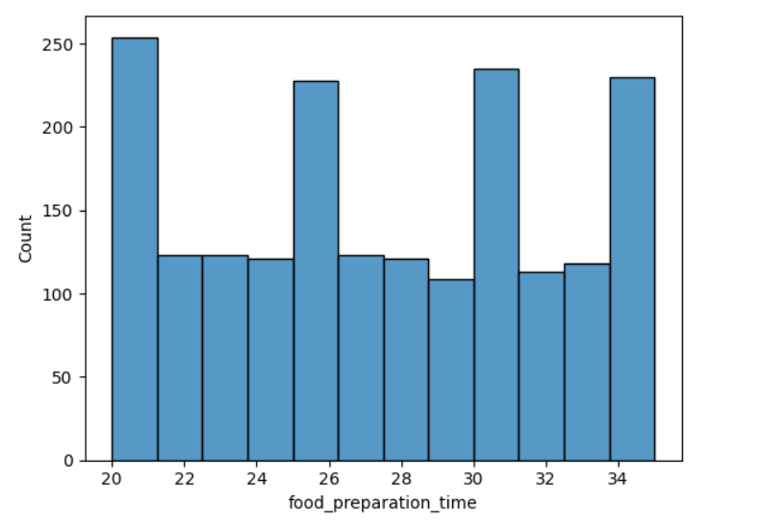
Univariate Analysis – food_preparation_time
Food Preparation time has a very slight righ skew but is mostly evenly distributed with the mean time = 27.37 and median time = 27
Most food preparation takes between 23 – 31 minutes
There are no outliers

Slide 13
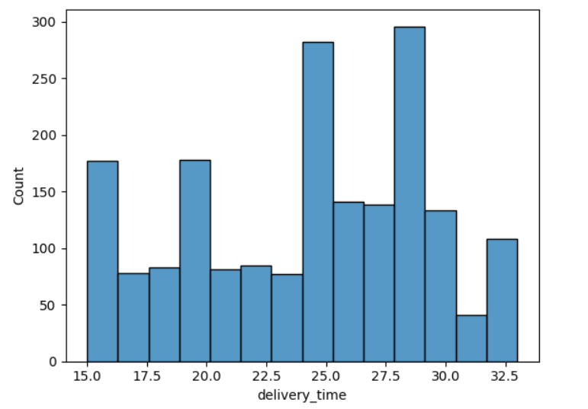
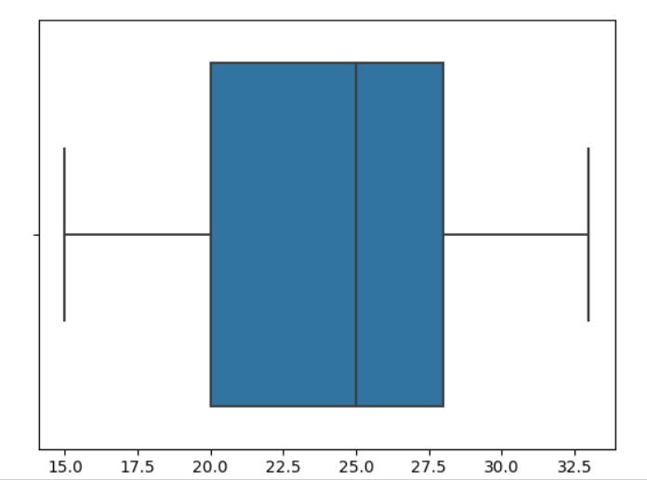
Univariate Analysis – delivery_time
Delivery time has a slight left skew with a mean time = 24.16 and median time = 25
min delivery time = 15 and max time = 33
The middle 50% of delivery times are within the 20 – 28 mins
There are no outliers

Slide 14
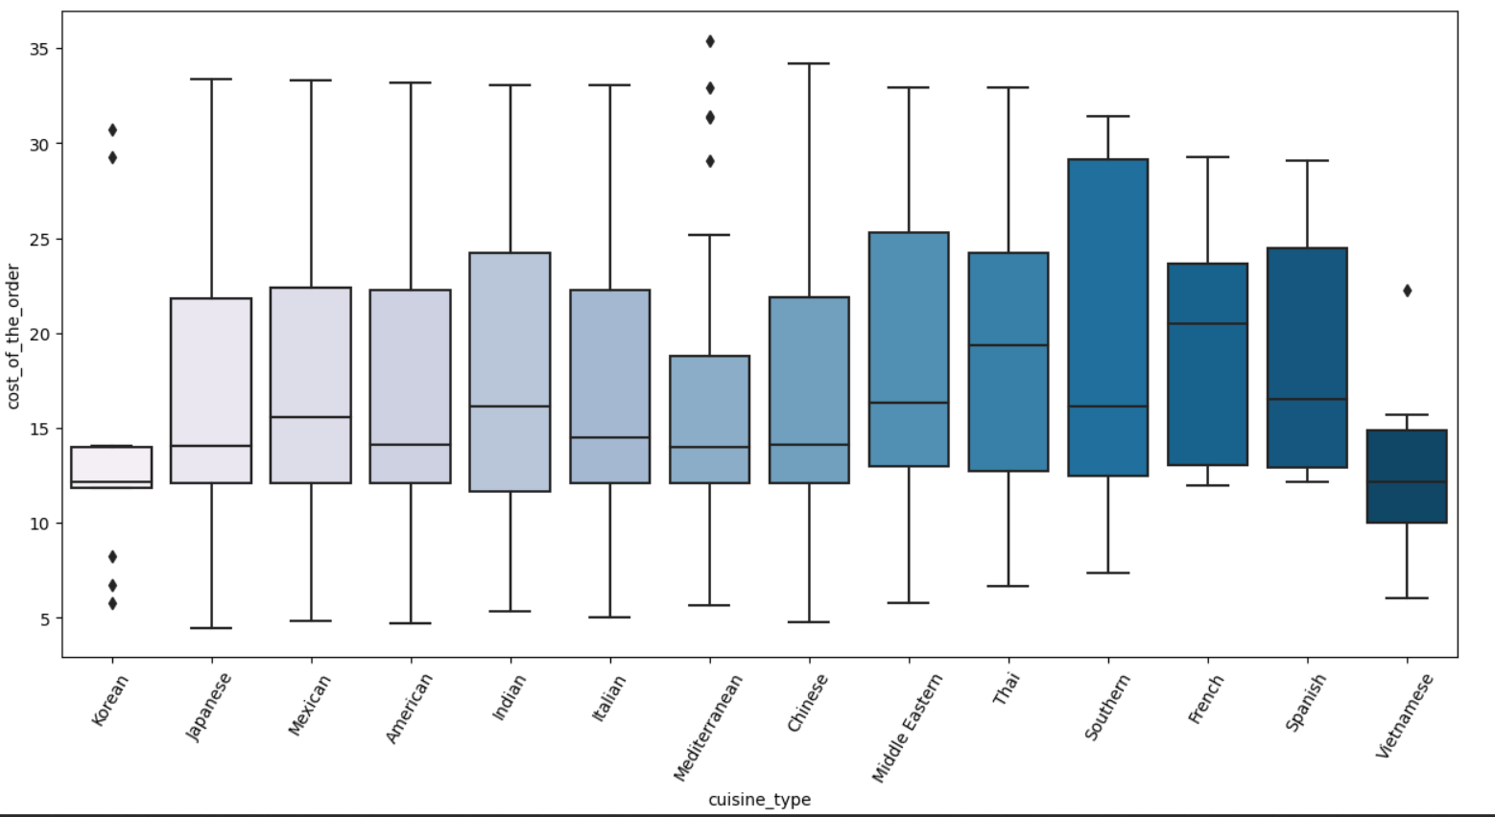
Multivariate Analysis – cuisine v/s cost_of_the_order
cost_of_the_order for most cuisines is right skewed with the exception of Thai and French cusines, which indicates the average the cost of the order is higher than the mean cost. This means that most of these cuisines do have many high cost orders
There are outliers for Korean, Mediterranean and Vietnamese cuisine
Median cost of Vietnamese cuisine is lowest whereas French cuisine has highest median cost
Chinese cuisine has a wide range of cost whereas Korean cuisine is less variant with the exception of some outliers

Slide 15
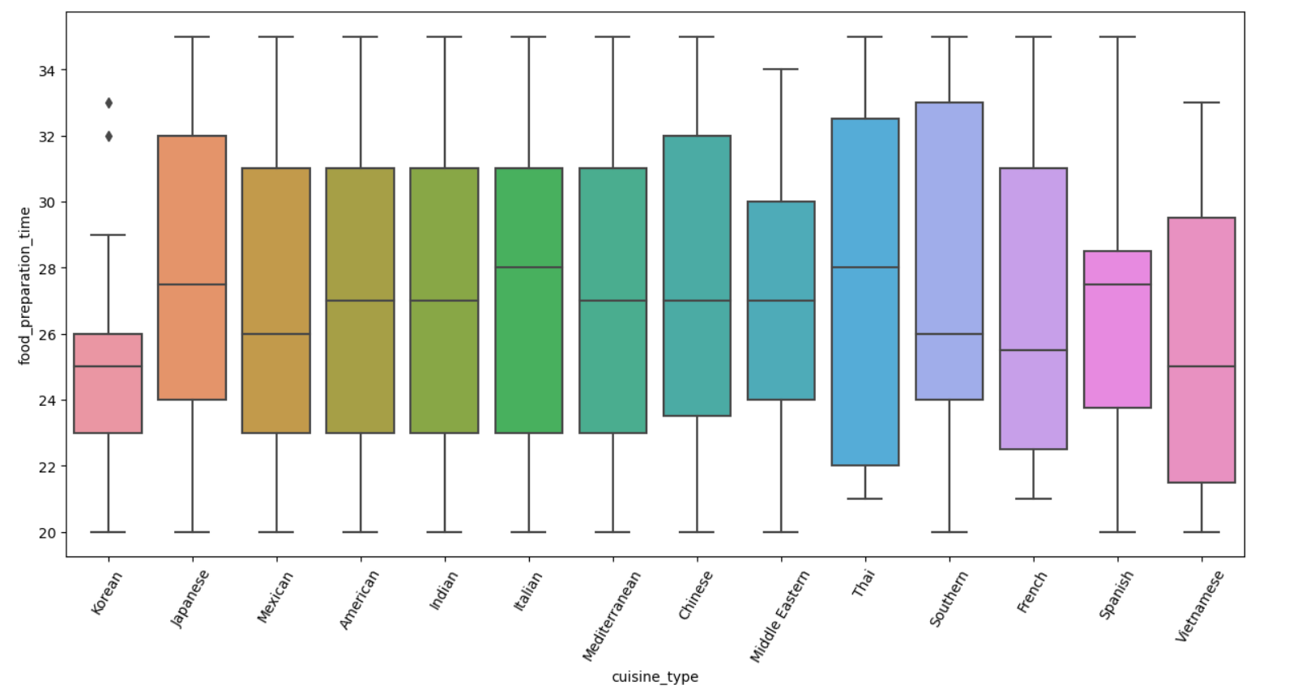
Multivariate Analysis – cuisine v/s total_preparation_time
Korean and Vietnamese cuisines have the lowest median preparation times of 25 mins
Korean cuisine has the lowest mean
Italian cuisine has the highest median preparation time of 28 mins
Min food preparation time across all cuisines except for Thai and French is 20 mins. Thai and French cuisine the minimum time is 21 minutes
Southern cuisine followed by Thai cuisine have the most spread out preparation times

Slide 16
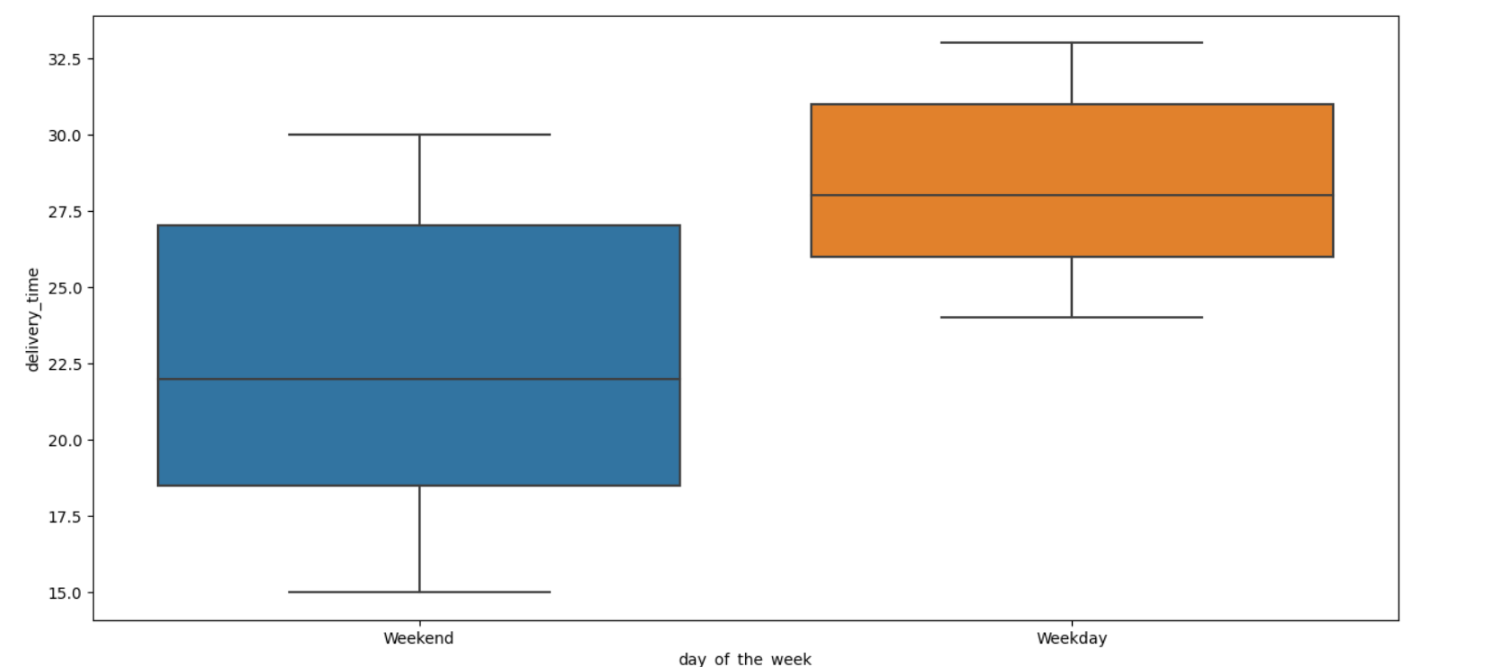
Multivariate Analysis – day_of_the_week v/s delivery_time
The minimum, maximum, and median of weekday delivery times is higher than the same measures for the weekend.
The spread of delivery times on weekdays is much smaller than the spread of delivery times of weekends.
The data indicates much higher number of weekend orders than weekday hence more data points may need to be explored to understand the cause for longer delivery times on weekdays. It could be due to less delivery staff on weekdays, increased traffic during delivery due to rush hours etc

Slide 17
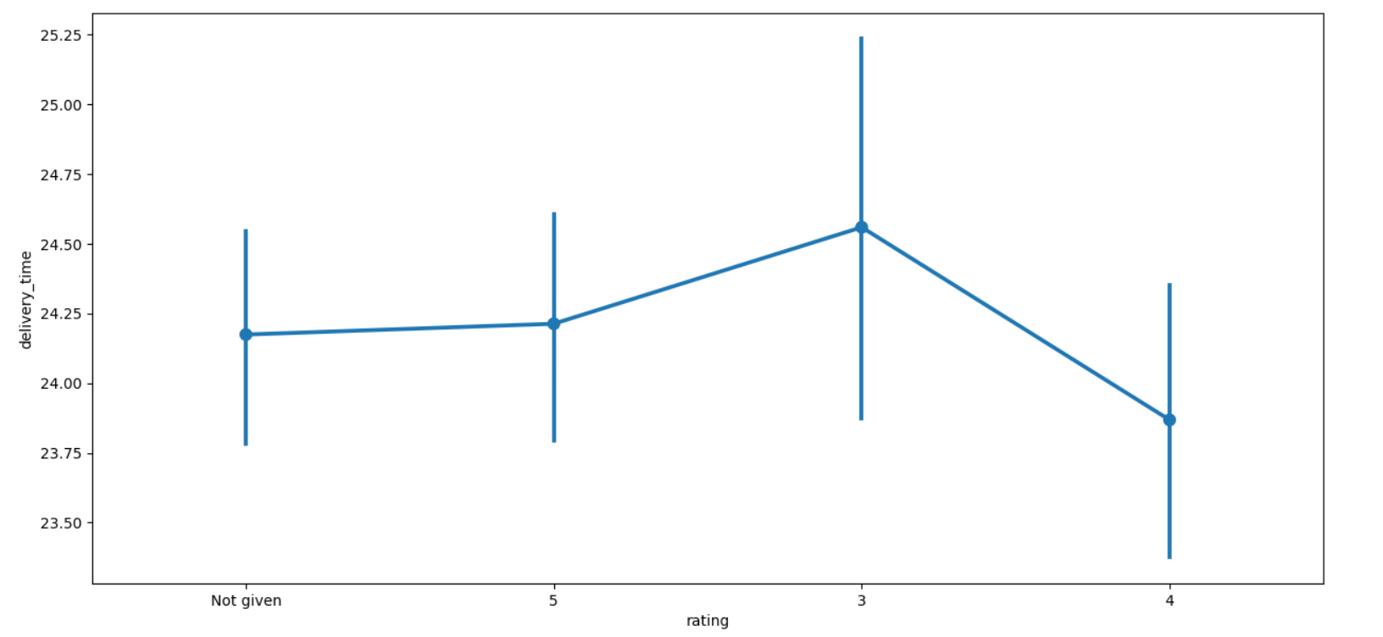
Multivariate Analysis – rating v/s delivery_time
Higher delivery times have a rating of 3
Delivery time for orders rated 5 are higher than orders rated 4
There does not seem to be any relationship between rating and delivery_time

Slide 18
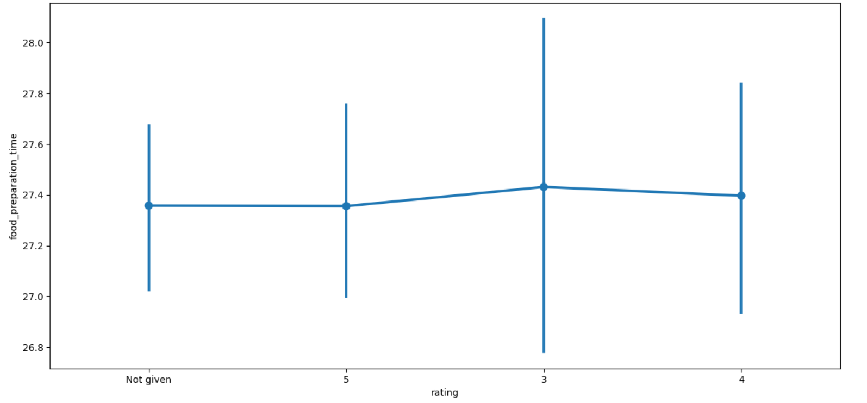
Multivariate Analysis – rating v/s food_preparation_time
Food preparation time has a slight negative correlation with rating
As the food preparation time decreases the rating is higher

Slide 19
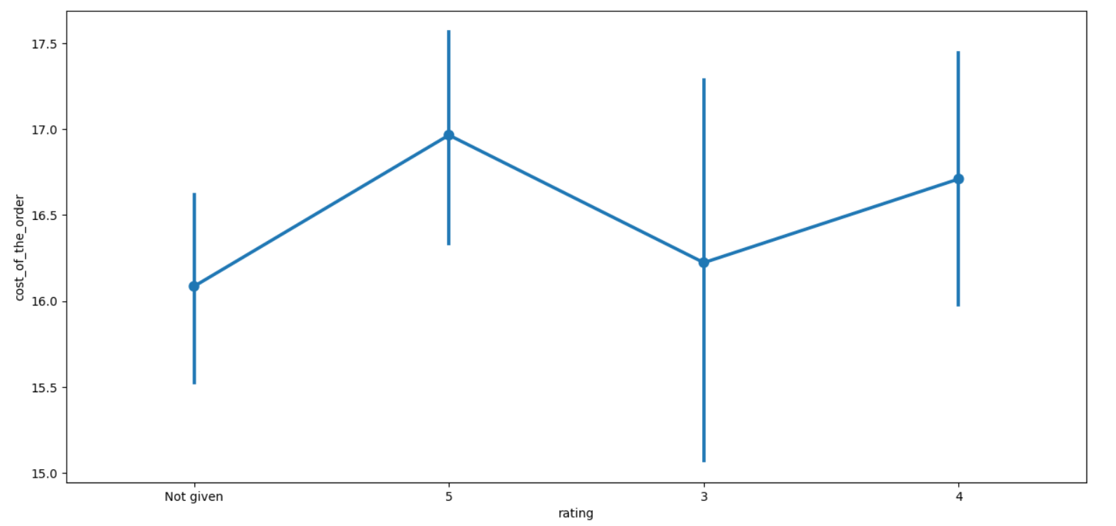
Multivariate Analysis – rating v/s cost_of_the_order
Cost of order seems to have a slight positive correlation with rating

Slide 20
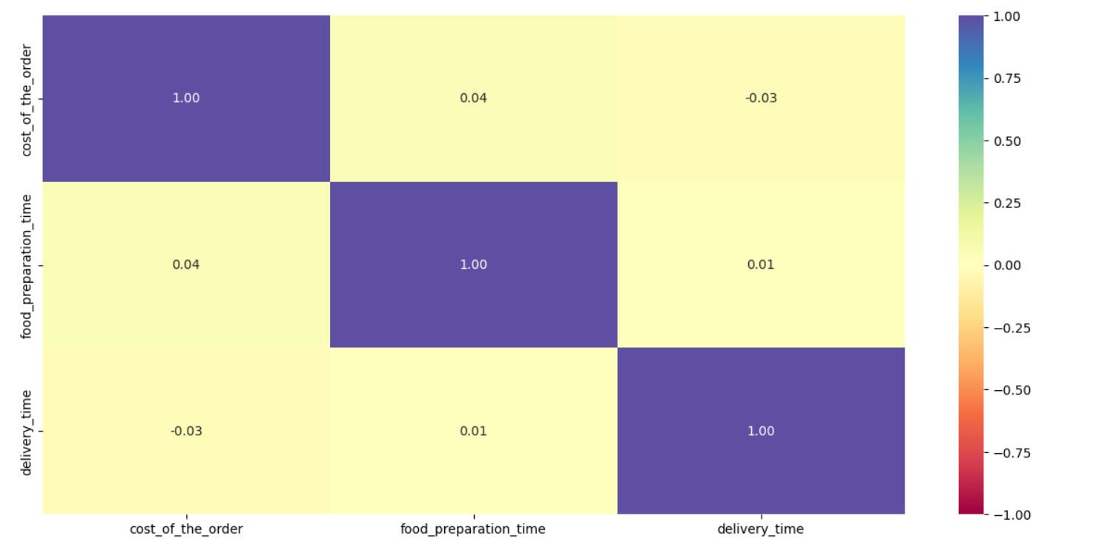
Multivariate Analysis – Correlation among variables
The chart on the left depicts the correlation heatmap between the following variables
Cost_of_the_order
Food_preparation_time
Delivery_time
Based on the chart it is very evident that there is extremely low between the above three variables
The cost of the order has a slightly positive correlation with prep time, indicating that as the time to prepare food increases, the cost of the of the order increases slightly.
The cost of the order has a slightly negative correlation with delivery time, indicating that as cost of the order increases, the delivery time decreases slightly

Slide 21
Multivariate Analysis – Top Restaurants by Revenue
restaurant_name | Revenue
Shake Shack | 3579.53
The Meatball Shop | 2145.21
Blue Ribbon Sushi | 1903.95
Blue Ribbon Fried Chicken | 1662.29
Parm | 1112.76
RedFarm Broadway | 965.13
RedFarm Hudson | 921.21
TAO | 834.5
Han Dynasty | 755.29
Blue Ribbon Sushi Bar & Grill | 666.62
Rubirosa | 660.45
Sushi of Gari 46 | 640.87
Nobu Next Door | 623.67
Five Guys Burgers and Fries | 506.47
The table on the left depicts top 14 restaurants by revenue
Shake Shack has the highest revenue amongst all the 178 restaurants that had the orders
Foodhub can also negotiate revenue based commisions with restaurants e.g. higher commisions with top restaurants to increase revenue or promote lowere revenue restaurants to increase their sales and gain more revenue share

Slide 22
Multivariate Analysis – Restaurant Promo Offer
The company wants to provide a promotional offer in the advertisement of the restaurants. The condition to get the offer is that the restaurants must have a rating count of more than 50 and the average rating should be greater than 4.
restaurant_name | Count of rating
Shake Shack | 133
The Meatball Shop | 84
Blue Ribbon Sushi | 73
Blue Ribbon Fried Chicken | 64
RedFarm Broadway | 41
The restaurants fulfilling the criteria to get the promotional offer were arrived by the following steps
Identify all the restaurant orders that were rated and aggregate the data by the restaurant names to get a count of ratings for each restaurant. Sort the result in descending order of the number of ratings to get below
From the subset of data above, filter out all restaurants that have less than 50 ratings
Using the above dataset, calculate the average rating and sort by the average rating.
All the restaurants with an average rating greater than 4 are eligible for promotional offer
These restaurants have more than 50 ratings
This restaurant was not further included in analysis as it has less than 50 ratings
List of restaurants eligible for promotional offer based on the criteria
restaurant_name | Average rating
The Meatball Shop | 4.511905
Blue Ribbon Fried Chicken | 4.328125
Shake Shack | 4.278195
Blue Ribbon Sushi | 4.219178

Slide 23
Multivariate Analysis
The company charges the restaurant 25% on the orders having cost greater than 20 dollars and 15% on the orders having cost greater than 5 dollars. The net revenue generated by the company across all orders is calculated in below steps
Calculate revenue for each order based on the cost_of_the_order applying appropriate percentage of commission
Aggregate revenue across all the orders
Foodhub Net Revenue
$6166.30
The company wants to analyze the total time required to deliver the food. The percentage of orders that take more than 60 minutes to get delivered from the time the order is placed is calculated as below
Calculate total time for each order based food_preparation_time and delivery_time
Select the number of orders where total time is greater than 60 mins and calculate the percentage
# of Orders with Total Time > 60 mins
200
% of Orders with Total Time > 60 mins
10.54 %
The company wants to analyze the delivery time of the orders on weekdays and weekends. The mean delivery time varies during weekdays and weekends and is indicated on the right
Average Delivery Time on Weekdays
28 mins
Average Delivery Time on Weekends
22 mins

