Slide 1
AMERICAN EXPRESS · CODESTREET 2026
The End-to-End Servicing Agent
Resolves fee reversals, credit-limit increases & card replacements in a single conversation — with a tamper-evident audit trail and a human escape hatch.
Problem Statement: End-to-End Servicing Agent
Team: <your team name> Members: <names>
Demo video: <link> Repo: github.com/VaibhavDangaich/Codestreet_2026

Slide 2
THE PROBLEM
Routine servicing is slow, costly, and repetitive
Fee reversals, limit increases, and replacement cards are the highest-frequency requests — and the most tedious to service.
Members wait on hold, repeat themselves, and get transferred between agents. Every touch adds compliance overhead.
Skilled human agents spend their time on routine work instead of the complex cases that actually need them.
~$13.50
cost per human-assisted contact
~$1.84
cost per self-service contact
The opportunity: resolve the routine autonomously — safely — and free humans for the hard cases.
End-to-End Servicing Agent · CodeStreet 2026
02

Slide 3
OUR SOLUTION
An agent that resolves the request — not just talks about it
Resolves end-to-end
Provably auditable
Escalates gracefully
Executes the actual fee waiver, limit change, or card order — start to finish, in one interaction.
Every decision & action is written to a hash-chained, tamper-evident audit trail — immutable by construction.
When policy limits or low confidence are hit, hands off to a human with full context — no repeating.
Single interaction. Real actions. Complete traceability.
Plus multi-turn follow-ups (slot-filling) · voice input · safe out-of-scope handling (answer / escalate / clarify)
End-to-End Servicing Agent · CodeStreet 2026
03

Slide 4
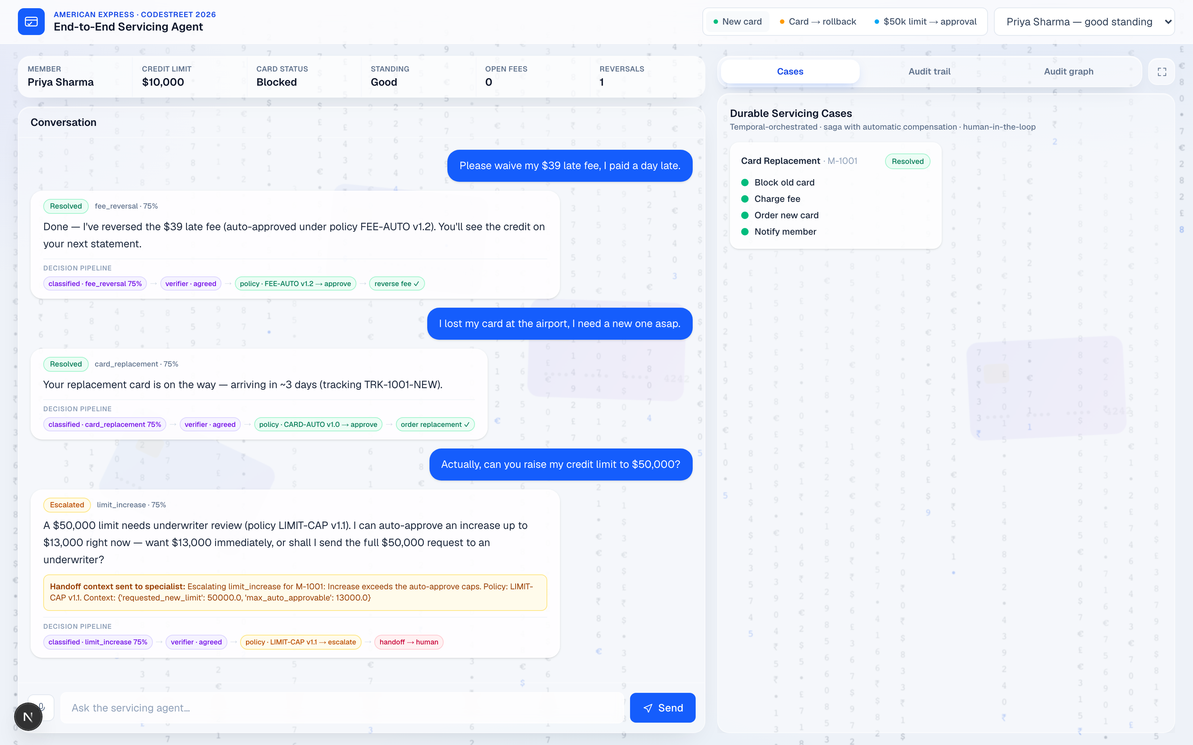
THE PRODUCT
One console — chat, durable cases & the audit trail
What you’re seeing
Visible decision pipeline per reply
classified → verified → rule → executed
Policy citation in every reply
“auto-approved under FEE-AUTO v1.2”
Counterfactual on escalation
“I can auto-approve up to $13,000 now”
Escalation with full handoff context
the specialist gets everything
Durable cases + live audit / graph
one screen, in real time
Live capture of the running app
End-to-End Servicing Agent · CodeStreet 2026
04

Slide 5
HOW A REQUEST IS DECIDED
The LLM proposes — a versioned engine decides and cites the rule
Request
Classifier
Policy-as-Code
Verify
Execute
LLM proposes
decides · cites rule
risk-based
over cap · low confidence · verifier disagrees
Escalate — with counterfactual
⛓ Hash-chained audit trail — every decision sealed in order, tagged with the rule that fired (e.g. LIMIT-CAP v1.1)
The model never has authority over money — a deterministic, versioned rule engine decides and cites the exact rule; a second agent verifies before anything executes.
End-to-End Servicing Agent · CodeStreet 2026
05

Slide 6
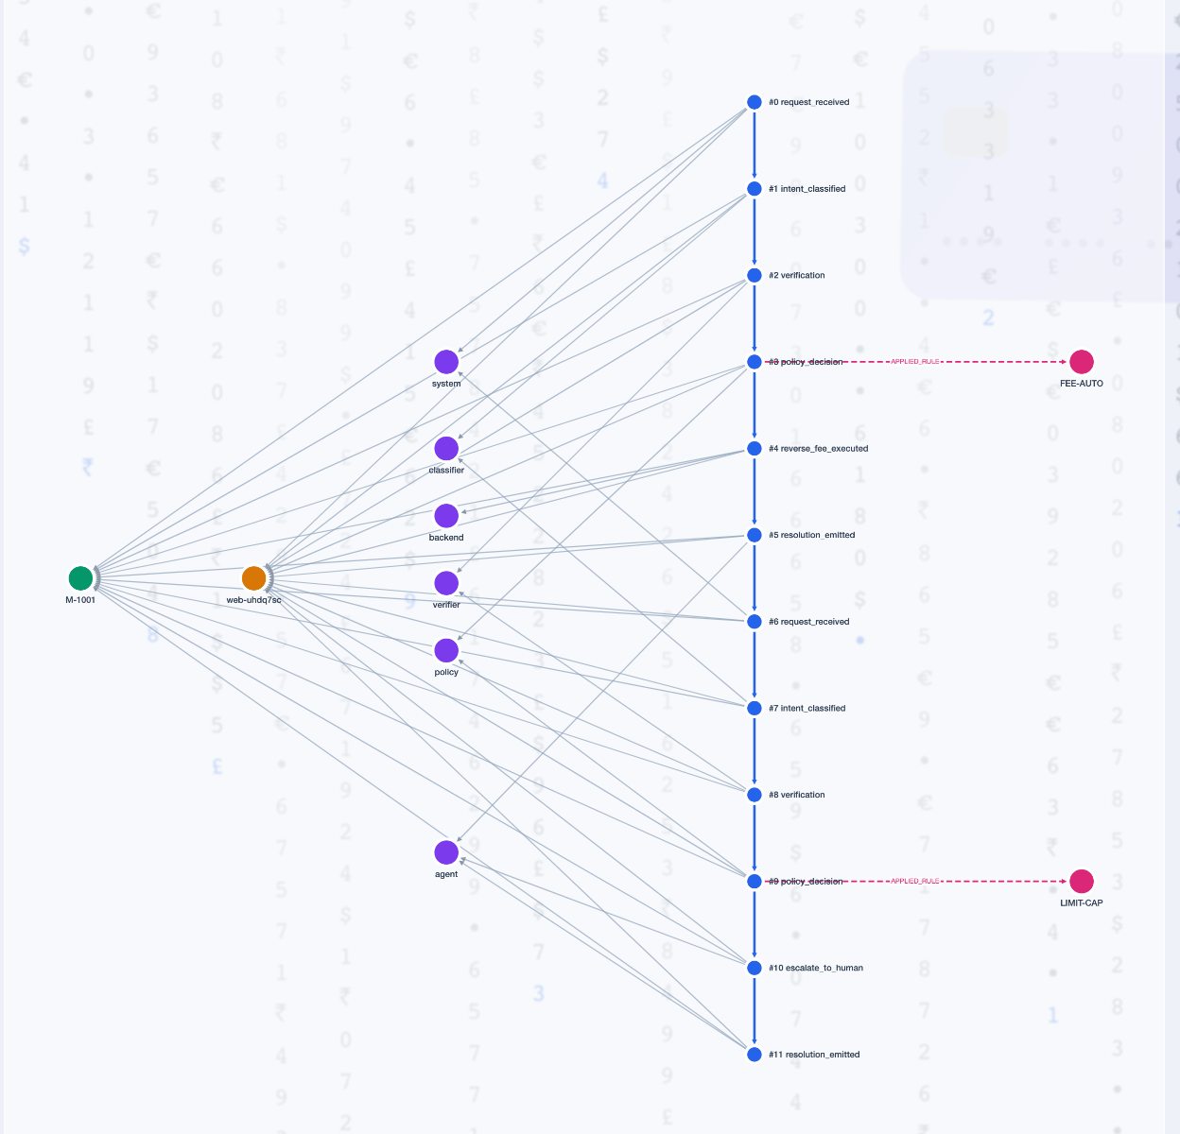
DIFFERENTIATOR 1
A verifiable, tamper-evident audit trail
Every decision, policy check & backend call is hash-chained (SHA-256) — each entry seals the one before it.
Edit any past entry and every downstream hash breaks — caught live in the demo (verify flips to ‘broken @ seq N’).
Complete chain-of-custody, not sampling — the difference between ‘we think’ and ‘we can prove’.
Persisted to Neo4j — explorable as an analyst graph — query the whole chain of custody, not scroll a log.
Maps to model-risk (SR 11-7) & adverse-action explainability — audit-ready by design.
Live Neo4j graph — the sequence spine, rules linked APPLIED_RULE
End-to-End Servicing Agent · CodeStreet 2026
06

Slide 7
DIFFERENTIATOR 2 · BEYOND THE BRIEF
Servicing cases that can’t be left half-done
Every high-stakes request becomes a durable Temporal workflow — it survives crashes and resumes exactly where it stopped.
Card replacement saga
✓ block old card
Saga with automatic compensation — if a step fails, completed steps roll back in reverse. Never partial.
✓ charge fee
Durable human-in-the-loop approval — over-policy cases wait on an underwriter for as long as it takes.
✗ order fulfillment — fails
↩ refund fee (compensate)
Live status + replayable event history — queryable in real time; the log is itself an audit.
↩ unblock card (compensate)
= rolled back · consistent
End-to-End Servicing Agent · CodeStreet 2026
07

Slide 8
DIFFERENTIATOR 3
Trustworthy by construction — the LLM never decides
Policy-as-Code
Self-verifying agentic loop
Versioned declarative rules decide; the LLM only proposes. Every decision cites the exact rule + version (e.g. LIMIT-CAP v1.1). Change policy = edit data + bump a version, no agent code.
A second reviewer LLM must agree the interpretation matches the request before acting — a bounded propose → verify → revise loop that escalates if the agents can't agree. Risk-based, so it's spent where it matters.
Counterfactual answers
Decision provenance
On a denial we compute the nearest-approvable outcome ('I can do $15,600 now'), mapping to ECOA/CFPB adverse-action 'specific reasons'.
Rules become nodes in Neo4j — analysts query which rule approved or denied across members, not just scroll a log.
In our research we found no prior example — hackathon or production — of rule citations in customer replies, or counterfactual offers in a servicing conversation.
End-to-End Servicing Agent · CodeStreet 2026
08

Slide 9
EVALUATION
Measured, not asserted
Metric
Result
How it’s graded
Intent classification accuracy
90% (n=20)
labeled eval set · LLM target ≥95%
First-contact resolution
80% (12/15)
multi-turn outcome check
Correct handling (resolve / safe-escalate)
86.7%
outcome check, in-scope
Escalation handoff completeness
100%
summary + reason + context present
Policy violations
0
engine caps enforced + verified
Audit integrity
100% intact
hash-chain verification
We report TRUE resolution + handoff quality — not just deflection (financial-services deflection is realistically 25–45%; one wrong answer is a compliance event, so the target error rate is <1%).
End-to-End Servicing Agent · CodeStreet 2026
09

Slide 10
WHY AMEX · WHY NOW
The governance layer that makes autonomy deployable
Amex’s 2026 direction is agentic commerce — agents that decide and act — this is exactly that, applied to servicing.
No deployed bank assistant performs autonomous write-actions on accounts today — Erica uses curated responses; Wells Fargo’s LLM only parses intent; Capital One kept its agent off bank accounts. We show how to do it safely.
Only 21% of enterprises have mature agentic-AI governance, yet 74% expect to use AI agents by 2027 (Deloitte) — most are scaling agents without the guardrails.
Deloitte names the missing controls: audit trails of every agent action + human-approval boundaries — the exact two things we built.
“With every use case, we’ve ensured there is human oversight.” — Ravi Radhakrishnan, EVP & CIO, American Express (Forbes, 2025)
Sources: Deloitte, “Agentic AI is scaling faster than guardrails” (2025) · Forbes/Peter High (May 2025) · American Banker (Erica) · VentureBeat (Fargo) · The Financial Brand (Capital One)
End-to-End Servicing Agent · CodeStreet 2026
10

Slide 11
ARCHITECTURE
Built to be real
Next.js UI
FastAPI
LangGraph agent: classifier · policy · flows · audit
Temporal server
Worker
ServicingCaseWorkflow → saga · compensation · approval
Audit chain → /graph
Neo4j Aura
Cytoscape analyst graph
Stack Python · FastAPI · LangGraph · Gemini · Temporal · Neo4j · Next.js · Cytoscape · SHA-256 hash-chain
Core-banking is mocked today; each call swaps to a real Amex API with no change to the agent logic.
End-to-End Servicing Agent · CodeStreet 2026
11

Slide 12
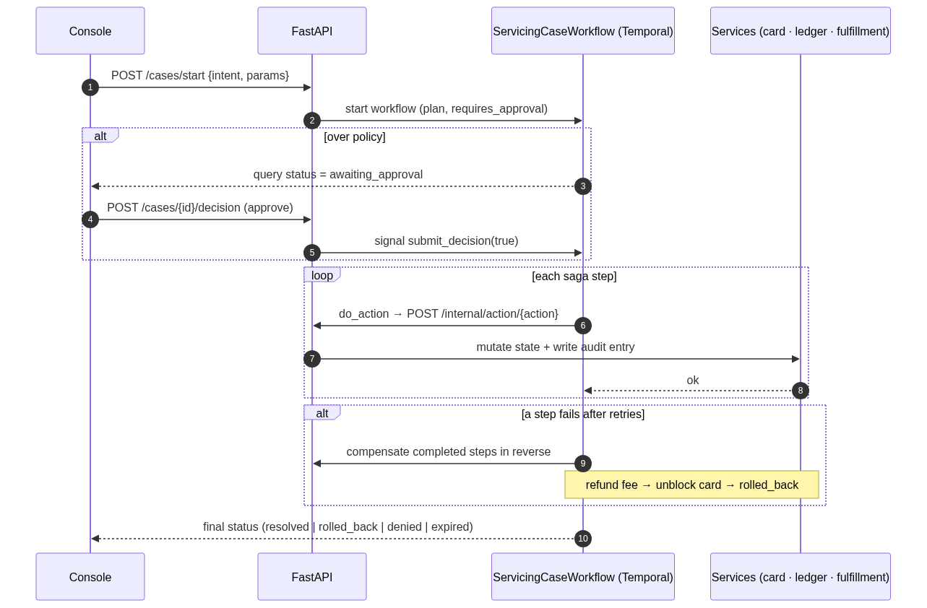
SYSTEM DESIGN
Low-level design — how a durable case executes
Components
FastAPI owns card state + audit chain
LangGraph classify · policy · flows · assist
Temporal worker durable saga + compensation
Neo4j Aura audit graph for analysts
Audit entry (hash-chained)
{ seq, actor, action,
payload, prev_hash, hash }
Key APIs
POST /chat
POST /cases/start · /decision
POST /internal/action/{action}
GET /cases · /graph
End-to-End Servicing Agent · CodeStreet 2026
12

Slide 13
WHAT’S NEXT
From prototype to production
Round 2: integrate real servicing APIs, add voice, expand intents, and add an LLM-judge clarity eval.
Production audit store: append-only, write-once storage behind the same hash-chain — exportable for auditors.
Guardrails & governance: per-action risk tiers, kill-switch, policy versioning — the governance substrate for Amex agents.
The ask: advance us to the prototype round — the core already works end-to-end.
End-to-End Servicing Agent · CodeStreet 2026
13

