Slide 1
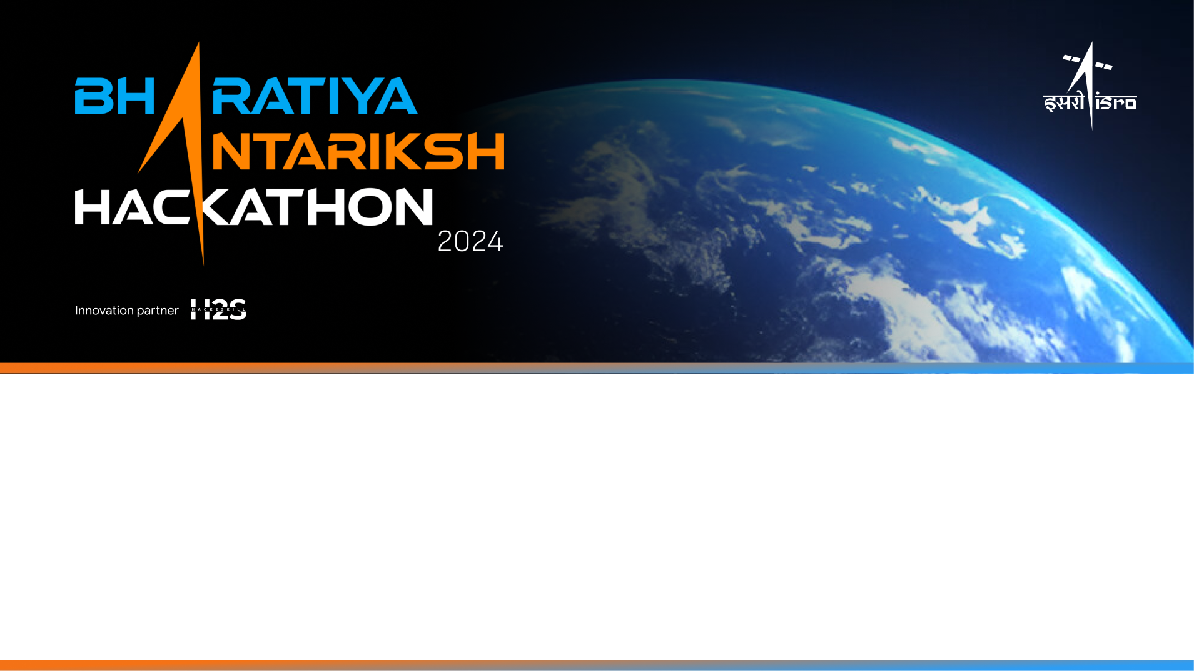
Team Name: HACKSTREET BOYS
Name of College(s)/University(s): DELHI TECHNOLOGICAL UNIVERSITY
Team Members Details:
VAIBHAV KANOJIA
VAIBHAV GUPTA
VARUN GUPTA
VISHAL

Slide 2
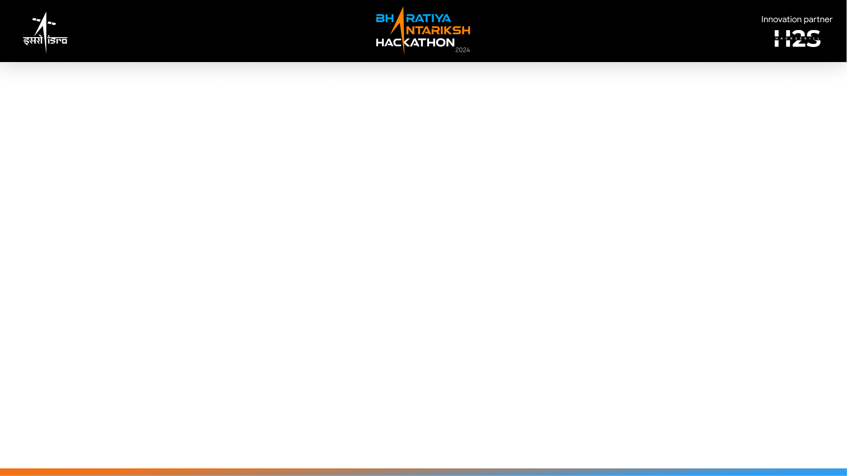
Detailed solution and Approach
1. Data Preparation and Preprocessing:
Data Acquisition: Obtain OHRC datasets in PDS4 format from Chandrayaan Map Browse.
Selenoreferencing: Use auxiliary information to accurately project and localize images.
Preprocessing Steps:
Convert images to grayscale.
Apply Gaussian blur to reduce noise.
Use Canny edge detection to highlight crater and boulder boundaries.
Objective: Simplify image features to enhance distinguishability for the detection model.
2. Model Development and Training:
Model Architecture: Convolutional Neural Network (CNN)
Layers: Multiple convolutional layers for feature extraction, max-pooling layers for down-sampling, dense layers for classification.
Training Process:
Data Augmentation: Increase diversity with transformations (rotation, scaling, etc.).
Loss Function: Minimize binary cross-entropy.
Performance Metric: Accuracy.
Evaluation: Test on separate dataset to ensure generalization to new images.

Slide 3
3. Detection, Post-processing, and Evaluation:
Detection:
Use the trained model to detect craters and boulders in OHRC images.
Extract contours using image processing techniques.
Quantification:
Measure selenographic position and diameter of detected features.
Generate a polygonal shape file with boundaries and relevant information.
Evaluation Metrics:
Accuracy: Precision of detected features compared to actual craters/boulders.
Relevance: Degree of match between detected features and actual craters.
Metrics: Use precision, recall, and F1-score for comprehensive evaluation.
Objective: Ensure accurate detection and detailed information presentation, meeting project objectives effectively.

Slide 4
Tools and Technology Used
Programming Languages: Python
Libraries and Frameworks: TensorFlow, Keras for deep learning; OpenCV for image processing
Data Handling: NumPy for numerical operations, Matplotlib for visualization
Development Environment: Kaggle, Jupyter Notebook, IDEs for code development

Slide 5
Opportunity should be able to explain the following:
How different is it from existing ideas?
Innovative Approach: Uses custom-built convolutional neural network (CNN) models tailored for crater and boulder detection from OHRC images.
No Pre-built Models: Unlike other solutions that use pre-built models like YOLO or RCNN, our model is built from scratch to specifically address the unique challenges of crater detection.
Integration of Shape File Generation: Directly outputs polygonal shape files for detailed spatial analysis.
How will it be able to solve the problem?
Automated Detection: Utilizes advanced AI/ML models to detect craters and boulders of varying shapes, sizes, and illumination conditions.
Quantitative Analysis: Provides accurate selenographic positioning and diameter measurements, enhancing geological assessments.
Comprehensive Reporting: Generates detailed shape files and metadata for precise analysis and visualization.

Slide 6
Opportunity should be able to explain the following:
USP of the proposed solution
High Accuracy and Efficiency: Leverages state-of-the-art AI techniques to ensure precise and efficient detection.
No Pre-built Models: Model built from scratch, specifically optimized for OHRC data, setting it apart from other teams using generic pre-built models.
User-Friendly Output: Outputs are in the form of shape files, making integration with GIS systems seamless and facilitating further analysis.
Scalability: Solution is adaptable to various datasets and scalable for different imaging resolutions and conditions.

Slide 7
Data Acquisition & Preprocessing
Model Development
Detection & Annotation
Shape File Generation
Output & Visualization
Proposed architecture/user diagram

Slide 8
List of features offered by the solution
High Precision Detection
Comprehensive Analysis
Shape and Size Measurement
Advanced Positioning
Selenographic Co-ordinates
Automated Identification
No Pre-Built Models
Detailed Visuals
Polygonal Boundary Extraction
Unique Solution Approach
Custom Model Development
Tailored to Original ISRO Images

Slide 9
Process flow diagram or Use-case diagram
Data Acquisition
Model Development
Crater/Boulder Detection
Data Pre-Processing
Source: OHRC Images
Chunking: Image Slicing
Splitting: Train/Test
Design: CNN Architecture
Training: Model Fit
Evaluation: Performance Metrics
Pre-Processing: Edge Detection
Detection: Crater/Boulder Identification
Annotation: Bounding Boxes
Visualization: Annotated images
Shape Files: Output Data
Result/Output

Slide 10
Solution Brief (Overall)
Objective
Develop an AI/ML model for detecting craters and boulders in OHRC images.
Provide detailed output with shape files and size information.
Solution Approach
Data Preparation: Process OHRC images into manageable chunks; split into training and testing datasets.
Model Building: Design and train a Convolutional Neural Network (CNN) to detect craters and boulders.
Detection and Annotation: Apply edge detection and contour analysis to identify and label craters and boulders; annotate with bounding boxes and size metrics.

Slide 11
Model Features
Custom CNN: Designed from scratch without pre-built models like YOLO.
Training: Optimized with custom data; evaluates accuracy and relevance.
Detection: Identifies craters and boulders, labels, and measures diameters.
Key Advantages
No Pre-built Models: Ensures tailored solution for specific detection tasks.
Detailed Output: Provides polygonal shape files and precise size information.
Scalability: Adaptable to various datasets and conditions.

Slide 12
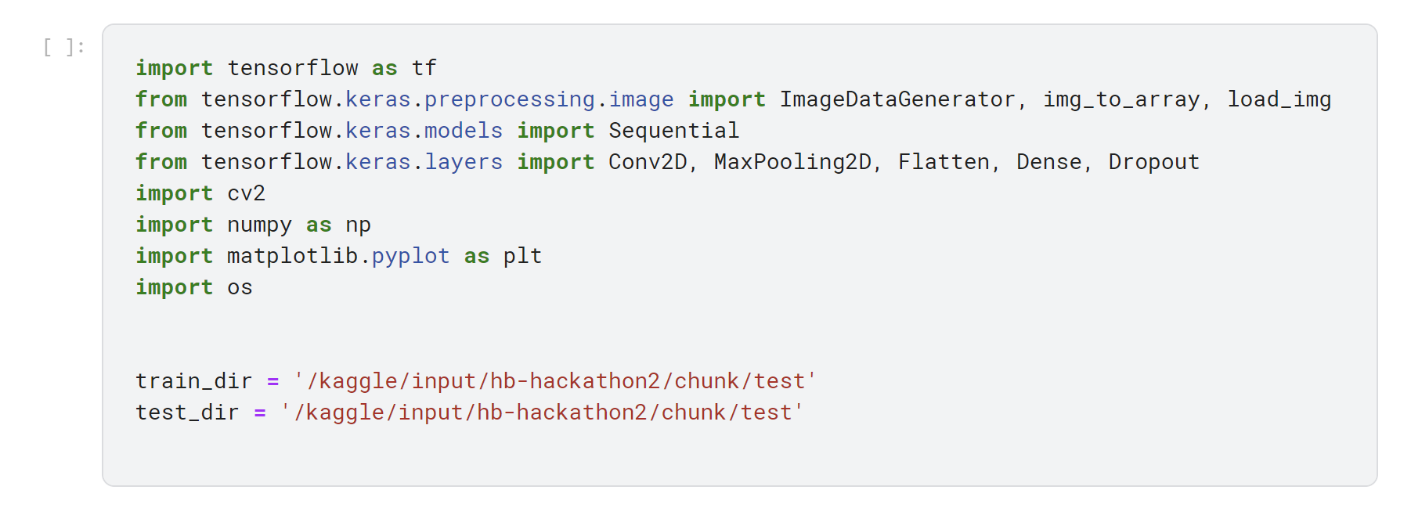
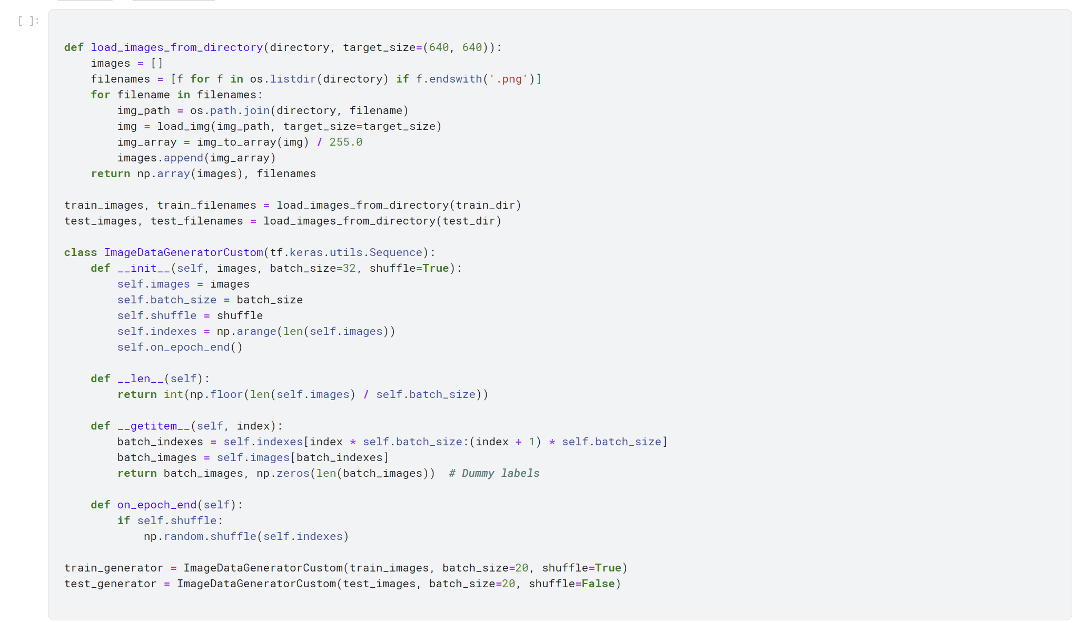
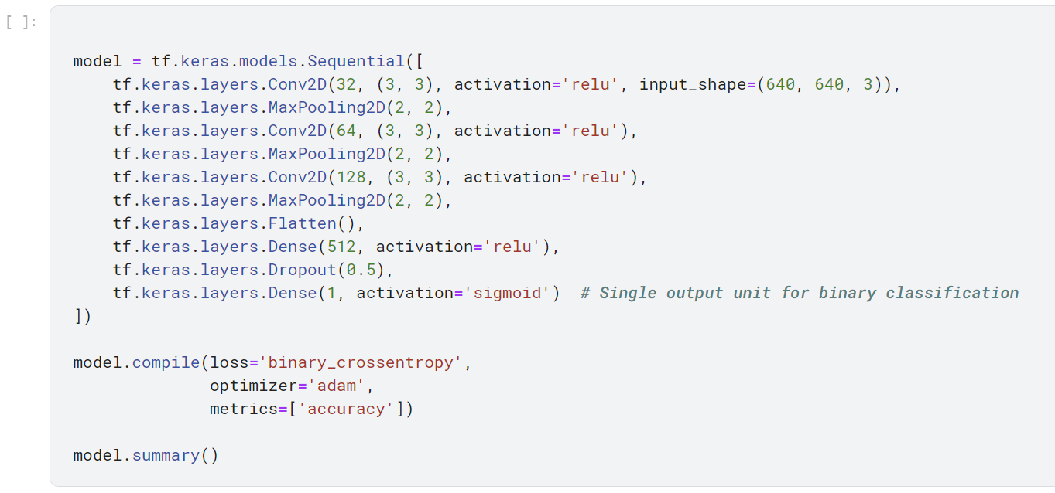
CODE
SNIPPETS

Slide 13
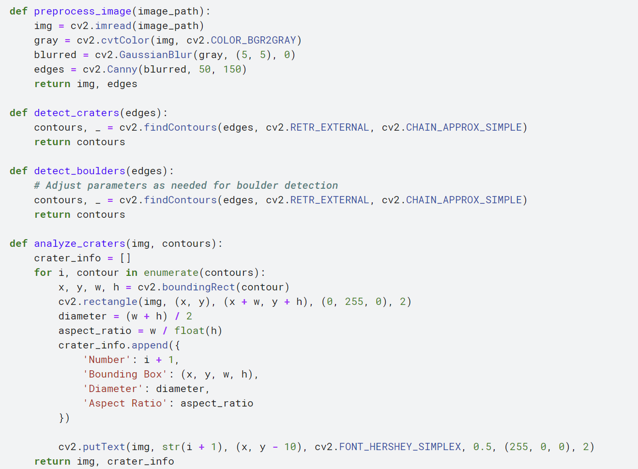
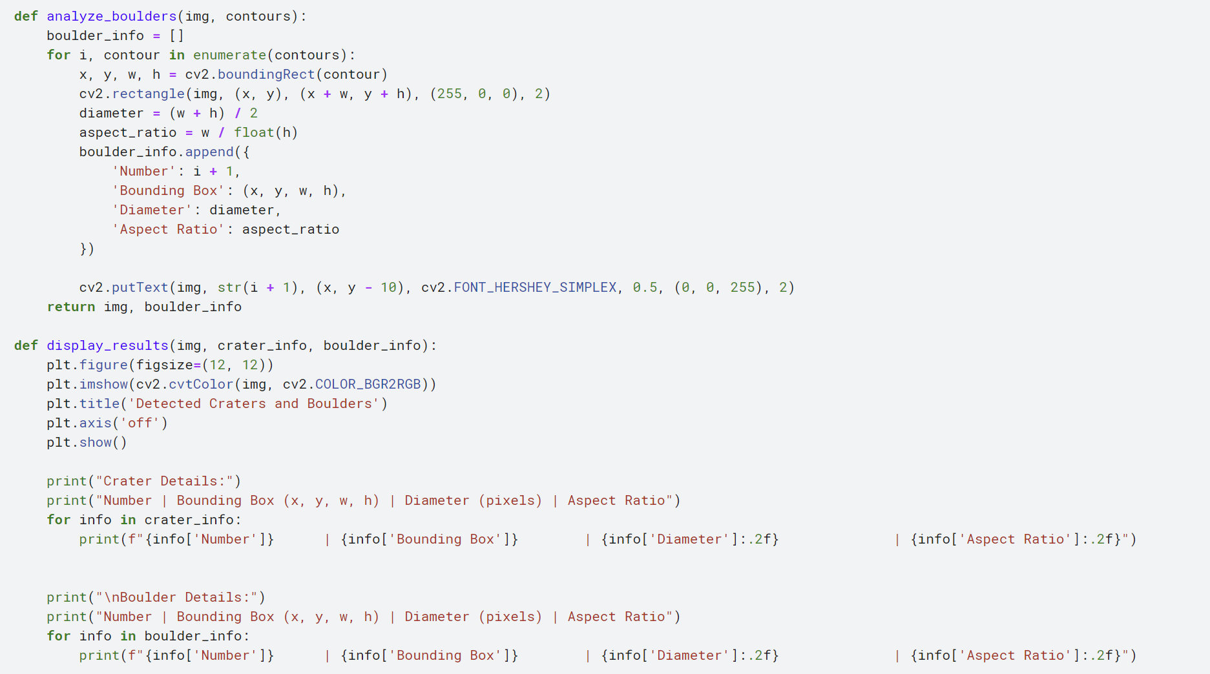
FUNCTIONS FOR CRATER AND BOULDER DETECTION

Slide 14
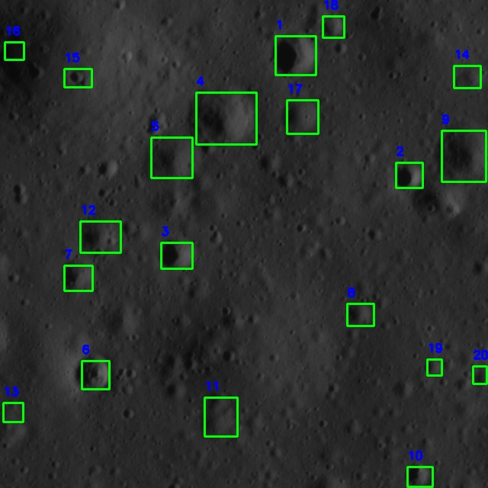
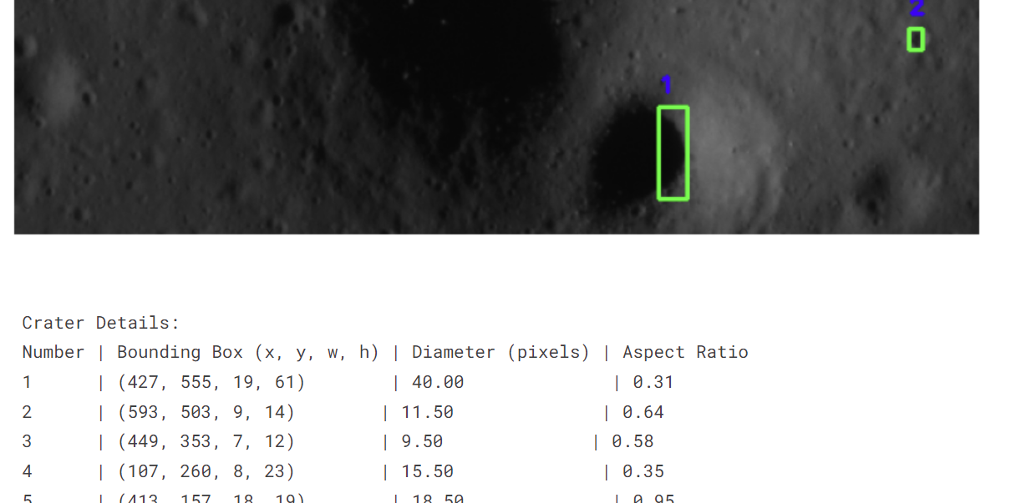
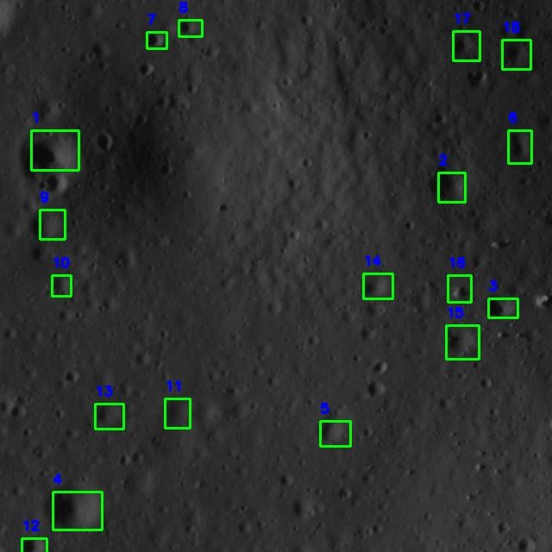
OUTPUTS

Slide 15
Future Work and Acknowledgments
Continuous Improvement
Enhancing model accuracy and efficiency
Incorporating advanced techniques and algorithms
Expanding dataset for better generalization
Knowledge and Experience
Gained hands-on experience in AI/ML
Developed practical skills in image processing
Learned valuable lessons in project execution
Gratitude
Thrilled to participate in this hackathon
Appreciate the opportunity to innovate and contribute
Thank you for providing this platform to showcase our work

Slide 16
