Slide 1



SMART INDIA HACKATHON 2024
Problem Statement ID – SIH1605
Problem Statement Title - Women Safety Analytics – Protecting Women from safety threats
Theme- Miscellaneous
PS Category- Software
Team ID-
Team Name- TechRizz

Slide 2
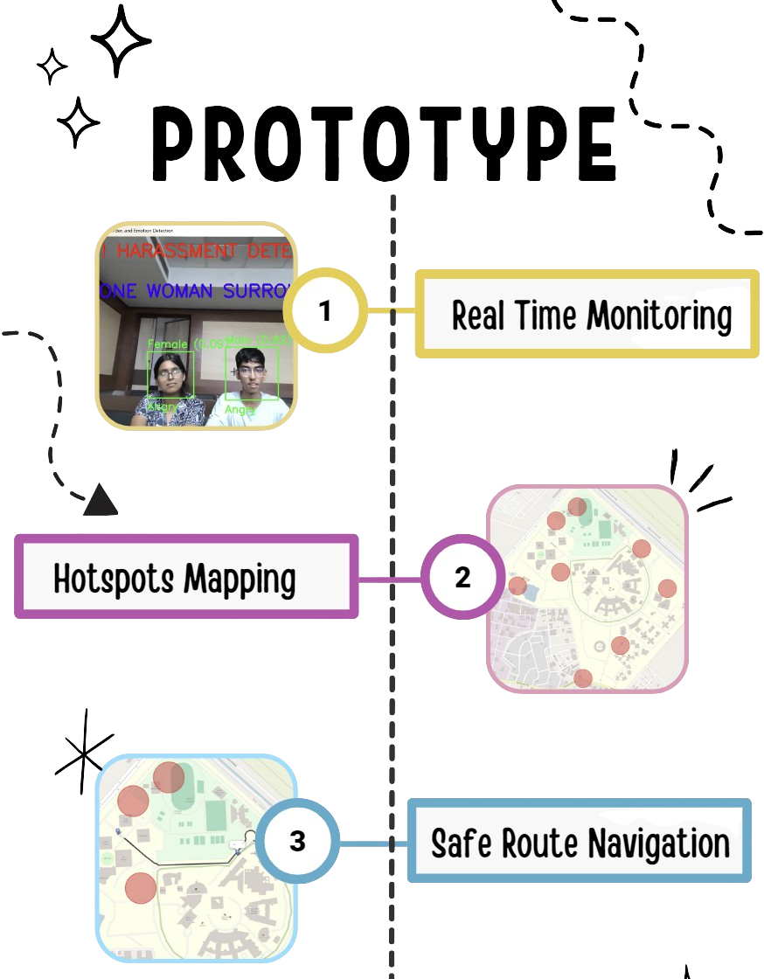
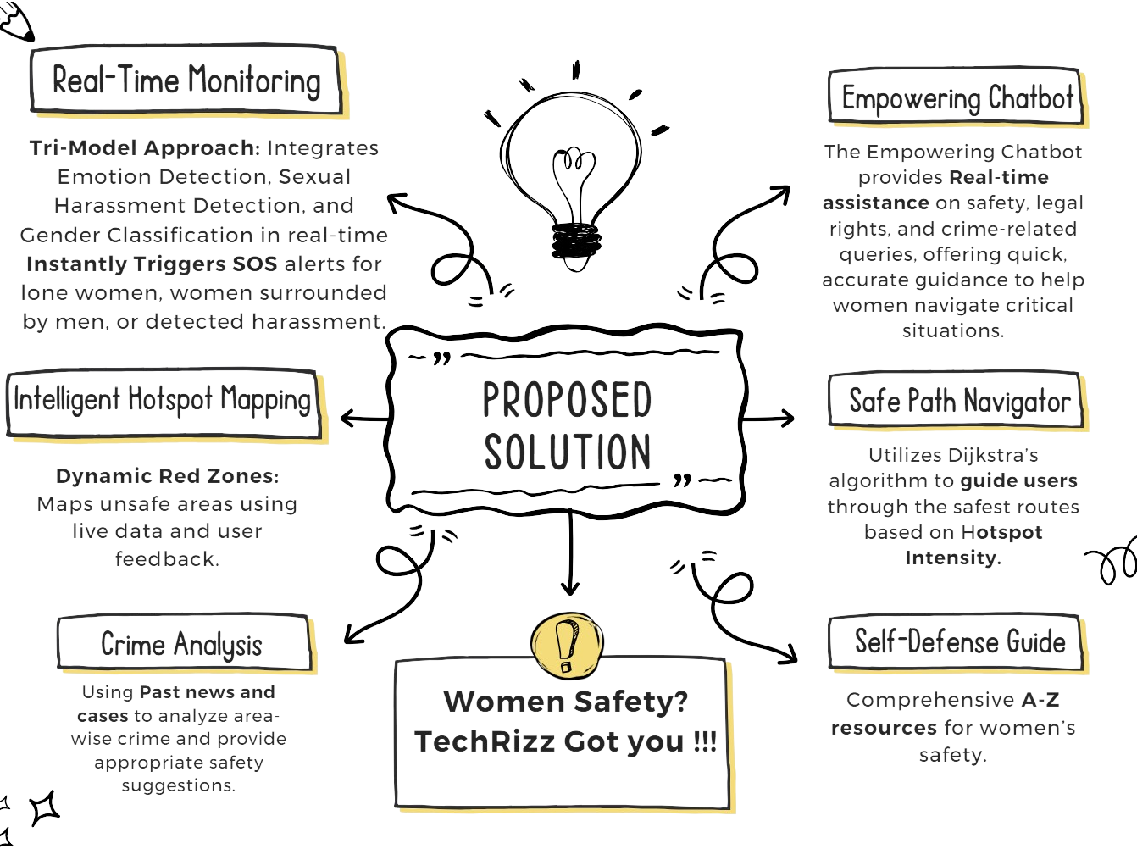

Slide 3
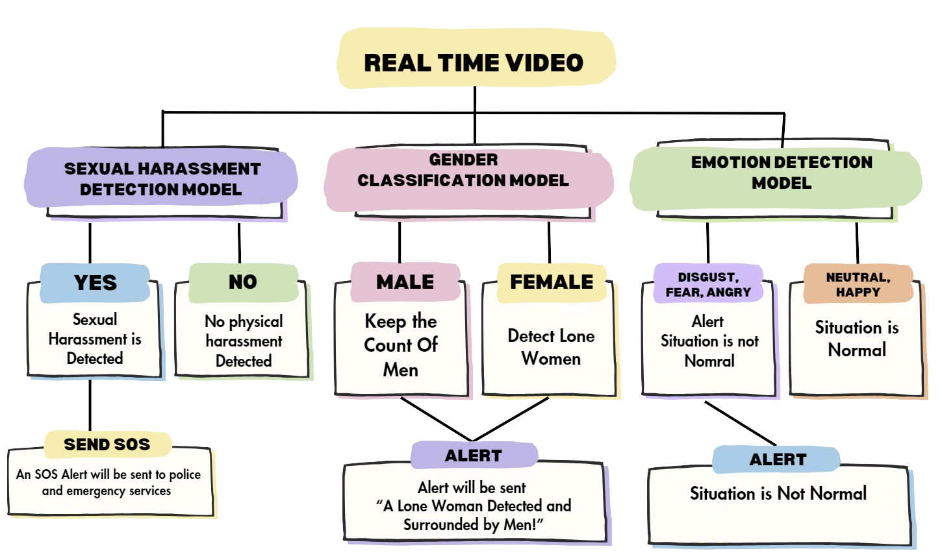
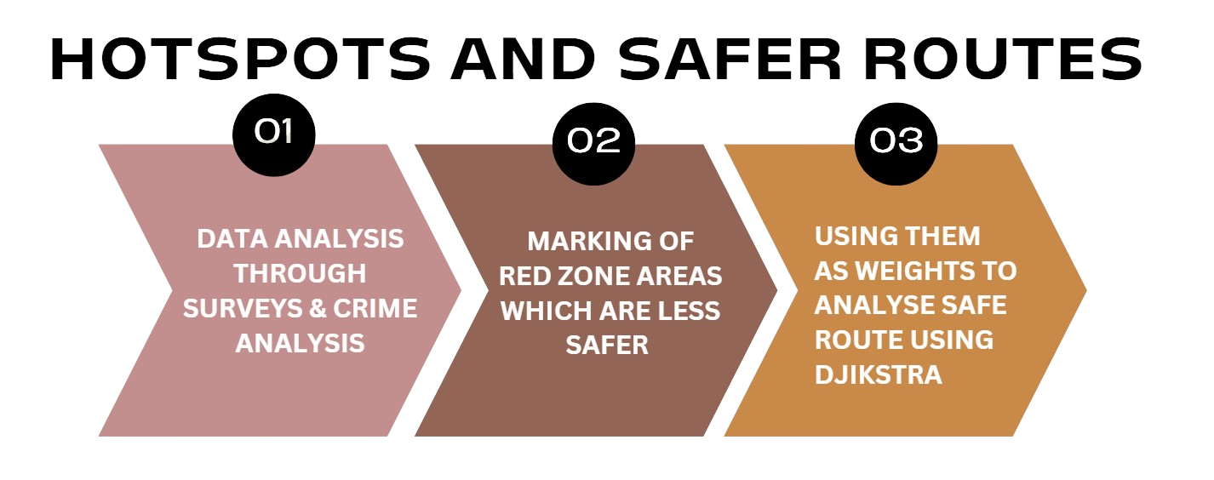

TECHNICAL APPROACH
@SIH Idea submission- Template
3

Slide 4
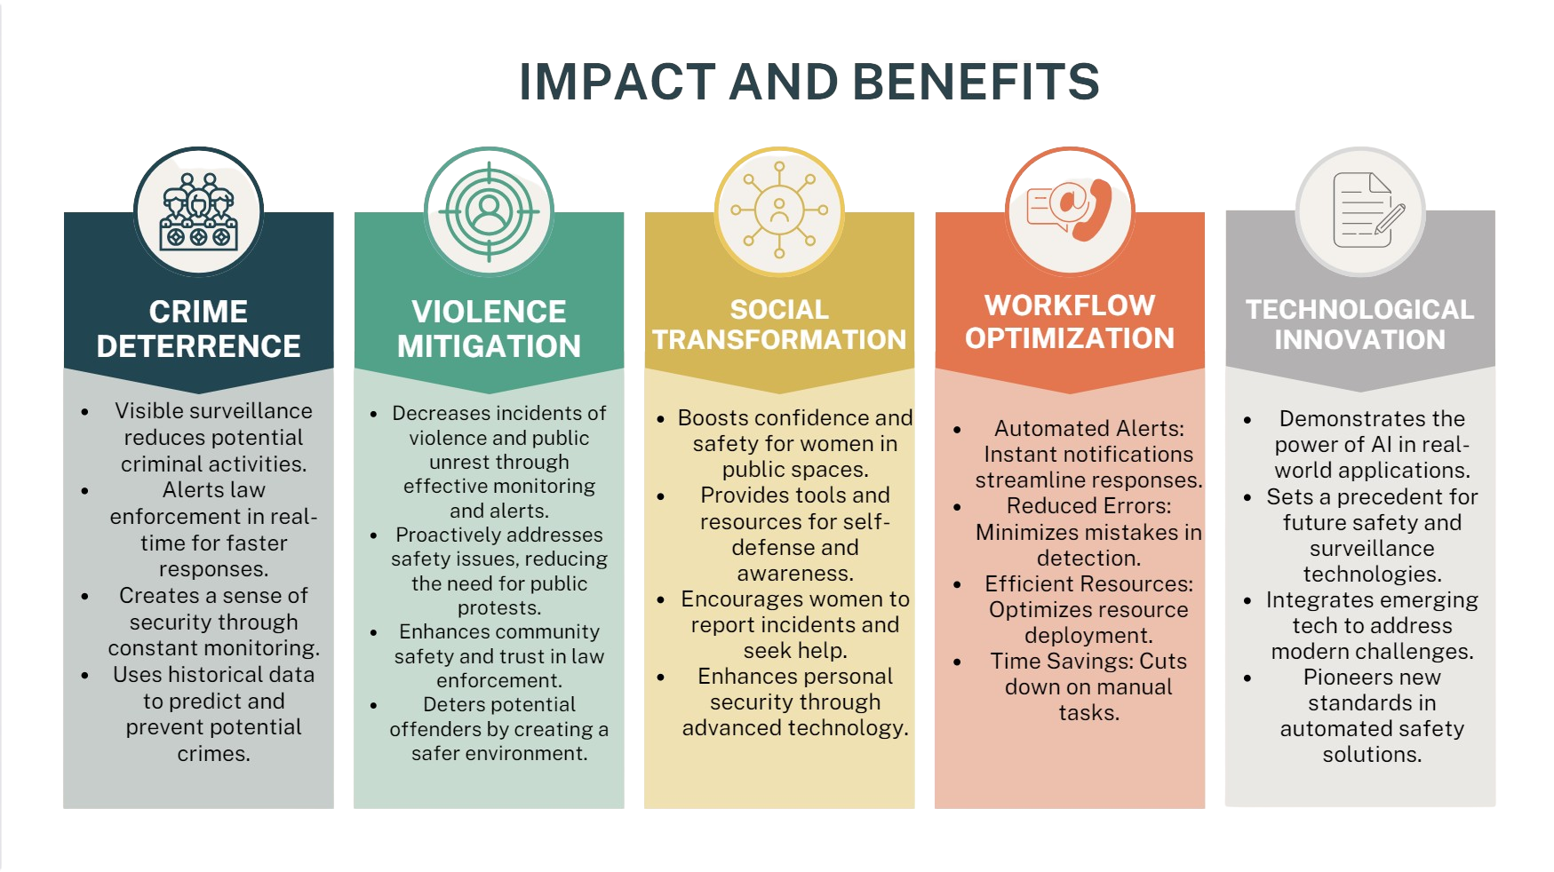

Slide 5
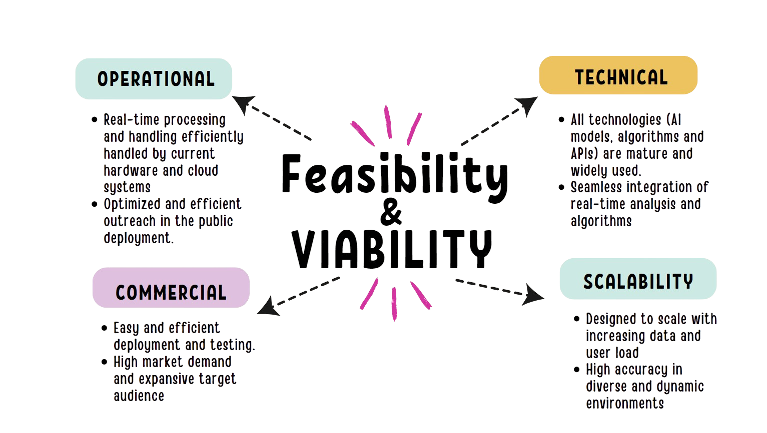

Slide 6
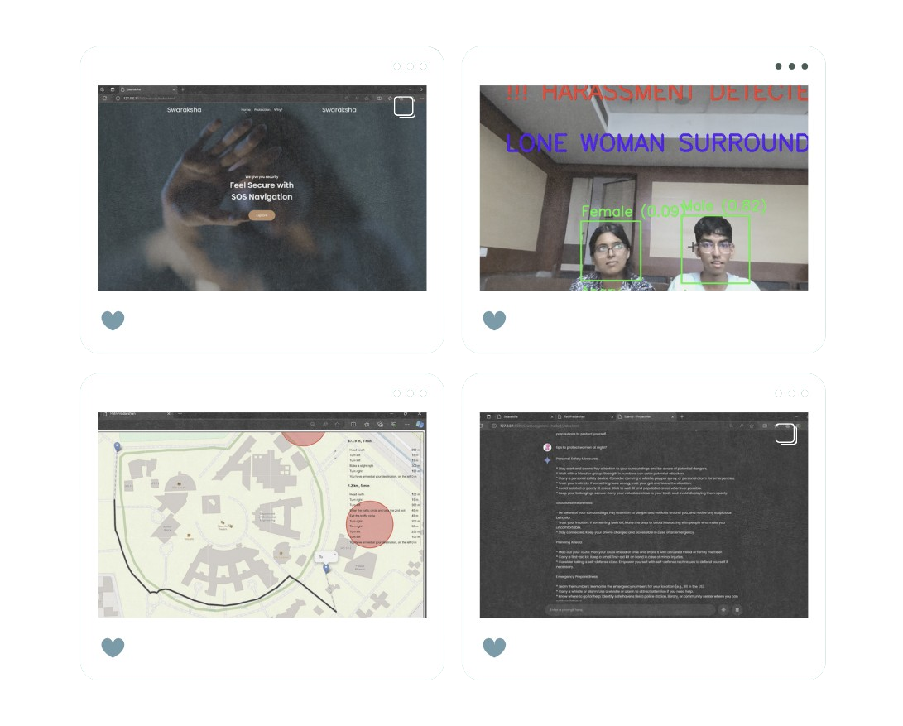
RESEARCH AND REFERENCES
https://www.researchgate.net/publication/342115800_Human_Gender_Classification_using_Machine_Learning
https://www.jetir.org/view?paper=JETIR1905110

