Slide 1
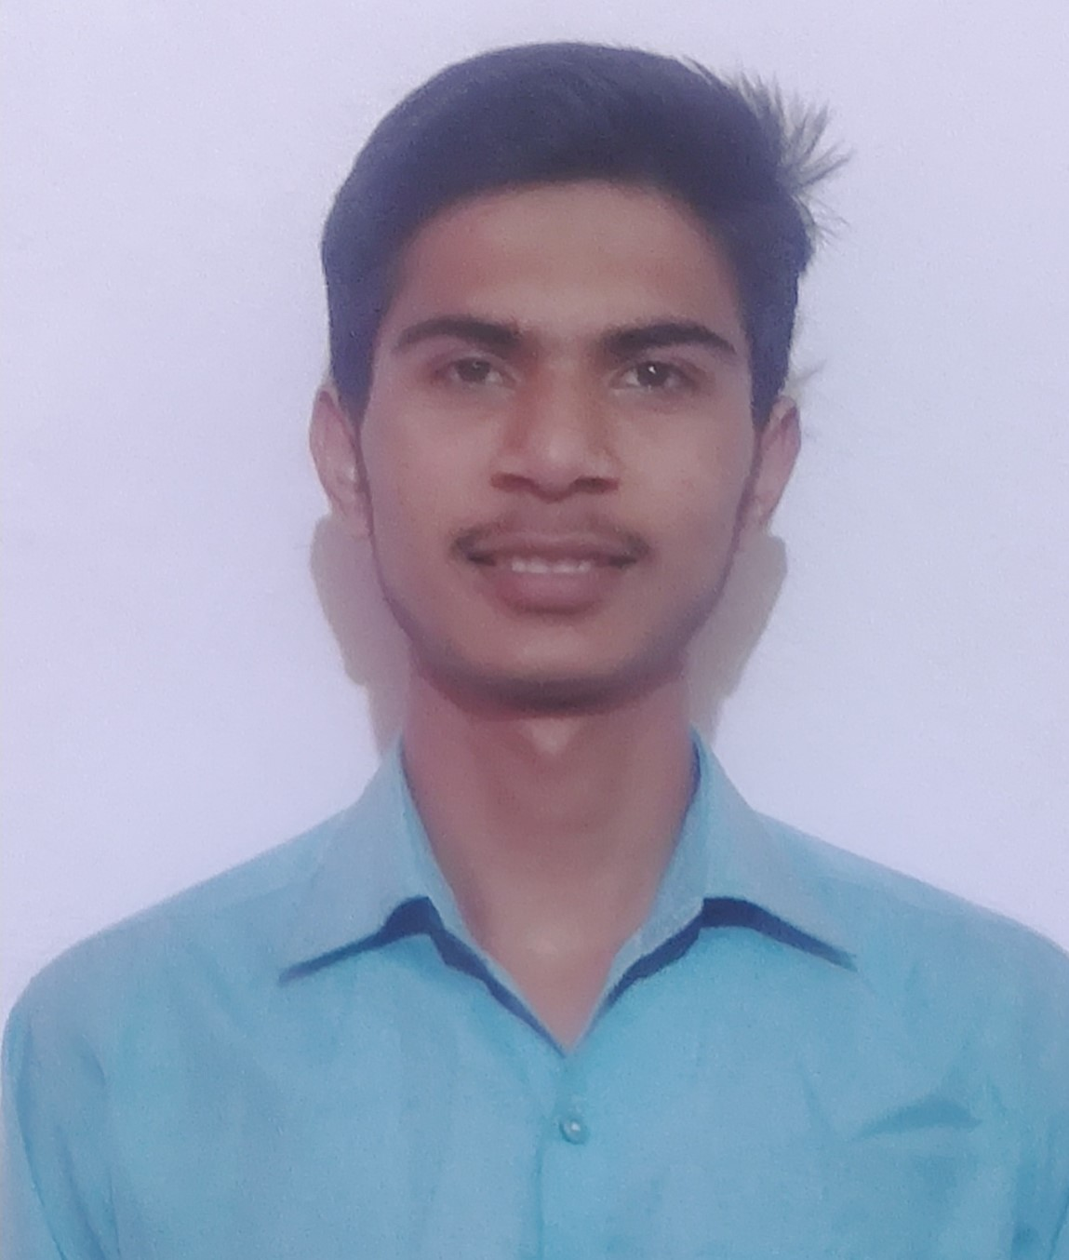
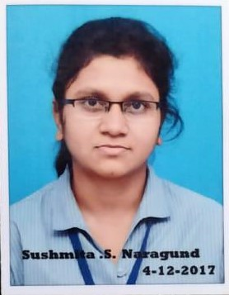
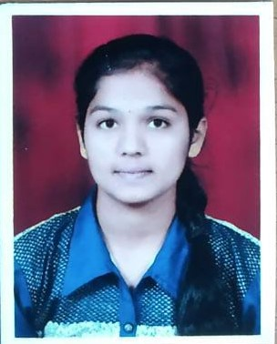
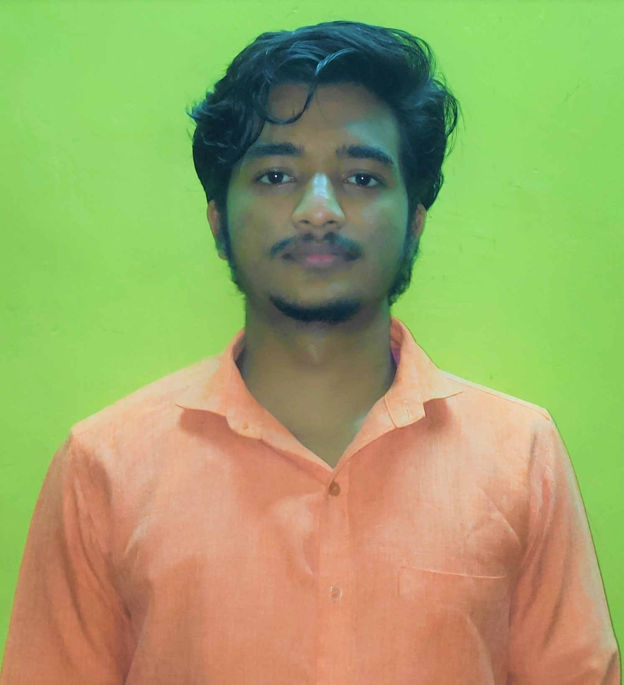
TEAM OF 4 MEMBERS
Vaibhav Kulkarni
Sushmita Naragund
Sejal Patil
Aditya Sutar

Slide 2
ABOUT TEAM MEMBERS AND THEIR CONTRIBUTIONS
1
Vaibhav Kulkarni: Data analysing , Data cleaning , Model generating, Model training , Research study.
2
Sushmita Naragund : Model training , Research study.
3
Sejal Patil : Research study , Model training.
4
Skills : Python, C , ML , IoT , Robotics, Embedded C.
Skill : C.
Skills : Python , C.
Aditya Sutar : Data cleaning, Data analysing , Model generating , Model training, Research study.
Skills : Python, C , ML , IoT , Robotics , Embedded C.

Slide 3
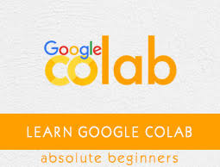
TECHNOLOGY STACK:
Google Colaboratory, or “Colab” for short, is a product from Google Research. Colab allows anybody to write and execute arbitrary python code through the browser, and is especially well suited to machine learning, data analysis and education. More technically, Colab is a hosted Jupyter notebook service that requires no setup to use, while providing free access to computing resources including GPUs.

Slide 4
PHASES OF DATA EXPLORING AND MODELLING :
Used given data set to filter unnecessary punctuations and new line characters.
Visualised data to check and filter more
UI/UX :
Ubuntu 18.04 LTS OS, Windows 10 home.
Tensorflow, Numpy, Keras.

Slide 5
ARCHITECTURE AND SOURCES :
The following sources were used to learn
Google NLP research study , Understanding TF, Keras , LSTM , RNN.
Natural Language Processing - Tokenization (NLP Zero to Hero - Part 1) https://youtu.be/fNxaJsNG3-s
NLP Tutorial 11 - Automatic Text Generation using TensorFlow, Keras and LSTM https://youtu.be/VAMKuRAh2nc
AI write poetry | Word prediction using LSTM | Deep Learning beginners https://youtu.be/Pe56OZ4aPds
How to Increase Google Colab Ram from 12 GB to 25 GB for free of cost in 2020 https://youtu.be/MHTsS0XEx8E

Slide 6
CODE WALKTHROUGH :
Importing required libraries.
Starting with analysing the given dataset and looking forward for cleaning the dataset .Splitting the data.
Vectorising the data and creating LSTM layers.
Training model for maximum accuracy and reducing loss.
Saving trained model into drive.
Using trained model to generate and predict sonnet.

