Slide 1

Machine Learning Project (classification)
NAME : VAIBHAV NEWASE
BATCH : P-309

Slide 2
objective
The objective of this project is to develop a machine learning model capable of predicting player engagement levels in a video game based on historical gameplay data.
By understanding the player engagement factors will be the key for game developers in achieving in enhancing their user experience and retention. This project will dive into a rick dataset of video game players to discover patterns and insights that will help in their game development and their marketing strategies.

Slide 3
Dataset columns
1. Player ID : Unique identifier for each player.
2. Age : Age of the player.
3. Location : Geographic location of the player.
4. Game Genre : Genre of the game the player is engaged in.
5. Play Time Hours : Average hours spent playing per session.
6. In Game Purchases : Indicates whether the player makes in-game purchases (0 = No, 1 = Yes)
7. Game Difficulty : Difficulty level of the game.
8. Sessions Per Week : Number of gaming sessions per week.
9. Avg Session Duration(Minutes) : Average duration of each gaming session in minutes.
10. Player Level : Current level of the player in the game.
11. Achievements Unlocked : Number of achievements unlocked by the player.
12. Engagement Level (Target variable): Categorized engagement level reflecting player retention ('High’,
'Medium', 'Low').

Slide 4
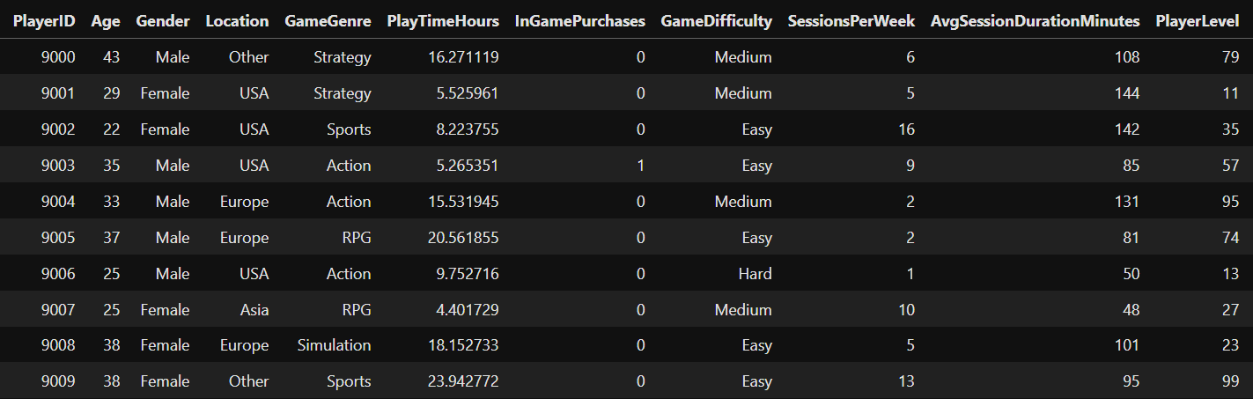
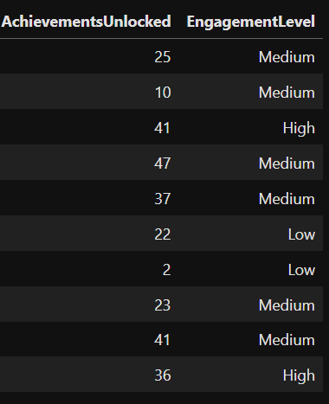
Table View
First 10 records of the table :

Slide 5
methodology
Collecting Data
Data Exploration
Data Visualization
Data Preprocessing
Implement model on dataset
Test Model
Train model
Selection of Principal Attributes
End

Slide 6
Steps taken in dataset analysis and model building
Getting data from a valid source
Importing Data
Importing necessary libraries
Fetching information about data (Data Exploration)
Dividing numerical and categorical columns
Feature engineering (Deleting columns that are not significant for model prediction)
Checking for null values and outliers
Data visualization to help understand the data
Checked skewness (Tells us if the data is positively skewed or negatively skewed)
Used Standard Scaler for numerical columns
Used Label Encoder and one hot encoding for categorical columns
Separating dependent and independent variables

Slide 7
Steps taken in dataset analysis and model building
Checked if the dependent (target) variable is balanced or not
Train Test Split For model building
Model Building using different classification algorithms
Checked model accuracy on Scaled data
Evaluated the performance of model using appropriate metrics,such as accuracy_ score,precision and recall score,classification report,confusion matrix,roc curve
Hyperparameter tuning for Decision Tree and Random Forest
Table showing accuracy for different algorithms used
Comparing Actual and Predicted values
Conclusion

Slide 8
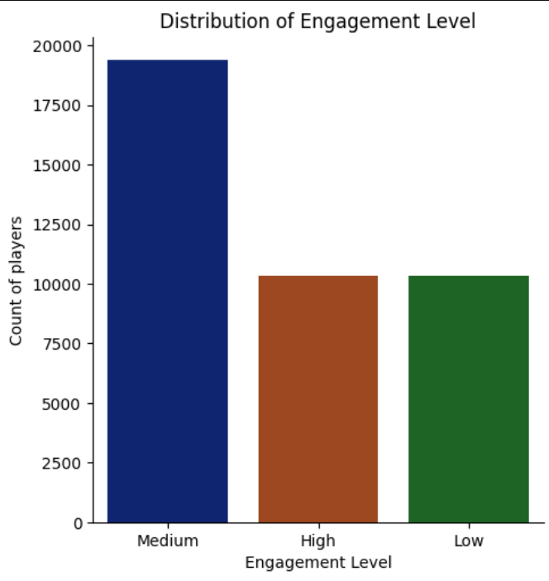
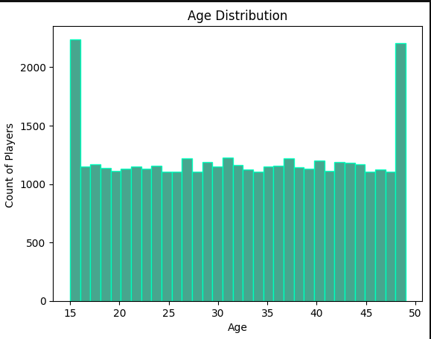
Exploratory data analysis(eda)
Distribution of Target Variable [Engagement level]
2. Distribution of players Age :
Most number of players were of age
15 and 48

Slide 9
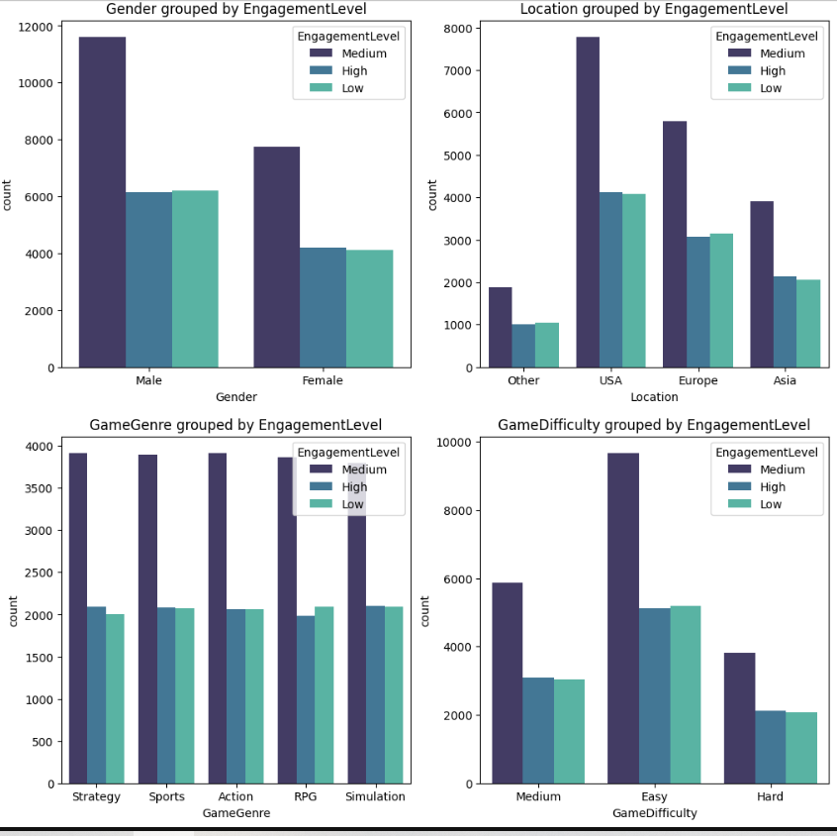
Exploratory data analysis (eda)
Distribution of different groups by Engagement Level :

Slide 10
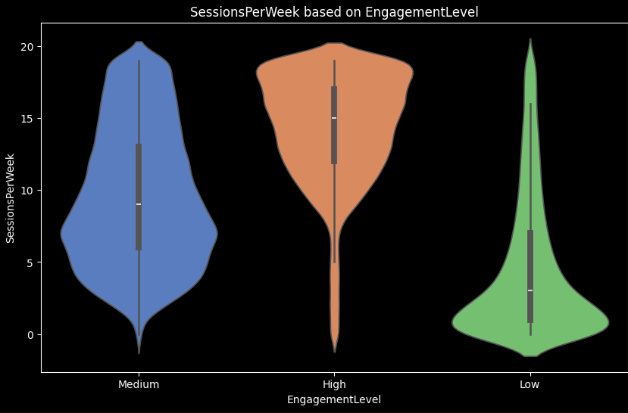
Exploratory data analysis (eda)
Session per week based on engagement level : From the below violin plot we can observe that the game engagement level were high for the players having higher number of sessions per week

Slide 11
Graphs used for eda
Histogram : Shows the distribution of Players age
Bar plot : Shows the count of each engagement level
Pie chart : Shows distribution of Engagement level
Distribution plot : Shows distribution of numerical columns
Violin plot : Shows session per week based on engagement level
Box plot : Shows Q1,median,Q3 and maximum and also highlight outliers
Heatmap : Shows the correlation between variable
Confusion matrix Display
Roc Curve

Slide 12
Algorithms used
1.Logistic Regression
2. Logistic Regression with Scaled data
3. Decision Tree
4. Random Forest
5. Bagging
6. AdaBoost
7. Gradient Boost
8. XGBoost
9. K-Nearest Neighbors
10. Support vector machine (SVM)
11. Hyperparameter Tuning for Decision Tree and Random forest.

Slide 13
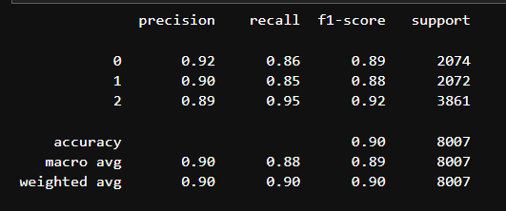
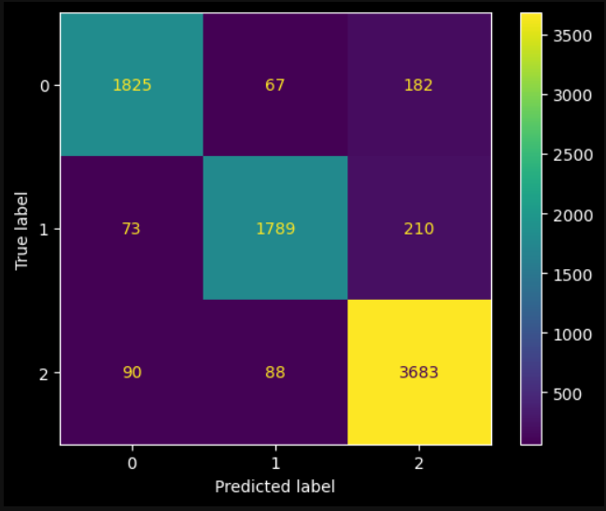
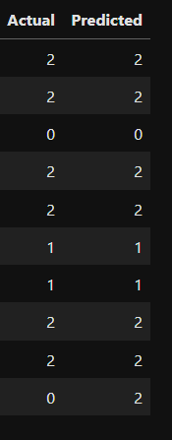
Actual vs predicted
Confusion Matrix : Shows how often the model predictions matches the true class labels.
Classification Report :

Slide 14
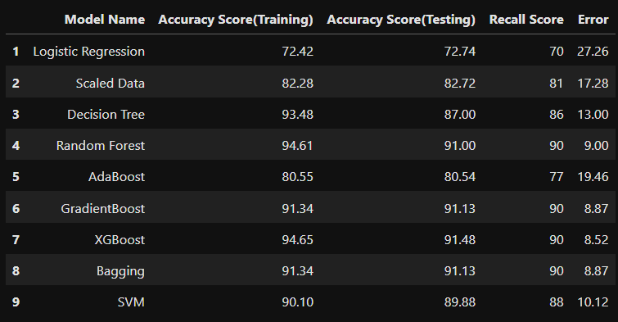
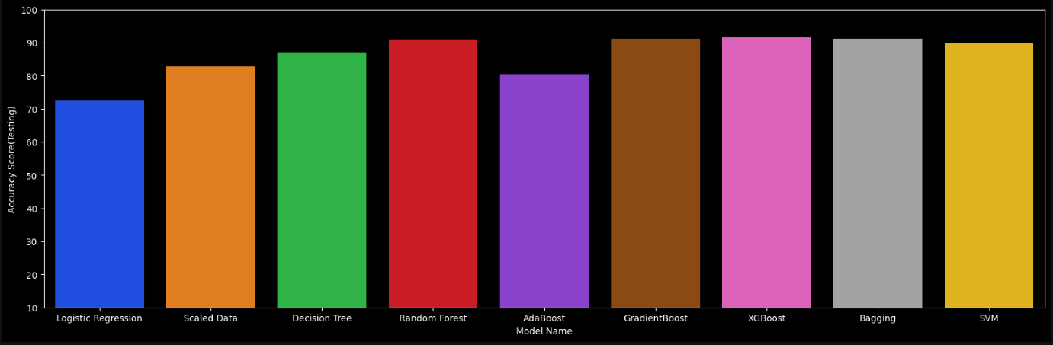
Accuracy Table

Slide 15
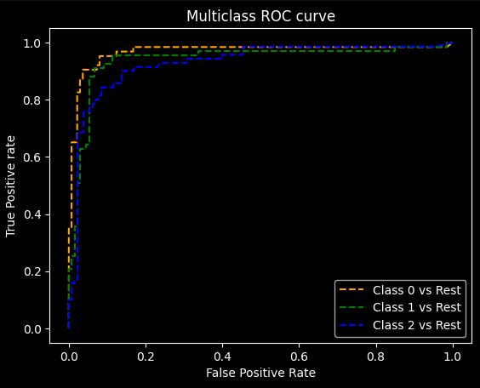
Multiclass roc curve
Each ROC curve shows the trade-off between sensitivity (recall) and specificity (1 - FPR) for different threshold values.
AUC (Area Under the Curve): The area under the ROC curve provides a single metric to summarize the model's performance. A higher AUC value indicates a better performing model.
ROC curve shows the trade-off between sensitivity (recall) and specificity (1 - FPR) for different threshold values.
From the below figure we can suggest that the model performs best at predicting high engagement (Class 0)
followed by low engagement(Class 1), and least well at predicting medium engagement(Claas 2).

Slide 16
Conclusion
The classification model demonstrated varying degrees of accuracy in predicting gaming enagement.
After comparing several classification algorithms, such as Logistic Regression, Decision Tree Classifier, Random Forest Classifier,XGBoost and Gradient Boosting Classifier, the Random Forest Classifier model and XGBoost provided the best accuracy .
The XGBoost model achieved an accuracy score of 0.91 ,,recall score of 0.90, f1 score of 0.91
precision score of 0.92 having precision score of 0.95 for class label 2.
The most influential features identified include Session Per week and Avg Session Duration Minutes.
To sum up, the classification model for gaming engagement behavior has been evaluated using various performance metrics and ROC curves for each class. The model shows varying degrees of accuracy across the different classes.
The ROC curves offer a clear picture of the model's ability to distinguish between high, medium, and low engagement levels, guiding further improvements and applications of the model.

