Slide 1
Argo Events
VAIBHAV PAGE
Software Engineer, Blackrock

Slide 2
Argo Events
Argo Events is Kubernetes-native event-driven workflow automation framework.

Slide 3
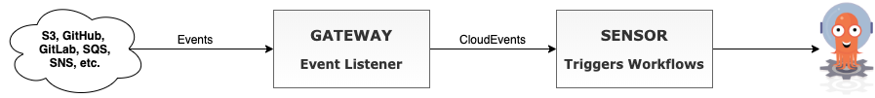
Overview

Slide 4


Image Processing Pipeline
Apply Gaussian filter.
Add noise.
Tune parameters for 80% image similarity.

Slide 5
Tools
Jupyter Notebook – Image Processing Model
Papermill – Notebook Parameterization
Argo Events – Event-Driven Workflow Automation Framework
Argo Workflow – workflow engine to run jupyter notebooks.
Minio – S3 Storage

Slide 6
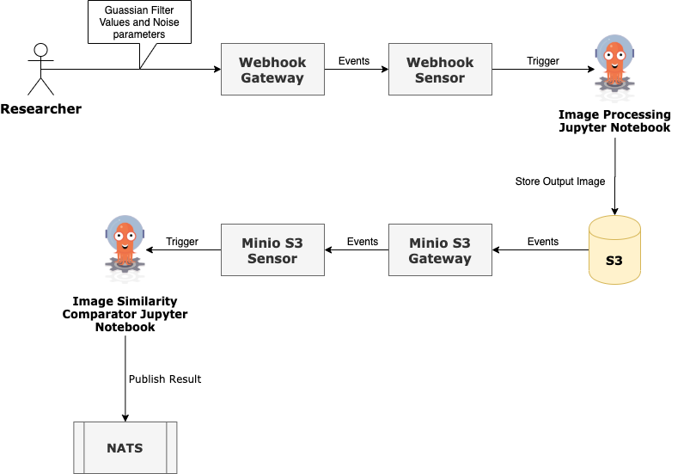
Flow

Slide 7
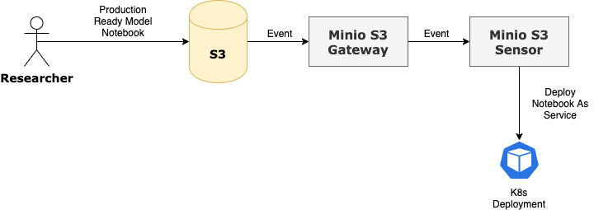
DEPLOY to Production

Slide 8
Links
Demo – https://github.com/VaibhavPage/argo-events-demo
Argo Events - https://github.com/argoproj/argo-events
Slack Channel - https://argoproj.github.io/community/join-slack

Slide 9
We’re Hiring
Send your resume at vaibhav.page@blackrock.com or ping me on Slack to know more about opportunities at BlackRock.

