Slide 1
PREDICTING AIRBNB LISTING PRICES
Reproducing a Stanford study paper and extending it with Extra Trees Regression
PART 1 • REPRODUCE THE REFERENCE | PART 2 • ADD A NEW MODEL
Dataset: Airbnb - New York City · Paris · Berlin
Team No:3
Vaibhav R - PES2UG24CS664
Palla Tejeswar Reddy - PES2UG24CS644

Slide 2
OVERVIEW
Problem statement & objectives
THE PROBLEM
OUR GOAL
Airbnb hosts need a defensible nightly price; guests need to judge whether a listing is fairly priced. Price depends on property, location, availability and listing-description features.
Reproduce the reference paper’s multi-city regression experiments, compare our results with its reported metrics, then test Extra Trees as an additional model.
• Predict listing price from listing-level features.
• Study NYC, Paris and Berlin rather than a single market.
• Compare models using test R² and mean squared error (MSE).
• Compare paper reported results with our obtained results.
02

Slide 3
OVERVIEW
Dataset & feature engineering
NYC
PARIS
BERLIN
47,840 listings after the $500 price filter
59,021 listings after the $500 price filter
22,470 listings after the $500 price filter
• Reference dataset starts from 96 raw listing features; we are using common fields available across all three datasets.
• Feature set C: 7 shared numeric features.
• Feature set C+O+T: numeric features + room type + area + listing title text.
• Listing titles are represented using TF–IDF followed by truncated SVD (50 components).
• Price is the regression target, the main reproduction experiments cap prices at $500.
03

Slide 4
REPRODUCE
Existing approaches in the reference study
• Linear regression: regularized linear baseline.
• K-nearest-neighbor regression: predicts from similar listings.
• Random Forest: bagged decision trees capture nonlinear feature interactions.
• Neural network (MLP): learns nonlinear combinations of features.
• XGBoost: gradient-boosted trees; a strong reference model in this notebook.
EXPERIMENTAL DESIGN
One shared 70 / 20 / 10 train-validation-test split strategy, with fixed random seed.
EVALUATION
Test R² and MSE are used to compare predicted prices with observed prices.
04

Slide 5
REPRODUCE
Reproduction workflow
01
02
03
Load city datasets
Clean/filter prices
Create feature sets C and C+O+T
04
05
06
Split: 70% / 20% / 10%
Train five reference-family models
Evaluate test R² and MSE
05

Slide 6
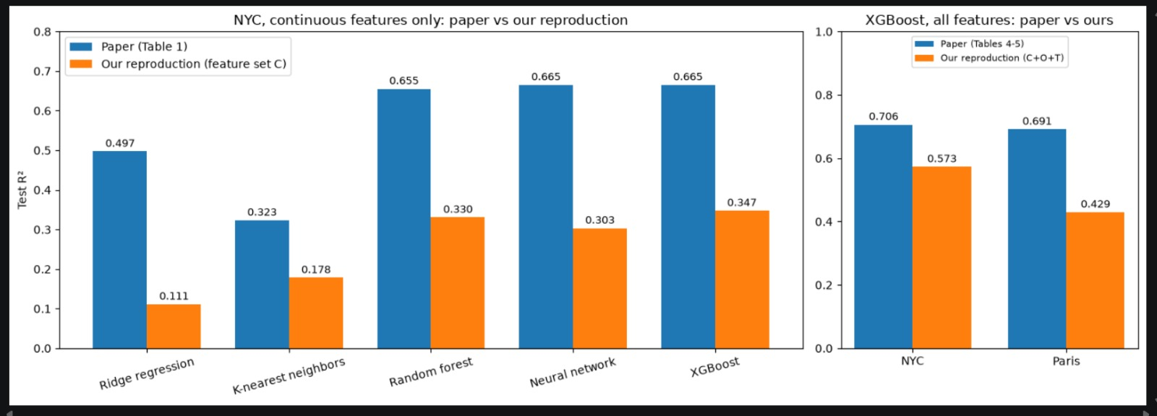
REPRODUCE
Reproduced results: NYC continuous features (C)
Test R²: paper-reported values compared with our reproduction
BEST IN OUR RUN
XGBoost: R² = 0.347
PAPER REFERENCE
XGBoost test R² = 0.665 on C; reported results are higher than this reproduction.
Differences are due to the changes in some of the datasets and also due to the deletion of the original datasets.
The new datasets do not have the same features as the original ones used in the reference paper.
06

Slide 7
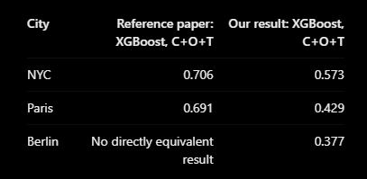
REPRODUCE
Reproduction results across all three cities
Reference-family models with C+O+T features. XGBoost has the highest test R² in each city in our run.
NYC
XGBoost R² = 0.573
PARIS
XGBoost R² = 0.429
BERLIN
XGBoost R² = 0.377
Adding categorical and text features improves performance versus numeric-only C in all three cities.
07

Slide 8
REPRODUCE
Reference paper vs reproduction: what changed?
PAPER BASELINE
OUR REPRODUCTION
NYC XGBoost test R²: 0.665 with continuous features (C); 0.706 with continuous + categorical + text features.
NYC XGBoost test R²: 0.347 with C; 0.573 with C+O+T. Paris C+O+T: 0.429.
• Our dataset’s C feature set contains only 7 shared numeric features, not the paper’s full continuous feature set.
• The C+O+T experiment adds room type, area and title text, bringing results closer to the paper’s richer feature view.
08

Slide 9
EXTEND
Proposed extension: Extra Trees Regression
WHY EXTRA TREES?
CONFIGURATION
The reference paper does not report ExtraTreesRegressor. It tests whether additional randomization of tree split thresholds can offer a useful alternative to Random Forest.
ExtraTreesRegressor with 300 estimators, max_features=1.0, min_samples_leaf=1
• Same city datasets, feature sets and train/test splits as the reference-family experiments.
• Evaluate with the same metrics: test R² and MSE.
• Compare directly with Random Forest and XGBoost to measure the value of the add-on model.
09

Slide 10
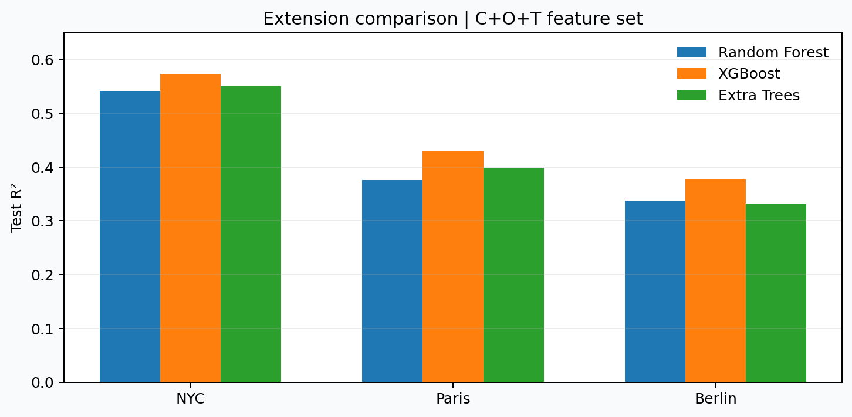
EXTEND
Extension results: Extra Trees vs tree ensembles
Test R² on C+O+T features
EXTRA TREES
NYC 0.551
Paris 0.399
Berlin 0.332
RANDOM FOREST
NYC 0.541
Paris 0.376
Berlin 0.338
XGBOOST
NYC 0.573
Paris 0.429
Berlin 0.377
10

Slide 11
FINDINGS
Comparison & key findings
• XGBoost is the strongest reference-family model by test R² for all three cities and both feature sets in this run.
• Extra Trees beats Random Forest slightly in NYC and Paris with C+O+T, but trails it slightly in Berlin.
• Extra Trees remains below XGBoost in all city/feature-set comparisons.
• Adding categorical and title-text features improves test R² substantially compared with numeric-only C.
• The extension is informative even without winning: it tests whether extra tree randomization adds value under the same evaluation setup.
11

Slide 12
DISCUSSION
Limitations & interpretation
• Numerical results differ from the paper, in part because our dataset has only 7 common numeric features for C and a particular shared feature construction for C+O+T.
• A single train/validation/test split can be sensitive to sampling; repeated splits or cross-validation would provide stronger evidence.
• Price filtering at $500 changes the prediction task and limits conclusions about high-priced listings.
• Transfer to Berlin is difficult: the notebook’s transfer experiment does not reproduce the paper’s positive combined-city transfer result.
12

Slide 13
CONCLUSION
Conclusion
REPRODUCE
EXTEND
FINDING
Implemented five reference model families across NYC, Paris and Berlin.
Added Extra Trees and evaluated it with the same feature sets and metrics.
XGBoost remains the strongest overall model, while Extra Trees is competitive with Random Forest in some cities
• Best C+O+T test R² in this run: NYC 0.573, Paris 0.429, Berlin 0.377 (XGBoost).
• Extra Trees C+O+T test R²: NYC 0.551, Paris 0.399, Berlin 0.332.
• Main lesson: feature representation matters, and the add-on model gives a fair comparison to the XGBoost
13

