Slide 1
Call 4 code 2020
Fight Against COVID-19
Vaibhav Rangare
Email: vrangare@in.ibm.com

Slide 2
Problem Statement
To get the worldwide information about COVID-19 patients based on the following categories. 1) Deaths 2) New Deaths 3) Confirmed cases 4) Active Cases 5) Recovered Cases. Information about the number of such cases should be available countrywide also. Information should be real time and accurate. Application for desktop and mobile devices to provide COVID-19 patients information.

Slide 3
Solution
I have created an application which access online data about the COVID-19 patients worldwide and present it in consolidated manner. Application contains Global number of patients records. Application also contains number of patients records of India Us Patients records can be search based on country selection. Application provides real time records. Application contains information in the form videos about the Coronavirus vaccine update. Application is available for desktop and mobile devices.

Slide 4
Features and Benefits
Application can be used as desktop/mobile native app. All browsers provide support for the application including Mozilla, IE and Chrome. Need internet connection to see the COVID-19 patients information. Date wise patients records are available. Patients information is available in the form of charts. Using https://about-corona.net/documentation to get the data.

Slide 5
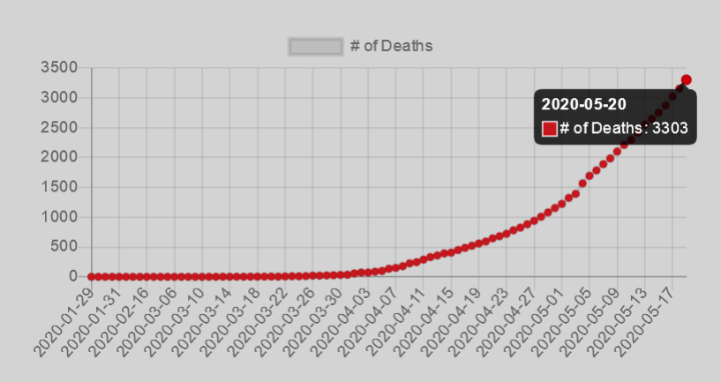
Features and Benefits
Patients information is available in the form of charts.

Slide 6
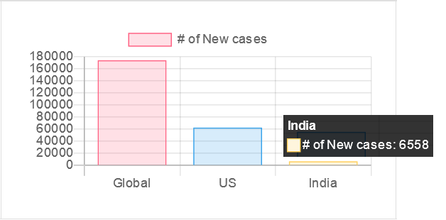
Features and Benefits
Easy view and comparison of cases using bar charts.

Slide 7
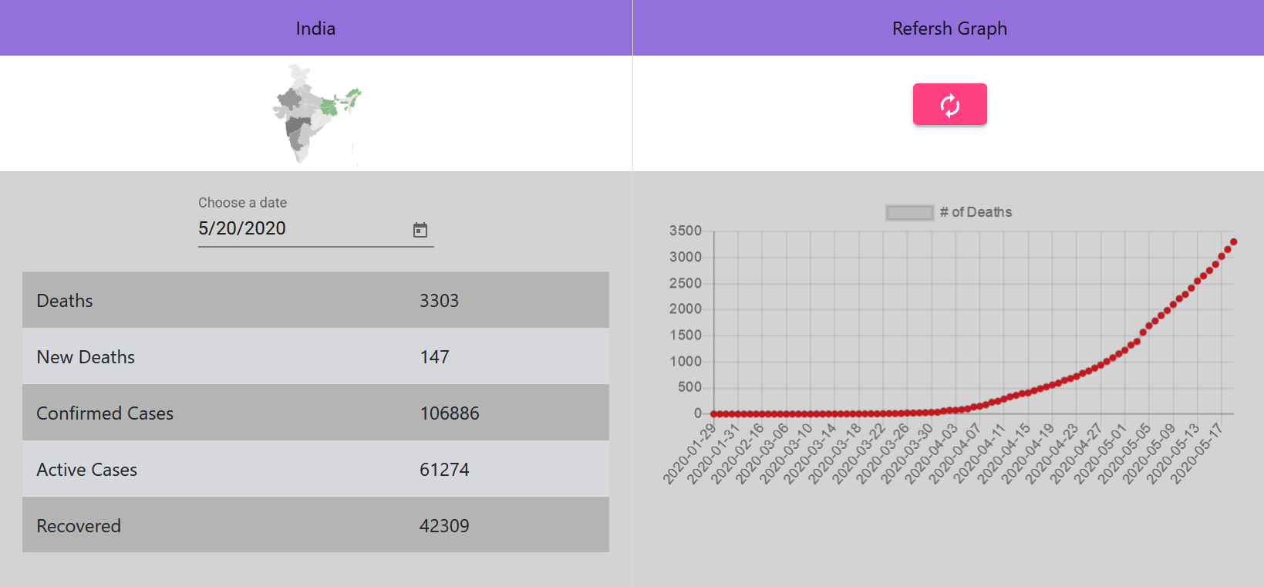
Features and Benefits
Information about India.

Slide 8
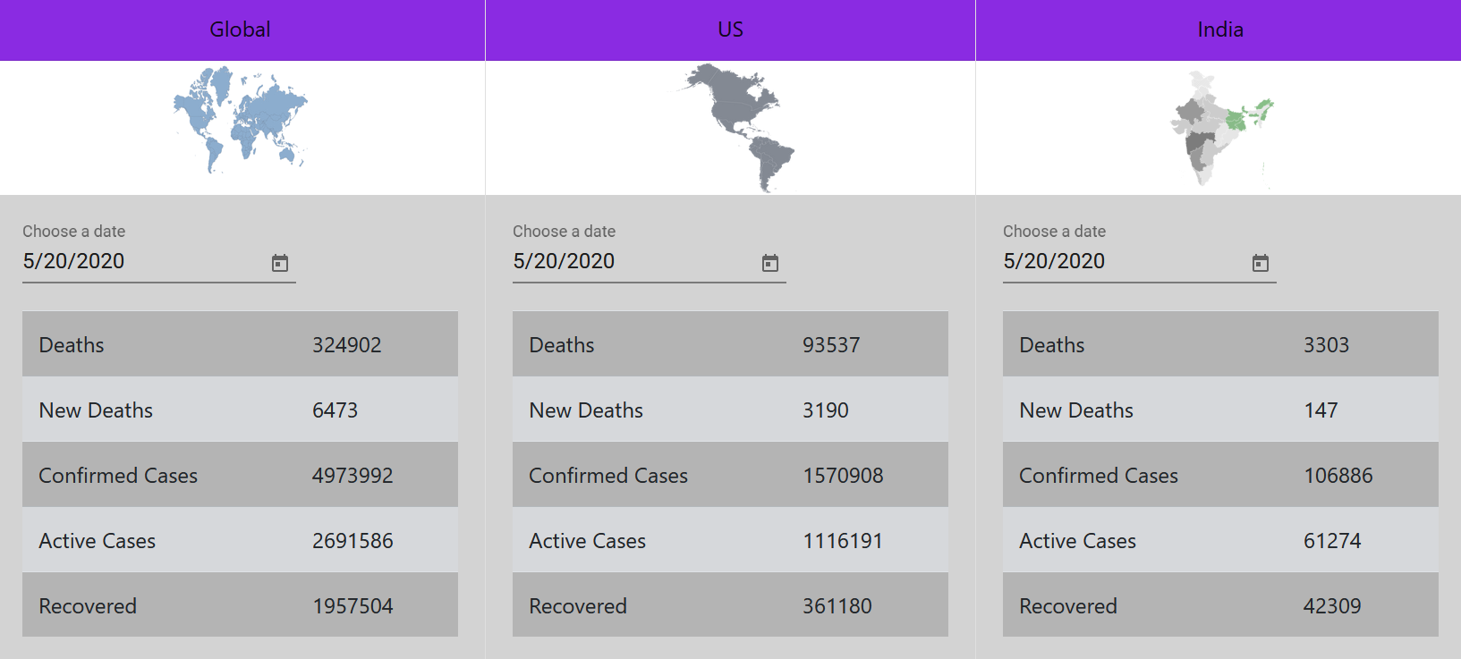
Features and Benefits
Information Comparison.

Slide 9
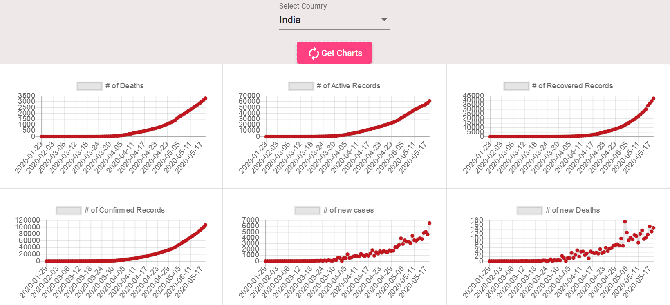
Features and Benefits
Countrywide patients information.

Slide 10
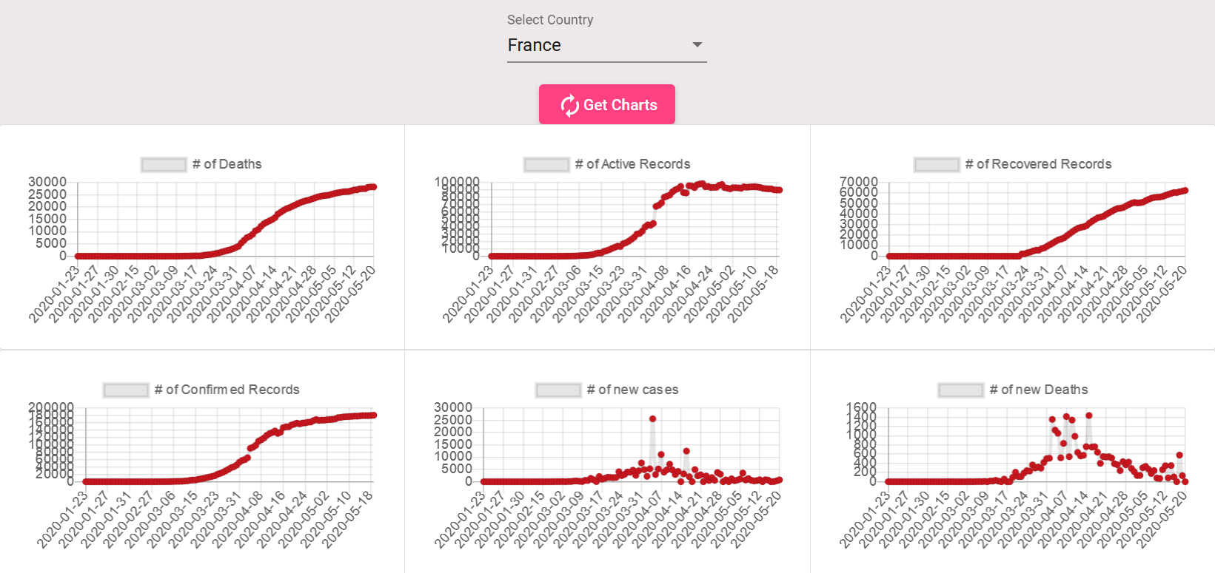
Features and Benefits
Countrywide patients information.

Slide 11
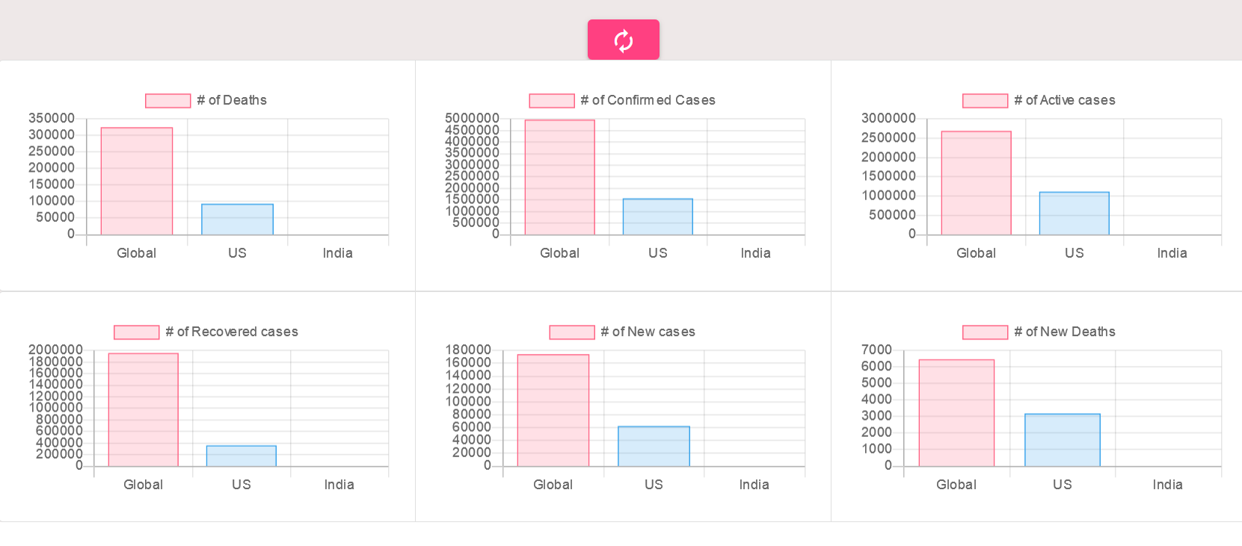
Features and Benefits
Information Comparison.

Slide 12
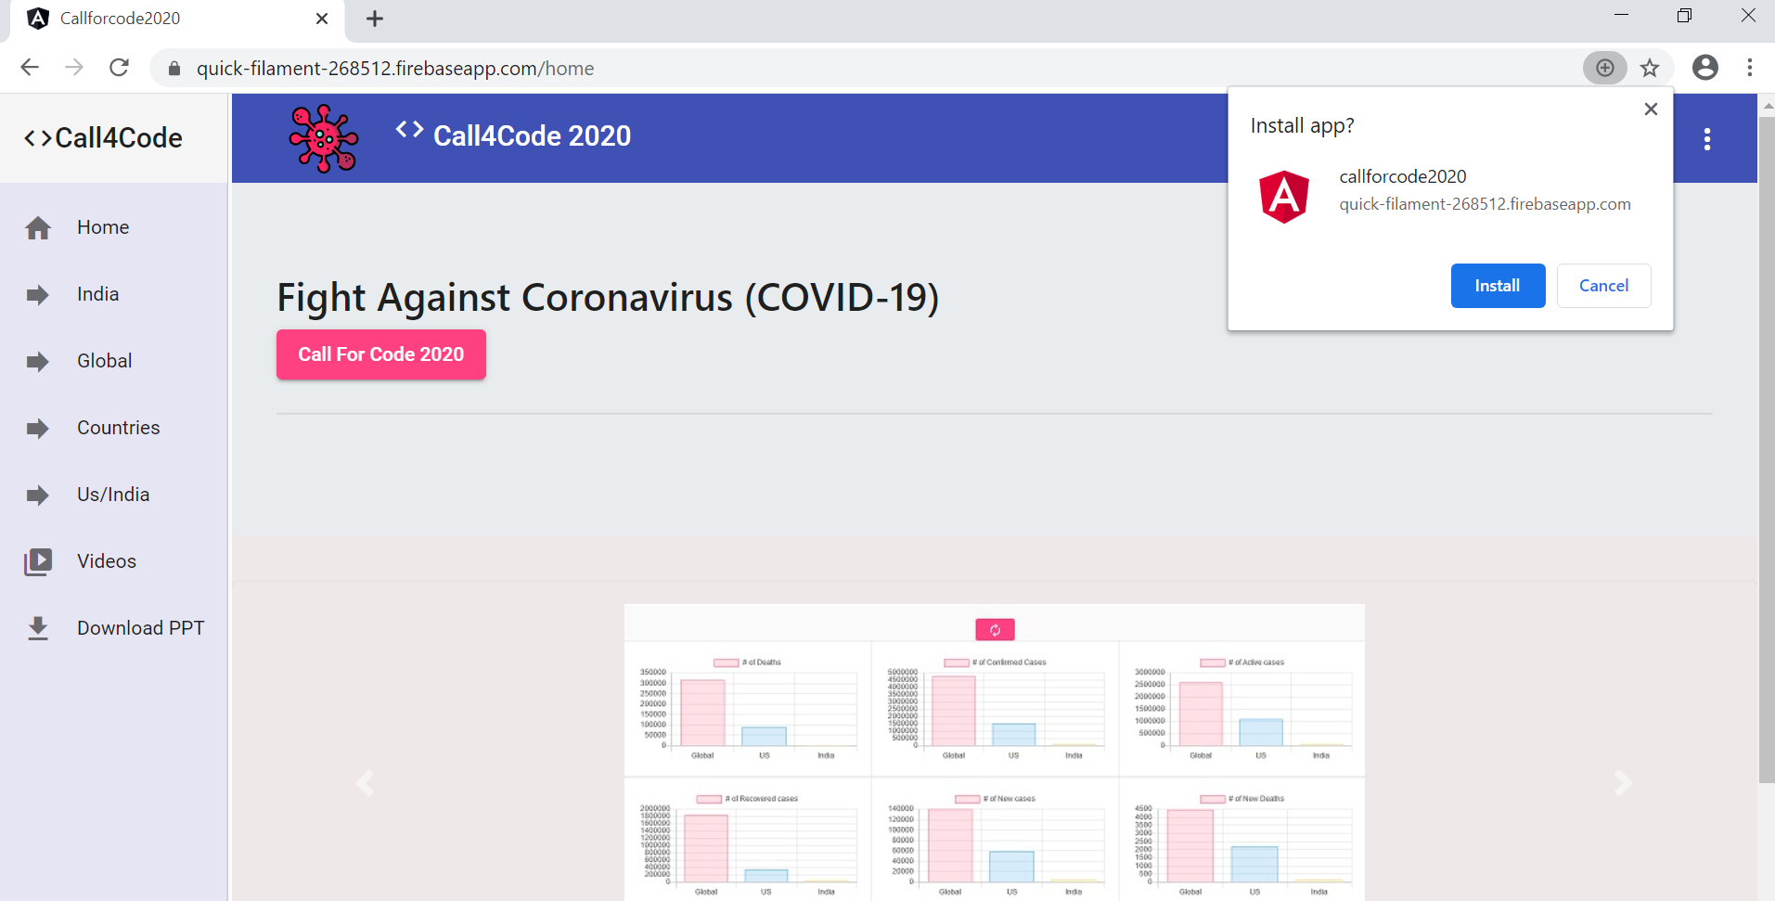
Features and Benefits
Install the application as desktop/mobile standalone app.

Slide 13
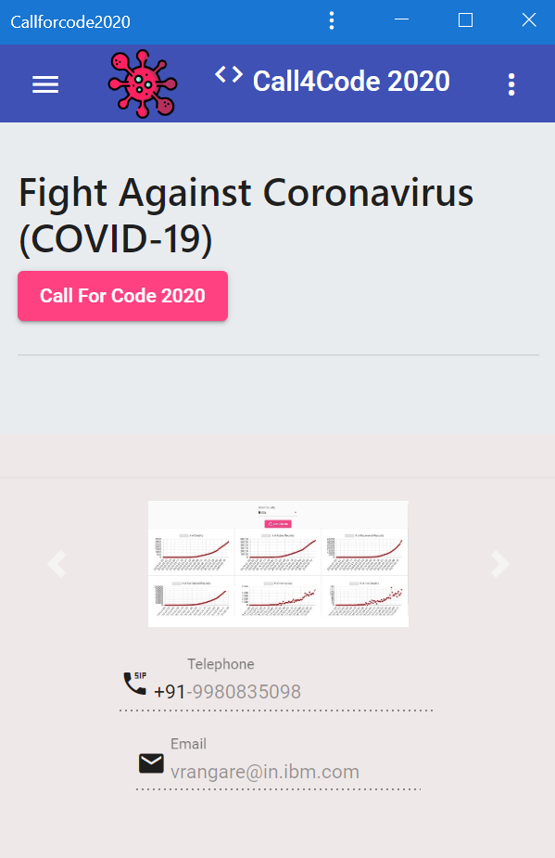
Features and Benefits
Access the application as mobile app.

Slide 14
Automate Ansible Automation [A3]
Thanks
Smart Automation
Vaibhav Rangare
Email: vrangare@in.ibm.com
Vaibhav Rangare
Email: vrangare@in.ibm.com

