Slide 1
FILE HANDLING IN C++

Slide 2
Files (Streams)
Files are used to store data in a relatively permanent form, on floppy disk, hard disk, tape or other form of secondary storage. Files can hold huge amounts of data if need be. Ordinary variables (even records and arrays) are kept in main memory which is temporary and rather limited in size. The following is a comparison of the two types of storage:

Slide 3
    Main memory
    Made up of RAM chips.
    Used to hold a program when it is running, including the values of its variables (whether integer, char, an array, etc.)
    Can only hold relatively small amounts of data.
    Is temporary (as soon as the program is done or the power goes out all of these values are gone).
    Gives fast access to the data (all electronic).
    Secondary memory
    Usually a disk drive (or magnetic tape).
    Used to hold files (where a file can contain data, a program, text, etc.)
    Can hold rather large amounts of data.
    Is fairly permanent. (A file remains even if the power goes out. It will last until you erase it, as long as the disk isn't damaged, at least.)
    Access to the data is considerably slower (due to moving parts).

Slide 4
C++ STREAMS
A Stream is a general name given to flow of data.
Different streams are used to represent different kinds of data flow.
Each stream is associated with a particular class, which contains member functions and definitions for dealing with that particular kind of data flow.

Slide 5
Flow of Data….
Data
PROGRAM
Input
Stream
>>
Output
Stream
<<
DEVICES OR
FILES
(Extraction
operator)
(Insertion operator)
Data
istream class
ostream class

Slide 6
The following classes in C++ have access to file input and output functions:
ifstream
ofstream
fstream

Slide 7
The Stream Class Hierarchy
NOTE : UPWARD ARROWS INDICATE
THE BASE CLASS
ios
istream
get()
getline()
read()
>>
ostream
put()
write()
<<
fstreambase
iostream
Ifstream
Open()
Tellg()
Seekg()
Ofstream
Open()
Tellp()
Seekp()
fstream

Slide 8
DIFFERENT FILE OPERATIONS
OPENING A FILE
CLOSING A FILE
READING FROM A FILE
WRITING ON A FILE
CHECKING FOR END OF FILE

Slide 9

WHAT IS FILE MODE?
The File Mode describes how a file is to be used ; to read from it, write to it, to append and so on
Syntax
Stream_object.open(“filename”,mode);
File Modes
ios::out: It open file in output mode (i.e write mode) and place the file pointer in beginning, if file already exist it will overwrite the file.
ios::in It open file in input mode(read mode) and permit reading from the file.

Slide 10
File Modes
Name | Description
ios::in | Open file to read
ios::out | Open file to write
ios::app | All the data you write, is put at the end of the file. It calls ios::out
ios::ate | All the data you write, is put at the end of the file. It does not call ios::out
ios::trunc | Deletes all previous content in the file. (empties the file)
ios::nocreate | If the file does not exist, opening it with the open() function gets impossible.
ios::noreplace | If the file exists, trying to open it with the open() function, returns an error.
ios::binary | Opens the file in binary mode.

Slide 11
OPENING A FILE
(Associating a stream with a file)
1. By using the CONSTRUCTOR of the stream class.
ifstream transaction(“sales.dly”);
ofstream result(“result.02”);
2. By using the open() function of the stream class
ifstream transaction;
transaction.open(“sales.dly”);

Slide 12
Closing a File
A File is closed by disconnecting it with the stream it is associated with. The close( ) function is used to accomplish this task.
Syntax:
  Stream_object.close( );
Example :
fout.close();

Slide 13
Checking For Successful File Opening
ifstream transaction(“sales.dly”);
if (transcation == NULL)
{
cout<<“unable to open sales.dly”;
cin.get(); // waits for the operator to press any key
exit(1);
}

Slide 14
Closing of File
Stream_name.close();
e.g., transaction.close();

Slide 15
eof ( ) Function
This function determines the end-of-file by returning true(non-zero) for end of file otherwise returning false(zero).
  Syntax
  Stream_object.eof( );
Example :
fout.eof( );

Slide 16
Text File Functions
get() – read a single character from text file and store in a buffer.
e.g file.get(ch);
put() - writing a single character in textfile
e.g. file.put(ch);
getline() - read a line of text from text file store in a buffer.
e.g file.getline(s,80);
We can also use file>>ch for reading and file<<ch writing in text file. But >> operator does not accept white spaces.

Slide 17
Program to create a text file using strings I/O
#include<fstream.h> //header file for file operations
void main()
{
char s[80], ch;
ofstream file(“myfile.txt”); //open myfile.txt in default output mode
do
{ cout<<”\n enter line of text”;
gets(s); //standard input
file<<s; // write in a file myfile.txt
cout<<”\n more input y/n”;
cin>>ch;
}while(ch!=’n’||ch!=’N’);
file.close();
} //end of main

Slide 18
Program to read content of ‘myfile.txt’ and display it on monitor.
#include<fstream.h> //header file for file operations
void main()
{
char ch;
ifstream file(“myfile.txt”); //open myfile.txt in default input mode
while(file)
{ file.get(ch) // read a character from text file ‘ myfile.txt’
cout<<ch; // write a character in text file ‘myfile.txt ‘
}
file.close();
} //end of main

Slide 19
#include <fstream>
#include <iostream>
using namespace std;
int main ()
{ char data[100];
// open a file in write mode.
ofstream outfile;
outfile.open("afile.txt");
cout << "Writing to the file" << endl;
cout << "Enter your name: ";
cin.getline(data, 100);
// write inputted data into the file.
outfile << data << endl;
cout << "Enter your age: ";
cin >> data;
cin.ignore(); // ignore the newline char inserted when you press enter
// again write inputted data into the file.
outfile << data << endl;
// close the opened file.
outfile.close();
// open a file in read mode.
ifstream infile;
infile.open("afile.txt");
cout << "Reading from the file" << endl;
infile >> data;
// write the data at the screen.
cout << data << endl;
// again read the data from the file and display it.
infile >> data
; cout << data << endl;
// close the opened file.
infile.close();
return 0
; }
Writing to the file
Enter your name: Zara
Enter your age: 9
Reading from the file
Zara
9

Slide 20
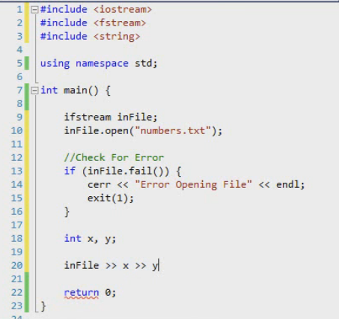
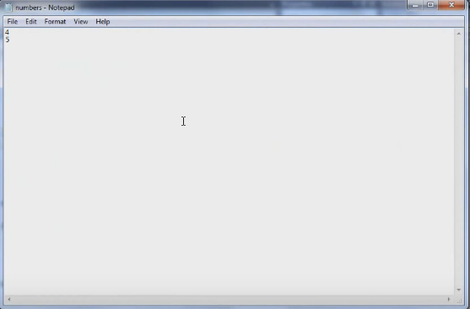
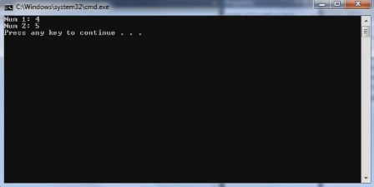

Slide 21
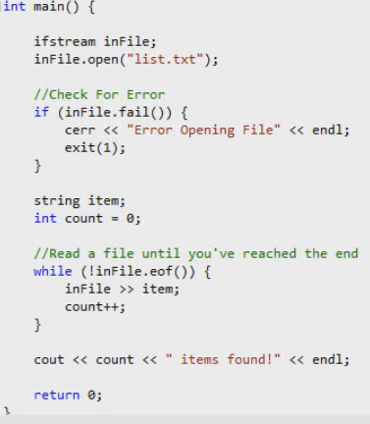
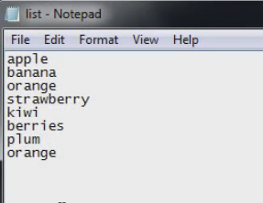
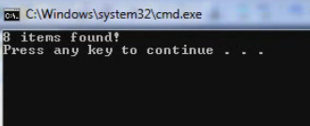

Slide 22
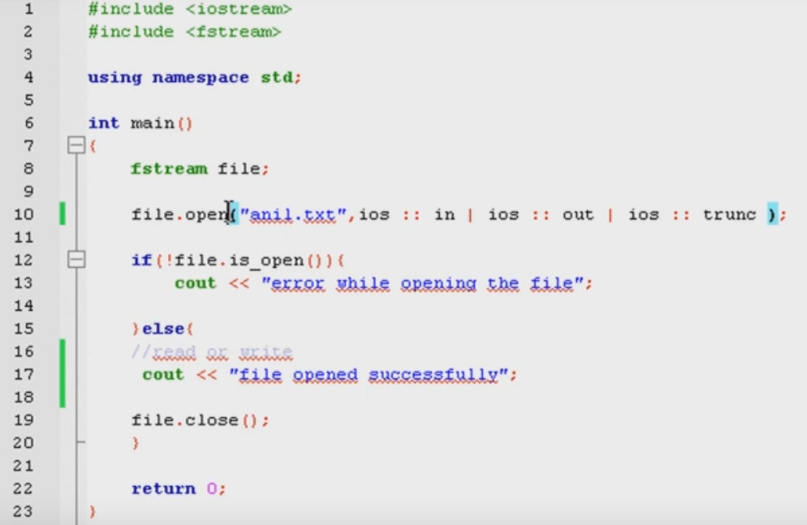

Slide 23
// Create a sequential file.
#include <iostream>
#include <fstream> using namespace std;
int main() {
// ofstream constructor opens file
ofstream outClientFile( "clients.txt",ios::out );
// exit program if unable to create file
if ( !outClientFile ) { // overloaded ! operator
cout << "File could not be opened" << endl;
exit( 1 );
} // end if

Slide 24
cout << "Enter the account, name, and balance." << endl
<< "Enter \’N\’ to end input.\n? ";
int account;
char name[ 30 ], ch=‘y’; double balance;
// read account, name and balance from cin, then place in file while (ch == ‘y’) {
cin >> account >> name >> balance;
outClientFile << account << ' ' << name << ' ' << balance
<< endl; cout << "? ";
cin>>ch;
} // end while
return 0; // ofstream destructor closes file
} //
end main
16

Slide 25
Copy content of one fille to other
#include<fstream>
using namespace std;
int main()
{
ifstream fin;
fin.open("out.txt");
ofstream fout;
fout.open("sample.txt");
char ch;
while(!fin.eof())
{
fin.get(ch);
fout << ch;
}
fin.close();
fout.close();
return 0;
}

Slide 26
Types of Files
. The two basic types are
  text and
  binary.
A text file consists of readable characters separated into lines by newline characters. (On most PCs, the newline character is actually represented by the two-character sequence of carriage return (ASCII 13), line feed (ASCII 10).

Slide 27
A binary file stores data to disk in the same form in which it is represented in main memory.
If you ever try to edit a binary file containing numbers you will see that the numbers appear as nonsense characters. Not having to translate numbers into a readable form makes binary files somewhat more efficient.
Binary files also do not normally use anything to separate the data into lines. Such a file is just a stream of data with nothing in particular to separate components.

Slide 28
When using a binary file we write whole record data to the file at once. When using a text file, we write out separately each of the pieces of data about a given record.
The text file will be readable by an editor, but the numbers in the binary file will not be readable in this way.
The programs to create the data files will differ in how they open the file and in how they write to the file.

Slide 29
For the binary file we will use write to write to the file, whereas for the text file we will use the usual output operator(<<) and will output each of the pieces of the record separately.
With the binary file we will use the read function to read a whole record, but with the text file we will read each of the pieces of record from the file separately, using the usual input operator(>>)

Slide 30
:
Sequential access. With this type of file access one must read the data in order, much like with a tape, whether the data is really stored on tape or not.
Random access (or direct access). This type of file access lets you jump to any location in the file, then to any other, etc., all in a reasonable amount of time.
Types of File Access

Slide 31


Slide 32
FILE POINTERS
Each file object has two integer values associated with it :
  get pointer
  put pointer
These values specify the byte number in the file where reading or writing will take place.

Slide 33
File pointers…..
By default reading pointer is set at the beginning and writing pointer is set at the end (when you open file in ios::app mode)
There are times when you must take control of the file pointers yourself so that you can read from and write to an arbitrary location in the file.

Slide 34
Functions associated with file pointers :
The seekg() and tellg() functions allow you to set and examine the get pointer.
The seekp() and tellp() functions allow you to set and examine the put pointer.

Slide 35
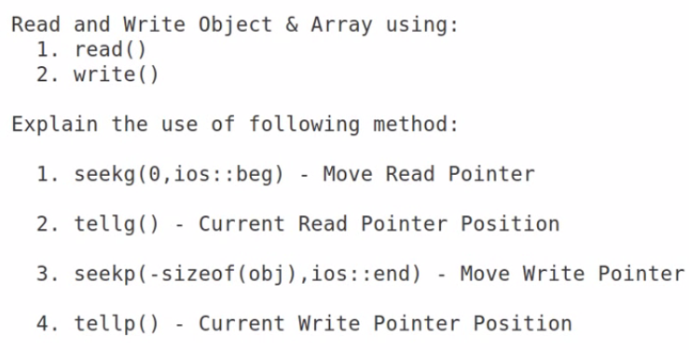

Slide 36
seekg() function :
With one argument :
seekg(k) where k is absolute position from the beginning. The start of the file is byte 0
File
End
Begin
k bytes
^
File pointer
The seekg() function with one argument

Slide 37
seekg() function :
With two arguments :
  the first argument represents an offset from a particular location in the file.
  the second specifies the location from which the offset is measured.
Begin
End
^
Offset from Begin
The seekg() function with two argument

Slide 38
seekg() function :
With two arguments :
Begin
End
^
Offset from Begin
^
Offset from end
^
Offset from current
position
The seekg() function with two argument

Slide 39
Binary File Functions
Note: Both functions take two arguments.
• The first is the address of variable, and the second is the length of that variable in bytes. The address of variable must be type cast to type char*(pointer to character type)
• The data written to a file using write( ) can only be read accurately using read( ).

Slide 40
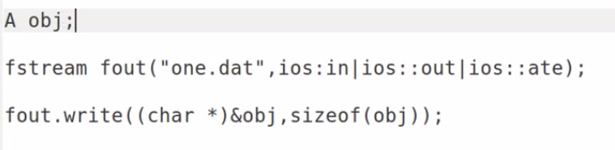
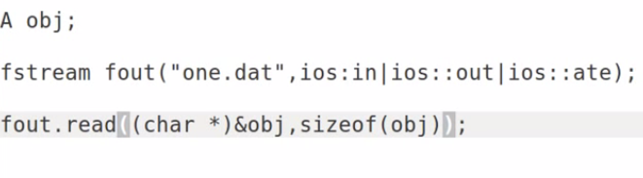

Slide 41
Program to create a binary file ‘student.dat’ using structure.
#include<fstream.h>
struct student
{
char name[15];
float percent;
};
void main()
{
ofstream fout;
char ch;
fout.open(“student.dat”, ios::out | ios:: binary);
clrscr();
student s;
if(!fout)
{
cout<<“File can’t be opened”;
exit(0);
}

Slide 42
do
{ cout<<”\n
enter name of student”;
gets(s);
cout<<”\n enter percentage”;
cin>>percent;
fout.write((char *)&s,sizeof(s)); // writing a record in a //student.dat file
cout<<”\n more record y/n”;
cin>>ch;
}while(ch!=’n’ || ch!=’N’);
fout.close();
}

Slide 43
Program to read a binary file ‘student.dat’ display records on monitor.
#include<fstream.h>
struct student
{
char name[15];
float percent;
};
void main()
{
ifstream fin;
student s;
fin.open(“student.dat”,ios::in | ios:: binary);
fin.read((char *) &s, sizeof(s)); //read a record from file ‘student.dat’
CONTD....

Slide 44
while(file)
{
cout<<s.name;
cout<<“\n has the percent: ”<<s.percent;
//fin.read((char *) &s, sizeof(student));
}
fin.close();
}

Slide 45
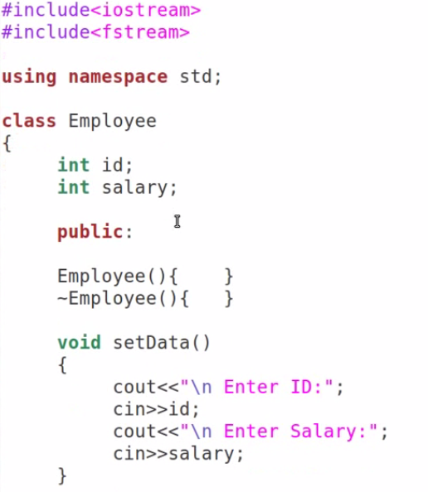
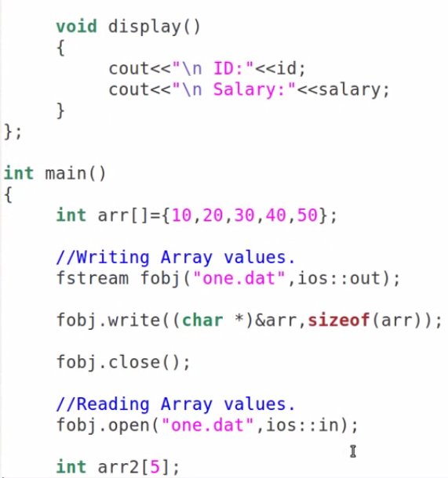

Slide 46
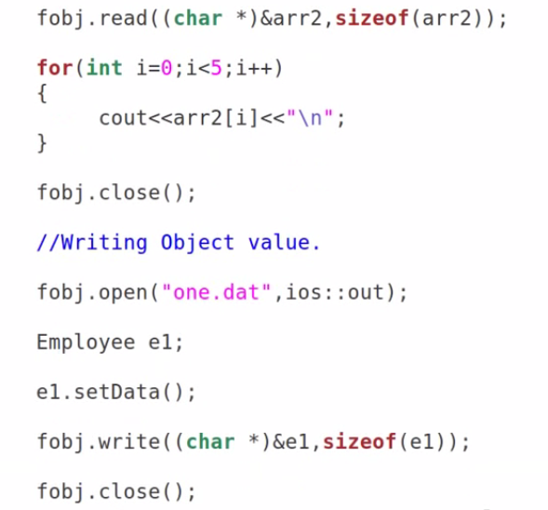
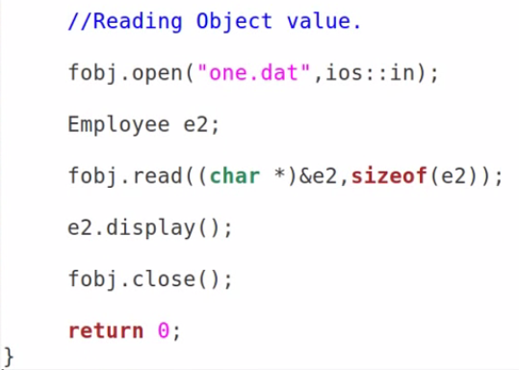

Slide 47
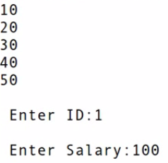


Slide 48
Command Line Argument :
#include<iostream>
int main(int argc,char* argv[])
{
int counter;
cout<<"Program Name Is: “<<argv[0];
if(argc==1)
cout<<“\nNo Extra Command Line Argument Passed Other Than Program Name";
if(argc>=2)
{
cout<<“\nNumber Of Arguments Passed: “<<argc;
cout<<“\n----Following Are The Command Line Arguments Passed----";
for(counter=0;counter<argc;counter++)
cout<<“\nargv[“<<counter<<“]:“<< argv[counter];
}
return 0;
}
$ ./a.out First Second Third
Program Name Is: ./a.out
Number Of Arguments Passed: 4
----Following Are The Command Line Arguments Passed----
argv[0]: ./a.out
argv[1]: First
argv[2]: Second
argv[3]: Third
O/P :
Program Name Is: ./a.out
No Extra Command Line Argument Passed Other Than Program Name

