Slide 1

Introduction
Vaibhav Chaudhary
https://www.linkedin.com/in/vaibhav-chaudhary-30/

Slide 2
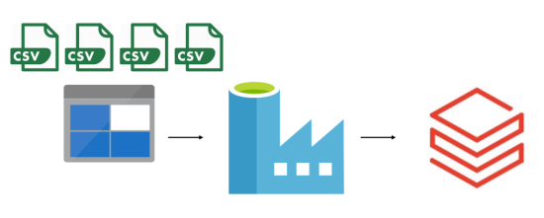
Azure Data Factory
This Photo by Unknown Author is licensed under CC BY-NC

Slide 3
What is ADF
Does not store data itself
Orchestrate the movement of data between supported data stores
Process data using spark in the backend
Allows cloud computing or on-premise computing of data

Slide 4
Azure Data Factory Architecture
On premises
Cloud DB
Linked service 1
(Connection String)
Dataset – 1 (pointer)
Dataset - 1
Dataset - 1
R/W
R/W
Integration run time
R/W
R/W
Dataset - 2 (pointer)
Dataset - 2
Dataset - 2
Linked service 2 (Connection String)

Slide 5
SQL order of execution
Dataset1
Where
having
order
Dataset2
Result
Join
Group
Select
Dataset-n
Dataset-n

Slide 6
Data Factory Components
Pipelines
Datasets
Dataflows
Change data Capture
Power Query

Slide 7
Objective
1. Read data from cloud storage – Azure blob (Data Lake Storage)
2. Transform data using dataflow
3. Output data to SQL server on cloud
4. Schedule above data pipeline for a specific period

Slide 8

Publish to GitHub
https://github.com/VaibhavStClair/AzureDataFactory_Project

Slide 9
References
WafaStudies - https://www.youtube.com/watch?v=Mc9JAra8WZU&list=PLMWaZteqtEaLTJffbbBzVOv9C0otal1FO

