Slide 1
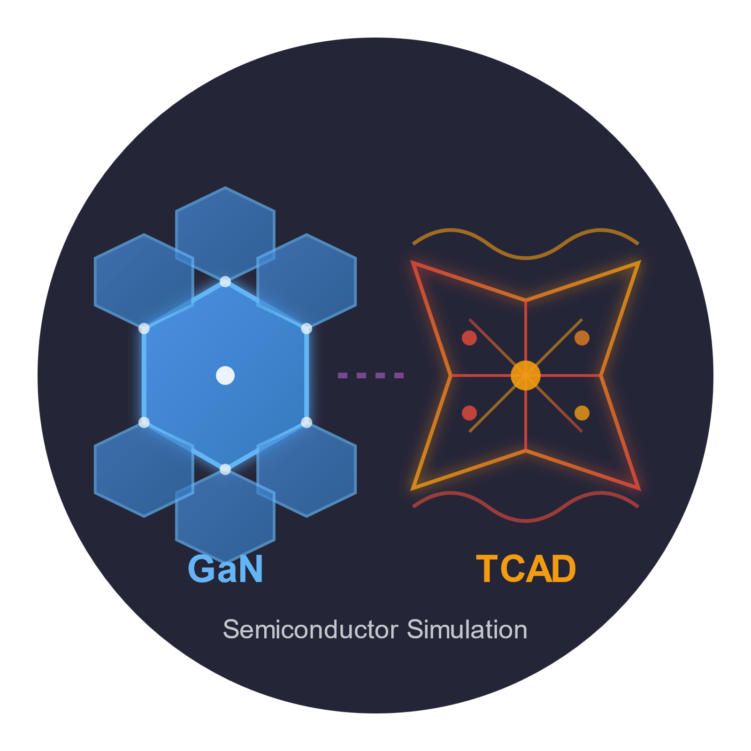
Institute of Electrical Energy Conversion
Parametric TCAD-Based Investigation of 1200 V Class GaN Power HEMTs on Silicon and Sapphire Substrates.
Vaibhav Balotra
Research Thesis - MSc. Electrical Engineering

Slide 2
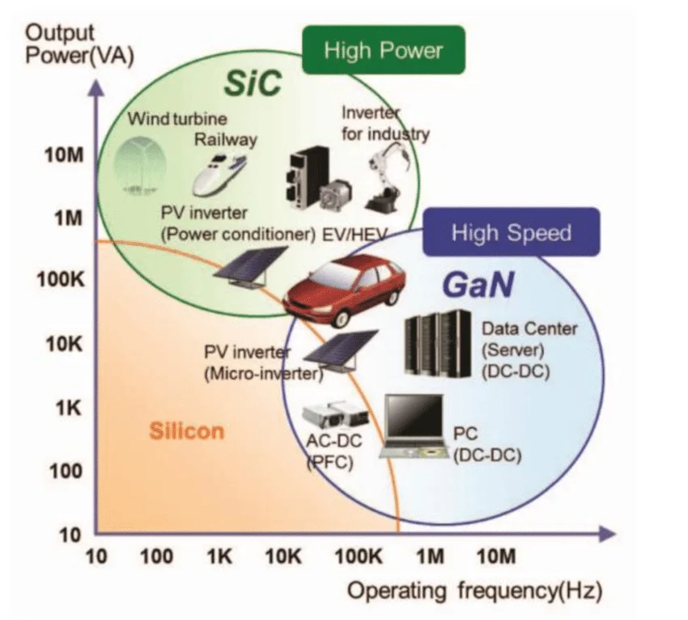
Background
The transition to an emission-free future requires efficient, cost-effective power conversion at higher voltages for electric vehicles and renewable energy systems.
These high-power applications remain dominated by expensive SiC MOSFETs, as current GaN technology cannot yet meet the structural demands for higher voltage operation.
Lateral GaN-on-Si technology has demonstrated strong performance in the 600V class with relatively low-cost manufacturing compared to SiC.

Slide 3
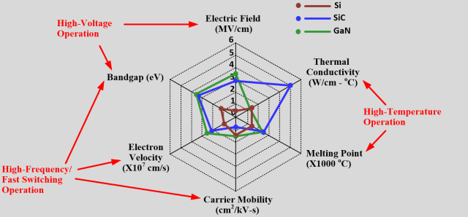
Motivation
The radar chart compares GaN, SiC, and Silicon across key material properties. GaN leads in critical electric field and electron velocity. The two properties that matter most for high-voltage, high-frequency switching. This is why GaN can, in theory, outperform SiC at 1200 V.

Slide 4
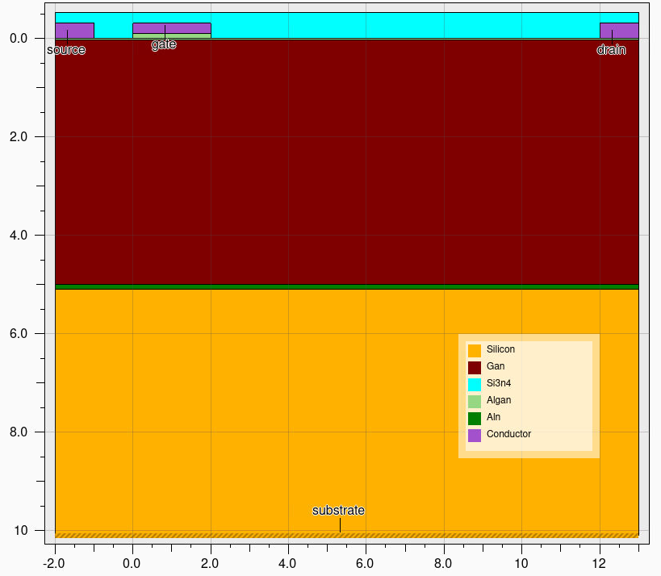
Problem
The major challenge for GaN-on-Silicon is scaling beyond 1200V, primarily due to lattice mismatch that restricts the GaN buffer thickness to roughly 5 µm. With a breakdown field significantly below 200V/µm, the blocking voltage is effectively capped at 600V–1000V, falling short of the 1200V and 1500V ratings required for modern electromobility and renewable energy systems.
Limited to 5um

Slide 5
Research Question
How can we implement an insulating backplane to stop vertical leakage, and how does this alter parasitic capacitance?
If vertical failure is prevented, what is the exact trade-off between extending the drift region for higher voltage and losing efficiency to resistance?
What new electric field stress emerges at the surface under extreme voltages, and how can we mitigate it without ruining high-frequency switching?

Slide 6
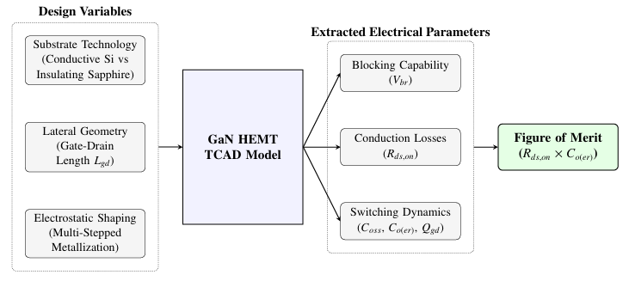
Approach

Slide 7
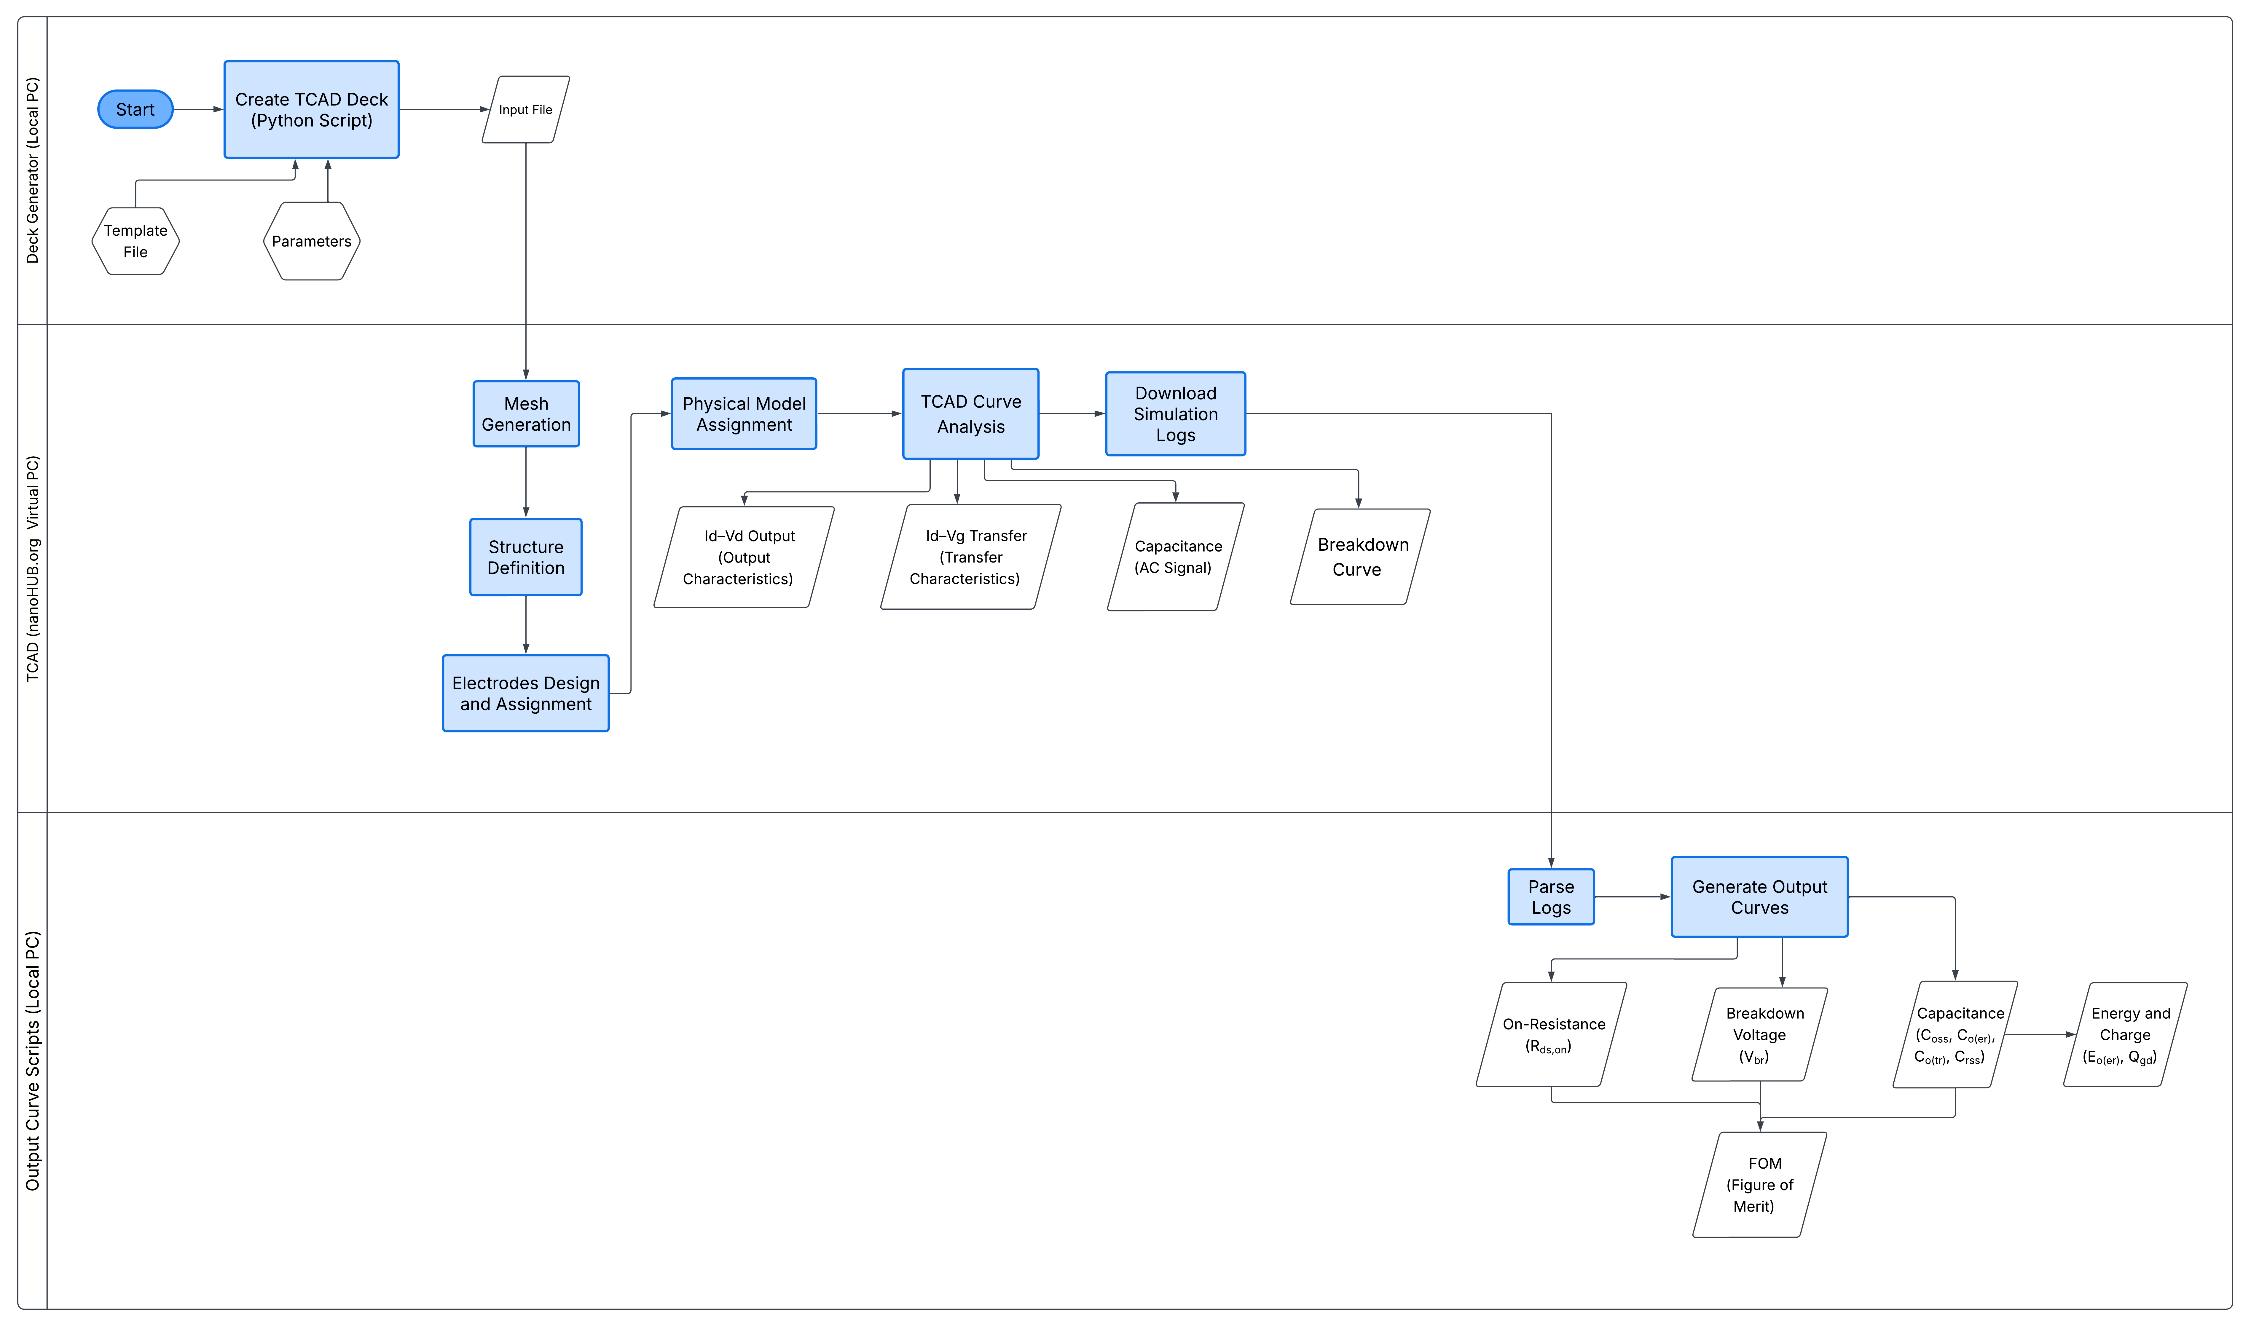
Approach - Workflow

Slide 8
TCAD Framework
Category | Parameter / Feature | Implementation Details
Physical Models | Polarization | Spontaneous and piezoelectric polarization with a 0.6 scale factor (60% relaxation) alongside calculated strain.
 | Recombination | Shockley-Read-Hall (SRH), Auger recombination, and Fermi-Dirac statistics at 300K.
 | Mobility | Field-dependent saturation velocity (VSAT) and temperature-dependent mobility models.
 | Impact Ionization | Selberherr impact ionization model implemented to capture GaN high-voltage breakdown.
Meshing Strategy | 2DEG Channel | Ultra-fine vertical grid spacing down to 1nm precisely at the AlGaN/GaN heterojunction.
 | Electrode Edges | 0.1µm refinement at Gate, source and Drain edges to resolve peak electric fields.
 | Substrate | Relaxed grid (up to 10 µm spacing) to optimize speed.
Numerical Execution | Simulator Engine | Silvaco Victory Device (2D Finite-Element)
 | Mathematical Solver | Newton Method: Solves standard Id-Vg, Id-Vd , and AC sweeps for fast, coupled convergence. Block Method: Solves breakdown sweeps to prevent divergence during extreme avalanche stiffness.

Slide 9
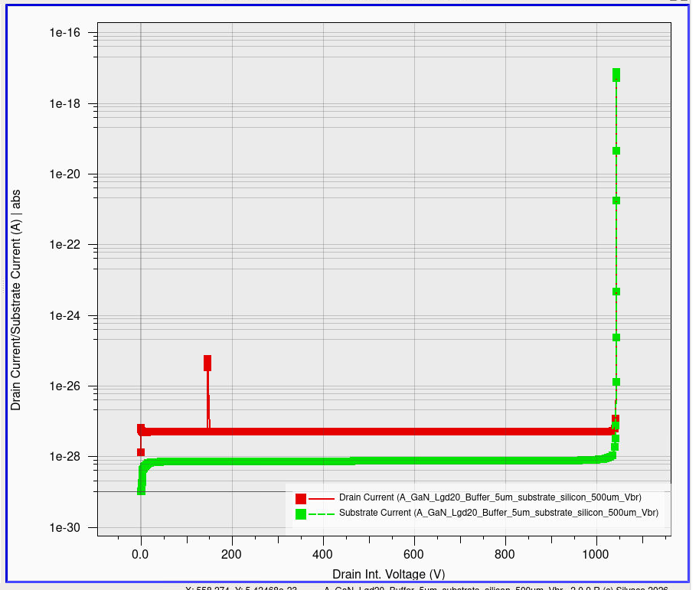
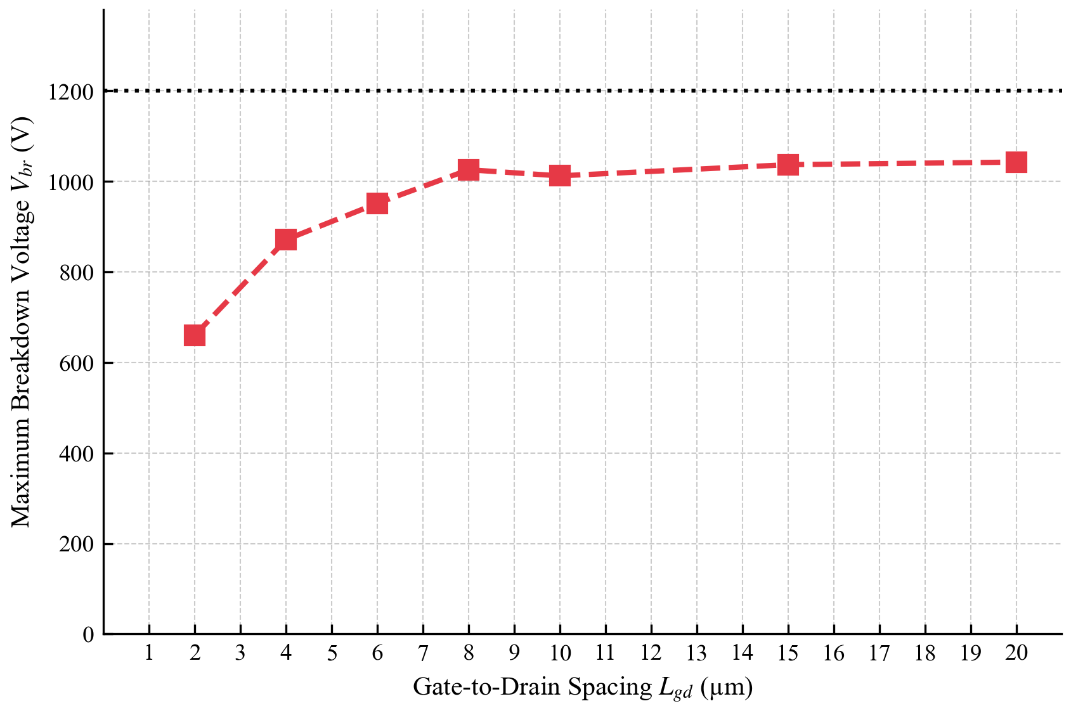
Results: Si Baseline - 1200 V Limitation
The breakdown voltage hits a hard ceiling at 1043 V. Even when applying the maximum geometric effort by extending the gate-to-drain spacing and using a thick 5 µm buffer, the device still falls short.

Slide 10
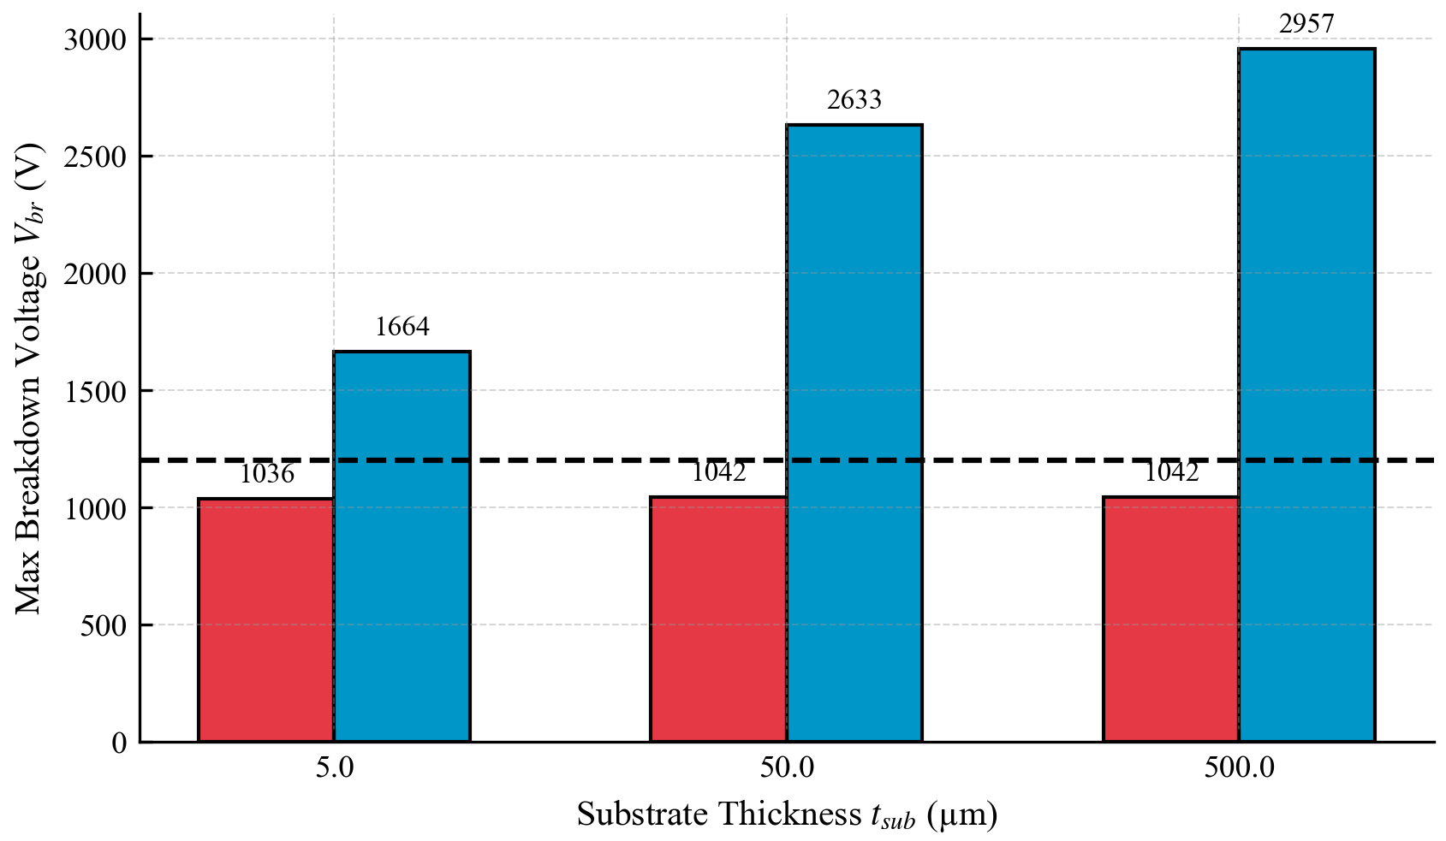
Results: Sapphire Enables 1200 V Class.
Replacing silicon with sapphire immediately unlocks the 1200 V class. The dashed line marks the 1200 V target.
Every red bar (silicon) falls below it. Most blue bars (sapphire) clear it comfortably.

Slide 11
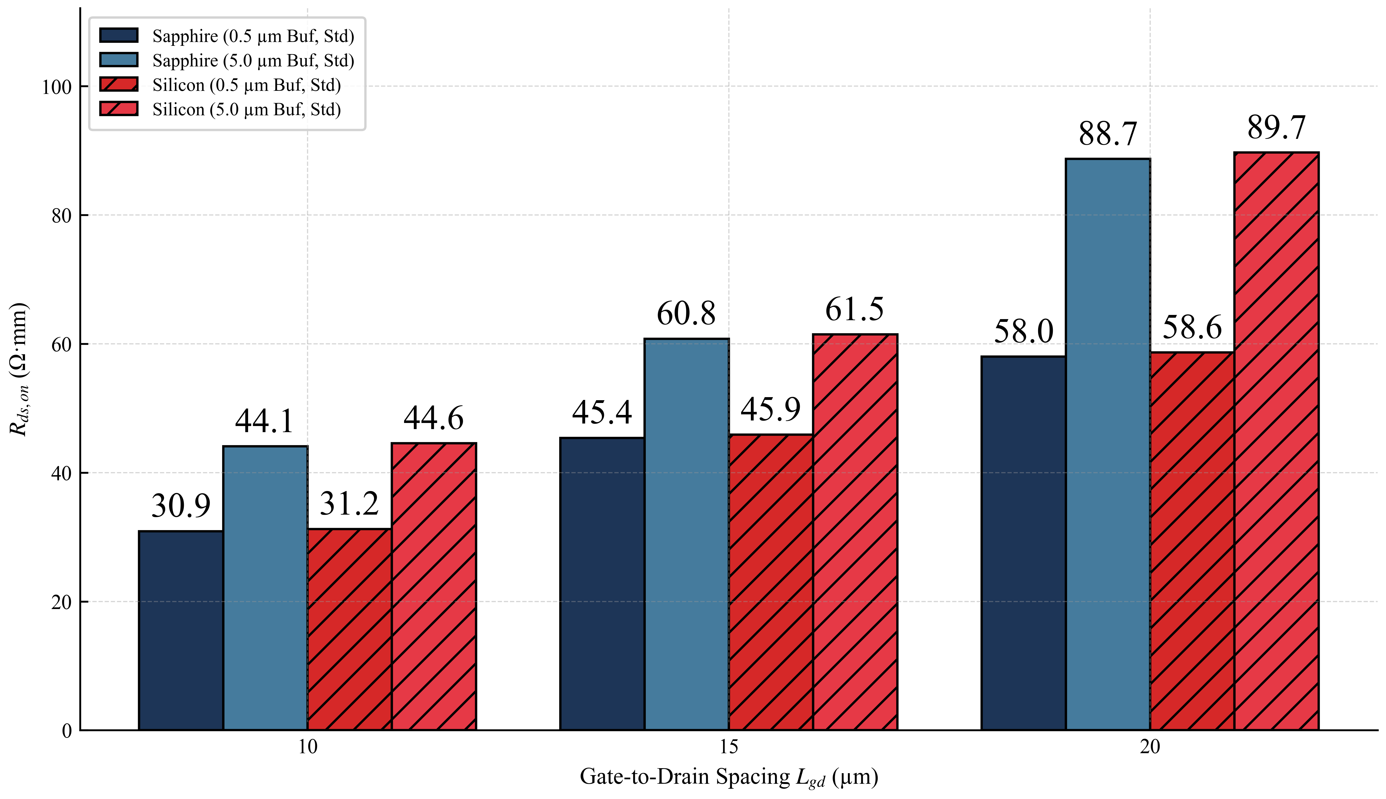
Results: Conduction Performance
This plot shows how on-resistance changes as the gate-to-drain spacing increases.
The silicon and sapphire points fall on the same line which means Ron is identical for both substrates at every Lgd value.
This confirms that switching to sapphire costs nothing in terms of conduction performance.

Slide 12
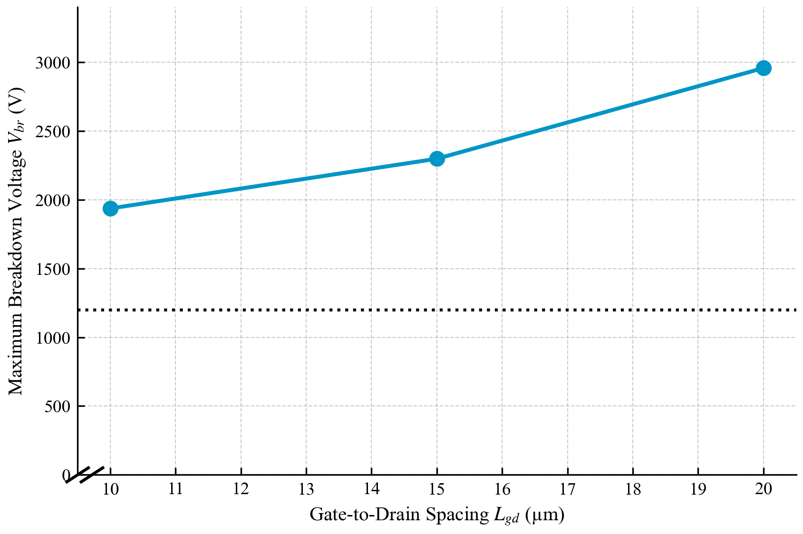
Results: Vbr Scaling with Lgd​
With the vertical leakage path removed due to Sapphire, the drift region now controls breakdown voltage.
The plot shows Vbr increasing consistently with Lgd on sapphire. A relationship which is completely absent on silicon.

Slide 13
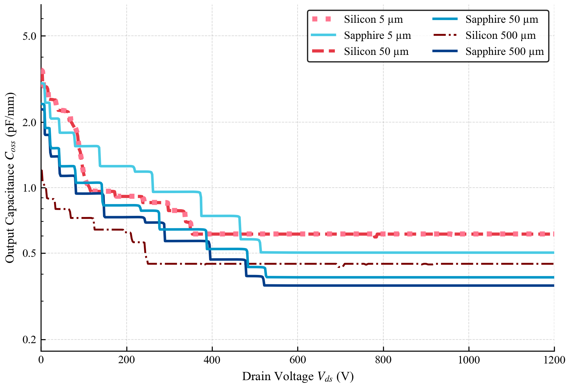
Results: Output Capacitance
The output capacitance (Coss) drops steeply as drain voltage increases which is normal for any transistor.
The key point is that sapphire curves (blue) sit consistently below silicon curves (red) at every voltage.
This means the sapphire device stores less energy per switching cycle, which directly reduces switching losses.

Slide 14
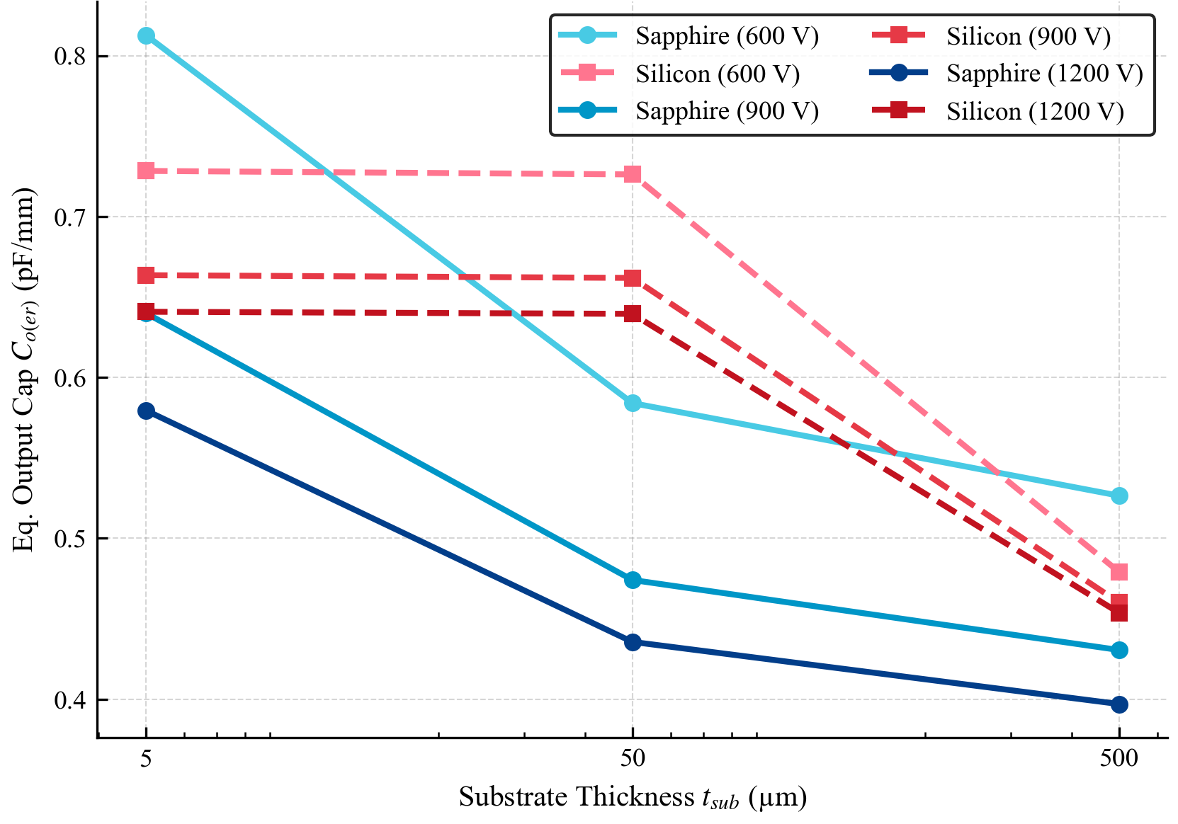
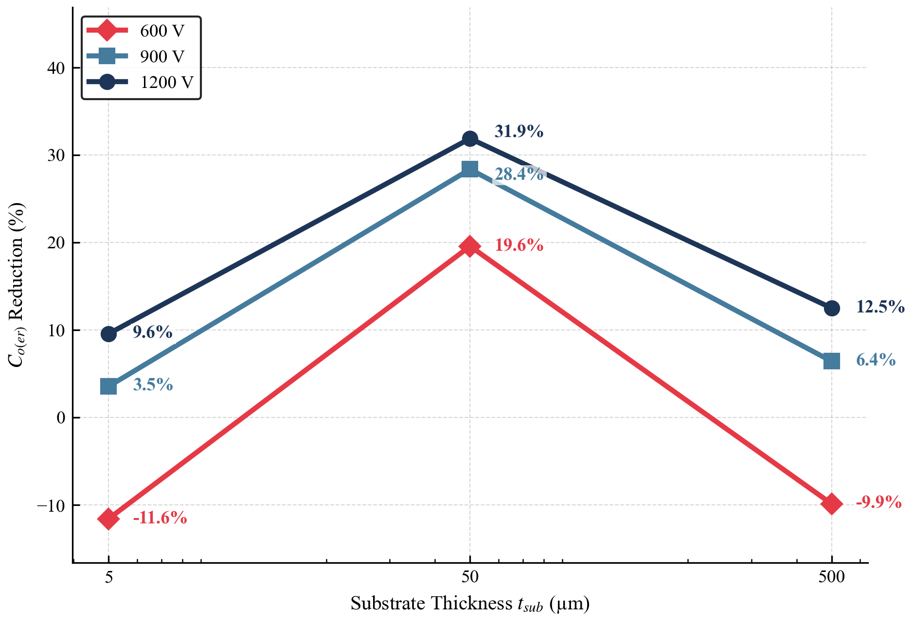
These plots show the benefit of using a thicker sapphire substrate. The left plot shows that Co(er) drops as the substrate gets thicker. The right plot shows how much better sapphire is compared to silicon. The comparison shows that Co(er) is reduced by up to 31.9% relative to the silicon device. The 500 µm substrate has the lowest Co(er) and is also the standard off-the-shelf wafer size, so no extra processing is needed to achieve this improvement.

Slide 15
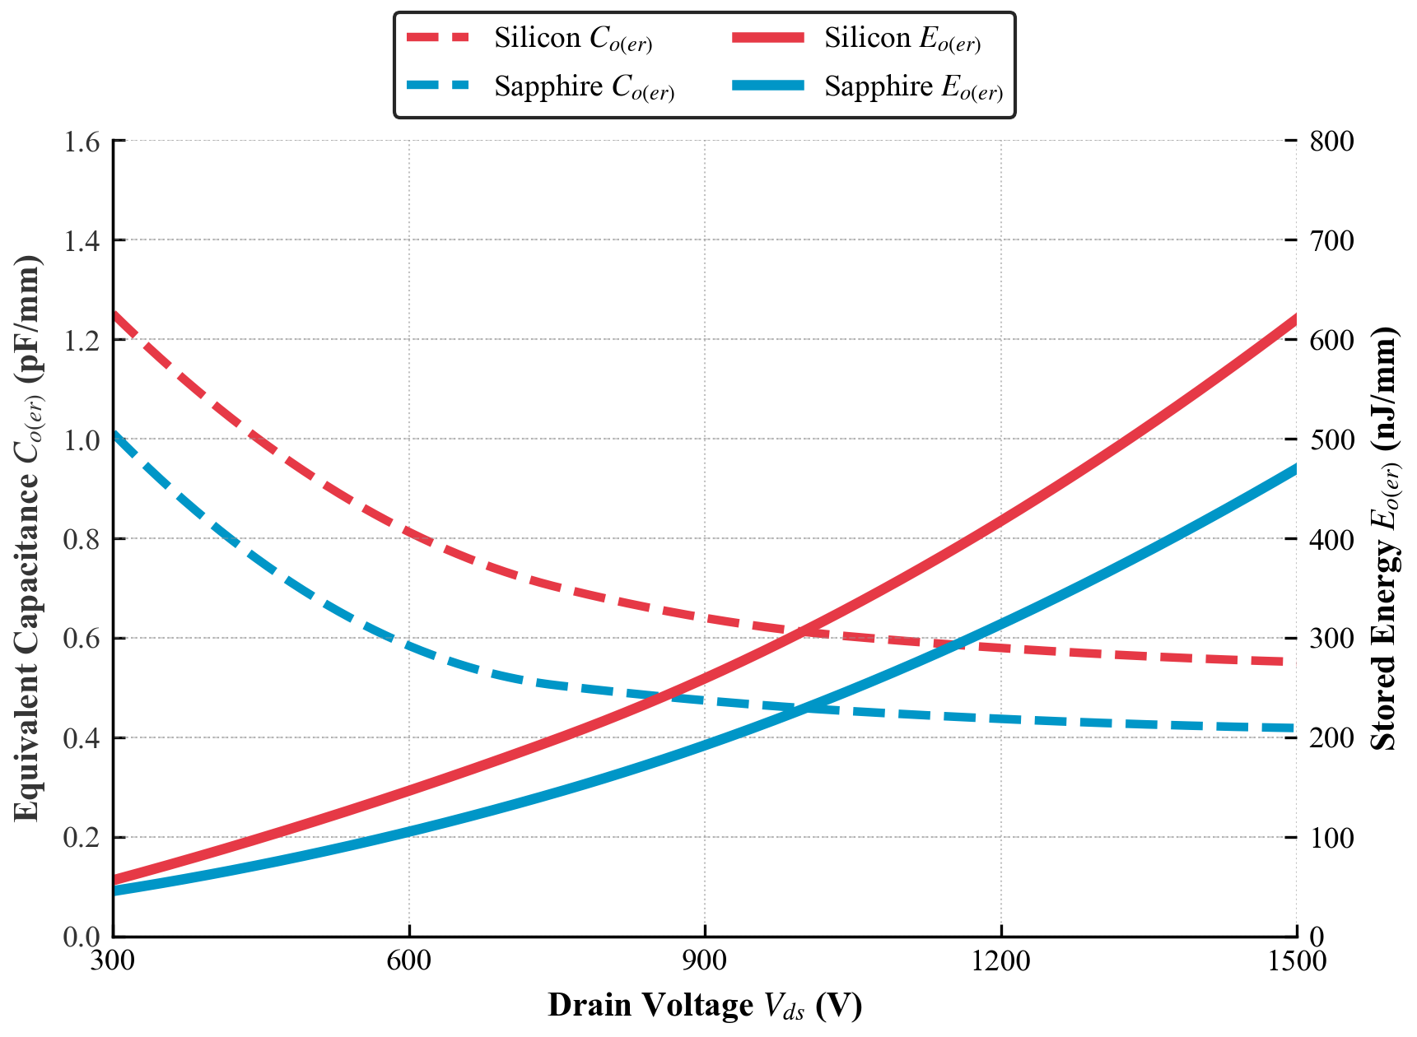
Results: Capacitance and Energy
These curves show the energy stored in the output capacitance as a function of drain voltage.
Sapphire stores less energy than silicon across the full voltage range.
Since this stored energy is lost as heat every time the device switches, lower Co(er) means lower switching losses.
The sapphire device is not just better at blocking voltage but also switches more efficiently.

Slide 16
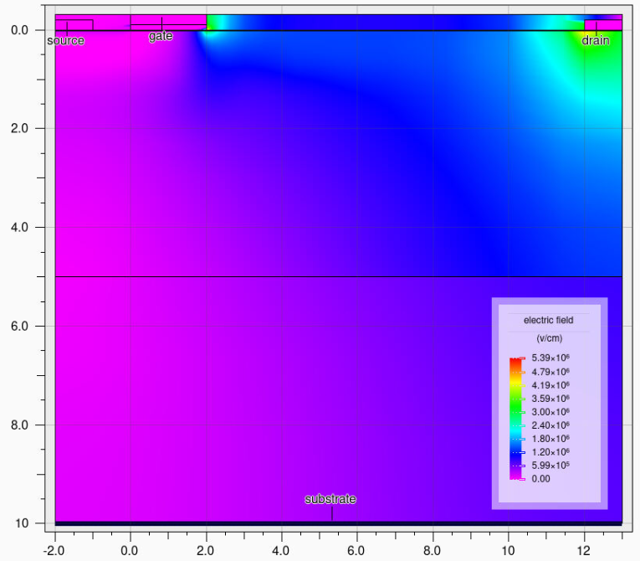
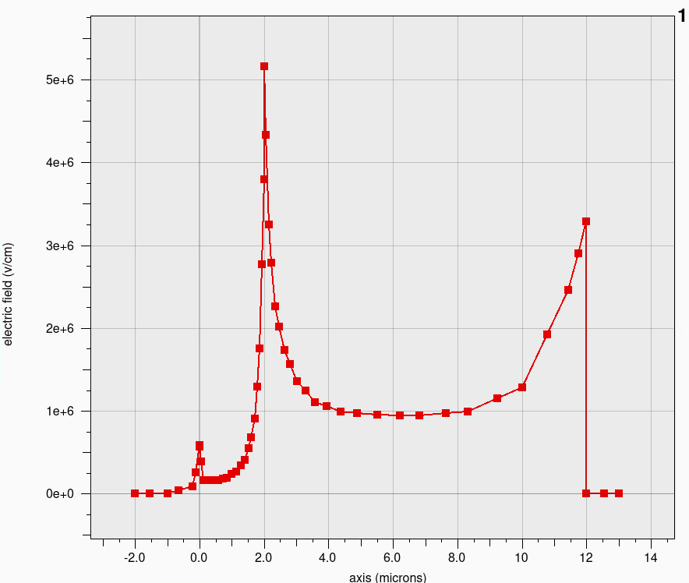
Results: Electric-Field Distribution
The color map shows the electric field inside the device at high drain voltage. The bright spot at the gate edge is the problem. The field peaks dangerously there and triggers breakdown. The graph on right confirms the spike exceeds 5 MV/cm. This gate-edge crowding is the lateral failure mechanism that needs to be solved.

Slide 17
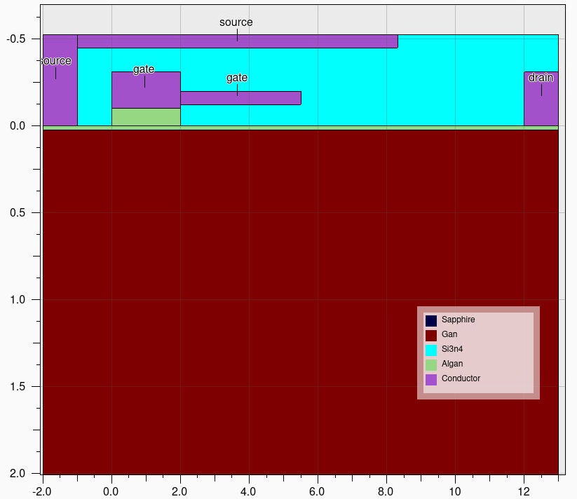
Results: Dual Field-Plate Concept
The solution to gate-edge field crowding is a dual field plate. A metal extension connected to both the gate and source that spreads the electric field across the drift region.
The gate-connected plate manages the field immediately beyond the gate, while the source-connected plate extends further into the drift region, both separated from the semiconductor surface by the passivation layer.

Slide 18
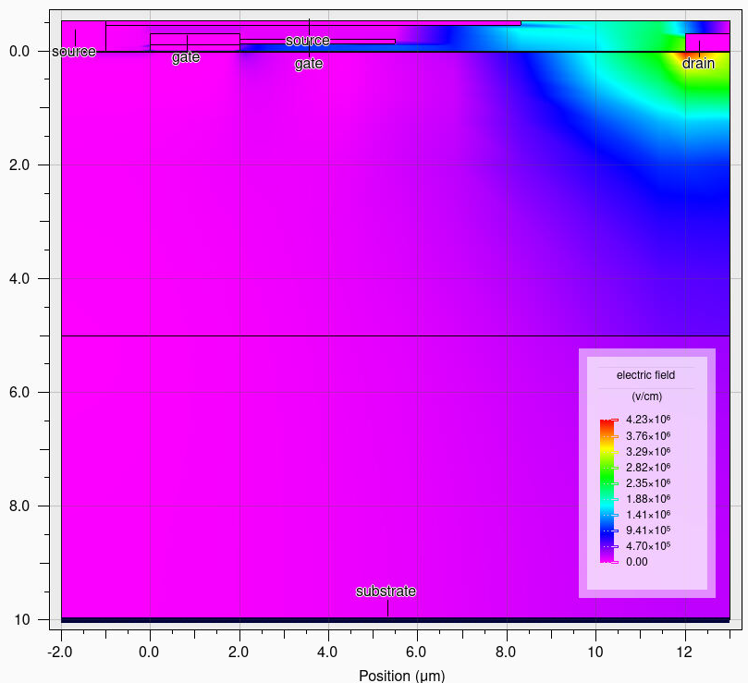
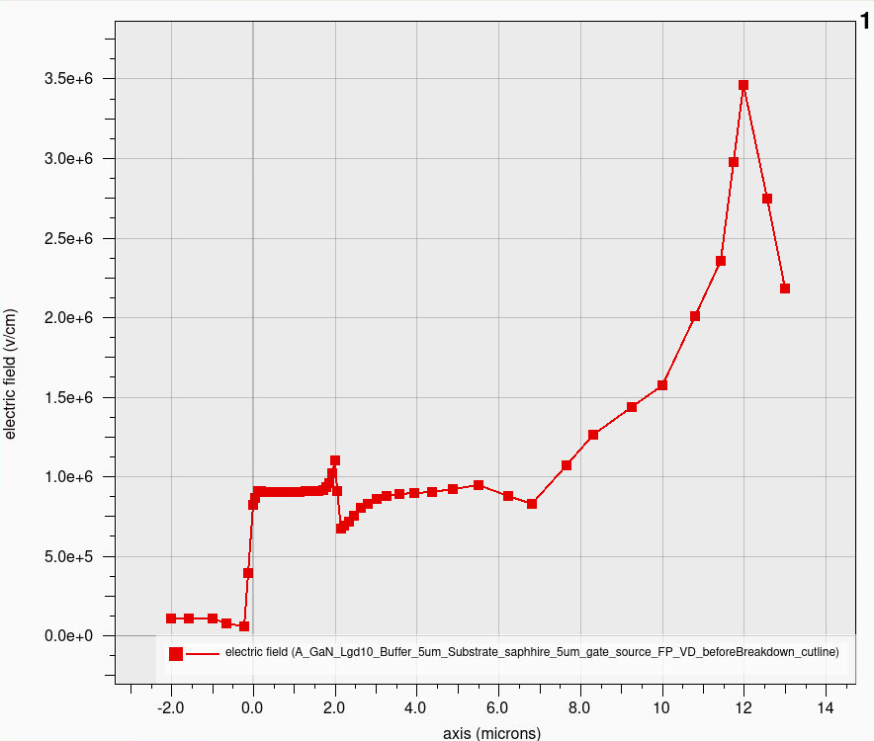
The 2D color map and 1D cutline confirm a five-fold suppression of the gate-edge electric field peak from above 5 MV/cm down to approximately 1 million V/cm. This redistribution of the electric field across the drift region is exactly what is needed to support higher breakdown voltage.

Slide 19
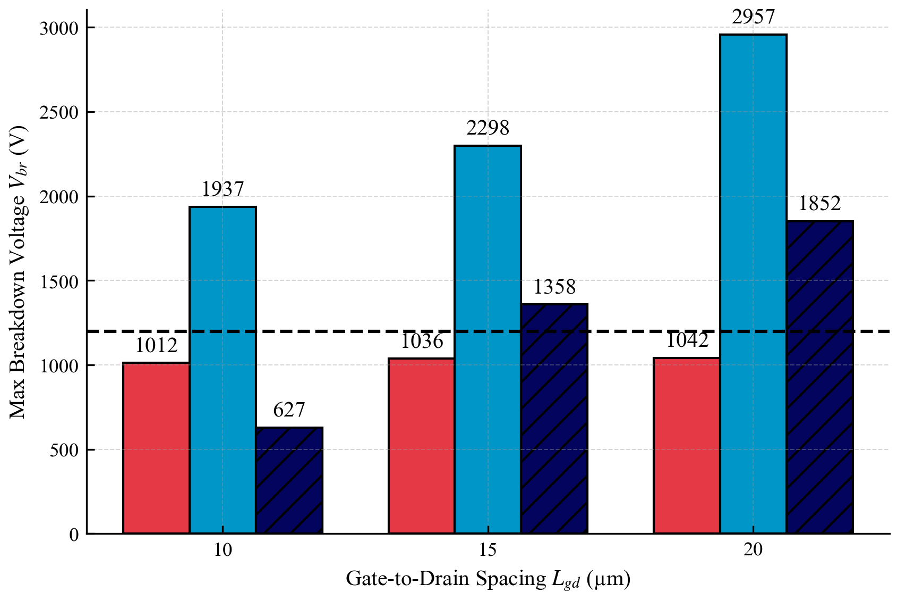
The bar chart shows that the field-plated device (dark hatched bars) achieves lower Vbr than the un-plated sapphire device (light blue bars) which contradicts what the electric field evidence on the previous slide tells us.
This is not a physical result. The sharp geometric corners introduced by the multi-dielectric field plate structure cause the TCAD solver to fail before true avalanche breakdown is reached. The simulator stops early, reporting a lower Vbr but the real device, as confirmed by the field distribution, would break down at a higher voltage.

Slide 20
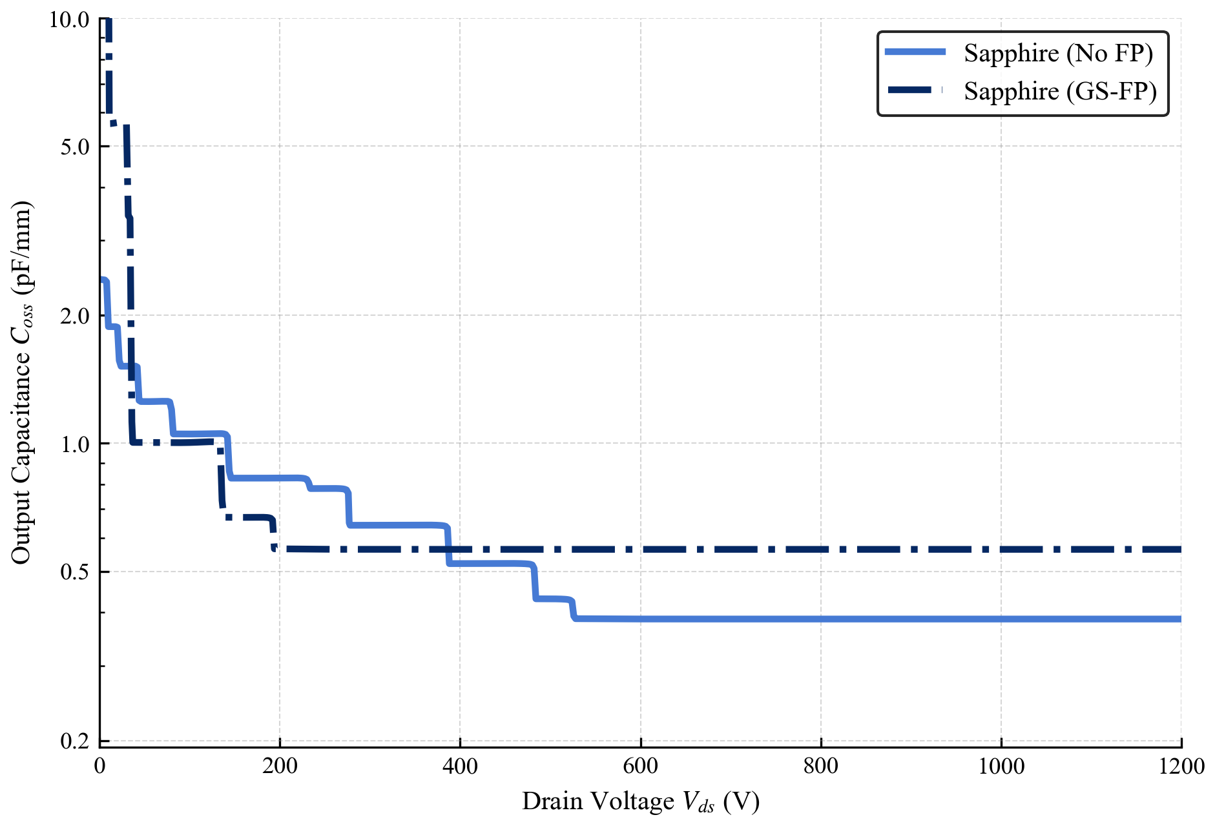
Results: Field-Plate Trade-off
The field plate adds capacitance at low drain voltages because of the metal plate overlap and that is the spike visible on the left side of the curve.
Above 400 V, the field-plated device settles at a higher Coss than the un-plated device. This is the genuine switching trade-off of the field plate, it improves the electric field distribution and is expected to raise breakdown voltage, but it comes at the cost of higher output capacitance across the full operating voltage range.

Slide 21
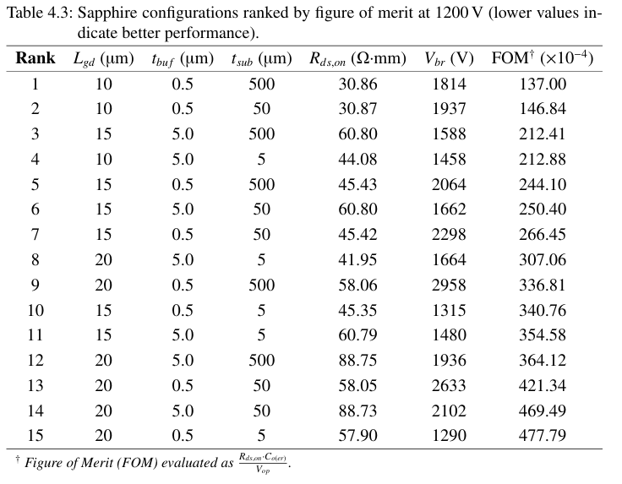
Results: Figure of Merit (FOM)
This table ranks all sapphire configurations by figure of merit defined as Ron times Co(er) divided by operating voltage. Silicon configurations are excluded entirely because none of them crossed the 1200 V qualification threshold.
The top-ranked configuration is Lgd = 10 µm, 0.5 µm buffer, 500 µm substrate achieved 1814 V breakdown voltage at the lowest on-resistance in the sweep.
Importantly, this is also the cheapest configuration to manufacture: the thinnest buffer reduces reactor time and 500 µm is the standard commercial wafer thickness.

Slide 22
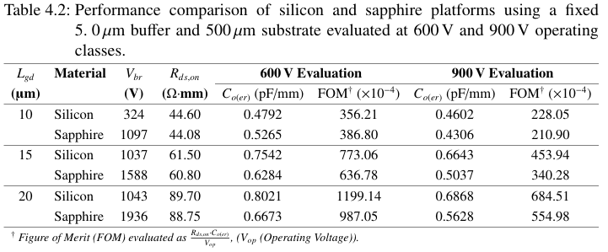

Since silicon never reaches 1200 V, a direct comparison at that voltage is not possible. Instead, both platforms are evaluated at 600 V and 900 V, the voltage classes where silicon can still operate. Comparison was done using the same buffer thickness and substrate thickness.
At every Lgd and at both voltage classes, sapphire achieves lower Co(er) and better figure of merit than silicon. The Ron is virtually identical between the two platforms at the same geometry. This confirms that sapphire is not just better at high voltage, it is a strictly superior platform at every voltage level tested, with no trade-off in conduction performance.

Slide 23

Summary
A TCAD-based investigation was performed for 1200 V-class GaN HEMTs using silicon and sapphire substrates.
The GaN-on-Si device achieved a maximum breakdown voltage of 1043 V, demonstrating the limitation of the silicon.
Replacing silicon with sapphire enabled the investigated devices to exceed the 1200V target.
Sapphire showed similar Ron to silicon while providing improved high-voltage blocking capability.
The sapphire structures exhibited lower Coss and reduced capacitive energy over the investigated voltage range.
Increasing sapphire thickness further reduced the effective output capacitance, with a maximum reduction of approximately 31.9% relative to the silicon.
Electric-field analysis identified gate-edge field peaks as a critical lateral breakdown mechanism, with peak electric field exceeding 5 MV/cm.
A dual field-plate structure reduced the simulated peak gate-edge electric field to approximately 1 MV/cm, corresponding to roughly five-fold suppression.

Slide 24
Conclusion
Among the investigated configurations, Lgd=10 μm, 0.5 µm buffer and 500 µm sapphire substrate provided the highest-ranked performance according to the FOM, with a simulated breakdown voltage of approximately 1814V.
Beyond pure performance, this specific configuration provides three massive manufacturing cost advantages. First, the 500 µm sapphire substrate utilizes standard commercial wafer dimensions without requiring custom mechanical thinning processes. Second, the ultra-thin 0.5 µm buffer layer significantly reduces epitaxial growth times inside the MOCVD reactor, which directly maximizes manufacturing throughput. Finally, the compact 10 µm lateral geometry minimizes the total die footprint, allowing a strictly higher device yield per wafer.
Even at 600 V and 900 V operating classes, sapphire universally outperforms silicon by yielding significantly lower equivalent capacitance (Co(er)) at identical Rds,on geometries.
Future Work
Electro-Thermal Simulation: Sapphire possesses lower thermal conductivity than silicon. Electro-thermal TCAD simulations are required to quantify self-heating during continuous high-power operation.
Circuit-Level Modeling: Extraction of SPICE parameters from the TCAD capacitance profiles to evaluate the optimized sapphire HEMT in a 1200 V half-bridge topology.
Physical Prototyping: Device fabrication and experimental double-pulse testing to physically validate the TCAD avalanche models and the predicted Eo(er) reductions.

Slide 25

Institute of Electrical Energy Conversion
Vaibhav Balotra
MSc. Electrical Engineering
E-Mail:
st192662@stud.uni-Stuttgart.de
Phone:
+4915752481938
University of Stuttgart
Institute of Electrical Energy Conversion

