Slide 1
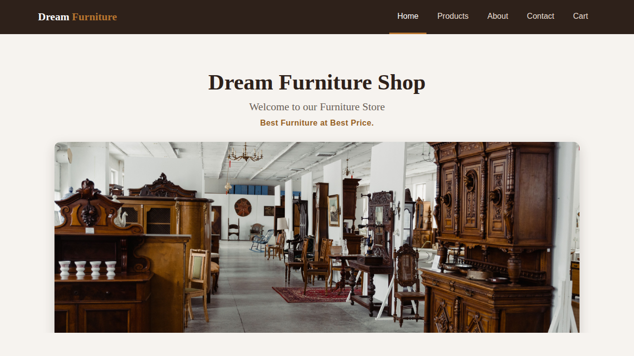
PROJECT PROGRESS REVIEW · LATEST VERSION
Dream Furniture Shop
A Django web application with a database, shopping cart and order management
TEAM MEMBERS
Home page of the running application
Vaibhav Bhor · Samadhan Hake · Sakshi Londhe
Project Guide: Prof. Sharmila Shaikh
Notes:
Introduce the project and team. Replace the placeholder names and guide name on this slide before presenting.

Slide 2





2
Problem Statement and Objectives
Objectives
Problem statement
Give the shop a professional online presence
Small furniture shops depend on walk-in customers. Without a website, buyers cannot browse products, compare prices or place orders before visiting the store.
Show products from a database with images and prices
Let customers add items to a cart and place orders
Our answer
Collect and store customer feedback
A web application that puts the catalogue, offers, cart and ordering online, with all data stored in a database.
Let the owner manage everything from an admin panel
Notes:
Explain why the shop needs an online presence, then walk through the five objectives. Adjust the wording to match your project report.

Slide 3





3
Work Completed After 1st Progress Presentation
Database layer
Admin panel
4 tables: Product, ContactMessage, Order, OrderItem
Manage products, messages and orders
Contact form saves data
Shopping cart
POST request stored in the database
Buy button adds items; session-based cart
Checkout and orders
Styled interface
Order and items saved; confirmation page
Shared CSS, navbar, cards, mobile friendly
Notes:
These items were added after the first review. Remove anything that was already shown in your first presentation.

Slide 4
4
System Design / Architecture / Methodology
Browser
urls.py
views.py
Templates
HTML and CSS
URL router
Views + cart logic
base + 6 pages
Request flow
Browser requests a URL
urls.py picks the view
View reads or writes the database
Template builds the HTML page
Session cart
Models + SQLite
Stored per browser
Implemented
Methodology
MVT pattern
Incremental build
Django + Python
SQLite ORM
HTML / CSS
Notes:
All three MVT layers are now working. The Model layer stores products, feedback and orders in SQLite. The cart is kept in the browser session until the order is placed.

Slide 5
5
Modules Developed and Current Status
Home page
Banner, tagline, navigation bar
Done
Products page
Cards loaded from the database
Done
About page
Description and special offer
Done
Contact form
Feedback saved to the database
Done
Shopping cart
Add, remove, totals, 5000+ offer
Done
Checkout and orders
Order + items saved, confirmation page
Done
Email Receipt
Email will send to the customer
Planned
Login and payment
Customer accounts, online payment
Planned
Notes:
Seven modules are complete. Only customer login and online payment remain.

Slide 6
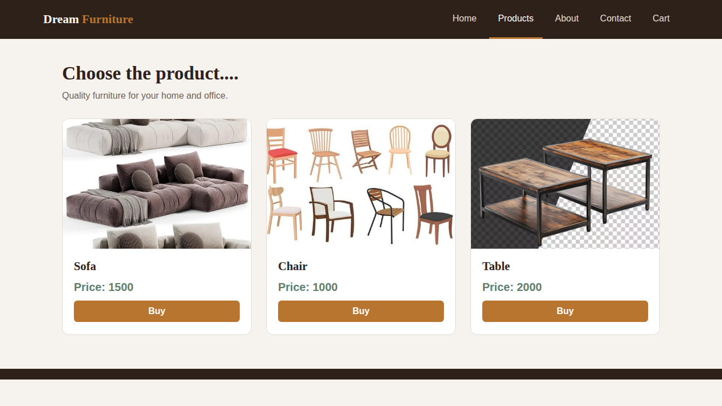
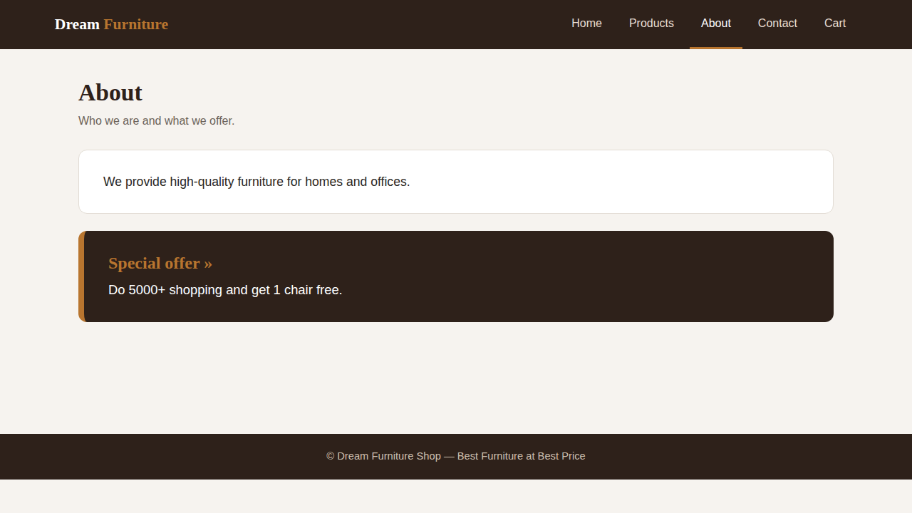
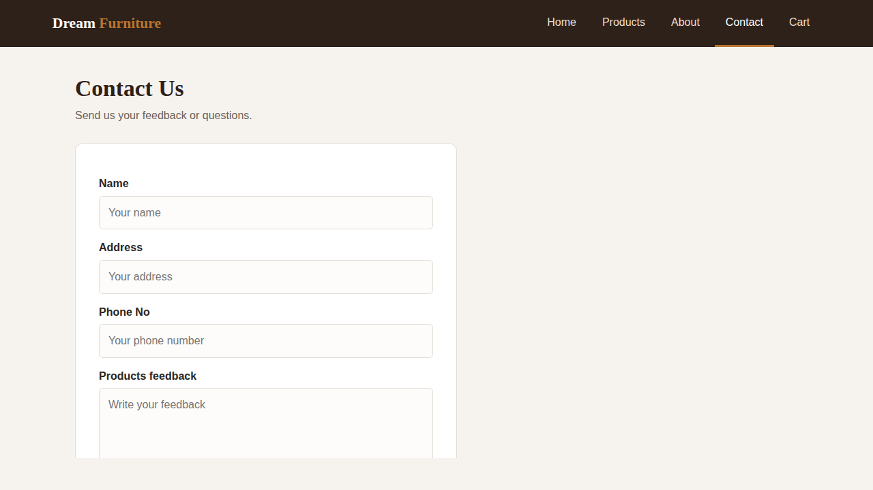
6
Implementation, Screenshots and Working Demo
Demo flow
Start the server
Browse Products, click Buy
Open Cart, place the order
Submit the contact form
Show saved data in /admin/
Home /home/
Products /products/
python manage.py
runserver
About /about/
Contact /contact/
Notes:
Run the live demo. Screenshots are shown in case the demo fails. Next slides cover the database design, cart workflow and admin screenshots.

Slide 7
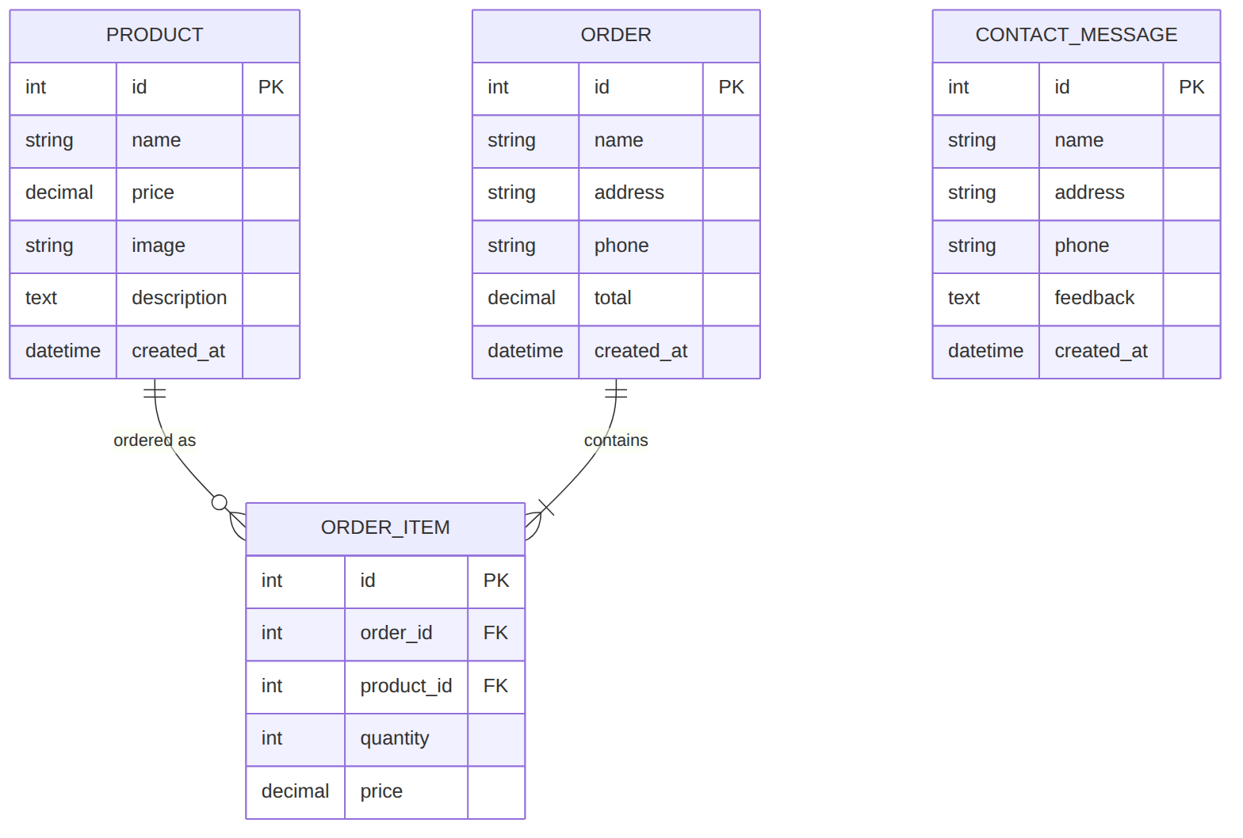
+
Database Design (ER Diagram)
4 tables in SQLite
Product
Catalogue with price and image
ContactMessage
Feedback from the form
Order
Customer details and total
OrderItem
Products in each order, with quantity and price at purchase
One Order has many OrderItems. Each OrderItem points to one Product.
Notes:
Explain the four tables and the one-to-many relationship between Order and OrderItem. Price is copied into OrderItem so old orders keep the price paid.

Slide 8



+
Cart and Order Workflow
EXTRA
Products
POST request
Session cart
Cart page
Place order
Customer clicks Buy
Sent with a CSRF token
Product id and quantity
Totals and offer check
Order + OrderItems saved
Notes:
Walk through the five steps left to right. The cart lives in the session and is written to the database only when the order is placed.

Slide 9
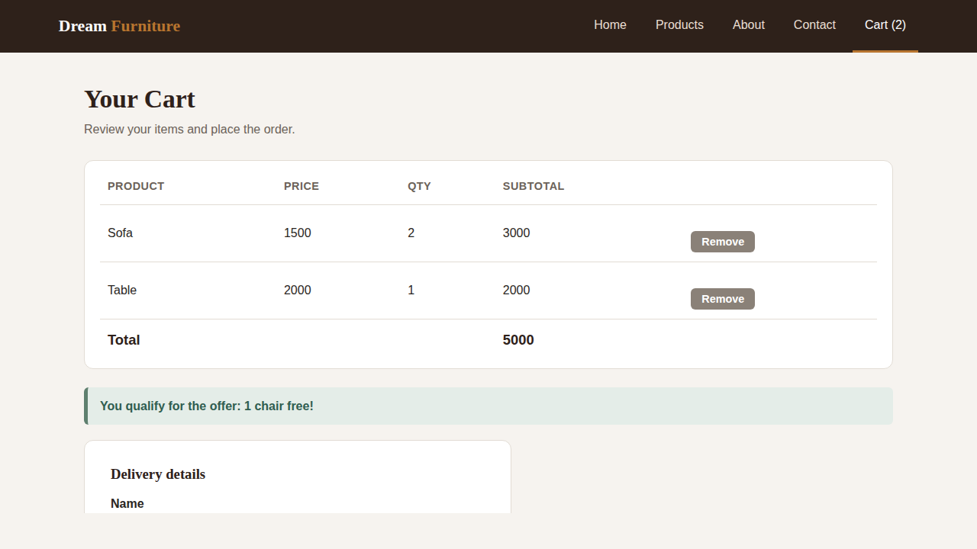
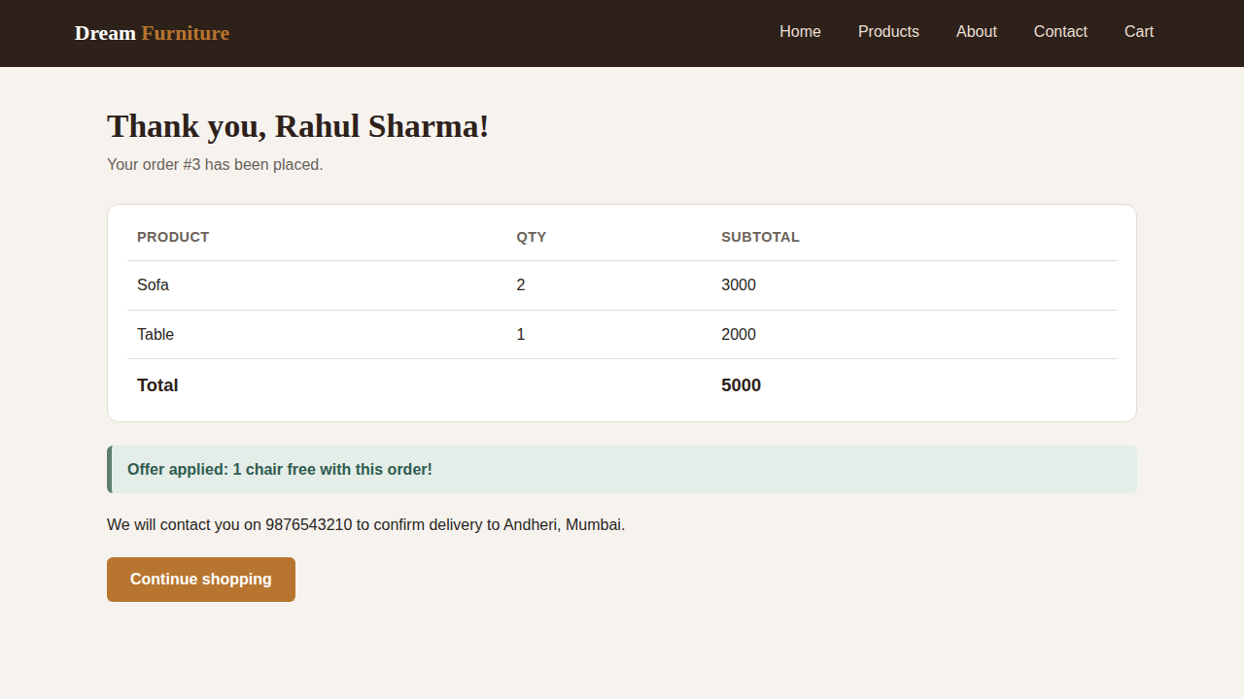
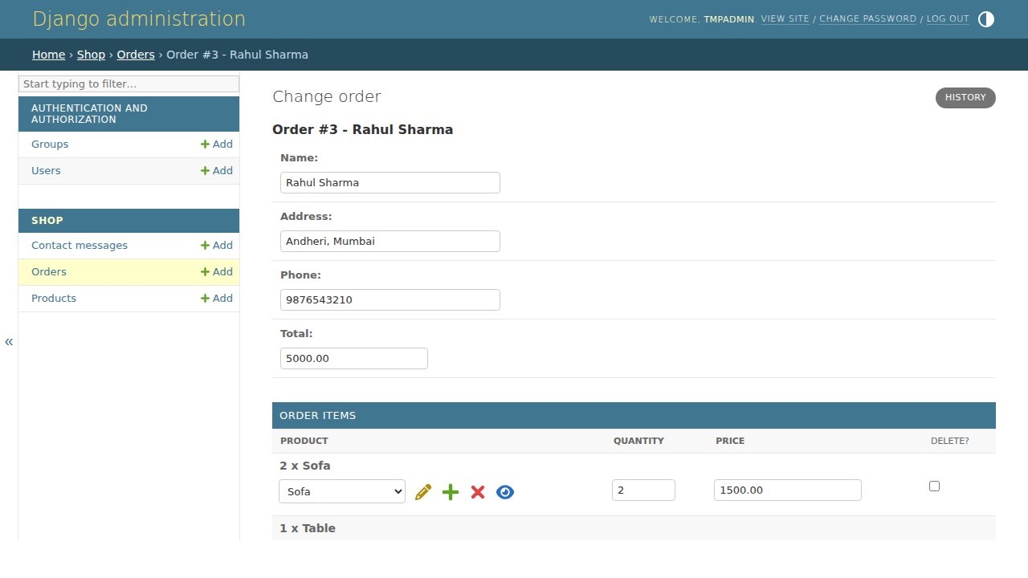
+
Cart, Order and Admin Screenshots
EXTRA
Cart with offer applied
Order confirmation
Order stored, seen in admin
The order placed by the customer appears in the Django admin with its items, so the owner can see who ordered what.
Notes:
Show the cart, the confirmation page, then the same order inside the admin panel. Customer name and address in these screenshots are sample test data.

Slide 10




7
Challenges Faced and Solutions Implemented
CHALLENGE
SOLUTION
Buy button did nothing
Session-based cart
It was only a styled button with no logic behind it.
Added views and URLs; Buy is now a POST form with CSRF protection.
Serving uploaded images
ImageField with media settings
Admin-uploaded product images need their own storage.
Installed Pillow, set MEDIA_ROOT and MEDIA_URL, added a seed command.
Repeated page layout
Shared base template
Every page repeated the same header and links.
base.html holds the navbar and footer; pages extend it.
Environment not portable
Fresh environment per machine
The bundled virtual environment pointed to the original machine.
Create a new venv, then pip install django pillow.
Notes:
Replace or add your own real problems if you faced others.

Slide 11



8
Remaining Work and Plan for Completion
PHASE 1
PHASE 2
PHASE 3
PHASE 4
Accounts
Payment and tracking
Email receipt
Testing and release
Automatic Receipt
Generation will send to the
customer
Automated tests
Deploy to a hosting server
Final report and demo
User registration and login
Link orders to users
Order history page
Online payment gateway
Order status updates
Email confirmation
Goal: a secure, deployed store where customers can register, order and pay online.
Notes:
Explain the three phases. Add real dates or weeks for each phase to make the plan concrete.

