Slide 1
“An Analytics Study on Customer Personalization & Add-On Buying Behaviour in Food Delivery Apps.”
Student Name : KALE VAIBHAV DNYANDEV
Course : MBA (Business Analytics Specialization)
Institution : AMRUTVAHINI INSTITUTE OF MANAGEMENT OF BUSINESS ADMINISTRATION , SANAGAMNER
Project Guide : Prof. P. S. SALBANDE

Slide 2
Summary
This study looks at how personalization affects customer behavior in food delivery apps by using both existing research and data collected from 118 users. Earlier studies show that personalization helps increase engagement and encourages people to buy more. Our survey results also support this, showing that personalized suggestions do influence add-on purchases. However, customers are still very price-conscious and often switch between apps instead of sticking to one. We also found that discounts and combo offers work better than general recommendations. Overall, the study suggests that using more targeted personalization along with better-designed app features can help increase add-on sales and improve overall revenue.

Slide 3
Introduction
The food delivery industry has grown rapidly due to digitalization, changing lifestyles, and increased smartphone usage. Platforms like Zomato and Swiggy use data analytics and personalization techniques such as recommendations and targeted offers to improve customer experience. One important outcome of this is add-on buying behavior, where customers purchase extra items like beverages or desserts. This study focuses on understanding how personalization influences these add-on purchases and identifies key factors affecting customer decisions.

Slide 4
LITERATURE REVIEW
Year & Article | Author & Publication | Pages | Study / Explanation
2026 – Consumer Purchasing Behaviour in Food Delivery Apps | Prasetyo et al. – Journal Study | 1–10 | Ease of use, price value, and promotions influence buying; personalization improves engagement and add-on purchases
2025 – AI in Food Delivery Applications | Shorbaji – Systematic Review | 15–25 | AI-based personalization improves user experience, but excessive personalization reduces trust
2025 – Personalized Recommendations & Purchase Intention | Zhao – Research Study | 30–40 | Personalization increases engagement by satisfying psychological needs
2025 – AI-driven Personalization Impact | Ahn & Kwon – Research Journal | 50–60 | Personalization improves purchase intention and perceived value; trust is important
2025 – Consumer Behaviour in Food Delivery Apps | Various Authors – IJHSSM Journal | 10–18 | UI design, trust, and personalization improve engagement and decision-making
2024 – Personalized Advertisements Impact | Research Study – Delhi NCR | 22–30 | Targeted ads increase click-through rate and order value

Slide 5
LITERATURE REVIEW
Year & Article | Author & Publication | Pages | Study / Explanation
2024 – ML-based Recommendation Systems | Li et al. – ScienceDirect | 40–55 | Recommendations and bundling increase basket size and cross-selling. However, excessive personalization may reduce user autonomy.
2023 – Omnichannel Personalization | Verhoef et al. – Journal of Marketing | 60–75 | Data-driven personalization increases engagement and purchase likelihood. Integration of customer data improves consistency across platforms.
2023 – Recommendation System Based on Orders | Sánchez et al. – Research Study | 20–35 | Order history improves recommendation accuracy and reduces decision effort. Even simple models can deliver effective personalization.
2022 – Personalization in Digital Commerce | Hallikainen et al. – Journal Study | 12–28 | Personalization reduces search cost and increases purchase depth. It also enhances perceived relevance of product suggestions.
2021 – Consumer Behaviour in Food Apps | Tandon et al. – Research Study | 45–60 | Convenience and perceived value influence purchase intention. Positive user experience strengthens customer attitudes toward apps.
2019 – Online Food Delivery Behaviour Study | Various Authors – Academic Study | 5–15 | Promotions, usability, and brand influence customer preference. Early findings highlight the importance of marketing incentives.

Slide 6
Problem Statement
This study focuses on how food delivery apps like Zomato and Swiggy are changing the way customers make purchase decisions through personalization. These platforms use features like recommendations, offers, and notifications to influence users and improve their experience.
However, even with these efforts, customers often do not respond to add-on suggestions like beverages, desserts, or side items. As a result, the number of add-on purchases remains low, which affects the overall order value and revenue. At the same time, customer behavior is quite unpredictable—people are very price-sensitive and frequently switch between apps instead of staying loyal to one.
Although previous studies suggest that personalization can improve engagement and buying behavior, there is limited evidence in the Indian context, especially when it comes to add-on purchases. Also, it is not very clear whether factors like discounts, recommendations, or convenience actually influence customer decisions the most.
So, this study aims to understand how personalization affects add-on buying behavior and to identify the key factors that influence customer purchasing decisions

Slide 7
Objectives of the Study
1 : To analyze personalization effects on add-on purchases.
2 : To compare customer add-on preferences between Zomato and Swiggy.
3 : To evaluate personalization features of food delivery apps.
4 : To assess determinants of customers’ add-on spending patterns.
5 : To examine add-on buying behavior across customer segments.

Slide 8
Hypotheses
1 : To compare customer add-on preferences between Zomato and Swiggy.
H₀: There is no significant difference in add-on preferences between Zomato and Swiggy.
H₁: There is a significant difference in add-on preferences between Zomato and Swiggy.
2 : To evaluate personalization features of food delivery apps.
H₀: Personalization features do not significantly influence add-on buying decisions.
H₁: Personalization features significantly influence add-on buying decisions.
3: To assess determinants of customers’ add-on spending patterns.
H₀: Determinants of add-on spending have no significant effect.
H₁: Determinants of add-on spending have a significant effect.

Slide 9
Research Methodology
Sample Design
Sample Population: Customers using food delivery applications.
Sampling Frame: Active users of food delivery apps during the study period.
Sample Area: Sangamner city.
Sample Size: 100–120 respondents.
Sample Technique: Convenience sampling method.
Sample Instrument: Structured questionnaire consisting of close-ended and Likert-scale questions related to personalization and add-on buying behaviour.

Slide 10
Research Methodology
Types of Research Design
Descriptive Research Design: Analyzes customer preferences and add-on purchase patterns using primary data from Zomato and Swiggy users.
Causal (Explanatory) Research Design: Examines the cause-and-effect relationship between personalization and add-on buying behaviour, and tests its impact.
Sources of Data Collection
Primary Data: Collected through a structured questionnaire capturing personalization, add-on behaviour, and spending patterns.
Secondary Data: Collected from journals, reports, and studies to support theory and analysis.

Slide 11
Research Methodology
Need & Significance of the Study:
Helps food delivery platforms understand customer preferences and the impact of personalization on add-on purchases. Provides insights for marketers and developers to improve recommendations, customer satisfaction, and revenue.
LIMITATIONS OF THE STUDY
The study is based on a small sample size, which may limit generalization of results.
Data relies on self-reported responses, which may include bias or inaccuracies.
Time constraints limited in-depth analysis and advanced statistical techniques.
The study focuses only on selected platforms (Zomato and Swiggy), reducing broader applicability.

Slide 12
Results
Which food delivery app do you use most frequently?
Sr. No | App Used | Respondents | Percentage
1 | Zomato | 43 | 36.4%
2 | Swiggy | 30 | 25.4%
3 | Both Equally | 38 | 32.2%
4 | Other | 7 | 5.9%
 | Total | 118 | 100%
Data Analysis: Zomato leads usage (36.4%), followed by both apps (32.2%) and Swiggy (25.4%), indicating multi-app usage and moderate competition.
Data Interpretation: Low platform loyalty and high price sensitivity are evident, suggesting the need for better personalization, offers, and user experience to retain customers.

Slide 13
Results
What is the main reason for using food delivery apps?
Sr. No | Reason | Respondents | Percentage
1 | Convenience | 19 | 16.1%
2 | Variety of Food | 24 | 20.3%
3 | Discounts & Offers | 55 | 46.6%
4 | Time Saving | 20 | 16.9%
 | Total | 118 | 100%
Data Analysis: Discounts and offers dominate usage (46.6%), followed by variety (20.3%), while convenience (16.1%) and time saving (16.9%) have lower influence.
Data Interpretation: Users are primarily driven by pricing incentives, showing that discounts are more influential than convenience or variety in attracting and retaining customers.

Slide 14
Results
How often do you purchase add-on items (desserts, beverages, side dishes) when ordering food online?
Sr. No | Response | Respondents | Percentage (%)
1 | Always | 25 | 21.2%
2 | Often | 22 | 18.6%
3 | Sometimes | 20 | 16.7%
4 | Rarely | 40 | 33.9%
5 | Never | 12 | 10.2%
 | Total | 118 | 100%
Data Analysis: Most users rarely purchase add-ons (33.9%), while fewer always (21.2%) or often (18.6%) do, indicating low overall frequency.
Data Interpretation: Add-on purchases are limited and require stronger incentives like bundling and personalized recommendations to improve conversions and order value.

Slide 15
Results
What motivates you to buy add-on items?
Sr. No | Factor | Respondents | Percentage (%)
1 | Discount offers | 29 | 24.6%
2 | App recommendations | 20 | 16.9%
3 | Combo deals | 42 | 35.6%
4 | Personal preference | 30 | 25.4%
 | Total | 118 | 100%
Data Analysis: Combo deals lead as the main motivator (35.6%), followed by personal preference (25.4%) and discounts (24.6%), while app recommendations are least influential (16.9%).
Data Interpretation: Customers are mainly driven by value-based incentives like combos and discounts, indicating bundling is more effective than current recommendation systems.

Slide 16
Results
Overall, personalization features influence my add-on buying behaviour.
Sr. No | Response | Respondents | Percentage (%)
1 | Strongly Disagree | 11 | 9.3%
2 | Disagree | 8 | 6.8%
3 | Neutral | 15 | 12.7%
4 | Agree | 31 | 26.3%
5 | Strongly Agree | 53 | 44.9%
 | Total | 118 | 100%
Data Analysis: A majority (71.2%) agree that personalization influences add-on buying, with moderate neutral (12.7%) and low disagreement, indicating a strong positive inclination.
Data Interpretation: Personalization influences decisions but works best with pricing incentives and timing, as it alone may not ensure actual purchase conversions.

Slide 17
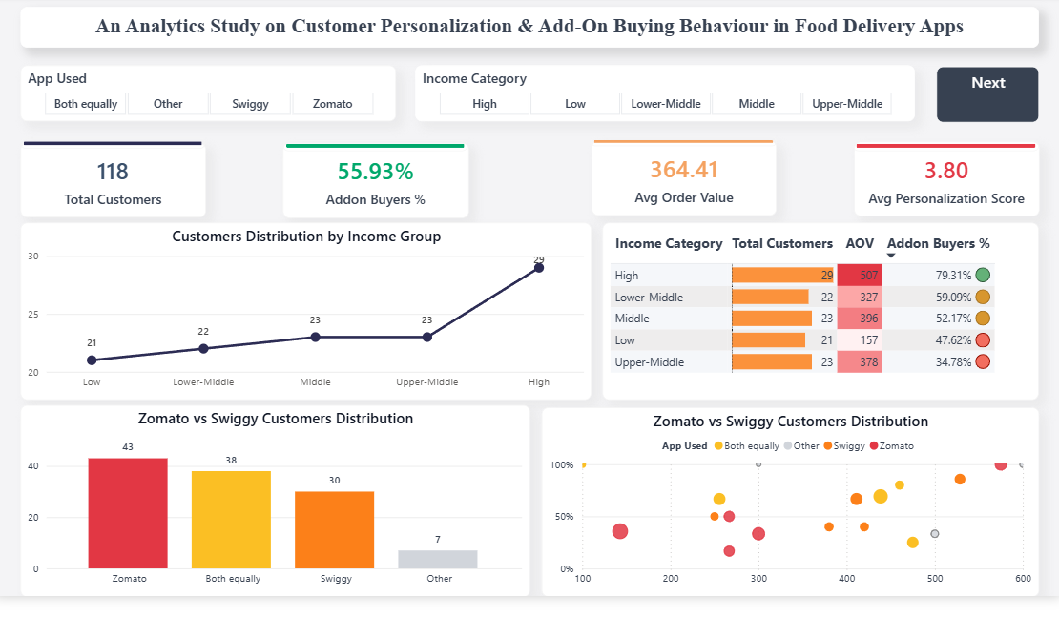
Results

Slide 18
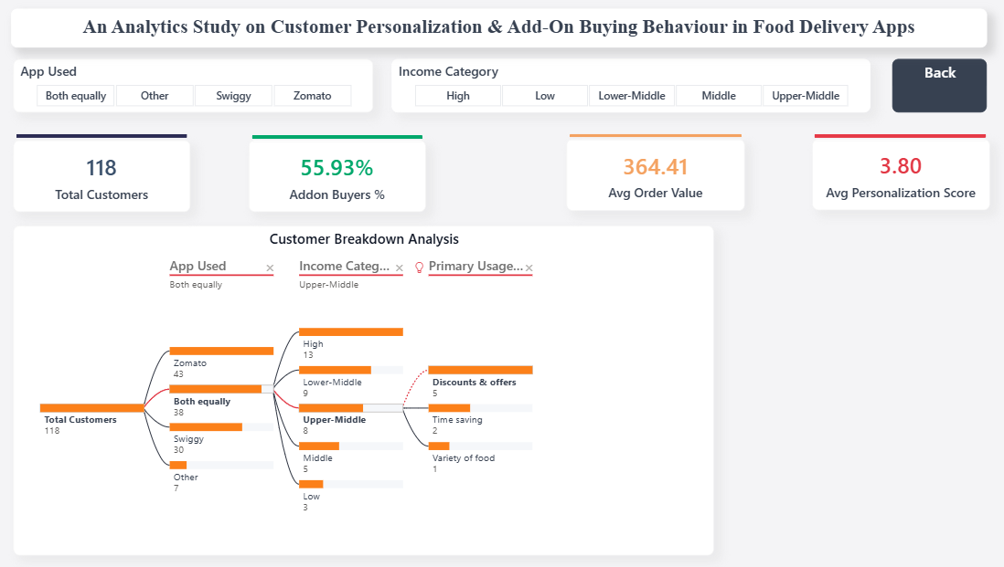
Results

Slide 19
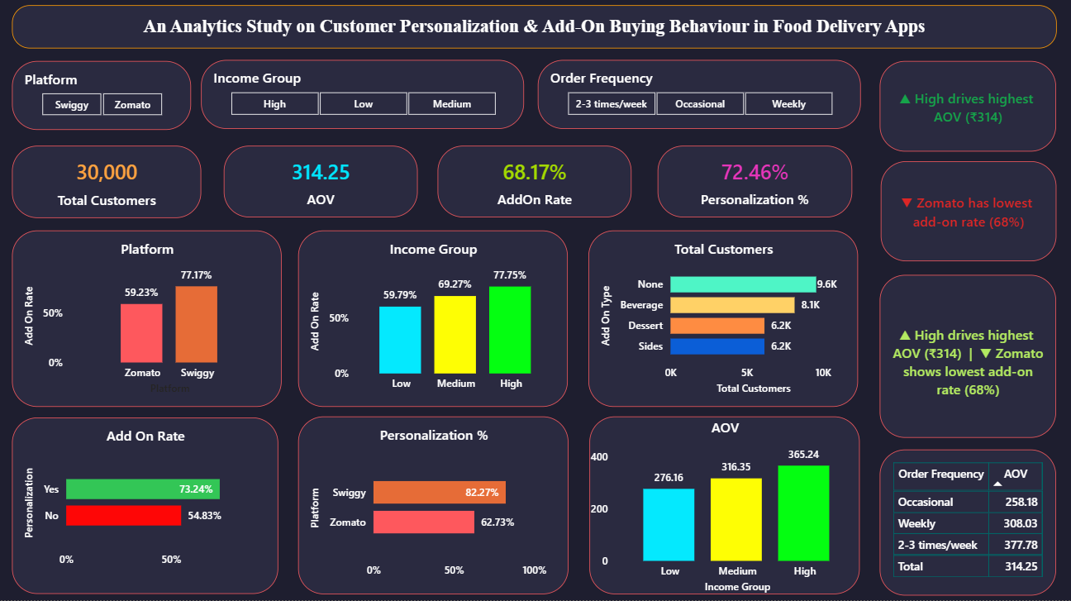
Results

Slide 20
FINDINGS
1. Discounts Drive Usage
Discounts and offers are the primary reason for using food delivery apps (46.6%), showing strong price sensitivity among users.
2. Low Platform Loyalty
A significant 32.2% of users use both Zomato and Swiggy, indicating frequent switching and low brand loyalty.
3. Add-on Purchases Are Low
About 33.9% of users rarely purchase add-ons, highlighting a gap in conversion.
4. Combo Deals Work Best
Combo offers (35.6%) are the most effective motivator for add-on purchases compared to recommendations.
5. Personalization Influences Decisions
Around 71.2% users agree that personalization impacts their behavior, but not always actual purchases.
6. Value > Recommendation
Users respond more to pricing (discounts, combos) than algorithm-based suggestions.

Slide 21
CONCLUSION
Personalization influences customer decisions, but pricing strategies like discounts and combo deals are the primary drivers of add-on purchases. Customers are price-sensitive and show low platform loyalty. Therefore, combining personalization with value-based strategies is essential to increase conversions and revenue.

Slide 22
SUGGESTIONS
Combine personalization with discounts
Promote combo deals and bundling
Improve checkout-stage recommendations
Use customer segmentation
Enhance UI/UX and loyalty programs

Slide 23
References
PwC. (2025). Voice of the Consumer Survey: India Perspective. IMARC Group. (2024). India Online Food Delivery Market Report. Renub Research. (2026). India Online Food Delivery Market Forecast (2026–2034).
Deliverect. (2025). State of the Food Delivery Industry Report. IMARC Group. (2025). Drivers of Online Food Delivery Growth in India. IJHSSM Journal. (2025). Consumer Preferences in Online Food Delivery Services. Mool.ai. (2025). Indian Food Delivery Tech Market Report.
Questionnaire (Customers Data)
https://docs.google.com/spreadsheets/d/18bzUXbetCb4u9wG6oPWHQ0yGBTTixHc8ZGY96I1dk4I/edit?usp=sharing

Slide 24
THANK YOU

