Slide 1
Health Insurance: Your Shield Against Medical Emergencies
An Overview of Health Insurance, Types, Claim Process & Role of TPA
Presented by: Kaveri Aladi

Slide 2
Health Insurance Overview
Types of Plans
Exploring various health insurance options like individual, family, and group
Future Trends
Coverage & Exclusions
Predicting future developments in the health insurance industry.
Understanding what is covered and excluded in health insurance policies.
Fraud Prevention
Claims Process
Implementing measures to prevent health insurance fraud.
Differentiating between cashless and reimbursement claims.
Digitalization
Government Schemes
Exploring digital advancements in health insurance.
Examining government initiatives like Ayushman Bharat.
Healthcare Accessibility
Financial Planning
Assessing how health insurance impacts access to healthcare.
Integrating health insurance into financial strategies.
Challenges
Addressing common issues like high premiums and claim rejections.

Slide 3
Health Insurance Cycle
Health insurance is a contract between an individual or a group and an insurance company. In exchange for a premium, the insurance company agrees to pay for medical expenses incurred due to illness or injury, as outlined in the policy. It is a crucial tool for managing healthcare costs and protecting individuals and families from financial hardship in the event of unexpected medical needs.
Pay Premium
Individuals or groups pay premiums to the insurance company.
Financial Protection
Health insurance protects against financial hardship.
Receive Coverage
The insurance company provides coverage for medical expenses.
Claim Reimbursement
Individuals claim reimbursement for medical costs.
Incur Medical Expenses
Medical expenses arise due to illness or injury.

Slide 4
Types of In Health Insurance Plans
1 Individual Health Insurance
An individual health insurance plan covers a single person. It is suitable for individuals who are not covered by a group plan or who prefer to have their own policy.
2 Family Floater Health Insurance
A family floater plan covers the entire family under a single policy. The sum insured is shared among all family members, making it a cost-effective option for families.
3 Group Health Insurance
Group health insurance is offered by employers to their employees. It typically provides comprehensive coverage at a lower cost compared to individual plans.
4 Senior Citizen Health Insurance
These plans are specifically designed for senior citizens, offering coverage for age-related illnesses and medical needs.
5 Critical Illness Insurance
Critical illness insurance provides a lump-sum payment upon diagnosis of a covered critical illness, such as cancer, heart attack, or stroke. This payment can be used to cover medical expenses, living expenses, or any other needs.

Slide 5
What does my health insurance cover?
1 Coverage
Covers hospitalization expenses.
Includes doctor’s visits.
Covers diagnostic tests.
Includes surgeries.
2 Exclusions
Pre-existing conditions (after waiting period).
Cosmetic surgery not covered.
Dental and vision care excluded (unless added).
No cover for self-inflicted injuries.
Exclusions
Excludes pre- existing conditions, cosmetic surgery, dental and vision care, self-inflicted injuries, and substance abuse treatment.
Coverage
Includes hospitalization, doctor's visits, diagnostic tests, prescription drugs, and surgeries.

Slide 6
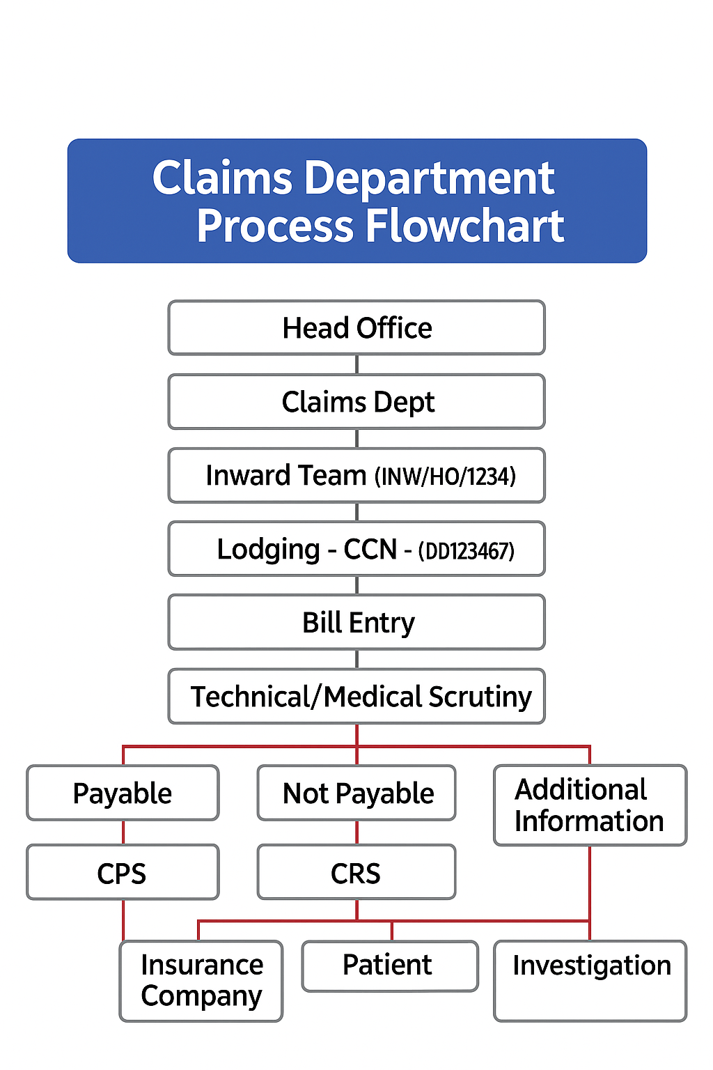
Claims Process
1 Cashless Claims
In a cashless claim, the insurance company directly pays the hospital for the medical expenses incurred. This requires the insured to seek treatment at a network hospital empanelled with the insurance company.
2 Reimbursement Claims
In a reimbursement claim, the insured pays the hospital expenses upfront and then submits the bills and documents to the insurance company for reimbursement.

Slide 7
Role of TPAs In Health Insurance
Third-Party Administrator (TPA) in health insurance is an organization that acts as a middleman between the insurance company, policyholder, and hospital, handling services like claim processing, cashless facility, and customer support.
Cashless Facility Approval
Facilitates cashless treatment by verifying coverage and authorizing hospitals
Claims Processing
Manages insurance claims by verifying accuracy and adjudicating based on policy terms
Network Hospital Management
Establishes and maintains a network of hospitals for cashless treatment
24/7 Customer Support
Provides round-the-clock assistance to policyholders for inquiries and emergencies

Slide 8
Government Health Insurance Schemes
1 Ayushman Bharat
Ayushman Bharat is a government-sponsored health insurance scheme that aims to provide affordable healthcare to economically vulnerable sections of the population.
2 PMJAY (Pradhan Mantri Jan Arogya Yojana)
PMJAY is a component of Ayushman Bharat that provides health insurance coverage of up to ₹5 lakh per family per year for secondary and tertiary care hospitalization.
Ayushman Bharat
PMJAY
Government scheme providing affordable healthcare to vulnerable sections.
Health insurance coverage up to ₹5 lakh per family annually.

Slide 9
Role of Health Insurance in Financial Planning
Health insurance plays a crucial role in financial planning by protecting individuals and families from financial risks associated with medical expenses. It helps to preserve savings and investments, ensuring that financial goals are not derailed by unexpected healthcare costs.
Ensure Financial Stability
Protect Savings
Health insurance safeguards savings from medical expenses.
Overall financial health is maintained.
Achieve Financial Goals
Preserve Investments
Financial goals are met without healthcare setbacks.
Investments remain intact due to covered medical costs.

Slide 10
Health Insurance Benefits
Health insurance makes medical care cheaper and easier to get. It helps people visit doctors and hospitals on time, which leads to better health and fewer gaps in treatment between different people.
Reduced Disparities
Decreases healthcare inequalities
Health Outcomes
Leads to better health results
Timely Care
Encourages seeking medical care promptly
Accessibility
Increases access to medical services
Affordability
Makes medical services more affordable

Slide 11
Common Challenges in Health Insurance
1 High Premiums
High premiums can be a barrier to accessing health insurance, particularly for low-income individuals and families.
2 Claim Rejection
Claim rejection can occur due to various reasons, such as incomplete documentation, non-disclosure of pre-existing conditions, or policy exclusions.
High Premiums
Affordability Issues
Low-Income Families
Barriers to Health Insurance Access
Policy Exclusions
Incomplete Documentation
Claim Rejection

Slide 12
Digitalization in Health Insurance Cycle
e-Cards – Digital health cards make it easy to see your policy details and benefits anytime.
Telemedicine Tie-ups – They let you talk to doctors online, which is very helpful for people living in faraway places.
Telemedicine Consultations
Digital Insurance Cards
Telemedicine tie-ups enable policyholders to consult with doctors remotely, improving access to healthcare services, especially in remote areas.
Digital health insurance cards provide convenient access to policy information and benefits.

Slide 13
Preventing Health Insurance Fraud
Fraud increases premiums and reduces benefits for everyone.
Be aware of common fraud types (false claims, identity misuse, inflated bills).
Verify medical bills and claim documents.
Share policy details only with trusted parties.
Report suspicious activity to the insurance company or authorities.
Future Trends in Health Insurance
1 AI (Artificial Intelligence)
Automates claims processing.
Helps in fraud detection.
Enables personalized health insurance plans.
2 Wearable Devices
Track real-time health data (steps, heart rate, sleep, etc.).
Promote wellness and preventive care.
Help design customized health plans.
Encourage healthy lifestyle through rewards programs.
AI Applications
AI automates claims, detects fraud, and personalizes plans.
Wearable Devices
Wearables track health data, enabling personalized plans and programs.

Slide 14
Conclusion
Health Insurance protects against unexpected medical costs.
Choose the right type of plan for your needs.
Cashless and reimbursement facilities provide flexibility.
TPA simplifies the process and supports policyholders.
Prevents financial stress during medical emergencies.
Encourages timely treatment and better health outcomes.
Provides peace of mind and security for families.
Covers not only hospitalization but also preventive care.
Helps in managing rising healthcare costs.
Supports wellness through health check-ups and add-on covers.
Group and family floater plans ensure wider protection.
Critical illness cover provides a safety net against major diseases.
Digital services and e-cards improve convenience.
Future trends like AI & wearables will make insurance smarter.
👉 Invest in Health Insurance today for a healthier and secure tomorrow!

Slide 15


