Slide 1

REVIEW 3 FOCUS

Slide 2
The TEAM
Balaji M, 19BCE1512
S Vaibhave, 19BCE1401
S Lakshman Rao, 19BCE1452
Rahul Dakshnamoorthy, 19BCE1339

Slide 3
Abstract
The ongoing pandemic has forced us to adapt to online mode of interviews. Most the companies have opted for online interviews. These online meetings prove to be challenging for both the speaker and the listener. It becomes difficult for the interviewers to analyse the interviewees. This is where our project comes into picture. Our aim is to analyse the emotions of the people attending the interview using image processing and deep learning techniques and use this result along with analysis of the audio. NLP and Machine learning techniques are used to determine if the attendees are involved in the meeting or not. Our system provides a detailed analysis of the meeting. Companies can use the results from the system to judge the candidate.

Slide 4
Introduction
Focus is a Deep learning based system which can perform emotion detection on the video recording of the online interview and classify the audio files of the online interview based on their interactivity. The system is implemented using various libraries and Packages in Python.
We start off by collecting our data i.e. video and audio of the online interview recordings from various sources. The next step is to apply various combinations image processing techniques like thresholding, greyscaling etc.
We train the CNN model used for emotion detection with each combination and record the output.The next step involves conversion of these recordings to text format and retrieving the timestamps of the words using the Google Speech Recognition API. Then the timestamps of silence i.e. duration for which there is no interaction is obtained using pydub package in Python. After the timestamps are collected, we classify each sentence based on if it is a question or not using StanfordCoreNLP library.
The next stage involves classification of the questions based on trivialness and identifying the involvement of the interviewee.

Slide 5
Proposed System
Once an interview has been concluded and the interview recording has been fetched, the user uploads the meeting file to our application. Through the anvil cloud servers we fetch the file and pass it to our backend i.e python server where we upload it to Google storage. After processing the audio and video file and generating various attributes we present the final report back to the client in the application which contains the following information –
Bar chart signifying the count of each emotion
Average response time of the interviewee
Number of active speakers (in a normal interview setting it should be two, but may vary)

Slide 6
Number of questions asked
Percentage of non-trivial questions
Percentage of interesting questions
The modules which we employ are:
1. Decomposing the file into audio and video
To extract the audio from the file we use the VideoFileClip function from the MoviePy module in python, if the extraction is successful it returns 1. The file is then sent to a frame extractor function, which uses the VideoCapture function available in OpenCV to get a video capture object. It returns a tuple containing the image and a flag signifying the status of the operation, we run this function till the status becomes false

Slide 7
2. CNN
The core part of our project lies in the CNN module. It involves data pre-processing as well. First the data is split into training, privateTest, and publicTest based on the ’Usage’ column and pre-processing is applied onto them (reshaping and normalization). The model is designed as a sequential model. The Sequential model API is a way of creating deep learning models where an instance of the Sequential class is created and model layers are created and added to it. It is a linear stack of layers.
The first stack layer is a 2D convolution layer, this layer creates a convolution kernel that is wind with layers input which helps produce a tensor of outputs.
Conv2D(32, (3, 3), activation =′ relu′
Here 32 is the number of filters that this layer will learn from, it also determines the number of output filters in the convolution. The (3,3) signifies the size of the kernel, i.e height and width.

Slide 8
MaxPool2D((2, 2)))
We also use Max Pooling to reduce the spatial dimensions of the output volume. The ’relu’ is the activation parameter which specifies the name of the activation function which we apply after performing convolution. We also add dense and flatten layers. Dense Layer is used to classify image based on output from convolutional layers. A flatten operation on a tensor reshapes the tensor to have the shape that is equal to the number of elements contained in tensor non including the batch dimension. The model is then trained using back propagation for 12 epochs.

Slide 9
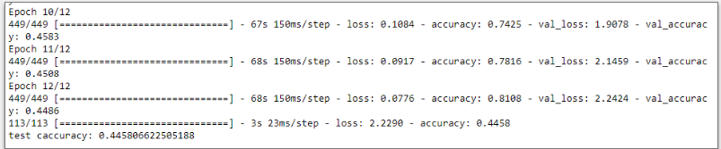
3. Image processing
We apply thresholding and grey-scaling to the dataset and train the CNN model using these inputs. Thresholding basically is used for segmenting the background and foreground in an image.
Fig. 1: Accuracy of the model

Slide 10
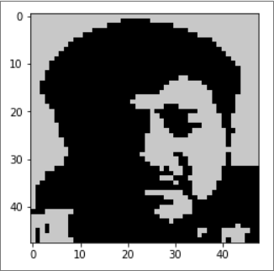
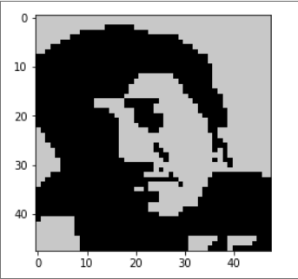
Fig. 2: Sample input after applying the operations

Slide 11
4. Speech to text
The cloud speech-to-text API from Google enterprise is used in this module. The API converts audio to text by applying powerful neural network models. The API call takes a file path to the resource in Google storage and a set of configurations as its arguments. The corresponding methods to add a file to the Google storage and subsequently remove them are uploadtobucket() and deletefrombucke (). Note We dont store the audio file in any manner to respect the privacy of users. The arguments enablewordtimeoffsets and enableau- tomaticpunctuation are set to TRUE to get the time stamps of each word and getting the punctuated text respectively.

Slide 12
5. Interesting and difficulty classifier
This module classifies the questions as interesting/not in- teresting and difficult/not difficult. The data used here was collected through a survey. The data is then transformed as a matrix using the tfidf vectorizer method, the query is also transformed into a vector. Stop words removal, lemmatization and other such techniques are employed for higher perfor- mance. Next, we use the cosine similarity to fetch similar sentences and calculate the scores for each query j as follows: If the computed score is greater than the threshold (0) the query falls into the positive class and negative class otherwise

Slide 13
6. Question detector
This module detects whether a given sentence is a question or not. The sentences extracted from the transcript are passed on to the function as input. Each word in the sentence is then compared with the words present in the NLTK npschat corpus, this corpus consists of ten thousand posts which are PoS tagged and dialogue tagged. All the words present in the sentence and the class of all the sentences ( ie statement/ynquestion/whquestion) obtained from the npschat corpus are used as features for training the Multinomial Nave Bayes Model which is inbuilt in NLTK. The feature set is split in the ration of 80:20 and given as train input and test input to the model. The model classifies the given statement as statement/ynquestion/whquestion based on the feature set. If it classifies as ynquestion or whquestion, the corresponding sentence is flagged as a question

Slide 14
7. Identifying the number of speakers present in the audio file
The cloud speech-to-text API from Google enterprise is used in this module. The API performs speaker diarization on the audio file using advanced Neural Networks. We use a function called speech.RecognitionConfig which acc the necessary configuration details corresponding to the audio file such as encoding, languagecode, diarization configuration, samplehetrzrate etc. The diarization configuration is passed as a speaker diarization config object which contains details like min speaker count, max speaker count etc. This RecognitionConfig object and the audio file are passed to a function called longrunningrecognize which performs the necessary operations on the file. The return object of this function contains the details of each word like the tag of the speaker etc. from this return object we obtain the number of speakers.

Slide 15
8. Finding the average response time
Once the questions and the word time stamps are ready they are passed to this module where for each question its time stamp and its corresponding response word stamp is fetched. The word time stamps are a datetime object, subtracting two datetime objects creates a delta datetime object from which the number of seconds can be fetched. The delta seconds for each question-answer is calculated and added to a global sum and finally the average is calculated.

Slide 16
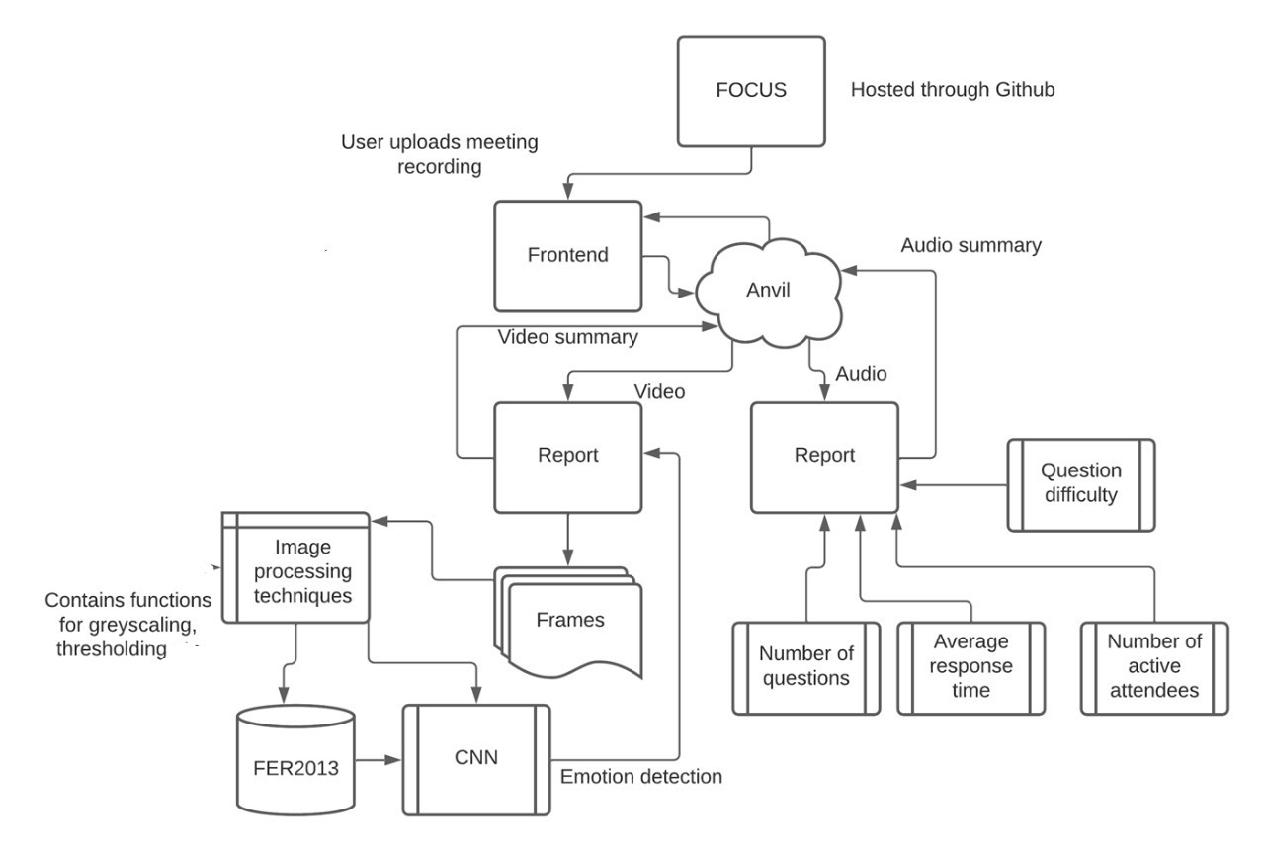
System architecture

Slide 17
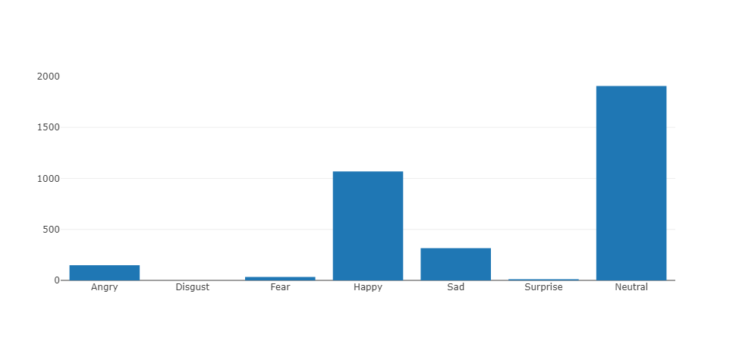
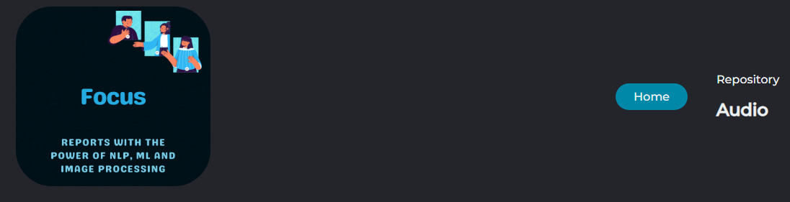
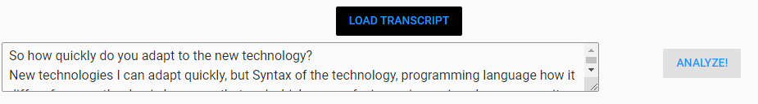
Results

Slide 18
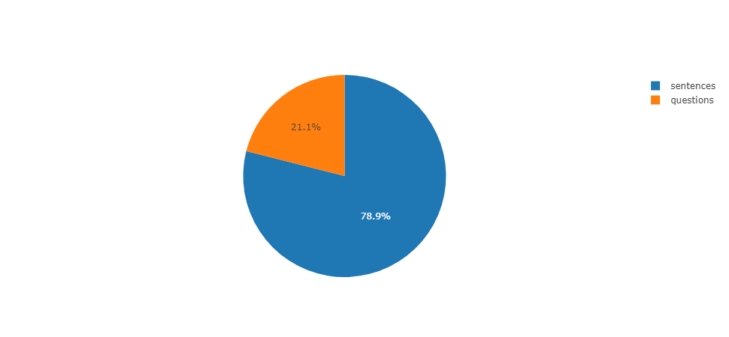
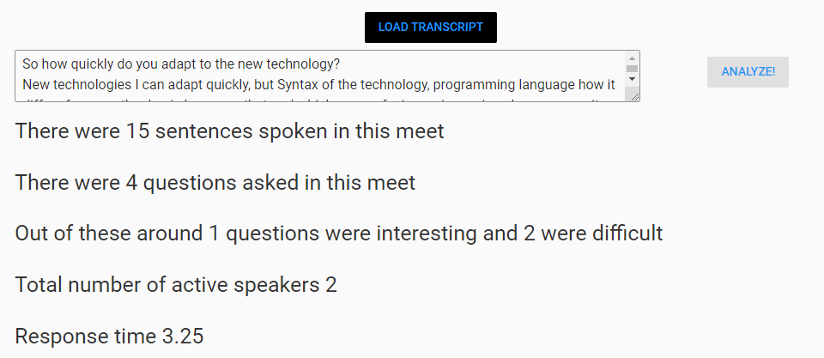
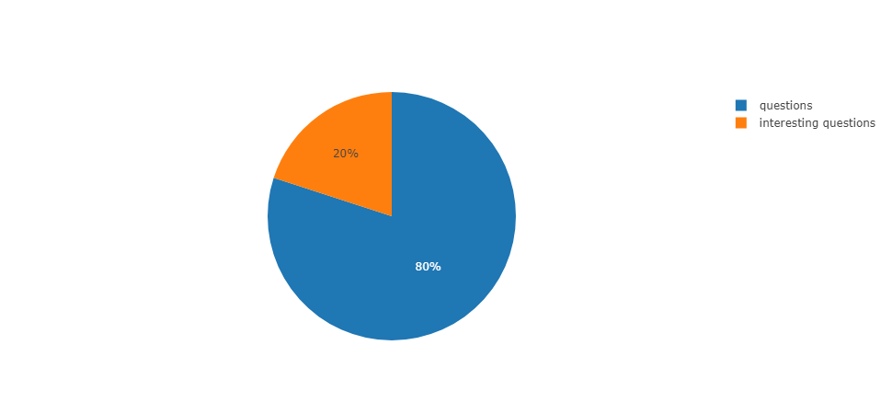
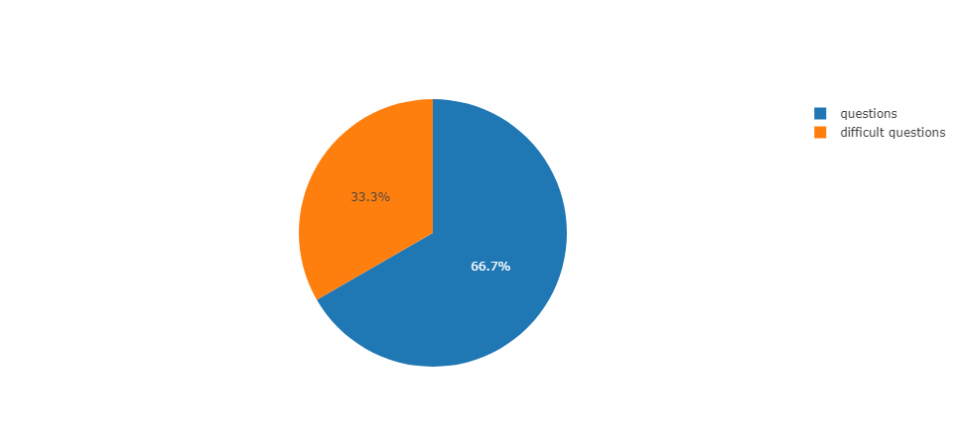

Slide 19
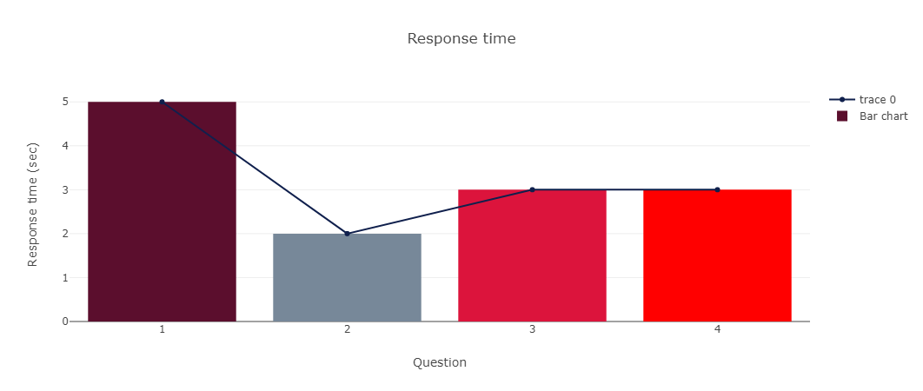

Slide 20
Conclusion
Online interviews are here to stay and tools like these would be useful for the future to come. Online meetings are dynamic in nature and cannot be measured with a few attributes however in this paper we used the most feasible attributes with respect to the audio and video of a meeting . The attributes along with supporting pie charts and bar graphs are generated and displayed for the interviewers to asses themselves as well as the candidate more accurately.

Slide 21
Thank You

