Slide 1
Massachusetts Emergency Response System
GROUP 15 :
Aviral Agrawal
Vaibhavi Khamar
Zichun Wang

Slide 2
PURPOSE
The purpose of this database is to maintain the data used for the Massachusetts Emergency Response System related to Fire, Medical, and Police emergencies.
This database can be used by Federal Services to track the emergencies, availability of vehicles and officers, their response time, and incident casualties.

Slide 3
BUSINESS PROBLEMS ADDRESSED
Ensures the most complete and up-to-date information about an incident, which would allow a reliable decision-making process.
Allows all different emergency responder services and federal services to generate descriptive reports.
To provide insights based on each department’s response time. It will help departments to improve their response.
To analyze the number of emergencies in each county, which will help to improve the overall emergency response system county-wise.
Provides insights about the number of emergencies, officers responded to.
Provides information about the vehicle’s conditions & availability.

Slide 4
ENTITY RELATIONSHIP DIAGRAM

Slide 5
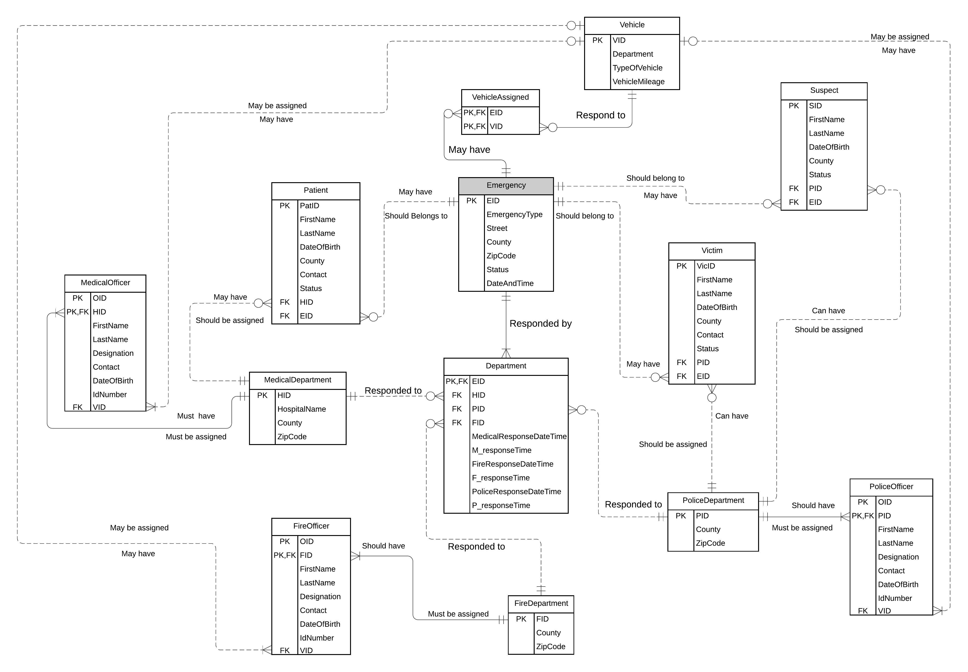

Slide 6
DATABASE IMPLEMENTATION
Table-level CHECK constraint using Function
On Department Entity: To ensure whether an emergency has been responded by any department
Computed Columns & Trigger
To calculate the Response Time
Data Encryption
To encrypt Id Numbers of Officers
Views
The number of emergencies (in each department) by county
Vehicle’s & Officer’s details
Patient details for given Emergency ID
Officer’s detail for given Emergency

Slide 7
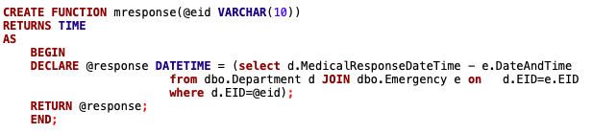
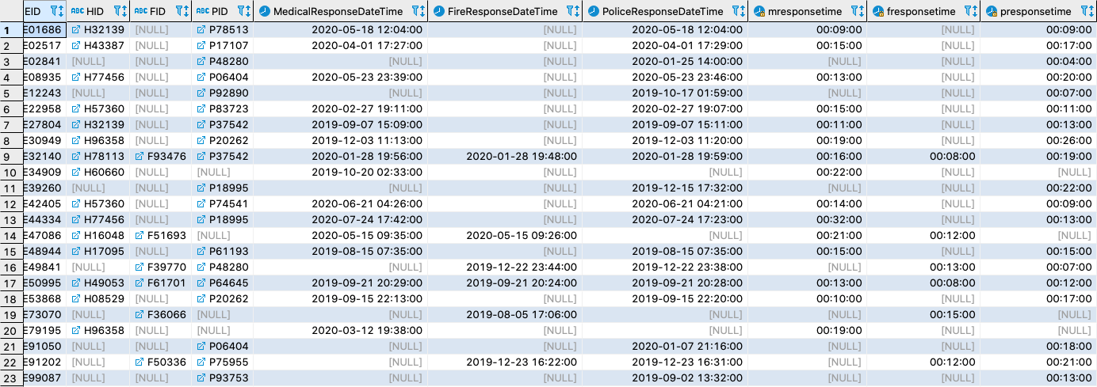
COMPUTED COLUMNS
To calculate the response time of departments for each emergency using Department & Emergency tables. The value is calculated by difference between Department’s ResponseTime & Emergency’s DateAndTime.

Slide 8
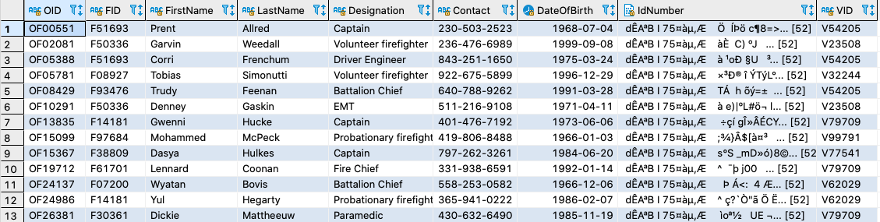
DATA ENCRYPTION
Encrypting Identification Numbers of all officers using AES_128 Algorithm in MedicalOfficer, FireOfficer & PoliceOfficer tables.

Slide 9
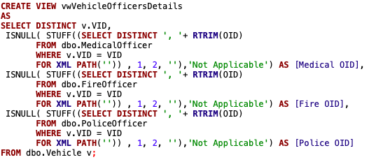
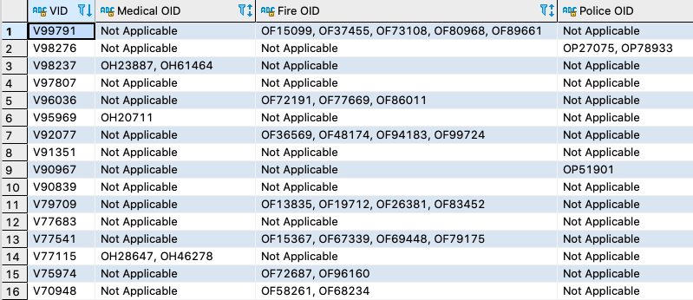
VIEWS
This view is to obtain the vehicleID and Officer's IDs who has used that vehicle in horizontal listing format.

Slide 10
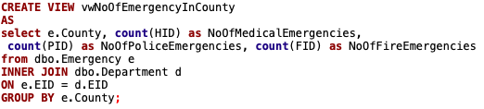
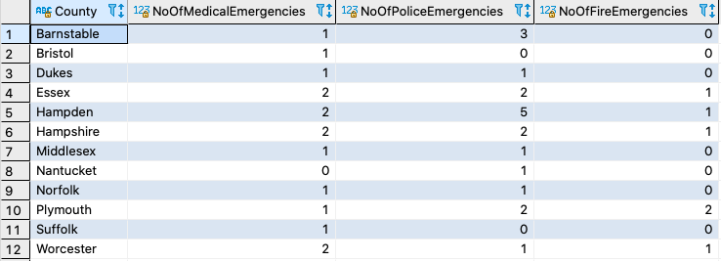
VIEWS
This view demonstrate the number of emergencies in each county.

Slide 11

DATA VISUALIZATION - TABLEAU

Slide 12
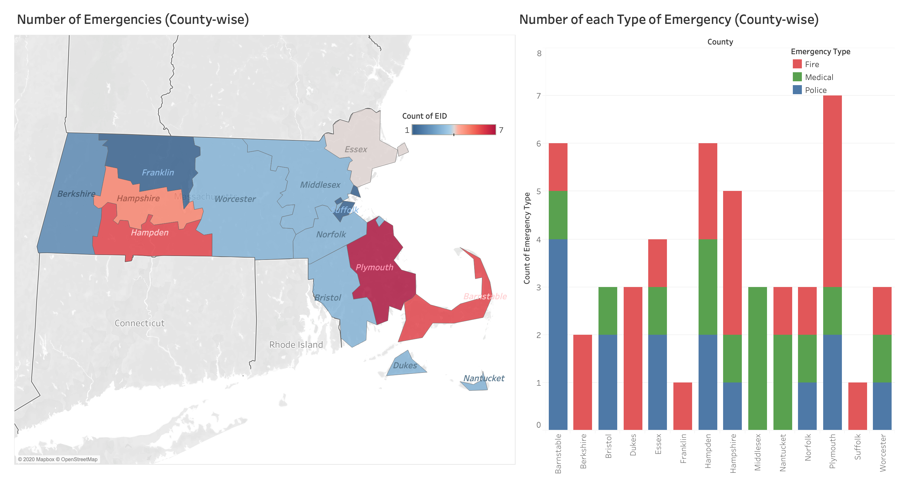
Number of Emergencies

Slide 13
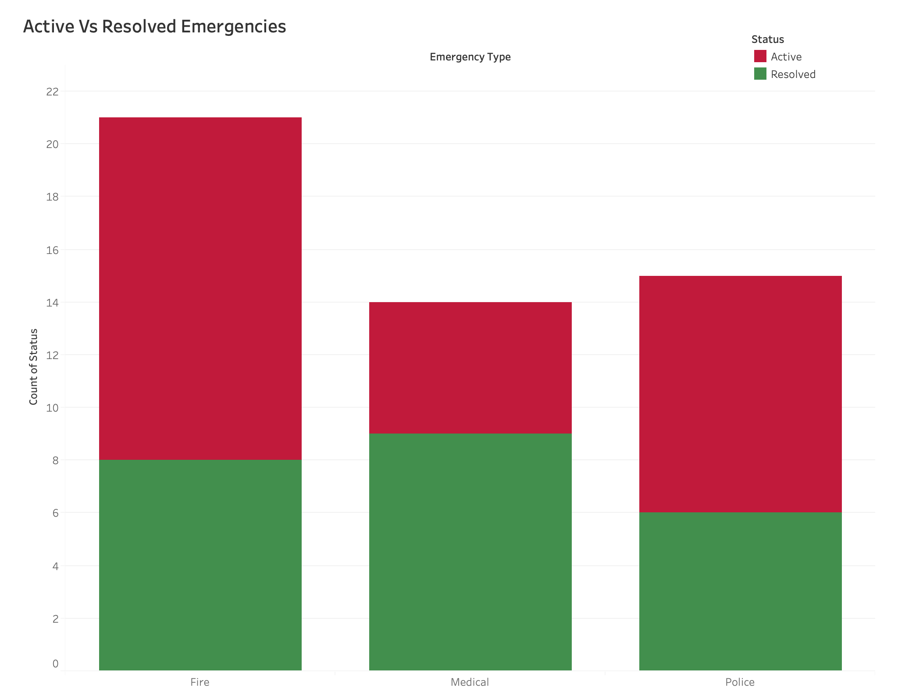
Active Vs Resolved Emergencies

Slide 14
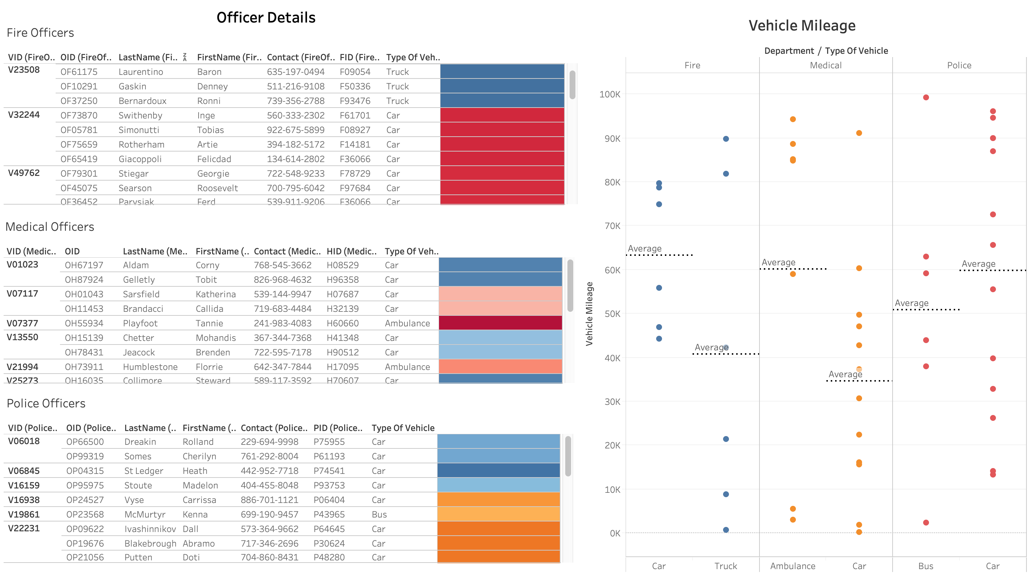
Vehicle Details

Slide 15

QUESTIONS ???

