Slide 1
Picture generation
Team 302
Qixiang Zhou (001822974)
Vaibhavi Khamar (001400149)
Zhouwei wang (001443886)

Slide 2
Introduction
This problem uses a Genetic Algorithm to model a population of individuals, each containing a string of DNA which can be visualised in the form of a picture.
By starting with a population consisting of a randomly generated gene pool, each individual is compared against the reference picture and the individuals can then be ranked by their likeness to it, known as their fitness, with the best fit being displayed on the output picture.
By breeding the fittest individuals from the population, the DNA which produces the most accurate representation of the reference picture is selected over successive generations.

Slide 3
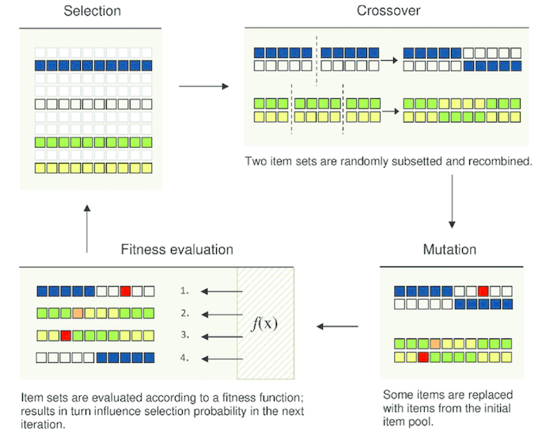
Genetic algorithm

Slide 4
First of all
All unit test has passed before we goes into the experiment.
We use Max heap priority queue as our population container, also is implemented based on book. And we use system container ArrayList and Array
The circles drawing ALG is based on Java swing class

Slide 5
Collections used
Priority Queue:
Stores the individuals
Best one at the top
List:
Stores genes
Array:
Used in Crossover for swapping

Slide 6
basic approach

Slide 7
Idea
Break down the picture to create gene pool
Use fixed number of genes to create chromosome
Initial size 1000 population, and evolve to 10000 size population.

Slide 8
Gene: Pixels of the picture, use 0/1 to present that the pixel is white or black.
Each gene shows a row of the picture.
Chromosome
Gene
1 | 1 | 1 | 1 | 1 | 1 | 1 | 1
0 | 0 | 0 | 0 | 0 | 0 | 0 | 0
……
1 | 1 | 1 | 1 | 1 | 1 | 1 | 1
1 | 1 | 1 | 1 | 1 | 1 | 1 | 1
0 | 0 | 0 | 0 | 0 | 0 | 0 | 0
1 | 1 | 1 | 1 | 1 | 1 | 1 | 1
1 | 1 | 1 | 1 | 1 | 1 | 1 | 1
1 | 1 | 1 | 1 | 1 | 1 | 1 | 1
1 | 1 | 1 | 1 | 1 | 1 | 1 | 1
1 | 1 | 1 | 1 | 1 | 1 | 1 | 1
1 | 1 | 1 | 1 | 1 | 1 | 1 | 1
1 | 1 | 1 | 1 | 1 | 1 | 1 | 1
1 | 1 | 1 | 1 | 1 | 1 | 1 | 1
1 | 1 | 1 | 1 | 1 | 1 | 1 | 1
1 | 1 | 1 | 1 | 1 | 1 | 1 | 1
1 | 1 | 1 | 1 | 1 | 1 | 1 | 1
1 | 1 | 1 | 1 | 1 | 1 | 1 | 1
1 | 1 | 1 | 1 | 1 | 1 | 1 | 1
phenotype
phenotype

Slide 9
MUTATION
3% mutation rate
Swap 2 genes to change the chromosome
10% of the chromosome’s genes may been mutated

Slide 10
crossover
Random cut point1
1 | 1 | 1 | 1 | 1 | 1 | 1 | 1 | 1 | 1
parents
0 | 0 | 0 | 0 | 0 | 0 | 0 | 0 | 0 | 0
Random cut point2
Temporary
children1
1 | 1 | 0 | 1 | 1 | 1 | 1 | 1 | 1 | 1
0 | 0 | 1 | 0 | 0 | 0 | 0 | 0 | 0 | 0
Temporary
children2
1 | 1 | 0 | 1 | 1 | 1 | 1 | 1 | 1 | 0
0 | 0 | 1 | 0 | 0 | 0 | 0 | 0 | 0 | 1
……
Do random cut for（chromosome.length * 0.4） times
This means the children is 60% from father and 40% from mother.
……
children
1 | 1 | 0 | 0 | 1 | 0 | 1 | 1 | 1 | 0
0 | 0 | 1 | 1 | 0 | 1 | 0 | 0 | 0 | 1

Slide 11
Fitness
Phenotype(Generated picture)
1 | 1 | 1 | 1 | 1 | 1 | 1 | 1
1 | 1 | 1 | 1 | 1 | 1 | 1 | 1
1 | 1 | 1 | 1 | 1 | 1 | 1 | 1
1 | 1 | 1 | 1 | 1 | 1 | 1 | 1
Compare each pixels of the generated picture and the target picture
If the pixel is the same, then the fitness +10
If the pixel is not the same, then the fitness -5
Same
Fitness+10
Target picture
Not Same
Fitness-5
1 | 1 | 1 | 1 | 1 | 1 | 1 | 1
1 | 1 | 1 | 1 |  | 1 | 1 | 1
1 | 1 | 1 | 1 |  | 1 | 1 | 1
1 | 1 | 1 | 1 |  | 1 | 1

Slide 12
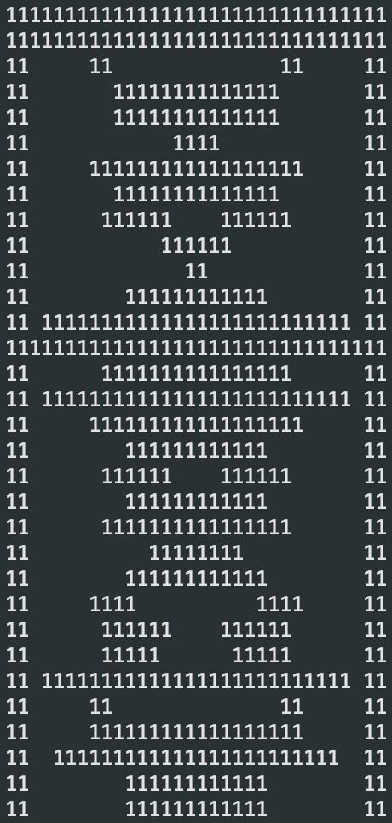
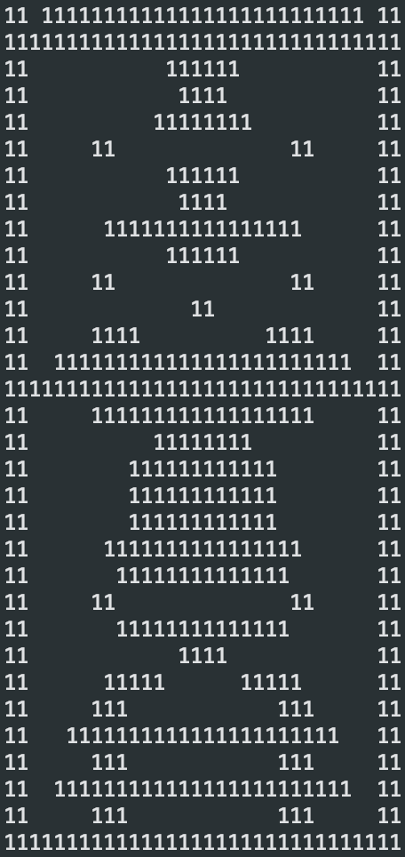
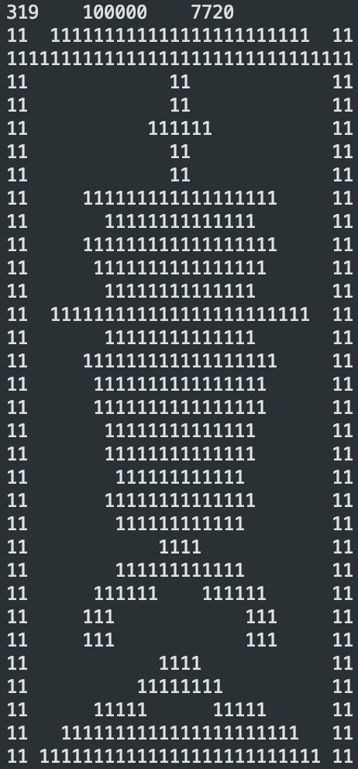
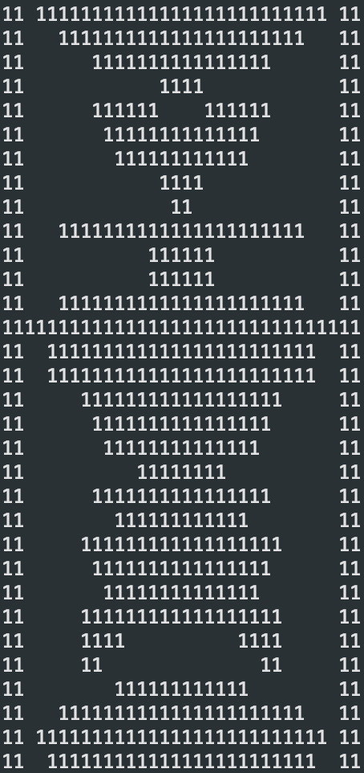
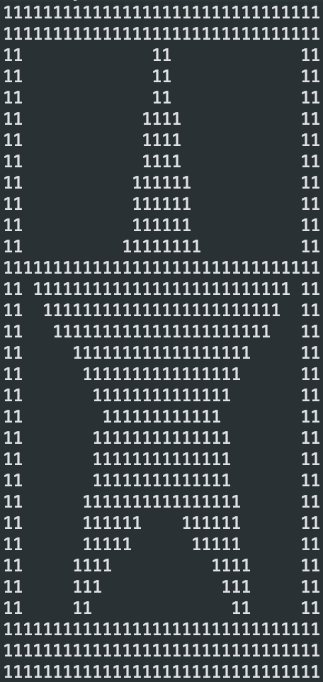
pictures
Generation: 1 23 200 340 target

Slide 13
Second approach

Slide 14
Idea
Draw random line to consist a picture.
Gene: line; Chromosome: lines; Individual: 2D-Array
Fixed chromosome size
Initial 5000 individuals, and evolve to 50000 individuals

Slide 15
Design
Gene class consist two position (x1, y1) and (x2, y2)
Use sequence container to store genes, and use toPhenotype() function to create 2D-Array
When gene present duplicated will override the value for that pixel

Slide 16
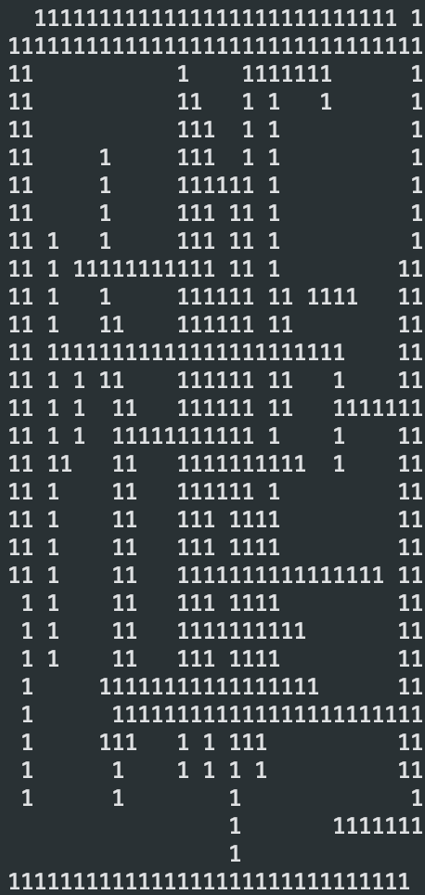
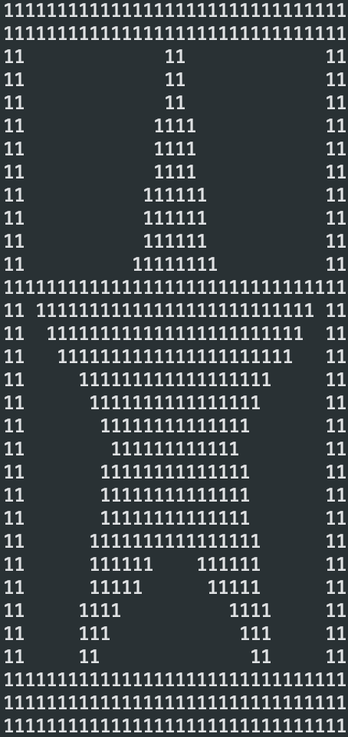
pictures
One individual Target

Slide 17
Third approach

Slide 18
Review
For the first two approach:
0, 1 to present each pixel.
Fixed chromosome size
Hit the target value for each pixel to increase the fitness
Those features above may lead to the solution not present very well so we need to design the experiment

Slide 19
IDEA
Use circle (Gene) to generation picture
Use RGB to present each pixel (with color)
Chromosome size will increase with the generation number
Mutation change the gene’s attributes and make it present first
Count the difference between RGB and add into fitness value

Slide 20
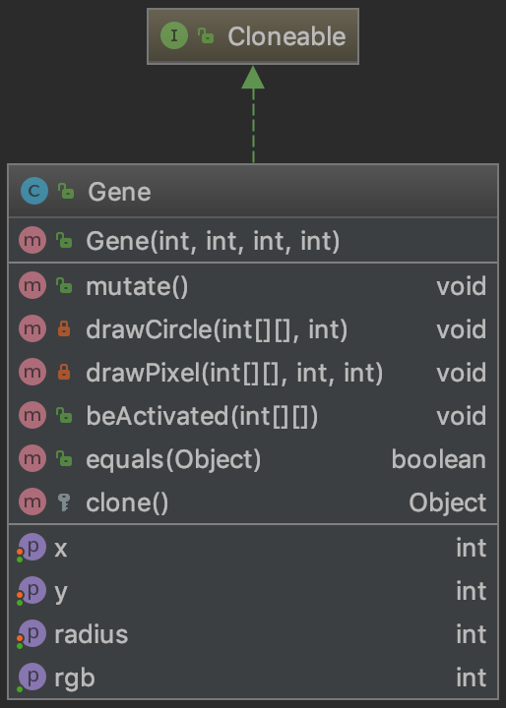
Gene
Attributes: x, y, radius, color
Draw a filled circle to make the gene presented
Shift position and change the radius when mutate

Slide 21
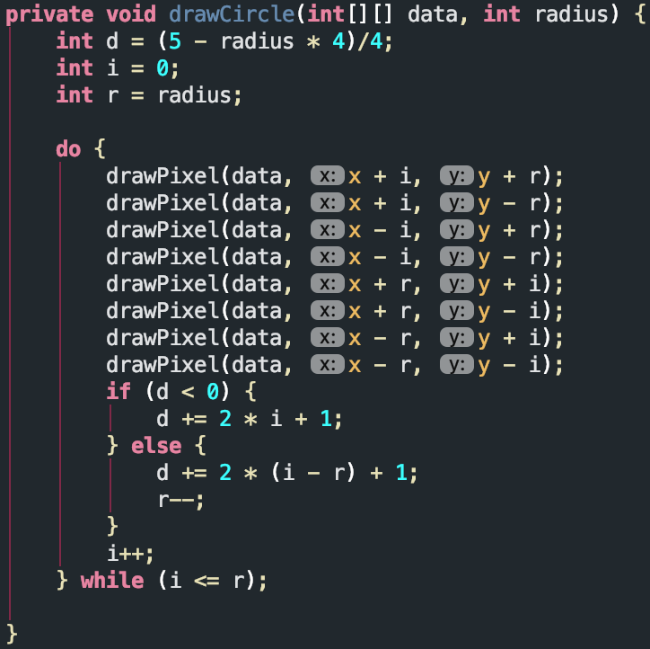
Circle Drawing ALG

Slide 22
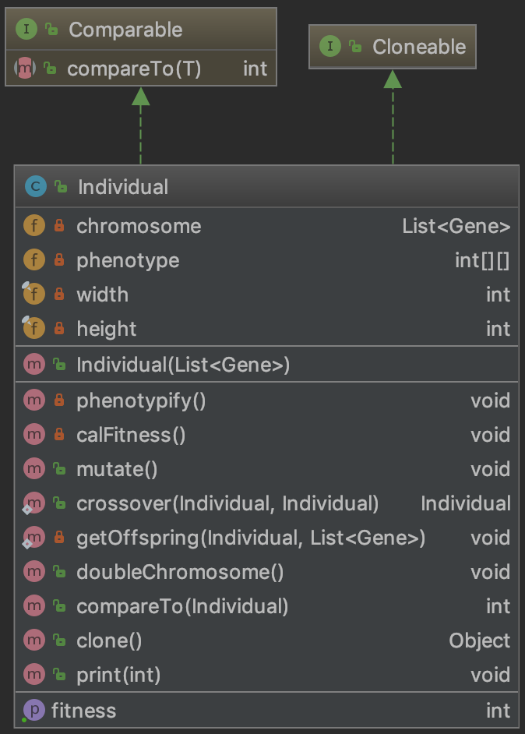
Individual
Use List to store the Gene.
Chromosome will increase with the evolve times
Phenotypify() will active gene in order, the gene in the tail will overlap the presenting in head.
When breed will create several offspring which will be define in the Config class.

Slide 23
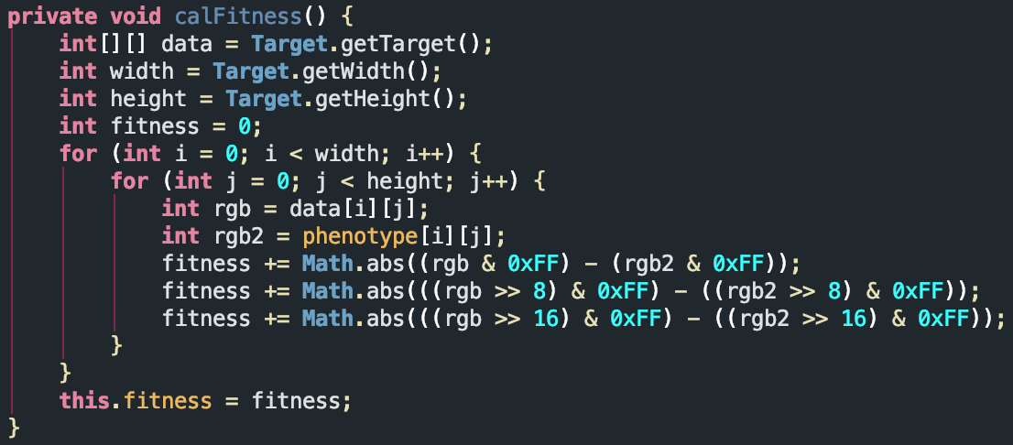
Functions in Individual Class

Slide 24
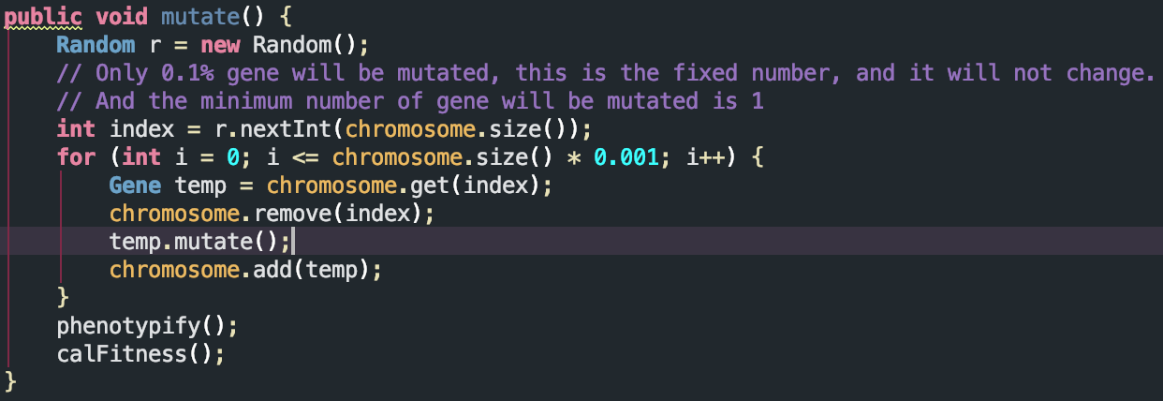

Slide 25
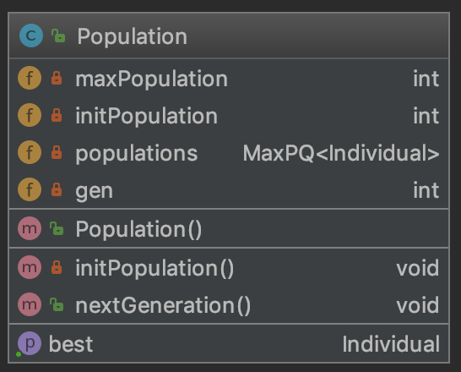
Population
Attributes: maxSize, initSize, populations
Populations store in Max heap priority Queue, which is easy to get the best individual in constant time.
Each generation, all population will go through the mutation part, breeding part and select survivals part.

Slide 26
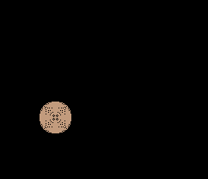
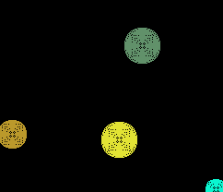
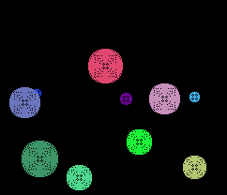
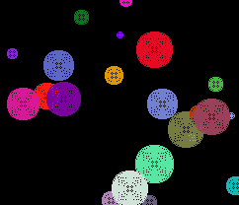
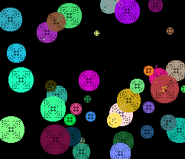
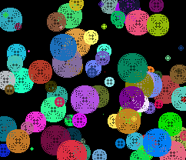
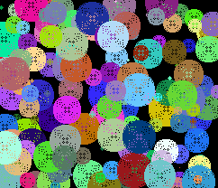
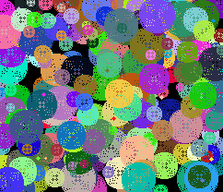
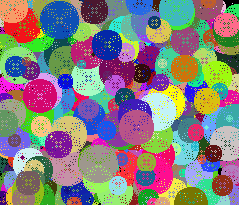
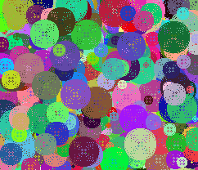
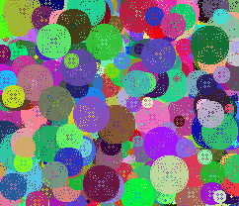
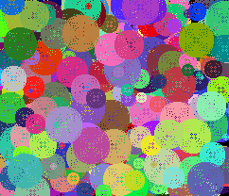
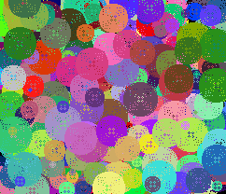
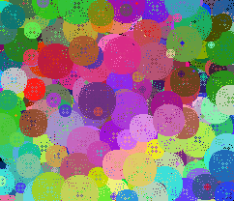
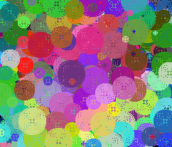

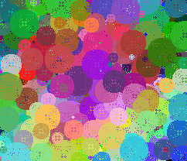
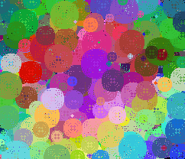

Slide 27
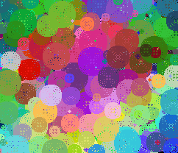
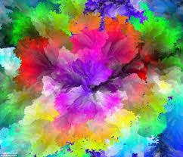
result
Right image above is evolve to generation 780, and below is the target image.
We can see the generation picture have the same color distribution with the target picture, and it still going to give a more optimal solution.

Slide 28
The fitness chart
Difference between the pervious two approach, we use differentiate between the generated picture and target picture. So the fitness going down.
When fitness == 0 means it is the best solution.

Slide 29
conclusion
Genetic Algorithm is an appropriate algorithm which can give many good solutions in short time instead of giving the best solution.
When solving problems need use exhaustion method, Genetic Algorithm can give a huge improve in run time.
In conclusion, we believe the Genetic Algorithm is a wonderful way to get a result close to the optimal solution. With other constrains and optimization, this algorithm will help deal with various kinds of problems.

