Slide 1

Enhancing Construction Site Safety: Leveraging AI-Driven Object Detection with E- SafeGuard
Vaibhavi Jha | Akshat Saxena | Sidharth Kakrani
21BCE0399 | 21BCE0284 | 21BKT0014

Slide 2
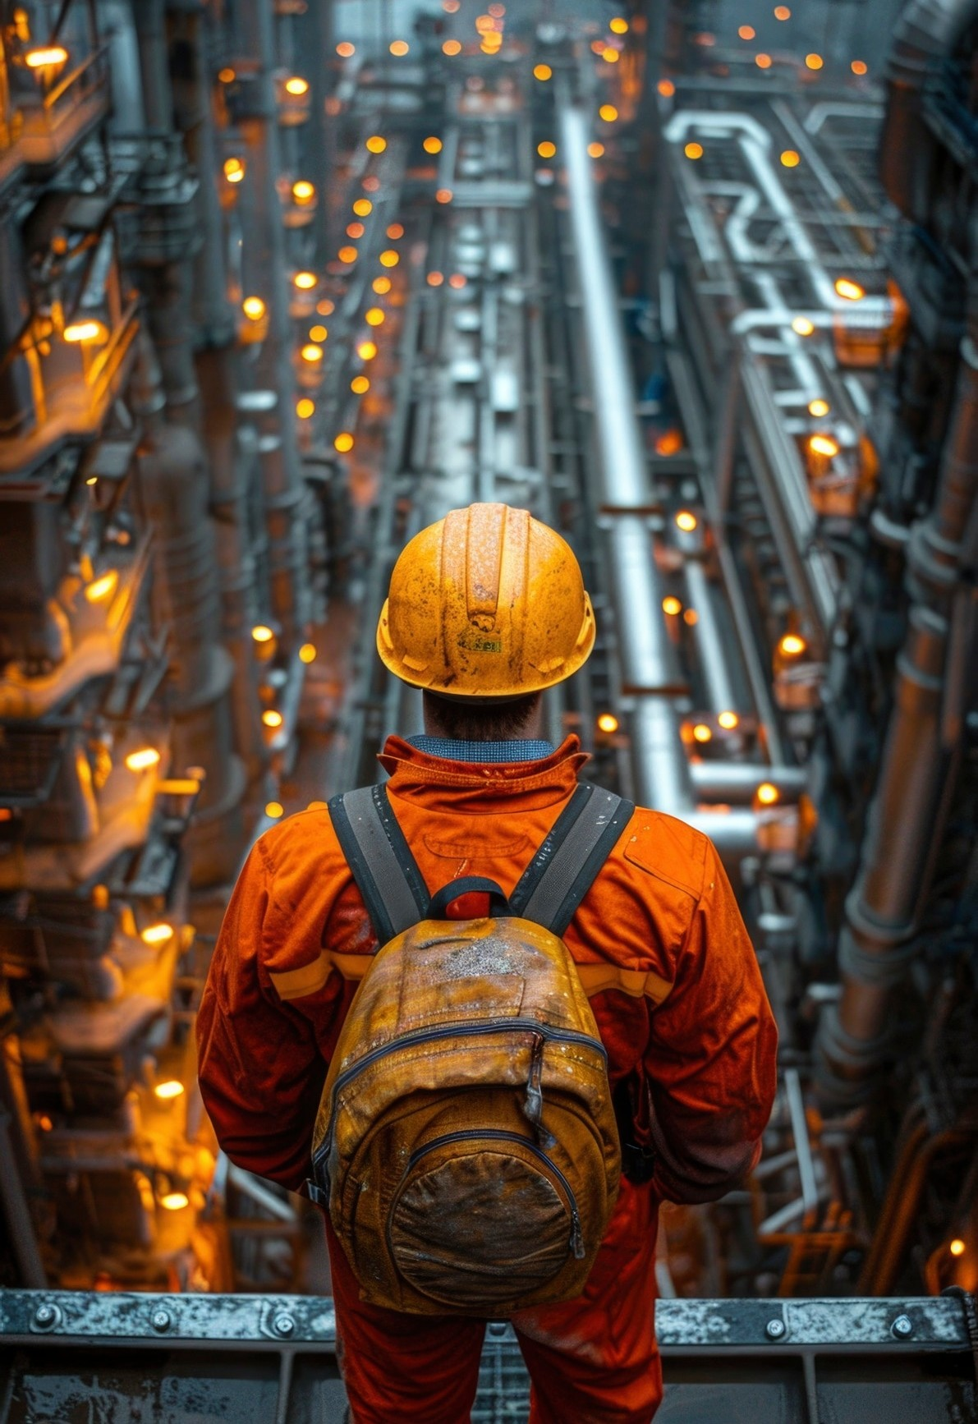
Introduction to E-SafeGuard
E-SafeGuard is a revolutionary system that integrates AI-driven object detection to enhance safety on construction sites. By leveraging advanced technology, we can signiﬁcantly reduce accidents and improve overall site management. This presentation will explore its features, beneﬁts, and impact on construction safety.

Slide 3


AI-driven object detection utilizes deep learning algorithms to identify and monitor objects in real-time. This technology can recognize hazardous situations and alert personnel instantly, ensuring a safer work environment. By implementing this system, we can proactively manage risks on-site.

Slide 4




Key Features of E-SafeGuard
E-SafeGuard oﬀers several key features including real-time monitoring, automated alerts, and comprehensive reporting, followed by analytics.
These features enable site managers to make informed decisions quickly, ensuring that safety protocols are adhered to and that potential
hazards are addressed promptly.

Slide 5


Benefits of Enhanced Safety
Implementing E-SafeGuard leads to signiﬁcant beneﬁts such as reduced accidents, improved compliance with safety regulations, and enhanced worker conﬁdence. By prioritizing safety through technology, construction companies can foster a culture of safety that ultimately beneﬁts everyone involved.

Slide 6
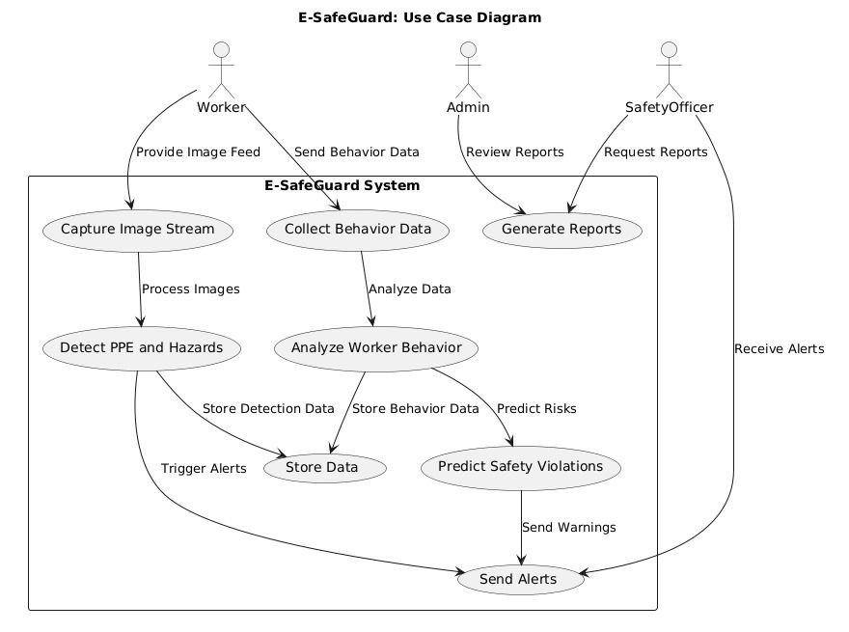
Use-Case Diagram
A Use Case Diagram for "E-SafeGuard" shows interactions between the Site Manager, who monitors safety violations and receives alerts, and Workers, who are tracked for PPE compliance and behavior. The AI System detects risks and predicts accidents based on worker data, sending real-time alerts for proactive safety measures.

Slide 7
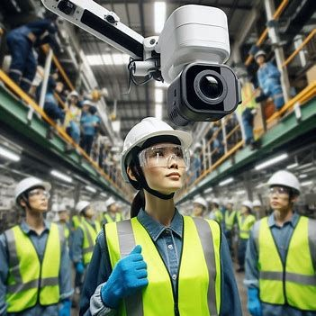
Literature Survey
Object Detection in Construction Sites: Numerous studies have investigated the application of computer vision techniques for detecting safety equipment, such as helmets, vests, and gloves on construction sites. The YOLOv8 approach has been utilized for real-time detection, emphasizing accuracy across diverse lighting and environmental conditions.
Predictive Safety Analytics: Research in worker safety analytics indicates an increasing focus on utilizing machine learning to forecast accidents by analyzing worker fatigue, behavior, and movement patterns. However, most implementations prioritize post-accident evaluations rather than proactively preventing incidents through real-time predictive insights.
PPE Detection: Several research papers have focused on the detection of PPE, particularly helmets and vests. Real-time detection of these items can prevent accidents caused by non-compliance with safety regulations. Faster R-CNN and YOLO models have shown high accuracy in PPE detection, with studies reporting over 80% accuracy under controlled conditions. However, the challenge arises in uncontrolled environments where lighting conditions, occlusions, and camera angles may reduce the accuracy of detection systems. More research is needed to enhance detection accuracy in these real-world scenarios.

Slide 8


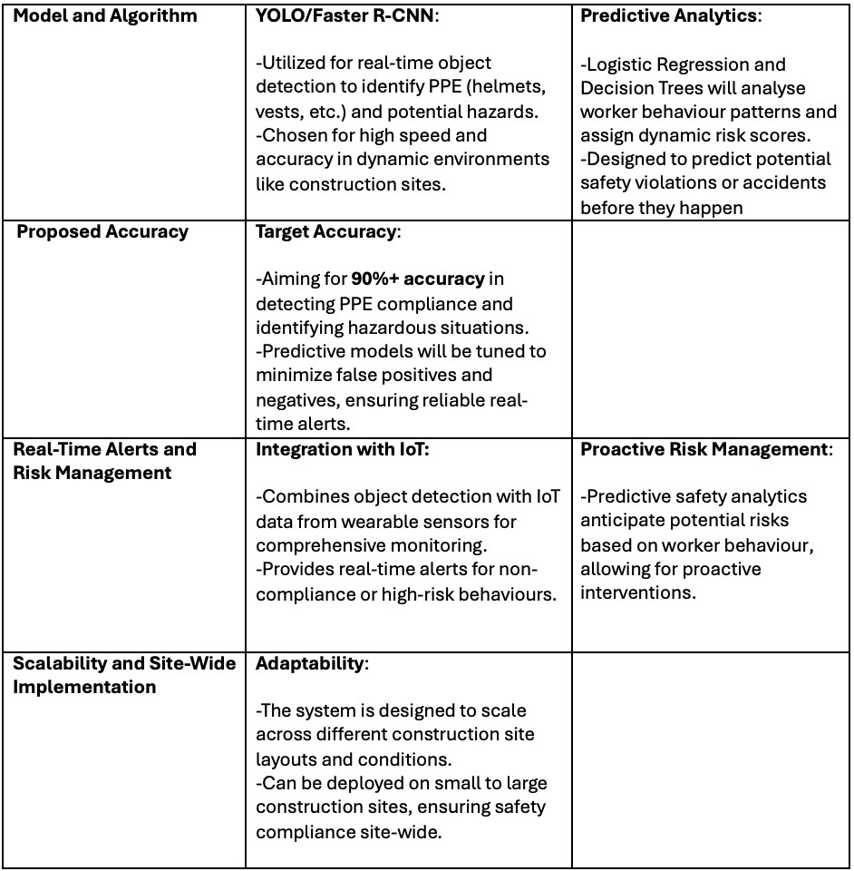

Slide 9

Limited Predictive Capabilities: Existing solutions focus on real-time detection of hazards and PPE non-compliance but lack mechanisms for predicting accidents based on worker behaviour patterns.
Scalability Challenges: Current systems often struggle with adapting to various site layouts and worker behavior complexities, limiting their scalability.
Integration of Multi-Modal Data: Few studies combine visual data from object detection systems with behavioral data from wearables and IoT devices to provide a holistic safety monitoring solution.

Slide 10

1. Objectives:
2. Project Plan:
Real-time Object Detection: Develop an AI- powered system capable of detecting PPE and hazardous objects in real-time.
Phase 1: Literature review and dataset creation for PPE and hazard detection.
Phase 2: Development of object detection models using CNN-based architectures (e.g., YOLO, Faster R-CNN).
Predictive Analytics for Safety: Implement a machine learning-based system to monitor worker behavior, assign dynamic risk scores, and predict potential accidents.
Phase 3: Design and implement the predictive safety analytics module to monitor worker behavior patterns.
Integrated Alert System: Create a comprehensive alert system that provides real- time notiﬁcations for safety violations and high- risk behaviours.
Phase 4: Integrate object detection and predictive analytics modules into a single system, test on a real or simulated site.
Scalability Across Sites: Ensure the solution is scalable and adaptable to diﬀerent construction site layouts and environments.
Phase 5: Fine-tuning and scalability testing across diﬀerent site environments.

Slide 11

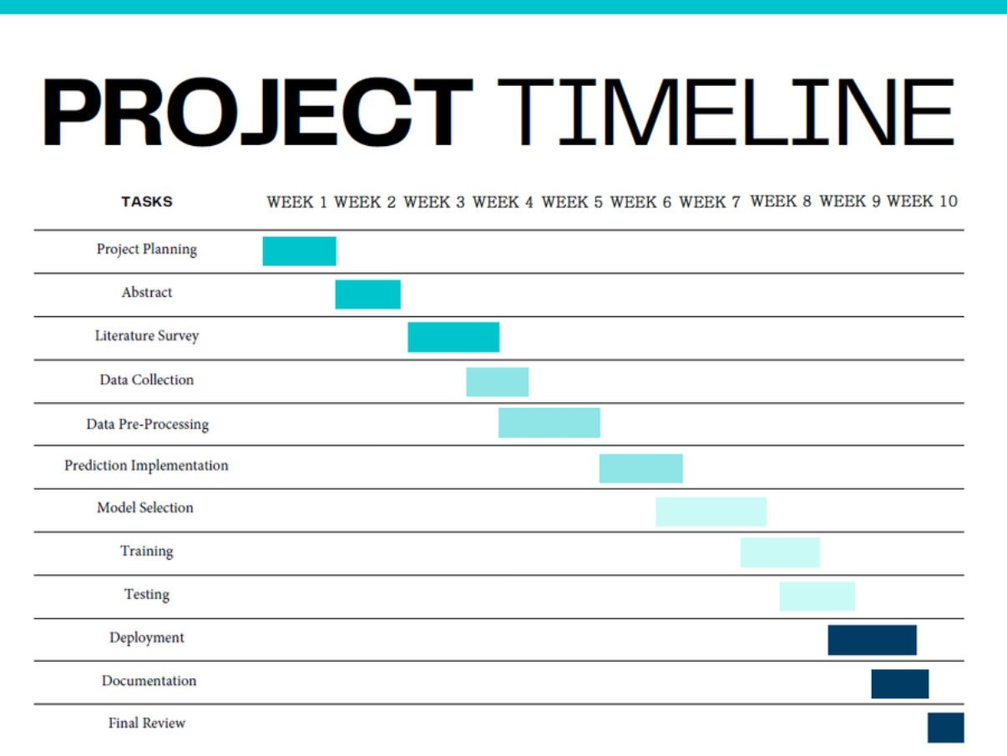

Slide 12

Requirement Analysis
Functional Requirements:
Object Detection System: Must accurately detect PPE (helmets, vests, goggles) and identify hazardous conditions in real-time.
Predictive Safety Module: Should analyze worker behavior and generate risk scores, predicting potential accidents before they occur.
Alert and Reporting System: Must provide real-time alerts for safety violations and generate reports for post-event analysis.
Non-Functional Requirements:
Performance: The system must operate in real-time, providing safety alerts with minimal latency.
Scalability: The system should adapt to various construction site layouts and handle data from multiple workers simultaneously.
Reliability: Must ensure high availability, especially during peak operational hours on the site.

Slide 13

Design and Implementation
System Architecture:
Data Collection: Cameras placed around the site collect real-time video, and IoT devices monitor worker movements and environmental conditions.
Object Detection Module: Uses YOLO or Faster R-CNN to detect PPE compliance and hazards from the video feeds.
Predictive Analytics Module: Applies machine learning algorithms (logistic regression, decision trees) to assess worker behavior patterns and generate risk scores.
Alerting and Reporting: When a high-risk threshold is exceeded, the system sends alerts to workers and supervisors via mobile applications or dashboards.

Slide 14

Design and Implementation
Implementation Plan:
Develop Object Detection Model: Train the model using labeled datasets for PPE and hazards.
Integrate Behavioral Data: Use sensor data from IoT devices to monitor worker fatigue and movement patterns.
Testing and Validation: Test the integrated system in real- world environments to ensure accuracy and eﬃciency.
Reﬁnement: Based on feedback, ﬁne-tune the model to reduce false positives and enhance predictive accuracy.

Slide 15

In conclusion, E-SafeGuard represents a signiﬁcant advancement in construction site safety through AI-driven object detection. As technology continues to evolve, we can expect even greater innovations that will further enhance safety measures and protect workers on-site.

Slide 16



