Slide 1


DATABASE Management and Database Design

Slide 2

SELECT @firstName = ‘VAIBHAVI’, @lastName = ‘KAMANI’,
@NUID = 001825058
FROM Students
WHERE Section = 06
AND Project_Topic = ‘Banking Database System’;

Slide 3
PROPOSAL
A database design is an important part of any system.
The purpose of the banking system is to develop a banking database design that provides banks with the facility to organize various information related to employees, customers, credit cards, loans, etc.
This database shall help banks to maintain their information at one place and provide an overview of the bank operations.
The database can be used to perform the statistical analysis like number of transactions done per week or month or year per branch, total profit generated by each branch, total number of accounts particular customer has, types of loans that granted more to the customers etc.
This kind of analysis is important for bank so as to ensure smooth and efficient functioning.

Slide 4
The users of the applications will be Branch Manager, Bank Teller, Bank Clerk, Loan Manager, Human Resource, Bank Manager.
Bank Manager will be having access to view the overall database across the branches.
Branch Manager will be having access to view only the information related to his/her branch.
Bank Teller will be having access to update the information of the customer, perform various transactions, view the overall reports generated for the clients.
Bank Clerk will be having access to just view the data related to accounts and provide information when queried by customer.
Loan Manager will be having access to grant loans to the customers as well as monitor the loan related information such as deciding loan rates, calculating interest for customers etc.
Human Resource will be having access for hiring the employees to work in the bank.

Slide 5
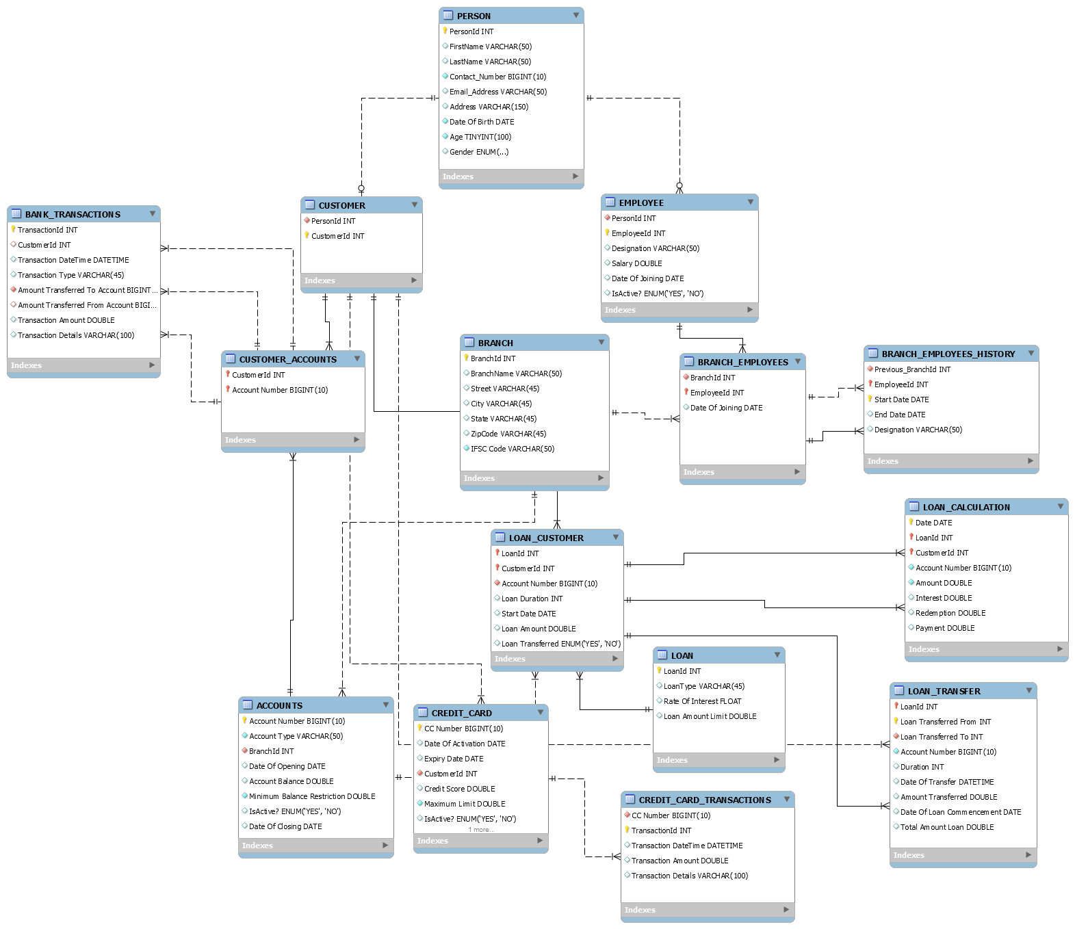

Slide 6
IMPLEMENTATIONS:
TRIGGERS
STORED PROCEDURES
UDF
VIEW
TRANSACTION
JOINS
SUBQUERY
VARIOUS FUNCTIONS
NORMALIZATION
INHERITANCE (Person IS A Customer, Person IS A Employee)
USERS & PRIVILEGES
BACKUP

Slide 7
PROCEDURES:
1. beginTransaction
The procedure “beginTransaction” is used to withdraw and deposit money to a particular account number.
The Stored Procedure calls Transaction within it and updates the amount in the respective accounts as well inserts the vales in the table.
It checks the various conditions such as don’t withdraw the amount if amount is greater than minimum account balance.

Slide 8
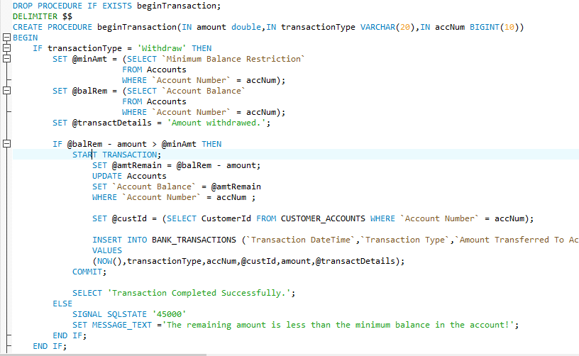

Slide 9
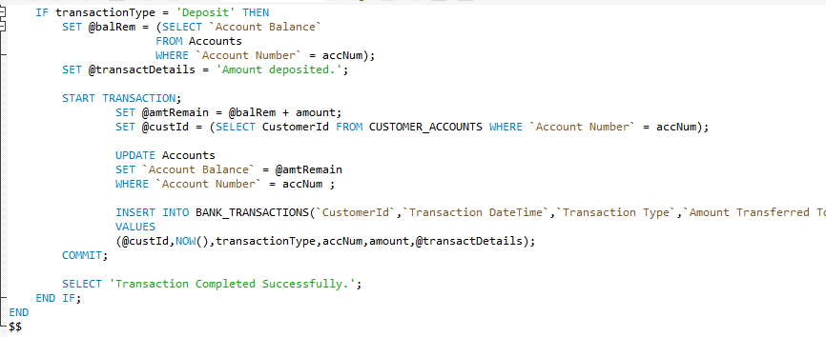

Slide 10
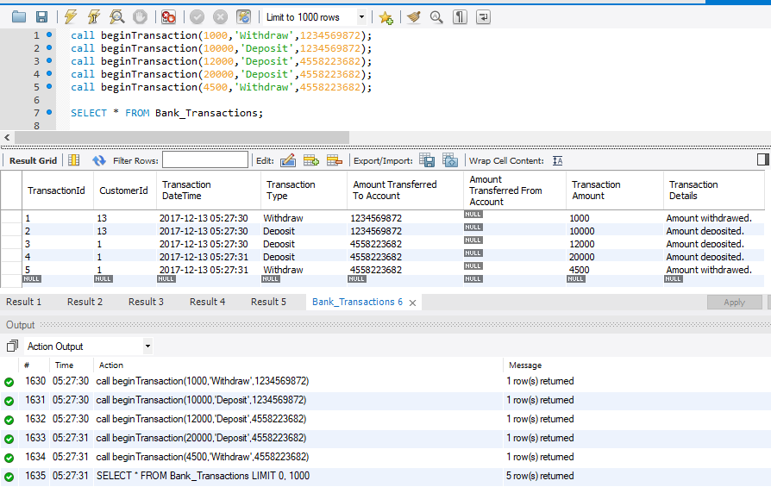

Slide 11
2. transferInterAccAmount
The procedure “transferInterAccAmount” is used to transfer amount from one account to another and update values in the respective accounts.
The Stored Procedure calls Transaction within it and updates the amount in the respective accounts as well inserts the vales in the transaction table.
It checks the various conditions such as don’t transfer the amount if amount is greater than minimum account balance.

Slide 12
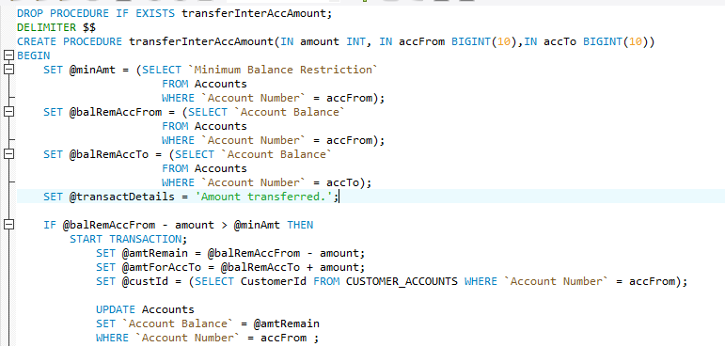
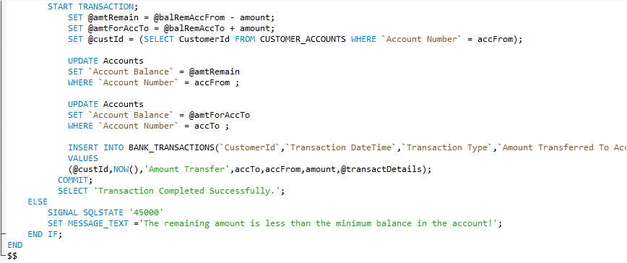

Slide 13
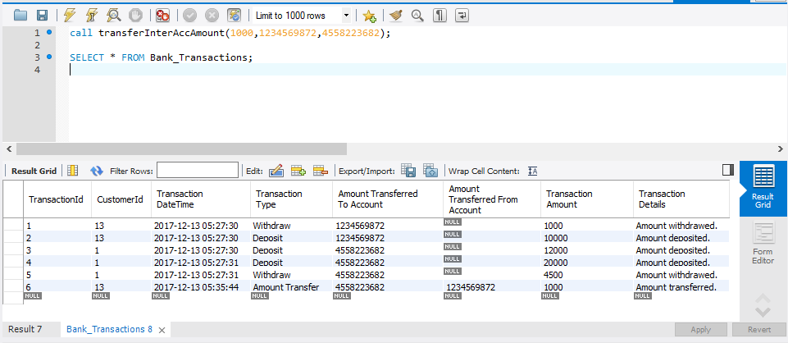

Slide 14

3. creditcardTransaction
The procedure “creditcardTransaction” is used to insert the values of the credit card transactions in the credit card transaction table.
It validates the maximum limit of the credit card and allows the insertion in the table if the transaction amount doesn’t exceed the maximum available limit.

Slide 15
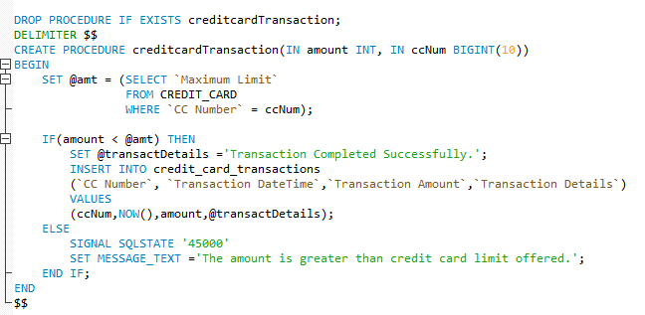
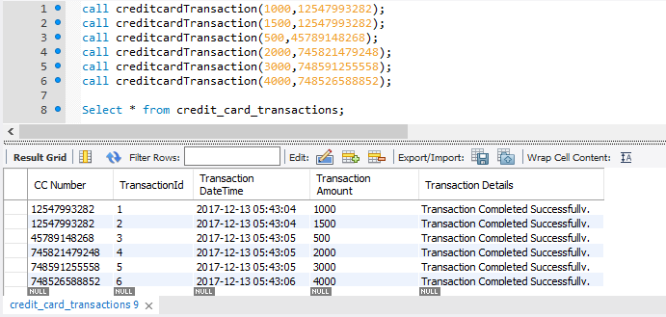

Slide 16
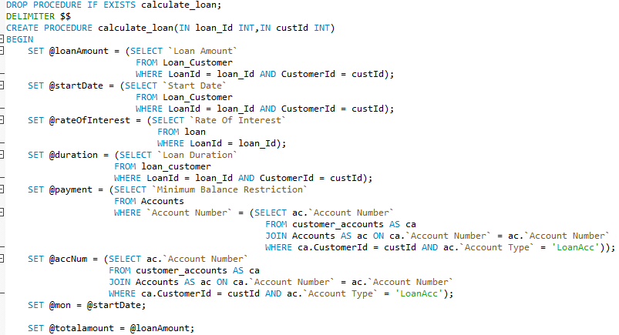
4. calculate_Loan
This stored procedure is one of the main feature since it calculates the loan amount for customer when provided with loanId, customerId.
It performs various calculations for validating the amount, calculating interest and the value is inserted in the loan_calculation table.

Slide 17
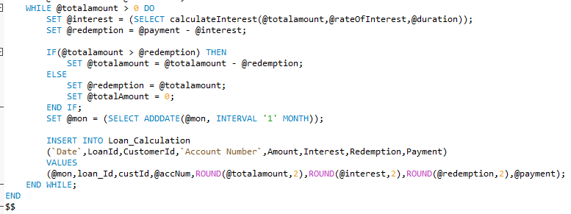
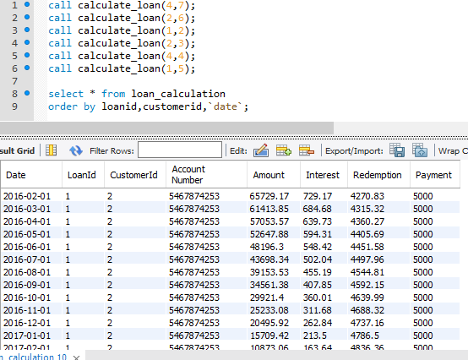

Slide 18
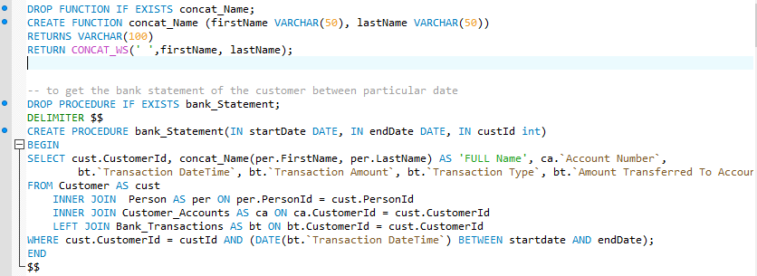
5. bank_Statement
This procedure is used to get the bank statement of the customer by providing customerid and time period between the transactions as input.
It uses the concat_Name function to get the customer’s first and last name concatenated along with the space.

Slide 19
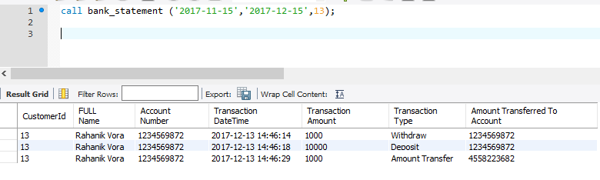

Slide 20
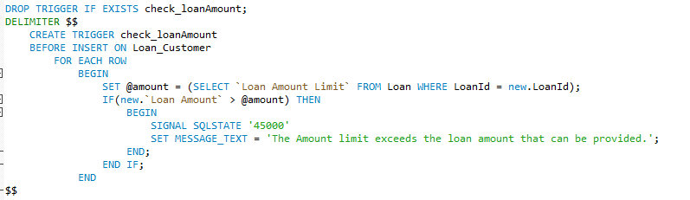
TRIGGERS:
check_loanAmount
It is triggered before insertion on loan_Customer that checks whether the row inserted has loan amount that does not exceed the maximum loan that can be given to the person.

Slide 21
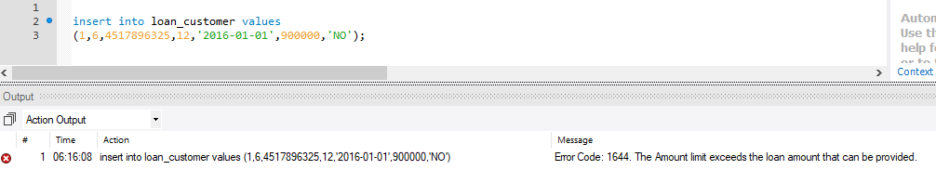

Slide 22
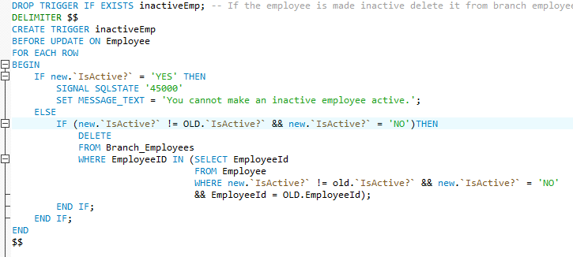
2. inactiveEmp
If the employee is made inactive delete it from branch employee and it add it in branch employee history.

Slide 23
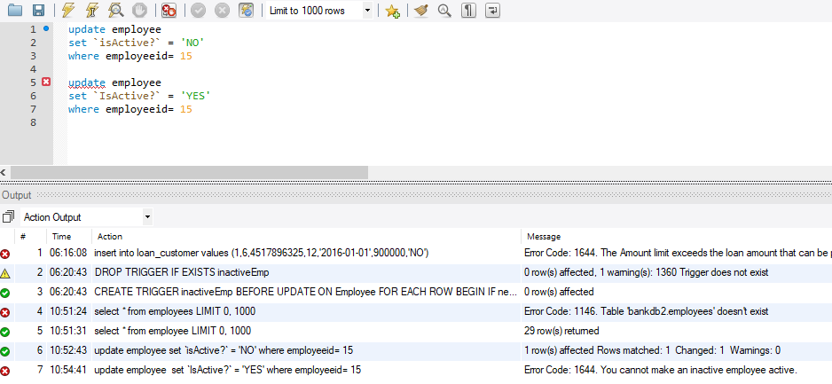

Slide 24
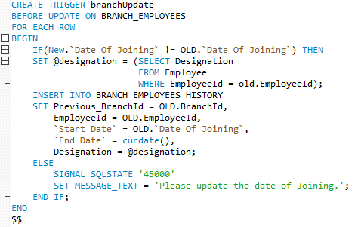
3. branchUpdate
If the employee changes from one branch to another then the entry of the old branch where he used to work and the other details are entered in branch_employee_history table which has all the history of the previous employees and branch.
If the date of joining is not updated then it gives error and Branch_Employee table is not updated.

Slide 25
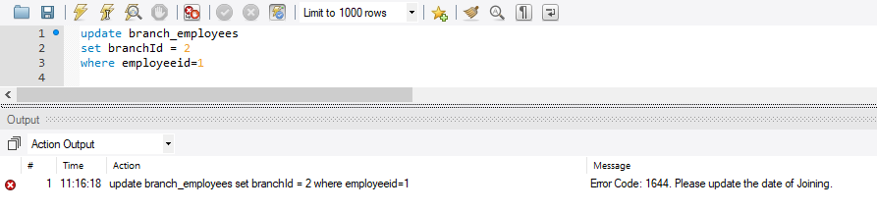

Slide 26
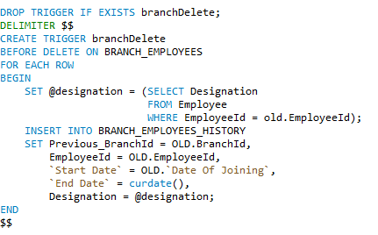
4. branchDelete
If employee is deleted from particular branch in branch_Employee table then she/he should be inserted into branch_employee_history table.

Slide 27
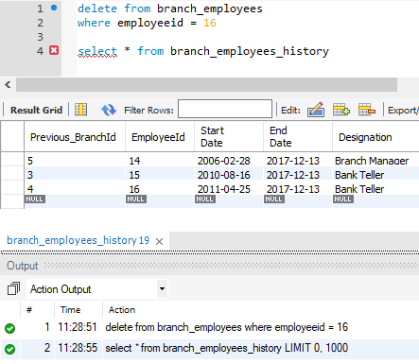

Slide 28
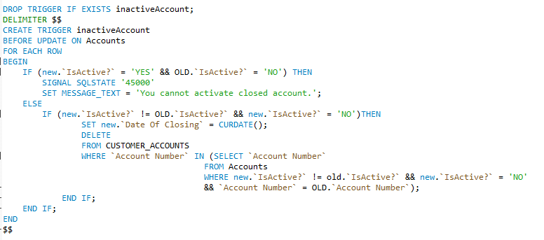
5. inactiveAccount
While updating accounts you cannot set the flag of inactive accounts to active.
Once the account is closed the person cannot re-open it, he/she has to open a new account.

Slide 29
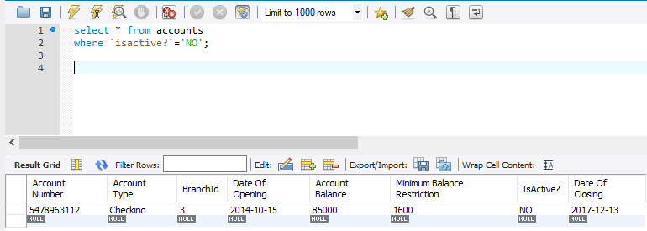
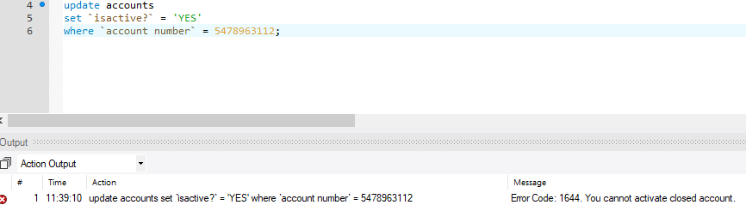

Slide 30
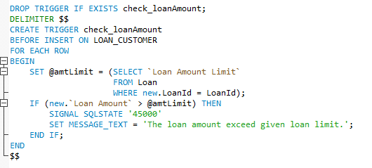
6. check_loanAmount
While inserting row in the loan customer table i.e. while granting loan to customer the amount is checked against the maximum amount of loan that can be given.

Slide 31
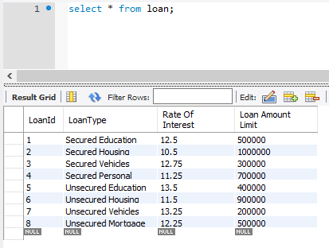
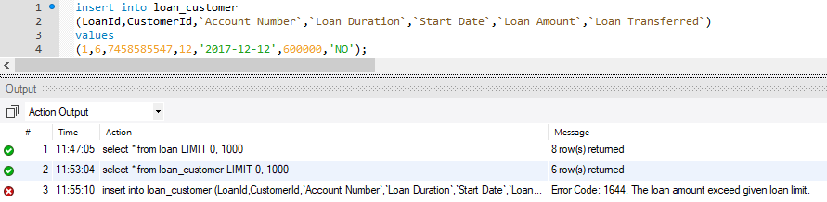

Slide 32
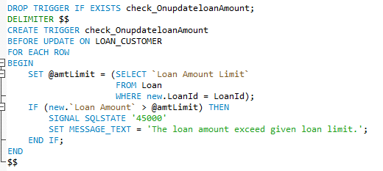
7. check_OnupdateloanAmount
While updating the existing record for loan amount it checks that the loan amount does not exceed the maximum amount that can be provided for a particular loan type.

Slide 33
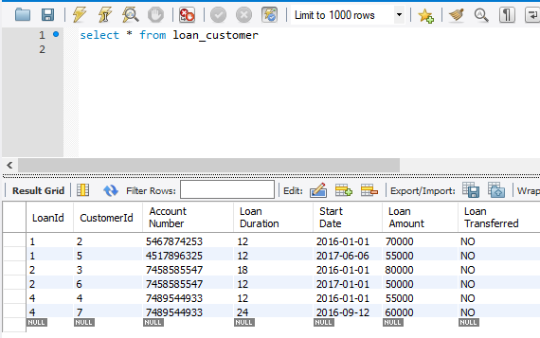
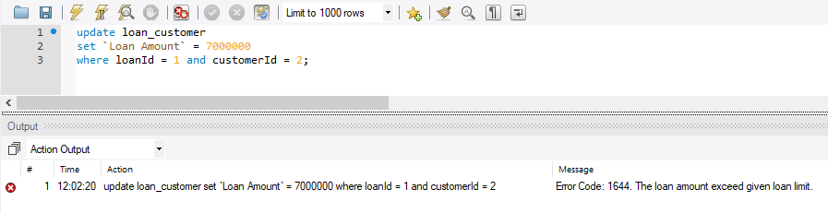

Slide 34
8. loanTransfer
The trigger is called when the loan_customer table is updated with new customerId i.e. when the loan amount is transferred to different person the details are added to loan_transfer table.
It performs the check before updating the loan transfer such as the person to whom loan is transferred does not have the same loan with him/her already.
If the person does not have loan the values are inserted into the loan transfer table.

Slide 35
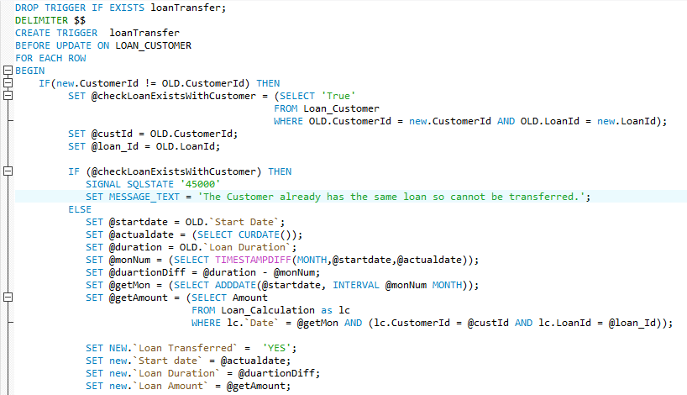
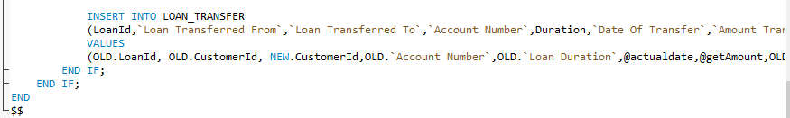

Slide 36
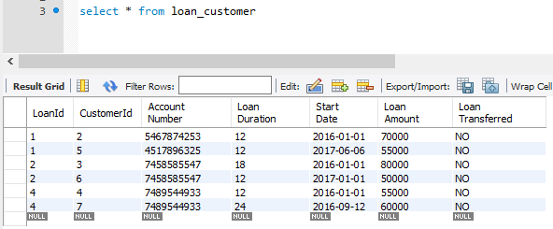

Slide 37
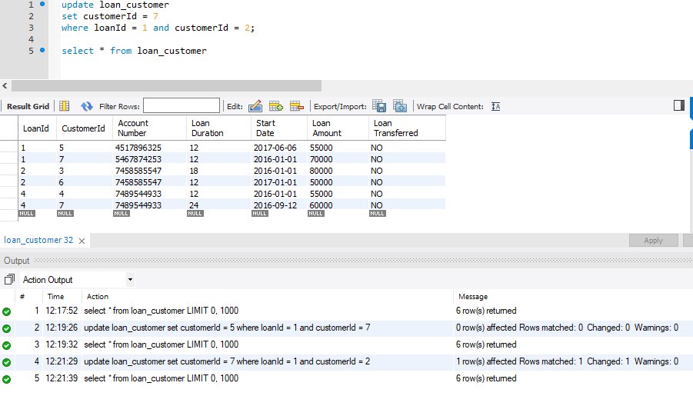

Slide 38

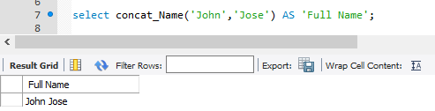
FUNCTIONS
concat_Name(firstName VARCHAR(50), lastName VARCHAR(50))
This function concats the first and last name of person and is used in lot of queries and stored procedures.

Slide 39
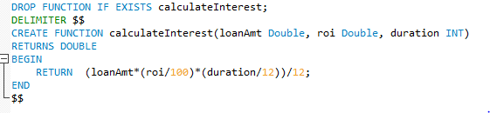
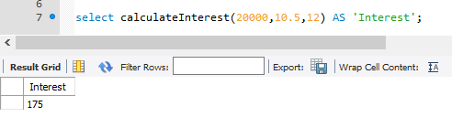
2. calculateInterest(loanAmt Double, roi Double, duration INT)
This function calculates the interest and returns the result.
It is called from calculate_loan stored procedure.

Slide 40
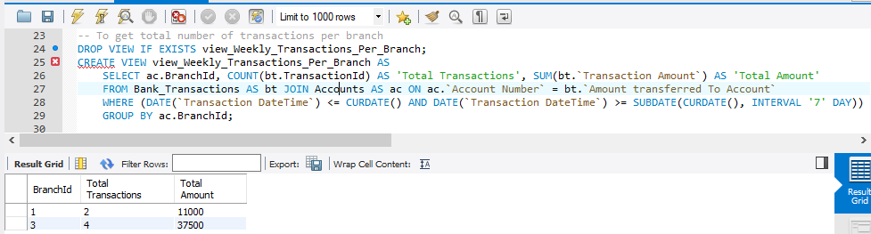
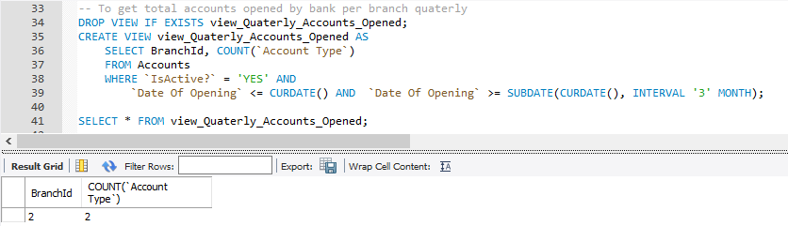
VIEWS
To view the total number of weekly transactions per branch.
2. To view the total accounts opened per branch quarterly.

Slide 41
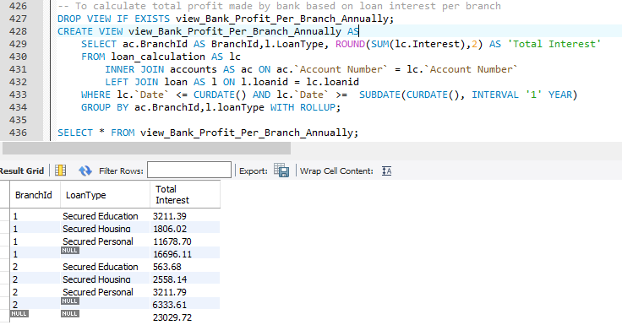
3. To calculate total profit made by the bank on loan interest per branch.

Slide 42
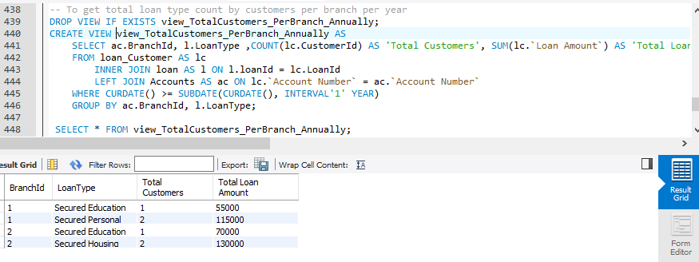
4. To get the total number of loans granted to customers based on loan type annually. i.e. to get the most popular loan among customers.

Slide 43
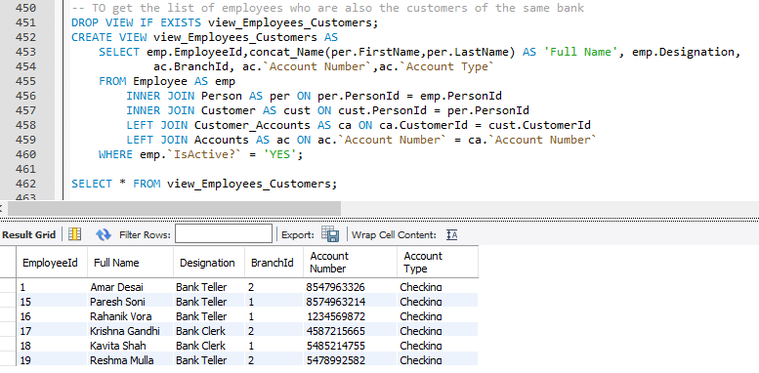
5. To get details of all the employees who are also the customers of the same bank.

Slide 44
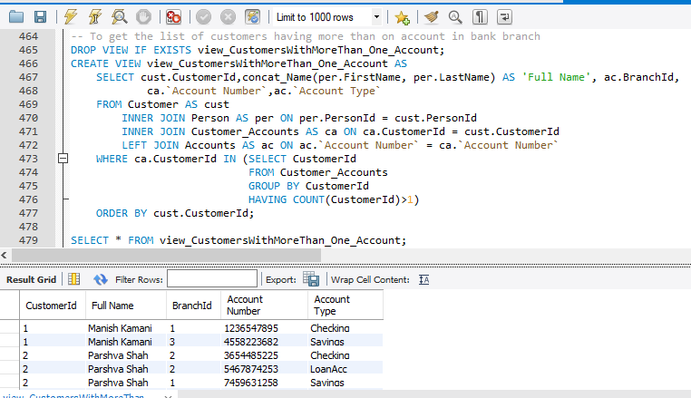
6. To get the details of the customers with more than one account.

Slide 45
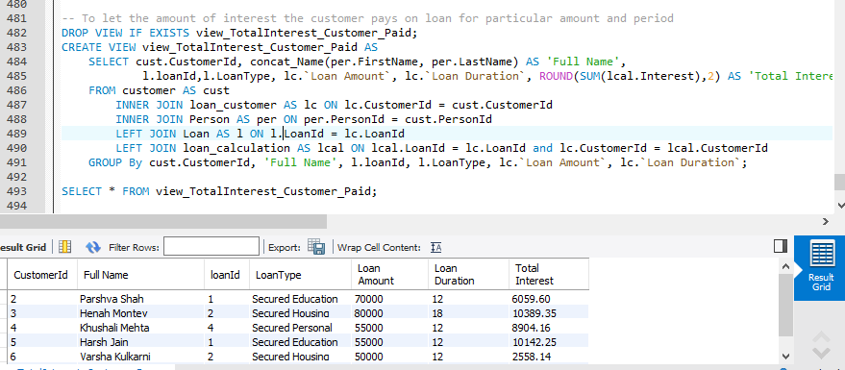
7. To get the total interest the customer pays on the loan.

Slide 46
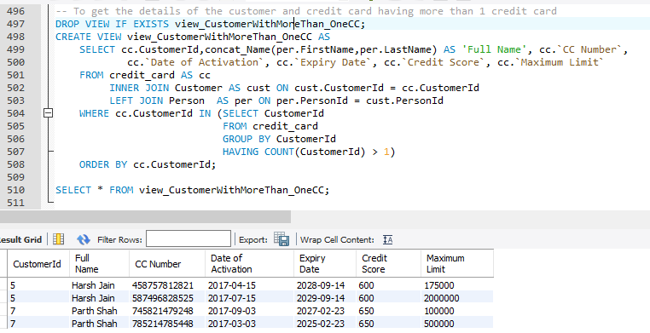
8. To get the credit card and customer details having more than 1 credit card.

Slide 47
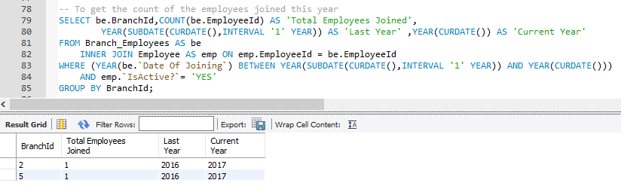
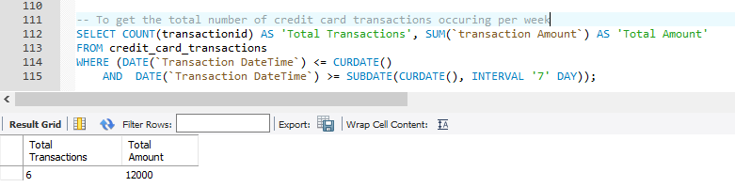
QUERIES
To get the count of the employees who joined in the current year seggregated by branch.
2. To get the total count of credit card transactions and total amount of the transactions per week.

Slide 48
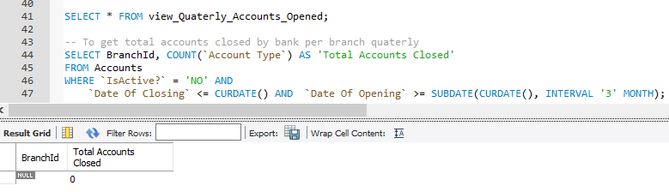
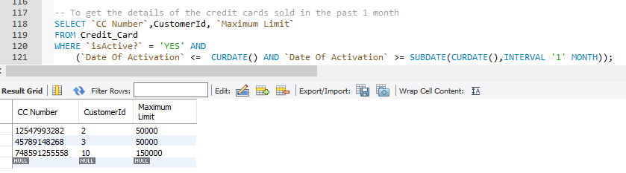
3. To get the accounts closed by the bank quarterly per branch.
4. To get the details of the credit cards sold in the past 1 month.

Slide 49

5. To get the details of the credit card that expires in the current month and year.

Slide 50
USERS & PRIVILEGES
The users are created for roles of Bank Manager, Bank Teller, Loan Manager, Bank Clerk, Human Resource.
Bank Manager is given access to entire database.
Bank Clerk is given access to select specific customer and their accounts related information as well as transactions done by the customer.
Bank teller is given access to perform CRUD operations on tables Bank_Transactions, Customer_Accounts, Accounts as well as view, update the information of Customers and few procedures to perform transactions .
Loan Manager is given access to all the loan, customer related tables and stored procedures as shown in the screenshot.

Slide 51

Human Resource has access to perform CRUD opertaions on the Person, Employee tables.

Slide 52


Slide 53



Slide 54

The screenshot for the clerk user is attached on the next page and the other users also work in the similar way.

Slide 55


:
The Clerk is given access to retrieve specific rows from the Person table.
The Clerk user gets the following error when trying to access all the columns of Person table.

Slide 56

BACKUP
Backup of the dump is taken every night at 9:28pm through Task Scheduler which automatically calls the BAT file to generate the backup at a particular path.
The bat file is attached in the zip folder.

