Slide 1
Financial Analysis Project Report and Insights
CoachX
Vaibhavi Hambire
Batch: CX-143

Slide 2
Introduction
This project focused on applying core financial concepts such as Annuity, EMI, Investment Decisions, and IRR using Microsoft Excel.
The aim was to analyze financial problems practically, use Excel’s financial functions to solve them, and present the findings with the help of charts and insights.
By simulating real-world cases such as loan repayment schedules and investment cash flows, we learned how financial analysis guides decision-making for both individuals and businesses.

Slide 3
Methodology
Excel Functions Used
PV – to calculate the present value of future payments (Annuity).
PMT – to compute fixed Equated Monthly Installments (EMI).
NPV – to evaluate and compare investment projects.
IRR – to measure the return percentage of uneven cash flows.
Visualization Designed three key charts in Excel for better interpretation:
Bar chart comparing PV of Installments vs One-time Payment.
Stacked column chart showing EMI split (Interest vs Principal).
Bar chart comparing NPV of different investment options.

Slide 4
Approches
For Annuity, we applied the PV function to compare the present value of installment payments against a one-time payment.
For EMI, we used the PMT function to calculate fixed installments, then built an amortization table with IPMT and PPMT to separate interest and principal.
For Investment Decisions, we calculated NPV using NPV and XNPV (when cash flow timings were irregular) and compared projects.
For Profitability, we used IRR and XIRR to measure returns, and applied MIRR to get a more realistic return rate when reinvestment assumptions were needed.

Slide 5
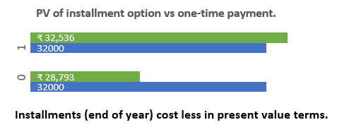
Insights
Annuity / PV: Installments often look cheaper in present value terms than lump-sum payments, depending on interest rate and timing.

Slide 6
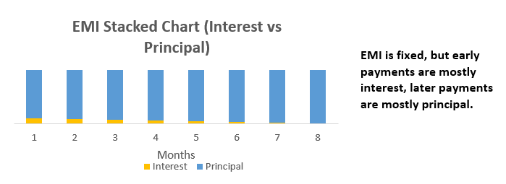
Insights
EMI: While the EMI remains constant, the interest portion is much higher in the initial months, gradually reducing as more principal is repaid.

Slide 7
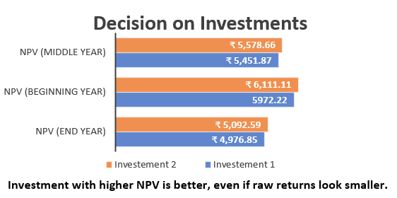
Insights
Investment Decision: NPV is a more reliable metric than simply comparing raw cash inflows. The project with the higher NPV should be chosen.

Slide 8
Insights
IRR: Helps assess profitability of irregular cash flows, confirming whether returns exceed required cost of capital.

Slide 9
Key Findings
Timing of payments significantly affects the true cost of a purchase (PV concept).
Loan structures favor lenders in early years due to high interest portions.
Investment alternatives must be evaluated on NPV and IRR, not just on total inflows.
MIRR is more accurate in complex investment scenarios.

Slide 10
Recommendations
Choose installment options if their present value is lower than a lump sum.
Make prepayments or shorter-term loans to save on interest burden.
Always use NPV and IRR before committing to an investment project.
Use MIRR for better profitability assessment.

Slide 11
Recommendations
From this project, we learned not only the mathematical functions of PV, PMT, NPV, and IRR in Excel, but also their real-world applications.
From a learning perspective, this project demonstrated how data analysis can simplify financial decision-making.
Overall, the analysis guides better decision-making for loans and investments.

