Slide 1
AIRRESOLVE: AIRLINE DISRUPTION RESOLUTION AGENT
Individual Assignment 3: Customer-Facing Resolution Agent
A policy-grounded conversational agent with deterministic business rules, auditability, and guardrails.
Candidate / Student Name: [PASTE YOUR NAME HERE]
Evaluated Against: Assignment 3 Ground Truth Data Pack (Date: 23 September 2026)

Slide 2
PHASE 1 • PROBLEM CONTEXT
The Airline Disruption Challenge & Automated Resolution
Current Disruption Pain Points
• High Friction & Long Wait Times: Flight cancellations and multi-hour delays cause extreme passenger surge at airport desks and contact centers.
• Unpredictable Agent Hallucinations: Standard generative LLMs hallucinate policies, promising unwarranted upgrades or illegal refunds.
• Compliance & Financial Leakage: Frontline errors in waiving fare differences or approving unauthorized hotel stays lead to major revenue loss.
• Lack of Auditability: Traditional chatbots fail to produce clear compliance traces explaining why a compensation benefit was granted or denied.
AirResolve Solution Architecture
✔ Deterministic Policy Engine: Business rules are codified in pure Python logic as the single, uncompromised source of truth.
✔ Empathetic Yet Gated AI: The conversational layer understands natural language and user frustration, but cannot override policies.
✔ Transparent Audit Trail: Every response includes a complete decision trace showing customer, booking status, and policy evaluation steps.
✔ Proactive Guardrails & Escalation: Automatically escalates legal threats, complaints, and waivers exceeding the ₹1,500 agent threshold.

Slide 3
PHASE 2 • OPERATIONAL CONTEXT (23 SEP 2026)
Assignment 3 Data Pack Ground Truth & Profiles
Priya Nair
Tier: Gold | PNR: SK4821X
Route: Delhi → Goa (SK-204)
Disruption: Cancelled
Context: Operational reasons. Return flight (25 Sep) unaffected.
Passenger Request:
"Requests full cash refund + complimentary Business Class upgrade on return flight."
Arvind Kulkarni
Tier: Silver | PNR: TR1190B
Route: Mumbai → Bengaluru (SK-118)
Disruption: Delayed 4h
Context: New departure: 11:10 (Original: 07:10). Missed connecting meeting.
Passenger Request:
"Requests hotel accommodation for the 4-hour delay."
Meher Kaur
Tier: Platinum | PNR: WL7742
Route: Delhi → Hyderabad (SK-305)
Disruption: Delayed 6h
Context: New departure: 20:00 (Original: 14:00). High-tier flyer (10 flights).
Passenger Request:
"Requests full night's hotel stay + voluntary rebooking on higher-fare flight (₹2,000 diff)."

Slide 4
PHASE 3 • POLICY FRAMEWORK
Deterministic Business & Service Rules
Cancellation Rebooking Rule
If flight is cancelled by airline, customer entitled to free rebooking within 24h OR full refund (customer's choice).
Delay Compensation Rule
• < 3h: ₹500 meal voucher
• 3h-5h: ₹500 meal voucher + lounge access
• > 5h: Meal voucher + lounge + hotel covering ONLY delayed hours.
Refund Processing Rule
Refunds for airline-caused disruptions are processed in full within 7 business days to original payment method only.
Fare Difference & Loyalty Rules
• Voluntary rebooking: Fare diff > ₹1,500 requires supervisor approval (strictly prohibited for agent).
• Gold/Platinum: Priority rebooking only; NO additional compensation.

Slide 5
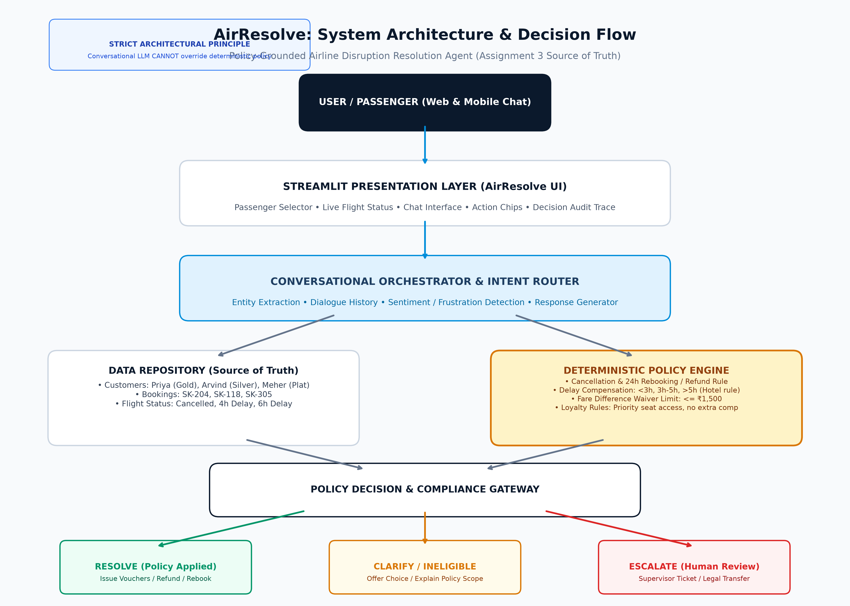
PHASE 4 • SYSTEM ARCHITECTURE
Complete AirResolve End-to-End Architecture
Key Principles
Deterministic Gate:
Policy engine is pure Python logic; cannot be bypassed.
No Policy Override:
LLM extracts intent but cannot relax or invent rules.
Strict Thresholds:
Hotel strictly > 5h; waiver ceiling strictly ₹1,500.
Structured Decisions:
Every output yields a structured audit record with rule ID.

Slide 6
PHASE 5 • DECISION ENGINEERING
Decision Flow & Policy Evaluation Pipeline
1. Passenger Identification
Matches PNR or Name to customer profile. Retrieves loyalty tier and past travel/complaint history.
2. Booking Verification
Checks flight segment status (Cancelled, Delayed 4h, Delayed 6h). Validates airline-caused disruption.
3. Intent & Entity Extraction
Identifies primary intent (Refund, Hotel, Upgrade, Rebook, Fare diff) and amounts (e.g. ₹2,000, full-night).
4. Policy Engine Evaluation
Executes deterministic Python rule functions against parameters. Identifies allowed vs prohibited actions.
5. Guardrail & Decision Gate
RESOLVE: Executes refund/vouchers.
CLARIFY: Prompts customer choice.
ESCALATE: Routes to supervisor.

Slide 7
PHASE 6 • SCENARIO VERIFICATION
Scenario 1: Priya Nair (Gold, SK4821X)
Disruption Context & Customer Request
• Flight: SK-204 (Delhi → Goa) Cancelled for operational reasons.
• Return: SK-205 (Goa → Delhi, 25 Sep) is Unaffected.
• Customer State: Furious.
• Requests: Full cash refund + complimentary upgrade to Business Class on return flight 'for the trouble'.
Immediate Escalation Trigger Test:
If Priya threatens legal action or files a formal complaint, the agent immediately halts automated processing and triggers specialist escalation.
Agent Behavior & Policy Rationale
1. Full Refund Approved (RESOLVED):
Processed in full within 7 business days to original payment method per Refund Processing Rule.
2. Free Business Upgrade REFUSED (INELIGIBLE):
Policy strictly does NOT provide complimentary cabin upgrades for flight disruptions or loyalty tiers. Gold tier grants priority rebooking, not free upgrades.
3. Empathetic Tone:
Validates frustration while upholding absolute compliance with policy boundaries.

Slide 8
PHASE 6 • SCENARIO VERIFICATION
Scenario 2: Arvind Kulkarni (Silver, TR1190B)
Disruption Context & Customer Request
• Flight: SK-118 (Mumbai → Bengaluru).
• Status: Delayed 4 hours (New departure: 11:10, Original: 07:10).
• Customer State: Frustrated about missing a connecting meeting.
• Request: Demands hotel accommodation 'since it's been such a long delay'.
Agent Behavior & Policy Rationale
1. Delay Benefits Issued (RESOLVED):
4-hour delay (> 3 hours, <= 5 hours) entitles customer to ₹500 meal voucher and lounge access. Both are applied automatically.
2. Hotel Accommodation DENIED (INELIGIBLE):
Delay Compensation Rule strictly states hotel accommodation applies ONLY to delays exceeding 5 hours. At 4 hours, Arvind is not eligible.
3. Zero False Promises:
Agent explains the policy boundary transparently without capitulating to pressure.

Slide 9
PHASE 6 • SCENARIO VERIFICATION
Scenario 3: Meher Kaur (Platinum, WL7742)
Disruption Context & Customer Requests
• Flight: SK-305 (Delhi → Hyderabad).
• Status: Delayed 6 hours (New departure: 20:00, Original: 14:00).
• Customer: Platinum Tier frequent flyer (10 flights past year).
• Request 1: Full night's hotel stay (rather than coverage for just delayed hours).
• Request 2: Voluntary rebooking to different, higher-fare flight with ₹2,000 fare difference.
Agent Behavior & Escalation Rationale
1. Delay Benefits & Partial Hotel (RESOLVED):
6-hour delay (> 5h) qualifies for ₹500 meal voucher, lounge access, and hotel accommodation covering ONLY delayed hours (until 20:00 departure). Full night stay is refused as it exceeds policy scope.
2. Mandatory Escalation on ₹2,000 Fare Diff (ESCALATE):
Fare Difference Rule: Agents CANNOT waive fare differences above ₹1,500 without supervisor approval.
Because ₹2,000 > ₹1,500, the agent creates an Escalation Ticket (ESC-WL7742-XXXX) for supervisor review.

Slide 10
PHASE 7 • DELIVERABLES & VERIFICATION
Implementation, Testing, Demo & GitHub Readiness
Tech Stack
• Python 3.11
• Streamlit (Modern Custom UI)
• Deterministic Policy Engine
• Pytest (100% Passing)
• python-pptx / Matplotlib
Test Suite
• 28 Automated Tests
• 100% scenario coverage
• Cancellation, delay brackets
• ₹1,500 waiver boundary
• Legal threat escalation
Deliverables
• Streamlit App (app.py)
• Exact 10-Slide PPT
• Architecture Diagram
• Demo Script (3-5 min)
• Technical Defense Guide
Demo & GitHub
• GitHub: github.com/USER/REPO
• Public Demo Video: Google Drive link placeholder
• One-Command Local Run:
streamlit run app.py

