Slide 1

University of Luxembourg
Report
2D Poisson Equation: Numerical Solutions via Finite Differences
Student
Vaibhav Mangroliya
Professors
BERIOT Hadrien
NUMERICAL ANALYSIS
January 30, 2025
1
Vaibhav Mangroliya

Slide 2
University of Luxembourg
0. Content
Abstract 3
Introduction 4
3. Finite Difference Discretization 5
3.1. Designing the Solver 6
3.2 Validation of the Poisson Solver 10
4. Solving the Liner System 21
4.1 Direct Method 21 4.2 Iterative Method 26
5. Reference 33
2

Slide 3
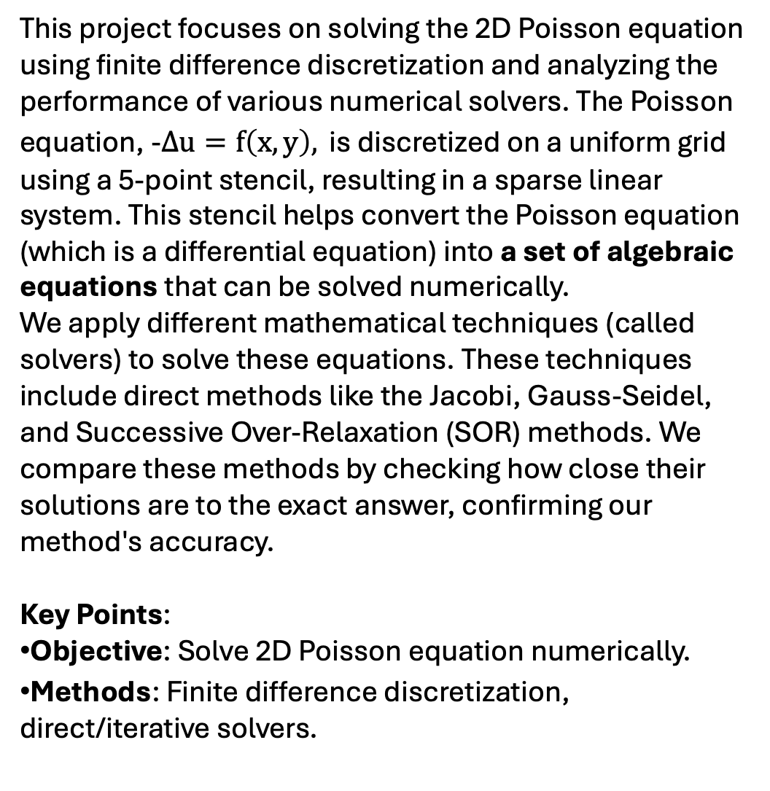
University of Luxembourg
1. Abstract
This project focuses on solving the 2D Poisson equation using finite difference discretization and analyzing the performance of various numerical solvers. The Poisson equation, -$Δu=f\left(x, y\right), \text{is} \text{discretized} \text{on} \text{a} \text{uniform} \text{grid} \text{using} \text{a}\text{ 5-}\text{point} \text{stencil}\text{, }\text{resulting} \text{in} \text{a} \text{sparse} \text{linear} \text{system}\text{. }\text{This} \text{stencil} \text{helps} \text{convert} \text{the} \text{Poisson} \text{equation}\text{ (}\text{which} \text{is} \text{a} \text{differential} \text{equation}\text{) }\text{into} \text{a} \text{set} \text{of} \text{algebraic} \text{equations} \text{that} \text{can} \text{be} \text{solved} \text{numerically}\text{.}$
We apply different mathematical techniques (called solvers) to solve these equations. These techniques include direct methods like the Jacobi, Gauss-Seidel, and Successive Over-Relaxation (SOR) methods. We compare these methods by checking how close their solutions are to the exact answer, confirming our method's accuracy.
Key Points:
Objective: Solve 2D Poisson equation numerically.
Methods: Finite difference discretization, direct/iterative solvers.
3

Slide 4
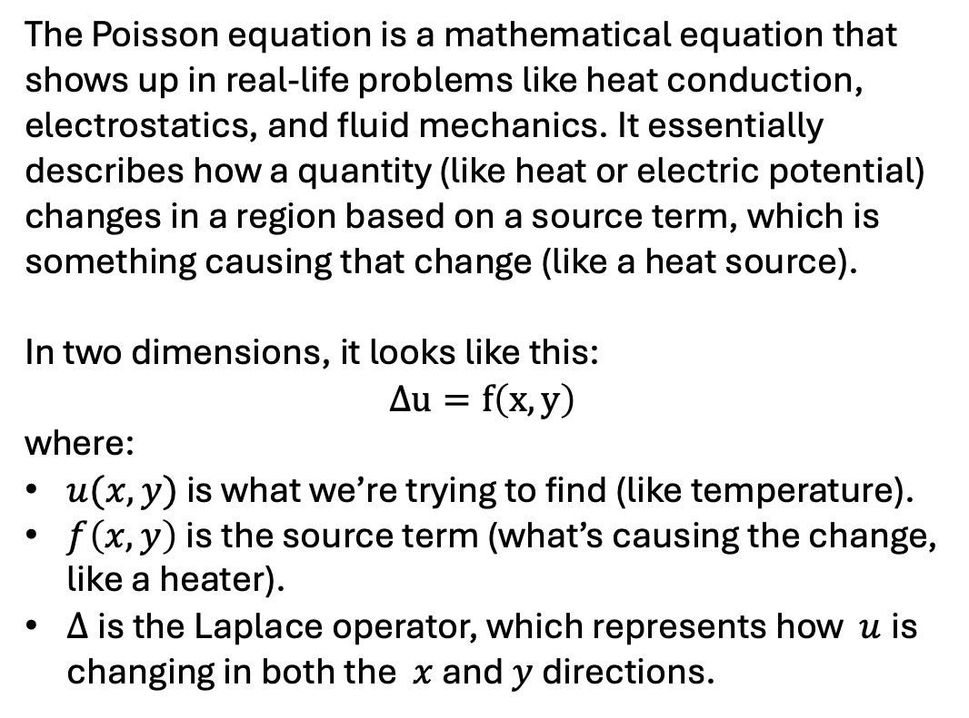
University of Luxembourg
2. Introduction: What is the Poisson Equation?
The Poisson equation is a mathematical equation that shows up in real-life problems like heat conduction, electrostatics, and fluid mechanics. It essentially describes how a quantity (like heat or electric potential) changes in a region based on a source term, which is something causing that change (like a heat source).
In two dimensions, it looks like this:
$$Δu=f\left(x, y\right)$$
where:
$u(x,y)$ is what we’re trying to find (like temperature).
$f\left(x, y\right)$is the source term (what’s causing the change, like a heater).
$Δ$ is the Laplace operator, which represents how $u$is changing in both the $x$and $y$ directions.
4

Slide 5
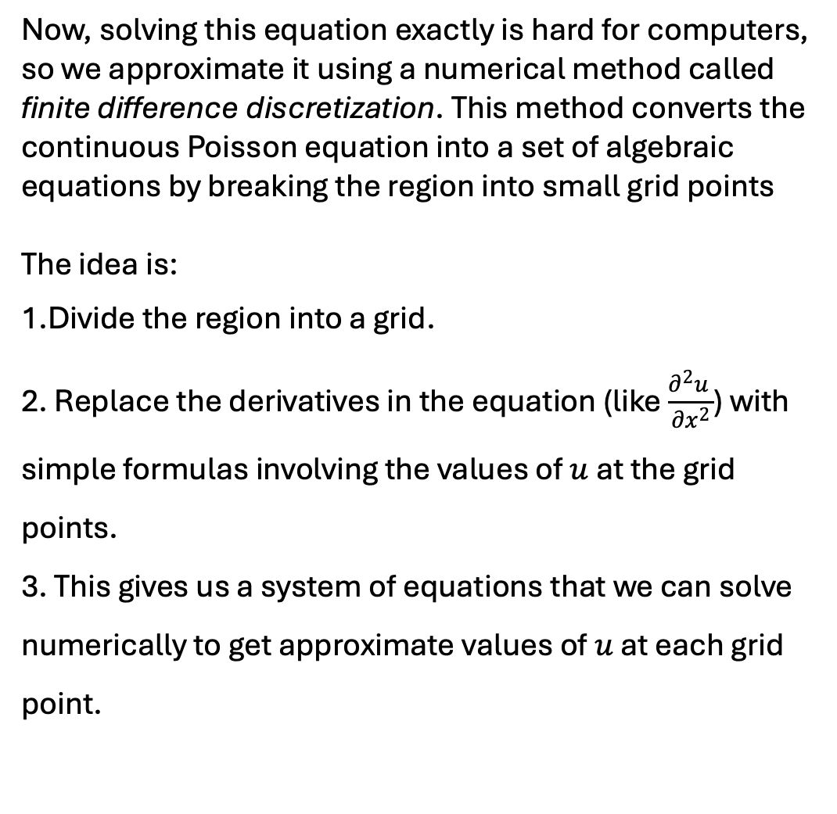
University of Luxembourg
3. Finite Difference Discretization
Now, solving this equation exactly is hard for computers, so we approximate it using a numerical method called finite difference discretization. This method converts the continuous Poisson equation into a set of algebraic equations by breaking the region into small grid points
The idea is:
Divide the region into a grid.
Replace the derivatives in the equation (like $\frac{∂^{2}u }{∂x^{2}}$) with simple formulas involving the values of $u$ at the grid points.
This gives us a system of equations that we can solve numerically to get approximate values of $u$ at each grid point.
5

Slide 6
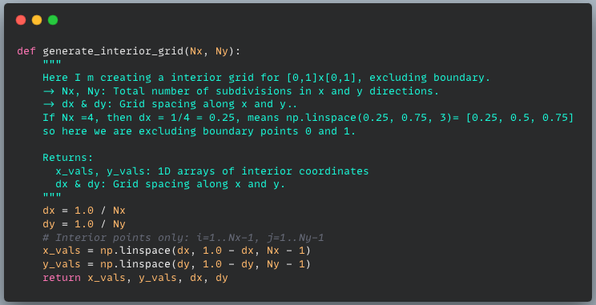
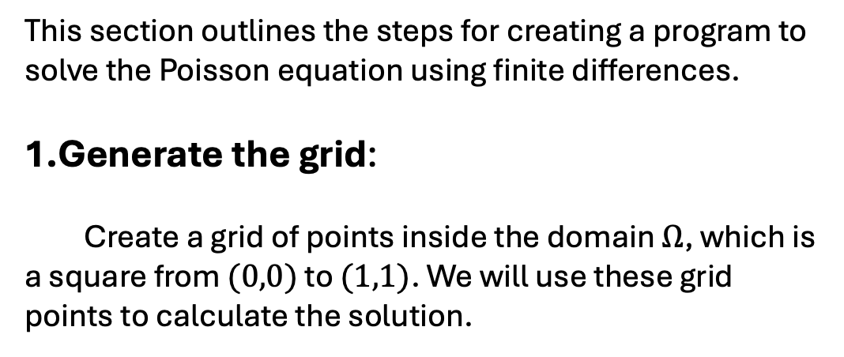
University of Luxembourg
3.1: Designing the Solver
This section outlines the steps for creating a program to solve the Poisson equation using finite differences.
Generate the grid:
Create a grid of points inside the domain $Ω$, which is a square from $(0,0)$ to $(1,1)$. We will use these grid points to calculate the solution.
6

Slide 7
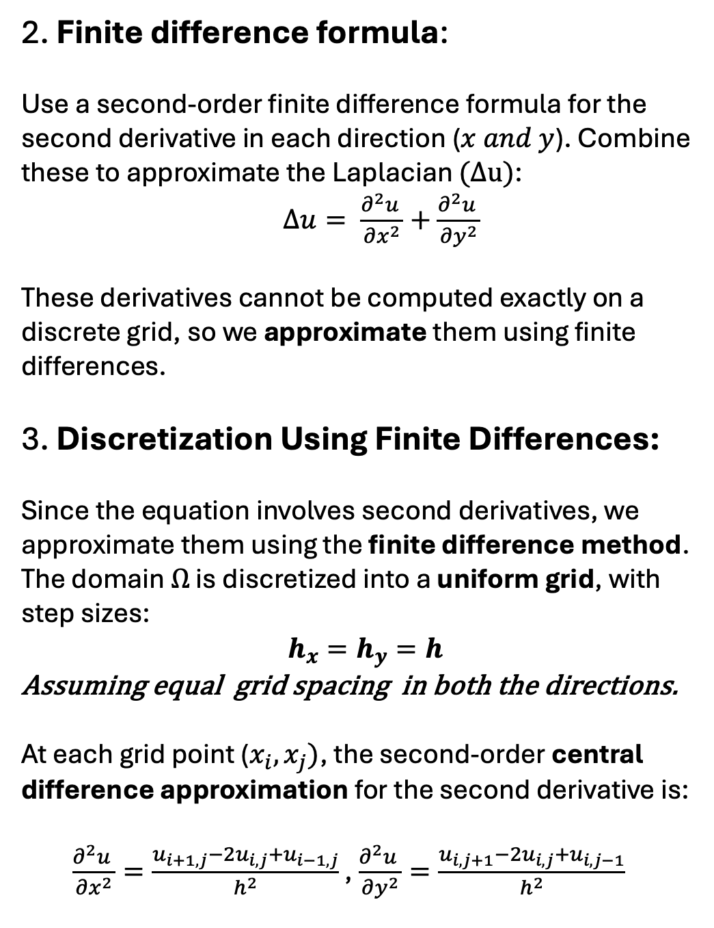
University of Luxembourg
3.1: Designing the Solver:
2. Finite difference formula:
Use a second-order finite difference formula for the second derivative in each direction ($x and y$). Combine these to approximate the Laplacian $(Δu)$:
$Δu= \frac{∂^{2}u }{∂x^{2}}+\frac{∂^{2}u }{∂y^{2}}$
These derivatives cannot be computed exactly on a discrete grid, so we approximate them using finite differences.
3. Discretization Using Finite Differences:
Since the equation involves second derivatives, we approximate them using the finite difference method. The domain $Ω$ is discretized into a uniform grid, with step sizes:
$$h_{x}=h_{y}=h$$
Assuming equal grid spacing in both the directions.
At each grid point ($x_{i}, x_{j})$, the second-order central difference approximation for the second derivative is:
$\frac{∂^{2}u }{∂x^{2}}=\frac{u_{i+1,j}−2u_{i,j}+u_{i−1, j}}{h^{2}}$ , $\frac{∂^{2}u }{∂y^{2}}=\frac{u_{i,j+1}−2u_{i,j}+u_{i, j−1}}{h^{2}}$
7

Slide 8
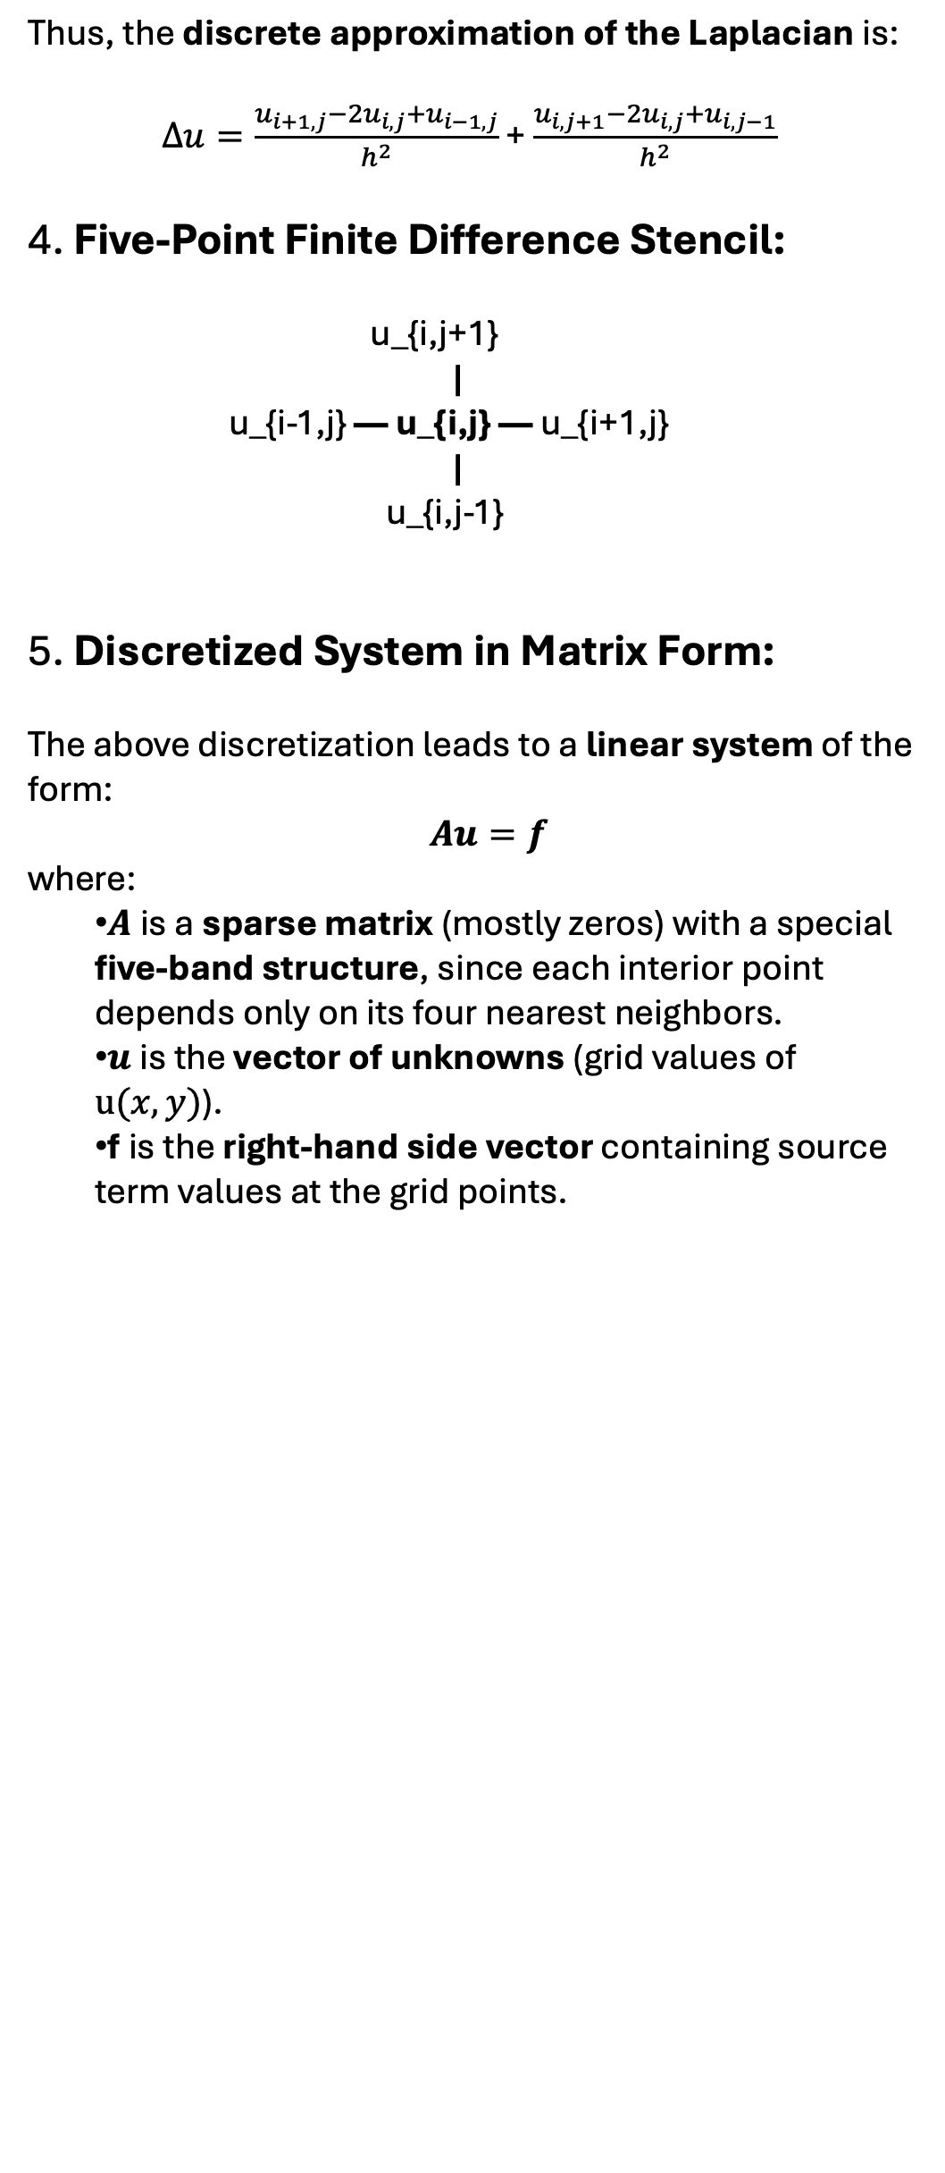
University of Luxembourg
3.1: Designing the Solver:
Thus, the discrete approximation of the Laplacian is:
$Δu=\frac{u_{i+1,j}−2u_{i,j}+u_{i−1, j}}{h^{2}}$ + $\frac{u_{i,j+1}−2u_{i,j}+u_{i, j−1}}{h^{2}}$
4. Five-Point Finite Difference Stencil:
u_{i,j+1}
|
u_{i-1,j} — u_{i,j} — u_{i+1,j}
|
u_{i,j-1}
5. Discretized System in Matrix Form:
The above discretization leads to a linear system of the form:
$Au=f$
where:
$A$ is a sparse matrix (mostly zeros) with a special five-band structure, since each interior point depends only on its four nearest neighbors.
$u$ is the vector of unknowns (grid values of $u(x, y)$).
f is the right-hand side vector containing source term values at the grid points.
8

Slide 9
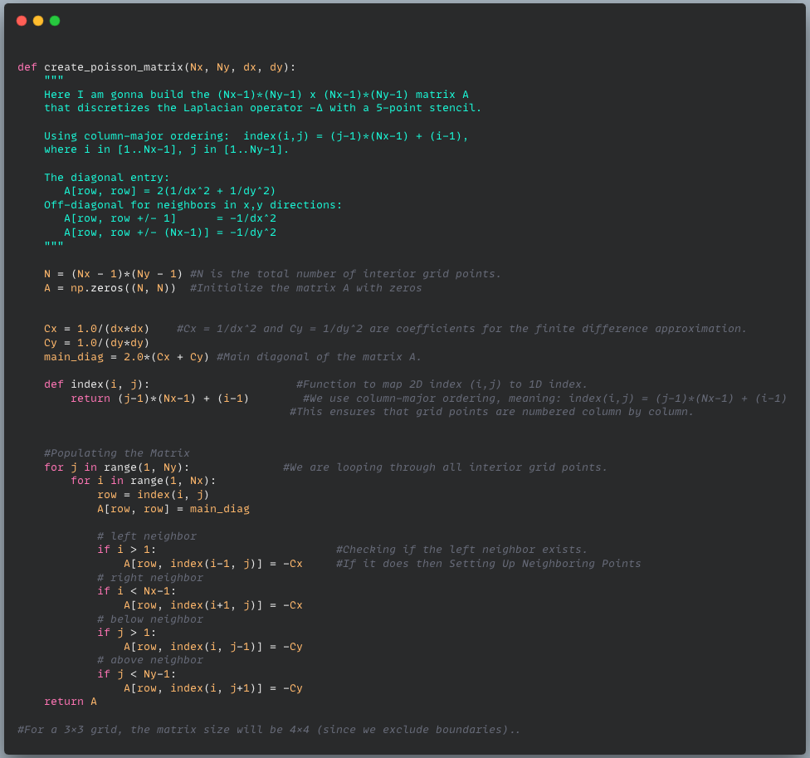
University of Luxembourg
Python Simulation: (LHS)
9

Slide 10
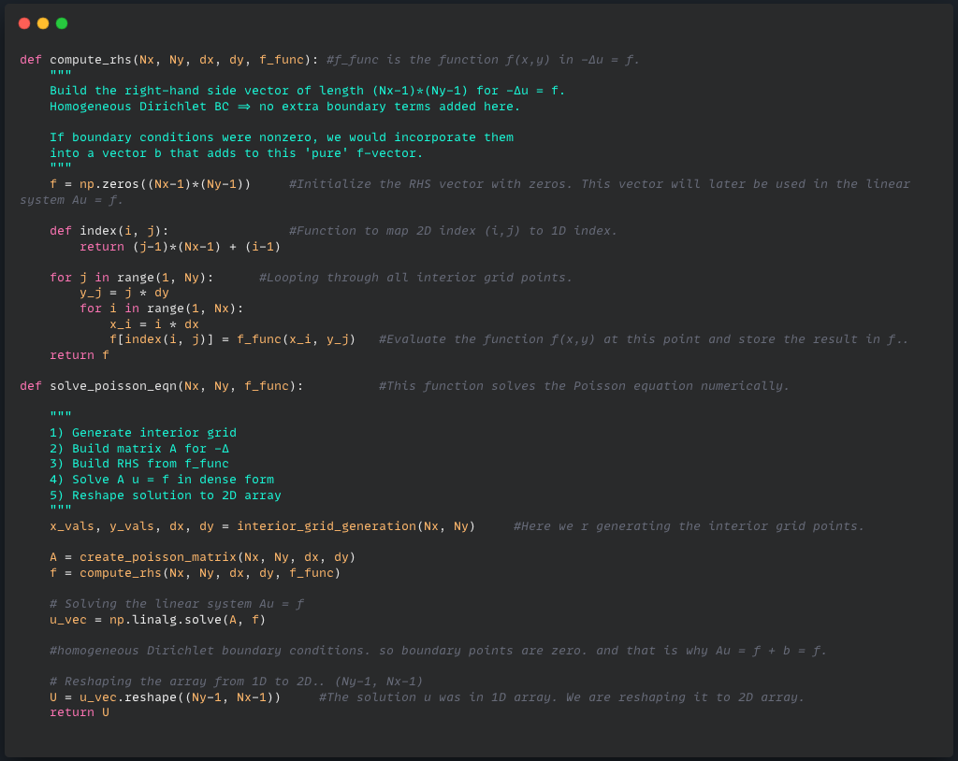
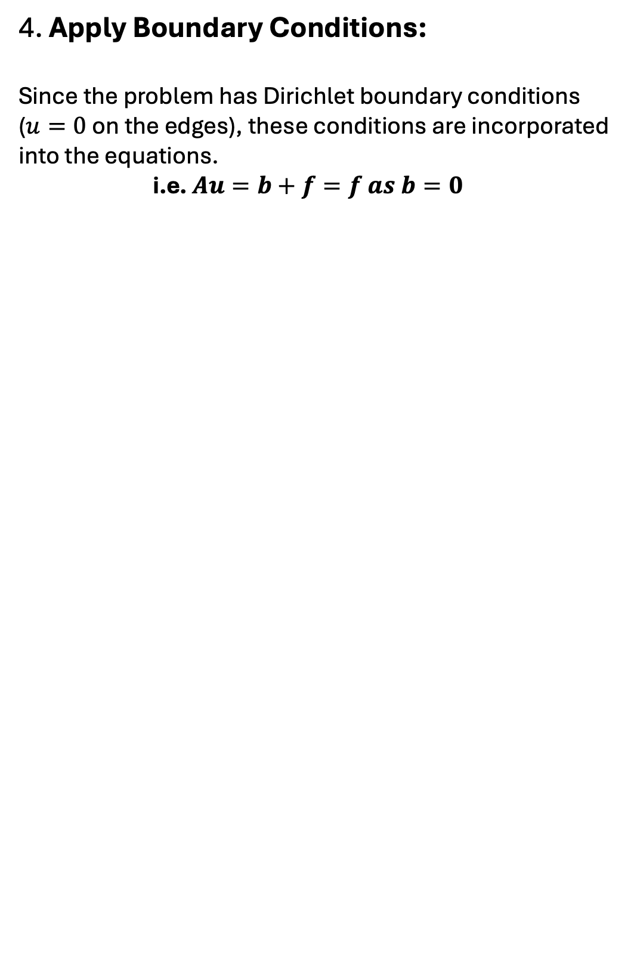
University of Luxembourg
3.2: Validation of the Poisson Solver
4. Apply Boundary Conditions:
Since the problem has Dirichlet boundary conditions ($u=0$ on the edges), these conditions are incorporated into the equations.
i.e. $Au=b+f=f as b=0$
10

Slide 11
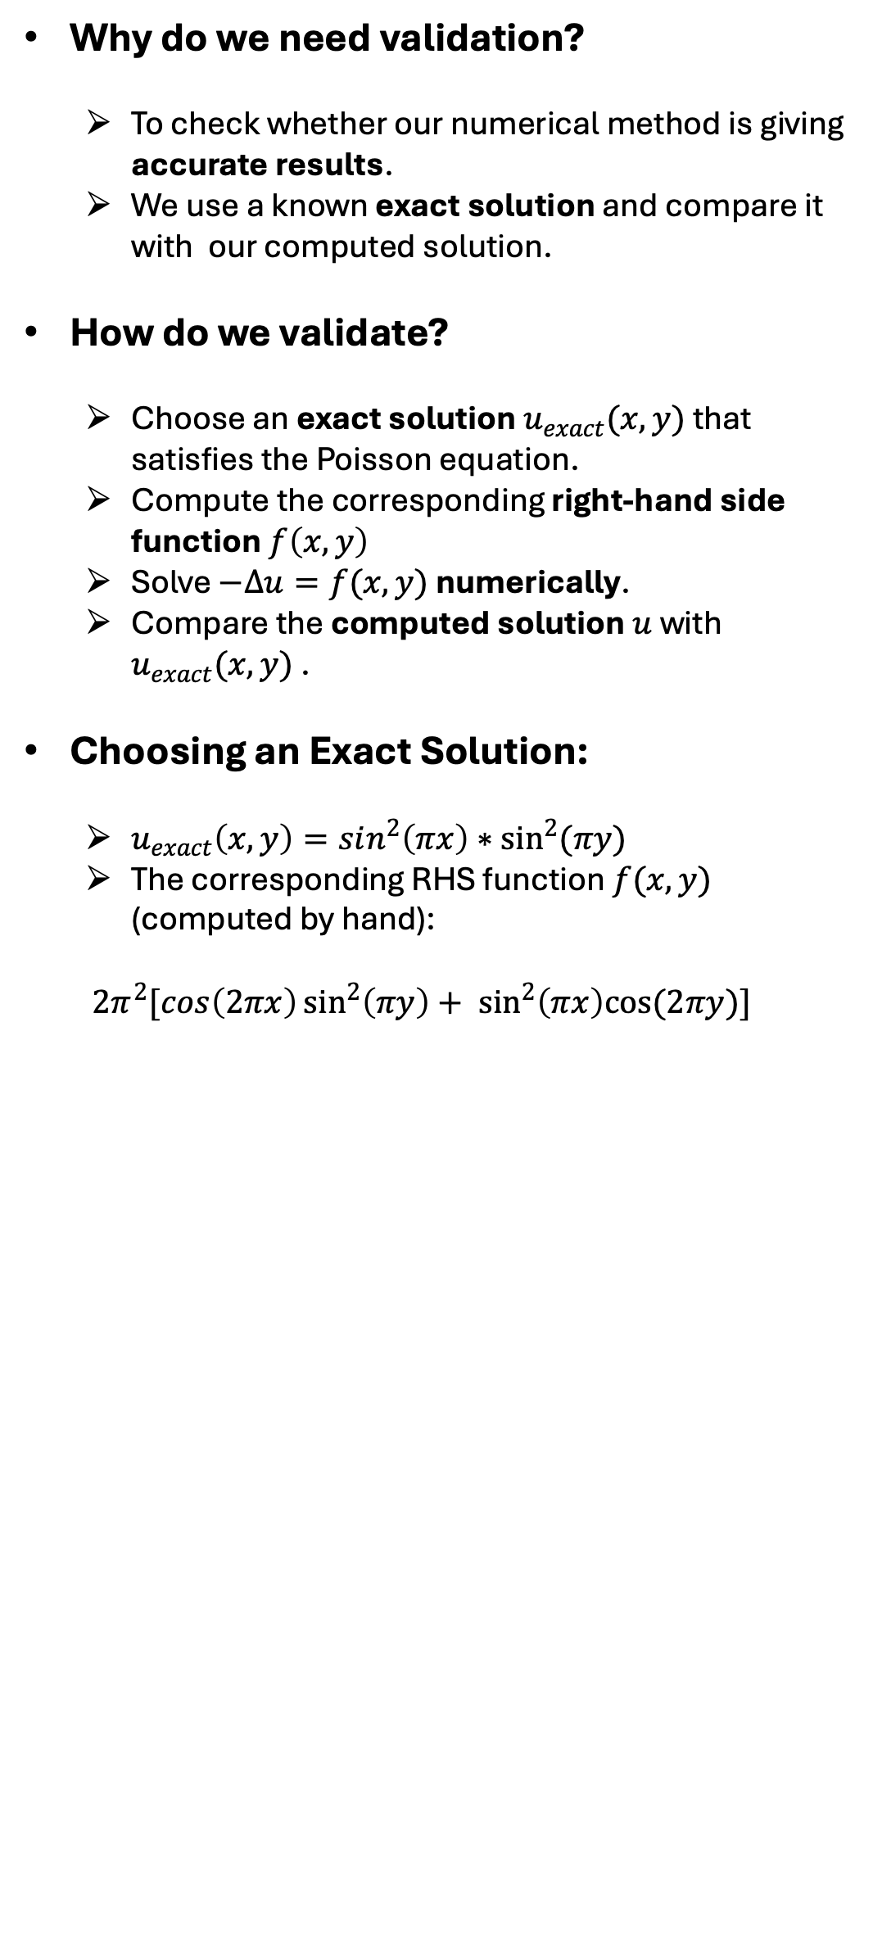
University of Luxembourg
3.2: Validation of the Poisson Solver
Why do we need validation?
To check whether our numerical method is giving accurate results.
We use a known exact solution and compare it with our computed solution.
How do we validate?
Choose an exact solution $u_{exact}(x,y)$ that satisfies the Poisson equation.
Compute the corresponding right-hand side function $f\left(x, y\right)$
Solve $−Δu=f(x,y)$ numerically.
Compare the computed solution $u$ with $u_{exact}(x,y)$ .
Choosing an Exact Solution:
$u_{exact}\left(x,y\right)=sin^{2}\left(πx\right)∗\sin^{2}{(πy)}$
The corresponding RHS function $f(x,y)$ (computed by hand):
$2π^{2}[cos\left(2πx\right)\sin^{2}\left(πy\right)+ \sin^{2}\left(πx\right)cos(2πy)]$
11

Slide 12
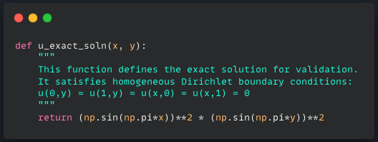
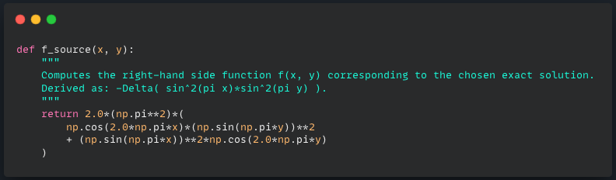
University of Luxembourg
Python Simulation:
12

Slide 13
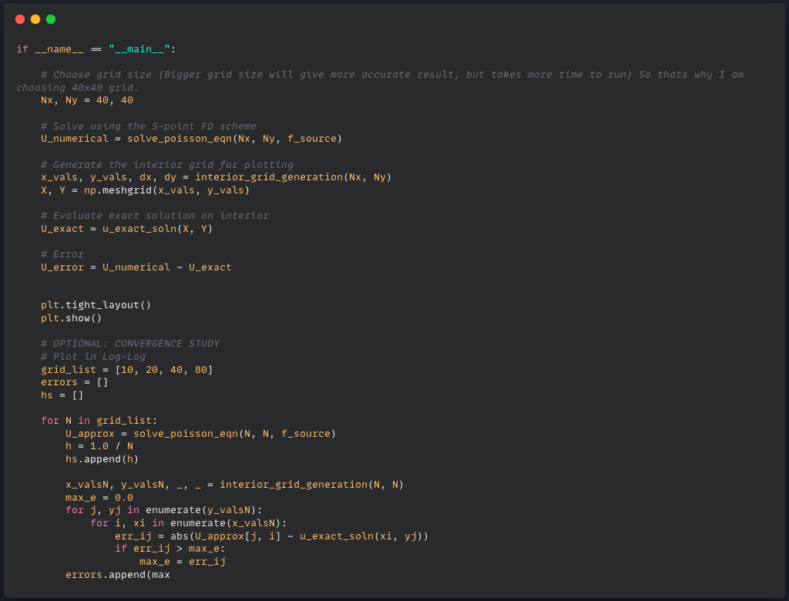
University of Luxembourg
Python Simulation:
13

Slide 14
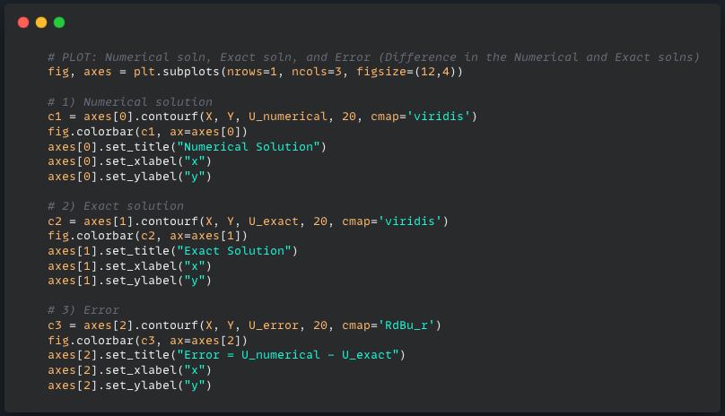
University of Luxembourg
Python Simulation:
14

Slide 15
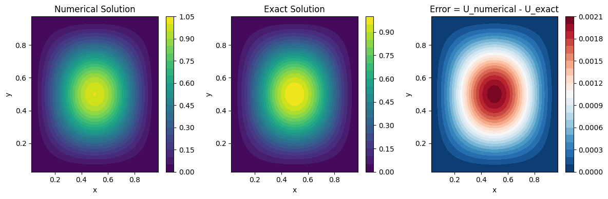
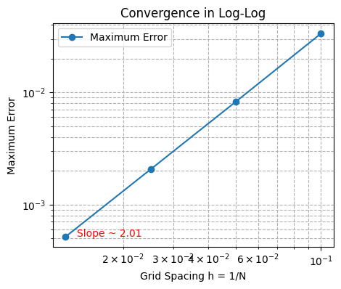
University of Luxembourg
Output:
1

Slide 16

University of Luxembourg
3.2: Validation of the Poisson Solver
Numerical Solution (Left Plot):-
This plot represents the numerical approximation of the function $u\left(x, y\right)$which satisfies the Poisson equation.
The values range from 0 to 1.05, similar to the exact solution.
The highest values (yellow) are at the centre, and the lowest values (purple) are at the edges.
This is expected due to the homogeneous Dirichlet boundary conditions, meaning $u=0$ on the boundary.
Conclusion:
The numerical solution correctly captures the shape and structure of the expected function.
16

Slide 17

University of Luxembourg
3.2: Validation of the Poisson Solver
Exact Solution (Middle Plot):-
This plot shows the analytical (exact) solution of the Poisson equation: the function $u_{exact}\left(x,y\right)=sin^{2}\left(πx\right)∗\sin^{2}{(πy)}$
The values range from 0 to 0.90.
The function has a similar structure to the numerical solution: peaking at the centre and vanishing at the boundaries.
Conclusion:
The exact solution is behaving as expected, matching the theoretical model.
17

Slide 18
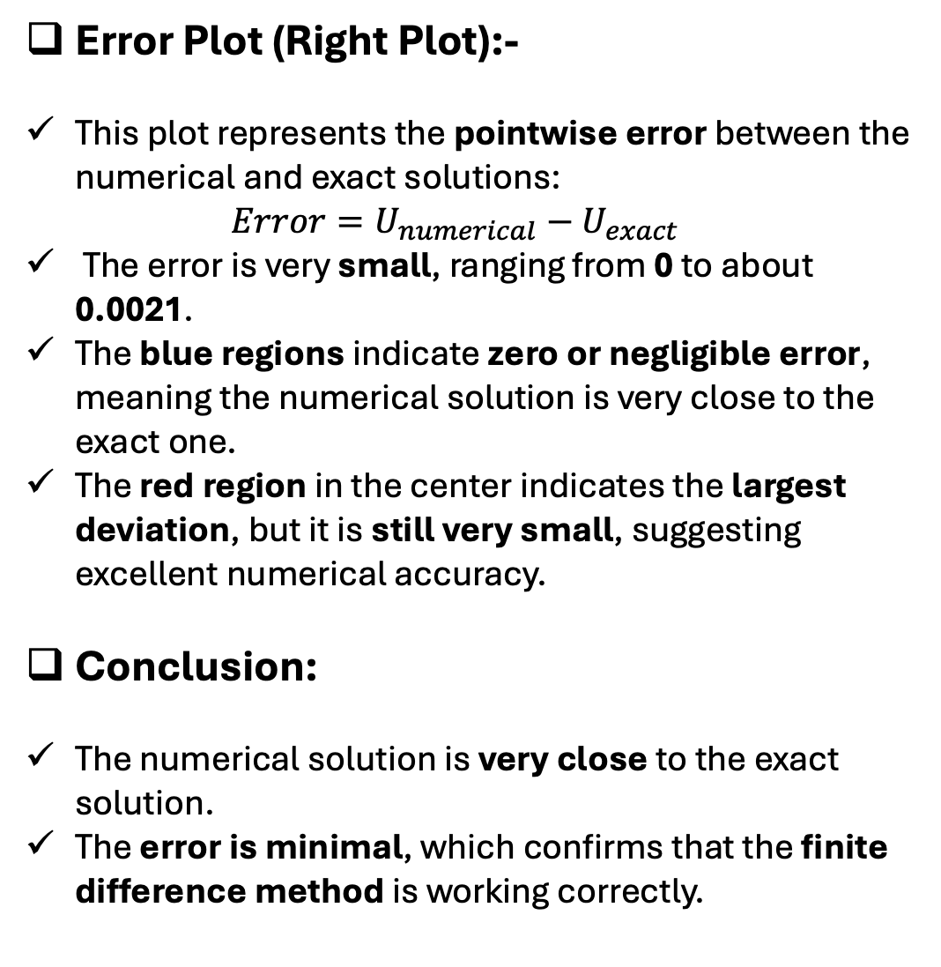
University of Luxembourg
3.2: Validation of the Poisson Solver
Error Plot (Right Plot):-
This plot represents the pointwise error between the numerical and exact solutions: $Error=U_{numerical}−U_{exact}$
The error is very small, ranging from 0 to about 0.0021.
The blue regions indicate zero or negligible error, meaning the numerical solution is very close to the exact one.
The red region in the center indicates the largest deviation, but it is still very small, suggesting excellent numerical accuracy.
Conclusion:
The numerical solution is very close to the exact solution.
The error is minimal, which confirms that the finite difference method is working correctly.
18

Slide 19

University of Luxembourg
3.2: Validation of the Poisson Solver
Convergence Plot (Log-Log Scale):-
X-axis (Grid Spacing $h=1/N$):
This represents the step size of the numerical grid.
Smaller h means a finer mesh (more grid points, higher resolution).
Larger h means a coarser mesh (fewer grid points, lower resolution).
Y-axis (Maximum Error):
This represents the maximum absolute error between the numerical and exact solutions.
The error should decrease as the grid becomes finer.
Blue Line and Markers:
These indicate the measured errors at different grid spacings.
The trend shows a decrease in error as the grid becomes finer.
19

Slide 20

University of Luxembourg
3.2: Validation of the Poisson Solver
Convergence Plot (Log-Log Scale):-
What does the slope ~ 2.01 mean?
The slope of the line in a log-log plot indicates the order of accuracy of the numerical method.
A slope of approximately 2 suggests that the method has second-order accuracy:
$$Error ∝h^{2}$$
The closer the slope is to 2, the more accurate and consistent the method is.
20

Slide 21
University of Luxembourg
4: Solving the Linear System:
In this study, we analyze different methods to solve the Poisson equation numerically.
We compare Direct Methods (Dense & Sparse) and Iterative Methods (Jacobi, Gauss-Seidel, SOR).
Direct methods are faster but use more memory, while iterative methods take more steps but are better for large problems. The goal is to understand when to use each method.
4.1: Direct Methods: (Dense vs Sparse)
- Dense Representation: Stores all elements of matrix A.
- Sparse Representation: Stores only non-zero elements, reducing memory usage.
-Used scipy.sparse library for efficient computation.
-Computational cost: Sparse method significantly reduces memory and time complexity.
21

Slide 22
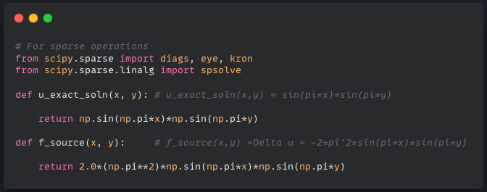
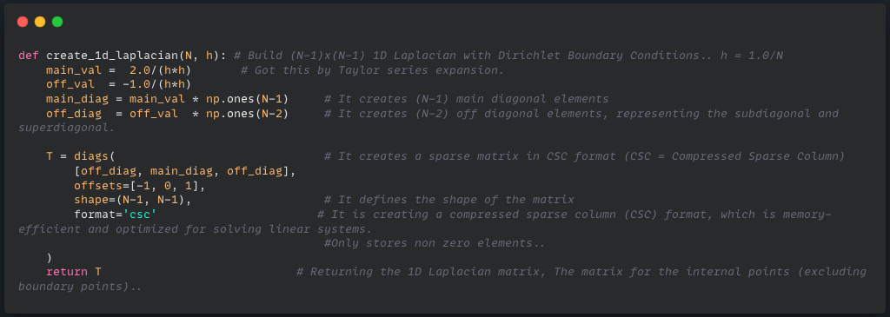
University of Luxembourg
Python Simulation:
U EXACT and F SOURCE
Create 1D Laplacian (Which is to be used in Kronecker):
22

Slide 23
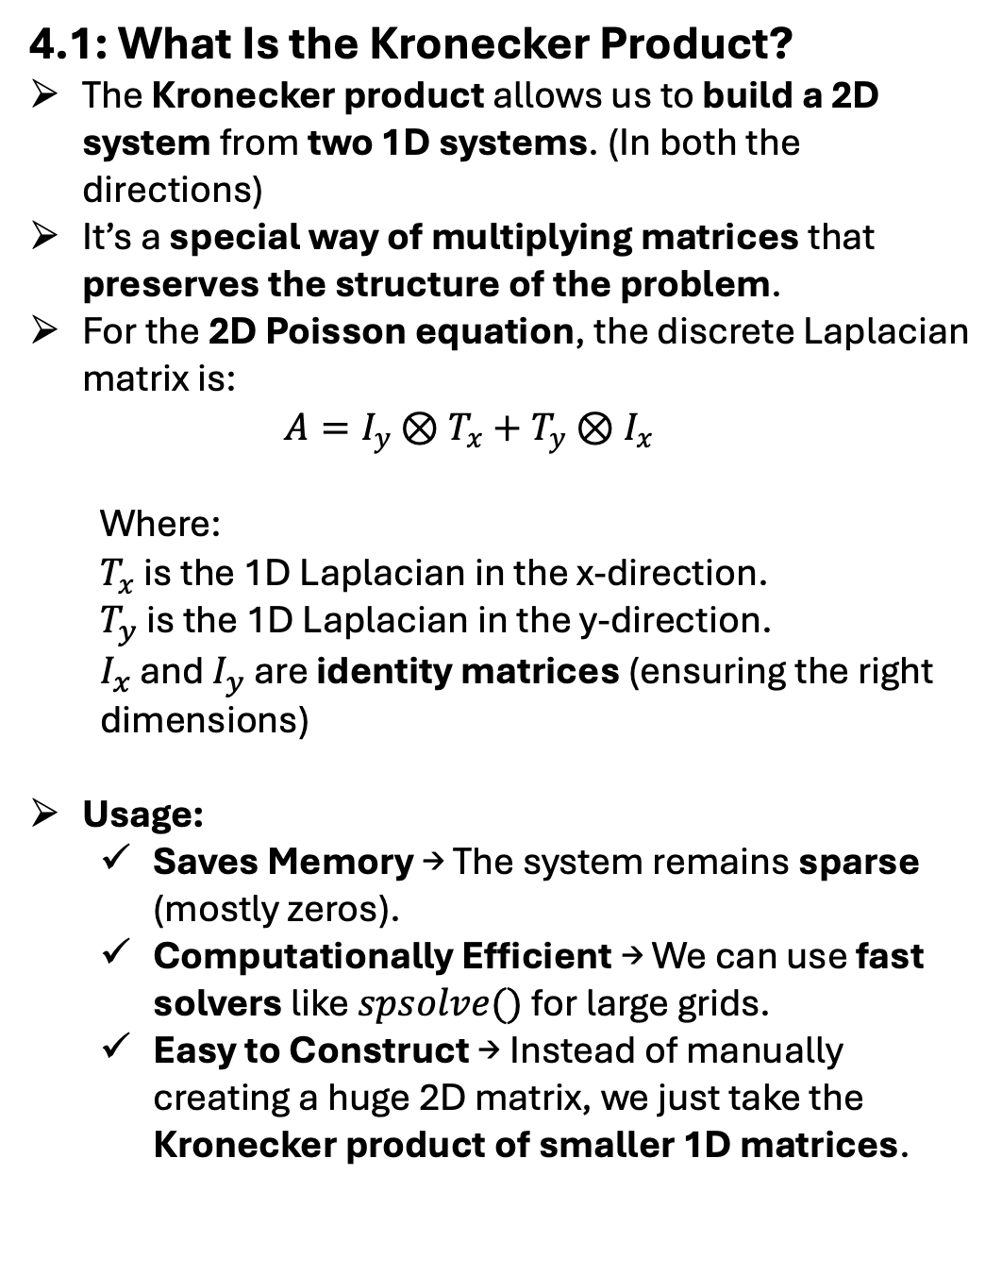
University of Luxembourg
4: Solving the linear system
4.1: What Is the Kronecker Product?
The Kronecker product allows us to build a 2D system from two 1D systems. (In both the directions)
It’s a special way of multiplying matrices that preserves the structure of the problem.
For the 2D Poisson equation, the discrete Laplacian matrix is:
$$A=I_{y}⊗T_{x}+T_{y}⊗I_{x}$$
Where:
$T_{x}$ is the 1D Laplacian in the x-direction.
$T_{y}$ is the 1D Laplacian in the y-direction.
$I_{x}$ and $I_{y}$ are identity matrices (ensuring the right dimensions)
Usage:
Saves Memory → The system remains sparse (mostly zeros).
Computationally Efficient → We can use fast solvers like $spsolve()$ for large grids.
Easy to Construct → Instead of manually creating a huge 2D matrix, we just take the Kronecker product of smaller 1D matrices.
23

Slide 24
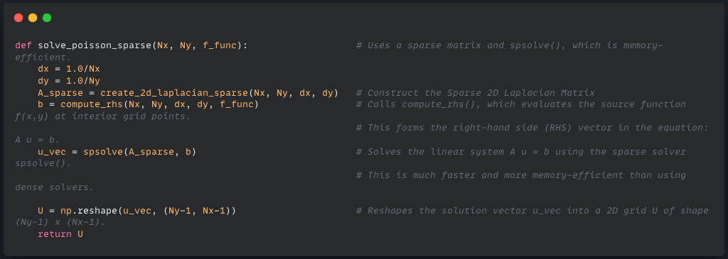
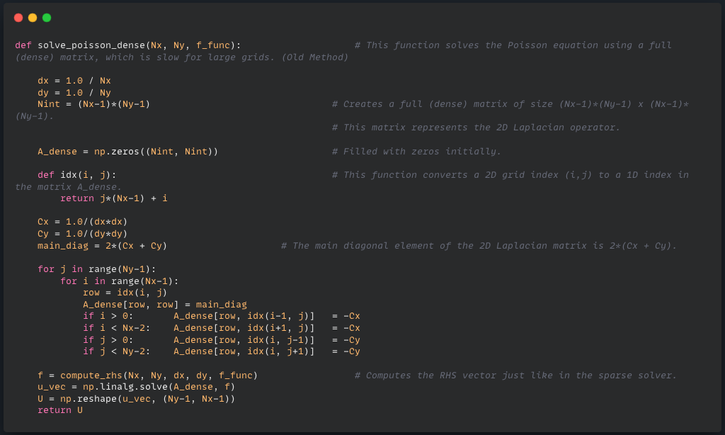
University of Luxembourg
Python Simulation:
Solve Poisson Sparse:- (Au=f) -> Efficient and faster, best for large grids.
Solve Poisson Dense -> Slower and memory-intensive, best for small grids.
25

Slide 25
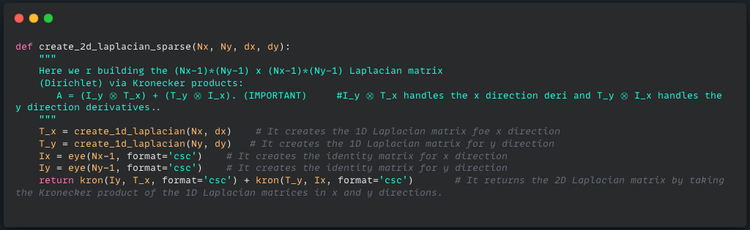
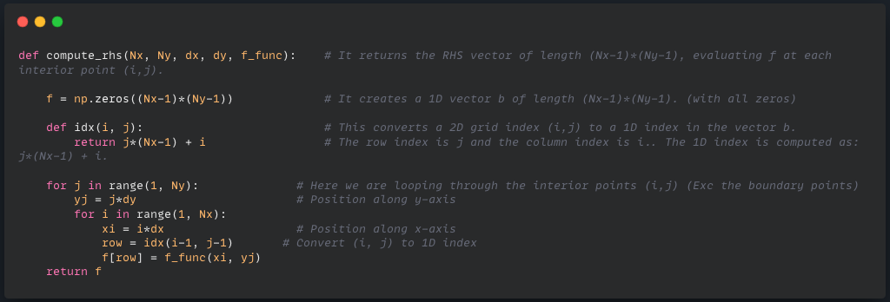
University of Luxembourg
Python Simulation:
Create 2D Laplacian Sparse:-
Compute RHS
24

Slide 26
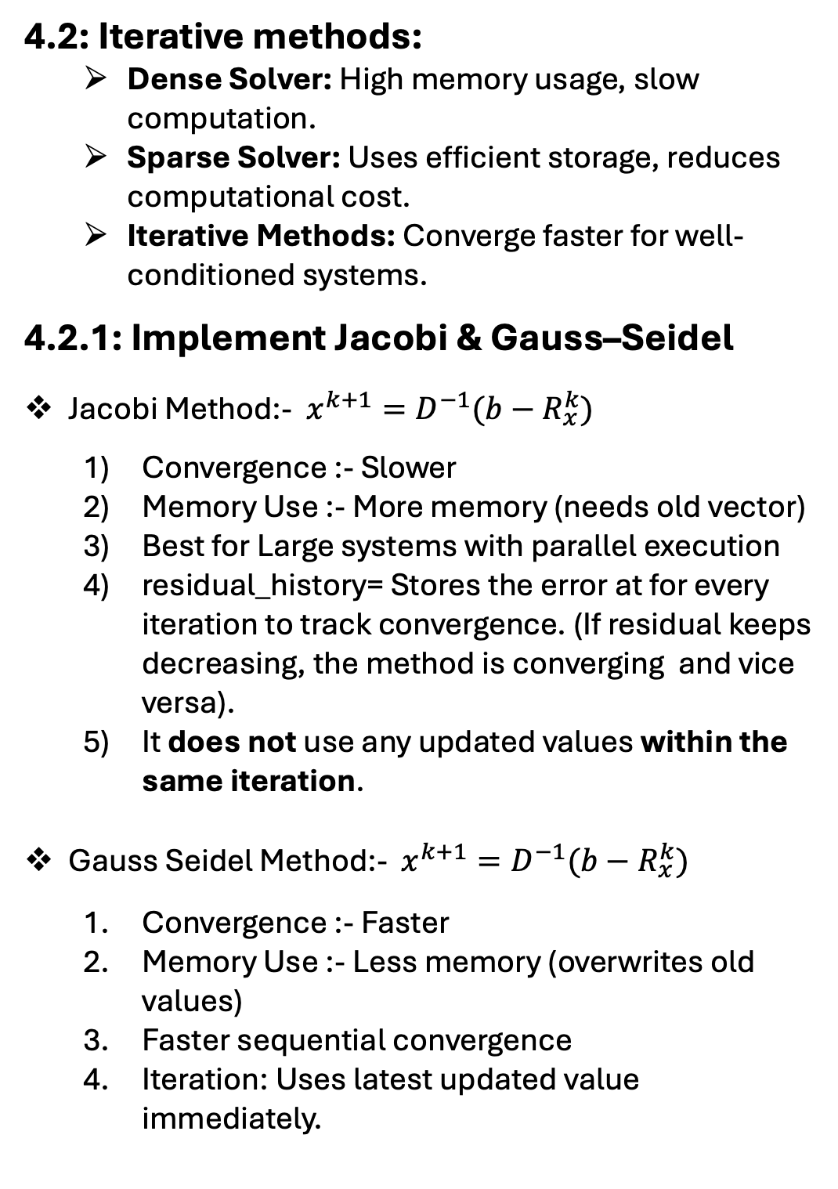
University of Luxembourg
4: Solving the linear system
4.2: Iterative methods:
Dense Solver: High memory usage, slow computation.
Sparse Solver: Uses efficient storage, reduces computational cost.
Iterative Methods: Converge faster for well-conditioned systems.
4.2.1: Implement Jacobi & Gauss–Seidel
Jacobi Method:- $x^{k+1}=D^{−1}(b−R_{x}^{k})$
Convergence :- Slower
Memory Use :- More memory (needs old vector)
Best for Large systems with parallel execution
residual_history= Stores the error at for every iteration to track convergence. (If residual keeps decreasing, the method is converging and vice versa).
It does not use any updated values within the same iteration.
Gauss Seidel Method:- $x^{k+1}=D^{−1}(b−R_{x}^{k})$
Convergence :- Faster
Memory Use :- Less memory (overwrites old values)
Faster sequential convergence
Iteration: Uses latest updated value immediately.
26

Slide 27
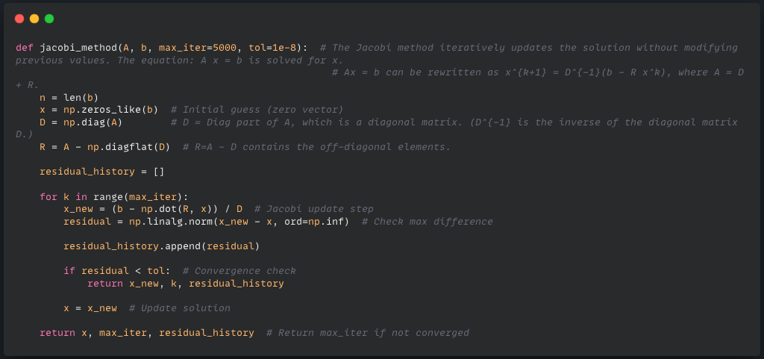
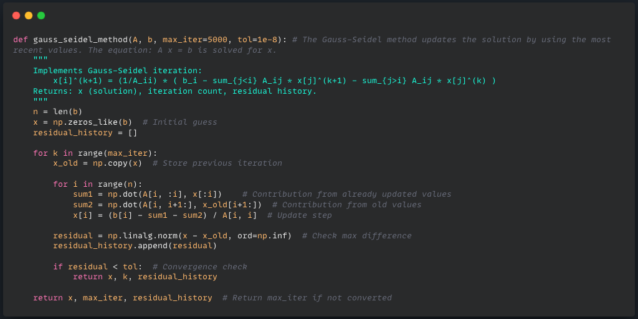
University of Luxembourg
Python Simulation:
Jacobi Method: (R = A-D = Remaining Part-> Off Diagonal Elem)
Gauss Seidel Method
27

Slide 28
University of Luxembourg
4.2.2: Key Differences Between Jacobi, Gauss-Seidel, and SOR
Method | Update Type | Speed
Jacobi | Uses only old values from the previous iteration | Slow
Gauss-Seidel | Uses latest updated values immediately | Faster
SOR | Uses latest updated values + acceleration factor ω | Fastest
Why is it Called Successive Over-Relaxation (SOR)?
Successive → It updates each variable one by one, just like the Gauss-Seidel method
Over-Relaxation → It modifies the update by introducing a relaxation factor ω, which pushes the solution further in each step to accelerate convergence.
28

Slide 29
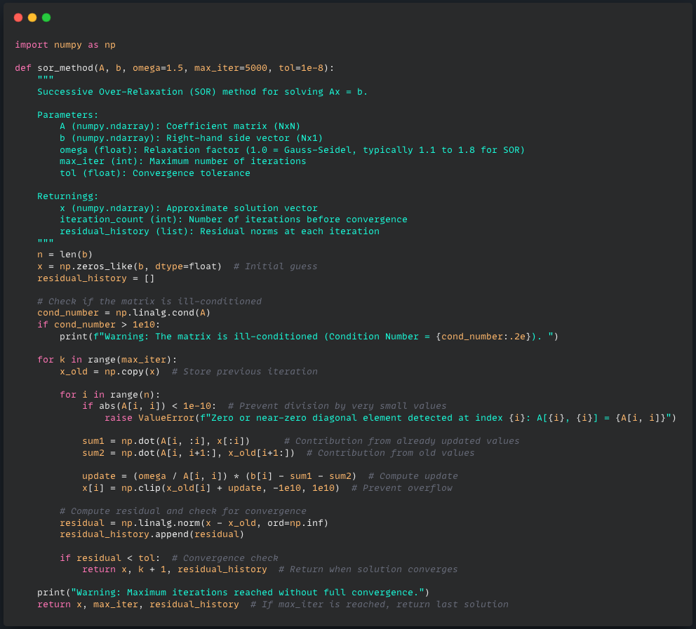
University of Luxembourg
Python Simulation:
Successive Over Relaxation (SOR):
29

Slide 30
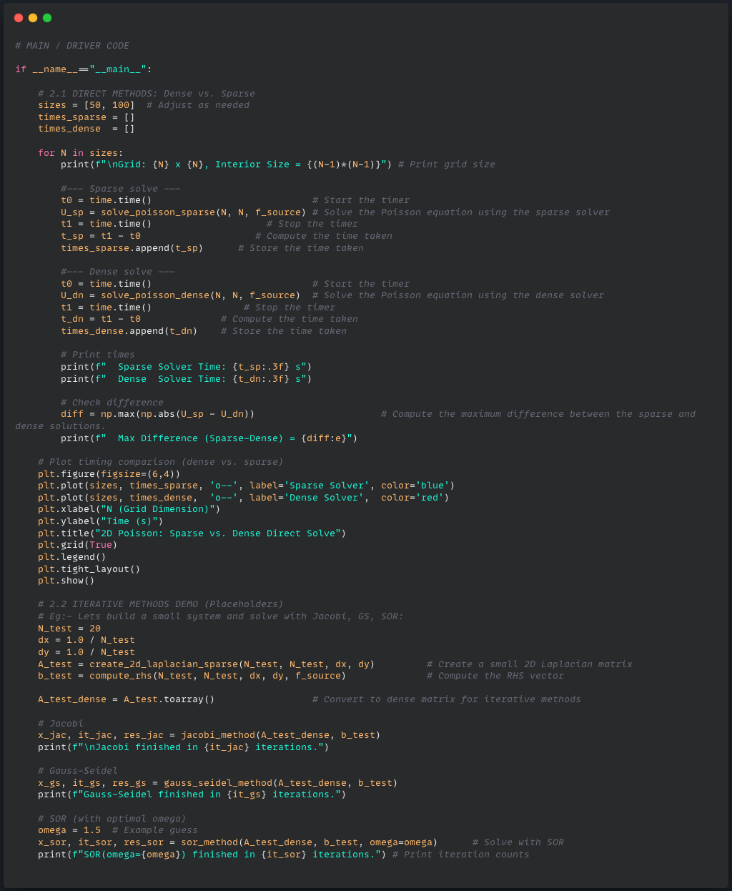
University of Luxembourg
Python Simulation:
30

Slide 31
University of Luxembourg
Output:
31

Slide 32
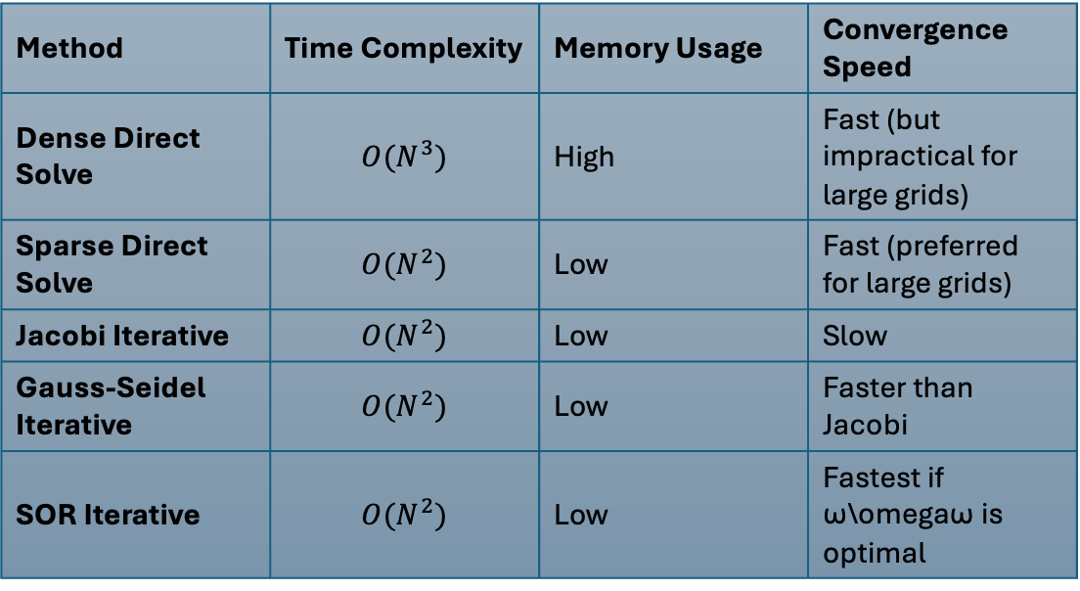
University of Luxembourg
Output:
-> Final Summary:
Method | Time Complexity | Memory Usage | Convergence Speed
Dense Direct Solve | $$O(N^{3})$$ | High | Fast (but impractical for large grids)
Sparse Direct Solve | $$O(N^{2})$$ | Low | Fast (preferred for large grids)
Jacobi Iterative | $$O(N^{2})$$ | Low | Slow
Gauss-Seidel Iterative | $$O(N^{2})$$ | Low | Faster than Jacobi
SOR Iterative | $$O(N^{2})$$ | Low | Fastest if ω\omegaω is optimal
32

Slide 33
University of Luxembourg
5. Reference:-
1) Finite Difference Methods for Partial Differential Equations
LeVeque, R. J. (2007). Finite Difference Methods for Ordinary and Partial Differential Equations: Steady-State and Time-Dependent Problems. SIAM.
2) Sparse Matrices and Efficient Solvers
Saad, Y. (2003). Iterative Methods for Sparse Linear Systems (2nd ed.). SIAM.
3) The Successive Over-Relaxation (SOR) Method
Young, D. M. (1971). Iterative Solution of Large Linear Systems. Academic Press.
4) Kronecker Product and Eigenvalues of Discrete Laplacian
Golub, G. H., & Van Loan, C. F. (2013). Matrix Computations (4th ed.). Johns Hopkins University Press.
5) Scientific Computing with Python (SciPy and NumPy)
Virtanen, P. et al. (2020). SciPy 1.0: Fundamental Algorithms for Scientific Computing in Python, Nature Methods, 17, 261–272.
6) Numerical Methods for Partial Differential Equations
Strikwerda, J. C. (2004). Finite Difference Schemes and Partial Differential Equations (2nd ed.). SIAM.
7) ChatGPT
OpenAI. (2025). ChatGPT (January 30, 2025) [Large language model]. https://openai.com
33

Slide 34
University of Luxembourg
Thank You!!
34

