Slide 1

University of Luxembourg
Report
Financial Market Analysis: Stochastic Models & Agent-Based Modelling
Student
Vaibhav Mangroliya
Professors Bordas Stéphane & Christian Vincenot
MMATH
February 6, 2025
1

Slide 2
University of Luxembourg
0. Content
Abstract 3
Introduction 4
a. Background and Motivation. . . . . . . . . . . . . . . . . . . . . . . . . . . .
b. Objective of the Project . . . . . . . . . . . . . . . . . . . . . . . . . . . . .
c. Methodology. . . . . . . . . . . . . . . . . . . . . . . . . . . . . . . . . .
3 Stochastic Models 6
a. Introduction . . . . . . . . . . . . . . . . . . . . . . . . . . . . . . . . . .
b. Why Are They Important . . . . . . . . . . . . . . . . . . . . . . . . . . . . . 3.1 Geometric Brownian Motion. . . . . . . . . . . . . . . . . . . . . . . . . . . . . .
a. Introduction. . . . . . . . . . . . . . . . . . . . . . . . . . . . . . . . .
b. Key Equation. . . . . . . . . . . . . . . . . . . . . . . . . . . . . . . . .
c. Highlights. . . . . . . . . . . . . . . . . . . . . . . . . . . . . . . . . .
-> Python Simulations (GBM):
-> Python Simulations Output (GBM):
3.2 Heston Model (Stochastic Volatility)
a. Introduction. . . . . . . . . . . . . . . . . . . . . . . . . . . . . . . . .
b. Key Equation. . . . . . . . . . . . . . . . . . . . . . . . . . . . . . .
-> Python Simulations (Heston):
-> Python Simulations Output (Heston):
4 Introduction to Agent Based Modelling (ABM) 13
a. What is ABM? . . . . . . . . . . . . . . . . . . . . . . . . . . . . . . . . .
b. Purpose . . . . . . . . . . . . . . . . . . . . . . . . . . . . . . . . . . . .
c. Agent Type. . . . . . . . . . . . . . . . . . . . . . . . . . . . . . . . . . .
d. Agent Characteristics. . . . . . . . . . . . . . . . . . . . . . . . . . . . . . .
e. Application of ABM in Finance, Why is ABM Useful?. . . . . . . . . . . . . . . .
-> Python Simulations (ABM):
-> Python Simulations Output (ABM):
5 Bridging Stochastic and Agent-Based Models 17
a. The Randomness of GBM with agent-driven demand/supply shocks . . . . . . .. .
b. Markov Chains for Agent Transitions . . . . . . . . . . . . . . . . . . . . . . . .
c. Why this Hybrid model is useful. . . . . . . . . . . . . . . . . . . . . . . .. . .
d. How Markov Chains Work in this Model. . . . . . . . . . . . . . . . . . . . . ..
-> Python Simulations (Hybrid):
-> Python Simulations Output (Hybrid):
6 Key Takeaways from the Hybrid Model 21
7 Comparison of Model 22
8 Conclusion- Bridging Theory & Reality 23

Slide 3
University of Luxembourg
1. Abstract:
Financial markets exhibit both stochastic randomness and structured trader behavior, making their price movements complex to model. Traditional models like Geometric Brownian Motion (GBM) assume random price fluctuations based on a log-normal process, while Agent-Based Modeling (ABM) captures individual trader behaviors influencing market trends. This project introduces a hybrid model that integrates GBM with ABM to simulate stock price dynamics more realistically.
The GBM component models market uncertainty and external shocks, while the ABM component introduces decision-making traders, including fundamentalists, chartists, contrarians, noise traders, and institutional investors. These agents interact, generating buy and sell pressures that affect stock prices over time.
Additionally, Markov Chains are incorporated to allow agents to transition between different trading strategies, making the simulation adaptive to market conditions. The results demonstrate how market prices fluctuate due to both random events and structured trader actions, leading to emergent behaviors like bubbles, crashes, and trend formations. The study concludes that hybrid models offer a more accurate and realistic approach to financial market simulations compared to purely stochastic or agent-driven models.
3

Slide 4
University of Luxembourg
2. Introduction
Background & Motivation:
Financial markets are influenced by two major factors:
Random external factors, such as macroeconomic news, interest rate changes, or unexpected geopolitical events.
Trader-driven actions, where market participants follow strategies like momentum trading, fundamental investing, and contrarian strategies.
Traditional models like Geometric Brownian Motion (GBM) assume stock prices follow a random walk with drift and volatility, making it useful for pricing options and risk analysis. However, real-world markets do not move purely randomly, they are shaped by trader behaviors.
To address this limitation, Agent-Based Modeling (ABM) is used to simulate trader interactions. However, ABM alone lacks the stochastic nature of external market fluctuations.
This project proposes a hybrid model combining GBM and ABM to better simulate real-world financial markets.
b) Objectives of the Project
The primary objectives of this study are:
To develop a hybrid market model combining GBM and ABM.
To simulate different trader types (fundamentalists, chartists, contrarians, noise traders, institutional traders) and analyze their impact on stock prices.
4

Slide 5
University of Luxembourg
To introduce Markov Chain-based agent transitions, making the market adaptive.
To compare hybrid models against purely GBM-based models to evaluate realism.
c) Methodology Overview
GBM Component: Models random price fluctuations.
ABM Component: Introduces trading agents who follow different strategies.
Markov Chain Transitions: Allows agents to change strategies based on market conditions.
Simulation Over 252 Days: Tracks stock price changes and agent behaviors.
Analysis: Compares the hybrid model against traditional models to assess realism, stability, and volatility effects.
5

Slide 6
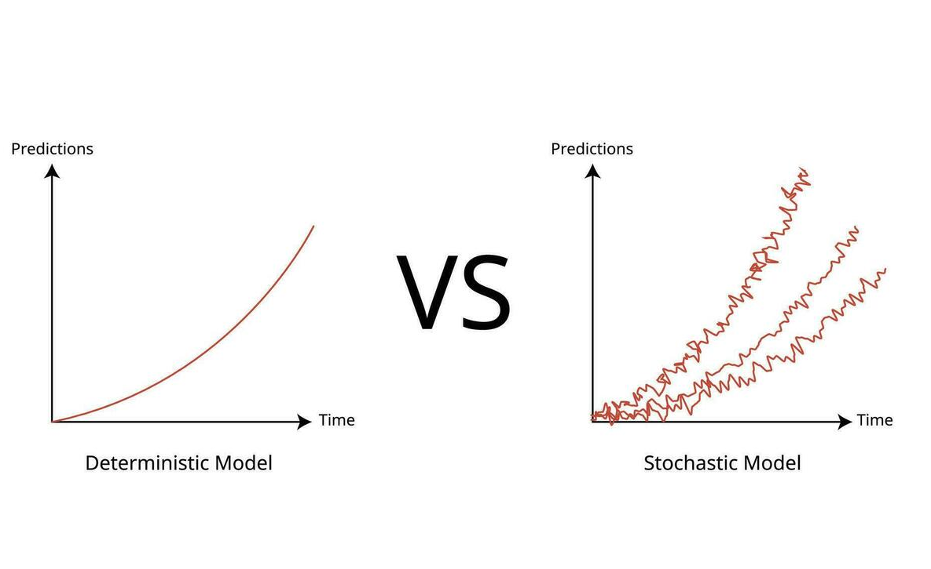
3. Stochastic Models
University of Luxembourg
a. Introduction:
Stochastic models are mathematical models that incorporate randomness.
Unlike deterministic models (which give the same result every time), stochastic models produce different outcomes even with the same input.
Used in finance, physics, biology, and economics.
b. Why Are They Important?
Many real-world systems (like stock prices) don’t follow fixed patterns.
Instead, they have random fluctuations, which stochastic models help predict.
6

Slide 7
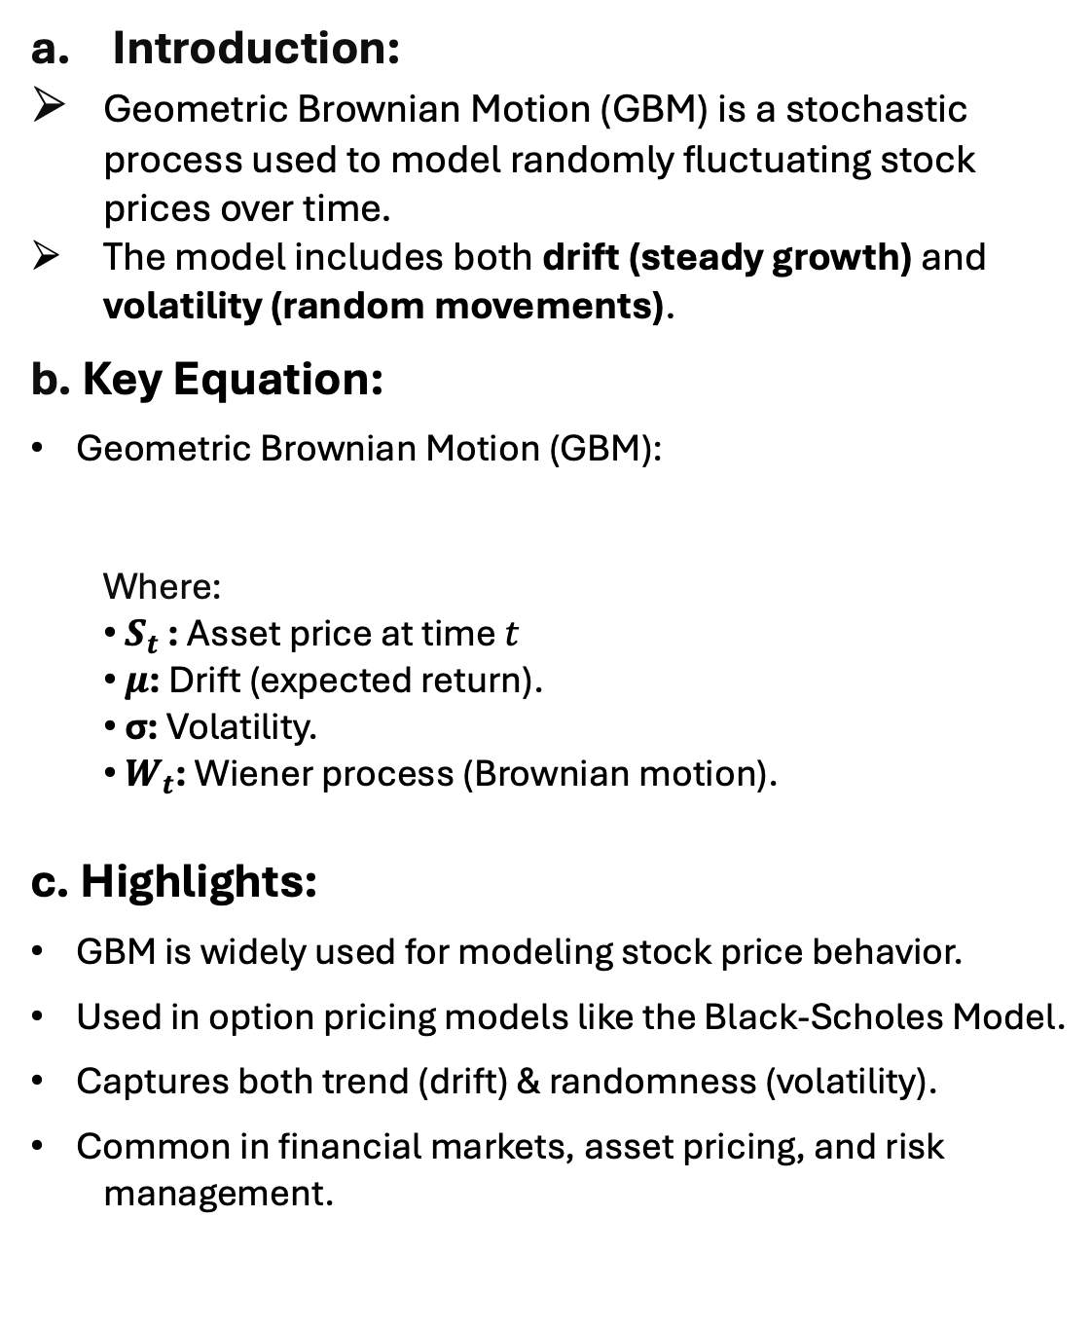

University of Luxembourg
3.1 Geometric Brownian Motion:-
Introduction:
Geometric Brownian Motion (GBM) is a stochastic process used to model randomly fluctuating stock prices over time.
The model includes both drift (steady growth) and volatility (random movements).
b. Key Equation:
Geometric Brownian Motion (GBM):
Where:
${ S}_{t}$ ​: Asset price at time $t$
$μ$: Drift (expected return).
σ: Volatility.
​ $W_{t}$: Wiener process (Brownian motion).
c. Highlights:
GBM is widely used for modeling stock price behavior.
Used in option pricing models like the Black-Scholes Model.
Captures both trend (drift) & randomness (volatility).
Common in financial markets, asset pricing, and risk management.
$$ds_{t}=μS_{t} dt+σS_{t} {dW}_{t}$$
7

Slide 8
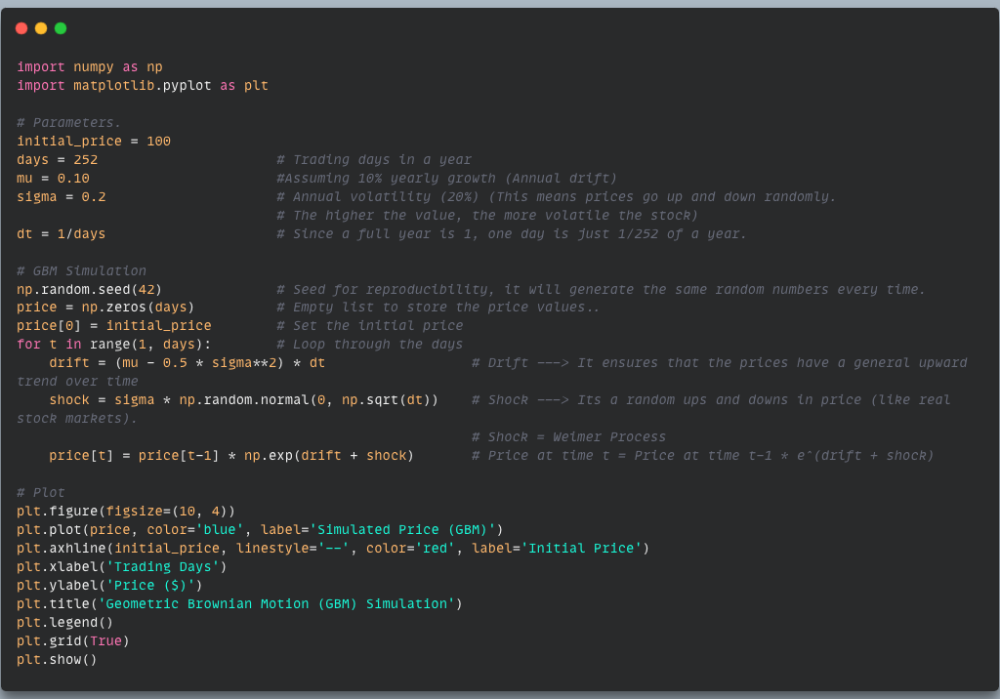
University of Luxembourg
Python Simulations (GBM):
Simulating Stochastic Models:
-> This code simulates Daily stock price movements over a year (252 trading days) based on the GBM model.
8

Slide 9
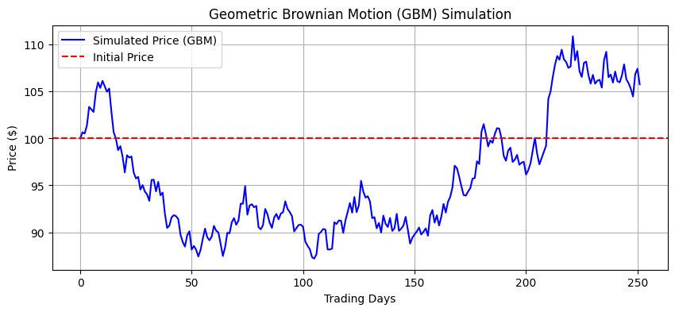
University of Luxembourg
Python Simulation Output (GBM)
9

Slide 10
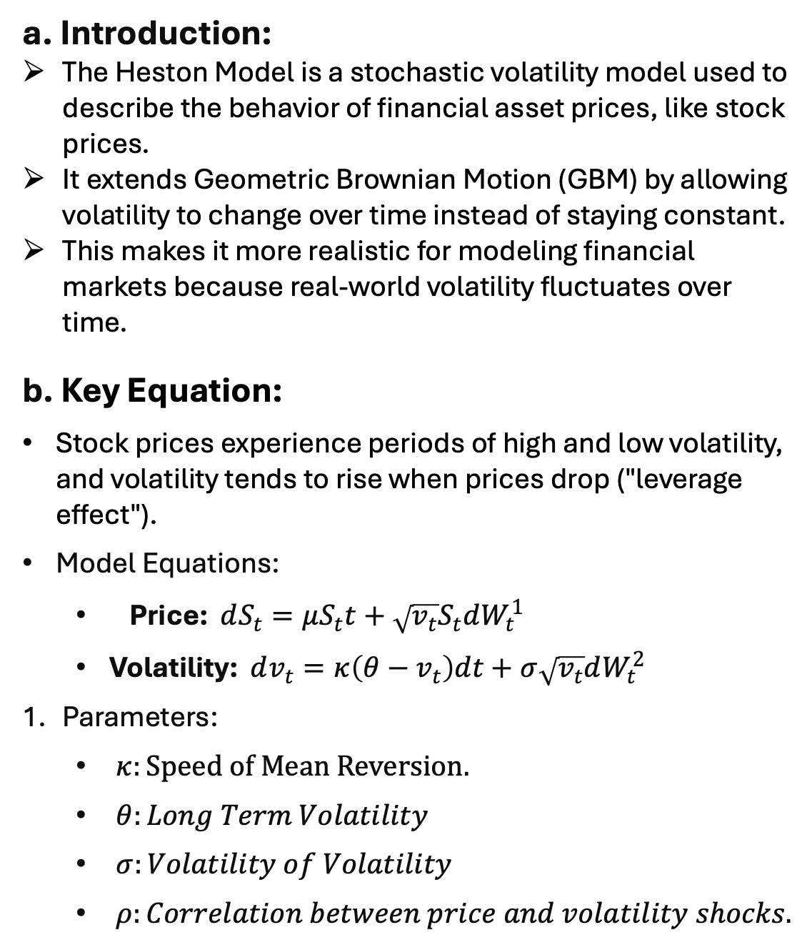
University of Luxembourg
3.2 Heston Model (Stochastic Volatility)
a. Introduction:
The Heston Model is a stochastic volatility model used to describe the behavior of financial asset prices, like stock prices.
It extends Geometric Brownian Motion (GBM) by allowing volatility to change over time instead of staying constant.
This makes it more realistic for modeling financial markets because real-world volatility fluctuates over time.
b. Key Equation:
Stock prices experience periods of high and low volatility, and volatility tends to rise when prices drop ("leverage effect").
Model Equations:
Price: $dS_{t}=μS_{t}t+\sqrt{v_{t}}S_{t}dW_{t}^{1}$
Volatility: $dv_{t}=κ\left(θ−v_{t}\right)dt+σ\sqrt{v_{t}}dW_{t}^{2}$
Parameters:
$κ:Speed of Mean Reversion.$
$θ:Long Term Volatility$
$σ:Volatility of Volatility$
$ρ:Correlation between price and volatility shocks.$
10

Slide 11
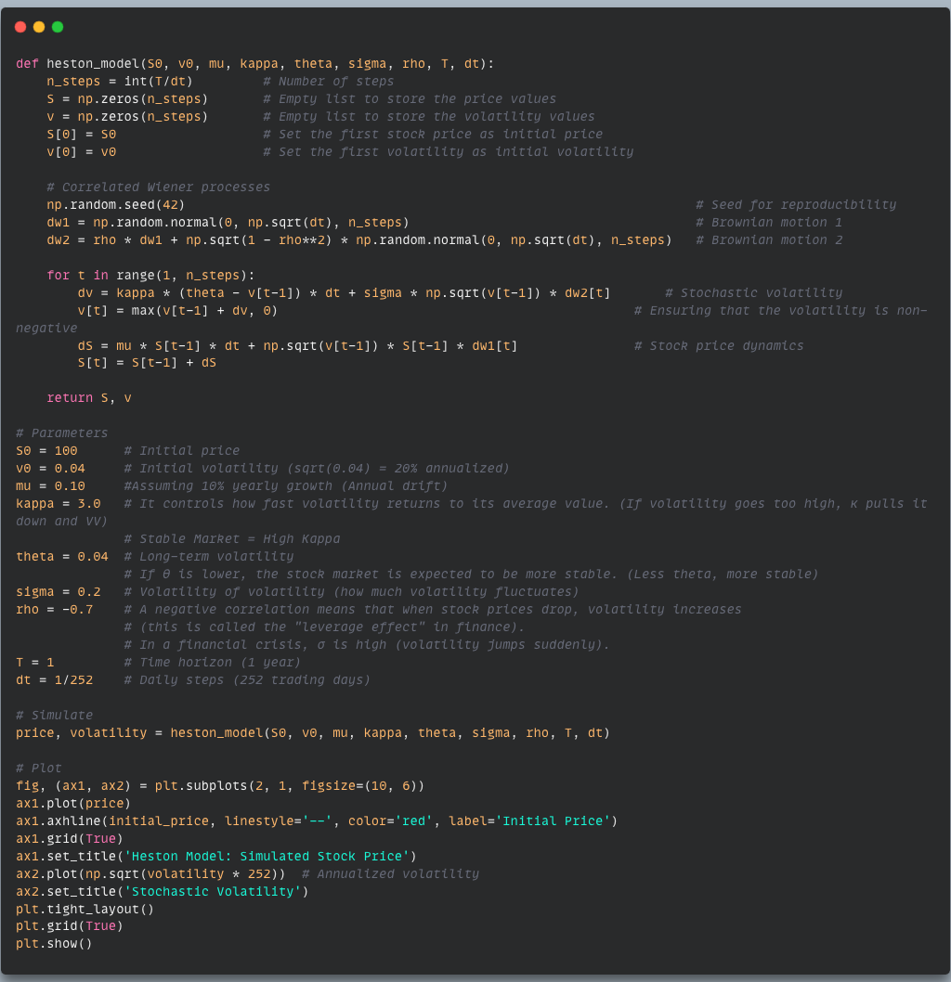
University of Luxembourg
Python Simulations (Heston)
Simulating Stochastic Models: Heston Model Simulation:
This code simulates daily stock price movements over a year (252 trading days) using the Heston model, which extends the GBM framework by incorporating stochastic volatility through correlated random process.
1

Slide 12
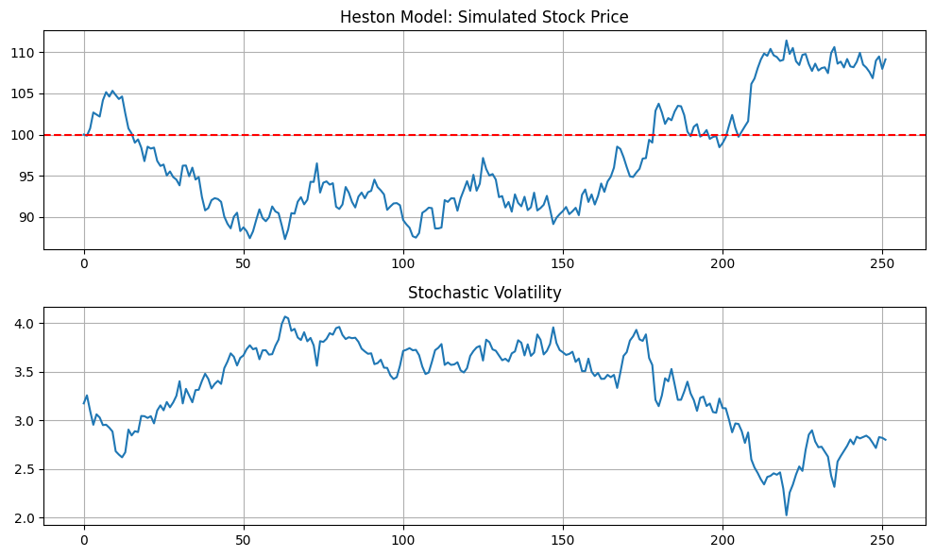
University of Luxembourg
Python Simulation Output (Heston)
Price Path: Shown a single simulated path with GBM vs. Heston (highlighting volatility clusters).
Volatility Plot: Demonstrating how volatility spikes and mean-reverts.
12

Slide 13
University of Luxembourg
4. Introduction to Agent-Based Modeling (ABM)
What is ABM?
A computational modeling approach that simulates interactions of individual agents in a system to observe emergent phenomena.
Purpose:
Model financial markets with heterogeneous agents to study price dynamics, market behavior, and phenomena like bubbles and crashes.
Agent Types:
Fundamentalists: Buy or sell based on value discrepancies between the stock price and fundamental value.
Chartists: Trend-following traders; buy in uptrends and sell in downtrends.
Noise Traders: Random decision-making; introduce stochastic noise into the market.
Contrarian: If price has risen, expect a reversal and sell; If fallen, buy.
Institutional: These traders use the fundamental value but trade in a larger volume.
13

Slide 14
University of Luxembourg
Agent Characteristics:
Risk Tolerance: Some agents take high risks (aggressive traders), while others are conservative.
Trading Horizon: Short-term (day traders) vs. long-term investors (mutual funds).
Wealth & Capital Allocation: Some agents have more capital, affecting their influence on the market.
Learning & Adaptation: Some agents can adjust their strategies based on past profits/losses.
Information Access: Some agents have better market data, while others act based on limited information.
Applications of ABM in Finance, Why is ABM useful?
Market Microstructure Analysis:
Understand liquidity, price impact, and trading behaviour.
Bubble & Crash Formation:
Study conditions leading to financial bubbles and bursts.
Impact of Regulations & Policies:
Simulate how taxes, regulations, and circuit breakers influence trading.
Behavioural Finance Studies:
Analyze how investor psychology affects market trends.
14

Slide 15
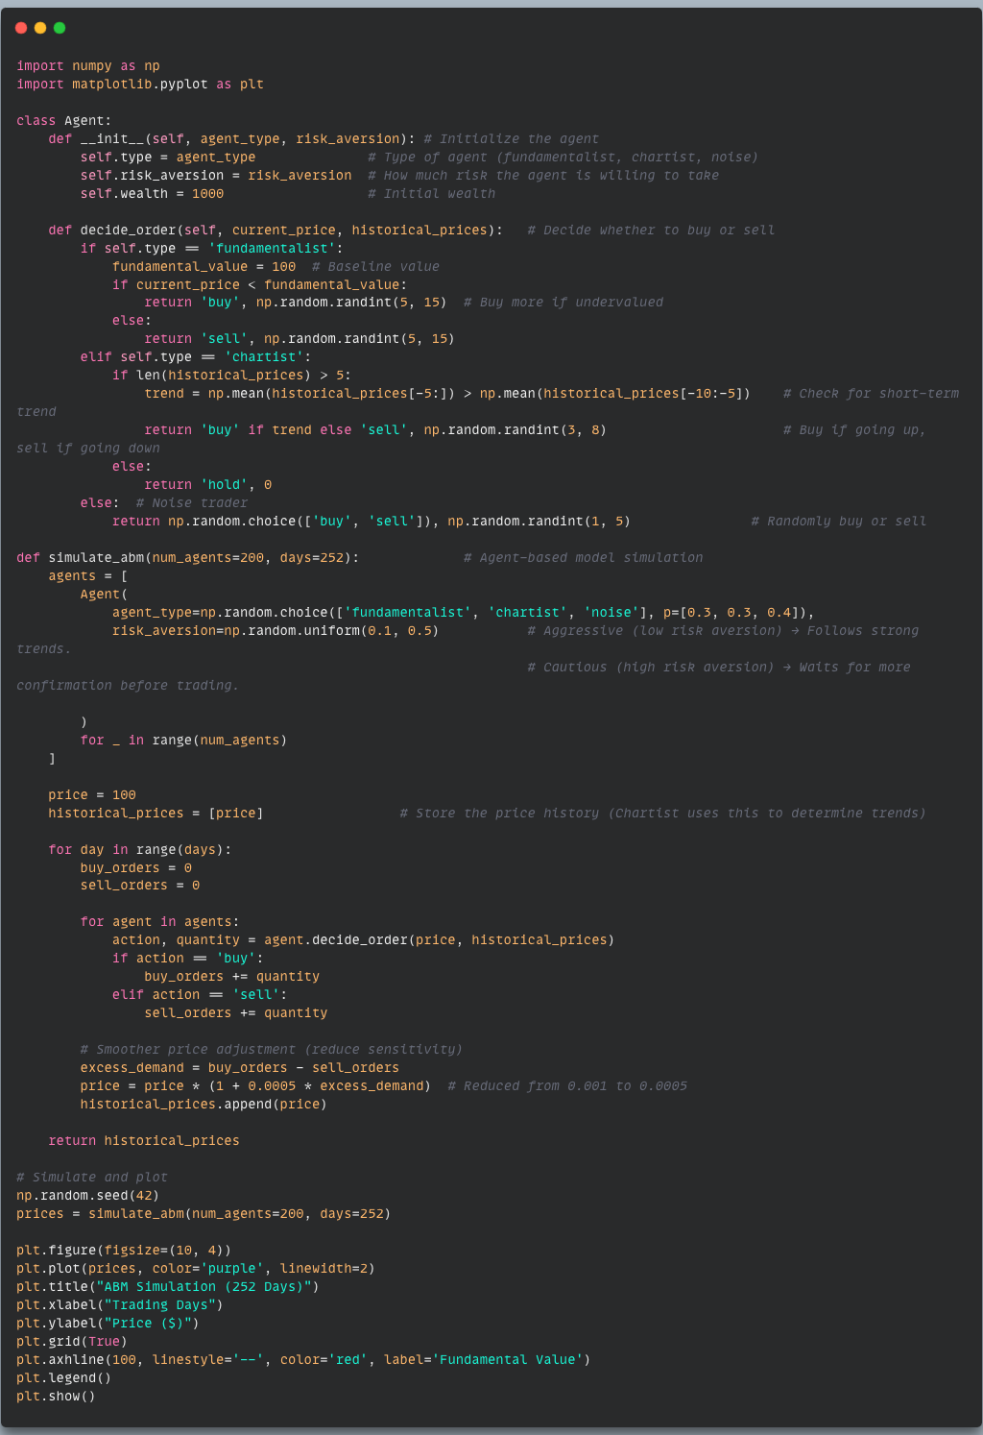
University of Luxembourg
6. Python Simulations
Agent Based Modelling Simulation
1

Slide 16
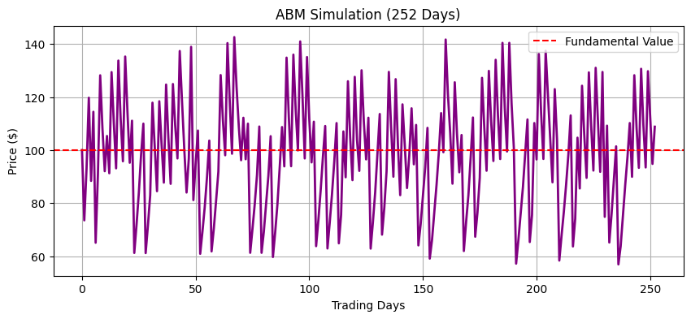
University of Luxembourg
6. Python Simulation Output
16

Slide 17
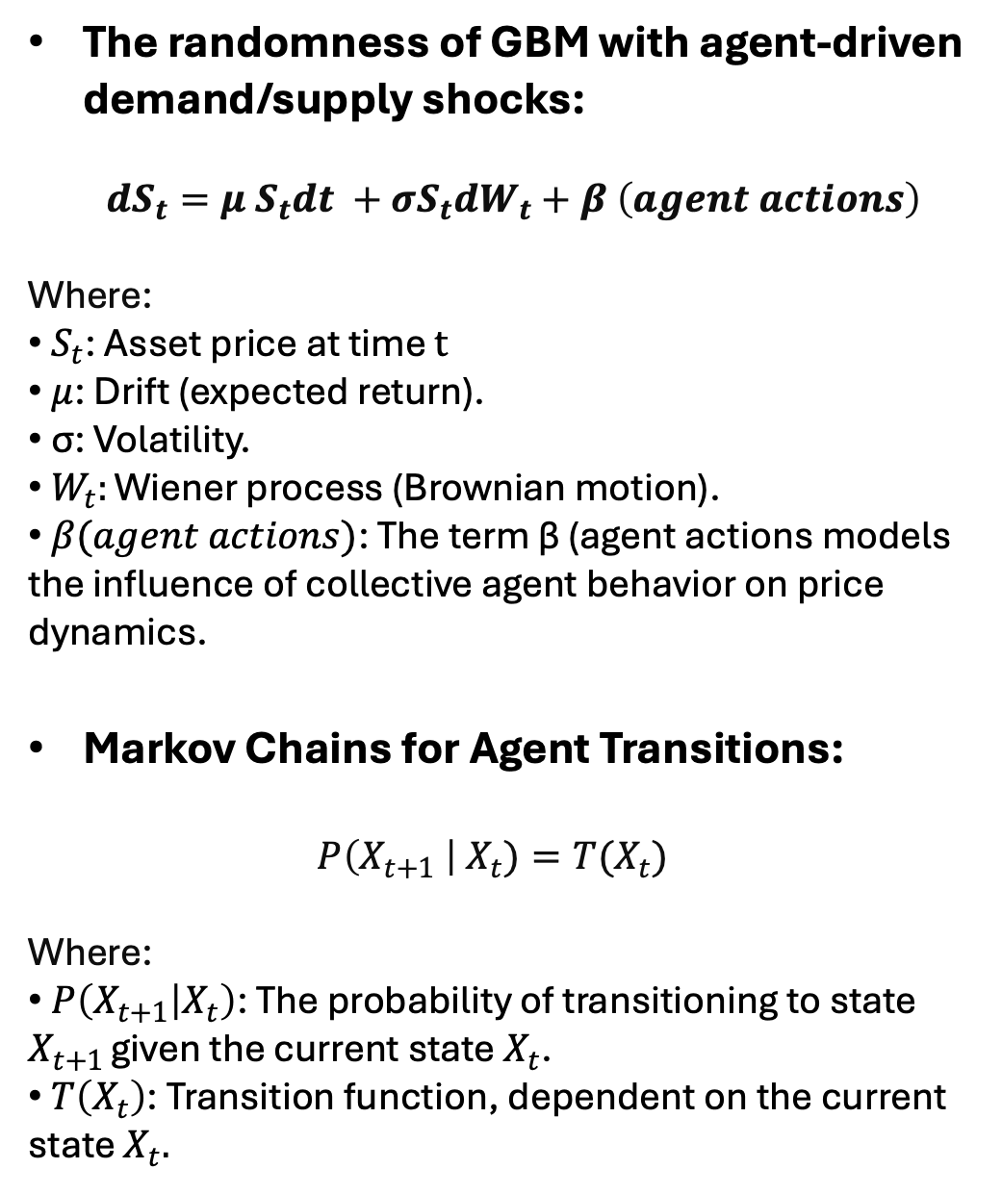
University of Luxembourg
5. Bridging Stochastic and Agent-Based Models
The randomness of GBM with agent-driven demand/supply shocks:
$$dS_{t}=μ S_{t}dt +σS_{t}dW_{t}+β \left(agent actions\right)$$
Where:
$S_{t}$​: Asset price at time $t$
$μ$: Drift (expected return).
σ: Volatility.
$W_{t}:\text{Wiener} \text{process}\text{ (}\text{Brownian} \text{motion}\text{).}$
​ $β(agent actions)$: The term β (agent actions models the influence of collective agent behavior on price dynamics.
Markov Chains for Agent Transitions:
$P\left(X_{t+1} \right| X_{t})=T(X_{t})$
Where:
$P\left(X_{t+1} | X_{t}\right)$: The probability of transitioning to state $X_{t+1 }$given the current state $X_{t}$.
$T\left(X_{t}\right)$: Transition function, dependent on the current state $X_{t}.$
17

Slide 18
University of Luxembourg
Why This Hybrid Model is Useful:
GBM alone assumes prices follow a random walk, ignoring trader behavior.
ABM alone simulates trader behavior but doesn’t incorporate stochastic processes.
The hybrid model captures both randomness & structured trading behavior → More realistic market simulation.
How Markov Chains Work in This Model:
Chartist → Contrarian (If price trends reverse)
Fundamentalist → Noise Trader (If uncertainty rises)
Noise Trader → Fundamentalist (If volatility is too high)
18

Slide 19
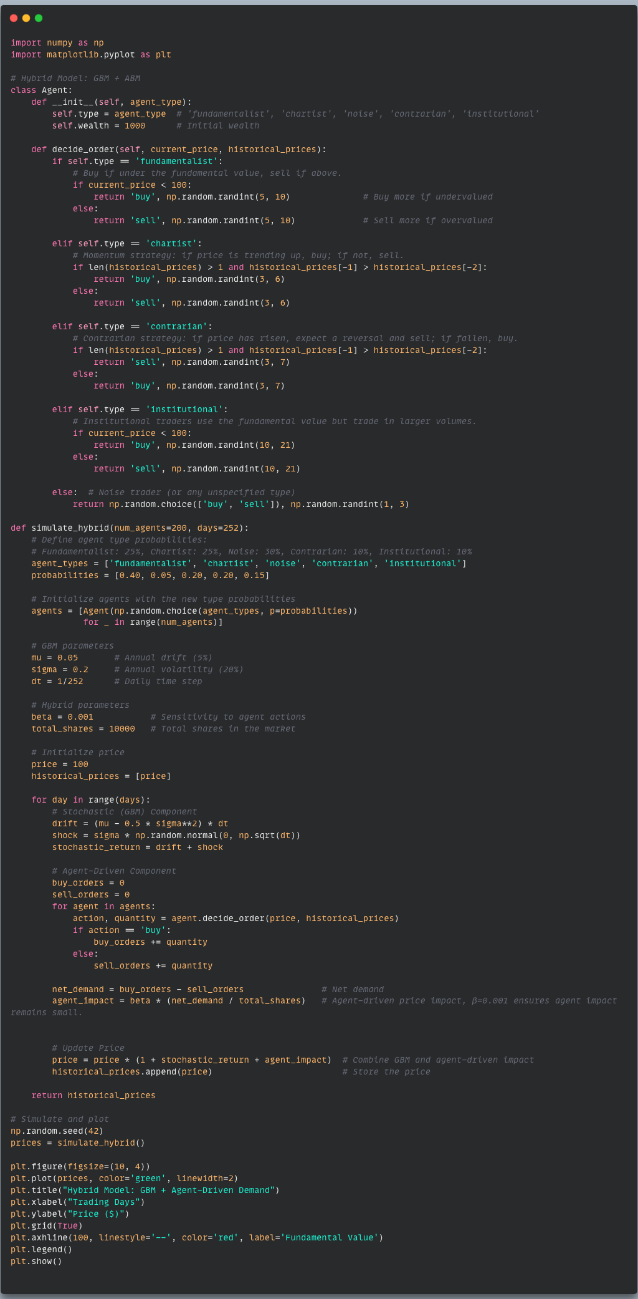
University of Luxembourg
6. Python Simulations
1

Slide 20
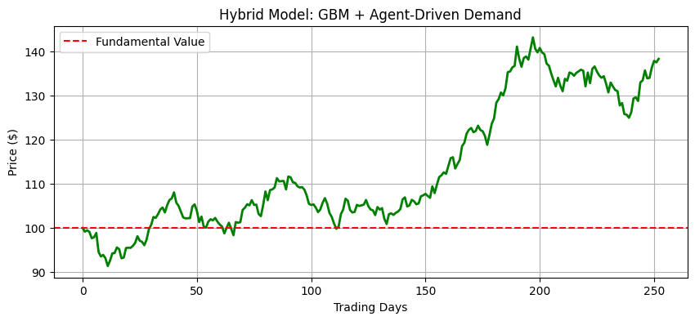
University of Luxembourg
6. Python Simulations
Simulating Stochastic Models:
-> A stock price path.
20

Slide 21
University of Luxembourg
6. Key Takeaways from the Hybrid Model:
We combined two powerful models:
Geometric Brownian Motion (GBM) → Captures random stock price movements.
Agent-Based Modeling (ABM) → Captures market behavior based on trader decisions.
This hybrid approach shows how market randomness & trader decisions interact.
Stock prices fluctuate due to both external shocks (GBM) and internal demand-supply imbalances (ABM).
Key Takeaway: The Hybrid Model better reflects real-world market behavior compared to using GBM or ABM alone.
Future Improvements:
Introducing Machine Learning-Based Agents:
What if traders learned from past prices using reinforcement learning?
Adding Market News Impact:
How would the model react to external economic shocks (e.g., inflation reports, war, or a Fed decision)?
Testing Different Market Structures:
What happens if we increase institutional trader dominance?
Multi-Asset Simulations:
Can we expand this model to multiple stocks, forex, or cryptocurrencies?
21

Slide 22
University of Luxembourg
7. Visual: Comparison of Models
Feature | GBM Only | ABM Only | Hybrid Model (GBM + ABM)
Market Trends & Reversals? | ❌ No | ✅ Yes | ✅ Yes
Captures Bubbles & Crashes? | ❌ No | ✅ Yes | ✅ Yes
Randomness | ✅ Yes | ❌ No | ✅ Yes
More Realistic? | ❌ No | Somewhat | ✅ Most Realistic
Trader Influence | ❌ No | ✅ Yes | ✅ Yes
22

Slide 23
University of Luxembourg
8. Conclusion – Bridging Theory & Reality:
Financial markets are complex, and no single model is perfect.
Our hybrid approach helps bridge the gap between randomness & trader psychology.
Markets are not purely mathematical – they are driven by human behavior, trends, and emotions.
This simulation provides valuable insights into market behavior & price fluctuations.
The future of financial modeling lies in combining traditional finance with behavioral science & AI.
Final Thought: This model is a stepping stone toward more advanced financial simulations.
23

Slide 24
University of Luxembourg
9. References:
Black, F., & Scholes, M. (1973). The Pricing of Options and Corporate Liabilities. Journal of Political Economy, 81(3), 637-654.
Farmer, J. D., & Joshi, S. (2002). The Price Dynamics of Common Trading Strategies. Journal of Economic Behavior & Organization, 49(2), 149-171.
Cristelli, M., Pietronero, L., & Zaccaria, A. (2014). Critical Overview of Agent-Based Models for Economics and Finance. Complexity Economics, 3(2), 85-115.
McKinsey & Co. (2022). How Algorithmic Trading is Transforming Financial Markets.
Tesfatsion, L., & Judd, K. L. (2006). Handbook of Computational Economics: Agent-Based Computational Economics. North-Holland Press.
LeBaron, B. (2006). Agent-Based Computational Finance: Suggested Readings and Early Research. Journal of Economic Dynamics and Control, 30(6), 853-890
Merton, R. C. (1973). Theory of Rational Option Pricing. The Bell Journal of Economics and Management Science, 4(1), 141-183.
Hull, J. C. (2018). Options, Futures, and Other Derivatives (10th ed.). Pearson.
24

