Slide 1
Causal Inference In Machine Learning

Slide 2

What is Causality?
Definition: Causality is about understanding how one thing causes another to happen.
Example:
Cause: Studying extra.
Effect: Getting good grades.

Slide 3

What is Inference?
Definition: Inference is using data to make conclusions or predictions.
Example: If a student has really high grades (that’s the data), we might conclude that they studied hard.

Slide 4

What is Causal Inference?
Definition: Causal inference is using data to figure out what causes what.
Example:
Data: Students who study extra get high grades.
Causal Inference: Studying extra causes better grades.

Slide 5

Correlation is NOT Causation!!
What is Correlation? When two things seem related, but one doesn’t necessarily cause the other.
Example: Kids with bigger shoe sizes read better. Does shoe size make them better readers?

Slide 6
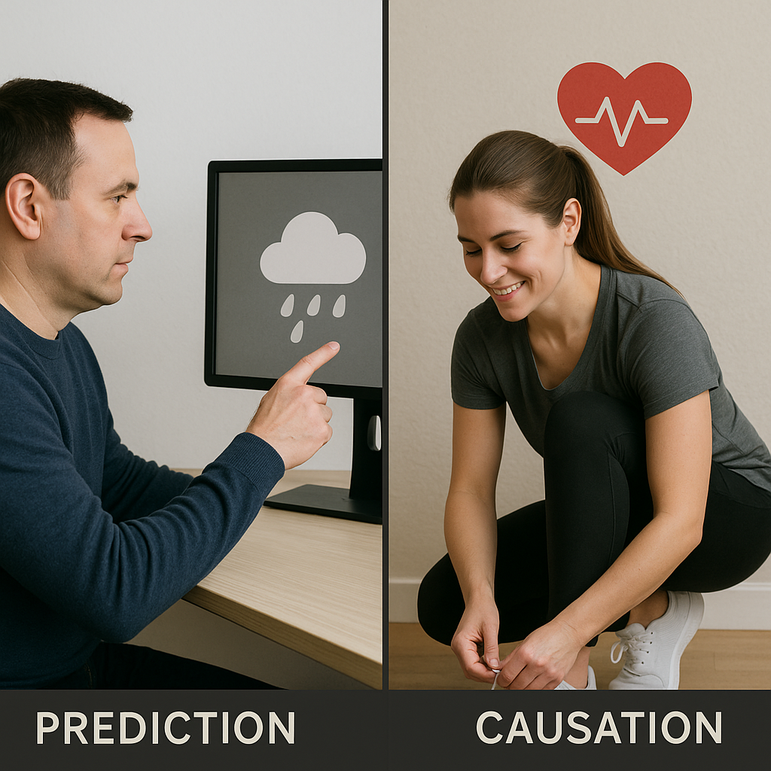
How Does Causal Inference Fit in Machine Learning?
Machine learning usually predicts what will happen, but causal inference explains why it happens.
Example: Traditional machine learning might say, ‘This person will be healthy.’ But causal inference asks, ‘Why are they healthy? Is it because they exercise regularly?’

Slide 7
How Does Causal Inference Fit in Machine Learning?
Machine learning predicts what will happen: A machine learning model can predict that it will rain this afternoon with 80% confidence, based on patterns in historical weather data..
Causal inference explains why it happens: Causal inference would dig deeper to explain that the rain is likely because a cold front (a cause) is moving in, lowering the temperature and increasing humidity, which leads to condensation and rainfall.
So, machine learning gives you the "what" (rain is coming), while causal inference provides the "why" (a cold front is causing it).
Machine learning usually predicts what will happen, but causal inference explains why it happens.
Example: Traditional machine learning might say, ‘This person will be healthy.’ But causal inference asks, ‘Why are they healthy? Is it because they exercise regularly?’

Slide 8
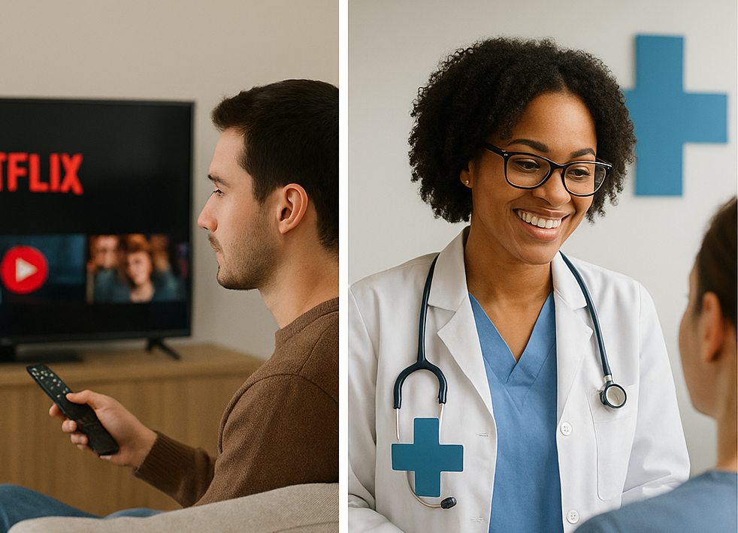
Where is Causal Inference Used in Machine Learning?
Applications: Personalized Recommendations: Suggest movies or products people will love.
A/B Testing: Find out if a new website design causes more clicks.
Healthcare Interventions: Check if a treatment causes better health.

Slide 9
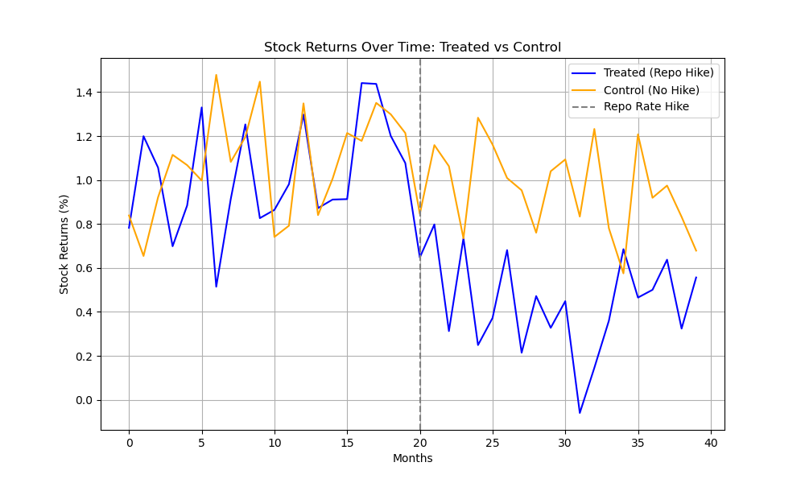
Demo: Causal Impact of Repo Rate Hike on Tesla vs. Microsoft
How to find if a repo rate hike causes lower stock returns.
We compare two groups (stocks with and without a rate hike) before and after the hike to see the real effect.
Difference-in-Differences (DiD) helps us find the true cause by removing other influences.

Slide 10
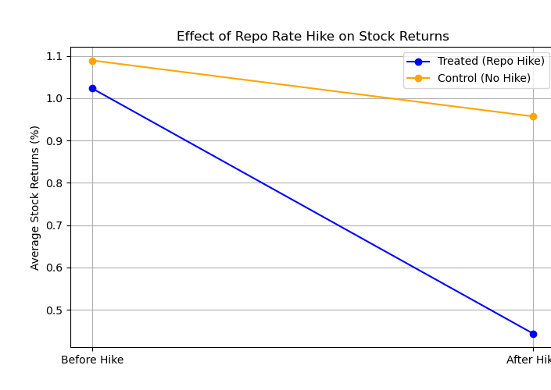
What is DiD?:
Compares changes in stock returns between:
Treatment group: Stocks affected by rate hike.
Control group: Stocks not affected.
Before vs. After: Pre- and post-rate hike periods.
Why DiD?
Isolates causal effect, removes external trends.

Slide 11
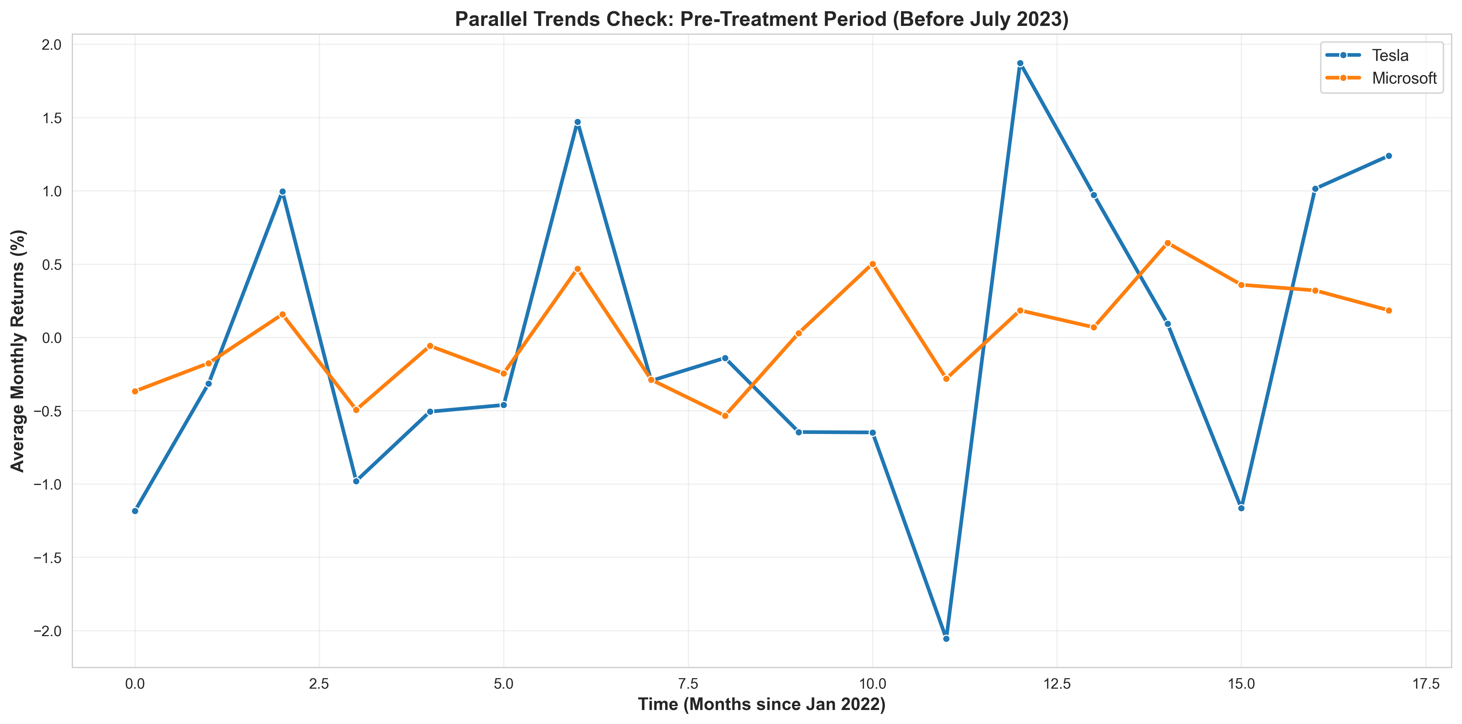
Output

Slide 12
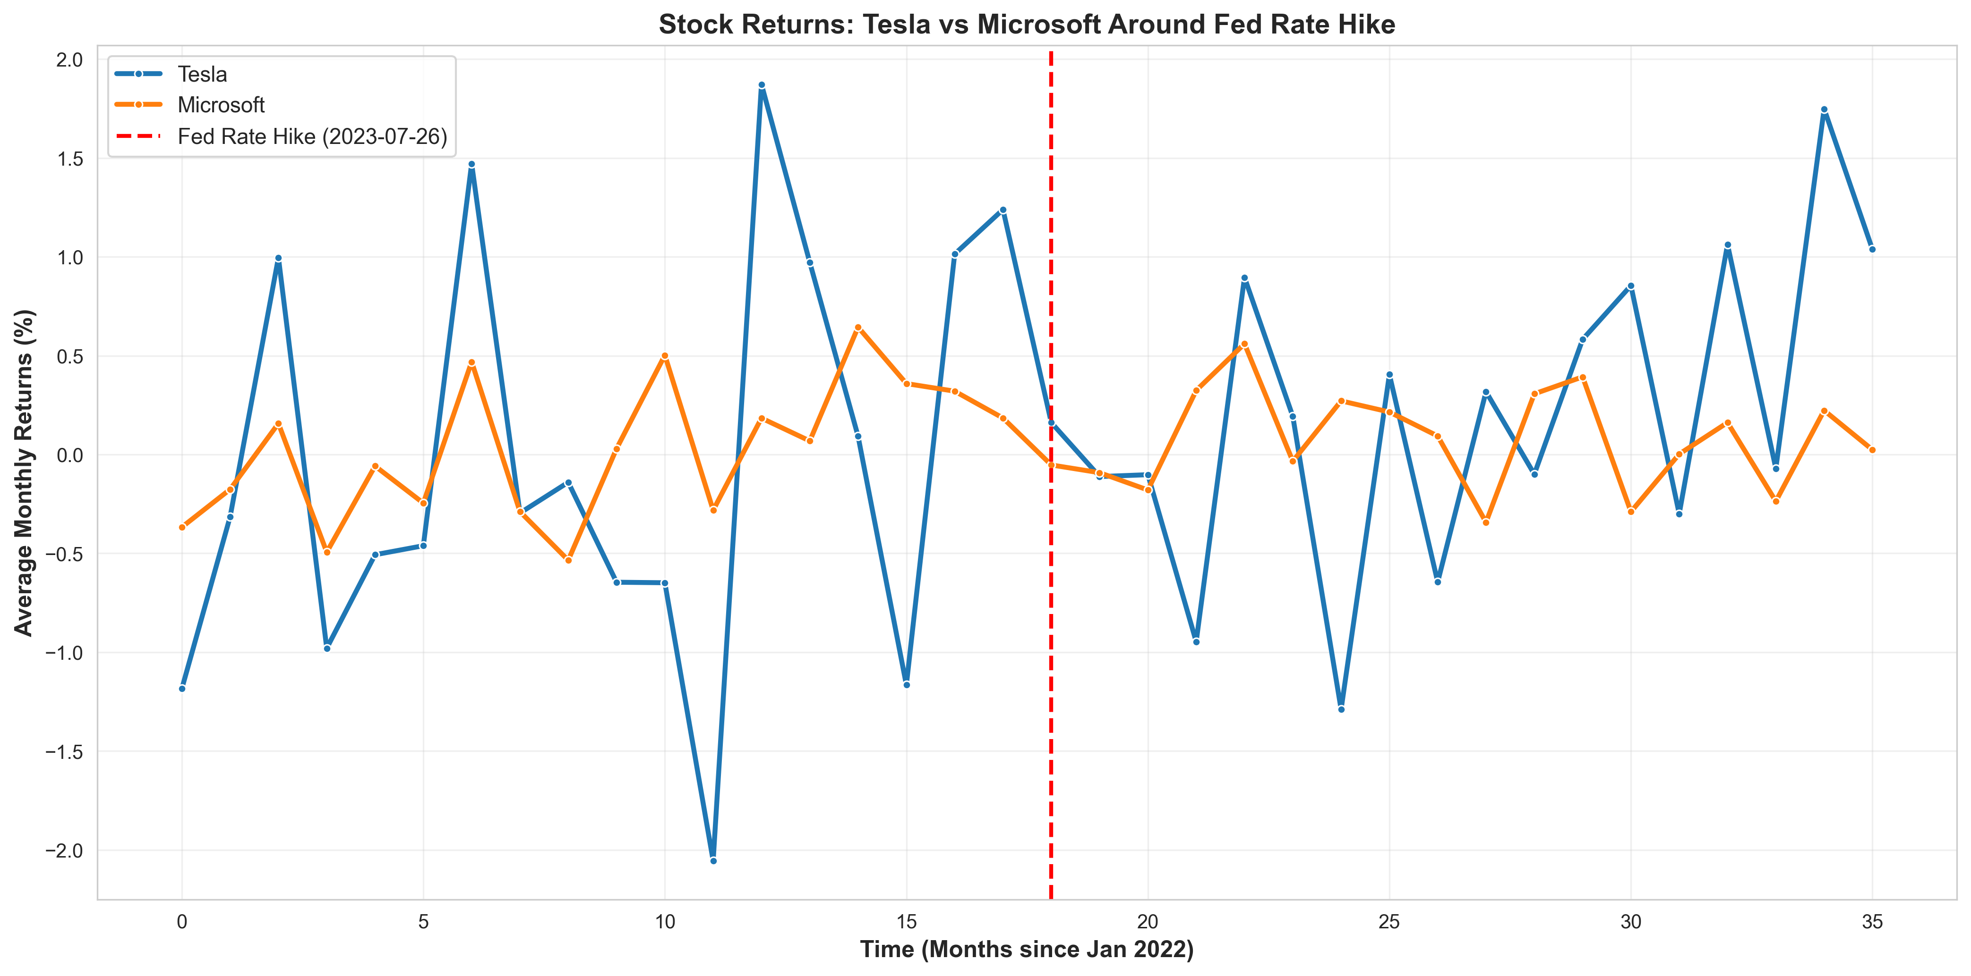
Output

Slide 13
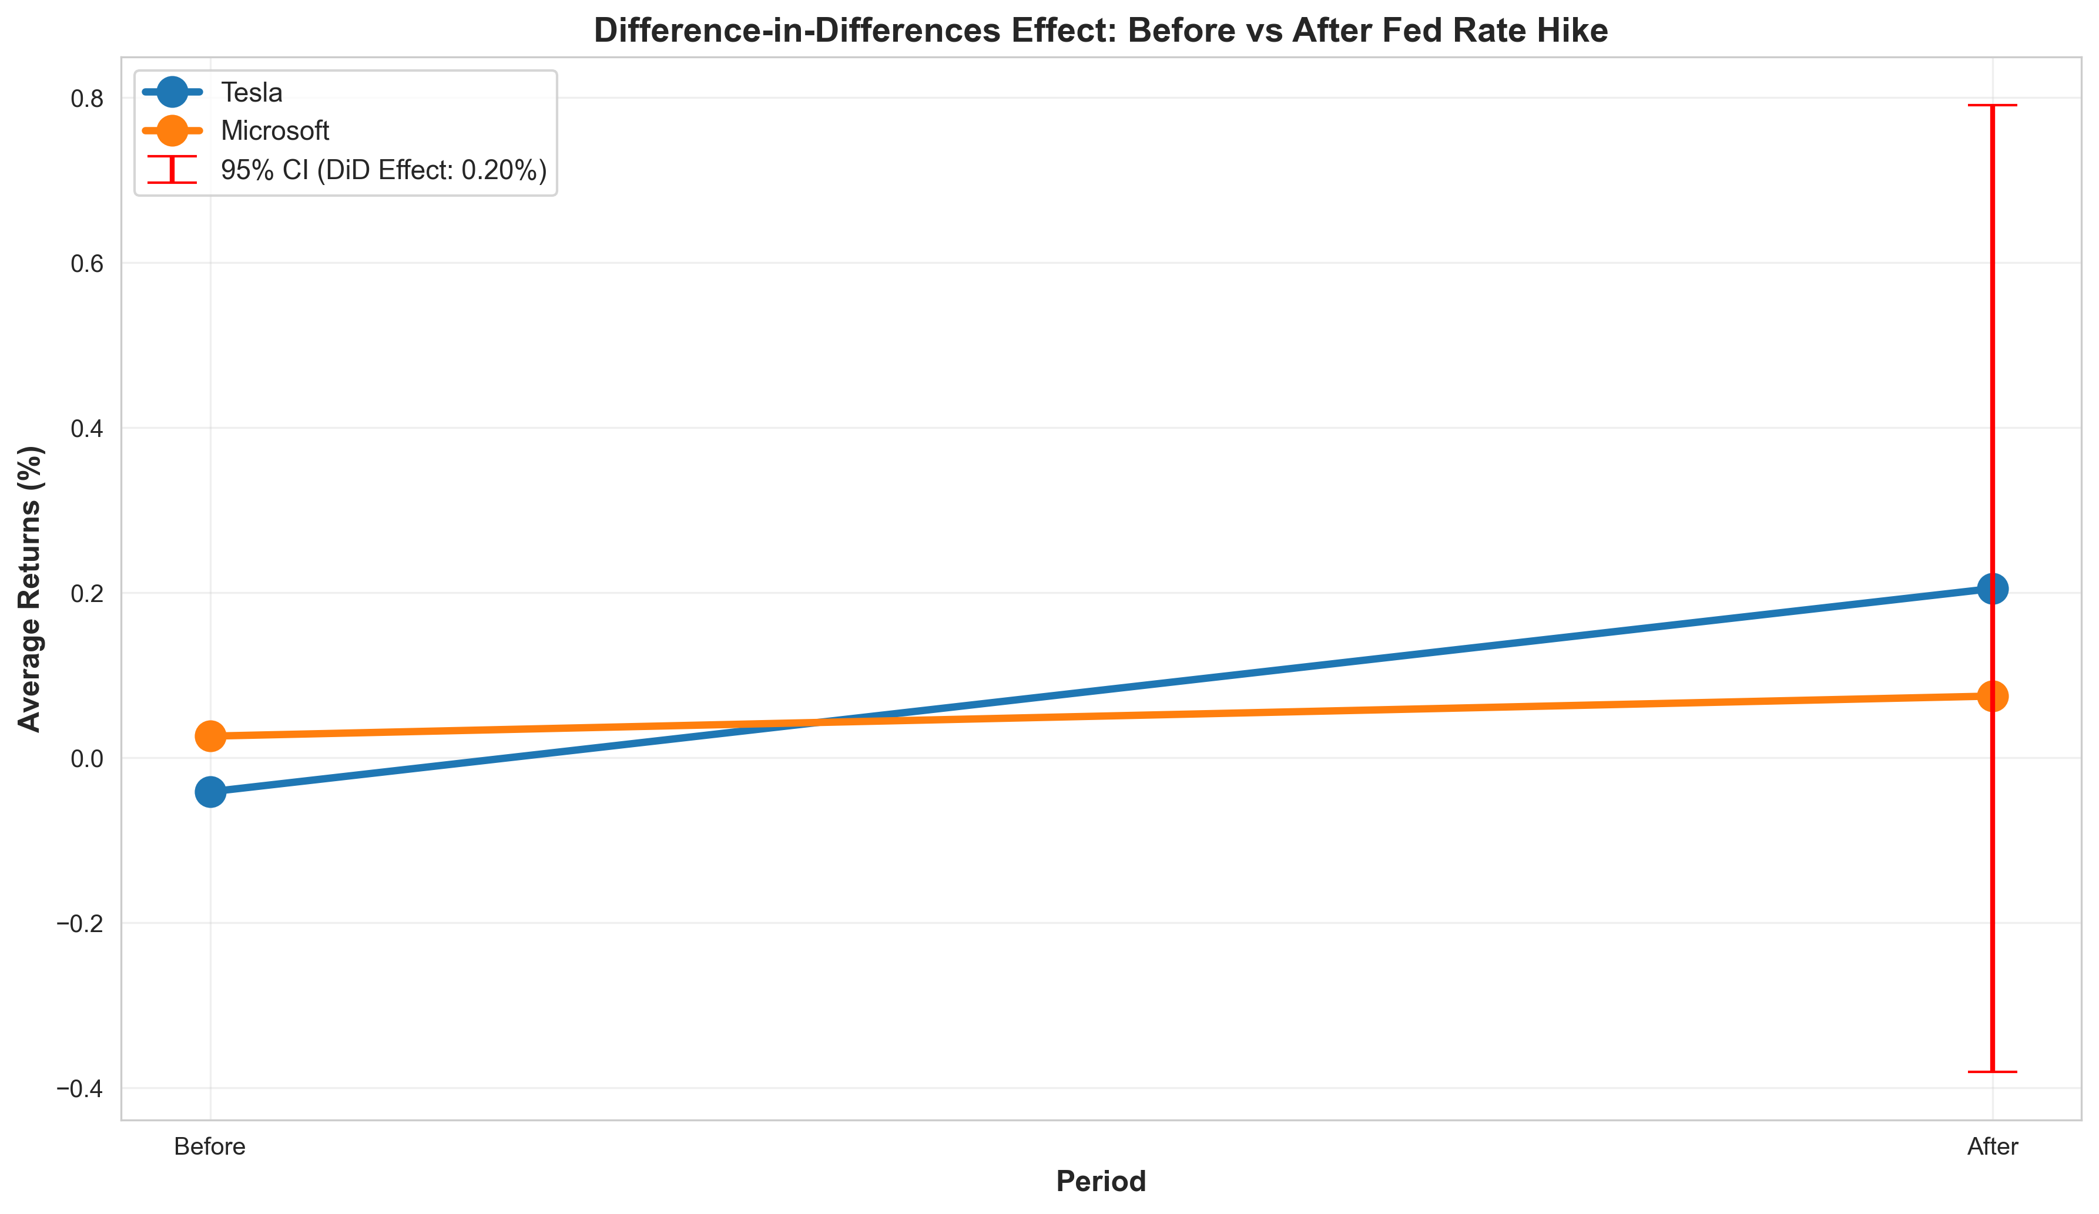
Output

Slide 14

Applications:
Economic Research: Researchers can use this method to study the effects of policy changes, like rate hikes, on different industries or companies.
Stock Market Decisions: Investors can use it to see how rate hikes affect growth stocks like Tesla compared to stable stocks like Microsoft, helping them make better buying or selling choices.
Market Forecasting: Financial analysts can study how policy changes, like rate hikes, affect different sectors, improving their market predictions.

Slide 15
Thank You!
Visit my website to learn more about my projects: www.vaibhavkkm.com

