Slide 1
Clean Code Assignment
-By Vaibhav Srivastava
-Employee ID:1866

Slide 2
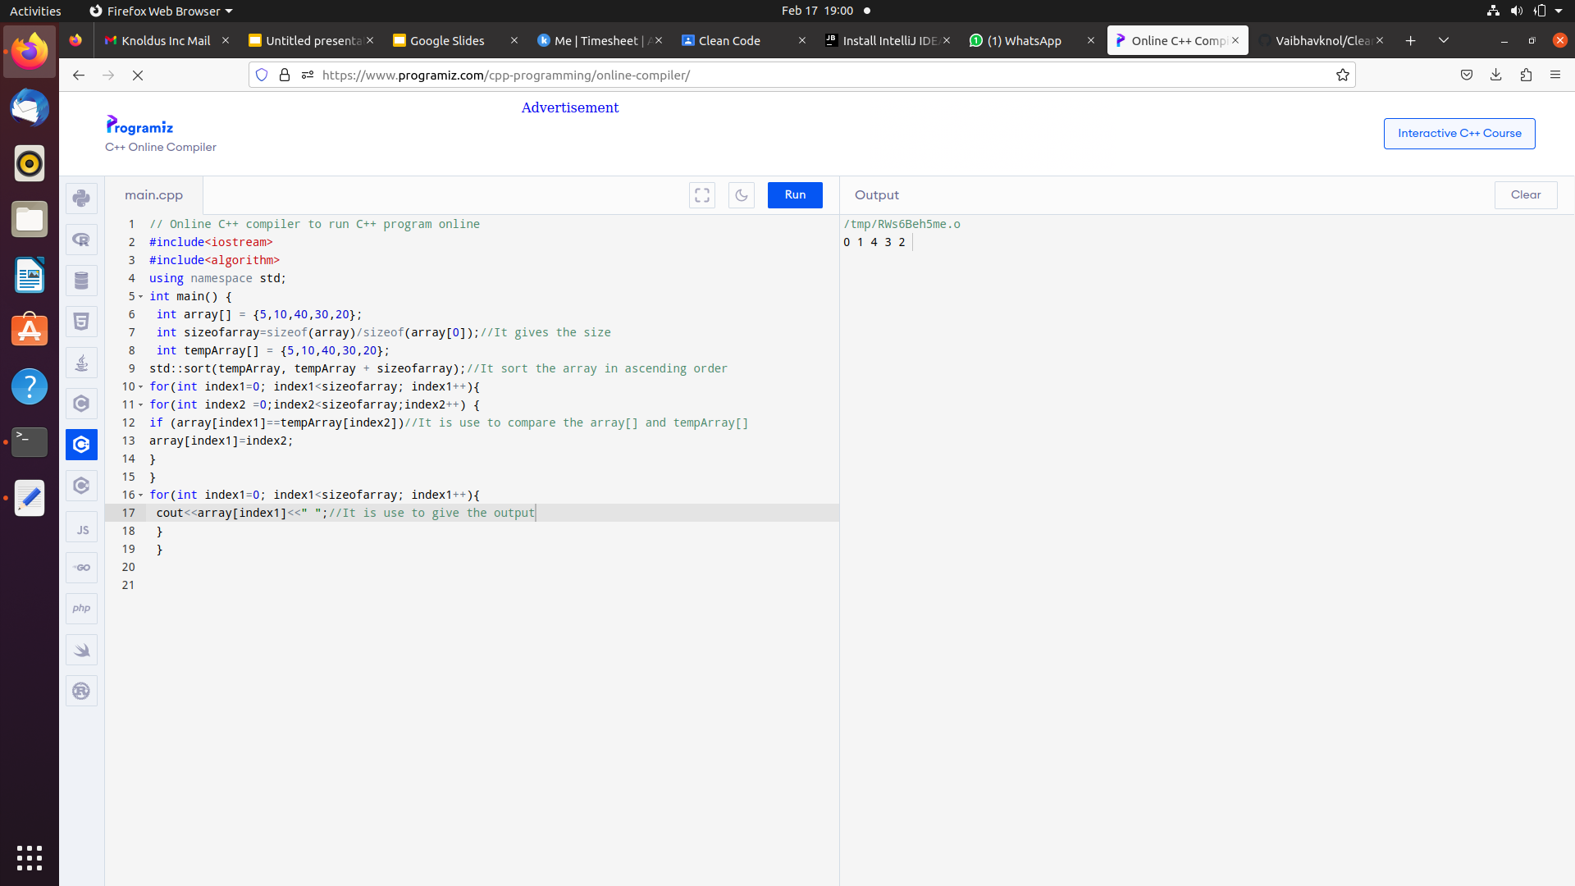
Code and output:

Slide 3
Code Repository
https://github.com/Vaibhavknol/Clean_code.git

Slide 4
Thank You

