Slide 1
SOLID PRINCIPLES
By – Vaibhav Srivastava
Emp id - 1866

Slide 2
Code Screenshots

Slide 3
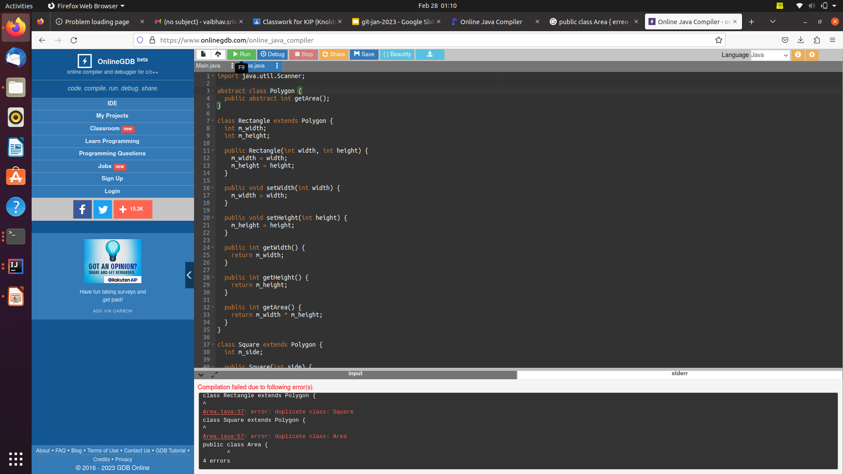

Slide 4
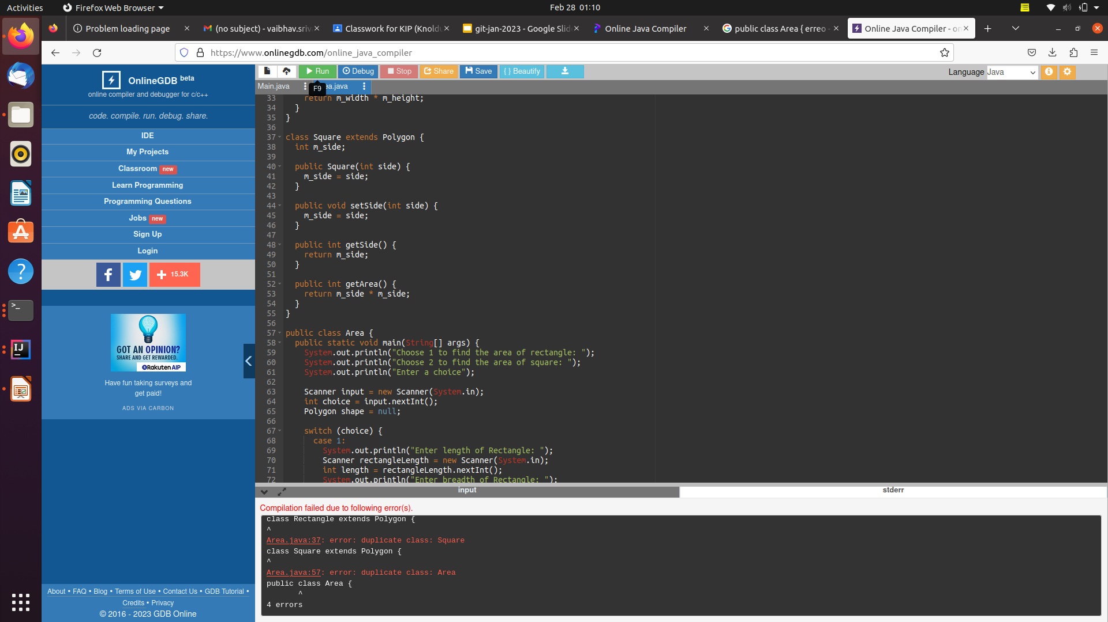

Slide 5
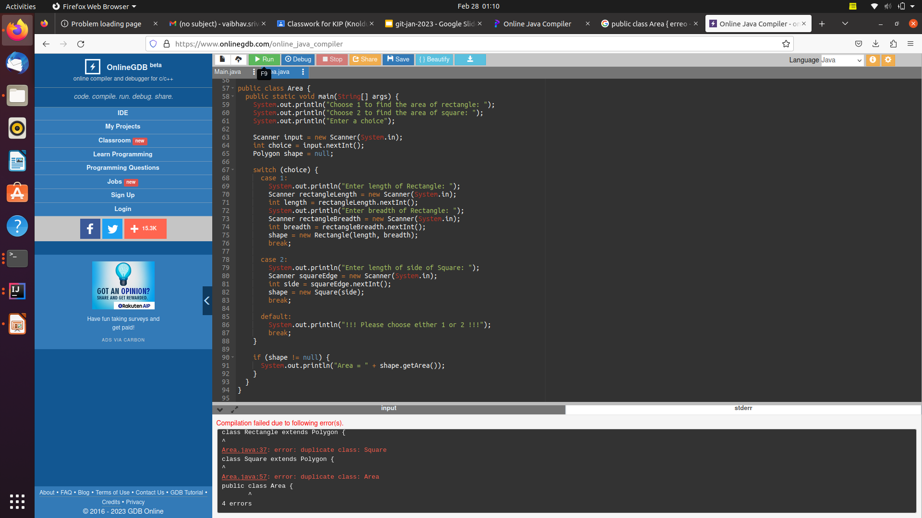

Slide 6
Output Screenshots

Slide 7
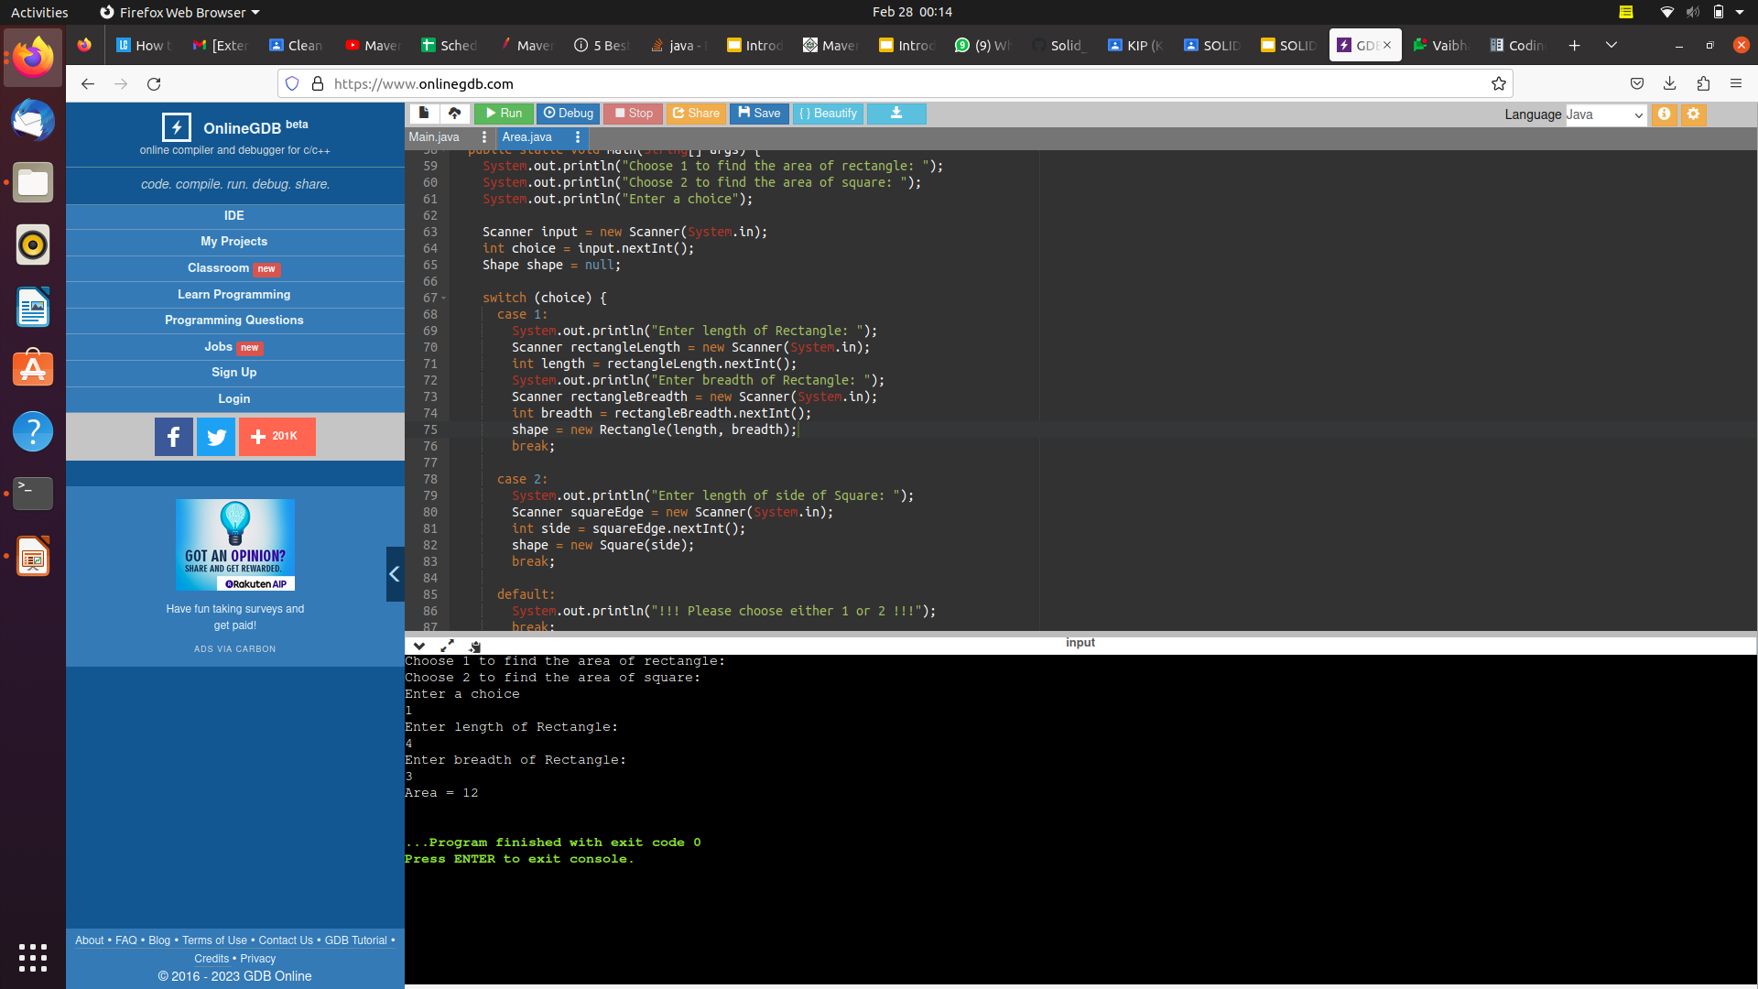

Slide 8
Explain
As a basis class for both the Rectangle and Square classes, we have added an abstract Polygon class. The concrete subclasses of the Polygon class implement the abstract getArea() function. As needed by the Liskov substitution principle, this guarantees the changability of any classes descended from the Shape class.
Also, since it is no longer necessary, we have eliminated the calculateArea() method and replaced it with a straightforward if statement to determine the area of the selected shape.

Slide 9
Thank You !

