Slide 1
TEAM #HVR PRESENTS (GRP 6)
BLUETOOTH CONTROLLED CAR
BLUETOOTH CONTROLLED CAR

Slide 2
PROJECTED BY :
HARSHAD GAHANE (I21)
RONAK PAWAR (I22)
VAIBHAV LANJEWAR (I23)

Slide 3
GUIDED BY:
Mr. Suhas S. Gajre
Mrs. Vinaya V. Khiste
Mrs. Madhuri Baswade
Mr. Suraj D. Kulkarni

Slide 4
Gantt Chart
Need And Problem Statement
Pugh Chart
PCC
Introduction
Block diagram
Working Principle
Schematic diagram
Application
Conclusion & Future Scope
References
CONTENTS :

Slide 5
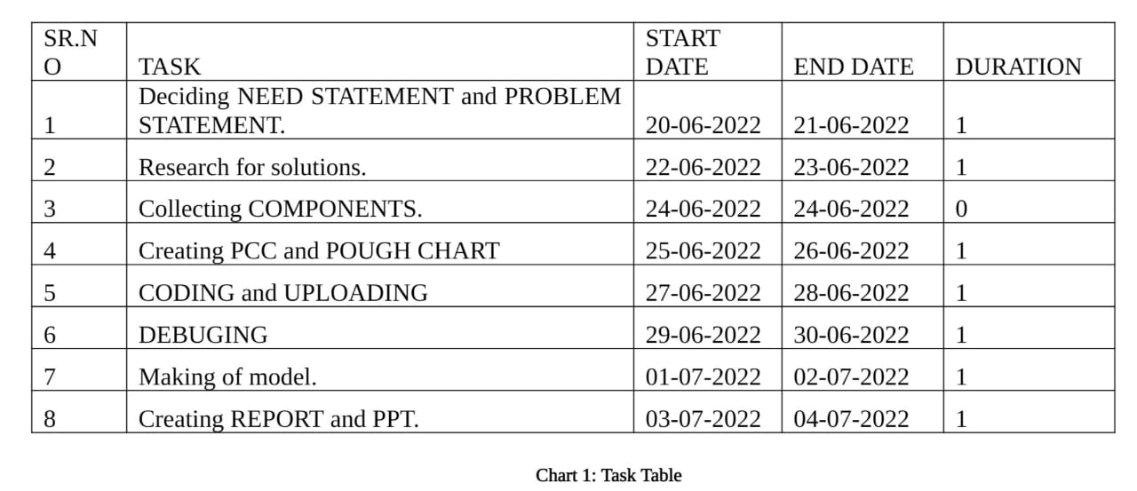
GANTT CHART :

Slide 6
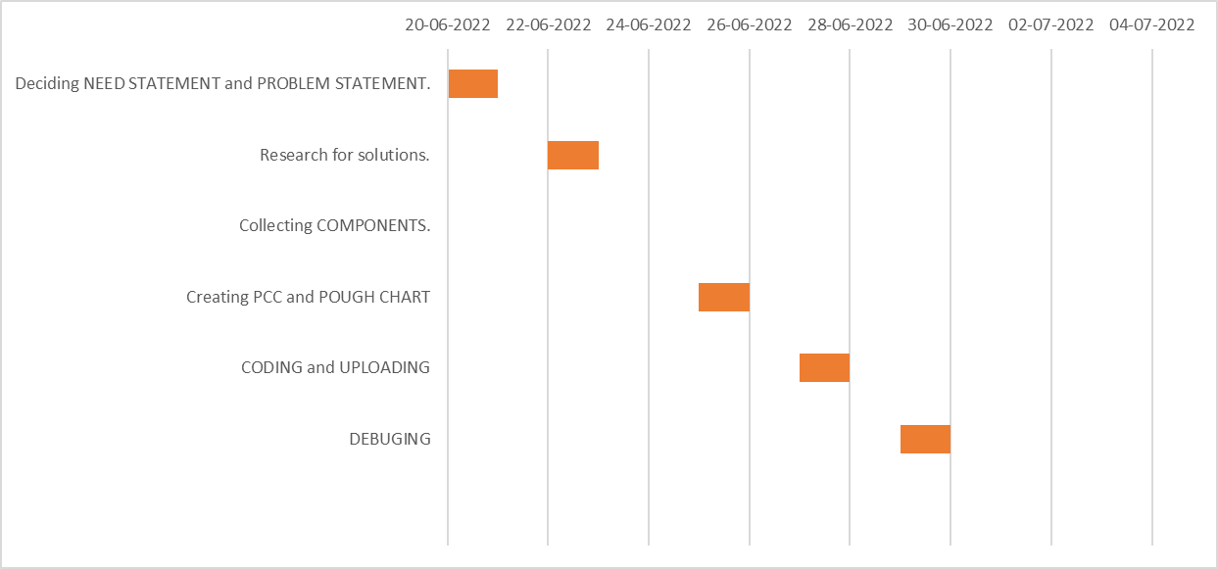
GANTT CHART :

Slide 7
NEED STATEMENT :
Nowadays, material handling with the help of robotics knowledge is the emerging part in our day-to-day life. Material handling can be used to diminish the physical efforts ,save time and to increase accuracy and speed. According to census 2011,there are 26 million people suffering from any disabilities which is nothing but 2.1% of population. Similarly there are 385 million farmers which get affected by pesticides every year i.e. about 44% of total.

Slide 8
PROBLEM STATEMENT :
We must make a car that can be operated using wireless technology (Bluetooth) and voice recognition technology to improve existing technology and reduce human efforts.

Slide 9
PUGH CHART :
Criteria | Weight | Bluetooth Controlled Car | Bluetooth Controlled Car | Conventional Cars | Conventional Cars | Remote (Joystick) Controlled Cars | Remote (Joystick) Controlled Cars | Electrical Self Driving Cars
Cost | 1 | ++ | ++ | D | D | + | + | ----
Safe | 2 | - | - | A | A | + | + | --
Maintenance | 2 | + | + | T | T | --- | --- | --
Ease of use | 2 | ++ | ++ | U | U | ++ | ++ | ++++
Mobility | 2 | ++ | ++ | M | M | + | + | ++
 | + | 12 |  |  | 0 |  | 9 | 12
 | 0 | 0 |  |  | 9 |  | 0 | 0
 | - | 2 |  |  | 0 |  | 6 | 12
 | Total | 10 |  |  | 0 |  | 3 | 0

Slide 10
PCC :
 | Ease of use | Durable | Reduce human effort | Cost | Reliable | Total
Ease of use | ----- | 1 | 1 | 1 | 0 | 3
Durable | 0 | ----- | 0 | 0 | 0 | 0
Reduce human effort | 0 | 1 | ----- | 1 | 0 | 2
Cost | 0 | 1 | 0 | ----- | 0 | 1
Reliable | 1 | 1 | 1 | 1 | ----- | 4

Slide 11
Rank of Objectives :
Reliable
Ease of Use
Reduce human effort
Cost
Durable

Slide 12
INTODUCTION :
Robotics is an evolving technology. There are Various approaches to build robots, and no one is sure which method or technology will be used 100 years from now. Robotics is evolving like the Darwinian evolutionary theory of survival+. The framework equipment comprises of a controller outfitted with Bluetooth communication module. It’ll be connected to the motors and other alternative components of car. When the Bluetooth app is turned on and is connected with the current system via Bluetooth, one will operate the car by giving wireless commands from the app using the functions already programmed in the app. The vehicle will motion in four directions: Forward, Backward, Right and Left. In forward movement, all motors will motion in the same direction and for backward motion; movement of the motors will be in opposite direction. For left and right movements, either of the motors will rotate and to stop the motors will stop. Instructions are given to the motors through the Bluetooth app of Android Smartphone by the user.
In this project, we will demonstrate how to control robot controlled car using Bluetooth module through Bluetooth application of an android mobile phone. The benefit of using robot-controlled car is it can be used to reduce manual work. This project can be modified quite easily to include a camera well that can stream the videos to the user over Wi-Fi using Wi Fi module.

Slide 13
Arduino Mega 2560
The Mega 2560 is a microcontroller board based on the ATmega2560. It has 54 digital input/output pins (of which 15 can be used as PWM outputs), 16 analog inputs, 4 UARTs (hardware serial ports), a 16 MHz crystal oscillator, a USB connection, a power jack, an ICSP header, and a reset button.

Slide 14
BLUETOOTH MODULE HC-05
Designed to replace cable connections HC-05 uses serial communication to communicate with the electronics. Usually, it is used to connect small devices like mobile phones using a short-range wireless connection to exchange files. It uses the 2.45GHz frequency band.

Slide 15
DC GEARED MOTORS
DC Gearmotors are electric motors that utilize a type of gear system on the output of the motor. This gearing arrangement is called a gear reducer or gearbox. The combination of an electric motor and gearbox reduces design complexity and lowers cost, particularly for motors built for high torque and low speed applications. In addition, gearboxes can be used as a means to reorient the output shaft in a different direction

Slide 16
ROBOT WHEELS
Wheeled robots are robots that navigate around the ground using motorized wheels to propel themselves. This design is simpler than using treads or legs and by using wheels they are easier to design, build, and program for movement in flat, not-so-rugged terrain.

Slide 17
L298N MOTOR DRIVER
The L298N motor driver is based on the H-bridge configuration (an H-bridge is a simple circuit that lets us control a DC motor to go backward or forward.), which is useful in controlling the direction of rotation of a DC motor. It is a high current dual full H-bridge driver that is constructed to receive standard TTL logic levels.

Slide 18
CHASIS
Chassis is very essential in robots as well as many mechanical devices. It helps in providing support to PCB, accessories and various parts which are connected to it. Robot chassis is particularly designed for robots and other mechanical devices.

Slide 19
12 Volt BATTERY
The 12v battery is characterized solely by its 12 volt potential. This higher voltage is typically found in SLA (sealed lead-acid) car batteries for SLI (Starting, Lighting, Ignition) purposes, or A23/27 batteries for radio frequency-transmitting in Bluetooth devices and home security systems.

Slide 20
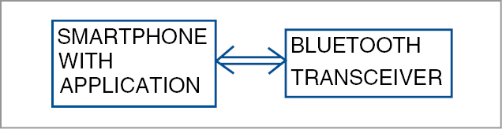
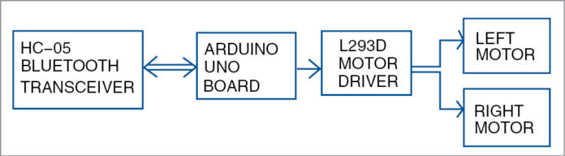
BLOCK DIAGRAM
ARDUINO MEGA 2560
L298N

Slide 21
WORKING PRINCIPLE :
Voice and Button Commands are processed by android app, and speech-to-text conversion is done within the app using Google’s speech-recognition technology. Text is then sent to the receiver side via Bluetooth. Text received via Bluetooth is forwarded to Arduino Mega 2560 board using TX & RX pins serial communication. Arduino code checks the text received. Whenever the text is a matching string, Arduino controls the movements of the robot accordingly in forward, backward, Turning Right, Turning Left & Stop.
The block diagram of the simple bluetooth controlled robotic vehicle given is consists of the smartphone that recognizes the voice commands and are being wirelessly transferred to the Bluetooth module HC05.

Slide 22
SCHEMATIC DIAGRAM :

Slide 23
CODE
// Voice Controlled Car Code v3
String c;
String voice;
int inp1=12;
int inp2=11;
int inp3=10;
int inp4=9;
int enA = 4;
int enB = 5;
void setup()
{
Serial.begin(9600);
pinMode(inp1, OUTPUT); //RIGHT MOTOR
pinMode(inp2, OUTPUT); //RIGHT MOTOR
pinMode(inp3, OUTPUT); //LEFT MOTOR
pinMode(inp4, OUTPUT); //LEFT MOTOR
pinMode(enA, OUTPUT); // Enable A
pinMode(enB, OUTPUT); // Enable B
}

Slide 24
void loop()
{
analogWrite(enA, 180);
analogWrite(enB, 180);
while(Serial.available()>0)
{
Serial.println("inside while");
delay(10);
char c = Serial.read();
//Serial.println(c);
if(c=='#')
{
break;
}
voice+= String(c);
Serial.println(voice);
}

Slide 25
if(voice=="forward"){
digitalWrite(inp1, LOW);
digitalWrite(inp2, HIGH);
digitalWrite(inp3, LOW);
digitalWrite(inp4, HIGH);
delay(3000);
}
else
if(voice=="back"){
digitalWrite(inp1, HIGH);
digitalWrite(inp2, LOW);
digitalWrite(inp3, HIGH);
digitalWrite(inp4, LOW);
delay(2000);
}

Slide 26
else
if(voice=="right"){
digitalWrite(inp1, LOW);
digitalWrite(inp2, HIGH);
digitalWrite(inp3, HIGH);
digitalWrite(inp4, LOW);
delay(100);
}
else
if(voice=="left"){
digitalWrite(inp1, HIGH);
digitalWrite(inp2, LOW);
digitalWrite(inp3, LOW);
digitalWrite(inp4, HIGH);
delay(100);
}

Slide 27
//Stop
digitalWrite(inp1, LOW);
digitalWrite(inp2, LOW);
digitalWrite(inp3, LOW);
digitalWrite(inp4, LOW);
//Stop
voice = "";
}

Slide 28
APPLICATIONS :
The robot is useful in places where humans find difficult to reach but human voice can reach. Such as in fire situations, in highly toxic areas.
Even it is controlled by button, which can be a game for kid.
The robot can be used for monitoring or investigation.
The voice controlled robotic car can be easily drive by unskilled driver by using voice commands with the help of android application in smart phone.

Slide 29
FUTURE SCOPE :
This task work has been limited to short range Bluetooth module. Utilizing a long range modules and other availability gadgets will bring about network with the robot for significant distances.
Picture preparing can be executed in the robot to distinguish the shading and the items.
A warm camera can be introduced to detect the warmth produced by bodies valuable in military purposes to distinguish foes on the lines.
Programmed Targeting System can be executed in the robot for following the objective.
Further upgrade in venture can be utilized for Home security and military purposes where the orders can be given to robot without chance by expanding the range and by introducing cameras.
The robot is valuable in places where people discover hard to reach however human voice comes to. For example, in fire circumstances, in profoundly poisonous zones.
It is the one of the significant phase of Humanoid robots.
Discourse and voice acknowledgment security frameworks.
The robot can be used for monitoring or investigation.

Slide 30
CONCLUSION :
The proposed framework of our project shows that how a robot can be control utilizing Bluetooth. The voice/bluetooth controlling orders are effectively transmitted through Bluetooth innovation and the desired activities effectively happen. This task lessens human endeavours at spots or circumstances where human intercessions are troublesome. Such frameworks can be brought into utilization at spots, for example, businesses, military and guard, investigate purposes, and so forth.

Slide 31
REFRENCES :
https://create.arduino.cc/projecthub/Yug_Ajmera/
https://drive.google.com/drive/folders/0BwsV1jJYW9dndjZKaTBwakJ
https://www.instructables.com/id/
https://www.researchgate.net/publication/325722323_IJSRST173866_
https://ieeexplore.ieee.org/document/8093565
https://www.viralsciencecreativity.com/post/
https://nevonprojects.com/
https://www.hackster.io/Yug_Ajmera/
IRJET-V7I5770.pdf
VOICE CONTROLLED Car - Arduino Project Hub

Slide 32
THANK YOU!

